Slide 1







Technology Trends Analysis
Enrique Villa
29 Jan 2022

Slide 2



OUTLINE
Executive Summary
Introduction
Methodology
Results
  Visualization – Charts
  Dashboard
Discussion
  Findings & Implications
Conclusion
Appendix

Slide 3

EXECUTIVE SUMMARY
Current Technology Usage Demographics
Language Gender
Database Country
Platform Age
Web frame Education Level
Future Technology Trend Implications of Findings.
Language
Database
Platform
Web frame

Slide 4

INTRODUCTION
Aim:
Analyzing the trends in software and web development around the world.
Purpose:
Identify the top programming languages, database, platform and web frame skills in demand.
Industry
Understanding industry demographics.
Audience:
Industry leaders
Human Resources
Developers
IT Aspirants

Slide 5

METHODOLOGY
Data Sources (Data Collection through API & web scrapping)
Stack overflow developer 2019 survey
Github job postings
Programming languages annual salary
Data Wrangling
Exploratory Data Analysis
Data Visualization (IBM Cognos Dashboard)
Presentation

Slide 6
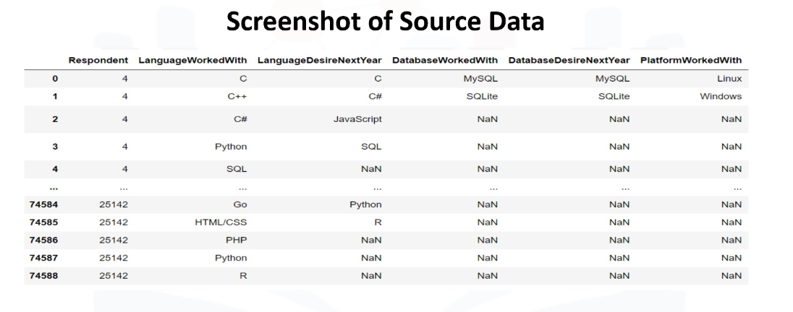
RESULTS

Slide 7
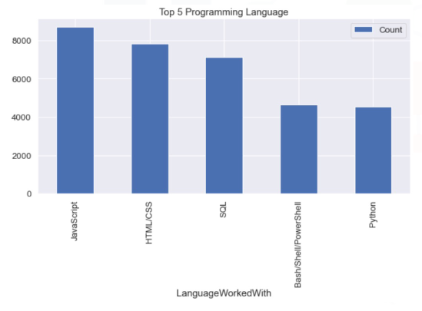
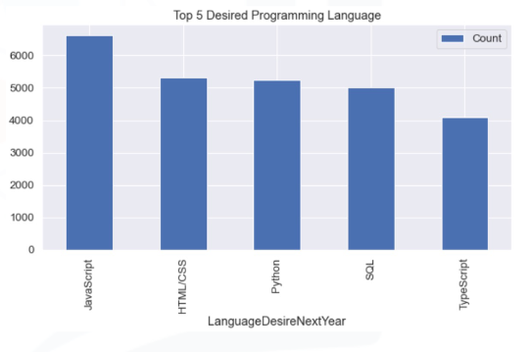
PROGRAMMING LANGUAGE TRENDS
Current Year
Next Year

Slide 8
PROGRAMMING LANGUAGE TRENDS - FINDINGS & IMPLICATIONS
Findings
JavaScript, HTML/CSS & SQL are top 3 languages this year.
Python and Typescript are gaining popularity.
Bash/Shell/Power Shell are becoming less popular.
Implications
JavaScript and HTML/CSS are in high demand.
Python is new trending language.
SQL retains its popularity in field of Big Data.

Slide 9
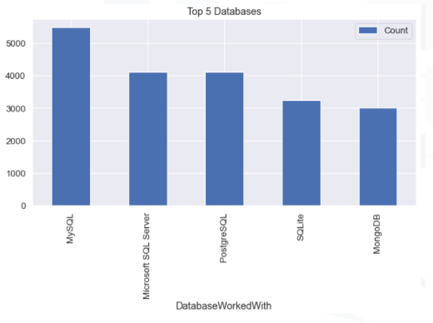
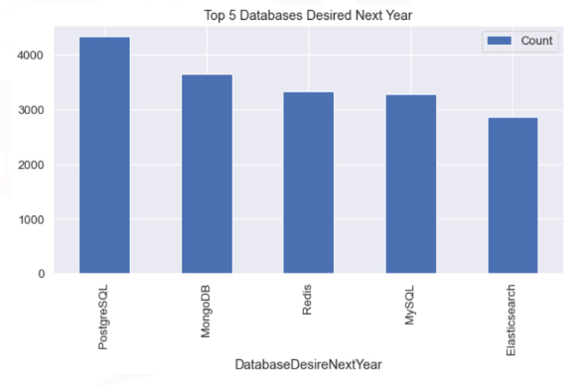
DATABASE TRENDS
Current Year
Next Year

Slide 10
DATABASE TRENDS - FINDINGS & IMPLICATIONS
Findings
MYSQL most popular.
MongoDB and Redis are gaining popularity.
Elasticsearch is upcoming favorite.
Sqlite losing popularity.
Implications
Open-source databases are still preferable in companies.
NoSQL databases are gaining popularity.
Elasticsearch is a document oriented database predicted to become a favorite.

Slide 11

DASHBOARD
https://dataplatform.cloud.ibm.com/dashboards/1a25e0b3-1635-444b-b9c2-4e529f2fb080/view/797be726339f14ff69b3c8e407c87a037f32775db5bb8550838d7b4908352497a93b42c3c87b4f0edd175030f5ec445a9a

Slide 12
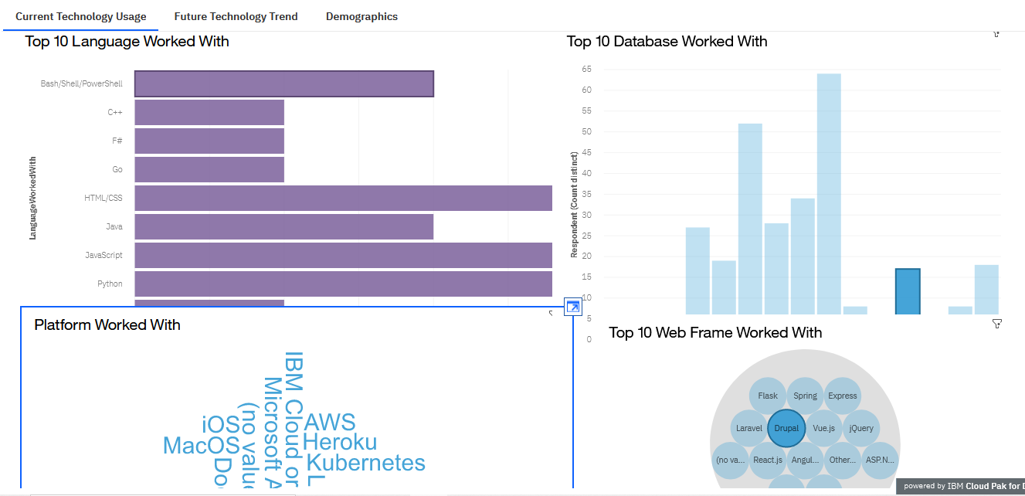
Current Technology Usage

Slide 13
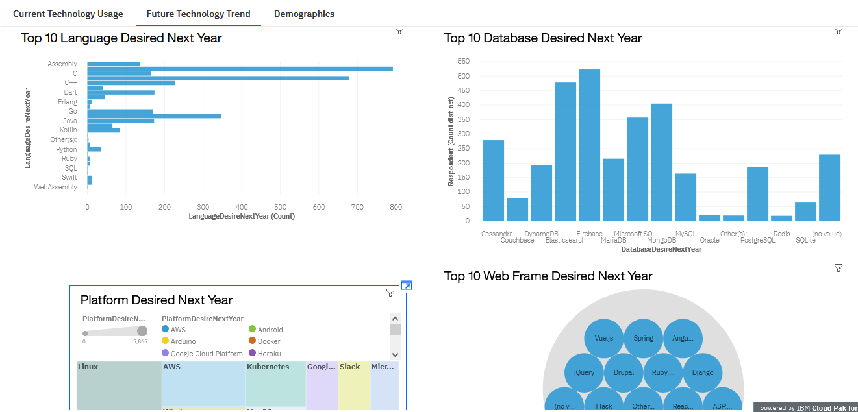
Future Technology Trends

Slide 14
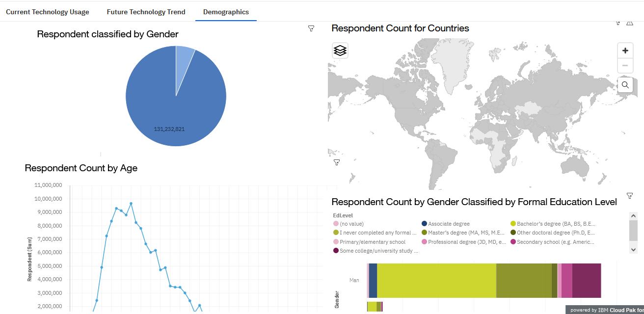
Demographics

Slide 15
DISCUSSION
Technology Trends at present and in future.
Low female participation in workforce.

Slide 16
OVERALL FINDINGS & IMPLICATIONS
Findings
Changing technological trends.
Concentration of jobs in a few countries like USA and India.
Gender gap in the workforce.
Platforms like Docker and AWS are growing
Implications
Companies need to be flexible and adjust to rapid changes
Need to spread technology out to lagging countries
Policies to increase female participation.
Demand for talent in upcoming technologies.

Slide 17

CONCLUSION
Technology Trends for current and next year.
Programming Languages, Database and Platform overview.
Demographics overview.
Actions to be taken.

Slide 18

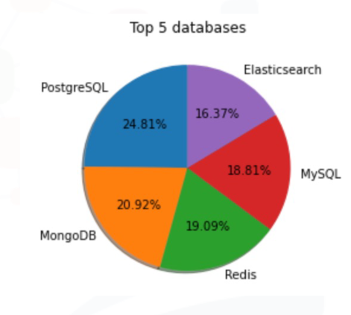
APPENDIX

Slide 19
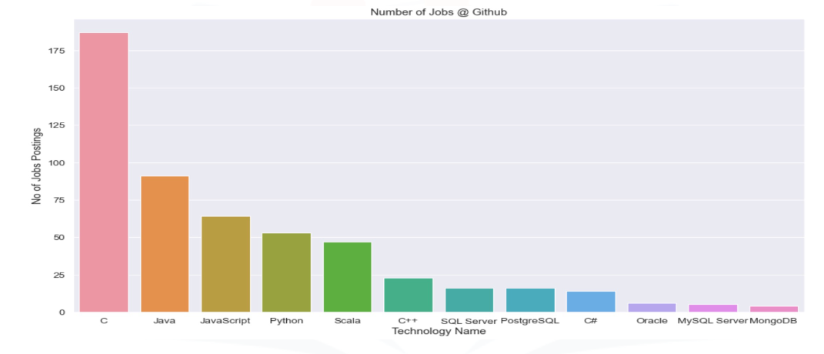
GITHUB JOB POSTINGS

Slide 20
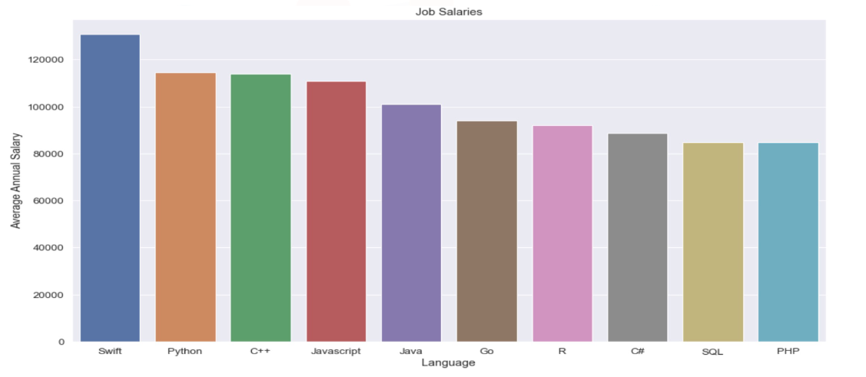
POPULAR LANGUAGES

