Slide 1
Modeling influenza dynamics in Italy: a multi-stage SIRS approach with integrated vaccination
Villa Emma – 885906
A. A. 2025/2026

Slide 2
Outline
Epidemiological context and project objectives
Classic SIR/SIRS models and their limitations
Proposed SIRnS model
Data used and numerical implementation
Main results on the 2017-2018 case study
Parameter sensitivity analysis
Conclusions

Slide 3
Context and Objective
This project focuses on seasonal influenza.
Seasonal influenza is characterized by:
  Rapid transmission
  Temporary immunity
  Annual vaccination campaigns
Objective: to analyze infections in Italy using an n-level structure for immunity, integrating vaccination as a dynamic flow rather than a static compartment.

Slide 4
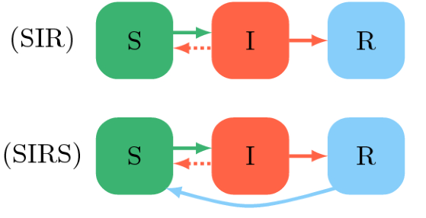
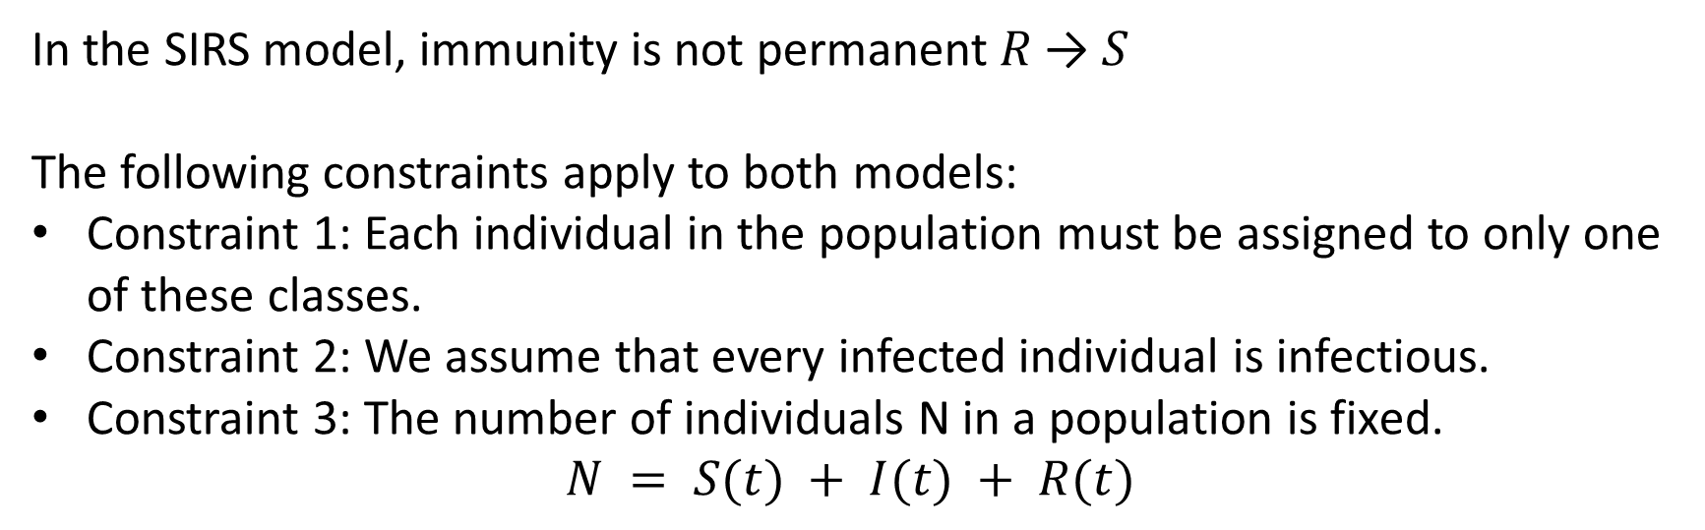
SIR and SIRS models
Compartments:
S: susceptible
I: infected
R: recovered/immune
In the SIRS model, immunity is not permanent 𝑅 → 𝑆
The following constraints apply to both models:
Constraint 1: Each individual in the population must be assigned to only one of these classes.
Constraint 2: We assume that every infected individual is infectious.
Constraint 3: The number of individuals N in a population is fixed.
$$N = S(t) + I(t) + R(t)$$

Slide 5
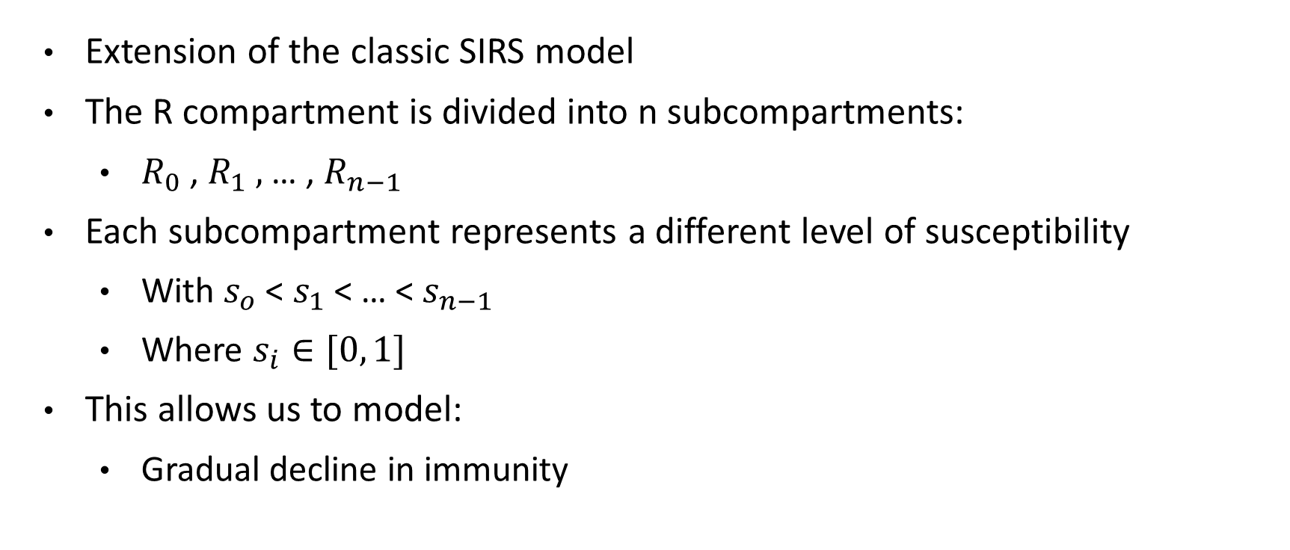
SIRnS model
Extension of the classic SIRS model
The R compartment is divided into n subcompartments:
  $R_{0}$ , $R_{1} ,$ … , $R_{n−1}$
Each subcompartment represents a different level of susceptibility
  With $s_{o}$ < $s_{1}$ < … < $s_{n−1}$
  Where $s_{i}∈[0, 1]$
This allows us to model:
  Gradual decline in immunity

Slide 6
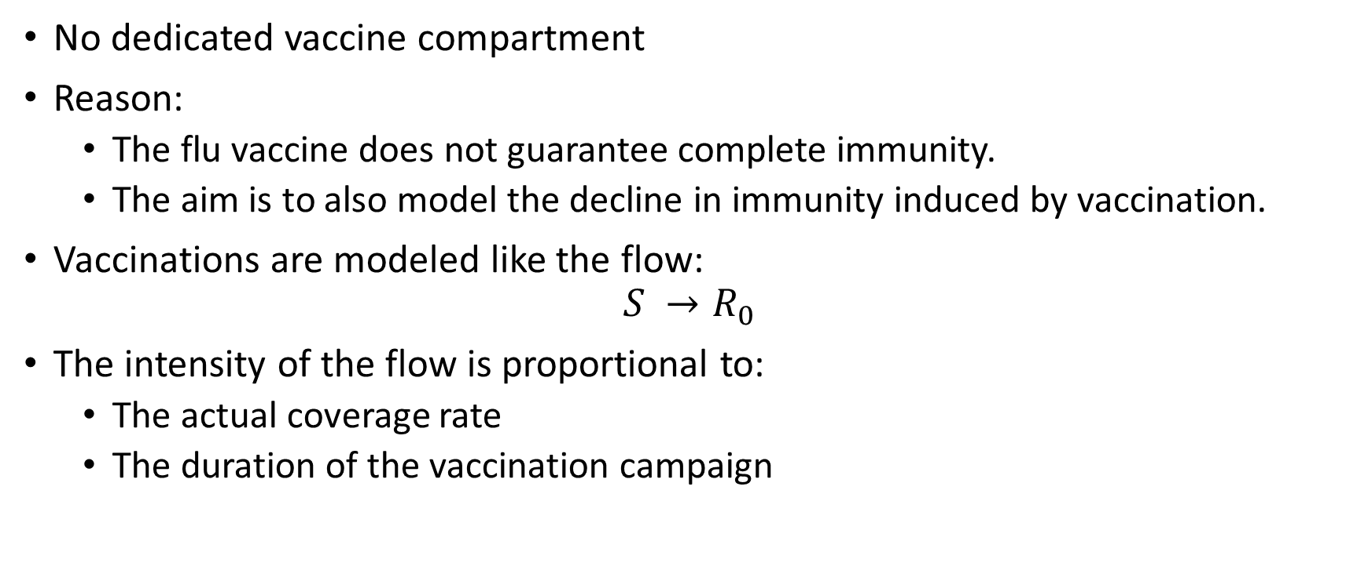
SIRnS model
No dedicated vaccine compartment
Reason:
  The flu vaccine does not guarantee complete immunity.
  The aim is to also model the decline in immunity induced by vaccination.
Vaccinations are modeled like the flow:
$$S →R_{0}$$
The intensity of the flow is proportional to:
  The actual coverage rate
  The duration of the vaccination campaign

Slide 7
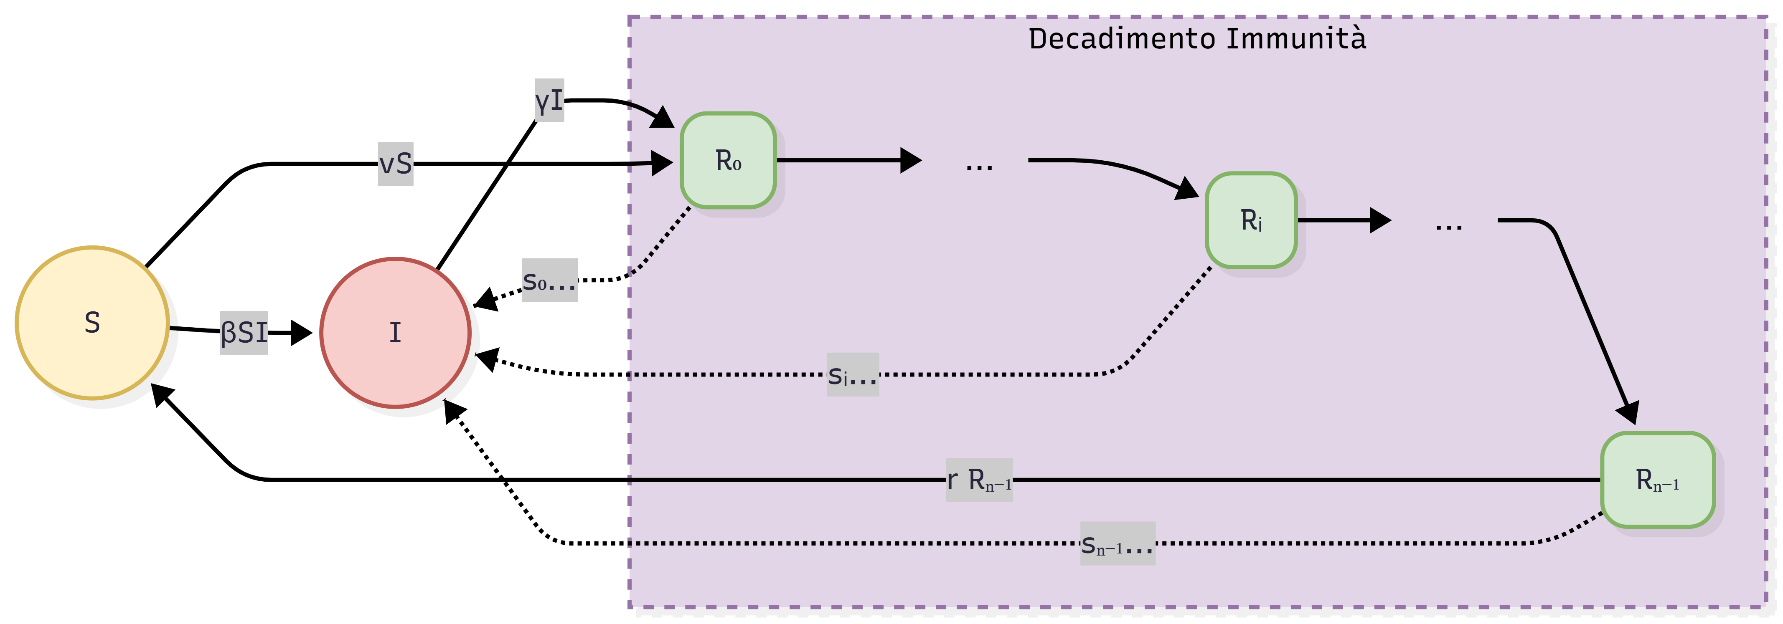
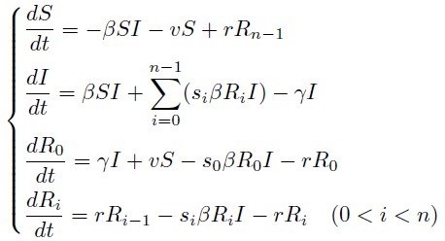
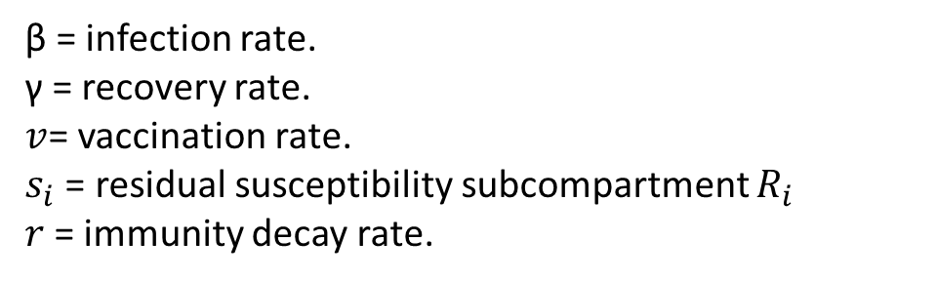
SIRnS model
β = infection rate.
γ = recovery rate.
$v$= vaccination rate.
$s_{i}$ = residual susceptibility subcompartment $R_{i}$
$r$= immunity decay rate.

Slide 8
Numerical implementation
The ODE system is solved numerically
Programming language: Python
Main libraries:
  NumPy and Pandas for data handling
  SciPy for ODE integration
  Matplotlib for visualization
Simulations are performed over:
  A single influenza season (November to April)

Slide 9
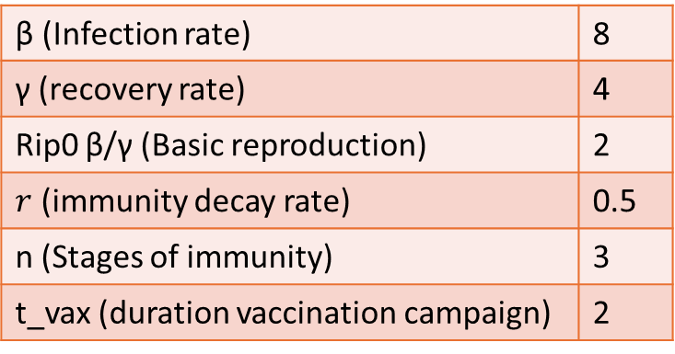
Data used and calibration
Epidemiological data:
  FluNet (WHO)
  Weekly cases aggregated monthly
  Only available for November-April
Vaccination data:
  Ministry of Health
Case study: 2017-2018 season in Italy
Basics Parameters:
β (Infection rate) | 8
γ (recovery rate) | 4
Rip0 β/γ (Basic reproduction) | 2
$r$ (immunity decay rate) | 0.5
n (Stages of immunity) | 3
t_vax (duration vaccination campaign) | 2

Slide 10
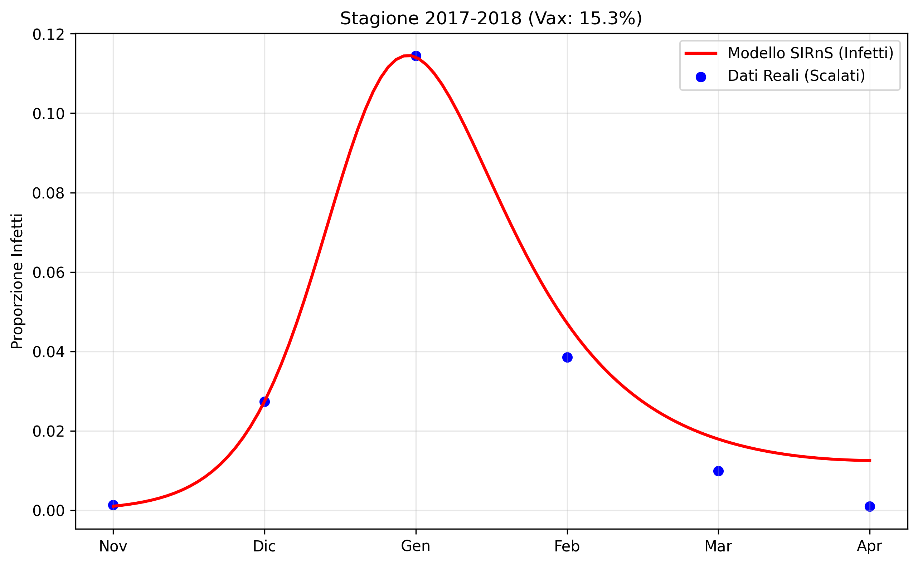
Comparison between model and real data
The comparison focuses on:
  Temporal position of the peak
  Overall shape of the curve
The actual data is scaled for visual comparison
The model correctly reproduces the timing of the peak, and the growth phase is consistent with the model

Slide 11
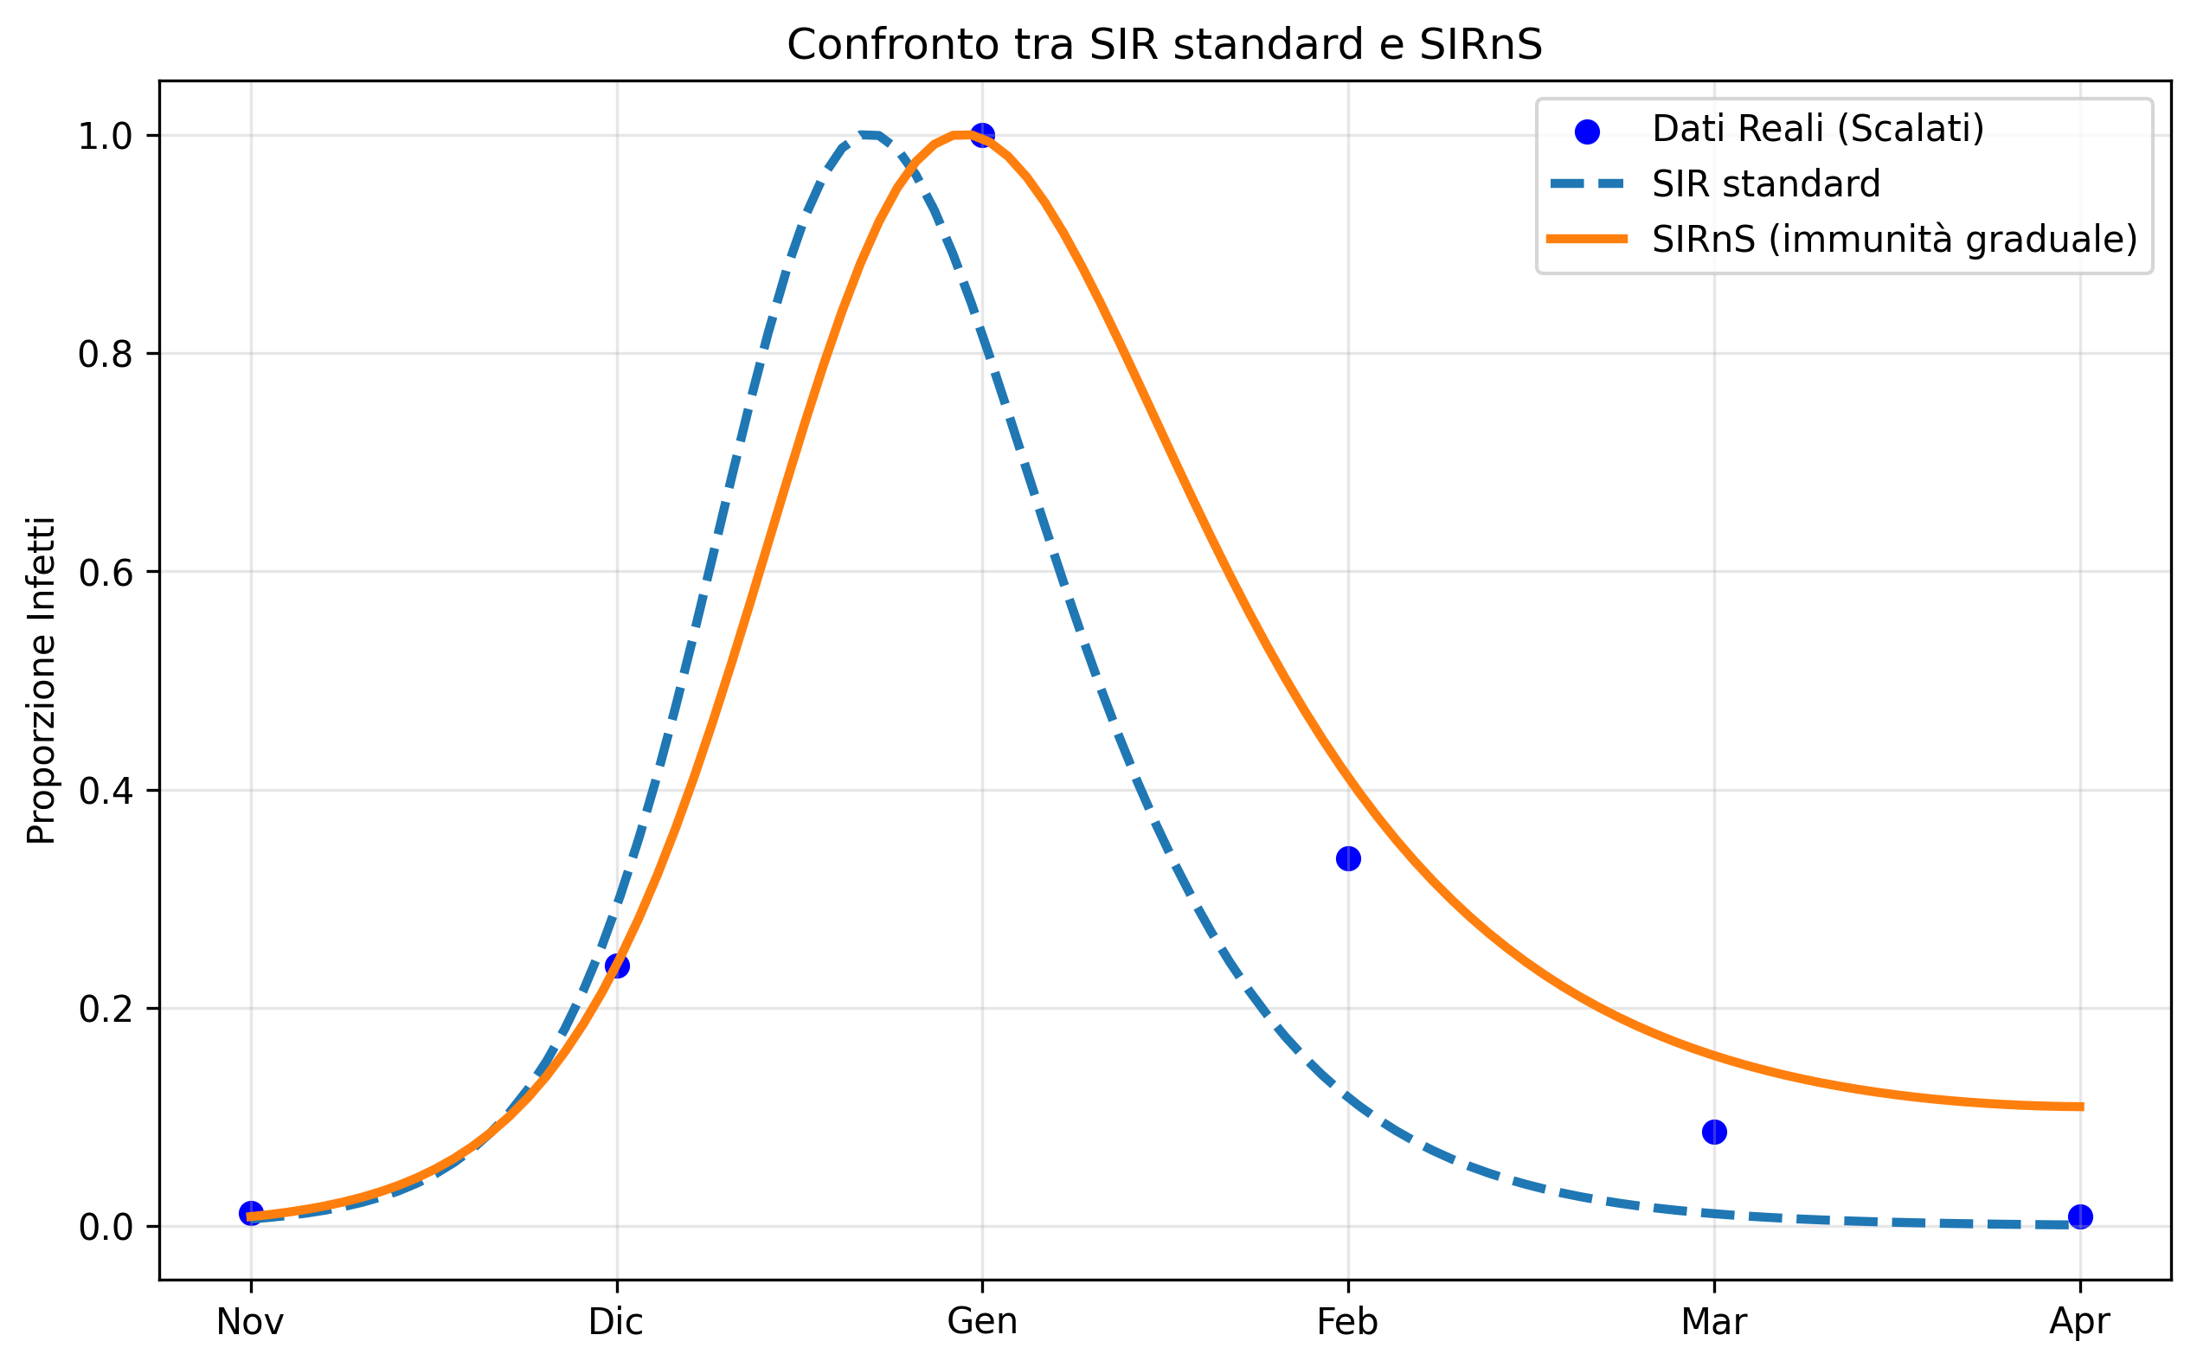
Comparison between SIR and SIRnS
Both have been normalized to compare the shape of the trend
The SIRnS shows:
  Slower growth and decline
  More realistic epidemic decline
The standard SIR shows:
  A premature peak
  Very steep decline

Slide 12
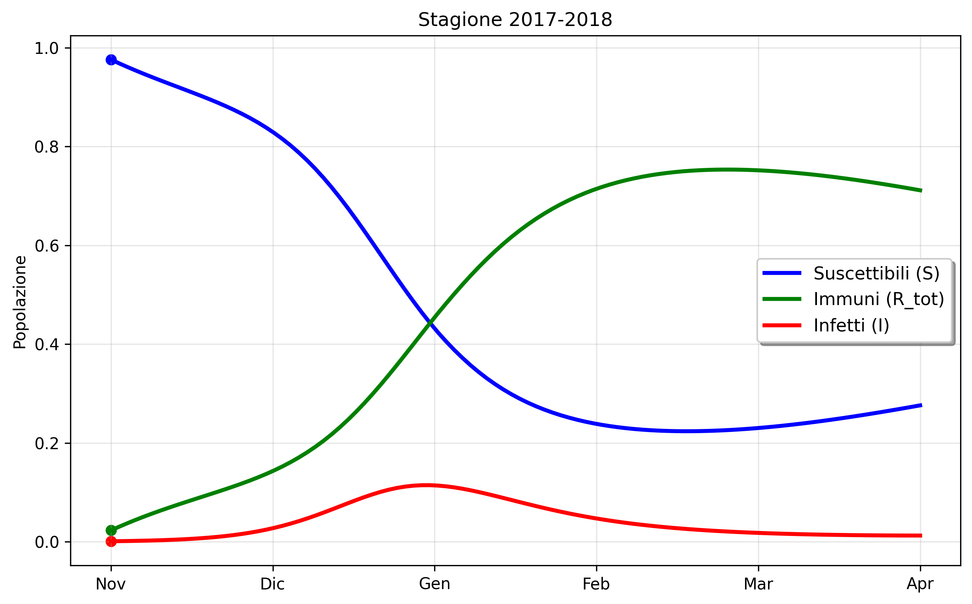
Population dynamics
The curve of susceptible and that of immune intersect in January.
The peak of infected corresponds to the moment when the number of immune exceeds that of susceptible individuals.
It is estimated that approximately 15% of the vaccination campaign will be carried out in the months leading up to November.
  Susceptible individuals do not start from 1.
  Immune individuals do not start from 0.

Slide 13
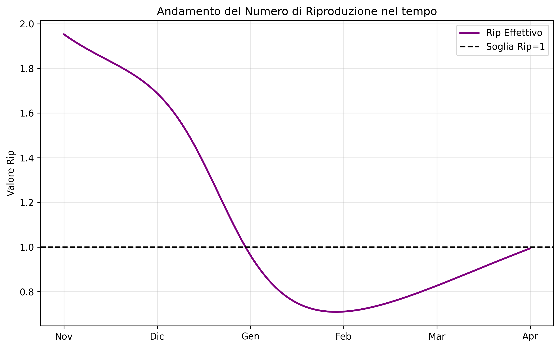
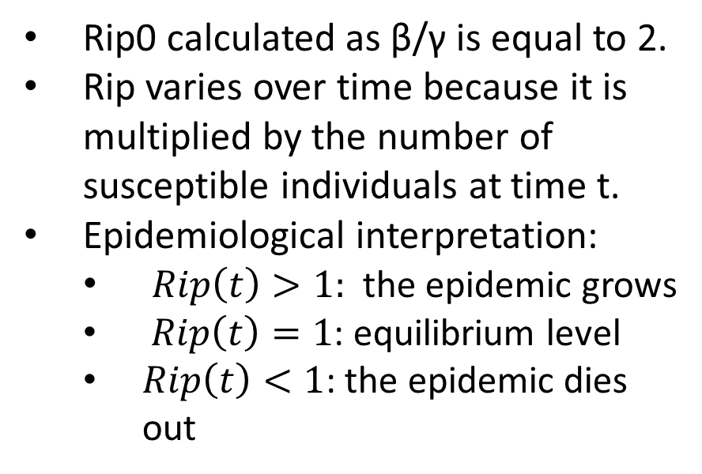
Analysis of the reproduction number
It indicates how many new infections an infected individual generates on average.
Rip0 calculated as β/γ is equal to 2.
Rip varies over time because it is multiplied by the number of susceptible individuals at time t.
Epidemiological interpretation:
  $Rip\left(t\right)>1:$ the epidemic grows
  $Rip\left(t\right)=1$: equilibrium level
  $Rip\left(t\right)<1$: the epidemic dies out

Slide 14
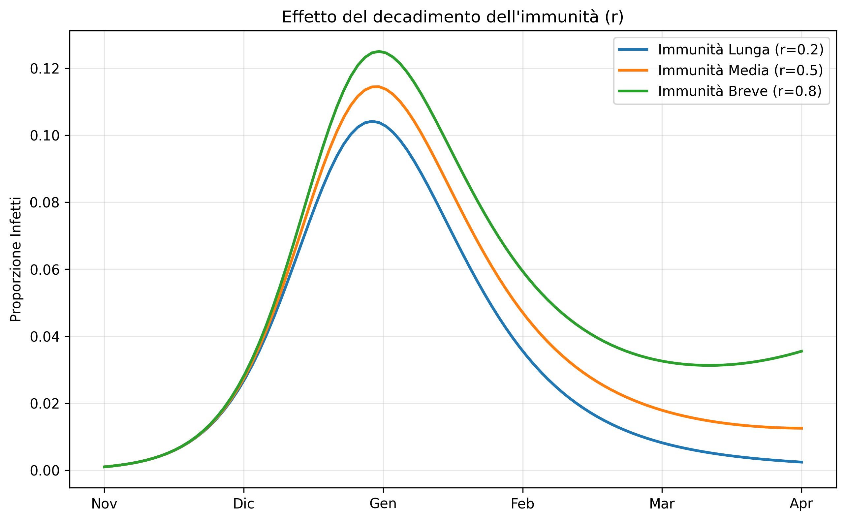
Waning immunity
The effect of the parameter r, which controls the rate of loss of immune protection, is analyzed.
High values of r lead to:
  Higher endemic peaks
  More persistent epidemic tail
Low values of r lead to:
  Reduced peak intensity
  Accelerated extinction of the
  epidemic

Slide 15
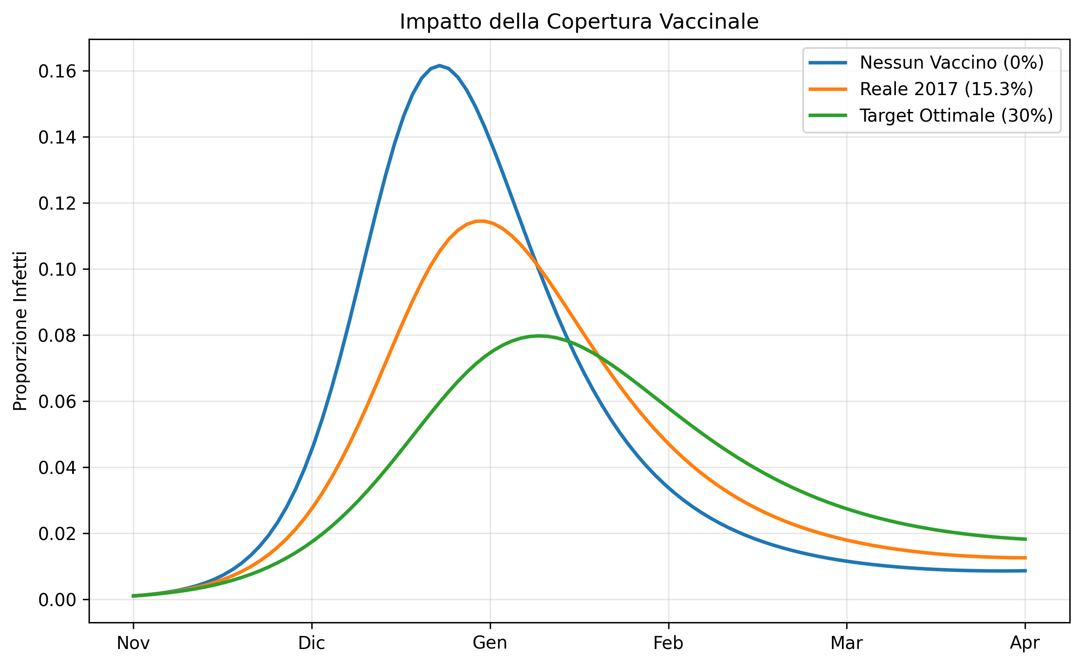
Impact of vaccination coverage
Comparison of 3 scenarios
  No vaccination (0%)
  Actual coverage in 2017 (15.3%)
  Optimal scenario (30%)
The absence of vaccination leads to an earlier and higher peak.
Increased vaccination coverage slows the spread of infection and reduces the peak.

Slide 16
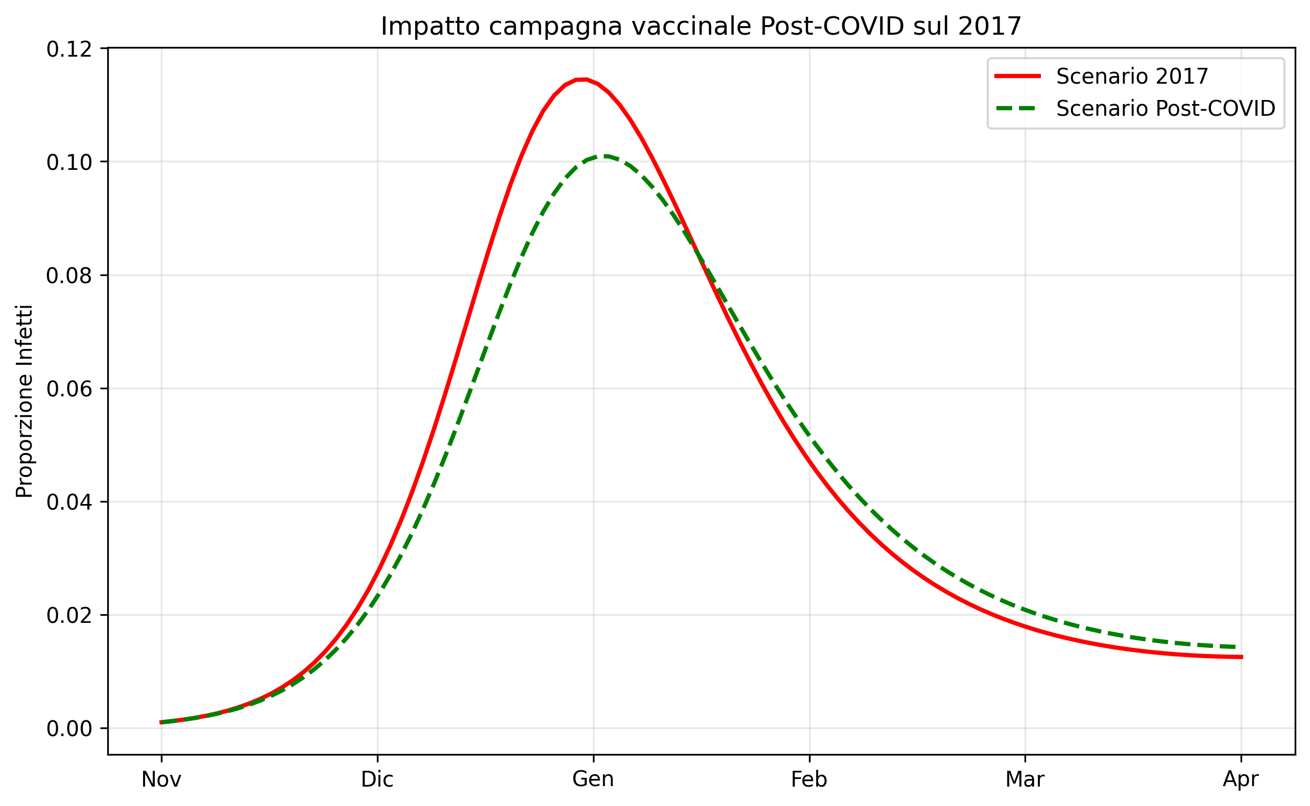
Post-COVID vaccination rates
What would have happened in 2017 if we had had the same vaccination rate as in 2021 (20.5%)?
  The peak would have been lower, at 11.8%, and slightly delayed.
In the post-COVID years, the vaccination campaign has been more intense, leading to higher vaccination rates and therefore lower epidemiological peaks.

Slide 17
Conclusions
Validation of the SIRnS model:
  The multi-stage model (n=3) approximates the actual data for the 2017-18 season better than the classic SIR model.
  It correctly captures the asymmetry of the epidemic curve and the slow decline due to waning immunity.
Immunity dynamics:
  Partial susceptibility and immunity decay are the main components of virus persistence at the end of the season.
Impact of vaccination:
  Applying 2021 vaccination rates, the model estimates a 9% reduction in the peak, confirming the importance of broad coverage.

Slide 18
THANK YOU FOR THE ATTENTION!

