Slide 1
Decoding No-Show Patterns

Slide 2
Overview
Business Problem: Understanding the drivers behind missed appointments
Stakeholder: Healthcare Operations Manager focused on scheduling efficiency
The Journey: Data Sourcing → Cleaning → Analysis → Dashboard → Recommendations.
Notes:
Today I will be presenting my capstone project ‘Decoding No-Show Patterns’ for a regional healthcare clinic in Colorado. The goal of this analysis is to transform raw appointment data into actionable insights that can improve operational efficiency and patient access.
During this presentation, I will walk you through the business problem, the data preparation process, my key findings, and specific recommendations for the clinic management.

Slide 3
Stakeholder Persona
Role: Healthcare Operations Manager at a regional clinic in Colorado
Responsibilities: Overseeing daily clinic operations, managing resources utilization, and ensuring scheduling efficiency.
Notes:
The stakeholder is a Healthcare Operations Manger at a regional clinic in Colorado who is responsible for overseeing daily clinic operations, managing resources utilization, and ensuring scheduling efficiency.

Slide 4
The Business Problem
Problem Statement: High no-show rates reduce clinic efficiency, limit patient access, and increase operational cost.
Why it Matters: Missed appointment disrupt workflows and reduce revenue in a regional clinic setting.
Key Questions:
Which demographics are highest risk?
Does transportation access or distance impact attendance?
How do lead times influence the no-show rate?
Notes:
The client, a Healthcare Operation Manager, is facing a critical challenge: high rates of missed appointments. This isn’t just a scheduling inconvenience; no-shows directly reduce revenue, increase wait times for other patients, and significantly disrupt staff workflows.
The clinic needs to understand which patient factors are most closely associated with these missed appointments so they can design targeted interventions.

Slide 5
Data Source
Data Source: ‘Colorado Healthcare: Decoding No-Show Patterns’ (Kaggle) a synthetic dataset with noise added via Google Gemini.
Scope: 50,000 patient records from November 2023 to November 2024.
Notes:
The foundation of this project is the ‘Colorado Healthcare: Decoding No-Show Patterns’ dataset from Kaggle, a synthetic dataset covering 50,000 appointments from November 2023 to November 2024. While the original dataset was relatively clean – only having blank spaces – I introduced synthetic ‘dirt’ using Google Gemini to simulate real-world data.

Slide 6
Ethics, privacy, and limitations
Ethics & Privacy: All data is synthetic; however, analyzing “Mental Health” or “Chronic Disease” require strict adherence to HIPAA-like privacy standards.
Limitations: The 50.14% no-show rate is exceptionally high for real-world clinic (typically 10-20%). This suggest either a data ‘dirt’ anomaly or a systemic failure in the clinic’s reminder system (or possibly a lack of one)
Notes:
From an ethical standpoint, because this data is synthetic, no one’s privacy was invaded. However, if it wasn’t synthetic, it’s important to prioritize data that keeps patient identifiers anonymous. This dataset simulates that by having patient ID numbers and not personal identifiable information. This becomes more important when analyzing medical conditions.
One primary limitation to note, and as you will see when we get into the analysis, the current no-show rate is about 50%, which suggest either an extreme systemic issue at the clinic or a side effect of the synthetic data.

Slide 7
Data cleaning and transformation
Normalization: Removed underscores from column names; applied “Capitalize Each Word” and “Trim” to text columns.
Quality Control: Replaced blanks with null.
Integrity: Removed duplicates from PatientID and filtered out empty PatientID and AppointmentOutcome records
Decision Logic: Kept nulls in secondary columns to preserve the integrity of the primary outcome data.
Notes:
To ensure the data was ready for analysis, I performed several transformations in Power BI. I standardized column names by removing underscores and used ‘Capitalized each Word’ and ‘Trim’ functions to ensure text consistency.
I handled missing values by replacing blanks with ‘null’ and specifically removed empty records from ‘PatientID and ‘AppointmentOutcome’ columns to ensure the target variable was accurate. I also removed duplicate PatientIDs to ensure each record represented a unique interaction.
I decided to keep nulls in secondary columns to preserve the integrity of the primary outcome data.

Slide 8
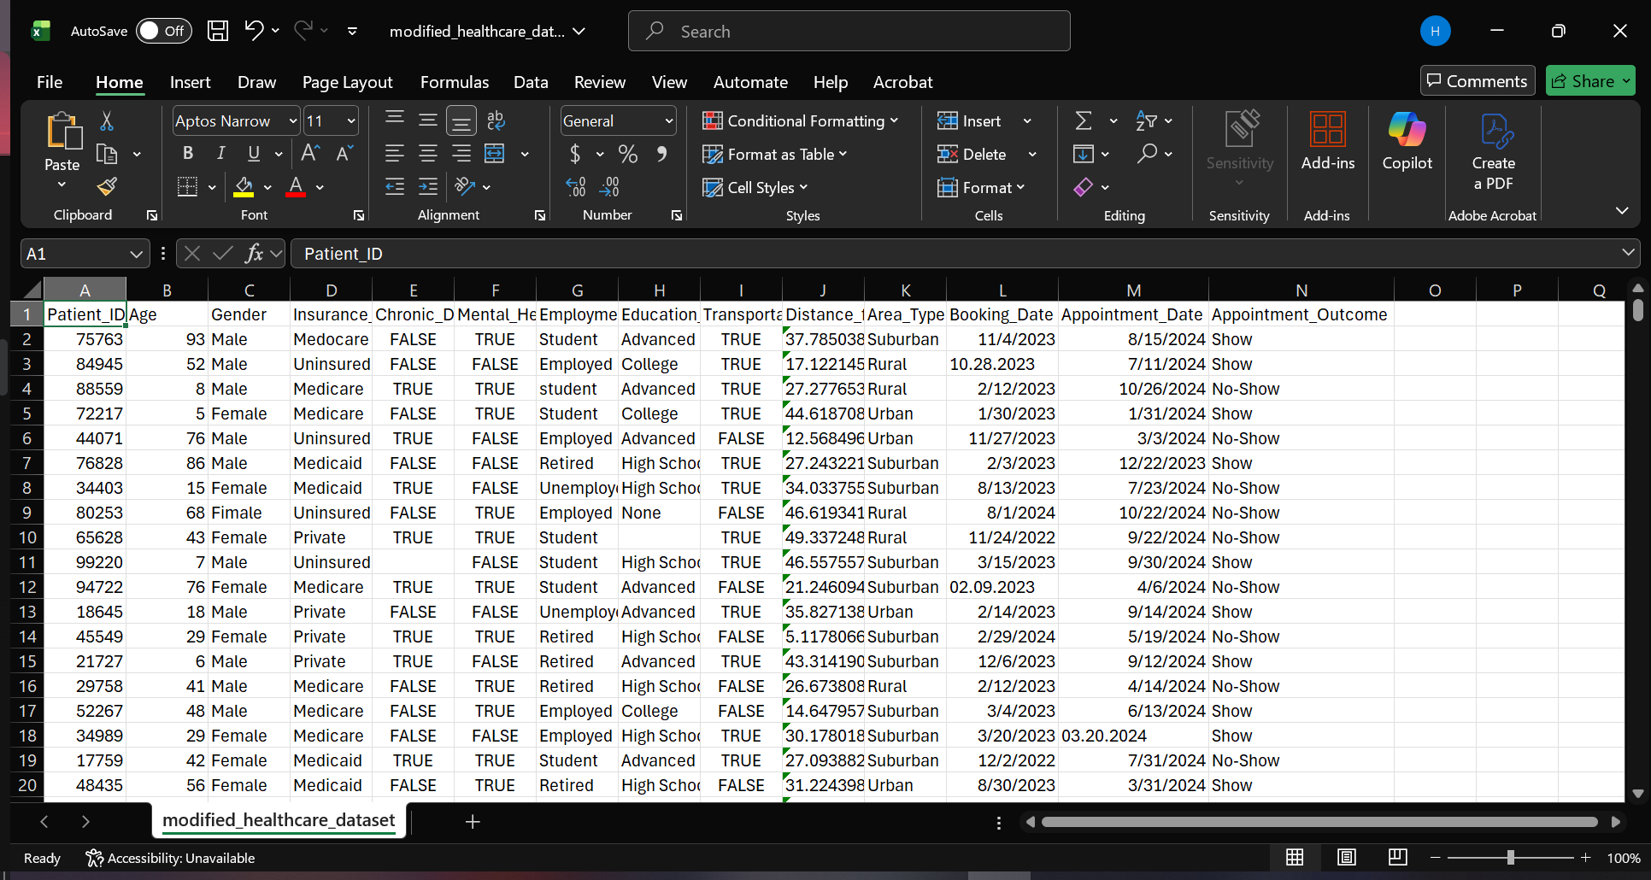
Dirty Data

Slide 9
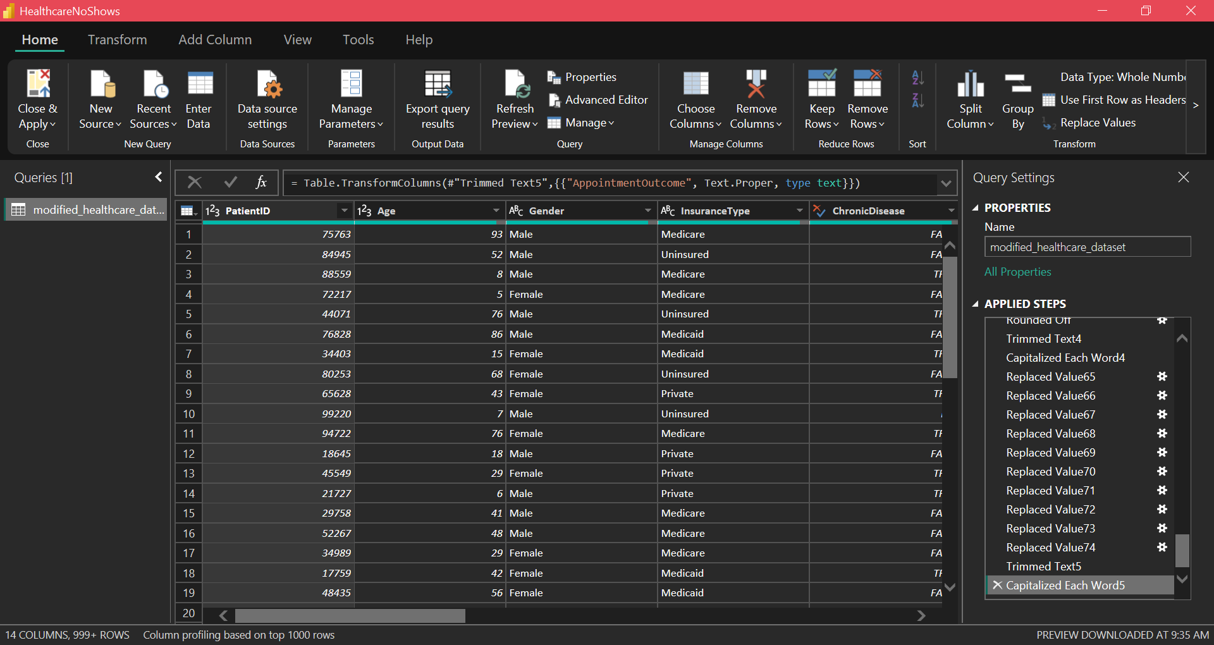
Clean Data

Slide 10
KPI Definitions and Key Insights
I measured success through three primary lenses:
Overall No-Show Rate: 50.14% (The baseline for all comparisons).
Segmented No-Show Rate: Identifying variances by age, insurance, transportation, etc.
High-Risk Accuracy: Using a decomposition tree to isolate the most likely no-show candidates.
Notes:
To measure success, I focused on three primary KPIs: the Overall No-Show Rate, which gives the baseline; the No-show Rate by Segment, which helps find high-risk demographics; and High-Risk Identification Accuracy
As noted earlier, the current overall no-show rate is 50.14%, which serves as the benchmark for all subsequent comparisons.
**Tour Power BI**

Slide 11
Analysis & Insights
The “Young Adult” Gap: Patients aged 19-35 have the highest no-show rate at 60%, especially when lead time exceed 14 days.
The transportation Barrier: When transportation is unavailable, no-shows jump to 59%. This is most acute for Uninsured(68%) and Medicaid (63%).
Lead Time Fatigue: No-shows climb steadily from 0-35 days, staying above clinic average after 49 days.
The Trend: The problem is getting worse, trending upwards from 49.27% to 50.26% over the year.
Notes:
My analysis revealed a clear ‘High-Risk’ profile. The most significant demographic factor is age: patients between 19-35 have a no-show rate of about 60%, about 10% higher than the clinic average.
Environment factors are also critical. Patients without transportation access have 59% no-show rate. When we look at the intersection of insurance and transportation, uninsured patients without a ride reach a staggering 68%.
Finally, timing matters. We see a steady climb in no-shows as the ‘Lead Time’ increases. Appointments booked 49 days in advance show no-show rate above clinic average.

Slide 12
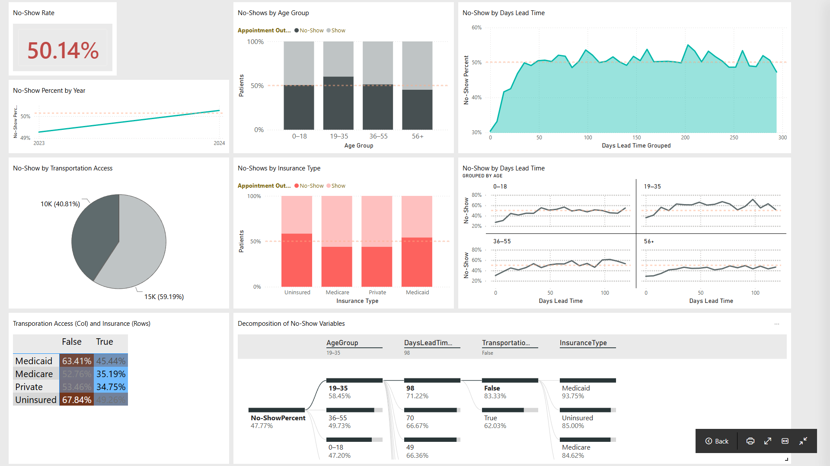
Dashboard
Notes:
** Show live dashboard**
I developed a Power BI dashboard to help the Operations Manager make data-driven decisions. It features a scorecard for the total no-show rate and a decomposition tree that allows users to drill down into the specific combinations of risk factors I described.
This tool doesn’t just show what happened, it helps the clinic predict who is most likely to miss their next appointment based on their age, insurance type, transportation access, and lead time.

Slide 13
Recommendations & Next Steps
Targeted Reminders: Implement a “High-Risk” SMS reminder protocol for the 19-35 age group, particularly for appointments booked greater than 14 days in advance.
Transportation Partnerships: Explore a pilot program with ride-share services for Medicaid and Uninsured patients who flag “No Transportation”
Shorten the Window: Reduce the “Days Lead Time” by implementing a waitlist system to fill gaps, as appointments booked 98 days out are highly likely to fail.
Audit the “Dirt”: Investigate why the no-show rate is 50%+ -- is there a technical glitch in how the clinic sends out appointment notifications?
Notes:
Based on these finding, I have a few recommendations for the clinic:
1. Implement a targeted reminder system: Prioritize automated SMS or phone call reminders for the 19-35 age demographic, especially for appointments booked more than two weeks in advance.
2. Address transportation barriers: since transportation is a major hurdle for Medicaid and Uninsured patients, the clinic should explore partnerships with local transit or ride-share services.
3. Optimize lead times: the data shows that the longer a patient waits for an appointment, the less likely they are to show. I recommend a waitlist system to move high-risk patients to sooner openings.
4. Audit the ‘Dirt’: investigate why the overall no-show rate is so high. Investigate if there is a technical glitch in how the clinic sends out appointment notifications.

Slide 14
Conclusion and Q&A
Summary: I identified that age, long lead times, and lack of transportation are the “perfect storm” for no-shows.
Final Word: By focusing on the 19-35 demographic and transportation access, the clinic can reclaim significant lost revenue.
Notes:
In summary, while the current no-show rate is high, the data provides a clear roadmap for intervention. By focusing on young adults, addressing transportation gaps, and managing lead times, the clinic can significantly improve its operational health.
Thank you for your time. I am now happy to answer any questions you may have regarding the data, the cleaning process, or my recommendations.

