Slide 1


Slide 2
PROJECT TITLE
SIREN
TEAM MEMBERS
Evin Brijesh
TEAM NAME
SUDOCODER

Slide 3

Problem Statement
THE CORE PROBLEM
Satellite data exists, but is disconnected from ground response—leaving emergency teams blind to immediate threats and exposure.
TARGET AUDIENCE
Emergency Operations Centers (NDMA / SDMA)
Search & Rescue Teams (First Responders)
Public Health & Water Teams (WASH)
CURRENT GAPS
Cloud Blindness: Optical satellites fail during storms
Hours of Delay: Manual GIS analysis is too slow
Network Collapse: Alerts fail when cell towers go down

Slide 4

Solution
Value Prop
Automated satellite-to-ground intelligence that turns orbital data into verified disaster action in minutes.
The Method
Cloud-Penetrating SAR
Hydrological Exposure
Human-in-the-Loop
Use Cases
Flash Flood & GLOF Alerts
Rescue Routing
Disease Prevention
Roadmap
Phase 1 (Done): End-to-end pipeline + <250-byte resilient alerts
Phase 2: Direct LoRa mesh & satellite terminal integration
Phase 3: Multi-basin scaling across the entire Himalayan belt

Slide 5

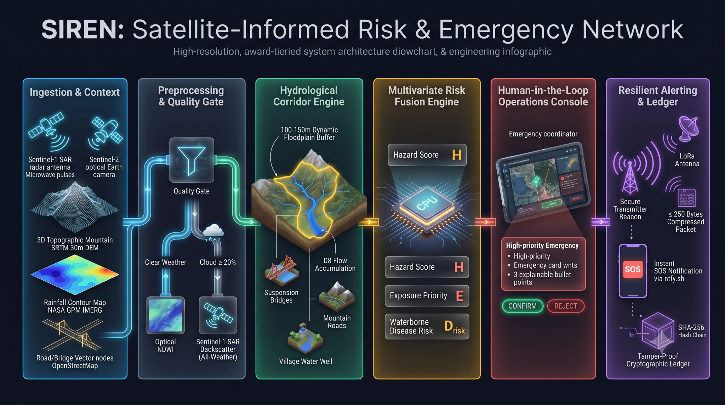
Structural Breakdown

Slide 6
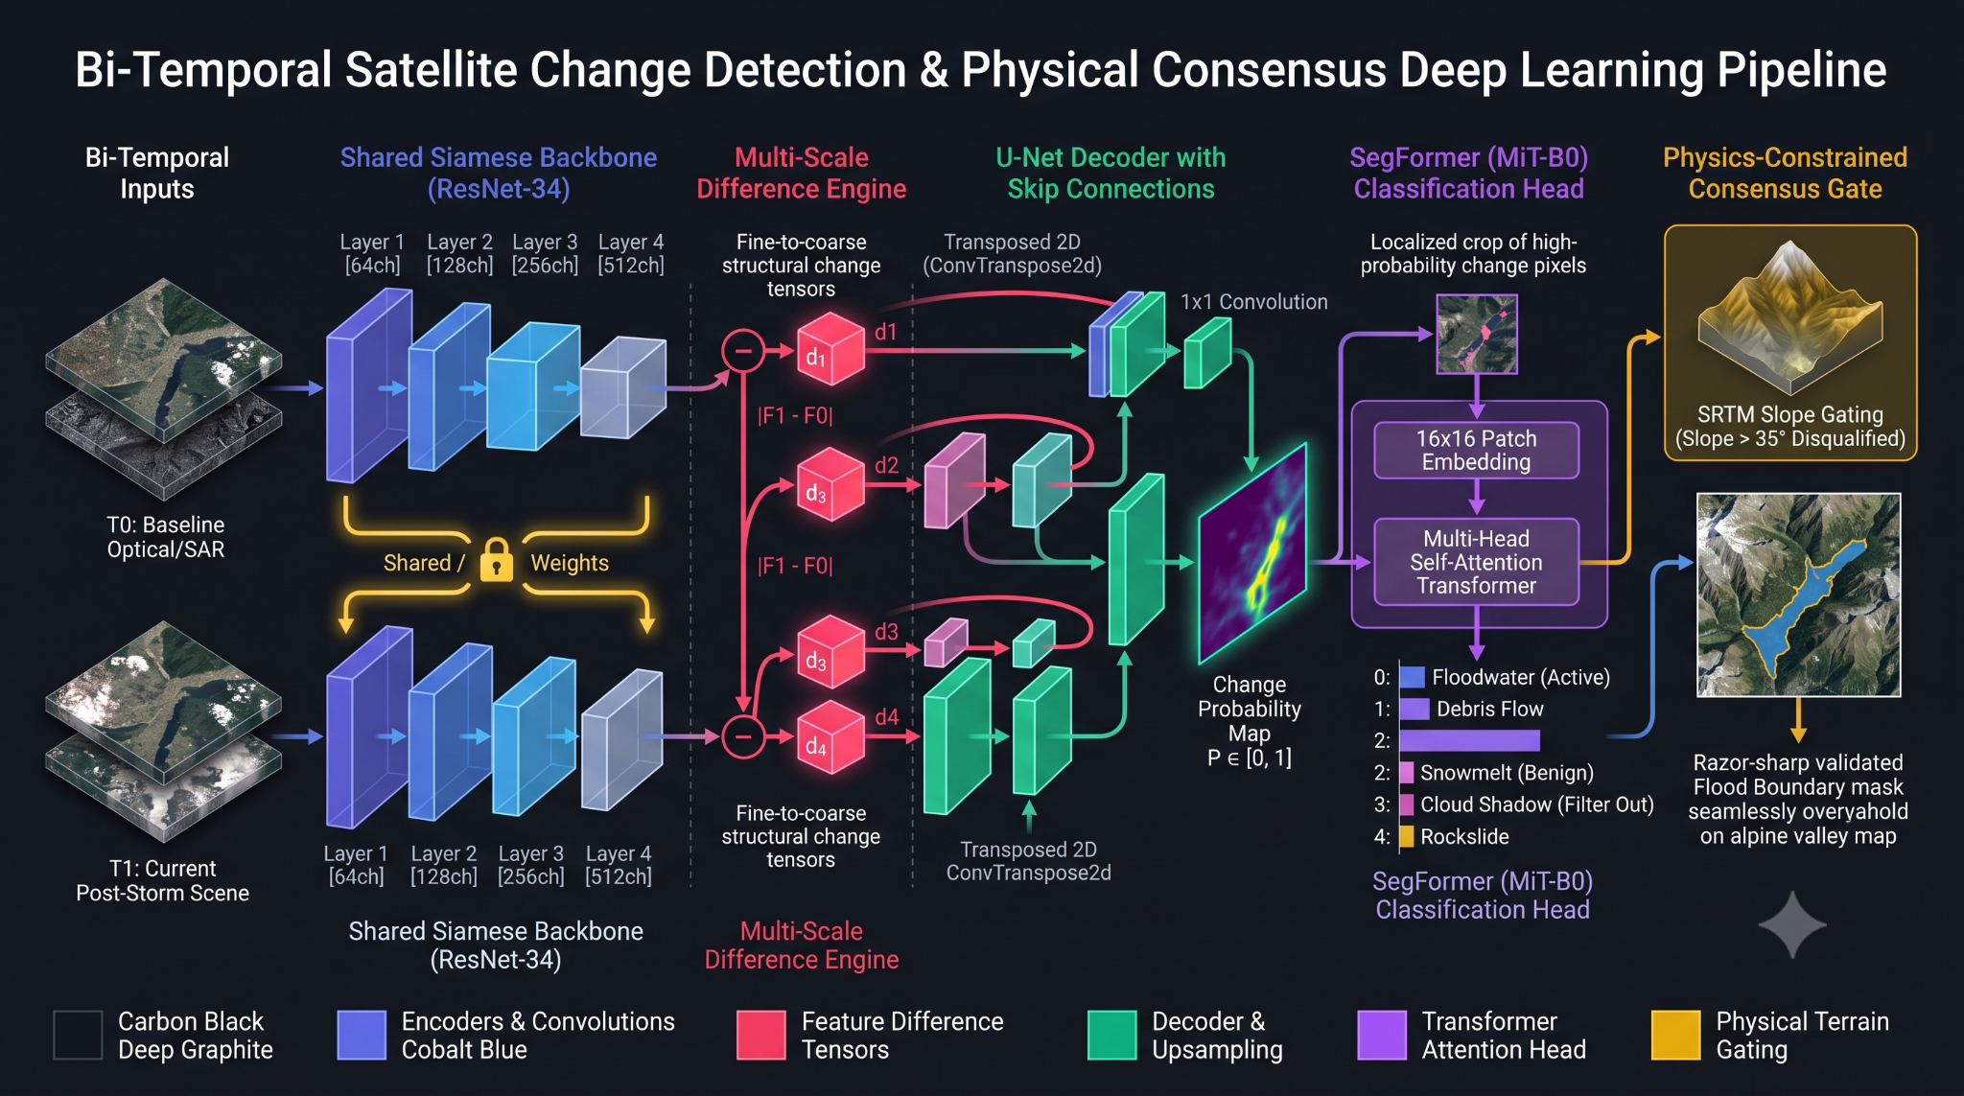
Structural Breakdown

Slide 7
Technologies Used
SOFTWARE STACK
Languages: Python 3.11+, TypeScript
Frameworks: React, Vite, MapLibre GL, Tailwind CSS
Geospatial & ML: Rasterio, GeoPandas, Shapely, PySheds, NumPy, PyTorch
Backend: FastAPI, Pydantic, Uvicorn
DATA & APIS
Earth Observation: Sentinel-1 SAR & Sentinel-2 Optical (CDSE STAC)
Terrain & Weather: SRTM 30m DEM & NASA GPM IMERG Rainfall
Infrastructure: OpenStreetMap
Storage & Audit: SQLite + SHA-256 Cryptographic Hash Chain

Slide 8

Scalability & Feasibility
01 . SCALABILITY
Fully basin-agnostic and runs on open satellite data, allowing any new watershed to onboard in minutes without GPUs.
02 . CHALLENGES
Satellite revisit gaps are bridged by continuous rainfall telemetry and ultra-compact (<250B) offline alerting.
03 . FEASIBILITY
Zero data licensing costs, lightweight local Docker/SQLite deployment, and an already working, test-verified MVP.

Slide 9
Marketing real world USP
Unique Selling Proposition (USP): Combines cloud-penetrating radar, automated disease prevention (submerged drinking wells), and ultra-compact (<250B) alerts that work even after cell towers collapse.
Real-World Value: Replaces 12+ hours of manual GIS analysis with automated, human-verified hazard and road-cut intelligence in minutes.
Target Adoption: Designed for direct integration into State/National Disaster Management Authorities (NDMA/SDMA) and humanitarian WASH emergency units.

Slide 10

Unit Economics
01 . COST BREAKDOWN
Zero Data Costs: Powered 100% by open-access public satellite constellations (ESA Copernicus & NASA) and OpenStreetMap.
02 . MINIMAL INFRASTRUCTURE:
Runs entirely on standard commodity CPUs or field laptops (~20–50/month per monitored river basin, no expensive GPUs).
03 . MASSIVE ECONOMIC ROI:
Prevents millions of dollars in secondary epidemic costs and infrastructure washouts by providing rapid, verified advance warning.
.

Slide 11

Future Plans & Roadmap
01 . PLANNED EXPANSIONS
Next-Gen Features
Deploy physical LoRa mesh / satellite radio nodes for off-grid alert delivery, paired with automated Sentinel-1 NRT live satellite triggers.
02 . LONG-TERM VISION
6M – 1 Year & Beyond
Expand beyond single basins to a state-wide portfolio covering vulnerable Himalayan flash-flood and GLOF corridors in partnership with SDMAs.
03 . HACKATHON PIVOT
Edge Intelligence
Integrate missing-personnel registries (Track 7.i) and automated evacuation routing that dynamically steers around severed bridges and cut roads.

Slide 12


