Slide 1
Machine Learning

Slide 2
Why Machine Learning

Slide 3
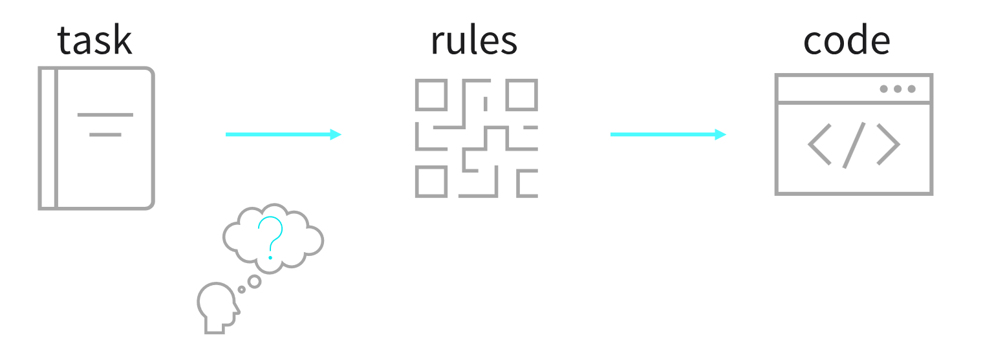

Why Machine Learning
For some problems we cannot simply write the rules
What if computer systems could learn through trial and error?

Slide 4
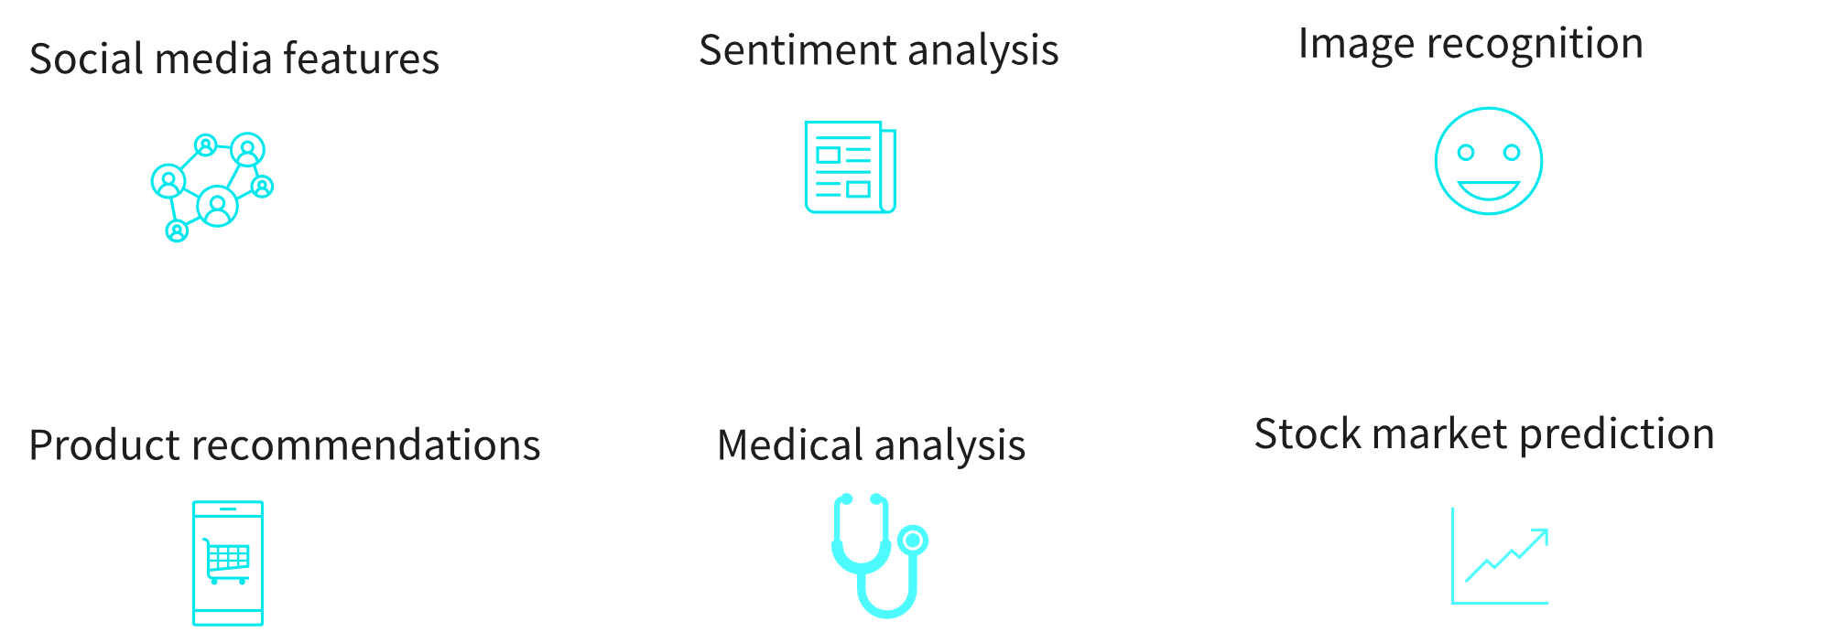
Why Machine Learning

Slide 5
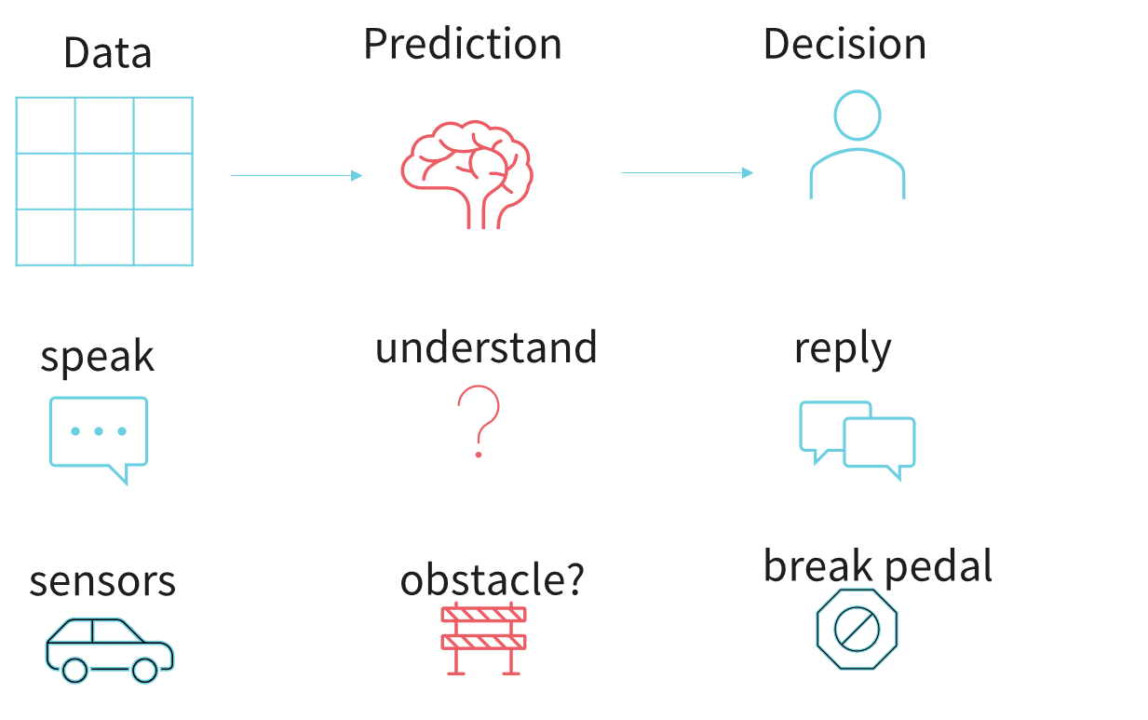
Why Machine Learning
Computer systems learn and improve from experience

Slide 6
ML Framework and Categories

Slide 7
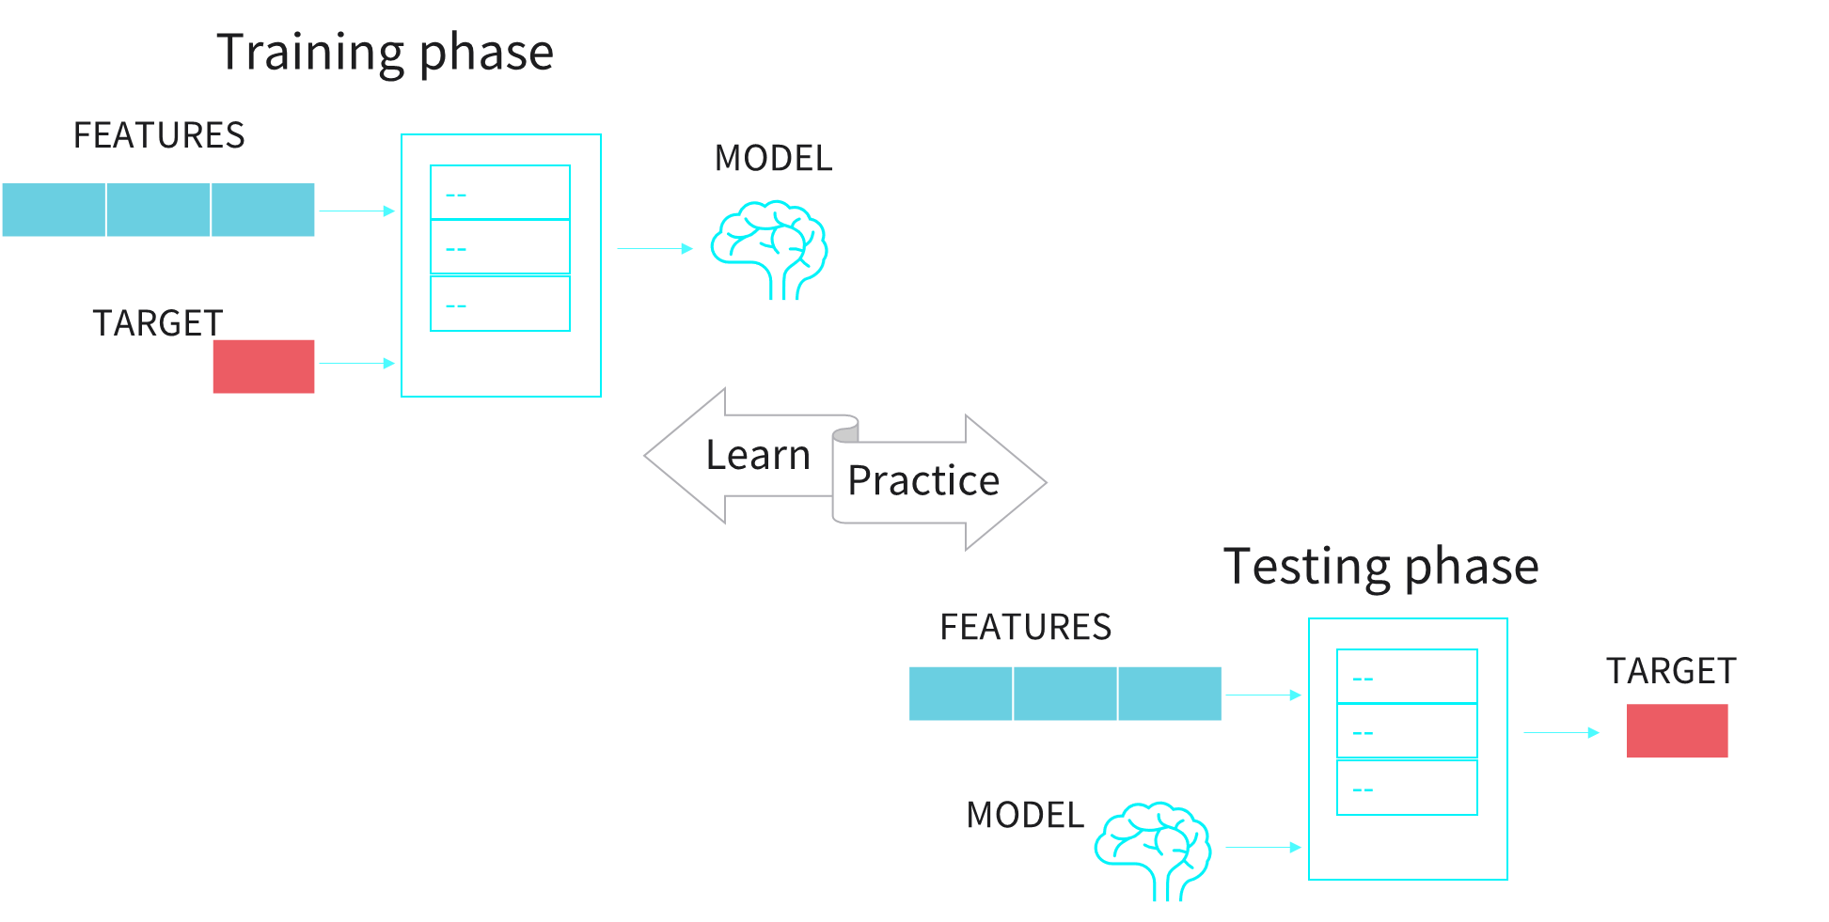
Machine Learning Framework

Slide 8




Supervised learning
Supervised learning
Applications
  use labeled dataset to train
  correct output is known
    image classification
    speech recognition
    weather forecast

Slide 9
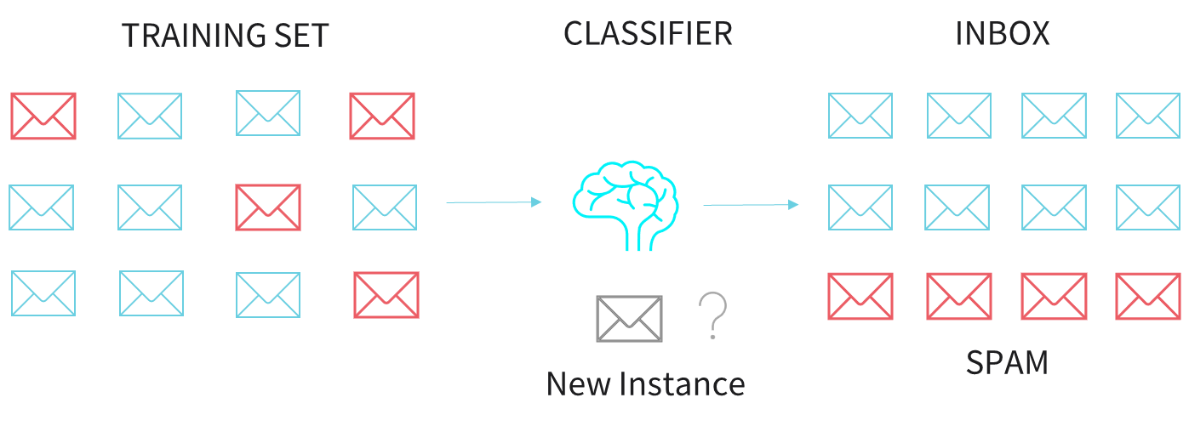
Supervised Learning
Classification example: filtering spam email

Slide 10
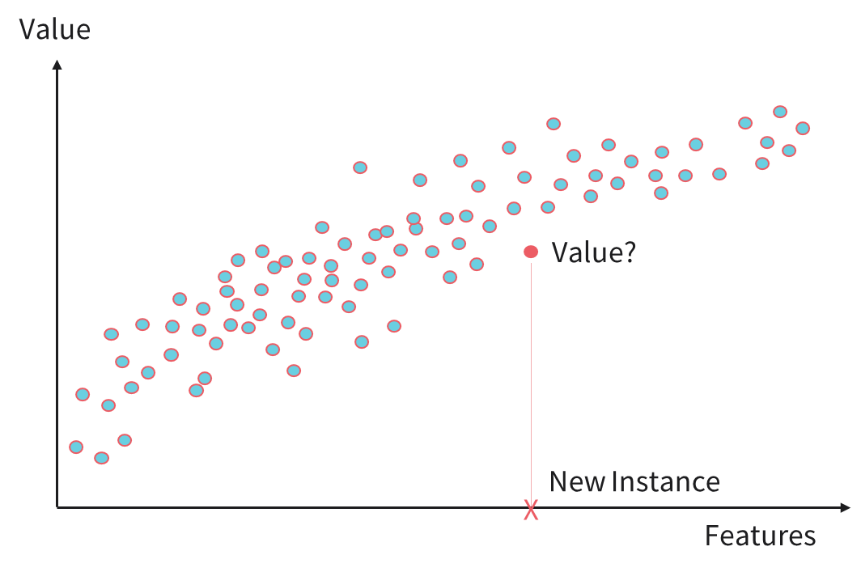
Supervised Learning
Regression example: predicting house prices

Slide 11
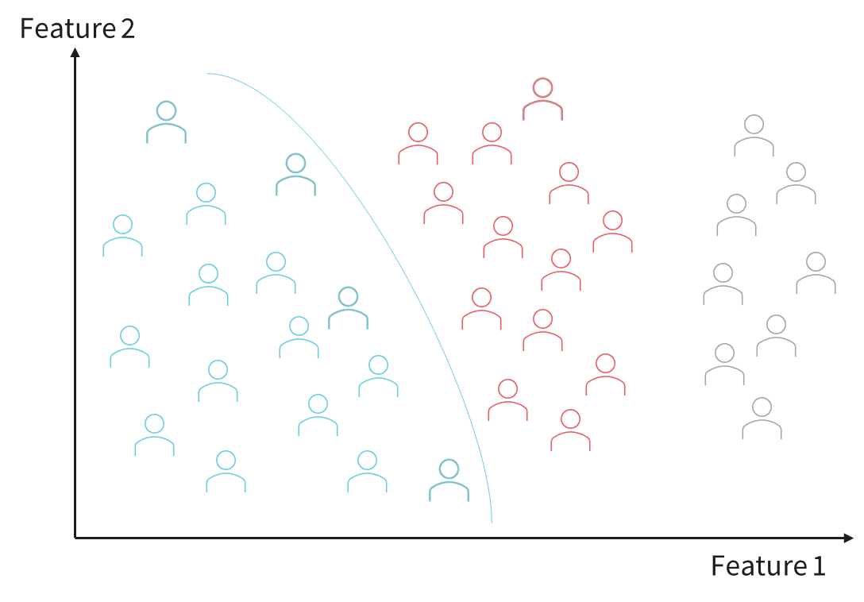
Unsupervised learning
Learn without a teacher
Group set of related data
Applications: data analytics, customer segmentation, recommender systems

Slide 12
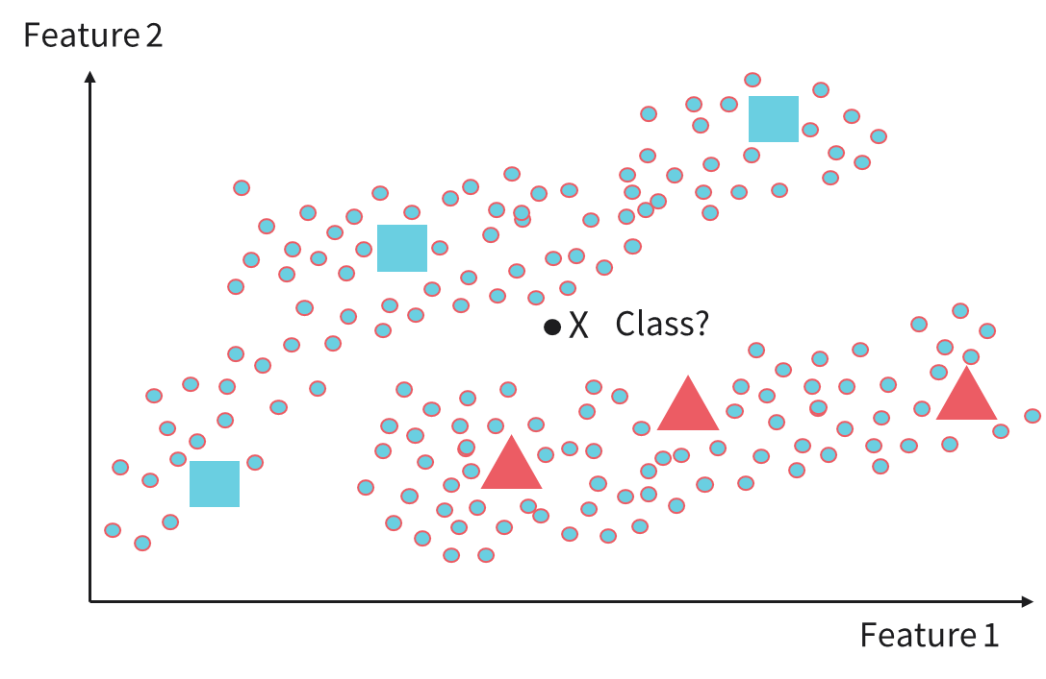
Semisupervised learning
Tradeoff between supervised and unsupervised learning
Large set of unlabeled data for grouping
Small set of labeled data for classification

Slide 13
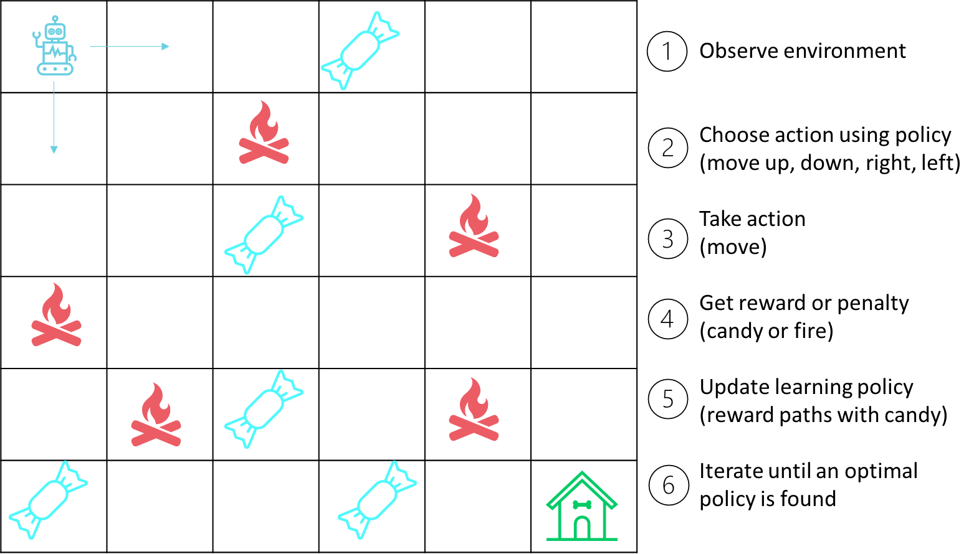
Reinforcement learning
Train through trial and error
Reward desired behavior
Punish undesired behavior

Slide 14
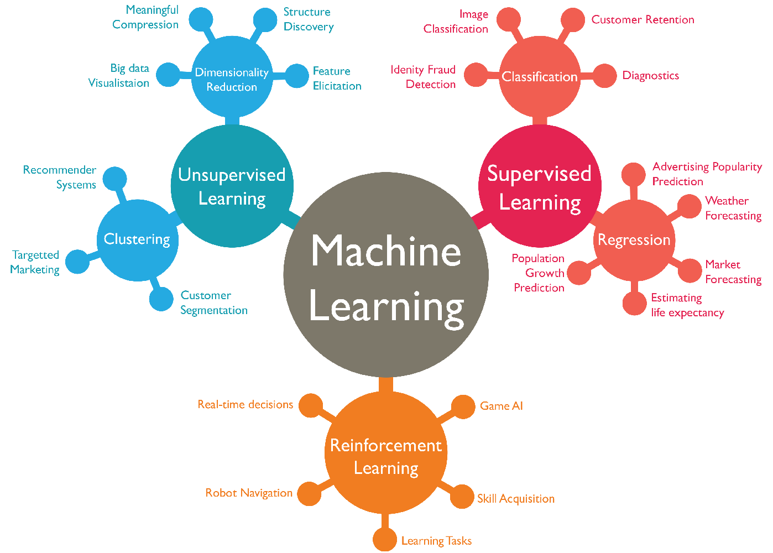
ML Categories and Applications in One Picture

Slide 15
Fundamental Concepts

Slide 16
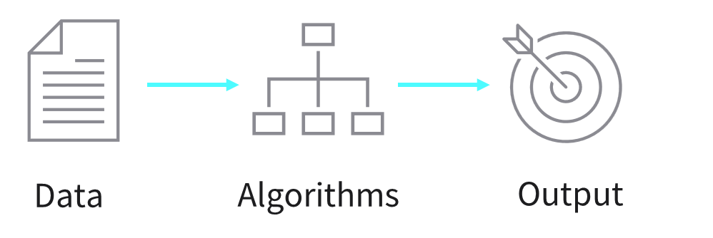
Fundamental concepts
Machine learning uses data and algorithms to solve tasks

Slide 17
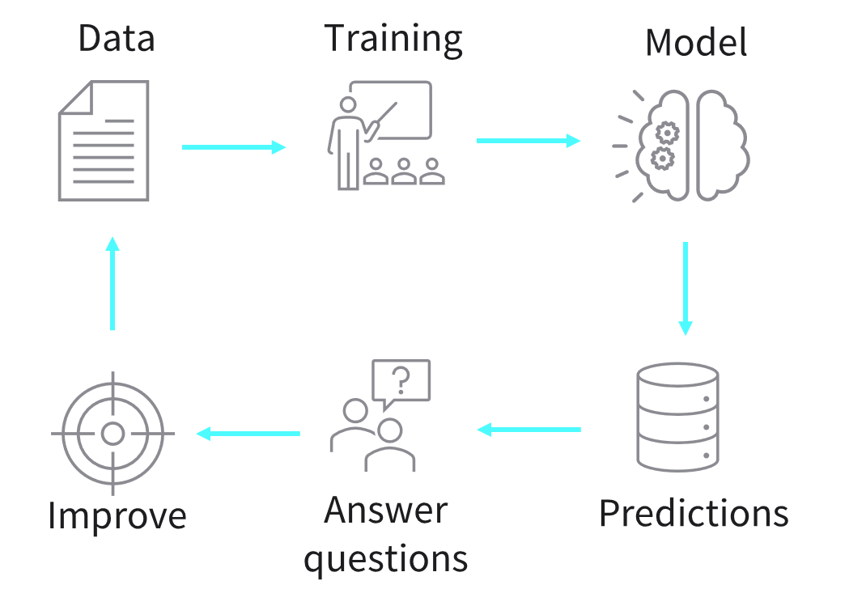
Fundamental concepts: the machine learning model

Slide 18






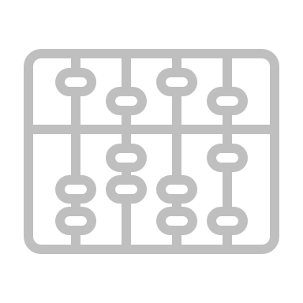

The Machine Learning Pipeline
Data
Problem definition
Data collection
Data processing
Exploratory data analysis
Document
and deploy
Test and
evaluate
Finetune and regulate model
Model selection and training
Algorithms

Slide 19

Any questions?

