Slide 1
Exploratory Data Analysis
From Data to Decisions

Slide 2

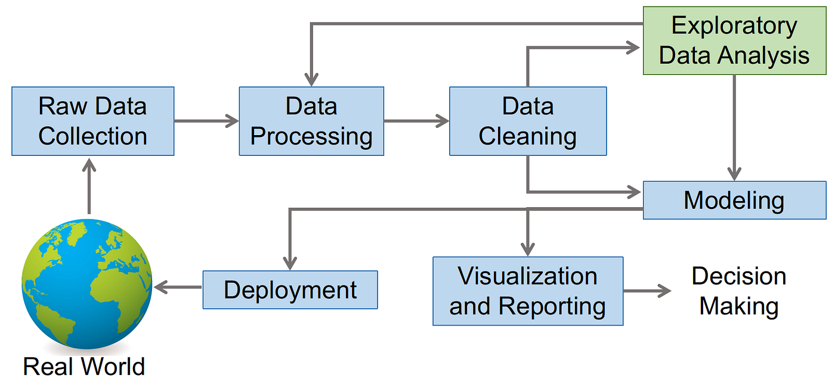
The Machine Learning Pipeline
A structured process from data collection to model deployment
Each step builds on the previous one for better results

Slide 3
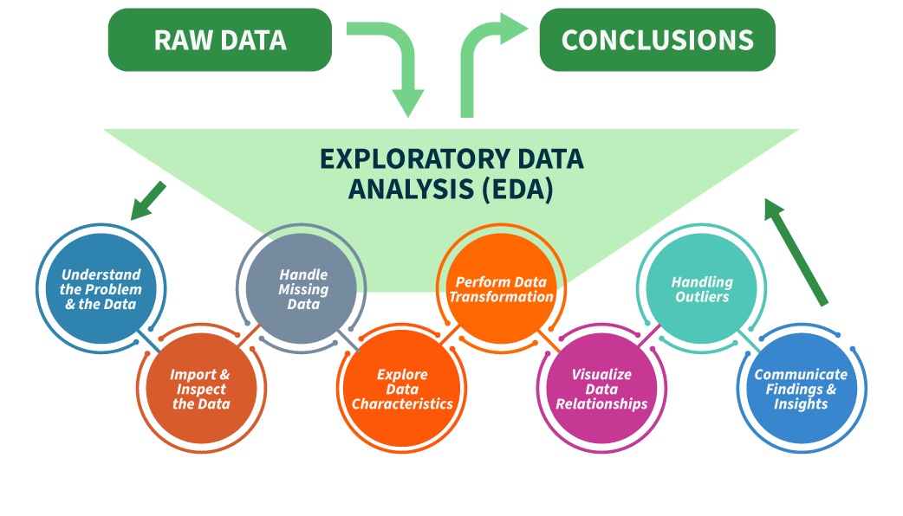
Exploratory Data Analysis
Understanding the data
to inform preprocessing and modeling
EDA helps understand data, find problems, and guide model choices

Slide 4







Exploratory Data Analysis
Analyze datasets to summarize
key characteristics
Statistical and graphical techniques
Uncover patterns, spot anomalies, and test hypotheses
Analysis: NumPy, Pandas
Visualization: matplotlib / seaborn
Software: Jupyter Notebook / Google Colab

Slide 5
EDA Key Steps
Load / Check Structure / Metadata
Distributions / Outliers Relationships / Plots
Understand data
Clean data
Explore features
Summarize findings
Missing or duplicate
Standardize
Descriptive statistics
Document insight

Slide 6
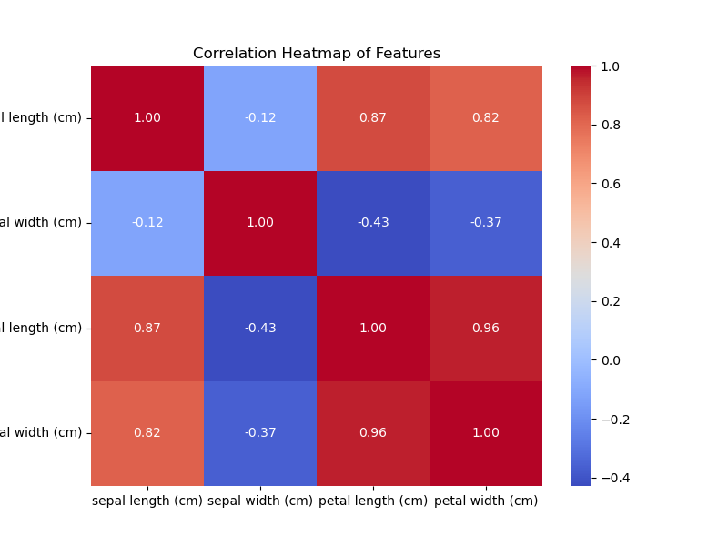
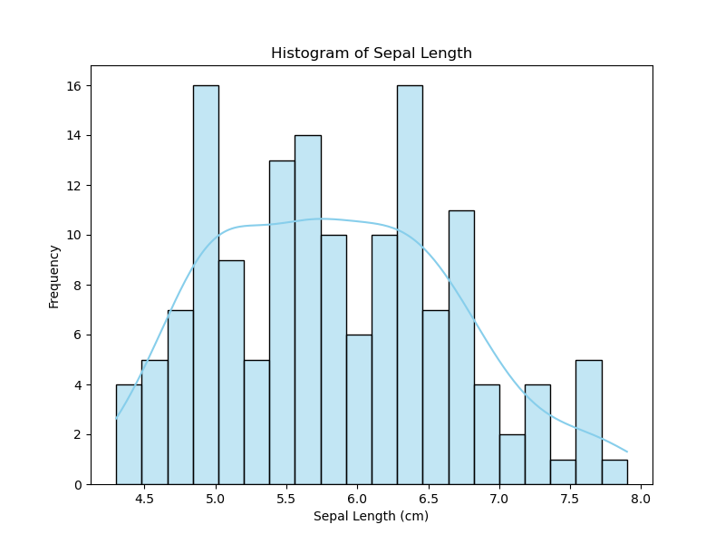
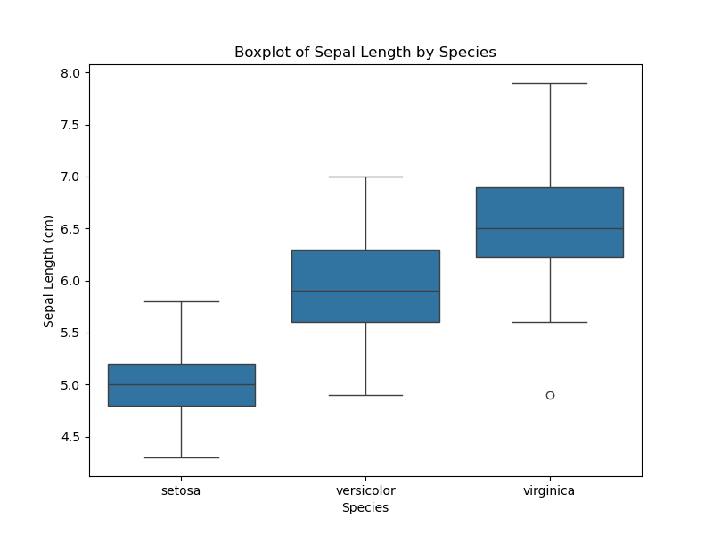
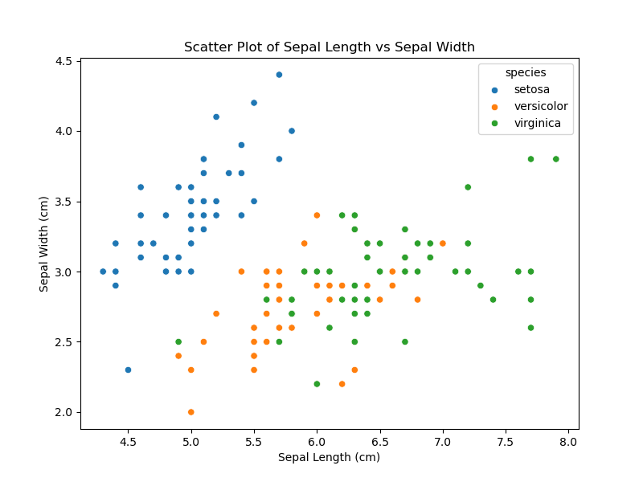
EDA Key Visualization Techniques
Histogram: distribution of single features
Heatmap: feature relationships
Scatterplot: relationship between two variables
Boxplot:
detect outliers

Slide 7


Challenges and Best Practices in EDA
Handle large datasets
Missing or inconsistent data
Right visualizations
Avoid bias in analysis
Clear objective
Document insights
Visuals and statistical tools
Question findings and
validate assumptions

Slide 8

Any Questions?

