Slide 1
A Simple RAG System
for
Holberton School Knowledge Base
Code to success

Slide 2

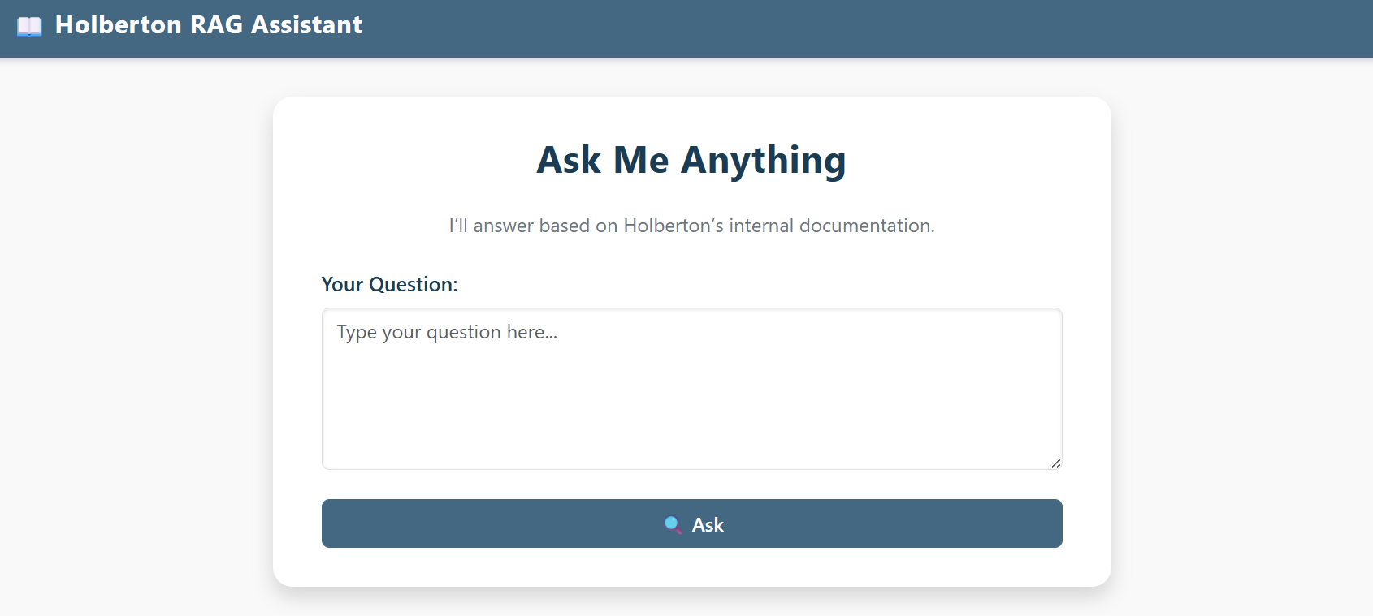
Project’s Goal
“Build a chatbot that answers questions using Holberton documentation”
Connect chatbot to internal Holberton knowledge sources
Use smart search to find relevant information
Generate clear answers based on matched content

Slide 3









Why Build the Chatbot for Holberton?
Centralize knowledge and provide instant support
Internal info is spread across many documents
Hard to search or access quickly when questions arise
A chatbot can answer common questions in real time

Slide 4
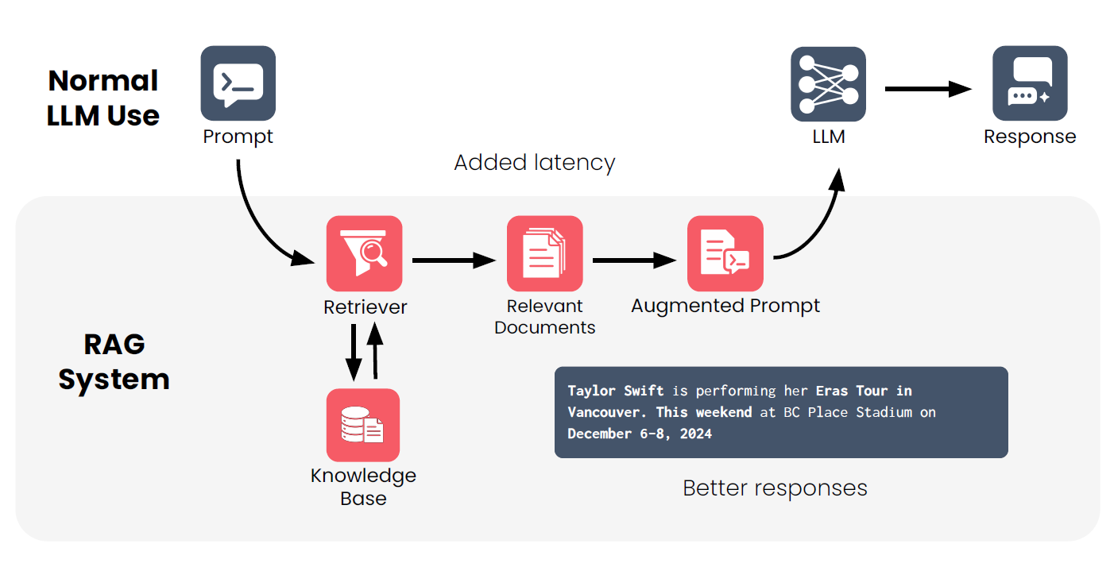
RAG Architecture
How does peer learning work at Holberton School?

Slide 5
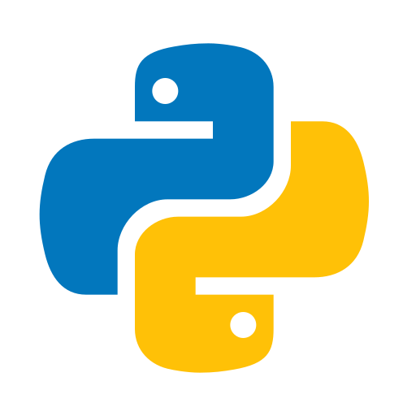
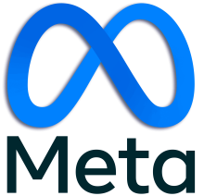
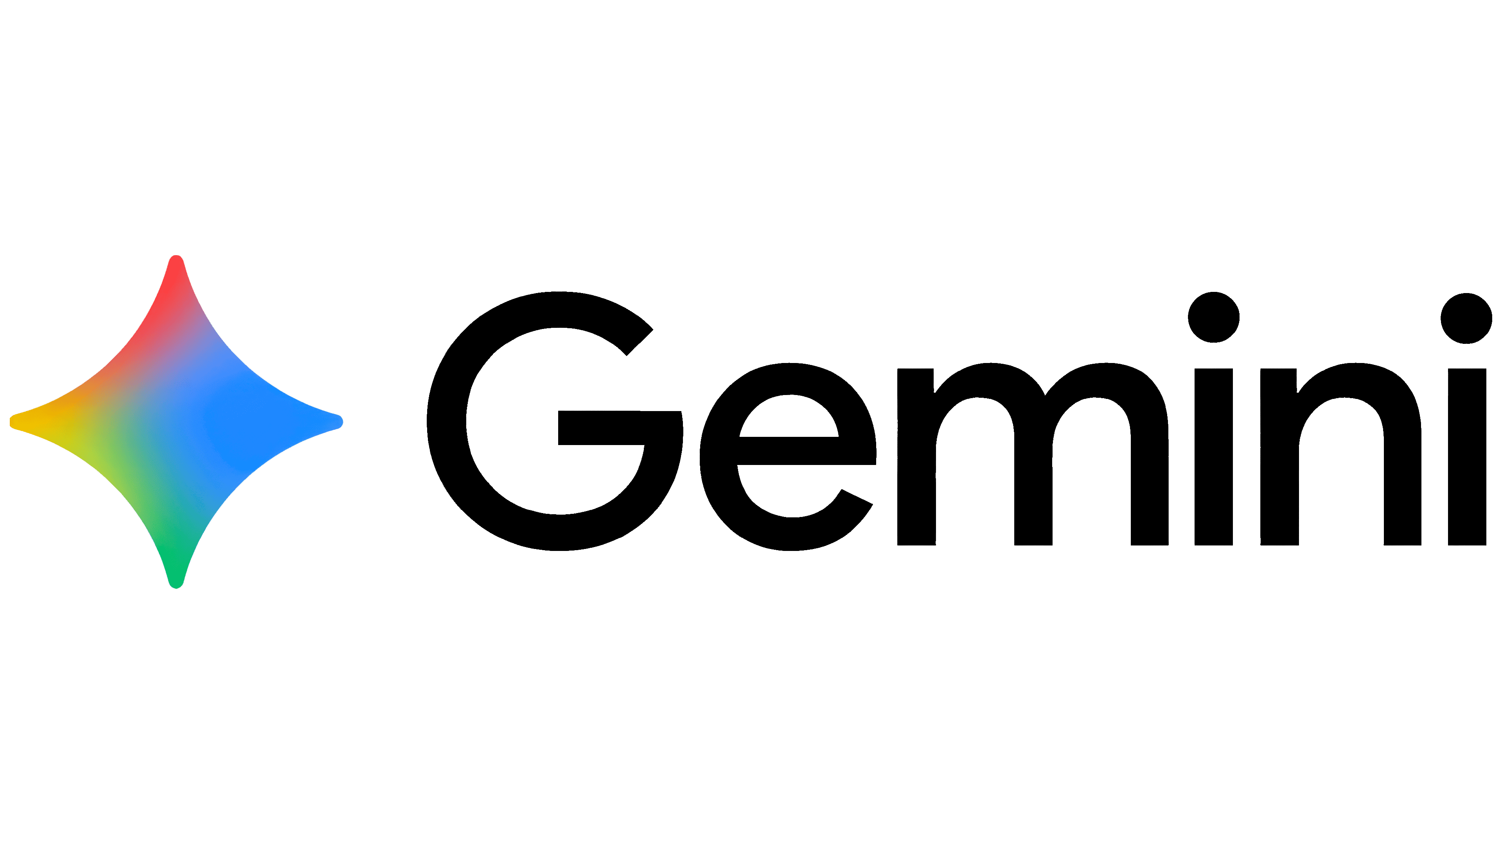

Project Architecture Overview
Flask Web Form
FAISS Vector Search
Augmented prompt (query + docs)
User
Retrieve relevant docs’ chunks
Gemini LLM
Retreival Layer
LLM & Response
Send response to Flask; render to user

Slide 6
Embedding Layer
Markdown files stored locally
1000 character chunks with 100 overlaps
FAISS vector database locally
Load files
Add metadata
Split to chunks
Generate embeddings
Store embeddings
Filename and document title
Google Generative AI model

Slide 7
Retreival Layer
Vector store with saved embeddings
Limit search to most relevant document
Retrieved chunks for answer generation
Load FAISS
Similarity Search
Retrieve Metadata
Pass info to LLM
Top 4 Documents
Calculate relevance score
For source tracking

Slide 8
LLM Communication Layer
Load FAISS index
Combine LLM with RetrievalQA
Clear answer plus list of sources
Load Vector Store
Set up RAG Chain
Initialize LLM
Ask & Retrieve
Answer & Sources
Gemini 2.5 Flash model with low temp
Generate answer grounded on retrieved documents

Slide 9
Key Tools & Libraries
Data Loading & Preparation
Embedding & Vector Storage
LLM & Retrieval Chain
DirectoryLoader, TextLoader
RecursiveCharacter TextSplitter
GoogleGenerativeAIEmbeddings
FAISS
ChatGoogleGenerativeAI
RetrievalQA
Web Interface
Rendering Helpers
Flask
HTML & Jinja
Markup
Markdown
Load Environment

Slide 10

Thank
You!

