Slide 1

Illustrations & design
by Stina Evjan
Using flash cards to improve your Ruby
A lightning talk
about flash cards
Melbourne, Australia
@peterevjan
peter.evjan@gmail.com
Notes:
My name is Peter Evjan, I am from a town called Boden in Sweden. But since September last year, I live in Australia.
I’ll talk about using flash cards to improve your Ruby skills.
But you can use this technique to memorize almost anything, not only Ruby.

Slide 2
Notes:
I like reading in order to improve my skills. As we all know, software development is a field where you need to constantly learn things, so having a good study technique is important.
So, here is the problem: I read a book about Ruby.
CLICK. I try to remember 100 % of what I think is important in the book.
CLICK. Over time, I forget roughly 95 % of what I read. So, what to do if I want to memorize more?

Slide 3
Yo Einstein!
If you’re so smart, then what’s the speed of light?
I do not carry such information in my mind since it is readily available in books
Notes:
First of all, should we even memorize a lot of things?
KLICK. Albert Einstein once got the question if he could recite the speed of light.
KLICK. He famously responded by saying “I do not carry such information in my mind since it is readily available in books”. Some people take that to mean that we should not memorize anything at all, but I think that is wrong.

Slide 4
Notes:
If that was the case, we could just invest in a lot of books where we could look up information whenever we needed it. A big library is useful, but we also need information in our heads.
This requires a lot of studying. And it turns out I have been studying the wrong way most of my life.

Slide 5
As it turns out, just studying something new over and over again doesn’t actually help you remember the material very well.
However, if you keep testing yourself by trying to recall the material over and over, you’ll strengthen those connections in your brain
Andy Hunt, blog post: “Test-driven Learning”
Notes:
This quote highlights my mistake:
KLICK.
KLICK.
The quote is from a blog post called “Test-driven learning”, written by Andy Hunt who also wrote the book ‘Pragmatic Thinking & Learning’

Slide 6
Notes:
One way of test-driving your learning is by using spaced repetition.
You have a pile of flash cards. You take the top card, read the question and try to recall the answer to it. Then you read the answer.
KLICK. if you were wrong, you put the card close to the top of your pile. That way you will get that card soon again, maybe tomorrow.
KLICK. If you were right, you put the closer to the bottom of the pile. That way you will see the card again some time in the future, maybe a few weeks from now.

Slide 7
This is how I do it
Notes:
So I will now show you how I read these days.

Slide 8


This seems like a sensible way to ensure that the number_of_cliches method always returns zero, but will it actually work? To put it another way, can you override a method in a module by defining that method in the class that includes the module?
Once you know that a mixin module effectively becomes a superclass when it is included, the answer is easy to come by: Yes. Since we know that the methods in a superclass cannot override the methods in subclasses, we can deduce that not module method
Notes:
Here is a piece of text from the excellent book Eloquent Ruby by Ross Olsen.
KLICK. I found this piece of text particularly interesting, and thought that this is something I want to remember. So I highlighted it and then I continued reading.

Slide 9
After 1-2 chapters…
Notes:
After 1 or 2 chapters, I stop reading.

Slide 10
Question
What is the relation between a class and the module that it just mixed in?
Answer
The module is like a superclass
Once you know that a mixin module effectively becomes a superclass when it is included, the answer is easy to come by: Yes. Since we know that the methods in a superclass cannot override the
Notes:
I go back to the parts of the text that I highlighted.
CLICK. Based on that text, I create a new flash card with a question.
CLICK. And a corresponding answer.

Slide 11
Notes:
At 7:30 every morning, an alarm on my phone reminds me to study my flash cards.

Slide 12
Question
What is the relation between a class and the module that it just mixed in?
Notes:
The spaced repetition algorithm makes sure I only study the flash cards that I need to work on.
Since this question is brand new, it shows up the morning after I wrote it.

Slide 13
Answer
The module is like a superclass
Notes:
I try to remember what the answer is.

Slide 14
Notes:
After seeing the answer, I grade myself on how well I remembered it.
Maybe I didn’t know the answer at all. Maybe I barely remembered, or maybe I thought it was way too easy.
Now you will get to feel what that is like. I will show you a question, and you will try to recall the answer. Don’t say anything – just think about it.

Slide 15
Question
What city was I born in?
Notes:
I told you this in the beginning. Do you remember?

Slide 16
Answer
Boden, in the north of Sweden

Slide 17
Common pitfalls
Notes:
Now, I have also discovered some common pitfalls while studying with flash cards

Slide 18
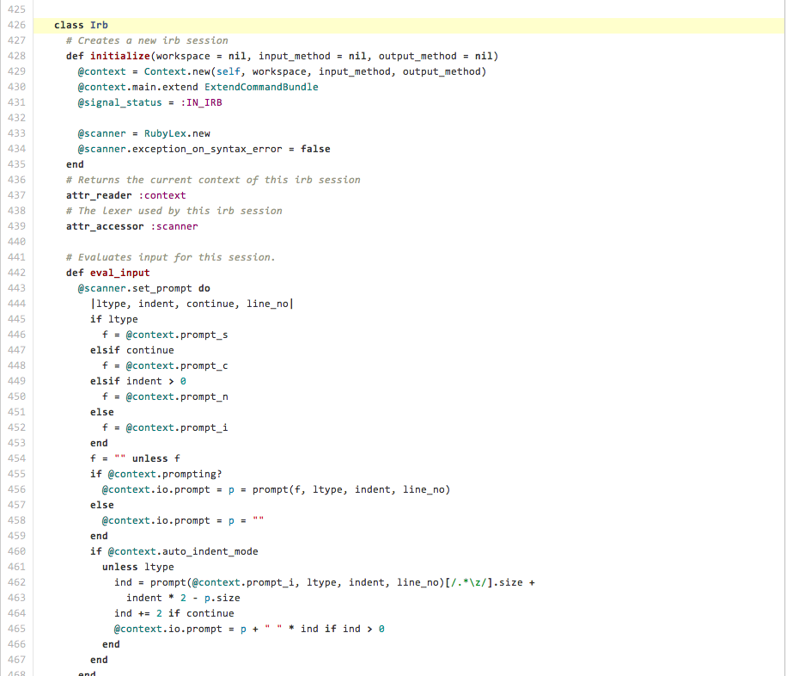
.pro
Notes:
One is that I tend to focus too much on details.
KLICK. Do I really need to memorize the exact syntax for everything?
I believe we need to store a lot of higher level concepts in our heads, and the pros and cons of different approaches. That way we can recognize a pattern when we come across it and we know where to look up more detailed information.

Slide 19
Question
What city was I born in?
Notes:
This might be a good example of an unnecessary detail.

Slide 20
Answer
Boden, in the north of Sweden
Notes:
It isn’t really important that you know this.
A better thing to be able to recall after my presentation could instead be:

Slide 21
Question
What is the name of the learning technique I use with my flash cards?

Slide 22
Answer
Spaced repetition

Slide 23
Notes:
Another common mistake is that I memorize something I don’t really understand
KLICK. It is much better to make sure I have the right context before writing a flash card.
KLICK. That way I don’t waste time on knowledge that doesn’t mean anything to me.

Slide 24
Question
Give an example of a tool for learning with spaced repetition
Notes:
An example of this could be the following flash card. I haven’t told you anything about tools yet.

Slide 25
Answer
Anki is quite good!
Notes:
You could memorize that “Anki is quite good”, but since you don’t really know what it is, it doesn’t make much sense to you.

Slide 26
http://ankisrs.net
Notes:
Anki is a fantastic tool.
It allows you to create flash cards and then it uses a spaced repetition algorithm to give you the right cards at the right time.
It is available on many platforms, and you can run it in the browser.

Slide 27
Question
Give an example of a tool for learning with spaced repetition
Notes:
Now this question makes much more sense to you

Slide 28
Answer
Anki is quite good!
Notes:
And you are much more likely to understand and make use of the answer.

Slide 29
Notes:
Using this simple technique, I’ve found that I do remember
CLICK. almost everything I want from the books I read.

Slide 30
Illustrations & design
by Stina Evjan
Thank you!
Melbourne, Australia
@peterevjan
peter.evjan@gmail.com
Notes:
Thanks for listening to me and I hope spaced repetition can improve your studying too.

