Slide 1
GENAI / ML BOOTCAMP CAPSTONE
Did the AI
invent this?
A hallucination detector: it reads your document and an AI's answer about it, and names what the document does not support.
Three detection methods, measured head to head on 300 human-labelled answers — and a recommendation.
EVGENIYA KOLESNIKOV
Notes:
[8 sec]
Hi, I am Evgeniya. My project is an AI hallucination detector, it asks one question: did the AI invent the answer?

Slide 2
01
THE PROBLEM
MOTIVATION
To check the answer, you have to read the document yourself
You give a document to an AI and ask it to summarise it, or ask a question about it. The answer sounds right. Checking it means reading the whole document — the work you do not have time for.
SUMMARIES WITH A FACT WRONG
5.5%
7.8%
12.0%
ChatGPT · GPT-5.4-mini
Gemini · 2.5 Flash
Claude · Sonnet 4.5
Not hypothetical: courts have logged 2,095 filings containing citations that do not exist — 57 of them in Israel.
Vectara’s public hallucination leaderboard, figures as of 30 September 2026. Every model summarises 7,700 documents and each summary is checked against its source. Above are the standard tiers of the three assistants most people open. Paying more does not fix it: GPT-5.4-pro is at 8.3%, Claude Opus 4.5 at 10.9%, Gemini 3 Pro at 13.6%. The best model on the whole list is at 1.8%, and it is a small one nobody opens in a chat. Court filings: AI Hallucination Cases database, as of 28 September 2026.
AI OUTPUT AUDITOR
EVGENIYA KOLESNIKOV
Notes:
[30 sec]
You give a document to an AI, and ask for a summary or ask a question about it. The answer sounds right. Checking it means reading the whole document — the work you do not have time for.
The numbers come from a public leaderboard: the standard ChatGPT, Gemini and Claude get a fact wrong in 6 to 12 percent of answers, and the pro versions are worse.
Courts have logged 2,095 filings with citations that do not exist. 57 of them in Israel.

Slide 3
One verdict: is the answer supported by your document?
02
THE SOLUTION
AND WHO IT IS FOR
METHOD 01
Text similarity
Encodes each text separately and measures the angle between the vectors. Topics, not claims: two texts can share a topic and say opposite things. all-MiniLM-L6-v2 — a compressed BERT (encoder-only), used as a bi-encoder · local · free
METHOD 02
Entailment
Natural language inference — does the answer follow from the document? Reads both texts together and scores it. HHEM-2.1-Open — the Hughes Hallucination Evaluation Model (encoder-decoder), used as a cross-encoder · local · free
METHOD 03
AI judge
Given both texts and a fixed instruction: return a verdict, and say what it considers unsupported. gpt-oss-120b — OpenAI’s open-weight model (decoder-only), prompted not fine-tuned · 120 billion parameters, on Groq’s free tier
Built for one person with a document that matters — a contract, a medical article, a report — not for a team running an AI platform.
AI OUTPUT AUDITOR
EVGENIYA KOLESNIKOV
Notes:
[25 sec]
So I built a tool. One verdict — is thе answer supported by your document?
I built 3 methods to answer this and compared them.
Text similarity encodes each text separately and measures the angle between the vectors.
Entailment — natural language inference, the classic NLP task — asks whether the answer follows from the document. That is the Hughes Hallucination Evaluation Model.
And the third I call an AI judge. It is a general-purpose language model. I give it both texts and one instruction: say whether the answer holds, and name what does not. That is gpt-oss-120b, OpenAI's open-weight model.
The product is built for one person with a document that matters — a contract, a medical article.

Slide 4
03
STACK
Three models, nothing trained from scratch
BUILT WITH
Python · Gradio · HuggingFace Spaces · sentence-transformers · transformers · Groq API · matplotlib · a JSONL result cache
THE MODELS
all-MiniLM-L6-v2 (embeddings) · HHEM-2.1-Open (entailment, built on flan-t5-base, 0.1B parameters) · gpt-oss-120b (the judge)
THE DATA
HaluEval — 300 human-labelled answers, split by record so no source text crosses between dev and test
NOT USED
FAISS — 80 sentences at the limit, where an index pays off at hundreds of thousands. A vector database — nothing is kept between checks. LoRA, and a fourth fine-tuned model — nothing honest to train on.
AI OUTPUT AUDITOR
EVGENIYA KOLESNIKOV
Notes:
[15 sec — cut this slide first if you are running long.]
Now the stack. Three models, nothing trained from scratch — Python, Gradio, HuggingFace, Groq.
The data - public dataset, HalluEval.

Slide 5
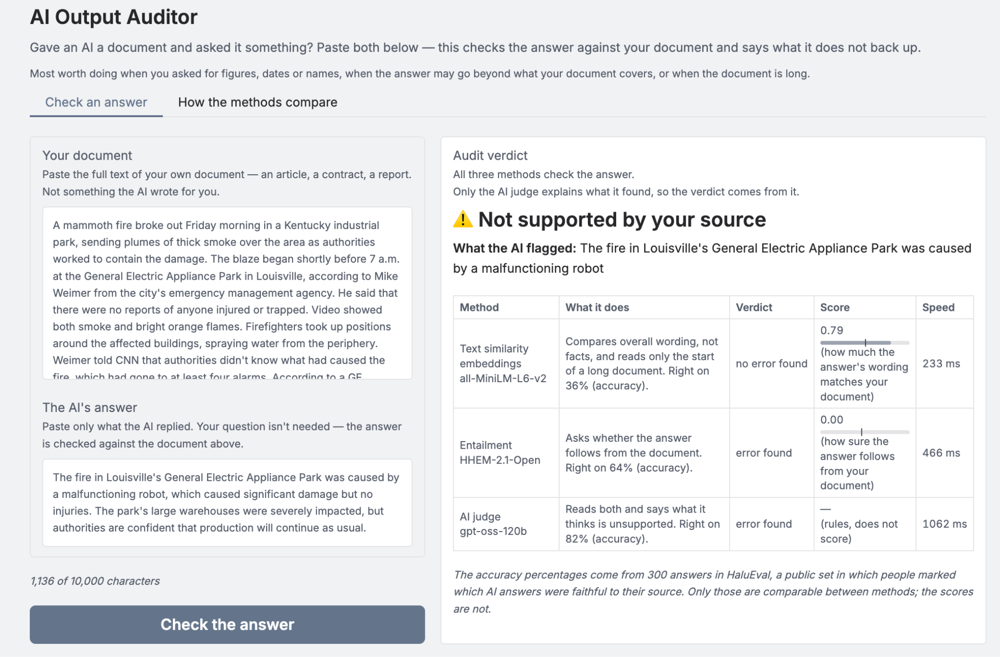
04
DEMONSTRATION
Two texts, one verdict
YOU GIVE
Your document, and the answer an AI gave you about it.
YOU GET
One verdict, the sentence the judge objected to, and what all three methods thought.
LIMITS
10,000 characters. English only. You supply the source — it checks grounding, not truth.
OPEN THE LIVE DEMO →
AI OUTPUT AUDITOR
EVGENIYA KOLESNIKOV
Notes:
[75 sec — LIVE. Two examples, two presses. The lines in quotes are what you say; the rest is what you do.]
Now I will show you what the product looks like: two texts, one verdict.
1. Switch to the Space, tab Check an answer.
“You give your document, and the answer the AI gave you. Any document, up to ten thousand characters — English only, and it checks grounding: if your source is wrong, the tool will not notice.”
2. Click the example: Fire at a GE plant.
“A CNN news report, and a summary of it that was generated as a hallucination on purpose — both from HaluEval, a public labelled dataset.”
3. Press Check the answer.
“Press check.”
4. The verdict appears.
“Not supported by your source.”
5. Point at What the AI flagged.
“And here is why. The answer gives a cause for the fire. The article never gives one.”
6. Scroll to the three-method table.
“Underneath, what each of the three methods thought about the same answer.”
7. Click the second example: Raspberry Pi, and press Check the answer.
“Now a Wikipedia article with a real Gemini answer.”
8. The verdict appears.
“Supported, and all three agree — it does not just flag everything.”
9. Open the second tab, How the methods compare, for five seconds.
“And the second tab is the measurement behind all of it — three methods, three hundred answers.”
10. Back to the deck.

Slide 6
05
WHAT I
MEASURED
The obvious method is worse than a coin toss
ACCURACY ON 300 LABELLED ANSWERS
36%
Text similarity
catches 13% of errors · free · instant
64%
Entailment
catches 42% of errors · free · instant
82%
AI judge
catches 79% of errors · $0.29 per 1,000 checks · 1.1 s
Accuracy on 300 answers from HaluEval — 150 records, each giving one faithful answer and one hallucinated, so a coin toss scores 50%.
AI OUTPUT AUDITOR
EVGENIYA KOLESNIKOV
Notes:
[40 sec — the slide that matters. Do not rush it.]
Now the numbers. The obvious method — text similarity — is worse than a coin toss.
Text similarity gets 36%.
Entailment 64%.
The AI judge 82%, and it catches 79% of the real errors, at 29 cents per thousand checks.
And accuracy alone hides something: entailment is right 64 percent of the time, but it catches only 42 percent of the real errors.

Slide 7
06
CHALLENGES
AND WHAT I DID
Measured, not assumed
THRESHOLDS
Two methods need a threshold. Tuned on a separate set of cases the reported numbers never touched.
THE LIMIT
Not the API quota — memory: 6 GB at 25,000 characters, on a server with 16 shared.
THE COST
More than half of what a judge call costs is reasoning the user never sees.
And the uncomfortable fact: a checker that is right 82% of the time creates a new risk. When it says it found nothing, you stop worrying — and one time in five it is wrong. The screen says so on every verdict.
AI OUTPUT AUDITOR
EVGENIYA KOLESNIKOV
Notes:
[30 sec]
Here is what was measured.
Two of the methods need a threshold, and it was tuned on a separate set of cases, which the reported numbers never touched.
Memory limits how much text you can paste. The entailment model reads the whole document at once, and the free server it runs on does not have enough for a longer one. And more than half of the cost of one judge call is reasoning the user never sees.
And the uncomfortable fact: a checker that is right 82% of the time creates a new risk. When it says it found nothing, you stop worrying — and one time in five it is wrong. So the screen shows that number under every verdict.

Slide 8
From a detector to a decision
07
FUTURE STEPS
COVERAGE
Checking an answer with no document behind it. That needs web search, and then absence stops being evidence.
SCALE
Past 10,000 characters the tool would split the document itself and send the judge only the relevant parts.
ADOPTION
A link it fetches, a file it opens, or an add-on that reads both texts out of any AI chat.
PRECISION
Today the judge describes what it doubts; asking it to quote would mark the exact words.
HONESTY
Separating “the article does not say this, though it is true” from passing the same claim off as the article’s.
COST
Cheap method first, so most answers never reach the judge. Same accuracy, lower cost — measured, not yet built.
AI OUTPUT AUDITOR
EVGENIYA KOLESNIKOV
Notes:
[25 sec]
Now the next steps. Six improvements that take this from a detector to a decision — and two of them matter most.
Coverage: checking an answer with no document behind it. That needs web search, and then absence stops being evidence.
And cost: run the cheap method first, so most answers never reach the judge. Same accuracy, lower cost — measured, but not yet built into the product.
There are also planned features for scaling, adoption, improving precision and honesty.

Slide 9
Accuracy did not pick the method
08
SUMMARY
CONCLUSIONS
AN EXPLANATION
AI judge (gpt-oss-120b). The only method that produces text — this is what ships.
FREE AND OFFLINE
Entailment (HHEM-2.1-Open) alone. Nothing goes to a third party — and half the errors pass.
HIGH VOLUME
Cheap method first, judge only the uncertain answers. The same accuracy for 18% less.
THE EXACT WORDS
None of them today. The judge describes what it doubts, it does not quote it.
LIVE DEMO →
SOURCE CODE →
VIDEO →
AI OUTPUT AUDITOR
EVGENIYA KOLESNIKOV
Notes:
[35 sec]
And the conclusion. The large language model — the AI judge — is the most accurate, but it is the right choice in only one of these four situations. In the other three, accuracy is not what decides.
The AI judge produces text, so it is the only one that can explain itself, and that is what ships.
Entailment is free and sends nothing to a third party, but half the errors pass.
At high volume, better run the cheap method first and send only the uncertain answers to the judge. Same accuracy, eighteen percent cheaper.
So I built a tool that tells you whether an AI invented something, and I measured how often the tool itself is right.
Thank you.

