Slide 1
Command Line Programming in Python
James R. Bradley

Slide 2
What is the Command Line?
Graphical User Interfaces (GUIs) have become the dominant mode in interacting with computers
Mice, point & on buttons, drop-down menus, and objects
No GUIs when I started programming
Punch cards
Green screens, typing on the command line/command prompt

Slide 3
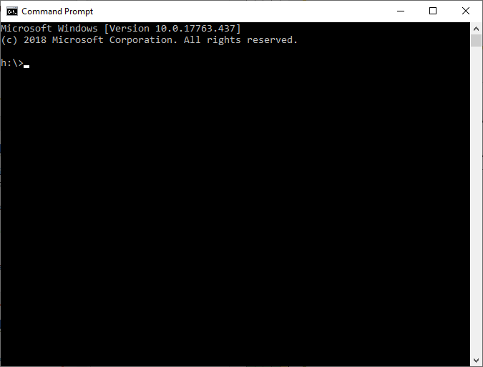
What is the Command Line?
Command prompt
On Start menu search for command prompt
We will execute Python programs from the command line

Slide 4
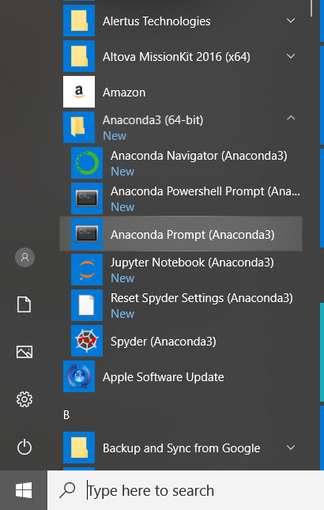
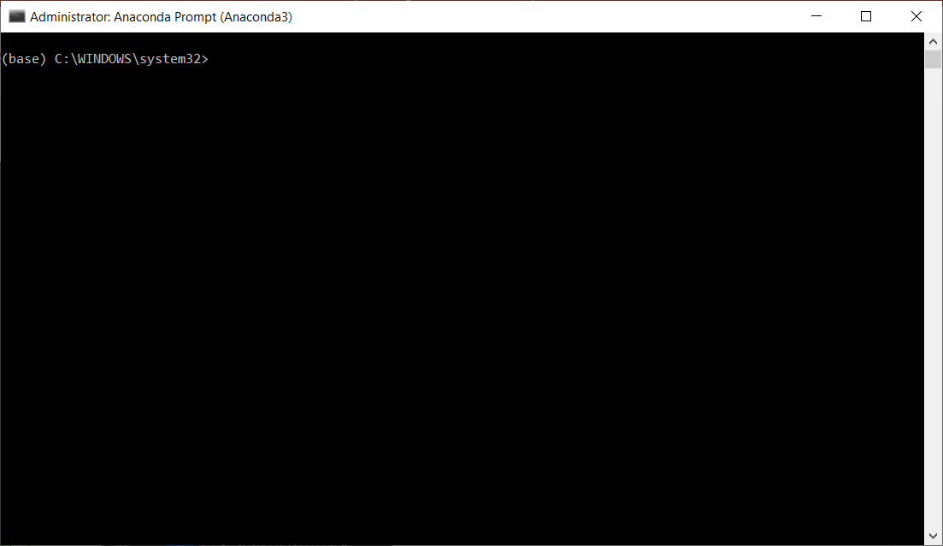
What is the Command Line?
Open Anaconda command prompt
Current directory is C:\WINDOWS\System32

Slide 5
What is the Command Line?
Why are we talking about the command line?
GUIs dominate human-computer interaction
But, you must be familiar with command line
Most of you will use it when you graduate
You will use the Linux command line in Big Data
An increasing amount of work is done on the command line, especially with the cloud and Big Data
Trend toward GUIs is reversing to some degree

Slide 6
Session Topics
Running programs from the command line
Navigating through the folder hierarchy with command line commands
Writing Python command line programs
From simple to more refined
Sub-theme
APIs

Slide 7
What is the Command Line?
conda is a program that you will run from the command line
Install packages
Create environments
Type conda -h and then Enter
-h is a ubiquitous argument to get help in well-written command line programs
Arguments are data we pass to command line programs to tell specifically what to do
Like arguments to a function

Slide 8
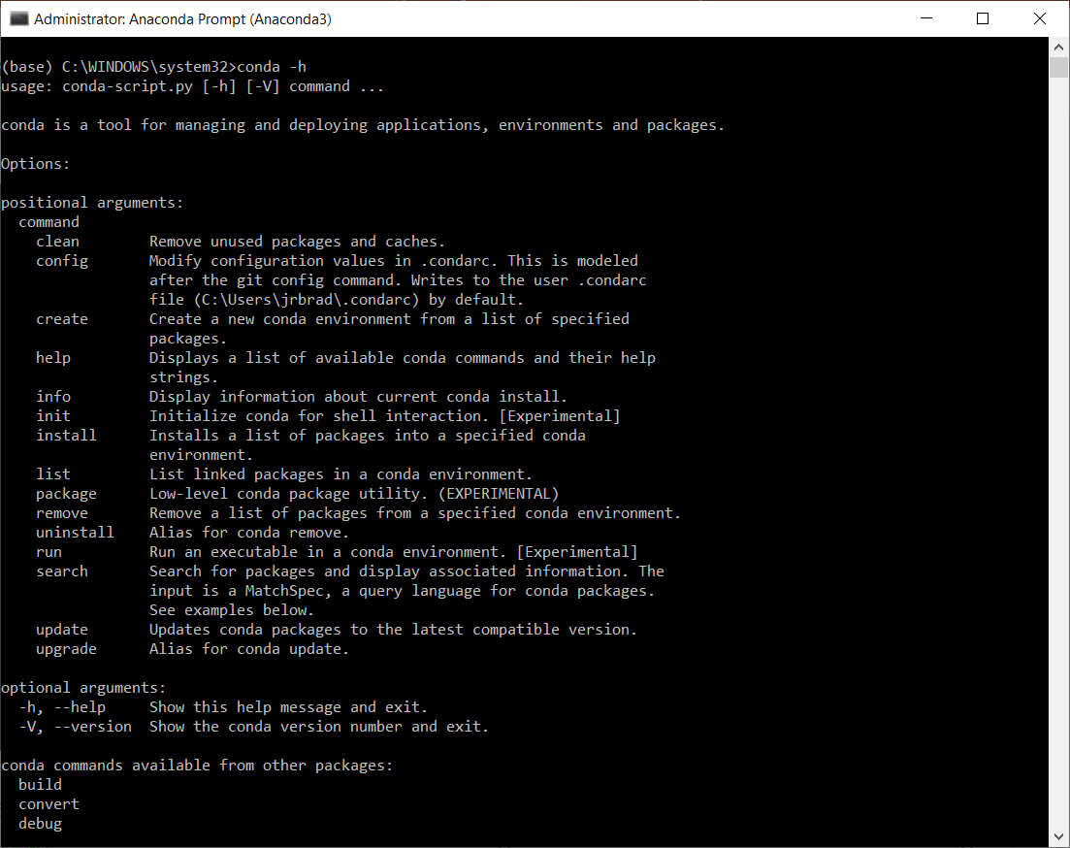
What is the Command Line?

Slide 9
What is the Command Line?
conda install seaborn
install and seaborn
2 arguments telling conda to install the seaborn package
Arguments are everything that comes after the name of the program we are going to execute
These direct the program to do what we desire

Slide 10
Anaconda Command Line
You’ll be using the Anaconda command line to create environments
https://docs.conda.io/projects/conda/en/latest/user-guide/tasks/manage-environments.html
Environment
A collection of Python packages appropriate for particular programming applications
E.g., neural networks
Each program could require different packages

Slide 11
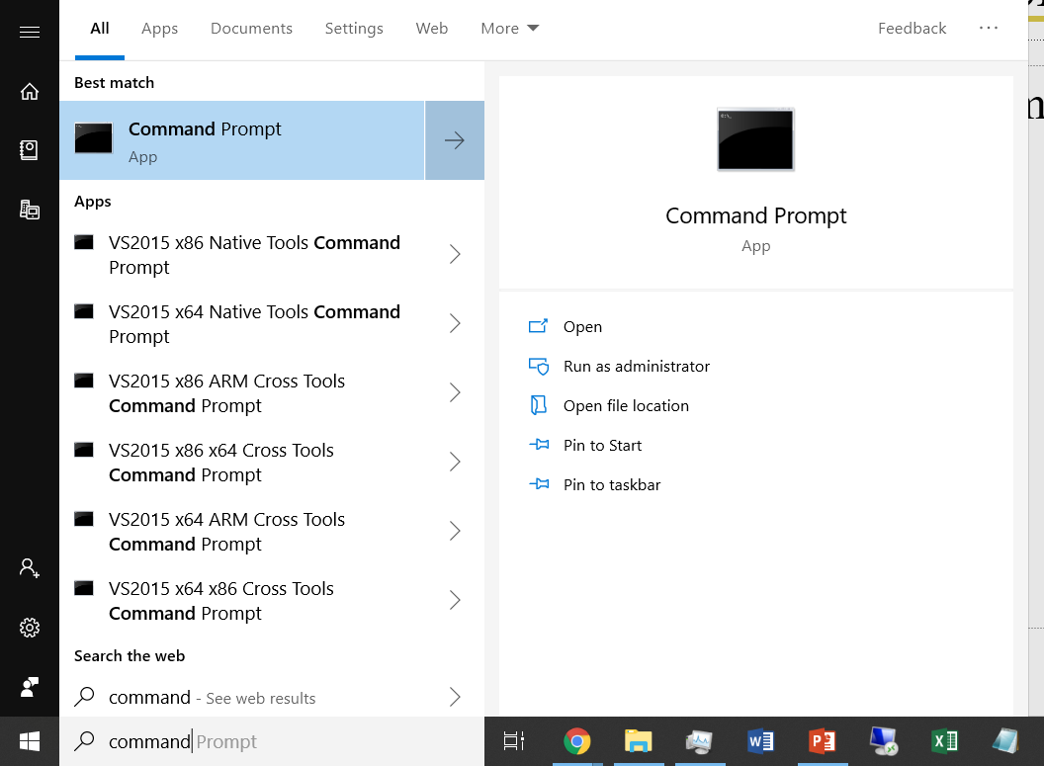
DOS Command Prompt
Open DOS command prompt window

Slide 12
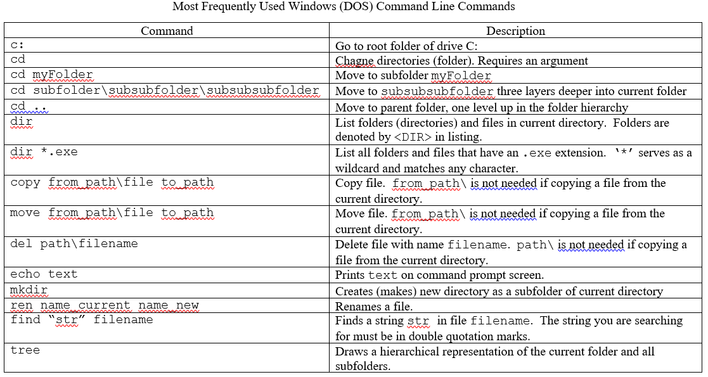
Frequent DOS Commands
Command Line Cheatsheet

Slide 13

Key Command Line Commands
c:
C:\ Program Files
c:\users
cd \
cd jrbrad
(from other drives) c:
cd ..
c:\users \jrbrad

Slide 14
Key Command Line Commands
c:
mkdir ctba
creates
C:\ Program Files
C:\users
C:\ctba
C:\users \jrbrad

Slide 15
Command Line Navigation Exercise
Download, and extract files from
https://github.com/jrb28/CommandLine into …
C:\Users\username\Downloads
Navigate to the folder above at DOS command prompt
Move up one folder with cd ..
Create cl subfolder
mkdir cl
This creates C:\Users\username\cl

Slide 16
Key Command Line Commands
C:\users \jrbrad
cd downloads
cd cl
cd ..
cd ..
C:\users \jrbrad\ downloads
C:\users \jrbrad\cl

Slide 17
Command Line Navigation Exercise
Move back to Downloads folder
cd ..
cd downloads
Move all files to cl subfolder
Use move command
Files are in
C:\Users\username\Downloads\CommandLine-master
Put them in C:\Users\username\cl
From C:\Users\username\Downloads
Hints
*.* specifies all files in a folder/file path
Path from downloads folder to cl folder is ..\cl\

Slide 18
Executing in the Command Line
Anaconda prompt execution of Python programs from the command line
Steps:
Navigate DOS command prompt to this folder:
C:\Users\username\cl
Type this in Command Prompt window
python HelloWorld.py
Hit Enter
Observe output: ‘Hello World!’

Slide 19
Writing a Python Program to Execute on the Command Line

Slide 20
Writing Command Line Programs
Distinctive feature of command line programs is capability to receive arguments from the computer system
2 methods
Easy un-sophisticated retrieval of arguments
More robust handling of arguments

Slide 21
Programming Goal
Input
Zip code as command line argument
Print
High and low temperature forecast for 5 days
Latitude and longitude
Applications Programming Interface (API)
Serves data, usually in JSON
Like we did with web scraping
Program requires 2 APIs
Google Geocoding API: latitude/longitude
OpenWeatherMap API: weather forecast

Slide 22
APIs
Google Geocoding API
https://developers.google.com/maps/documentation/geocoding/start
Using Google APIs
Create google account
Start free Google Developer trial
https://developers.google.com/
Checkout APIs and enable for your account
https://console.developers.google.com/apis/library
Get an API key
https://developers.google.com/maps/documentation/geocoding/get-api-key
Google APIs are not free: you’ll get $300 credit

Slide 23
APIs
OpenWeatherMap API
https://openweathermap.org/
https://openweathermap.org/api
https://openweathermap.org/forecast5
https://openweathermap.org/price

Slide 24
Writing Command Line Programs
Base Program—Hard Coded
clWeather1.py
Zip code is hard coded
No parameters to pass on the command line

Slide 25
Writing Command Line Programs
Arguments Via sys.argv
Operating system packages parameters and send to the executable program
Arguments passed to Python are accessible from sys.argv as a list
sys.argv[0] is always the program name
python, in our case
Need import statement
import sys
See clWeather2.py

Slide 26
Writing Command Line Programs
Arguments Via argparse Package
See clWeather3.py
argparse package permits
Various types of arguments
Help menu
Import package
import argparse
https://docs.python.org/3/library/argparse.html

Slide 27
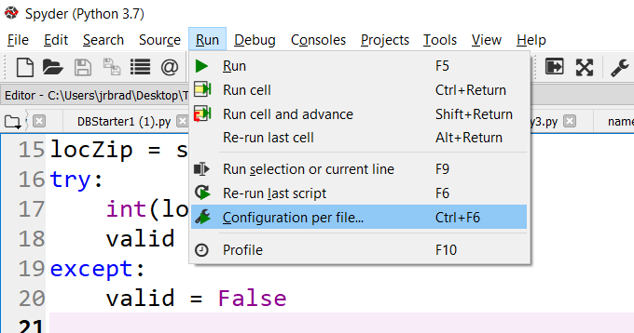
Writing Command Line Programs
It is more convenient to run programs in Spyder during development
Mimic command line execution
Select Run>Configuration per File

Slide 28
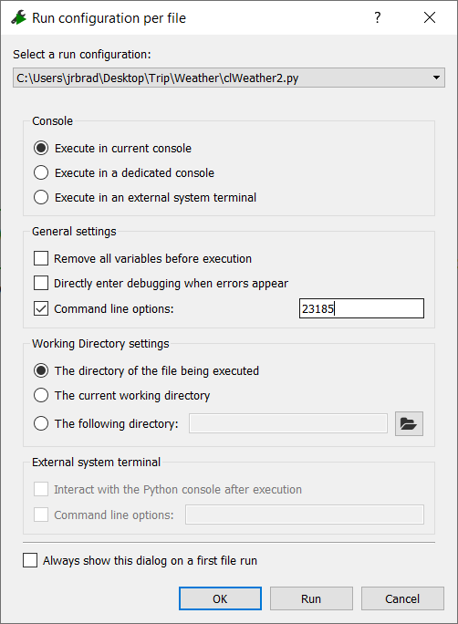
Writing Command Line Programs
Check Command line options
Enter arguments into text box
See clWeather4.py

