Slide 1
Git: Version Control & Collaboration
James R. Bradley

Slide 2
Topics
git on your laptop
GitHub Desktop App

Slide 3
Version Control
Have you revised a working program, and then it didn’t work anymore?
Version control permits program development while avoiding breaking a program
You can always revert to a previous functional copy
Git
For a sole developer:
Install git on your computer
For collaboration
Use desktop git with github.com

Slide 4
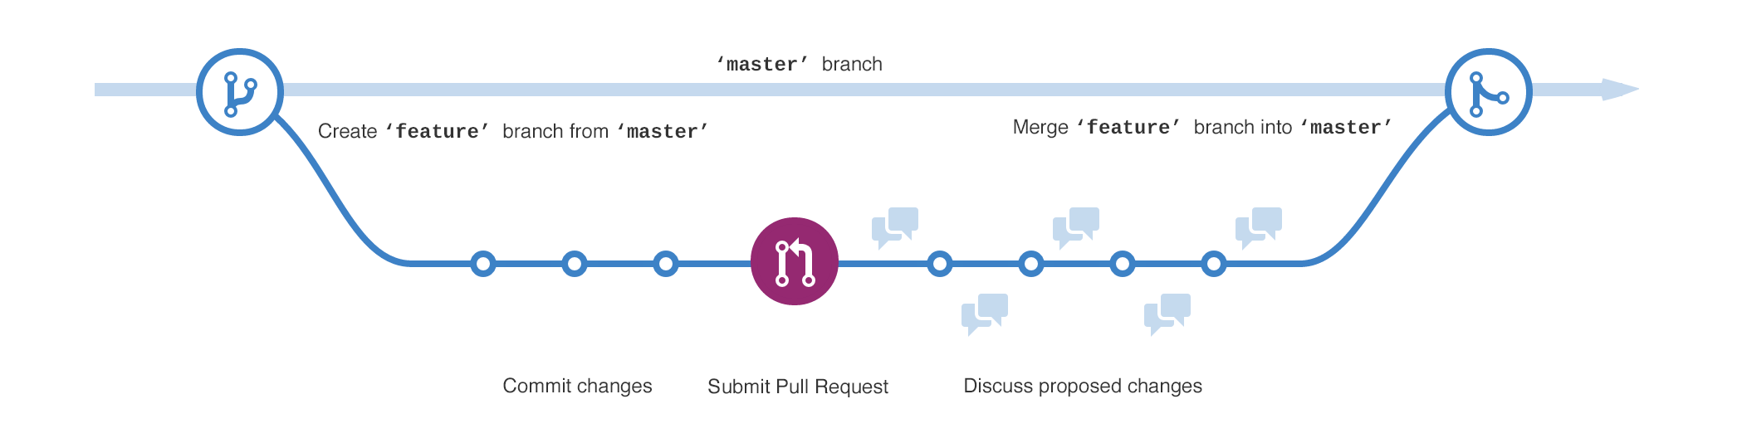
Version Control
Git permits a temporary copy of code to be created
A branch; can be multiple branches
Changes are made to branches
Discussed, debugged, then merged back into the master branch
Master branch code is never disrupted

Slide 5
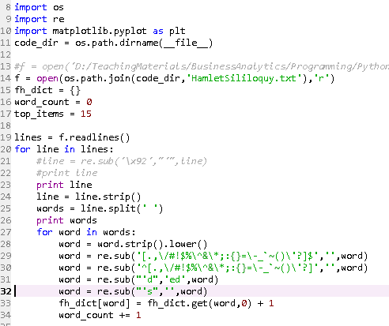


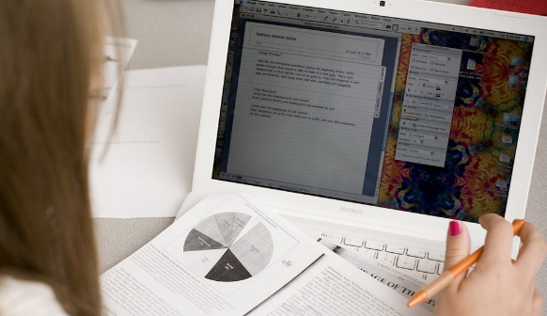
Version Control
Collaboration
Multiple people cannot edit software simultaneously
Conflicts
Corrupted Code

Slide 6
Version Control
We’ll focus on git in the context of a sole developer
… and Github as a portfolio repository
Relatively small step from there to collaboration
Extra session later for this, time permitting

Slide 7

Git on Your Laptop
Download and install git:
https://git-scm.com/download/win
Use all default configuration settings
Get session materials
github.com/jrb28/git
Move git_tutorial to another location
Folder has one file: my.py
This section of session:
We’ll step through a basic sequence of git commands

Slide 8
Git on Your Laptop
Conceptually what’s happening…
We’ll be working on a Python program:
my.py in a folder called git_tutorial
We’ll create a master branch and a test branch
The master branch works, but we want to make changes
We’ll make changes to the test branch
Git keeps track of multiple versions master and test by logging changes made in each version

Slide 9
Git on Your Laptop
′test ′
′test ′
work on ′test ′ version

Slide 10
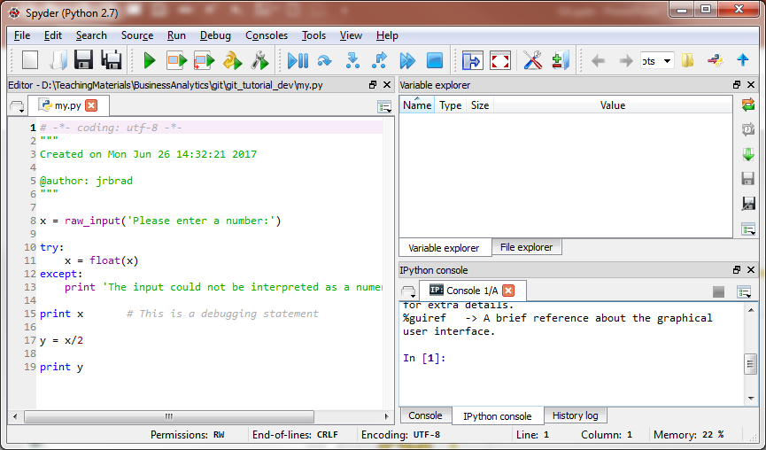
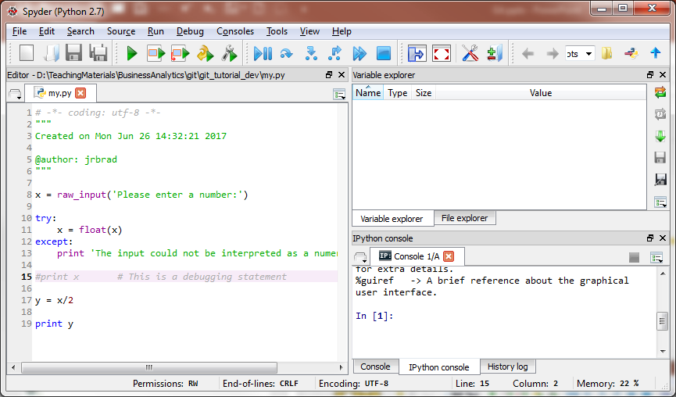
Git on Your Laptop
master
test
Only one my.py will ever appear in git_tutorial
Git permits switching between versions (branches)
Git will apply whatever changes are appropriate for the version you want to use

Slide 11
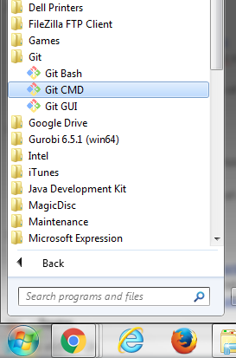
Git on Your Laptop
Open the Git Command window

Slide 12
Git on Your Laptop
Change directory to the git-tutorial folder
Type drive letter corresponding to the location of the git_tutorial folder, then a colon and Enter
Copy file path for my.py from Windows Explorer, Ctrl-c
Paste into Git Command window with cd command
cd = change directories
Pasting requires right-clicking on upper left Git icon
See subsequent slides for screenshots

Slide 13
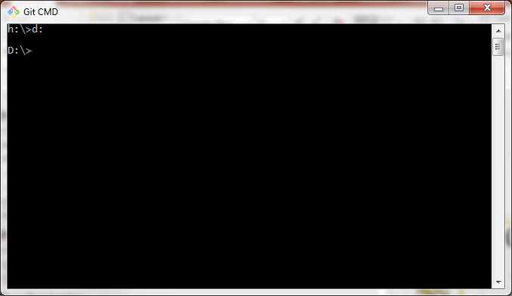
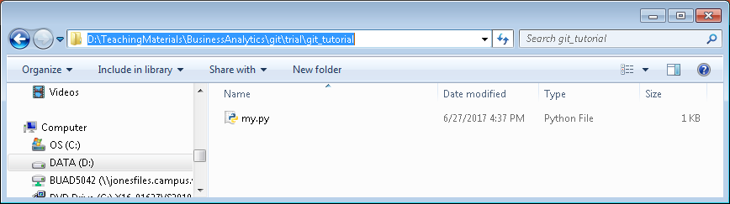
Git on Your Laptop
Your drive will most likely be c:

Slide 14
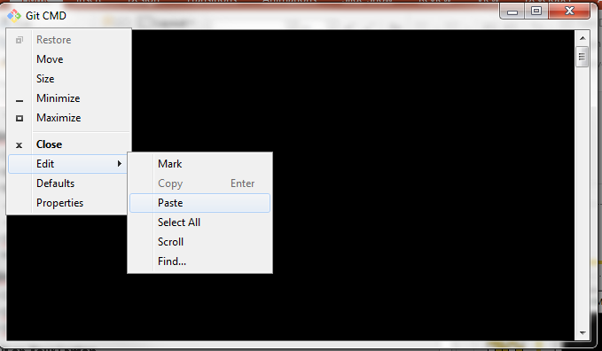
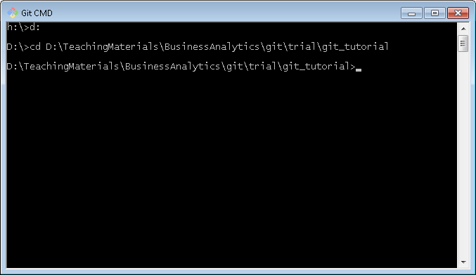
Git on Your Laptop

Slide 15
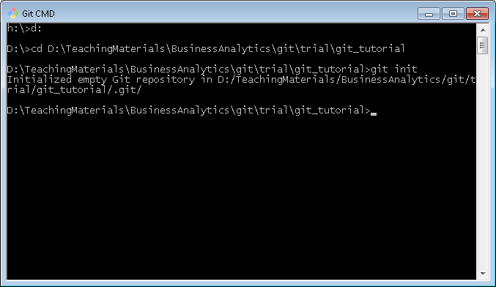
Git on Your Laptop
Initialize the folder as a git folder
This tells git to start tracking changes
Type git init in Git Command window, then Enter

Slide 16
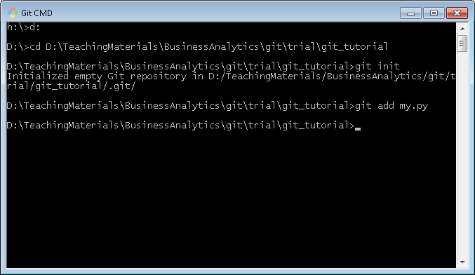
Git on Your Laptop
Add my.py as a file for git to keep track of
Type git add my.py, then Enter

Slide 17
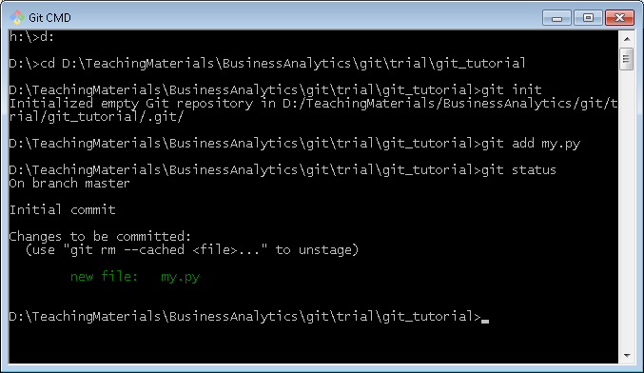
Git on Your Laptop
Check status of folder
Type git status, then Enter

Slide 18
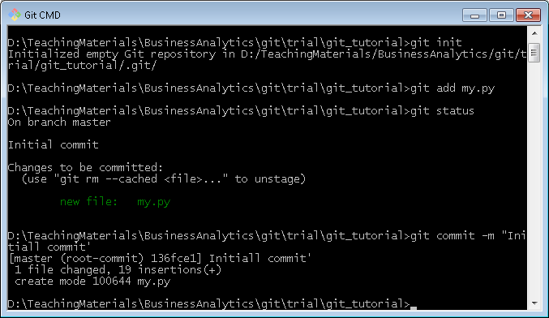
Git on Your Laptop
Commit initial version of my.py
Type git commit my.py –m “message”, then Enter
The message give a brief description of the change
… our message will be “Initial commit”

Slide 19
Git on Your Laptop
You’ll need to perform a git add command each time you want to commit changes to a file

Slide 20
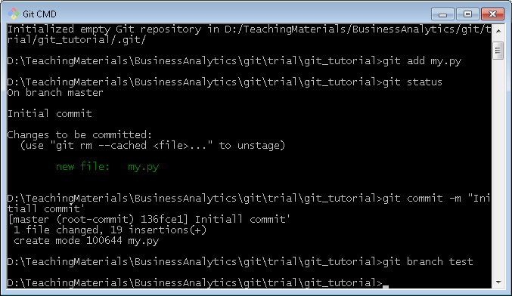
Git on Your Laptop
We will revise my.py so create a test branch
git branch test, then Return

Slide 21
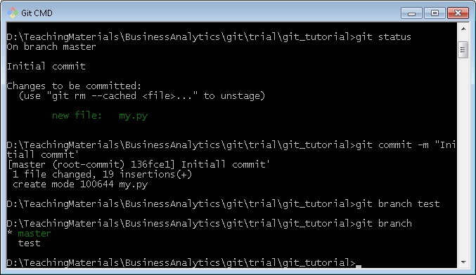
Git on Your Laptop
Check to make sure you created a branch
git branch gets list of branches
The * shows which branch you are working on

Slide 22
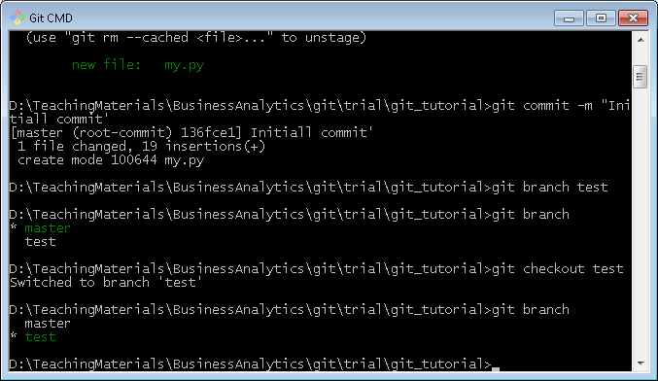
Git on Your Laptop
Change to test branch
git checkout test, then Return
git branch, then Return

Slide 23
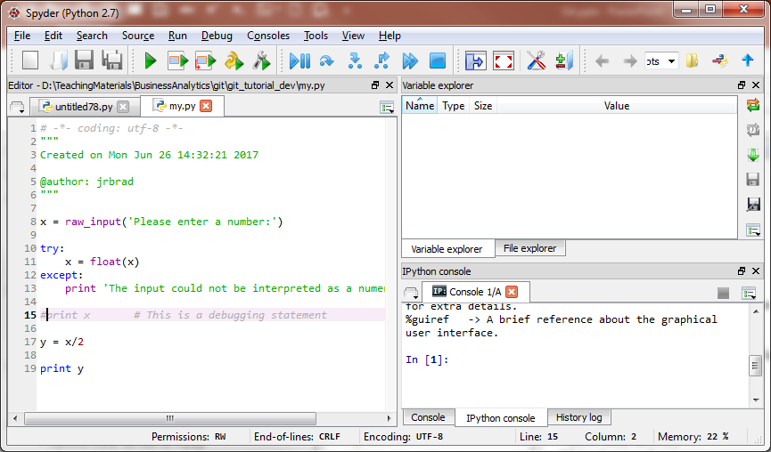
Git on Your Laptop
Revise the Python Program in Spyder, and save, close

Slide 24
Git on Your Laptop
Make desired revisions in the test branch
… so the working code in master branch is not disrupted
… make sure revisions work in test branch
… then merge back into the master branch when you want to finalize them

Slide 25
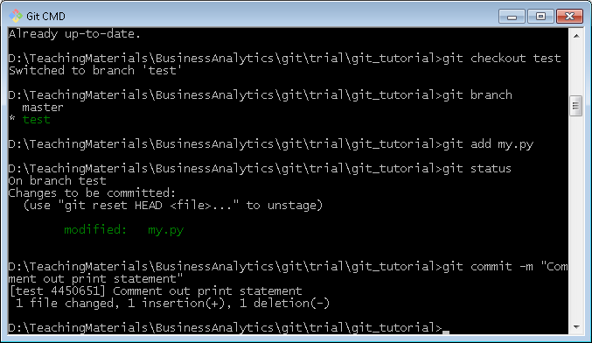
Git on Your Laptop
git add my.py, then Return
git status
git commit –m “Comment out print statement”

Slide 26
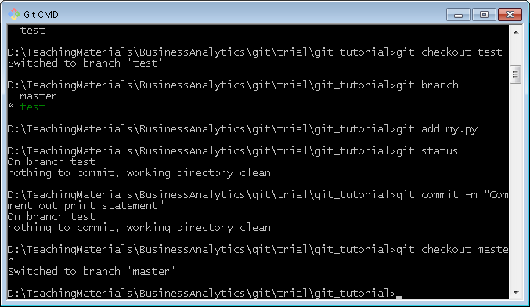
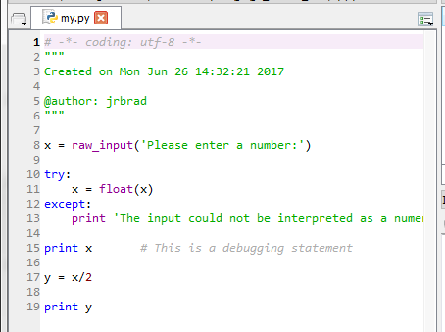
Git on Your Laptop
For illustration, go back to master branch
git checkout master, then Return
Reopen my.py in Spyder
Code is master branch
is untouched

Slide 27
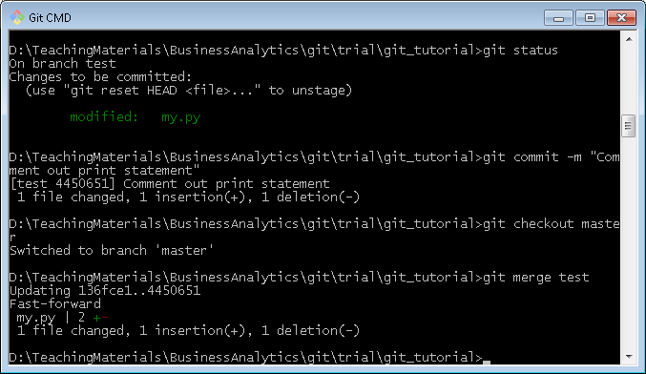
Git on Your Laptop
Merge changes from test branch into master
git merge test, then Return

Slide 28
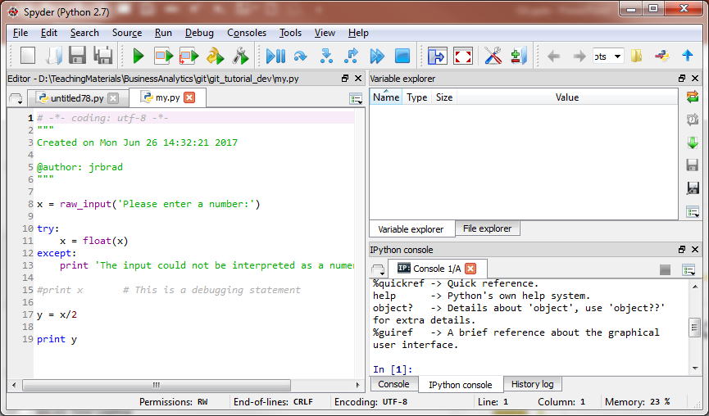
Git on Your Laptop
Now check out my.py in master branch
It reflects the change made in test branch

Slide 29
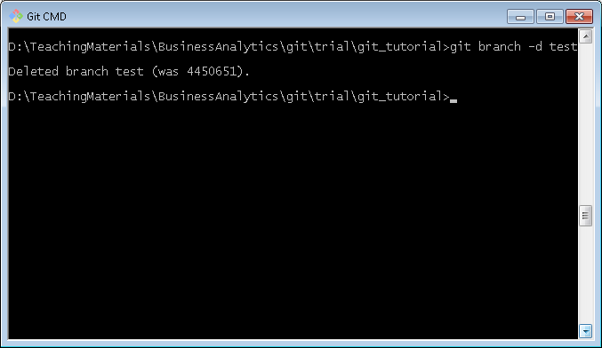
Git on Your Laptop
Delete test branch
git branch –d test, then Return
git branch, then Return to verify deletion

Slide 30
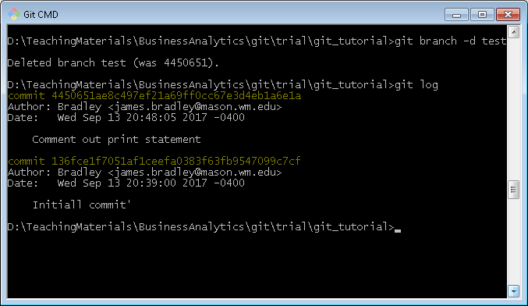
Git on Your Laptop
Revert to a former commit level
git log, then Return to see commit history

Slide 31
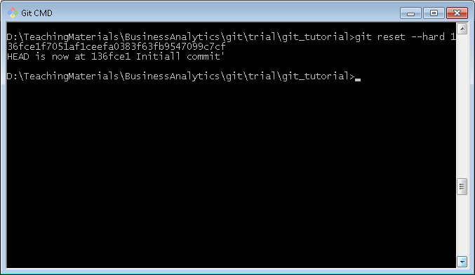
Git on Your Laptop
git reset --hard commit-hash-number

Slide 32
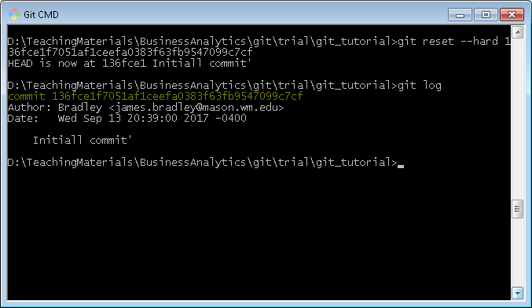
Git on Your Laptop
git log

Slide 33
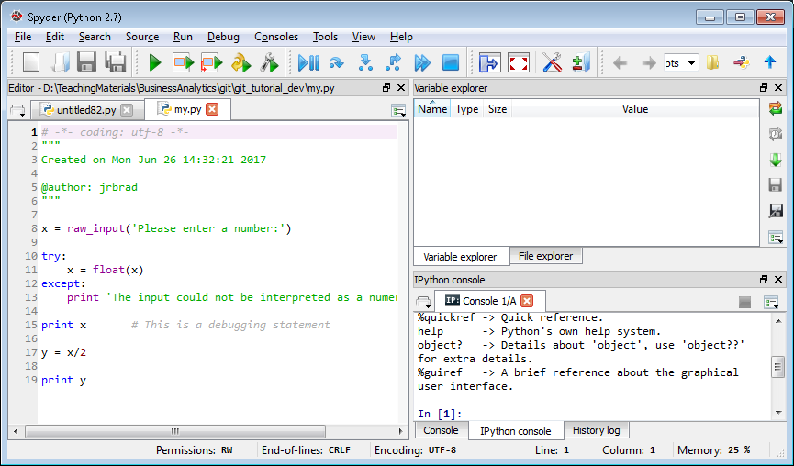
Git on Your Laptop
Check out the file in Spyder… back to original
You need to close the file in Spyder, then reopen

Slide 34
Git Resources
Install desktop git
https://desktop.github.com/
https://git-scm.com/download/win
udacity.com course
https://in.udacity.com/course/how-to-use-git-and-github--ud775/
Online interactive tutorial
https://try.github.io/levels/1/challenges/1

Slide 35
Git Resources
Cheat Sheet
https://services.github.com/on-demand/downloads/github-git-cheat-sheet.pdf
Written tutorials
https://git-scm.com/book/en/v2/Getting-Started-Git-Basics
Branching & merging
https://git-scm.com/book/en/v2/Git-Branching-Basic-Branching-and-Merging

Slide 36
Git Resources
Other tutorials
Udacity:http://blog.udacity.com/2015/06/a-beginners-git-github-tutorial.html
http://blog.scottlowe.org/2015/01/14/non-programmer-git-intro/
http://blog.scottlowe.org/2015/01/27/using-fork-branch-git-workflow/

Slide 37
GitHub Desktop App

Slide 38
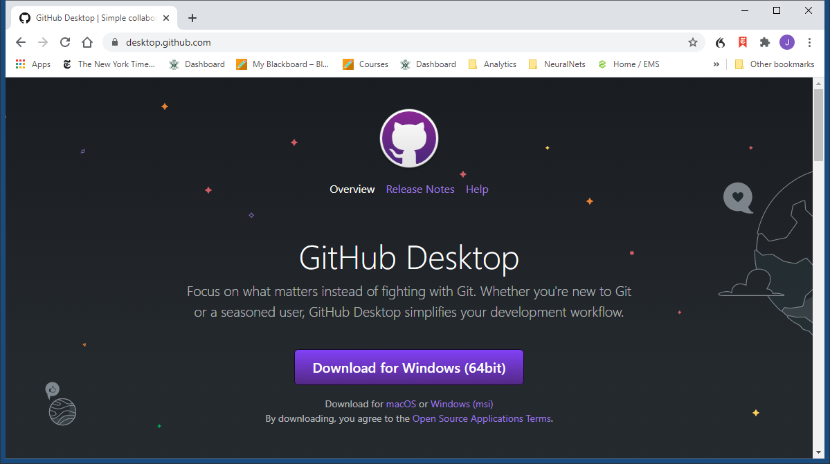
Install GitHub Desktop App
https://desktop.github.com/

Slide 39
GitHub Desktop App
Runs git on your desktop/laptop
Publishes repo to github.com

Slide 40
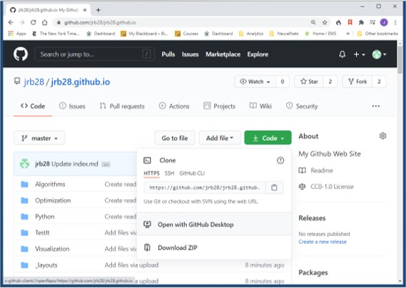
Exercise
Clone your GitHub personal website onto your computer with GitHub Desktop App

Slide 41
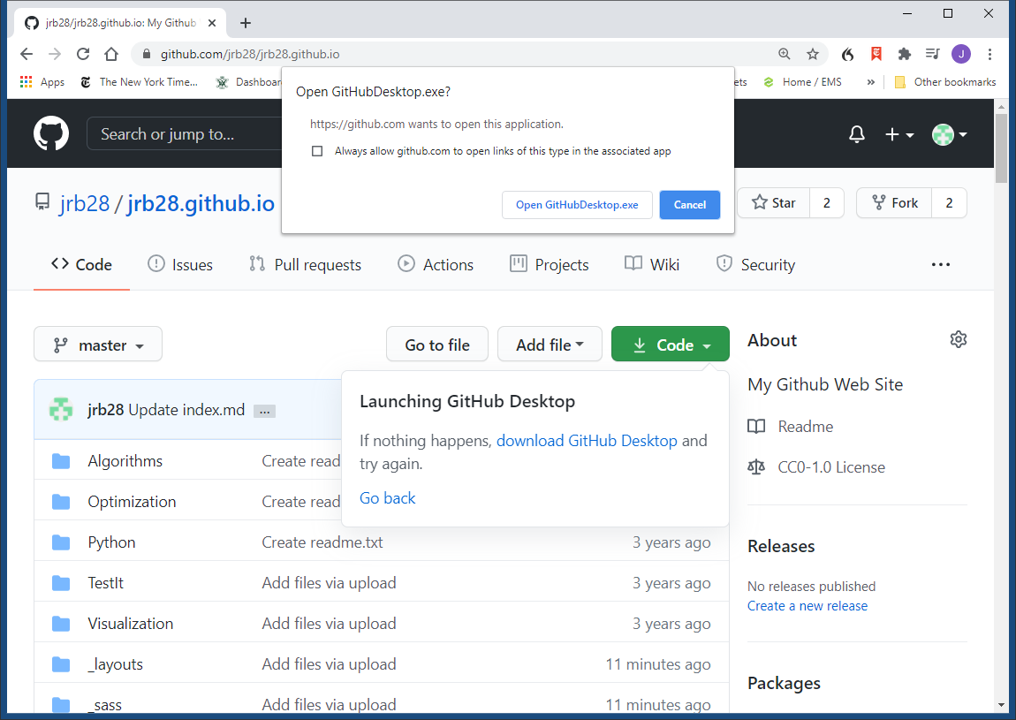
Exercise
Clone your GitHub personal website onto your computer with GitHub Desktop App

Slide 42
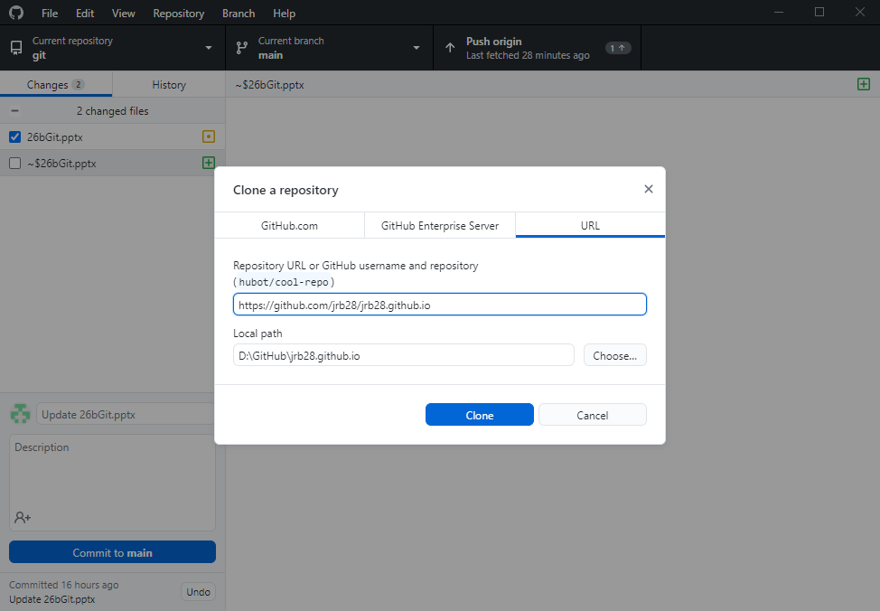
Exercise
Clone your GitHub personal website onto your computer with GitHub Desktop App

Slide 43
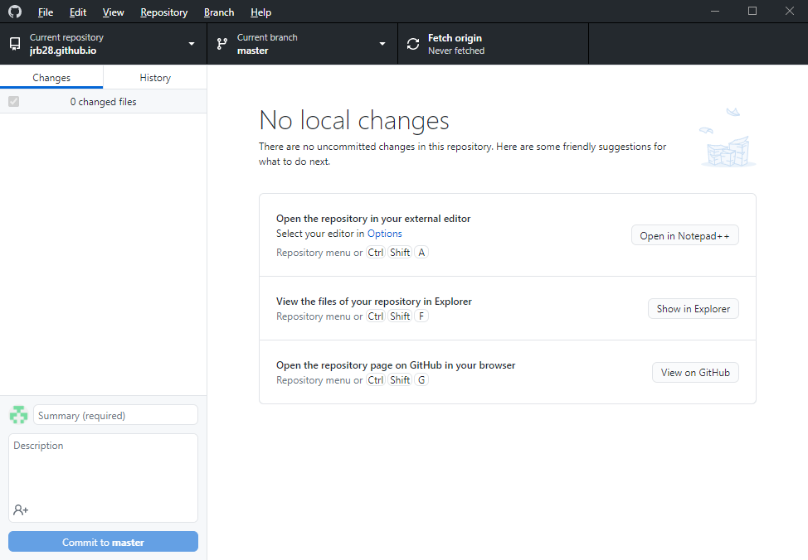
Exercise
Clone your GitHub personal website onto your computer with GitHub Desktop App

Slide 44
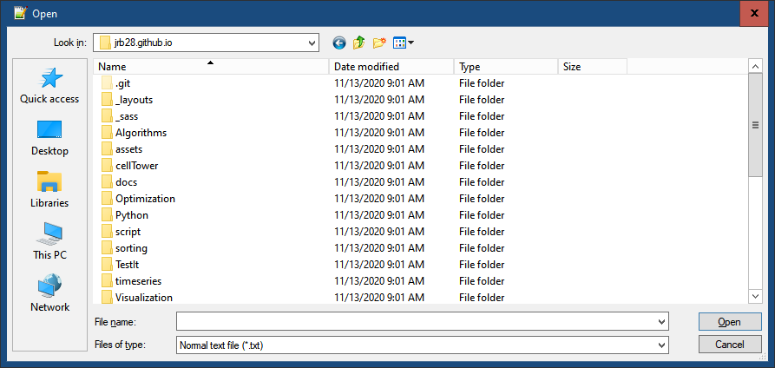
Exercise
Edit a file in that cloned repo on your computer

Slide 45
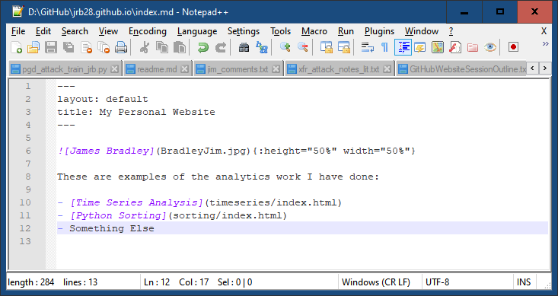
Exercise
Edit a file in that cloned repo on your computer

Slide 46
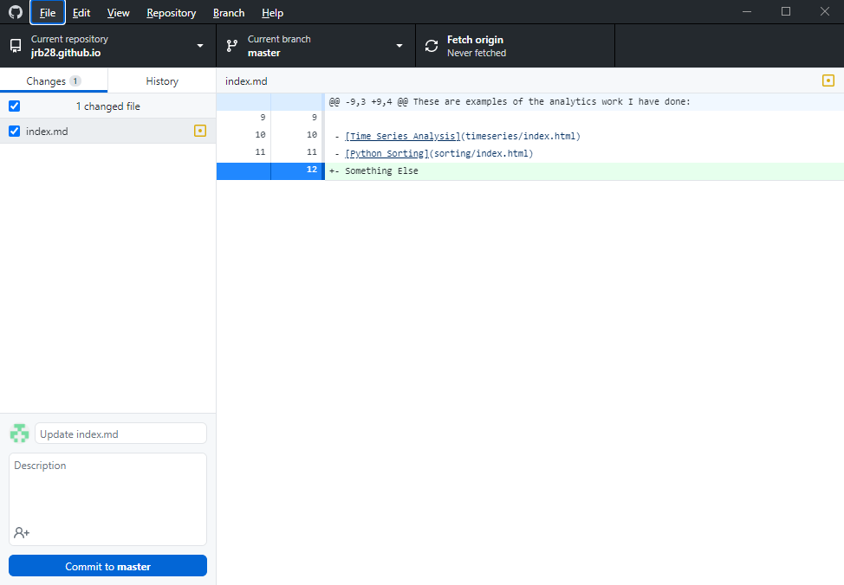
Exercise
Commit changes to your computer

Slide 47
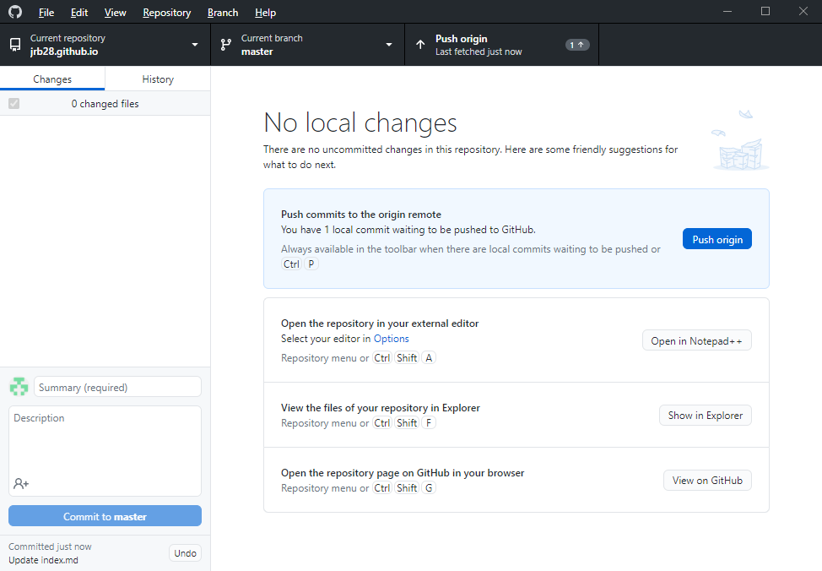
Exercise
“Push” to GitHub repo

Slide 48
Exercise
Summary
Manage your website files on your computer
Upload/push to GitHub.com
Easier than dragging and dropping
Can do this with any repo

