Slide 1
Git: Version Control & Collaboration
James R. Bradley

Slide 2
Topics
git on your laptop
GitHub Desktop App
git is being integrated into IDEs
Spyder (link)
Rstudio (link)
PyCharm (link)
Atom (link)

Slide 3
Version Control
Have you revised a working program, and then it didn’t work anymore?
Version control permits program development to safely continue without:
Breaking a program
You can always revert to a previous functional copy
Having multiple “versions” saved
Git
For sole developers or for collaboration

Slide 4
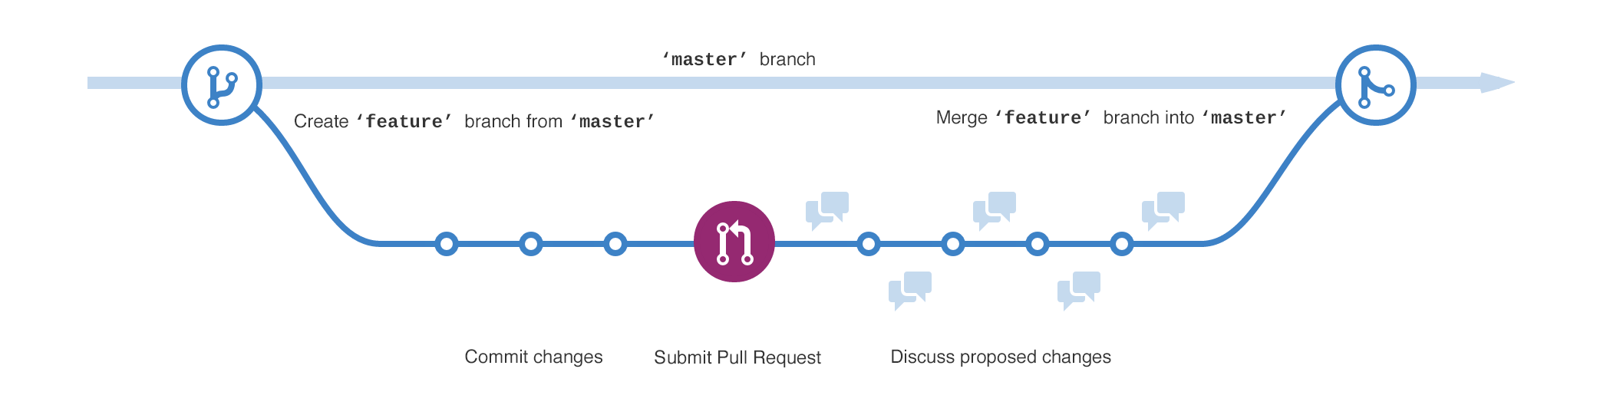
Version Control
Git permits a temporary copy of code to be created
A branch; can be multiple branches
Changes are made to branches
Discussed, debugged…
Then merged back into the master branch
Master branch code is never disturbed

Slide 5
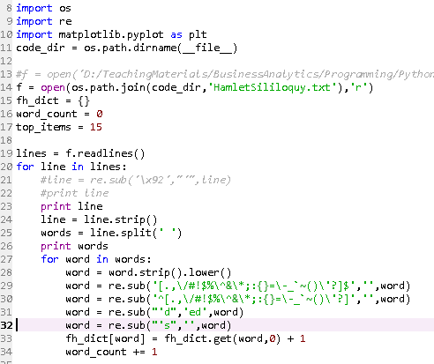


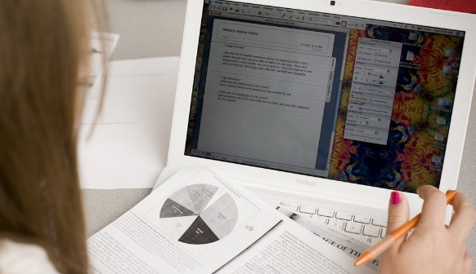
Version Control
Collaboration
Multiple people cannot edit software simultaneously
Conflicts
Corrupted Code

Slide 6
Version Control
We’ll focus on git in the context of a sole developer
… and Github as a portfolio repository

Slide 7
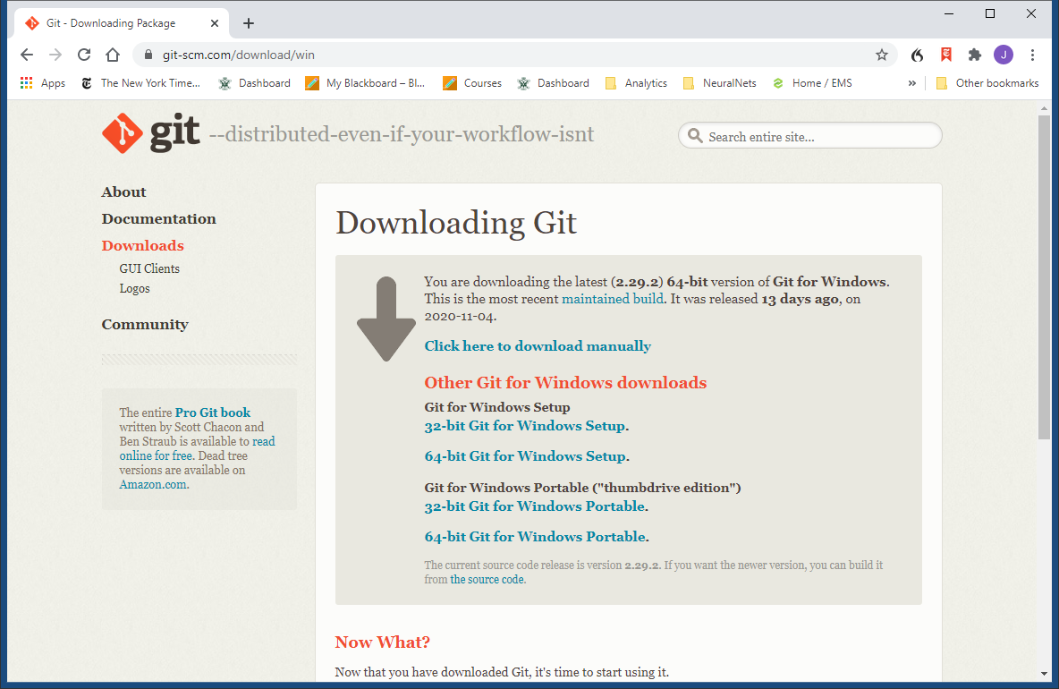
Git on Your Laptop
Download and install git:
https://git-scm.com/download/win
Use all default configuration settings
This link should work.

Slide 8

Git on Your Laptop
Get session materials
github.com/jrb28/git
Copy git_tutorial folder another location
Folder has one file: my.py
This half of the session:
Step through basic command line git commands

Slide 9
Git on Your Laptop
Conceptually what’s happening…
We’ll be working on a Python program:
my.py in the folder git_tutorial
We’ll create a master branch and a test branch
The master branch works, but we want to make changes
We’ll make changes to the test branch
Git keeps track of multiple versions master and test
Only one my.py will appear in git_tutorial at any one time
Switch which version (master/test) with git software

Slide 10
Git on Your Laptop
′test ′
′test ′
work on ′test ′ version

Slide 11
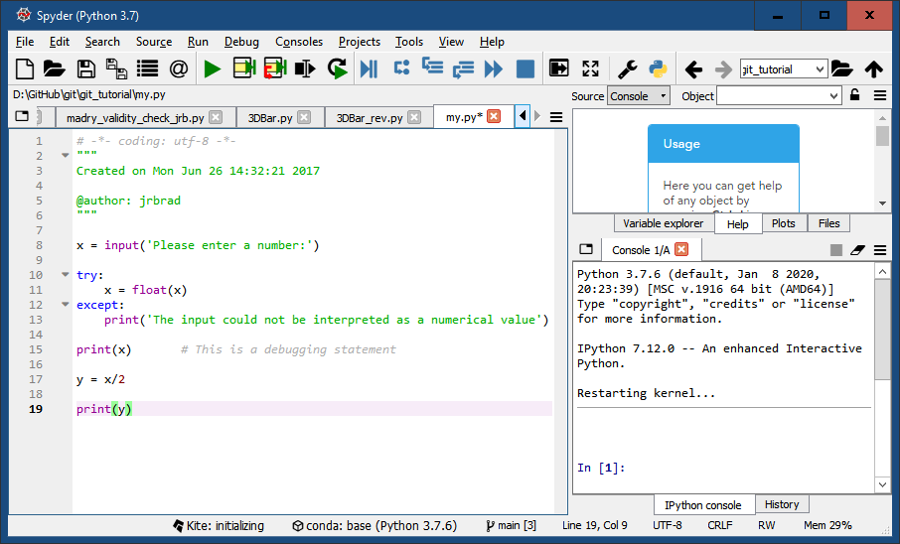
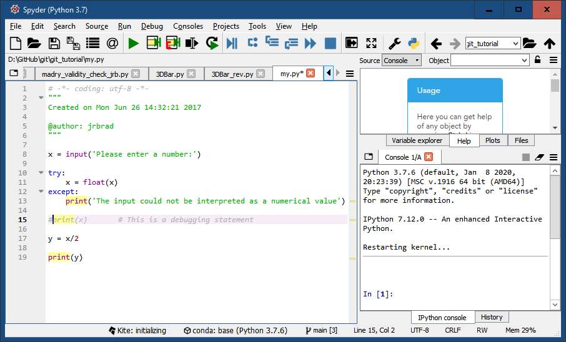
Git on Your Laptop
master
test
Only one my.py will ever appear in git_tutorial
Git permits switching between versions (branches)
Git will apply whatever changes are appropriate for the version you want to use

Slide 12
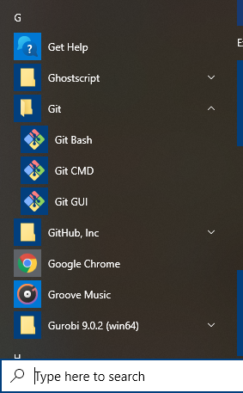
Git on Your Laptop
Open the Git Command window

Slide 13
Git on Your Laptop
Change directory to the git_tutorial folder
Type drive letter corresponding to the location of the git_tutorial folder, then a colon and Enter
Copy my.py file path from Windows Explorer: Ctrl-c
Paste into Git Command window with cd command
cd = change directories
Pasting requires right-clicking on upper left Git icon
See subsequent slides for screenshots

Slide 14
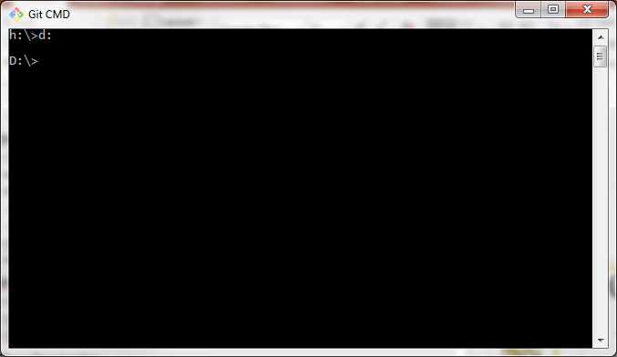
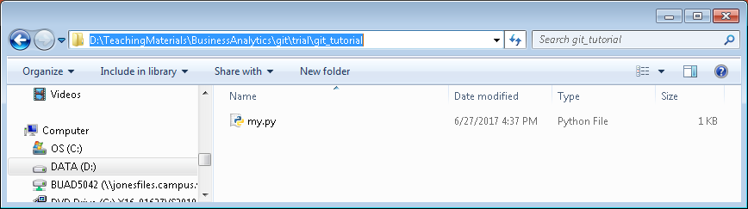
Git on Your Laptop
Your drive will most likely be C:

Slide 15
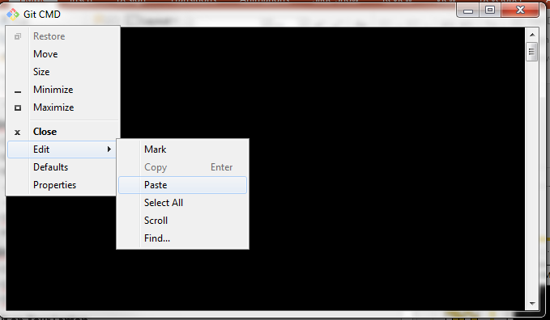
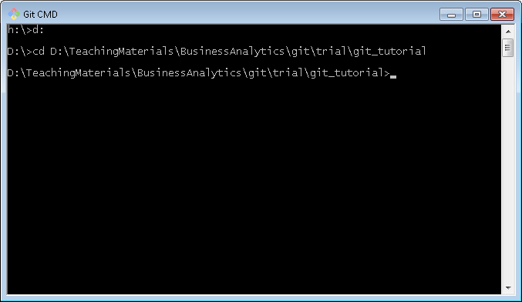
Git on Your Laptop

Slide 16
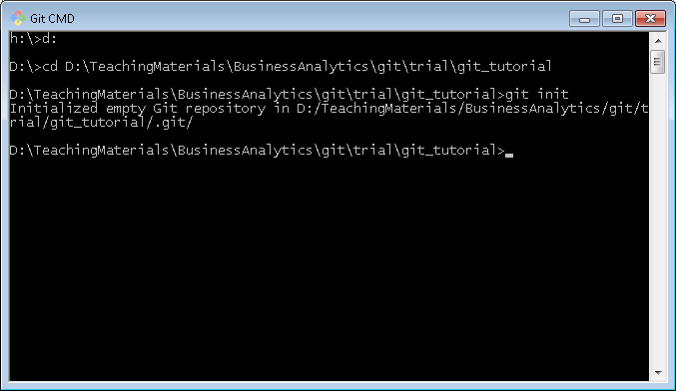
Git on Your Laptop
Initialize the folder as a git folder
This tells git to start tracking changes
Type git init in Git Command window, then Enter

Slide 17
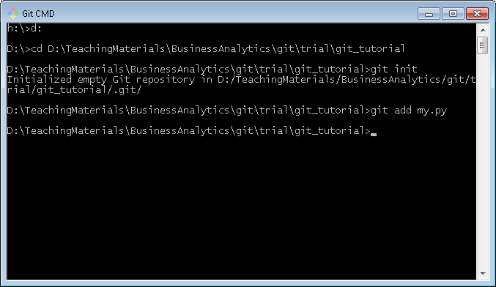
Git on Your Laptop
Add my.py as a file for git to keep track of
Type git add my.py, then Enter

Slide 18
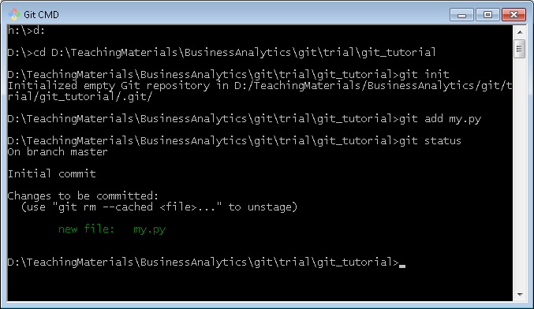
Git on Your Laptop
Check status of folder
Type git status, then Enter

Slide 19
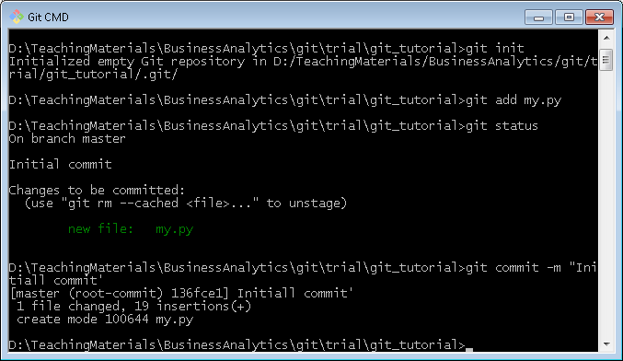
Git on Your Laptop
Commit initial version of my.py
Type git commit my.py –m “message”, then Enter
The message give a brief description of the change
… our message will be “Initial commit”

Slide 20
Git on Your Laptop
A git add command is required on the command line each time you want to commit changes to a file

Slide 21
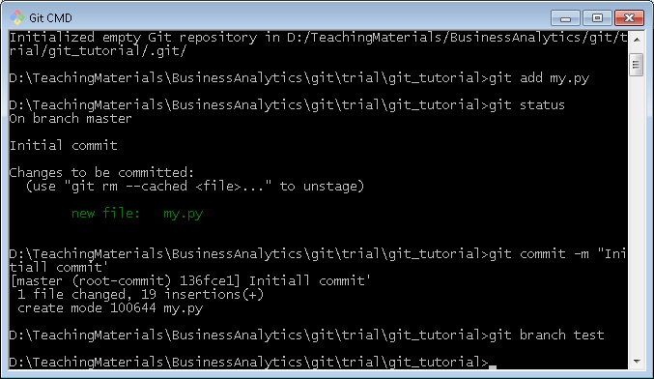
Git on Your Laptop
We will revise my.py so create a test branch
git branch test, then Return

Slide 22
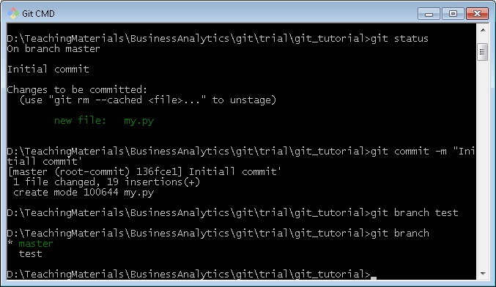
Git on Your Laptop
Check to make sure you created a branch
git branch gets list of branches
The * shows which branch you are working on

Slide 23
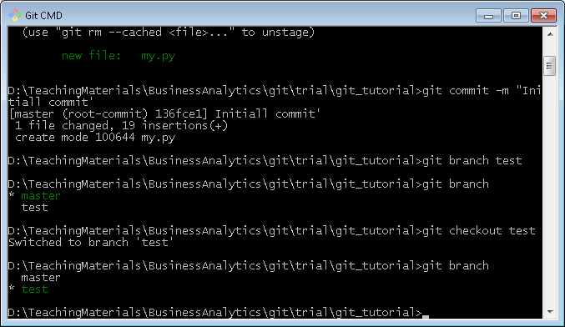
Git on Your Laptop
Change to test branch
git checkout test, then Enter
git branch, then Enter

Slide 24
Git on Your Laptop
Revise the Python Program in Spyder, and save, close

Slide 25
Git on Your Laptop
Make desired revisions in the test branch
Working code in master branch is not disrupted
Make sure revisions work in test branch
Commit changes in test branch
Then, merge test branch back into the master branch to incorporate them into the master branch

Slide 26
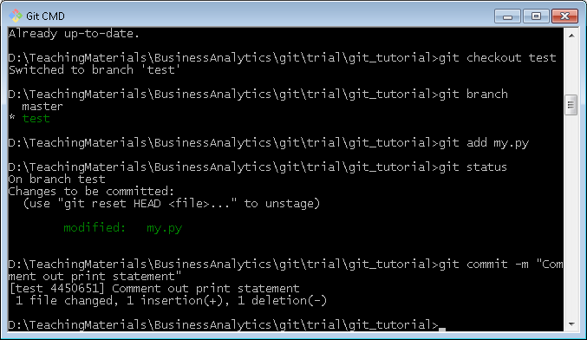
Git on Your Laptop
git add my.py, then Enter
git status
git commit –m “Comment out print statement”

Slide 27
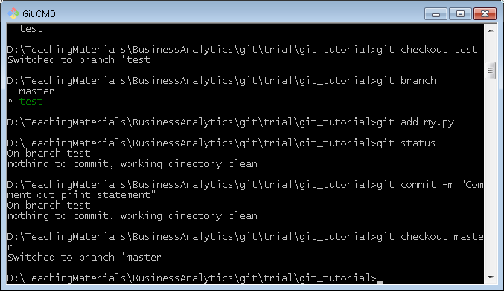
Git on Your Laptop
For illustration, go back to master branch
git checkout master, then Enter
Reopen my.py in Spyder
Code is master branch
is untouched

Slide 28
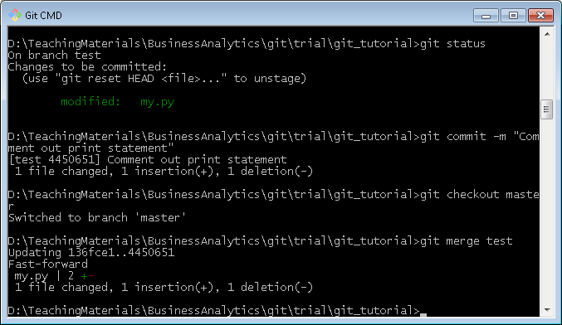
Git on Your Laptop
Merge changes from test branch into master
git merge test, then Enter

Slide 29
Git on Your Laptop
Now check out my.py in master branch
It reflects the change made in test branch

Slide 30
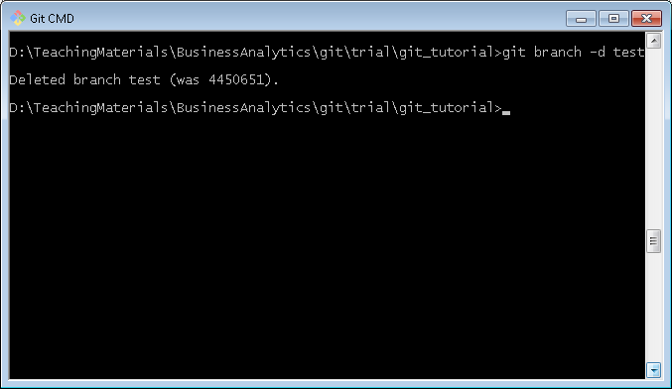
Git on Your Laptop
Delete test branch
git branch –d test, then Enter
git branch, then Enter to verify deletion

Slide 31
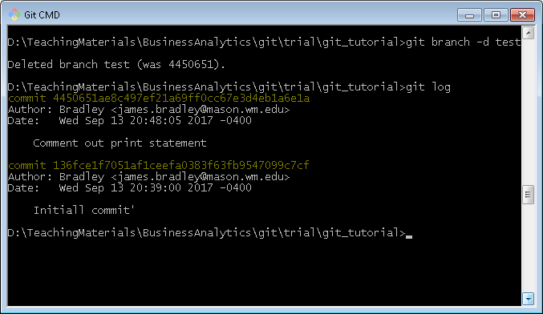
Git on Your Laptop
Revert to a former commit level
git log, then Enter to see commit history

Slide 32
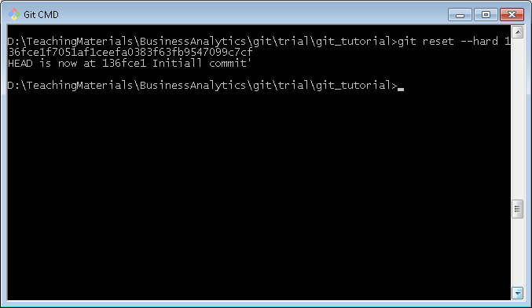
Git on Your Laptop
git reset --hard commit-hash-number

Slide 33
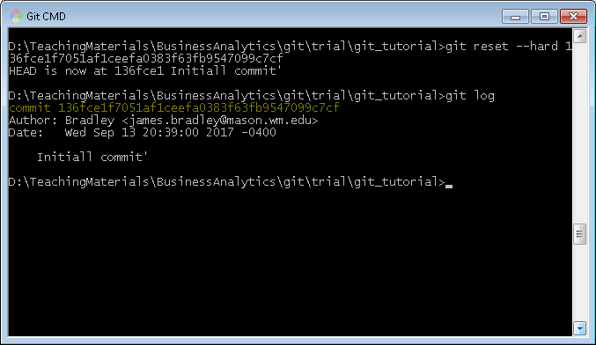
Git on Your Laptop
git log

Slide 34
Git on Your Laptop
Check out the file in Spyder… back to original
You need to close the file in Spyder, then reopen

Slide 35
Git Resources
Install command line git
https://git-scm.com/download/win
udacity.com course
https://in.udacity.com/course/how-to-use-git-and-github--ud775/
Online interactive tutorial
https://try.github.io/levels/1/challenges/1

Slide 36
Git Resources
Cheat Sheet
https://services.github.com/on-demand/downloads/github-git-cheat-sheet.pdf
Written tutorials
https://git-scm.com/book/en/v2/Getting-Started-Git-Basics
Branching & merging
https://git-scm.com/book/en/v2/Git-Branching-Basic-Branching-and-Merging

Slide 37
Git Resources
Other tutorials
Udacity:http://blog.udacity.com/2015/06/a-beginners-git-github-tutorial.html
http://blog.scottlowe.org/2015/01/14/non-programmer-git-intro/
http://blog.scottlowe.org/2015/01/27/using-fork-branch-git-workflow/

Slide 38
GitHub Desktop App

Slide 39
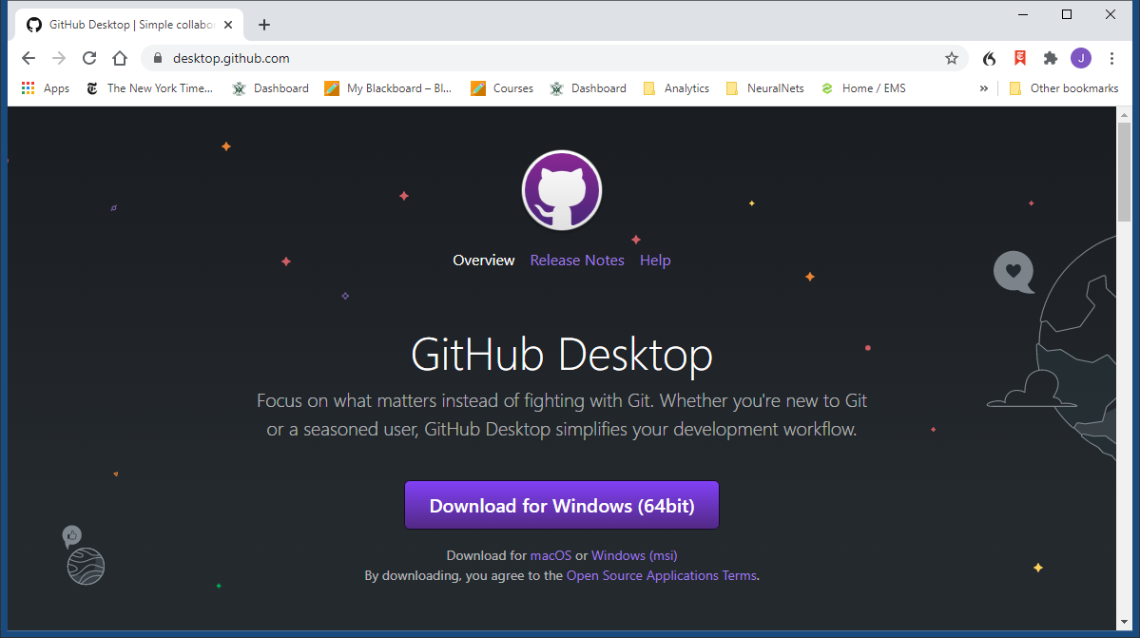
Install GitHub Desktop App
Install GitHub Desktop App
https://desktop.github.com/

Slide 40
GitHub Desktop App
Runs git on your desktop/laptop
GUI
GitHub Desktop is different than command line git
git add is implicit
Publishes repo to github.com
Clones repo from github.com
Not all git features

Slide 41
Exercise 1
Repeat 1st exercise with GitHub Desktop
Create C:\GitHub folder
Open GitHub Desktop
File>New Repository
Copy my.py from git_tutorial into folder above
Commit my.py addition to local repository
Edit my.py
Commit changes to local repository

Slide 42
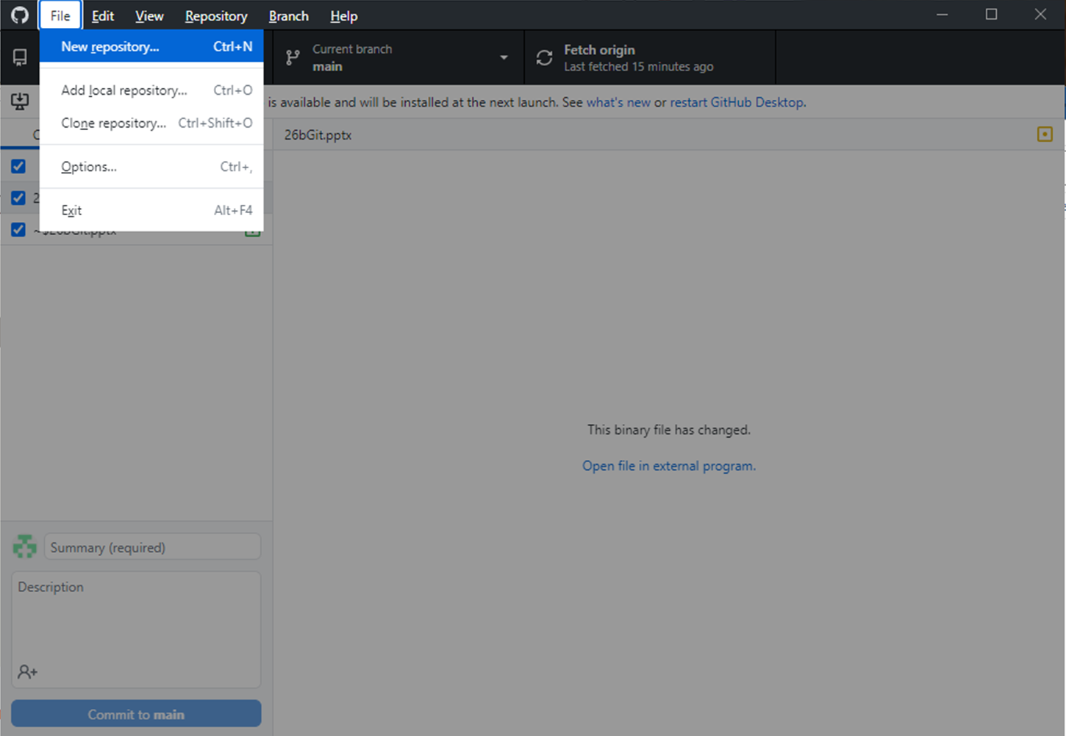
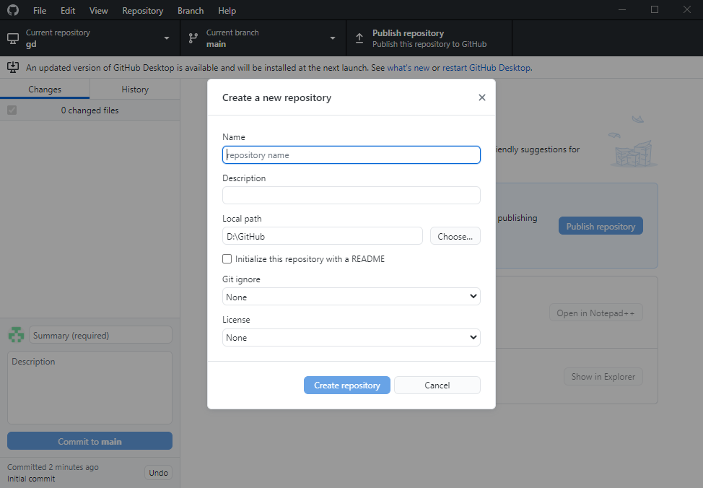
Create New Local Repository

Slide 43
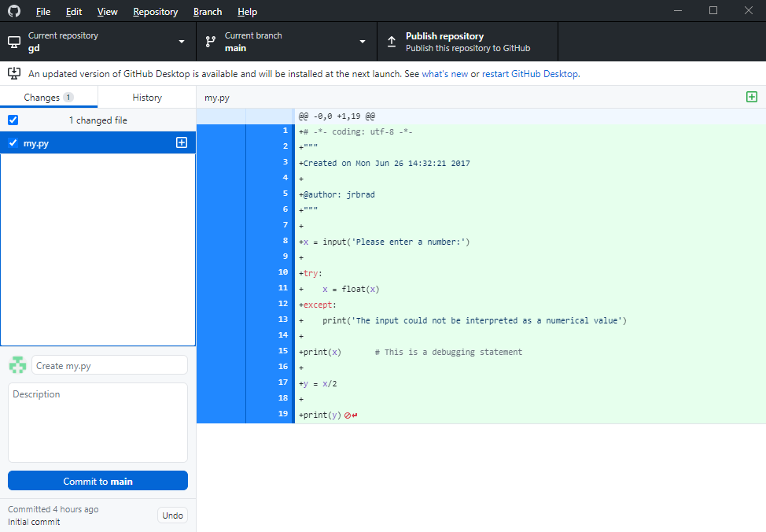
Commit my.py Addition

Slide 44
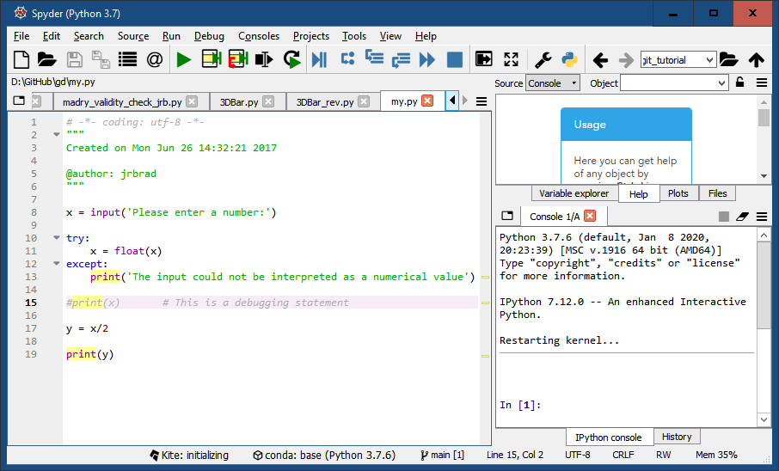
Edit Program

Slide 45
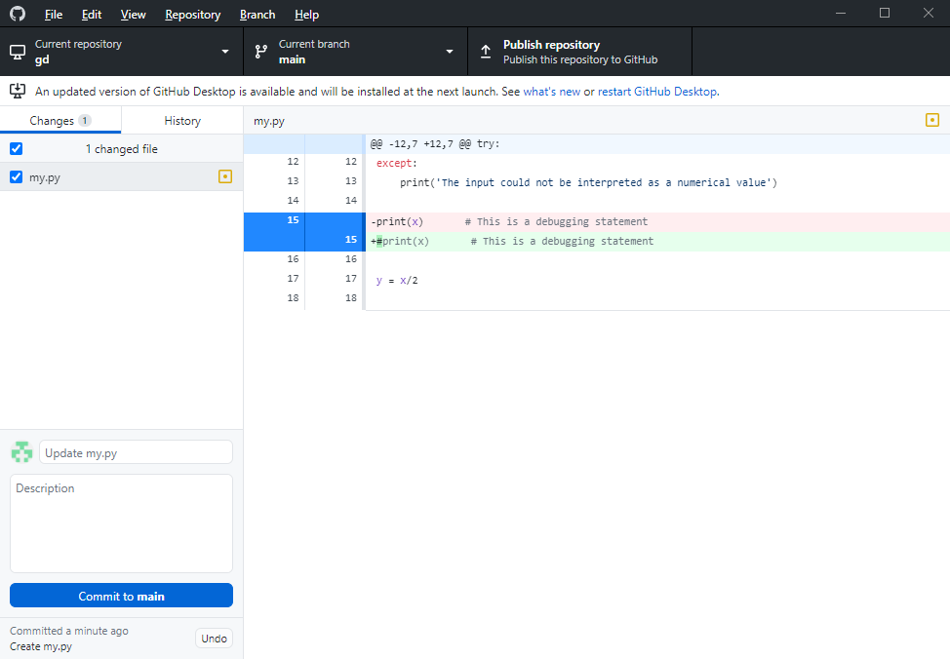
Commit Changes

Slide 46
Exercise 1
Repeat 1st exercise with GitHub Desktop (continued)
Publish repository to GitHub
Edit, push revisions to GitHub
Revert to original code
Use command line git
git reset --hard commit-hash-number

Slide 47
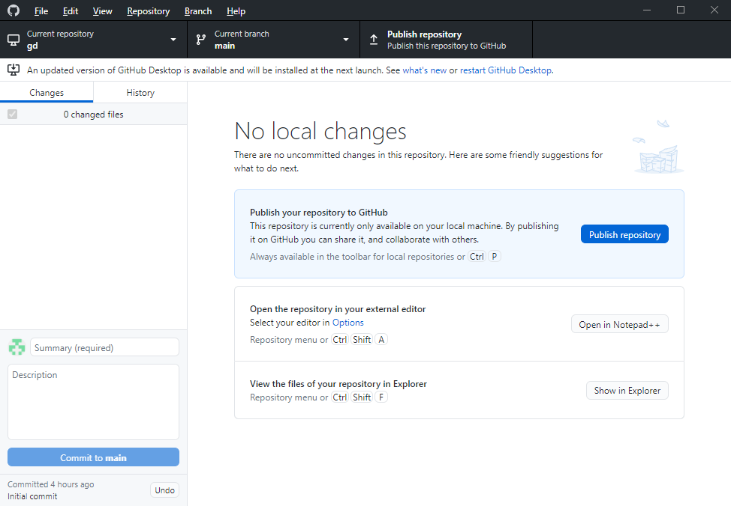
Publish Repo to GitHub Web

Slide 48
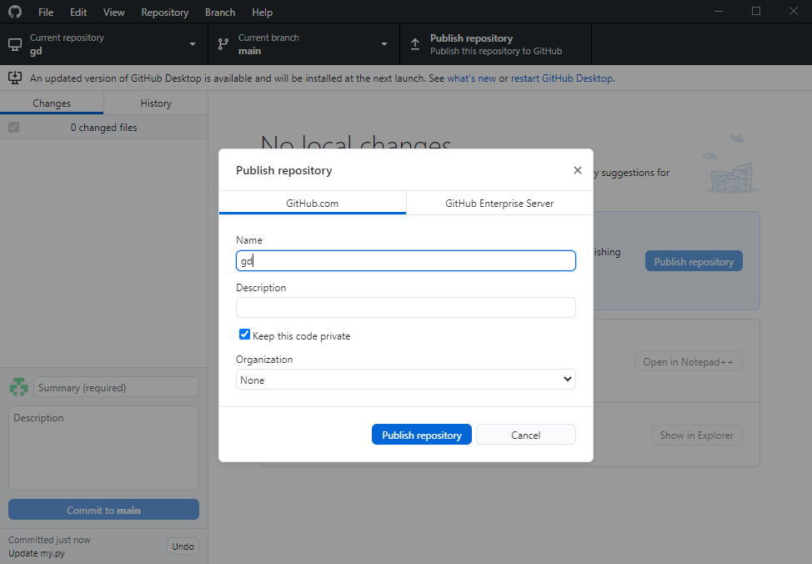
Publish Repo to GitHub Web

Slide 49
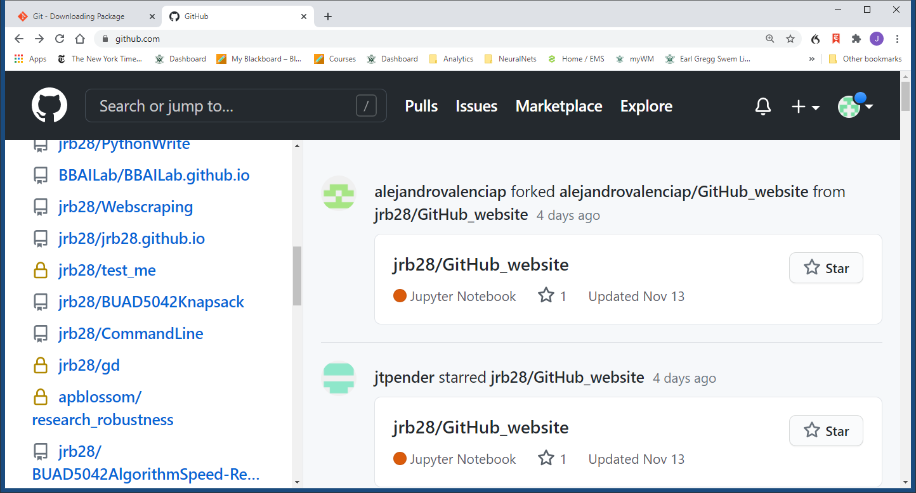
Publish Repo to GitHub Web

Slide 50
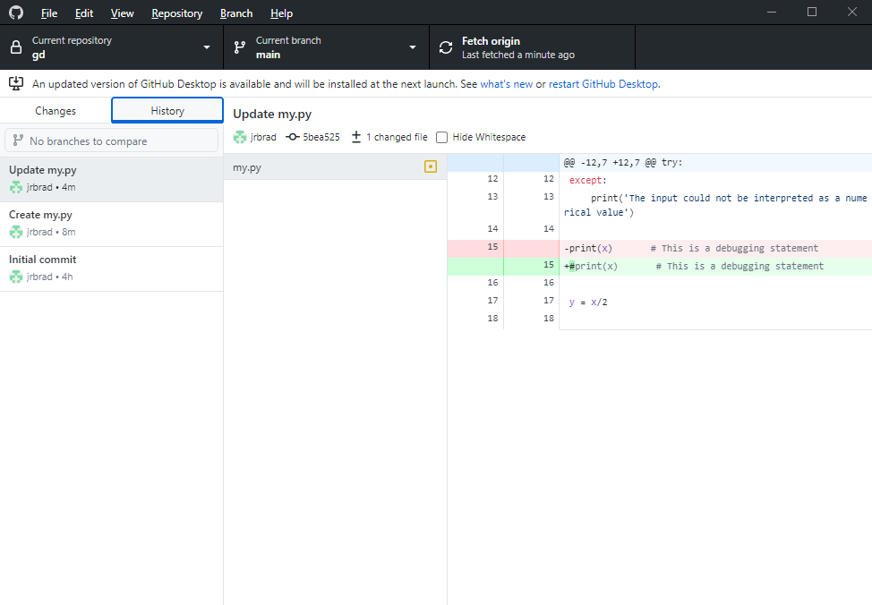
Revert to Previous Commit

Slide 51
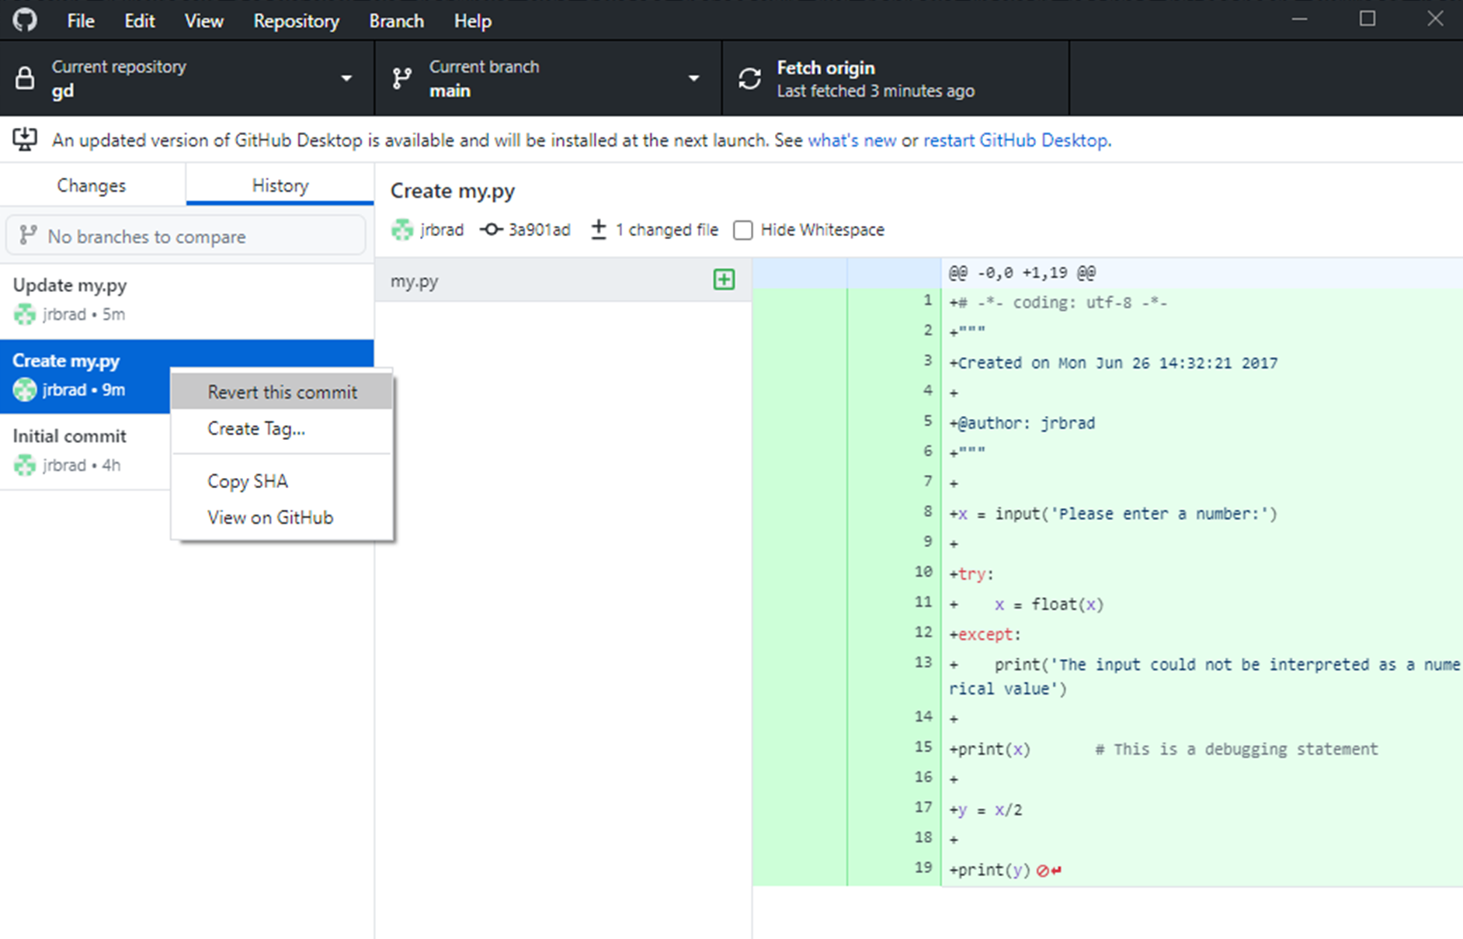
Revert to Previous Commit
Right click

Slide 52
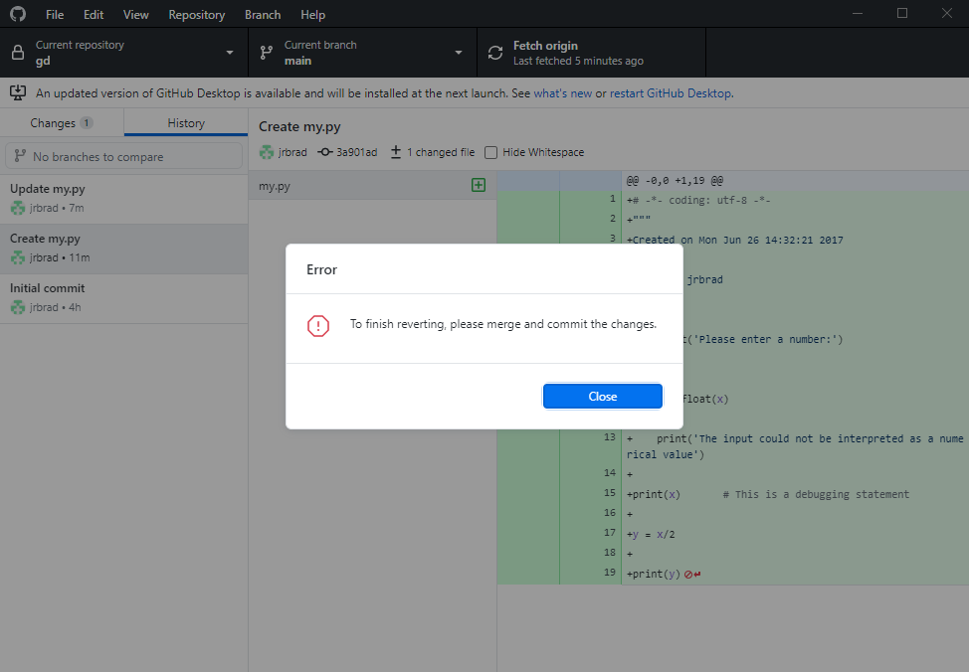

Slide 53
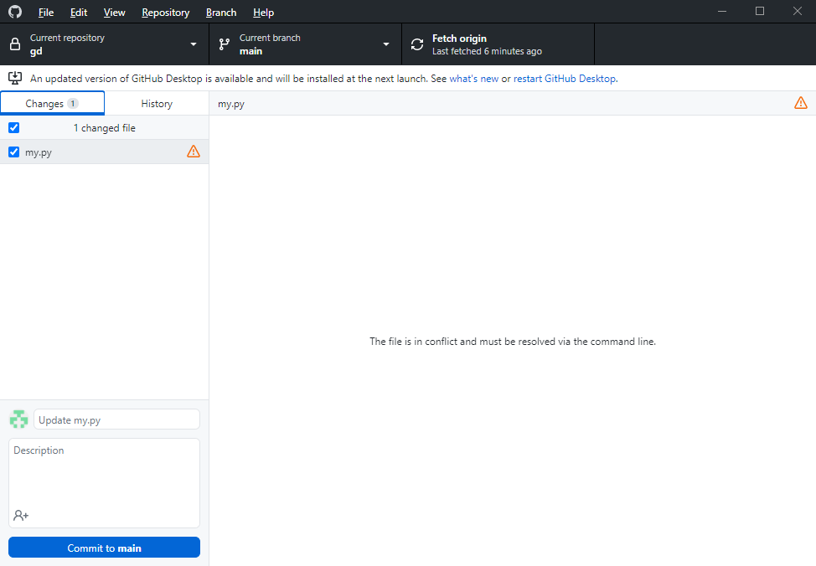

Slide 56
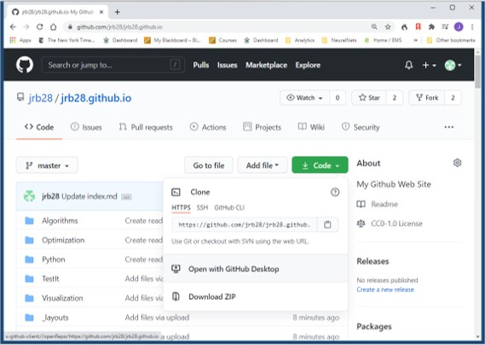
Exercise 2
Clone your GitHub personal website onto your computer with GitHub Desktop App

Slide 57
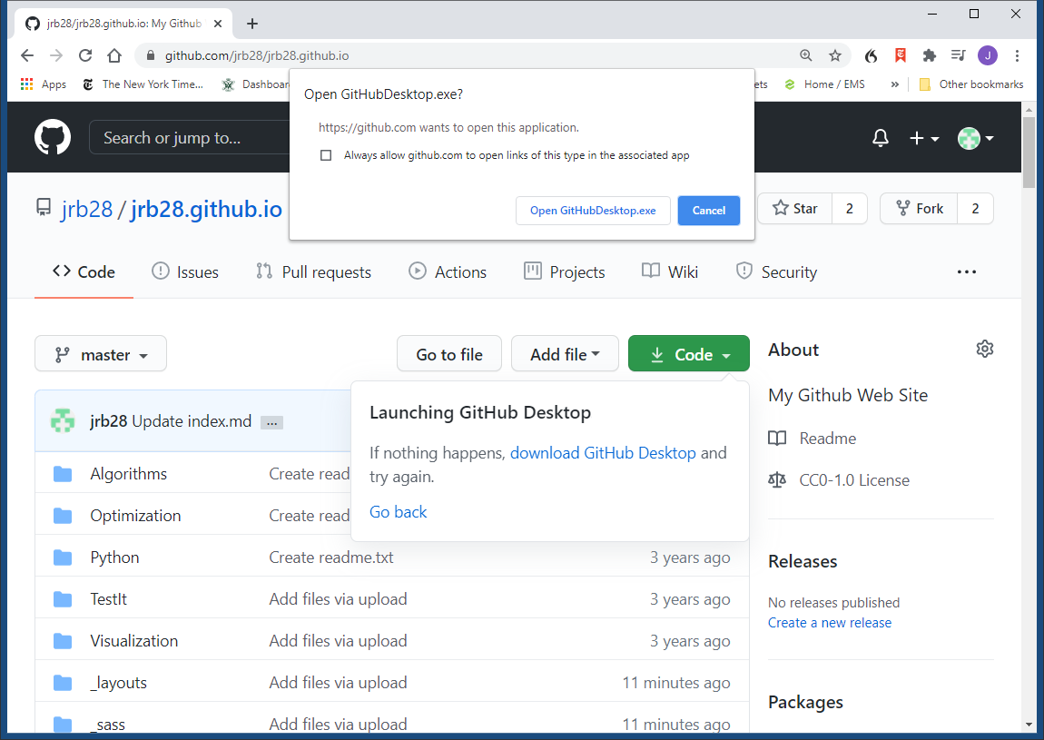
Exercise 2
Clone your GitHub personal website onto your computer with GitHub Desktop App

Slide 58
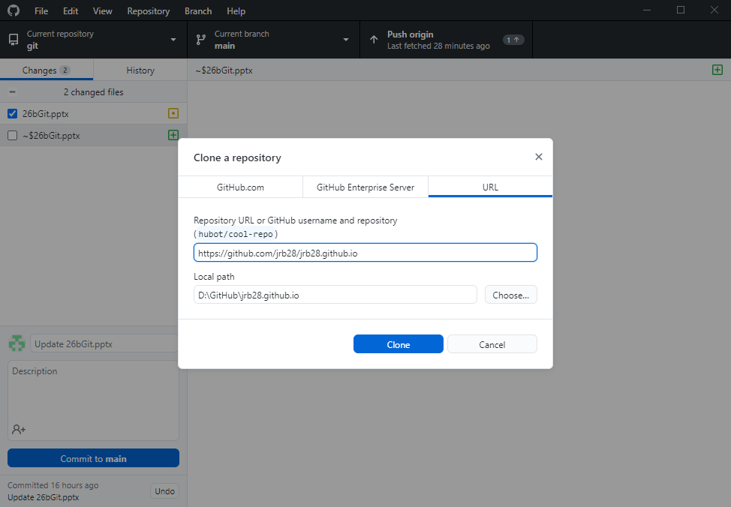
Exercise 2
Clone your GitHub personal website onto your computer with GitHub Desktop App

Slide 59
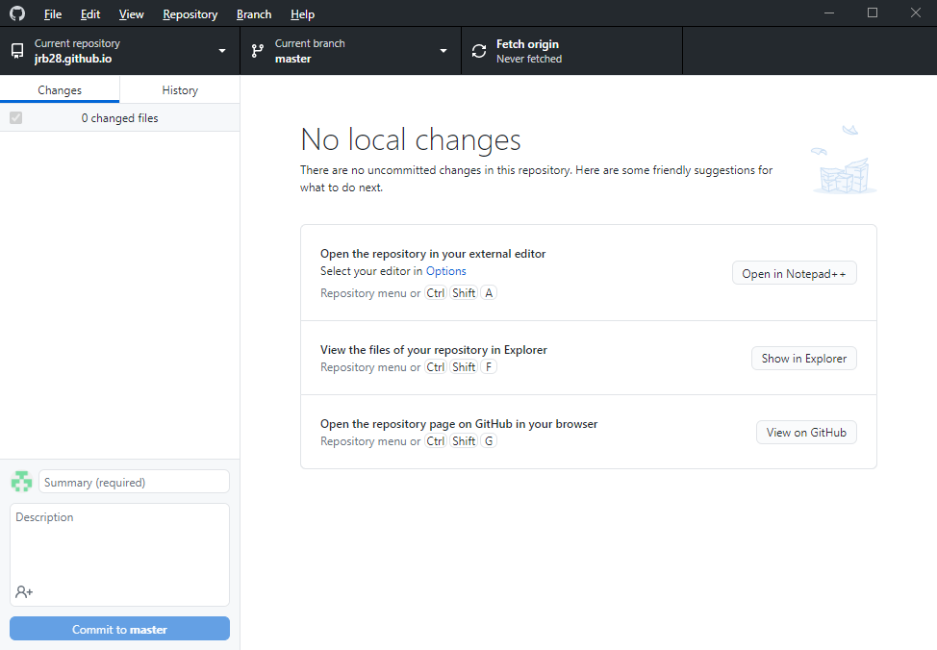
Exercise 2
Clone your GitHub personal website onto your computer with GitHub Desktop App

Slide 60
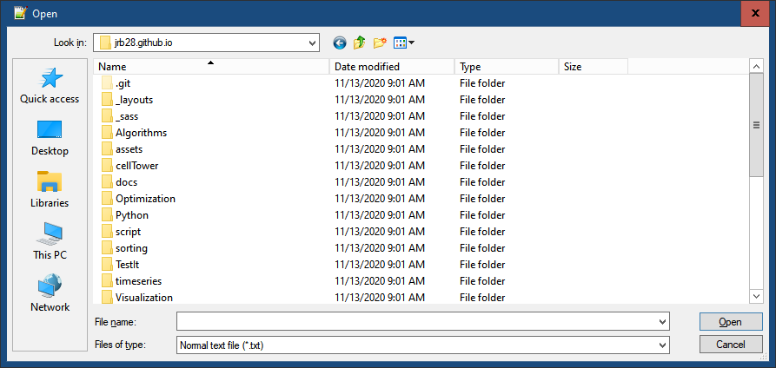
Exercise 2
Edit a file in that cloned repo on your computer

Slide 61
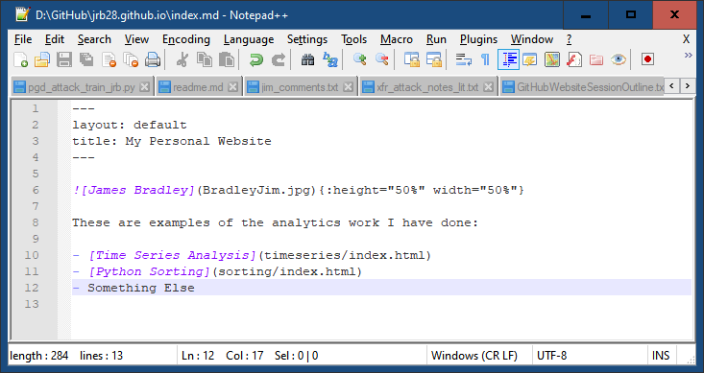
Exercise 2
Edit a file in that cloned repo on your computer

Slide 62
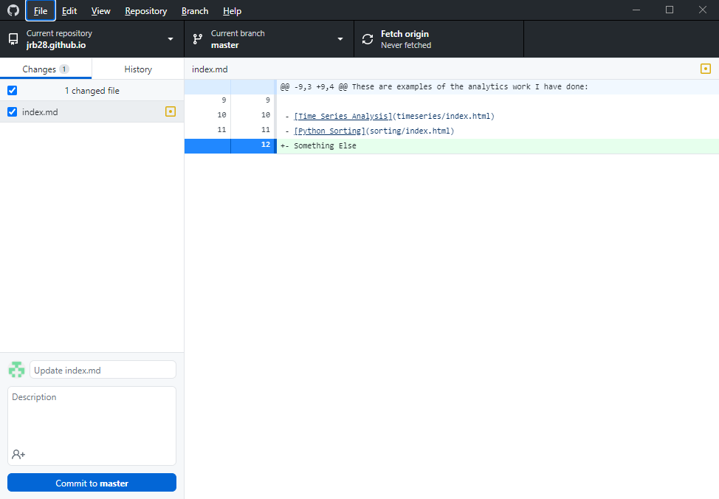
Exercise 2
Commit changes to your computer

Slide 63
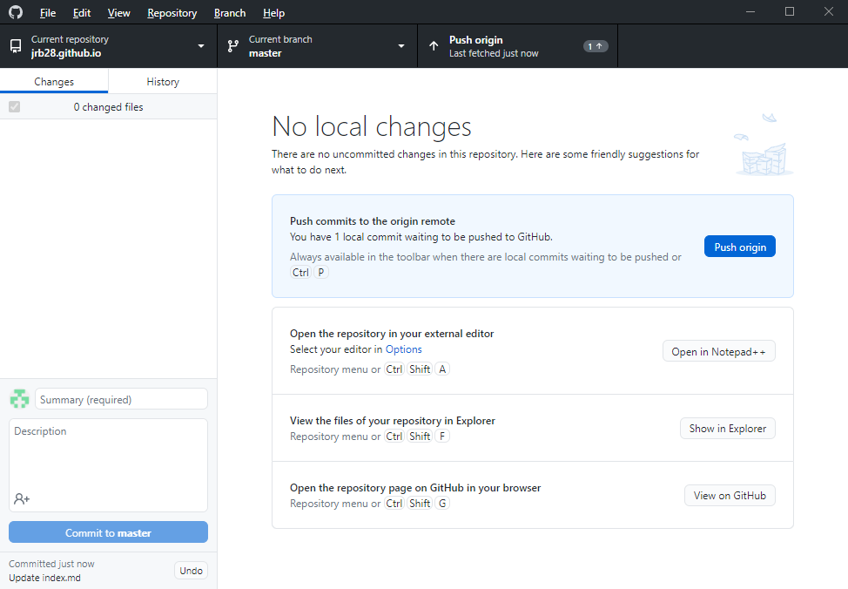
Exercise 2
“Push” to GitHub repo

Slide 64
Exercise 2
Summary
Manage your website files on your computer
Upload/push to GitHub.com
Easier than dragging and dropping
Can do this with any repo

