Slide 1
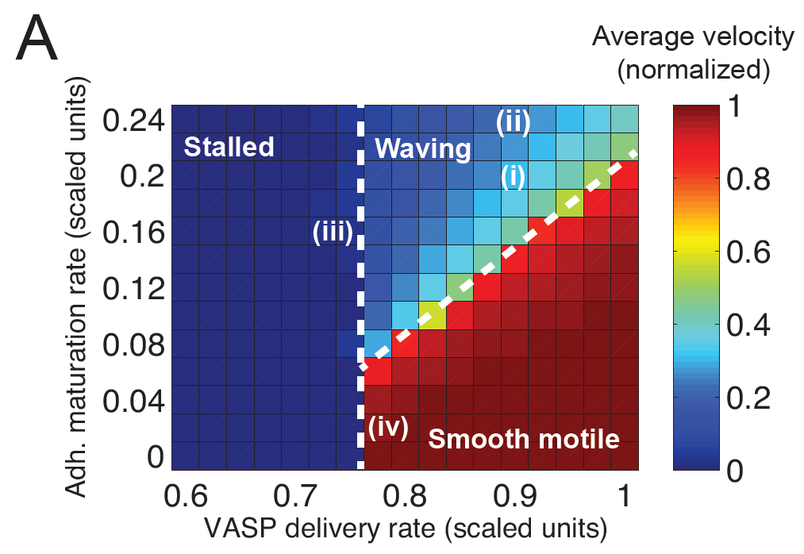
B
Stalled
Waving
Smooth motile

Slide 2
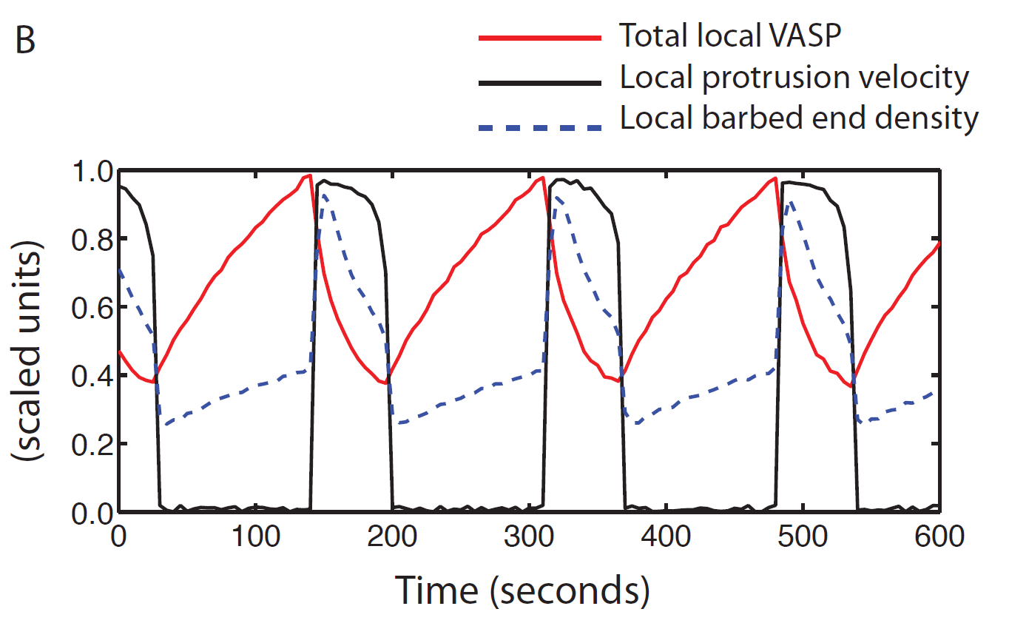
A
B
C
D

Slide 3
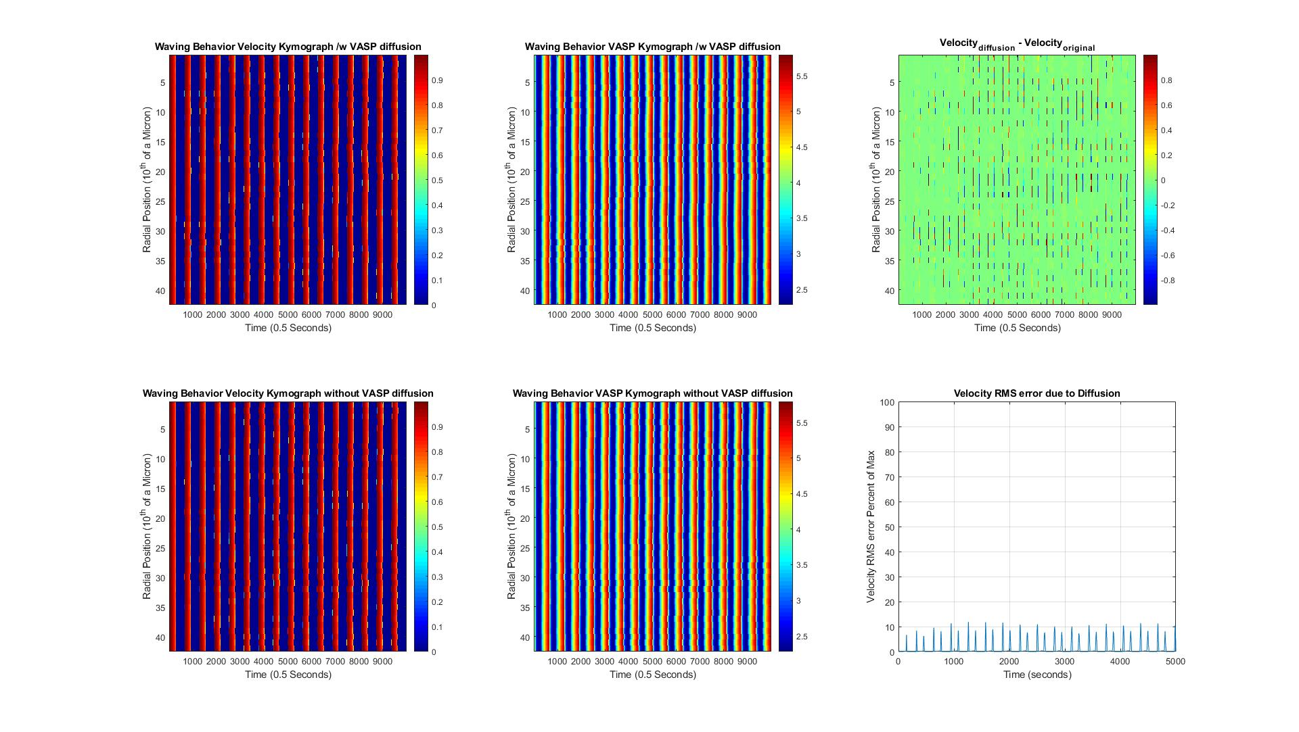
A

Slide 4
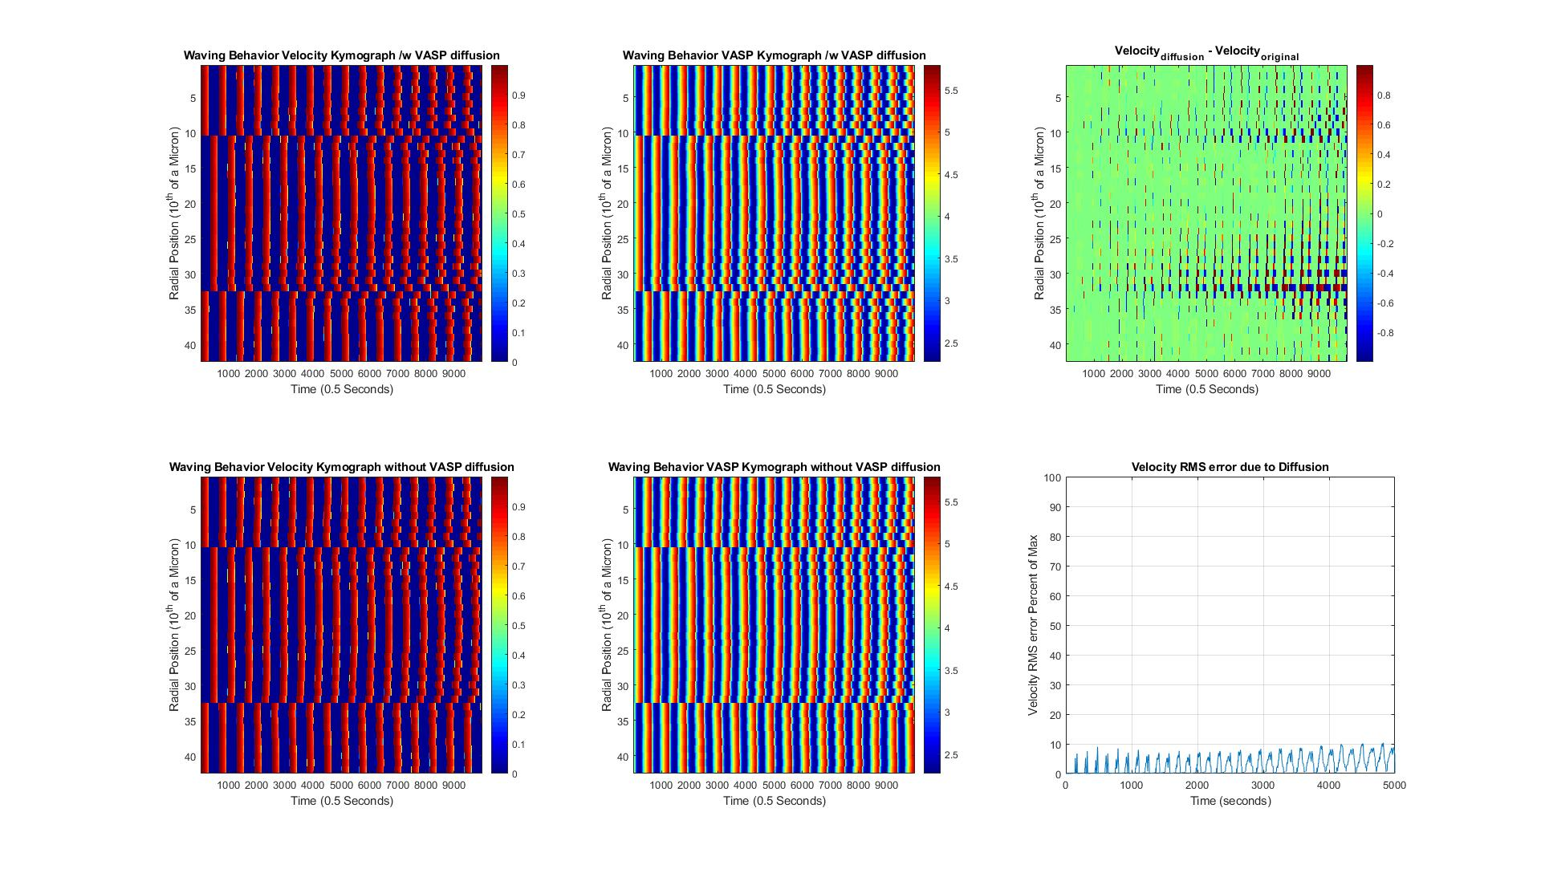
B

Slide 5
