Slide 1
FINAL PROGRESS REPORT
GROUP 10

Slide 2



TEAM MEMBER
Phạm Minh Đăng 20194737
Lê Đình Huy - 20194776
Đặng Minh Khôi - 20194781
- Backend Developer
Frontend Developer
Ui Designer
Frontend Developer
Ui Designer

Slide 3
TABLE OF CONTENTS.
2 | SOLUTION AND TECHNOLOGY
3 | APPLICATION PROTOCOL DESIGN
5 | RESULT AND DEMO
4 | SUMMARY
1 | INTRODUCE TOPIC
Introduce the topic of project
How we design protocol
How we design protocol
4 | USE-CASE AND PROCESS
Result of our work and demonstration
What we get after doing project
This is use case and app process, state

Slide 4
WE WILL TALK ABOUT 1. INTRODUCE TOPIC

Slide 5
Duoi hinh bat chu is a popular word puzzle game that challenges players to form words by connecting a series of given letters and picture
Although it has become a popular game, the game “Duoi hinh bat chu” can still be improved to be online game that players can play in their own devices (laptop, pc ...)
With online game, players can play it easily in their free time with difficulty variety, familiar user interface, play with friends or pratice with computer.....

Slide 6
2. SOLUTION AND TECHNOLOGY

Slide 7
Solution
Make a program that player can play online game with familiar user interface
Control data by building a database of words and images used for the game
Game process logic: create classes and data structures to store and manage game state
Communication with players: player can communicate with each other by answer the puzzle

Slide 8
Technology
Create user interface with Qt framework includes: login, play room, list room, list rank.....
Create database by beekeeper application (using sql lite)
Game process logic: using socket and api to control logic
Communication with players: communicate with each player in a game by socket

Slide 9
WE WILL TALK ABOUT 3. PROTOCOL DESIGN

Slide 10
App Architechture
We apply client – server architechture to our app
- Server apcept connect from client, listen for request from client
- Client send request to server for authentication (login, register), playing game (request to create room, join room, play with computer), and display rank

Slide 11
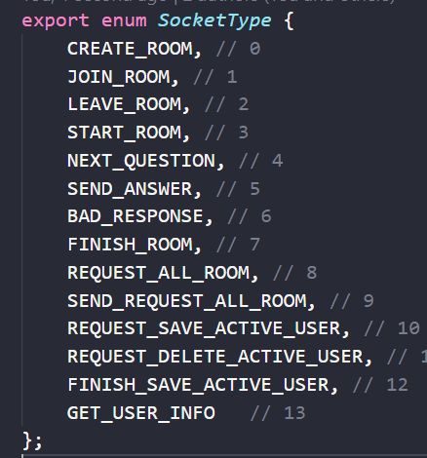
Type of message
- There are 13 types of message
- There are: CREATE_ROOM, JOIN_ROOM, LEAVE_ROOM, START_ROOM.....

Slide 12
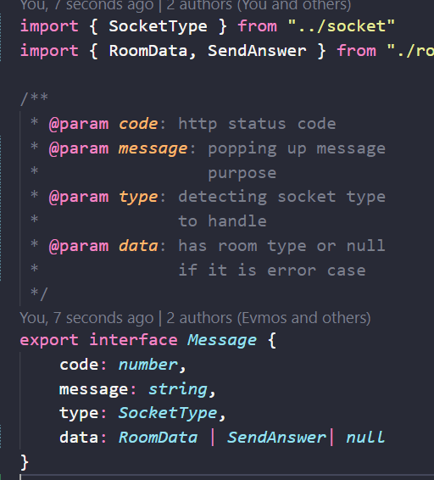
Structure of message
- There are 4 keys in a message: code, message, type, data - Code is about http status code - Message is popping up message purpose - Type is message type - Data is content data of message

Slide 13
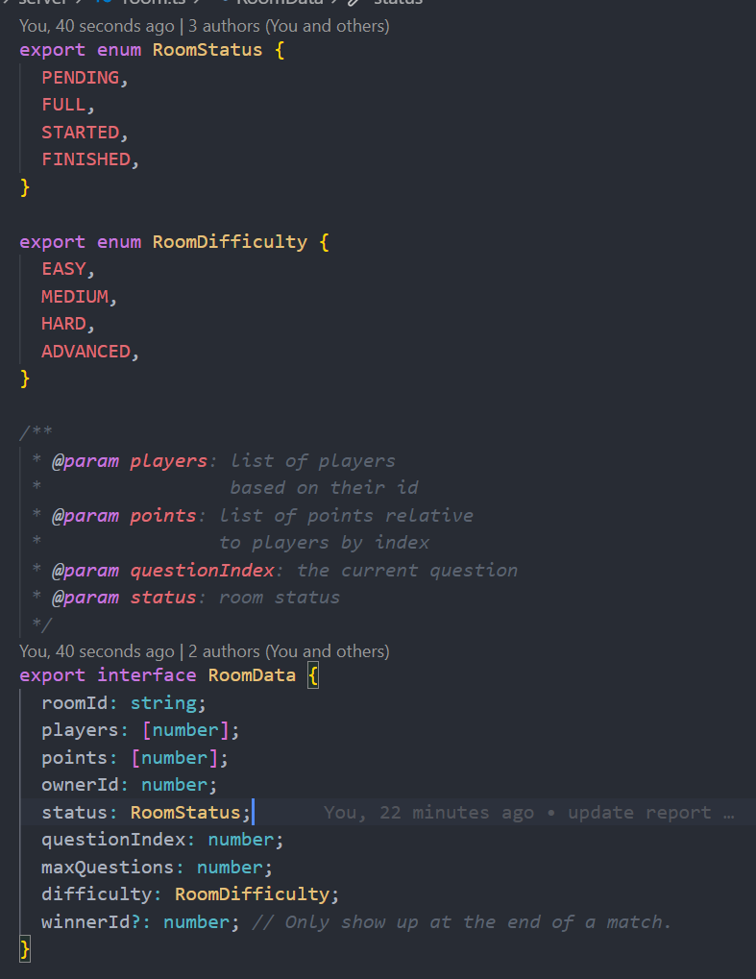
RoomData
Room data is include: roomID, players, points, ownerId, status, questionIndex, maxQuestions

Slide 14
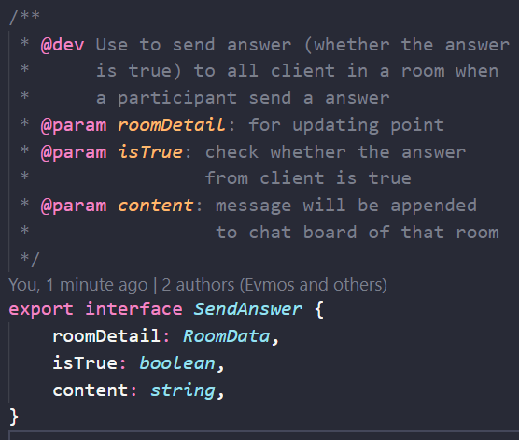
Send answer
SendAnswer is include: roomDetail, isTrue, content
isTrue is about the answer is true or not
Content is the message will append to chat

Slide 15
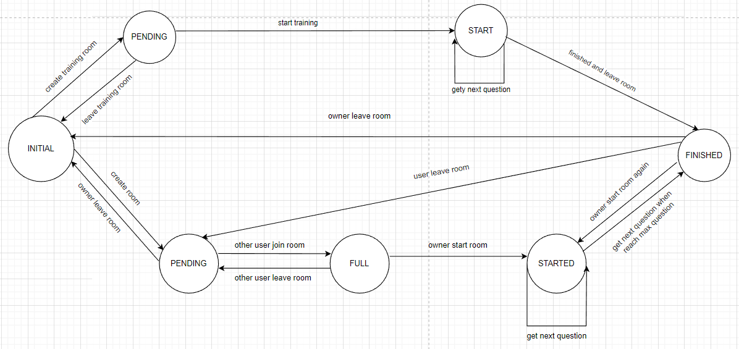
Protocol Processing
We use finite state machine to present state
Image beside is our finite state machine graph

Slide 16
4. Usecase, class diagram, flowchart

Slide 17
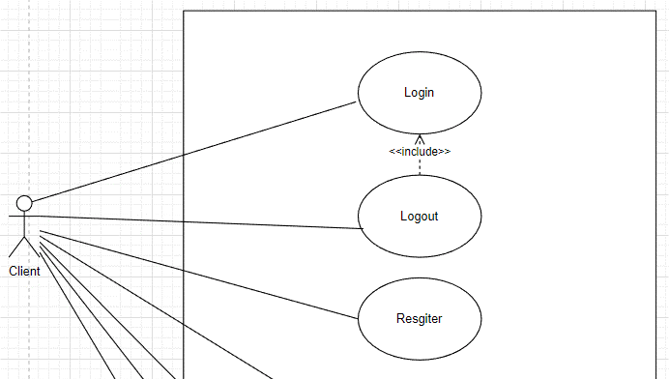
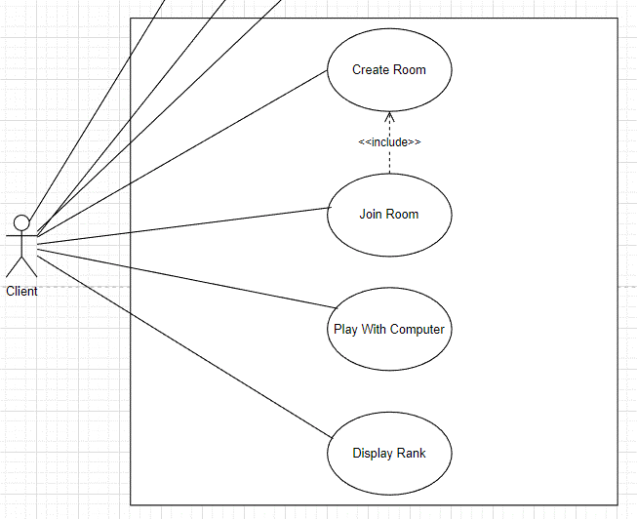
Usecase

Slide 18
Main Usecase
There are 2 main usecase: authentication, play game
Authentication is include: login, logout, register
Play game is about: play with opponent, play with computer, display rank

Slide 19
Auth Usecase
There are 3 sub usecase: login, logout, resgiter
If user has account then can login
If user don’t have account then resgiter

Slide 20
Play Game
There are 4 sub usecase: create room, join room, play with computer, display rank
User can create new room or join existed room or play with computer
User can view rank

Slide 21
Flow Chart
Because the flow chart is too big then we split it into two sub-flow charts: auth and play flow charts

Slide 22
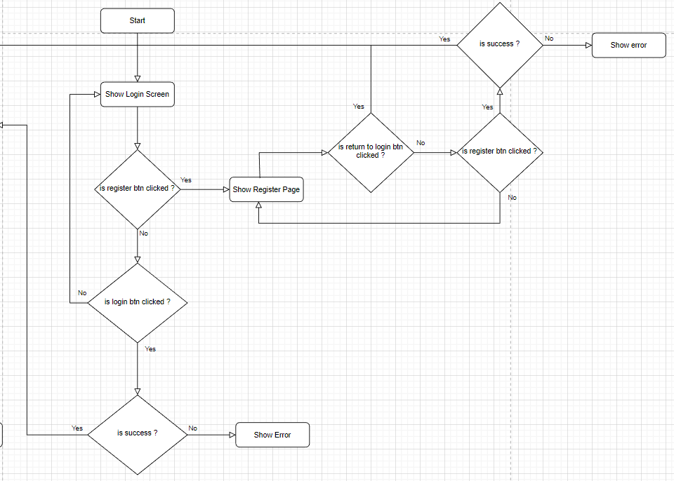
Flow chart

Slide 23
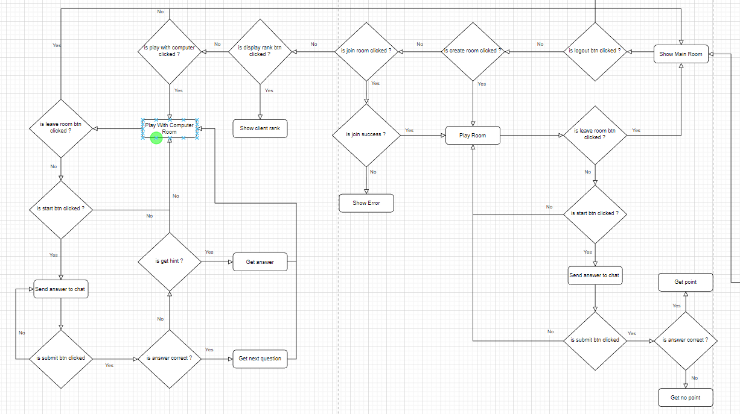
Flow chart

Slide 24
5. RESULT AND DEMO

Slide 25
Work Result
Players can login into their accounts, if they don’t have any, they can register new account
In the main room, players can see which room is available, which room is busy and room’s level. They can join room by room id
Players can see rank of all users when they click into display rank button
Players can player with computer to train theirselves: in play with computer room, player see question and send answer, if the question is difficult then it has hint for thems
Players can play game with other online players. In the room, owner player wait for opponent to start the game. If the room is full then the game can be started. When the game started, each player answer the question, who has the correct answer will has point. If opponent leaves room, owner has to wait other player join the room. If owner leave the room then the room is gone and opponent has to join another room

Slide 26
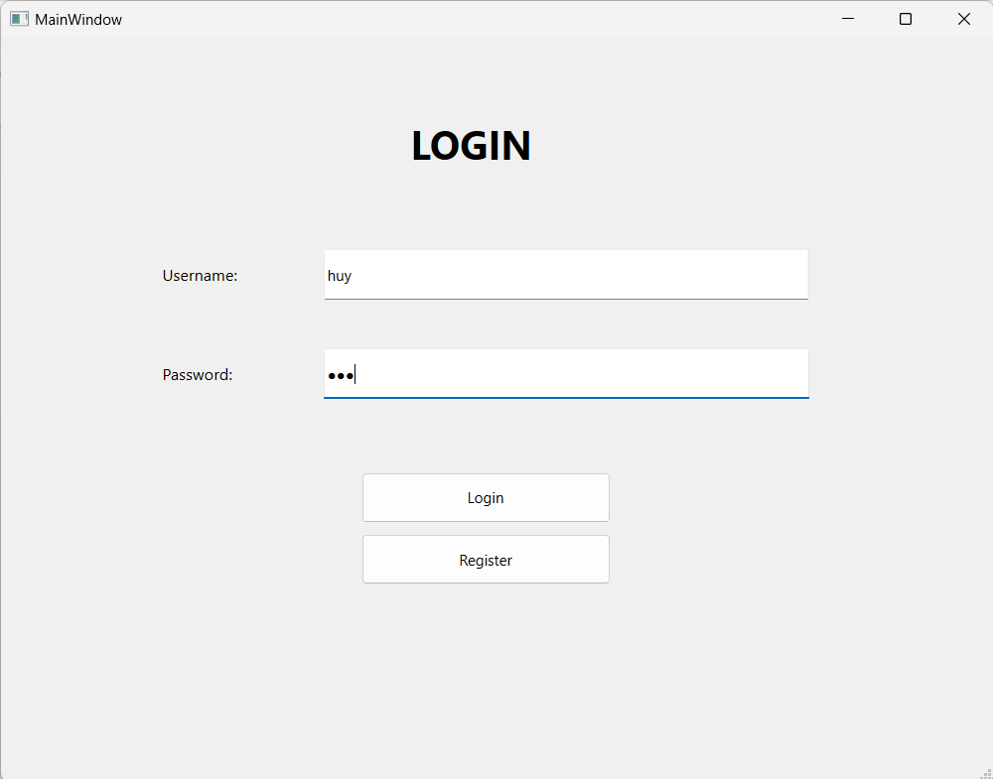
Auth
Login: if users have account then they can login to app. If account is not exist or password is wrong then it will show error

Slide 27
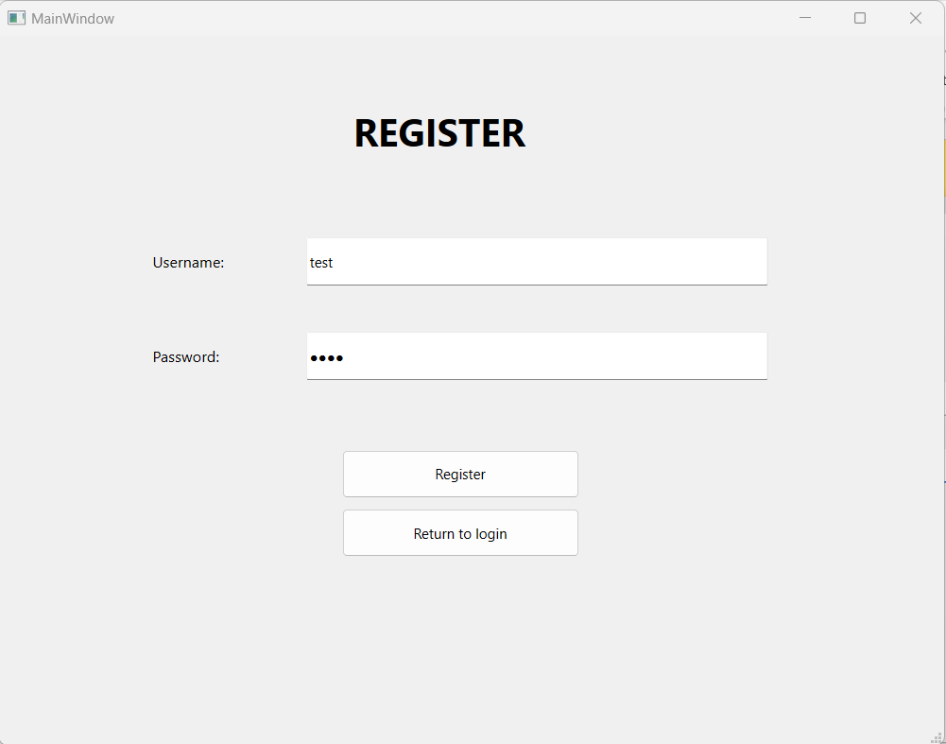
Auth
Register: if users don’t have account then they create new one. If account is exist then it will show error

Slide 28
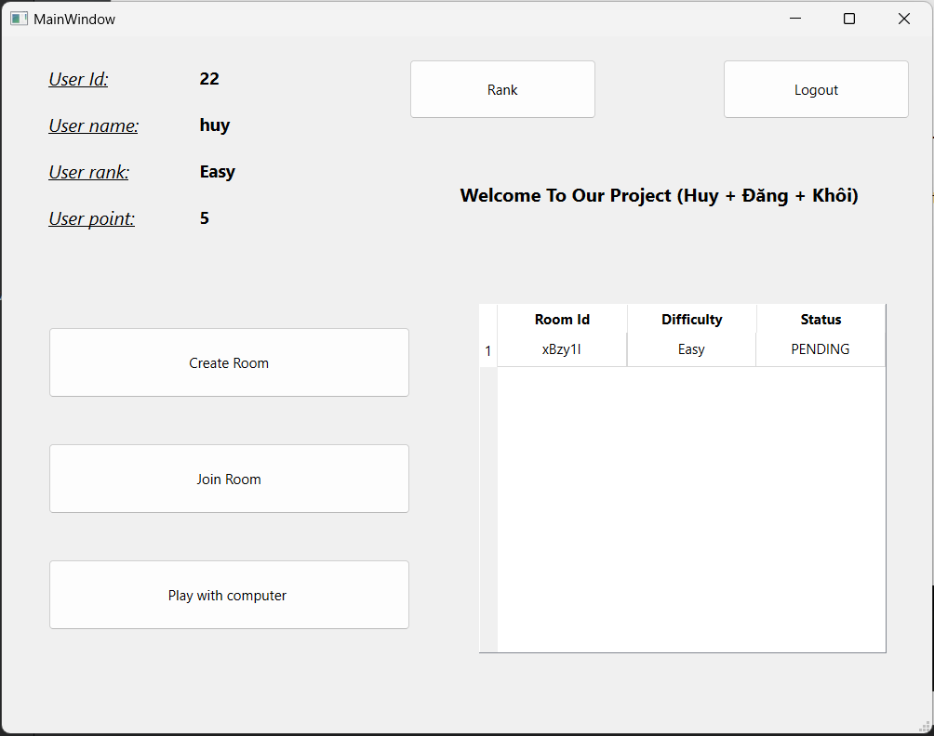
Playing game
In main room, user can: + Create room + Join room (from room list) + Play with computer + Show rank

Slide 29
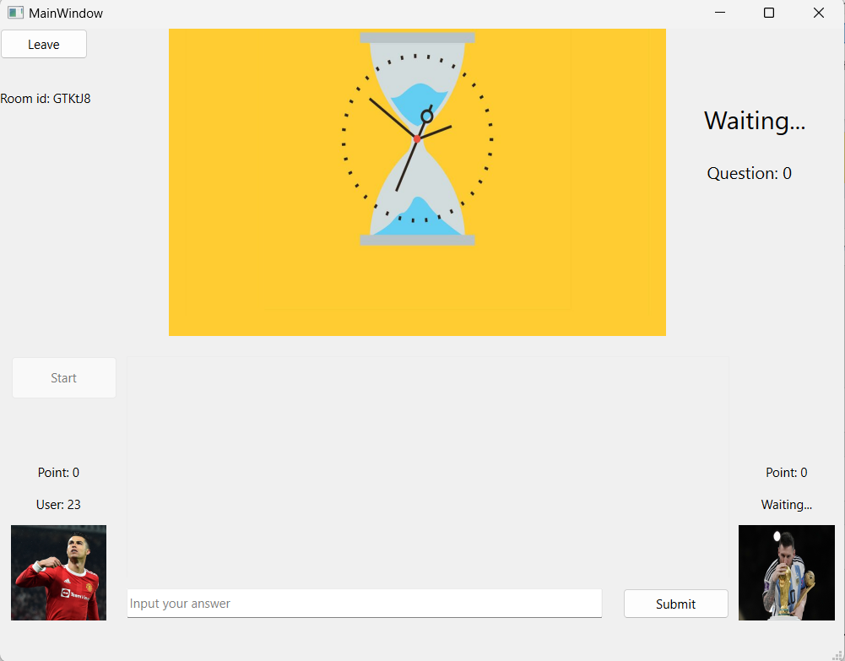
Playing game
After create room, owner room will wait for opponent. Only after opponent join, owner can click start then new question will show up and clock will run

Slide 30
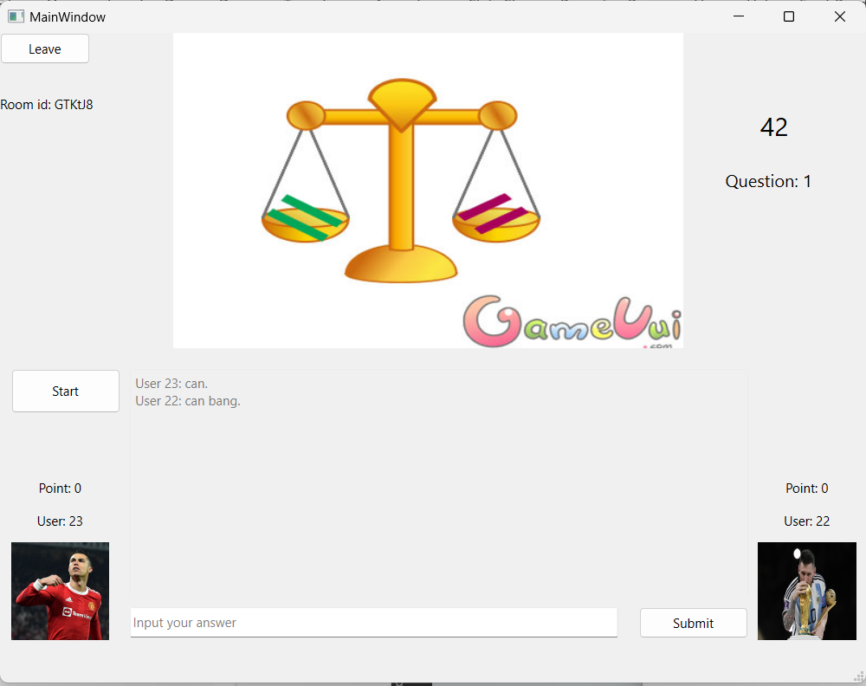
Playing game
After user joining room, the game starts and each user try to answer correct, who answer correct will get point and next question will show up and clock will run again

Slide 31
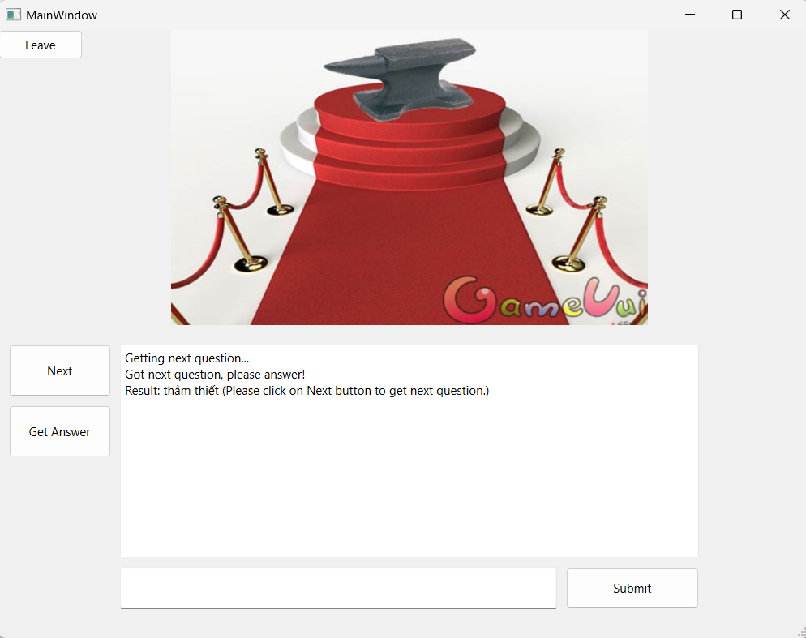
Play with computer
When users want to train, they can play with computer. It also has question and hint for users can play

Slide 32
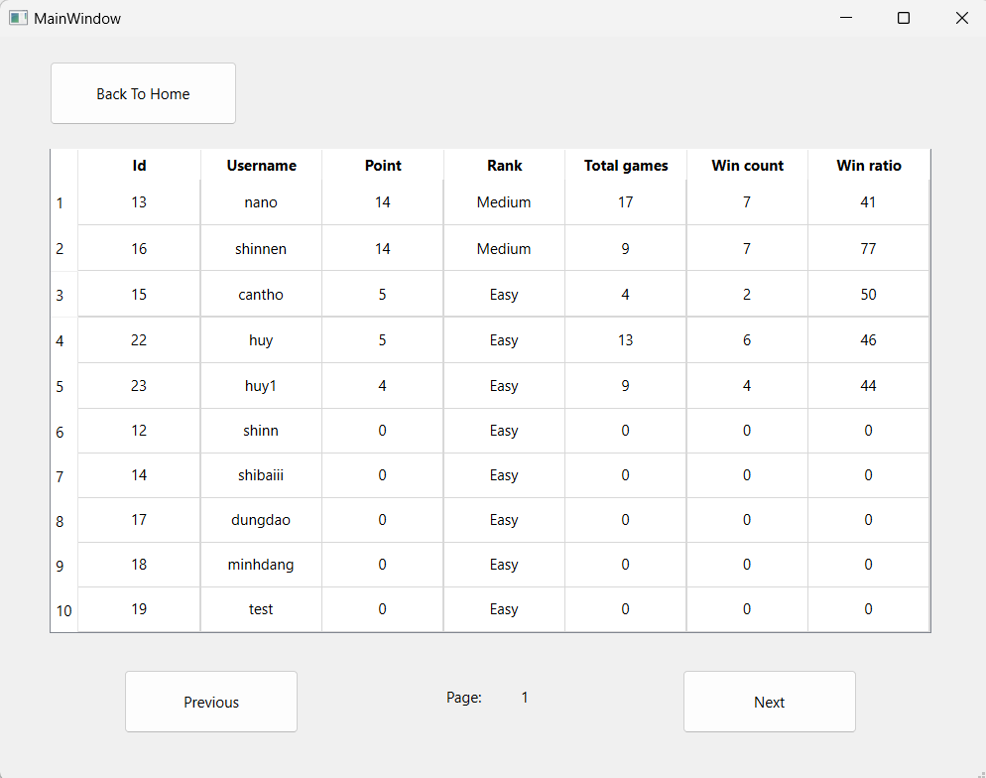
Rank
After click rank from main room, user can see all users rank

Slide 33
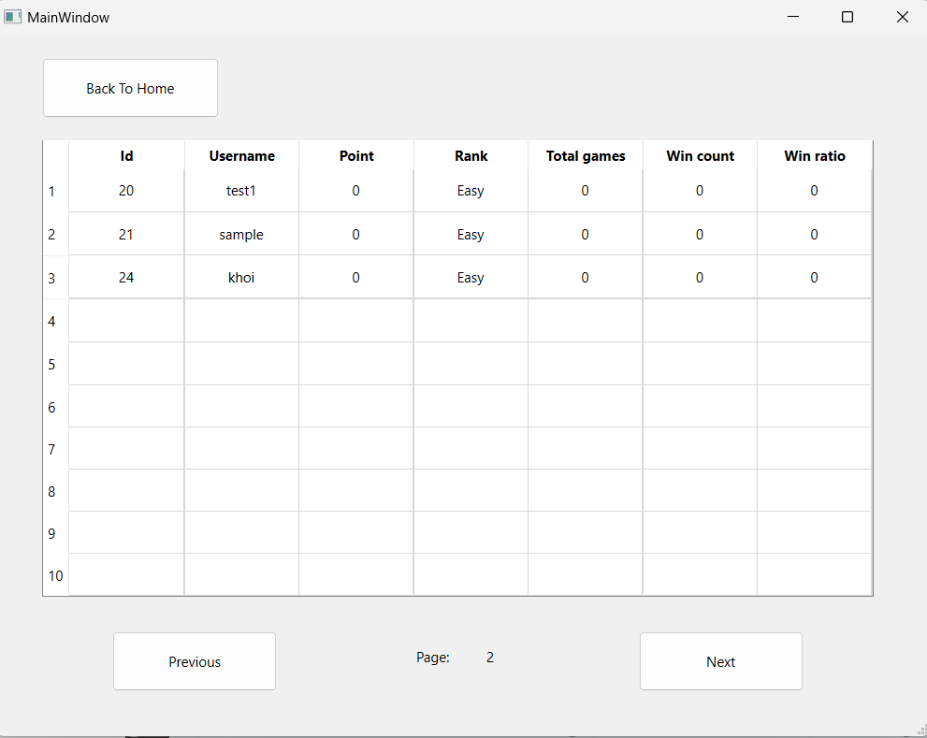
Rank
After click rank from main room, user can see all users rank

Slide 34
6. SUMMARY

Slide 35
Summary
Learning new technology
- After we’ve done this project, we learn more about Qt framework and C++ language
Building a game
- We know how to build a game and the result after building it is similar as we expected
Teamwork and time management
- We learn how to cooporate with each member and control our time more reasonably

Slide 36
THANK YOU!
DO YOU HAVE ANY QUESTIONS?

