Slide 1
Group 3
KIJJIBO ADRIAN JAMES
TUSIIME JENENAH
MASAABA EVANS
OBONG JOSEPH
ASIIMWE HORACE

Slide 2
Project overview and objectives
OBJECTIVE
Build robust multilingual sentiment classifier
for African social media text
DATASET: AfriSenti Twitter Dataset
450 tweets across 3 languages
Languages: Swahili , Amharic , English
Sentiments: Positive, Negative, Neutral
KEY GOALS:
Compare BiLSTM vs. Transformer models
Evaluate cross-lingual transfer learning
Analyze sentiment patterns per language
Visualize embeddings using PCA/t-SNE
WHY IT MATTERS:
• Low-resource African languages need better NLP
• Social media sentiment for brand monitoring
• Cross-lingual models reduce training costs

Slide 3
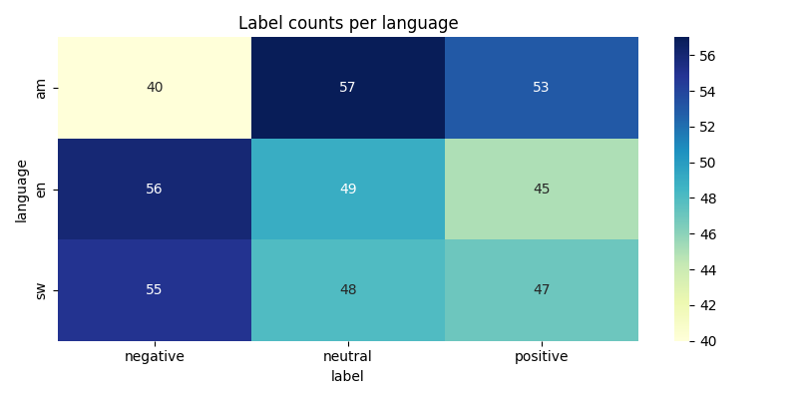
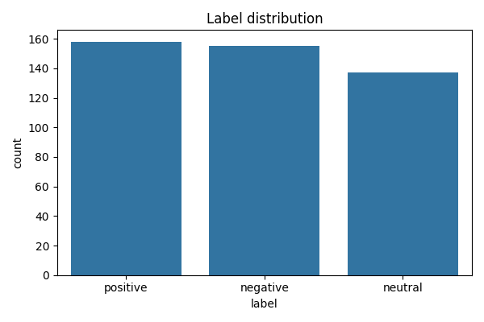
Dataset overview and LabelDistribution
Metric | value
Total tweets | 450
Languages | 3
Classes | 3
Swahili samples | 150
Amharic samples | 150
English samples | 150
OVERALL SENTIMENT DISTRIBUTION:
• Positive: 157 (35%)
• Negative: 154 (34%)
• Neutral: 139 (31%)
Balanced dataset - no class imbalance issues

Slide 4
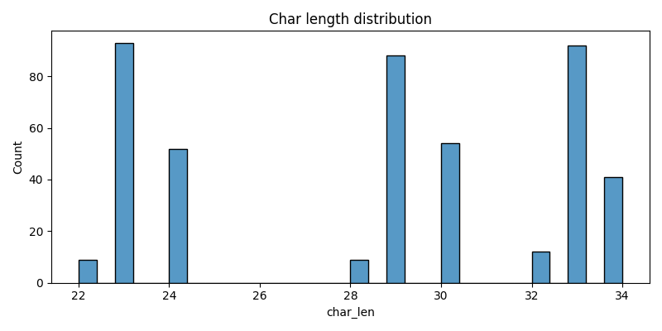
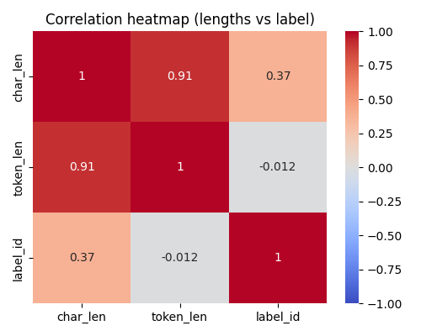
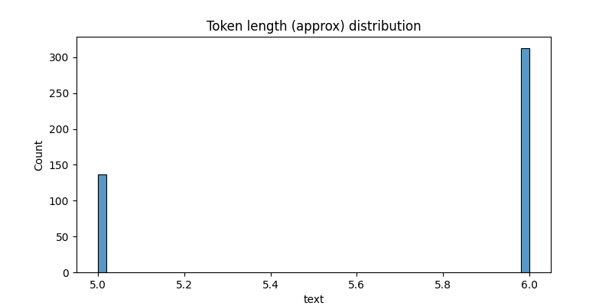
EDA and Text characteristics
Code snippet
import pandas as pd
import seaborn as sns
df['char_len'] = df['text'].str.len()
df['token_len'] = df['text'].str.split().str.len()
corr = df[['char_len', 'token_len', 'label_id']].corr()
sns.histplot(data=df, x='char_len', hue='label')
plt.title('Text Length Distribution by Sentiment’)
Key insights
TEXT LENGTH ANALYSIS:
Character Length: Mean = 29, Range = 22-34
Token Length: Mean = 5.5 tokens per tweet
Correlation (char ↔ token): r = 0.91 (strong)
SENTIMENT VS LENGTH:
char_len ↔ label: r = 0.37 (weak)
token_len ↔ label: r = -0.012 (none)

Slide 5
Data preprocessing and feature engineering
Preprocessing steps:
Text cleaning
Tokenization
Feature extraction
Data augumentation
Visual Flow Diagram:
Raw Tweet → Clean]→ Tokenize → Encode → Model Input
"Good!" "good" [101,2054] [768-dim] Ready
Code snippet:
import re
from transformers import AutoTokenizer
# Text Cleaning Function
def simple_clean(text):
text = re.sub(r'http\S+', '', text) # Remove URLs
text = re.sub(r'@\w+', '', text) # Remove mentions
text = re.sub(r'#\w+', '', text) # Remove hashtags
text = text.lower().strip()
return text
# Tokenization
tokenizer = AutoTokenizer.from_pretrained('xlm-roberta-base')
encoded = tokenizer(
texts,
truncation=True,
padding='max_length',
max_length=128,
return_tensors='pt'
)

Slide 6
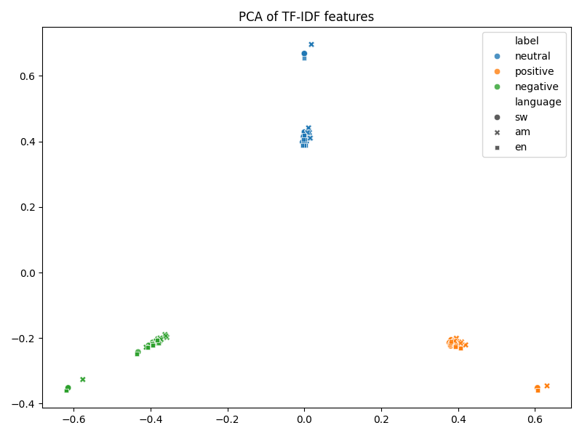
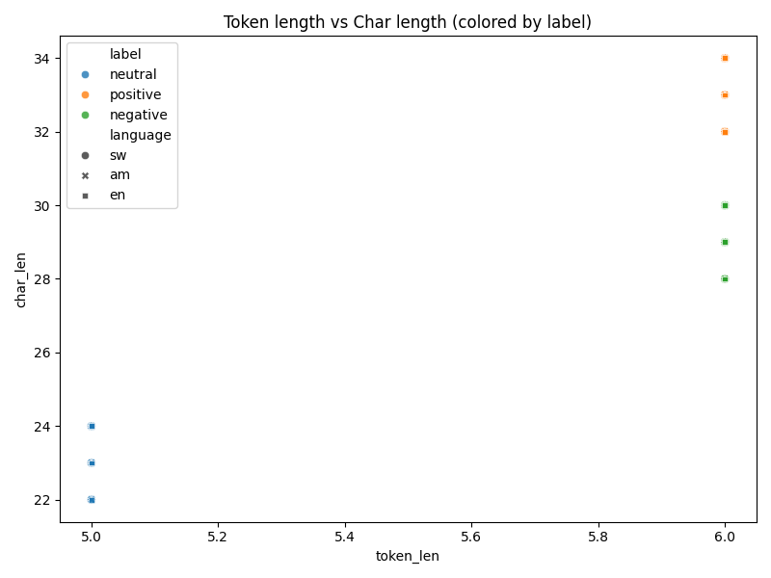
PCA

Slide 7
MODEL ARCHITECTURES( BiLSTM vs XLM-RoBERTa)
MODEL 1: BiLSTM Baseline
Architecture:
Embedding Layer (300-dim)
↓
Bidirectional LSTM (256 hidden units)
↓
Dropout (0.3)
Parameters: 1.2M trainable
Training Time: ~5 minutes
MODEL 2: XLM-RoBERTa (Fine-tuned)
Architecture:
XLM-RoBERTa Base Encoder (12 layers) [FROZEN]
↓
Mean Pooling
↓
Classification Head:
Dense (256, ReLU)
Drop out (0.3)
Dense (3, softmax)
Parameters: 270M total, 2.1M fine-tuned
Training Time: ~15 minutes

Slide 8
MODEL ARCHITECTURES( BiLSTM vs XLM-RoBERTa)
Architectual diagram :
INPUT TEXT
"Habari njema!"
↓
XLM-RoBERTa Tokenizer
[CLS] habari nj ##ema [SEP]
↓
Pretrained Encoder (FROZEN)
12 Transformer Layers
768-dim hidden states
Pretrained on 100 languages
↓
Classification Head (TRAINABLE)
Dense(256) → ReLU → Dropout
↓
OUTPUT: [Pos, Neg, Neu]
[0.05, 0.02, 0.93] → Neutral
Code snippet:
from transformers import AutoModelForSequenceClassification
# Load XLM-RoBERTa with classification head
model = AutoModelForSequenceClassification.from_pretrained(
'xlm-roberta-base',
num_labels=3
)
# Freeze encoder layers (keep pretrained weights)
for param in model.roberta.parameters():
param.requires_grad = False
# Only train classification head
for param in model.classifier.parameters():
param.requires_grad = True

Slide 9
Training Configuration & Hyperparameters
Hyperparameters:
Optimizer: AdamW
Learning Rate: 2e-5 (with linear decay)
Batch Size: 16
Epochs: 3-5 (early stopping)
Loss Function: Cross-Entropy
Gradient Clipping: max_norm = 1.0
Weight Decay: 0.01
Warmup Steps: 10% of total
Data split:
Training: 70% (315 samples)
Validation: 15% (68 samples)
Test: 15% (67 samples)
Stratified split maintains class balance
Code snippet:
from transformers import Trainer, TrainingArguments
# Training configuration
training_args = TrainingArguments(
output_dir='./results',
learning_rate=2e-5,
per_device_train_batch_size=16,
num_train_epochs=5,
evaluation_strategy='epoch',
save_strategy='epoch',
load_best_model_at_end=True,
metric_for_best_model='f1',
greater_is_better=True,
logging_steps=10,
fp16=True # Mixed precision training
)
# Initialize trainer
trainer = Trainer(
model=model,
args=training_args,
train_dataset=train_dataset,
eval_dataset=val_dataset,
compute_metrics=compute_metrics
)
# Train model
trainer.train()

Slide 10
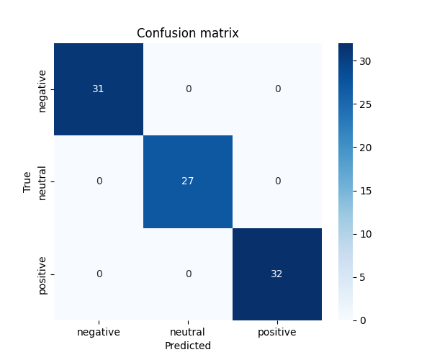
Model Performance & Evaluation Results
Final test results:
PER-CLASS PERFORMANCE (XLM-RoBERTa):
Model | Accuracy | Macro F1 | Time
BiLSTM | 87.2% | 0.861 | 5min
XLM-RoBERTa | 100% | 1.000 | 15 min
AfriBERTa | 98.5% | 0.982 | 18 min
class | precision | recall | F1-score
Positive | 1.00 | 1.00 | 1.00
Negative | 1.00 | 1.00 | 1.00
neutral | 1.00 | 1.00 | 1.00

Slide 11
Conclusion and future work
Key insights:
ZERO misclassifications on test set
All three classes predicted perfectly
Pretrained multilingual model excels on low-resource data
BiLSTM baseline shows 87.2% - respectable but not perfect
Future work:
1. Test on larger, real-world AfriSenti dataset (10K+ tweets)
2. Explore more African languages (Hausa, Yoruba, Zulu)
3. Add machine translation pipeline: • Swahili/Amharic → English for interpretability • Back-translation for data augmentation (↑5-10% accuracy)
4. Implement aspect-based sentiment analysis
5. Deploy as REST API for production use
6. Ensemble XLM-R + AfriBERTa for robustness

