Slide 1
Version Control System
“Let me send you my project in zip file.”

Slide 2
Why we need version control system?
Loss of data
Cooperation with others
Go back and forth in time

Slide 3
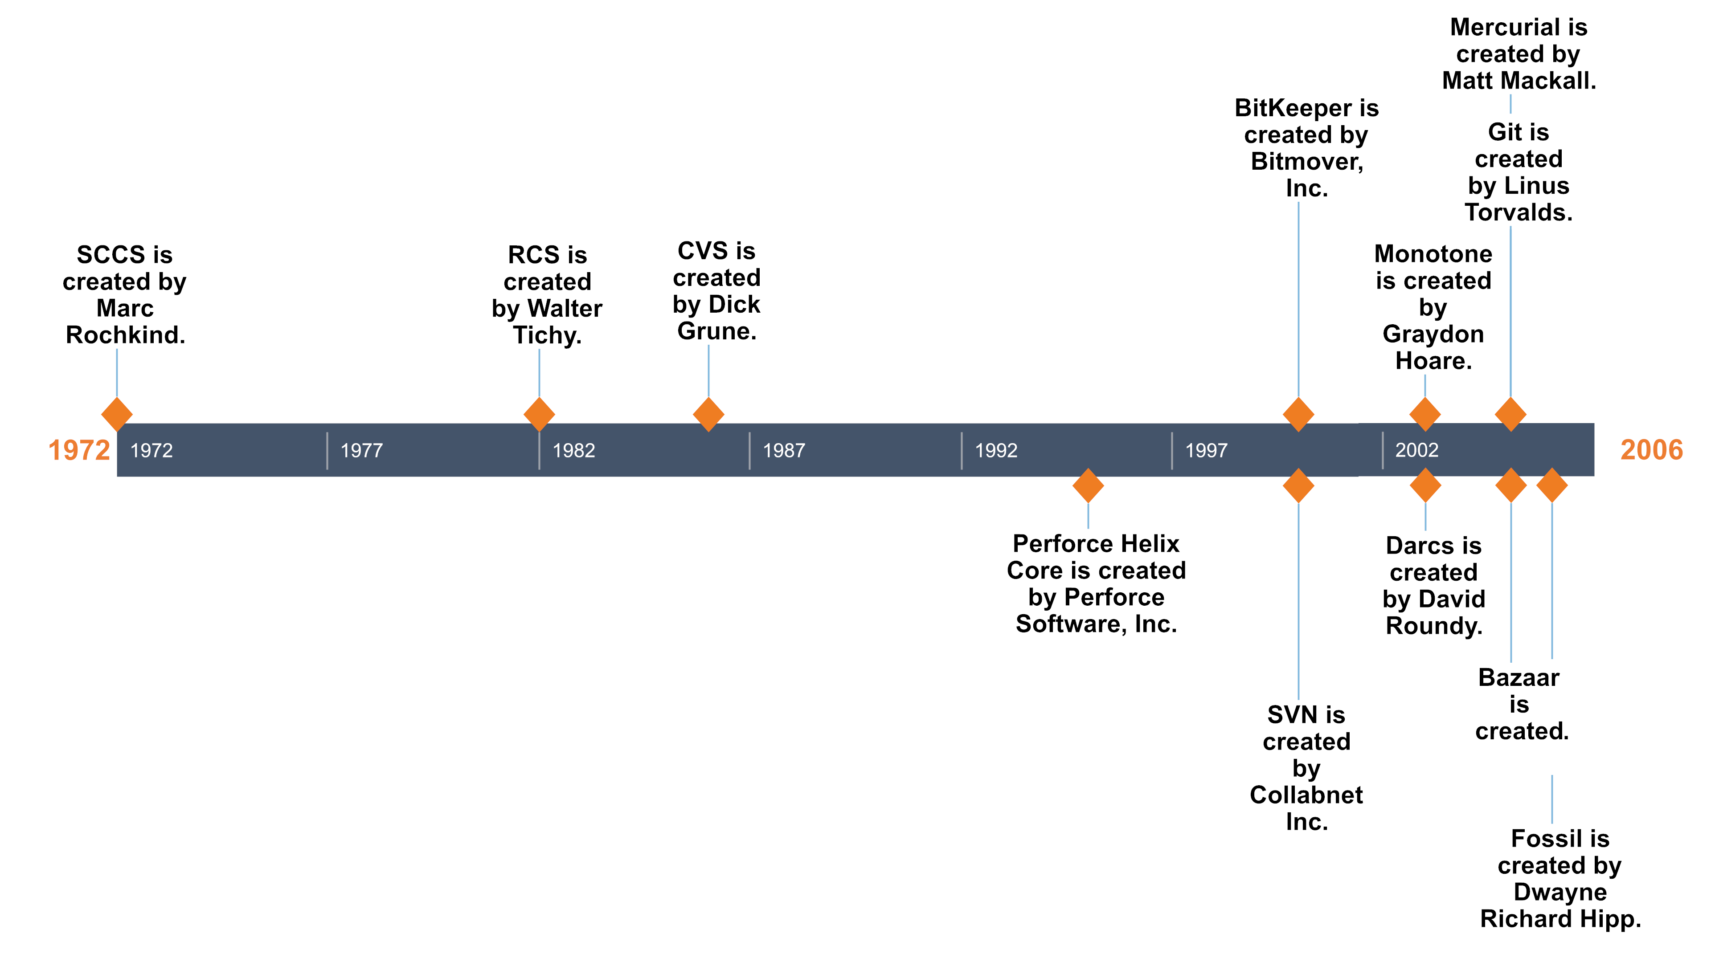
Version control system history
Notes:
https://initialcommit.com/blog/Technical-Guide-VCS-Internals
https://www.red-gate.com/blog/database-devops/history-of-version-control

Slide 4
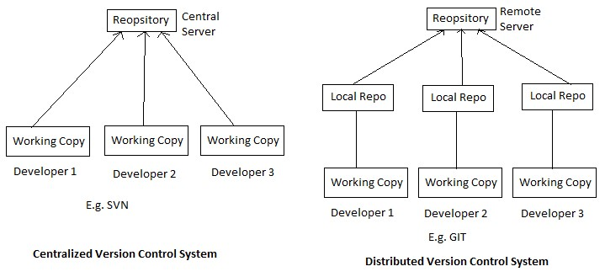
Type of version control system
Notes:
https://www.ecanarys.com/Blogs/ArticleID/400/Subversion-Centralized-Version-Control-System

Slide 5
Distributed vs centralized VCS
PROS
CONS
CVCS is easy to learn and easy to set up
DVCS allows you to work offline and gives flexibility
DVCS is faster
Working on branches is easy in DVCS
DVCS can take more time and space
DVCS has the backup or entire history of the code
DVCS might be confusing initially
CVCS is not flexible when working offline
CVCS is slower
CVCS it’s difficult and time-consuming to work on branches
CVCS you just need to get few lines of code
CVCS has not the backup or entire history of the code
Notes:
https://www.geeksforgeeks.org/centralized-vs-distributed-version-control-which-one-should-we-choose/
-You have the entire history of the code in your own hard drive, so all the changes you will be making in your own server or to your own repository which doesn’t require an internet connection, but this is not in the case of CVCS
-Every developer has an entire history of the code in DVCS
-CVCS branching is difficult, because it requires to communicate with the server directly
-CVCS you just need to get few lines of code because you don’t need to save the entire history or complete project in your own server so there is no requirement for additional space

Slide 6
Git vs Github
Git is a free and opensource distributed version control system lets you manage and keep track of your source code history.
GitHub is a cloud-based hosting service that lets you manage Git repositories.
Notes:
https://blog.devmountain.com/git-vs-github-whats-the-difference/

Slide 7
Git Basics
git init – Initializes a git repository on your local file system. Creates .git file.
Git states (git status)
Modified
Staged
Commited
Notes:
https://medium.com/@d3vild06/getting-started-with-version-control-part-i-d7b768079676

Slide 8
Git Basics
Working directory
Staging area
Local repository
Remote repository
git add
git commit
git push
git pull
Notes:
https://medium.com/@d3vild06/getting-started-with-version-control-part-i-d7b768079676

Slide 9
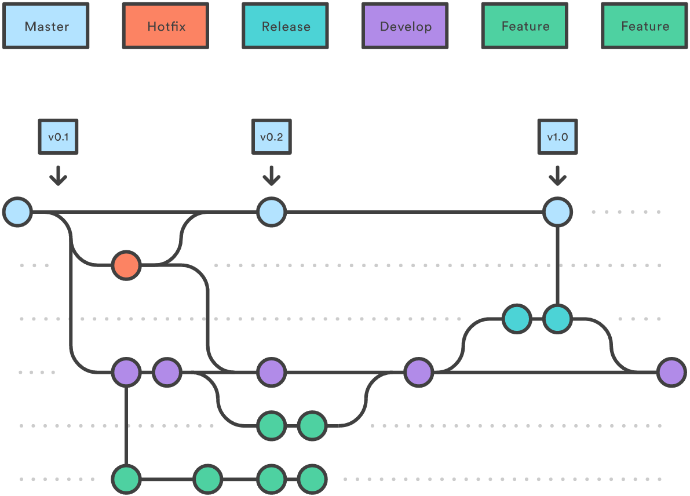
Git Advanced
Working with Git and GitHub
Create remote GitHub Repository
Pushing Up Local Repository
git config
git remote add
git push
Working with Branches: git branch
Reverting your changes: git revert HEAD
Merging you changes: git merge
Collaborating: pull request
Notes:
https://medium.com/@d3vild06/getting-started-with-version-control-part-ii-169d400c7440
https://medium.com/@d3vild06/getting-started-with-version-control-part-iii-a70d93161ba4
https://gitbetter.substack.com/p/how-to-work-in-multiple-git-branches

Slide 10
Homework
Create GitHub profile and setup git. Send GitHub profile to me and join organization.
Install Visual Studio and connect git to it.
Hello world project with favorite programming language.
Create changes in local repository then push to remote repository.
Create changes in remote repository then pull to local repository.
Use git 5 days in a row (15-30 min everyday small changesets).
Sources -> Mr. Internet:
https://www.youtube.com/playlist?list=PL6gx4Cwl9DGAKWClAD_iKpNC0bGHxGhcx
https://docs.github.com/en/get-started/quickstart/set-up-git
https://learngitbranching.js.org/
https://www.udemy.com/course/git-started-with-github/
https://www.udemy.com/course/the-ultimate-git-5-day-challenge/

