Slide 1
Ancestra
An AI agent leads an orthology research project in 48 hours
AI hackathon · Beltrao lab, ETH Zurich · [date to be added]
Slides generated by the PI agent (Claude Opus 5.5). Results are agent-generated and not yet verified by a human.
Notes:
Title. This deck documents the orthology project of the AI hackathon. Everything after the title page, including these slides, was produced by the agent.

Slide 2
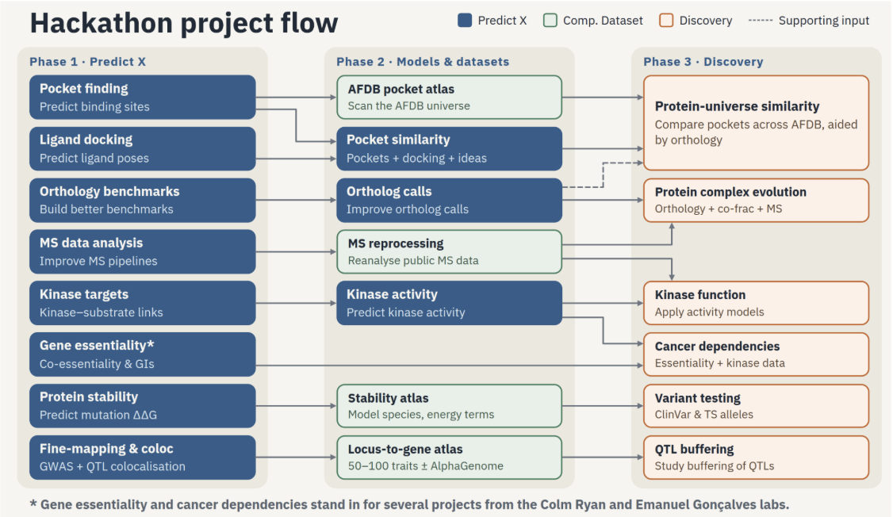
The hackathon: can AI agents run bioinformatics projects?
Organisers
Beltrao (ETH Zurich), Ryan (UCD), Gonçalves (IST), Dessimoz (UNIL) labs
Projects
12 projects, each led by Claude Opus 5.5 with Opus/Sonnet subagents
Rule
AI builds, benchmarks and documents; humans only verify
Dates · people
[to be added]
Code
Project flow shared by the organisers. This project: orthology. Its output feeds phase 3 (protein-universe similarity, complex evolution).
github.com/evocellnet/ai-hackathon
Notes:
Information from the hackathon repository README and the project-flow figure. Dates, participant list and the final hackathon link are left blank on purpose: the agent has no access to them.

Slide 3
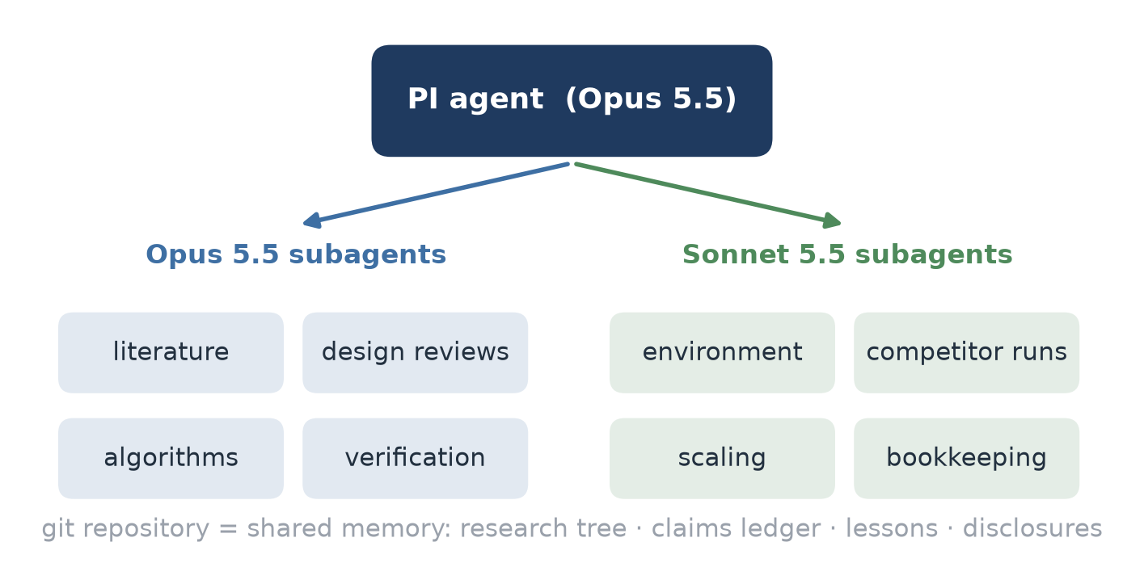
One PI agent, many subagents, one repository
48 h
budget, checked against START.txt at every milestone
24 → 48
CPUs; an A100 GPU was added after 19.5 h
7
human instructions after the first prompt
Notes:
The PI agent never wrote method code itself. It split the work, launched subagents in the background (often several at once), reviewed their reports and committed decisions to git. Opus subagents: literature, design, algorithms, verification. Sonnet subagents: environment, competitor and scaling runs, bookkeeping, reference checks. Human instructions: Foldcomp databases, include an OMA resource in every comparison, pause and move to a GPU node, resume, soft deadline plus README header, write the report, second round of data layers.

Slide 4
The prompt: half research protocol, half orthology task
“Obtain a new orthology prediction method that is conceptually different from the state of the art, with comparable if not better accuracy and/or compute time.”
General: any AI-led project
Specific: orthology
PI role: delegate, review, decide
Sub-tasks, each with its own benchmark
Conceptually different method
Dozens → thousands of proteomes
Literature + design critiqued by agents
Reproducible: seeds, DATA.md, no metric changes
Hierarchical groups in OrthoXML
Alternatives to one species tree
Results checked by a different agent
Research tree + lessons file
Extra data: structure, synteny, omics, isoforms, DNA
Benchmarks: QfO, OrthoBench, SwissTree
48 h budget with milestones
Journal-style REPORT
Separate benchmark repository
Consider GPU speed-ups
Notes:
The full prompt is in PROMPT.md (verbatim). Left: rules that would apply to any agent-led project and could be reused by the other hackathon projects. Right: what is specific to orthology.

Slide 5
48 hours at a glance
Start
Core works
Freeze v1
QfO final
Layers round 2
Deadline
prompt + START.txt
OrthoBench dev
two presets
then GPU node
5 agents in parallel
soft
Design v2
QfO peek 1
Test scored
Report
1,000 proteomes
8 agent reviews
recall too low
OrthoBench, once
writing starts
scaling done
Build and tune on development data
After the freeze: evaluation, GPU, layers, scaling
Notes:
Times are hours on the budget clock (the one-hour pause to move nodes is excluded). Freeze at T+15.4 h. Everything after the freeze is evaluation or post-freeze exploration on development data only. An API session limit at T+11.7 h stopped four agents; their background jobs survived.

Slide 6
How the method was chosen
Literature, agent critique, cost estimates and pre-registered rules

Slide 7
From idea to frozen method
Literature
Design v0
Design v2
Dev tuning
SYNERGY, Hieranoid, OMA/FastOMA, OrthoFinder
merge whole ancestral proteomes up the tree
families first, merge inside each family
OrthoBench, 34 reference groups
✗ only ~2.5× cheaper than all-vs-all (reviewer's cost estimate)
QfO peek 1
Fixes
Freeze v1
Test, once
recall too low: 78% of misses are merge failures
small FastTree trees + deep-node rule
accurate + fast presets
OrthoBench + QfO
Dropped after review: “novel” parts that SYNERGY, InParanoid/Hieranoid and OrthoFinder/SHOOT already had.
Notes:
v0 was rejected before any code was written: a reviewer agent estimated 2.0e11 pairs vs 4.9e11 for all-vs-all on QfO, because ancestral proteomes stay large and 60% of deep ancestral genes have no partner. v2 puts all proteins into families first and never searches ancestral genes again; their scores are aggregated from member proteins (as in SYNERGY). QfO peek 1 exposed low recall; a dev-only diagnosis found 78% of missed TreeFam-A pairs were merge failures at the pair's last common ancestor.

Slide 8
Four rules steered every decision
1
Pre-registration
2
Dev / test split
Hypothesis, arms and keep rule written before results
OrthoBench split by homology: 34 dev, 36 test groups
3
Shuffled controls
4
Independent checks
Every data layer vs a shuffled copy (seeds 11, 23, 47)
Another agent recomputes each result before it is used
83
claims in the evidence ledger
19
deviations disclosed
Test sets were scored once, after the freeze. Keep rule: lower 95% CI of the gain above 0, beating the shuffled control, no guard metric worse.
Notes:
The non-inferiority margin was -0.03 (3 F points on OrthoBench). Paired bootstrap B=2000, seed 11. Verification found real errors, for example omitted pre-registered comparators and a preset mismatch in the scaling claims.

Slide 9
The method: Ancestra
Rebuild the genes of every ancestor, one tree level at a time, inside protein families

Slide 10
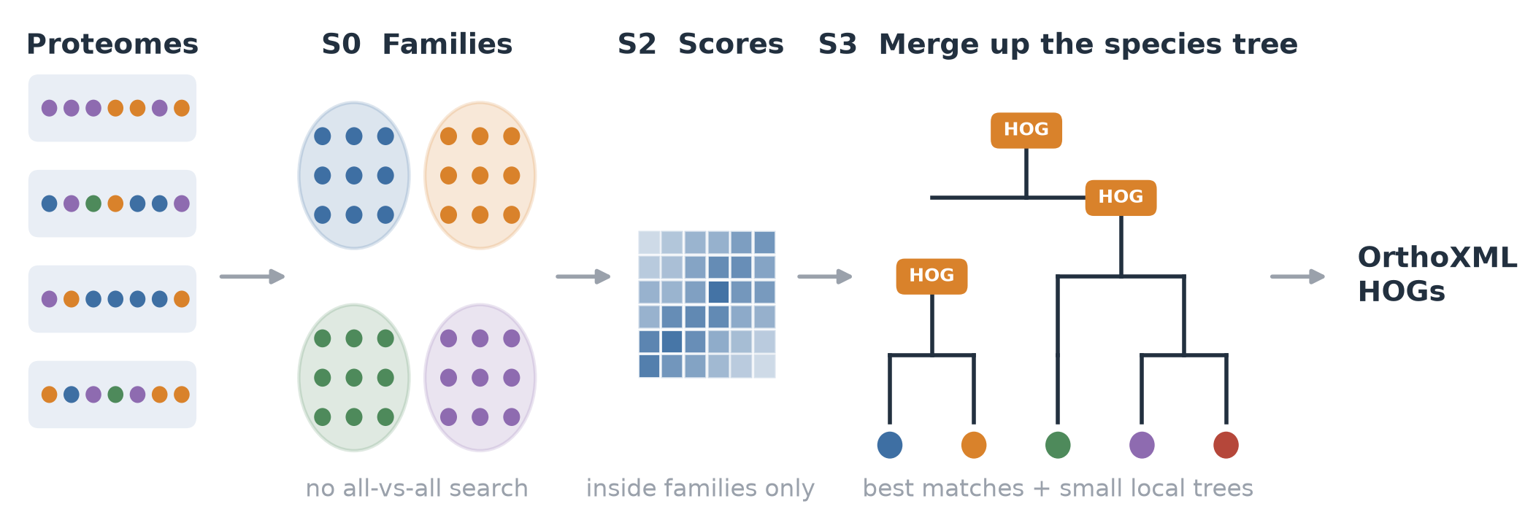
Ancestra in three steps
No reference database
Ancestral genes never searched again
Every tree level gives HOGs
Optional: gene order, 3Di
Notes:
S0: DIAMOND clustering at 30% identity, all genes vs cluster representatives, connected components, Leiden split of components above 7,500 genes. S2: DIAMOND inside families plus MMseqs2 re-alignment of missed pairs. S3: walk the NCBI taxonomy bottom-up; at each node merge child ancestral genes by mutual best matches, absorb in-paralogs, and resolve ambiguous clusters with a small FastTree (accurate) or NJ (fast) tree labelled by species overlap. Scores of an ancestral gene are aggregated from its member proteins.

Slide 11
Same goal as FastOMA, a different route
 | Ancestra | FastOMA | OrthoFinder | SonicParanoid2
Reference database needed | ✗ | OMA (OMAmer) | ✗ | ✗
All-vs-all search | ✗ | ✗ | ✓ | ✓ (reduced)
HOGs level by level up the species tree | ✓ | ✓ | from gene trees | ✗
Families found first | de novo | placed in reference | orthogroups | ✗
Gene trees | small, ambiguous cases | per HOG and level | every orthogroup | ✗
Gene order used | optional | ✗ | ✗ | ✗
Ideas credited: bottom-up merging with synteny (SYNERGY) · in-paralog absorption (InParanoid, Hieranoid) · HOGs per level (OMA, FastOMA) · representatives (OrthoFinder/SHOOT)
Notes:
Commonality with FastOMA: both build hierarchical orthologous groups level by level along a species tree, family by family. Differences: FastOMA places proteins into a precomputed OMA reference with OMAmer; Ancestra finds families de novo and uses score rules with small local trees only where candidates are ambiguous. SonicParanoid2 reduces its all-vs-all searches with machine learning but remains pairwise.

Slide 12
Results
OrthoBench, Quest for Orthologs 2022 and scaling to 1,000 proteomes

Slide 13
OrthoBench: highest F, lead not significant
+6.5 F
vs OrthoFinder, 95% CI [−6.5, +18.1]: non-inferiority not shown
+15.7 F
vs OMA HOGs [+1.8, +29.2], significant
3.9 vs 8.2
CPU-hours, Ancestra vs OrthoFinder
* OMA contains all 12 benchmark species
Notes:
Official Open OrthoBench scoring, test half only (36 reference orthogroups split by homology component), scored once after the freeze. Paired bootstrap over groups. With 36 groups the standard error of the difference is 5-6 F points. FastOMA was patched for a gene-dropping bug; F did not change (33.5 to 33.1).

Slide 14
QfO 2022: precise, but recall stays below the best methods
−0.16
TreeFam-A recall vs OrthoFinder
≈ OMA
recall on par with FastOMA and OMA
Misses sit at deep nodes: 34% Bilateria, 21% Eukaryota, 13% Opisthokonta, where an outgroup is missing or distant.
Notes:
Full official QfO 2022 suite run locally (78 species, 988,778 proteins). Local scoring reproduced 60 of 60 published TPR/PPV values. Competitor rows are the published OpenEBench submissions. Ancestra also has the worst G-STD2 Eukaryota species-tree discordance of the main comparators.

Slide 15
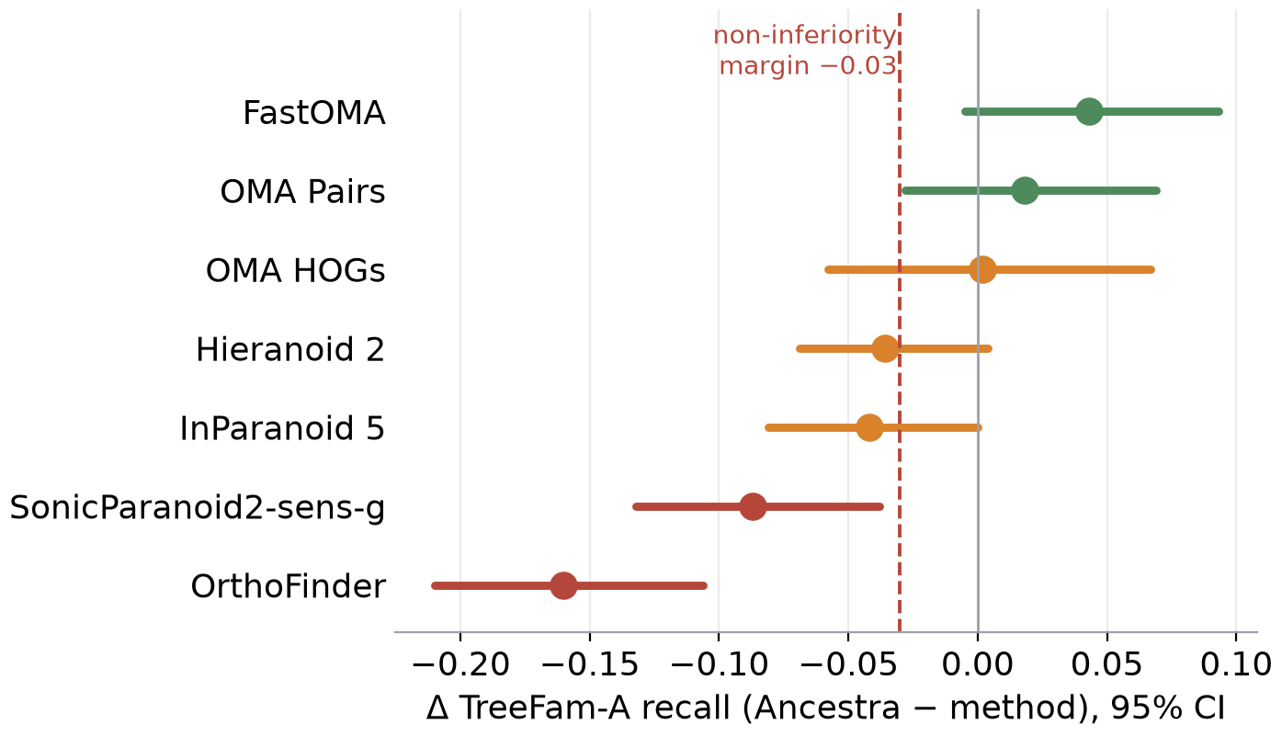
QfO test: non-inferior only to FastOMA and OMA Pairs
non-inferior
FastOMA, OMA Pairs
not shown
OMA HOGs, Hieranoid 2
fails
InParanoid 5, SonicParanoid2, OrthoFinder
Margin −0.03 recall, family bootstrap over 749 test families.
Notes:
Ancestra accurate minus each method, TreeFam-A test recall, 95% CI. Five primary comparators were pre-registered (OrthoFinder, FastOMA, Hieranoid 2, InParanoid 5, SonicParanoid2-sens-g); the OMA resources were added after the human instruction to include an OMA resource in every comparison.

Slide 16
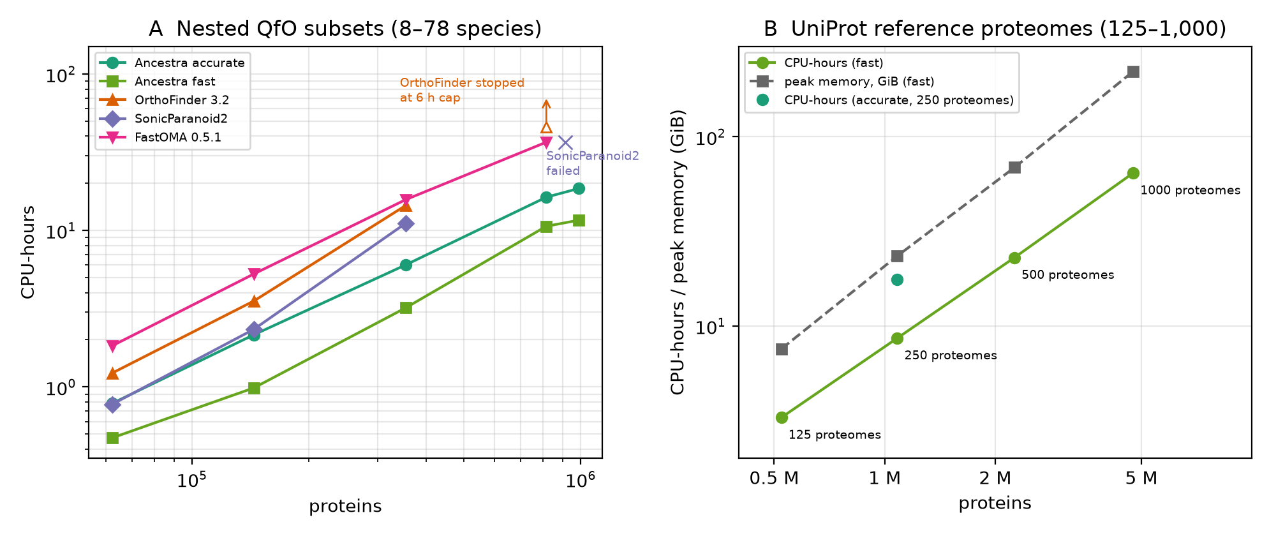
Scaling: 1,000 proteomes on one server node
10.6 h
wall time, 1,000 proteomes (4.75 M proteins)
221 GiB
peak memory, the likely first limit
16 vs 37
Cost is superlinear (CPU exponent 1.16 accurate on QfO; 1.35 fast at 0.5–4.75 M proteins). The family graph step grows about quadratically: the next thing to fix.
CPU-h at 64 species: Ancestra vs FastOMA
Notes:
OrthoFinder at 64 species was stopped at the 6 h cap (more than 45.9 CPU-h); SonicParanoid2 failed at 64 species with an internal error. Single runs on shared nodes; the QfO series spans two nodes. No competitor was run on the 1,000-proteome set and accuracy cannot be measured there; all outputs passed OrthoXML validation.

Slide 17
Take-home messages
76.2
−0.16
1,000
0 / 13
OrthoBench F (OrthoFinder 69.7); lead not significant
QfO recall vs OrthoFinder: deep nodes are the weak spot
proteomes in 10.6 h; memory, not time, limits next
extra data layers improved held-out results
Building HOGs ancestor by ancestor inside families is viable and cheap, but it does not yet beat the best methods on distant orthologs.

Slide 18
Extra data layers
13 layers in two rounds, each against a shuffled control

Slide 19
Where each layer entered the pipeline
Input
S0 families
S2 scores
S3 merge
Quality control
Isoforms
3D structure rescue
GPU alignment
Gene order
Species tree
Genomic DNA
pLM neighbours
Domains
Expression
Synteny repair
Networks
Abundance
Protein LMs
Introns
kept / useful
option, no held-out gain
rejected
Notes:
Round 1 (before the freeze): gene order, 3D structure, expression, isoforms, genomic DNA. Round 2 (after the freeze, development data only): networks, abundance, domain architecture, protein language models including a model trained on our own synteny labels, intron positions, synteny-driven fission repair, expression revisited, structure rescue at full coverage. The species tree and GPU slides are not data layers but were explicit asks of the prompt.

Slide 20
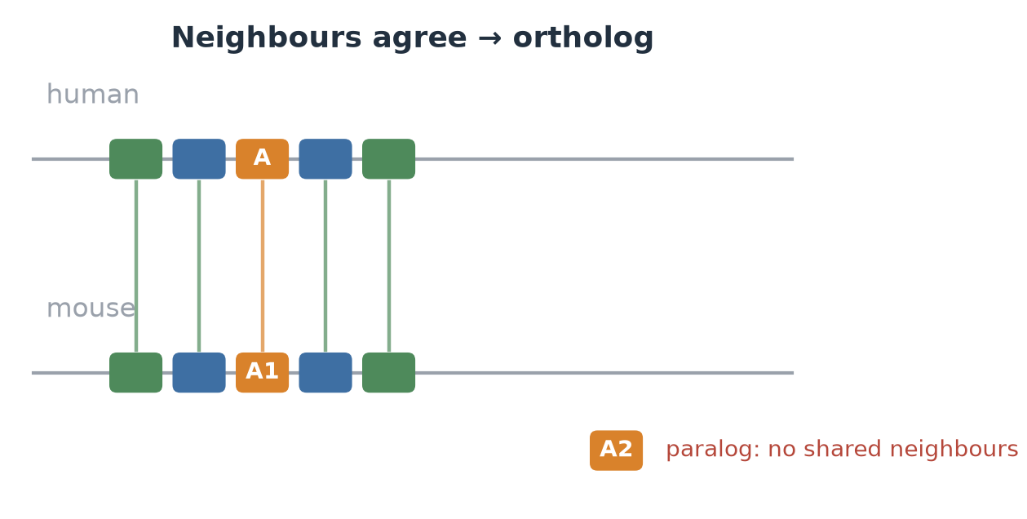
Gene order (synteny)
✓ Pros
Strong alone: AUC 0.92 human–mouse (shuffled 0.50)
Hard cases +0.16 on development data
Repair rule cut fission candidates by 29–40%
✗ Cons
No signal at deep splits (human–fly 0.49)
Sequence already solves the same cases
Test: −0.1 F and −0.012 recall when removed
Rounds 1 + 2
Neighbouring genes stay together; the true ortholog shares them.
Kept as an option (default on); no measurable held-out gain
Notes:
Gene order may only re-rank partners inside the group the sequence-only pass chose (constrained mode); an unconstrained bonus cost 4-8 recall points. Round 2 tried gated synteny repair of fission errors: fission candidates fell from 706 to 426-499 with no change under shuffled order, but only 7 executed joins touched a labelled pair (5 correct), so its accuracy is unmeasured.

Slide 21
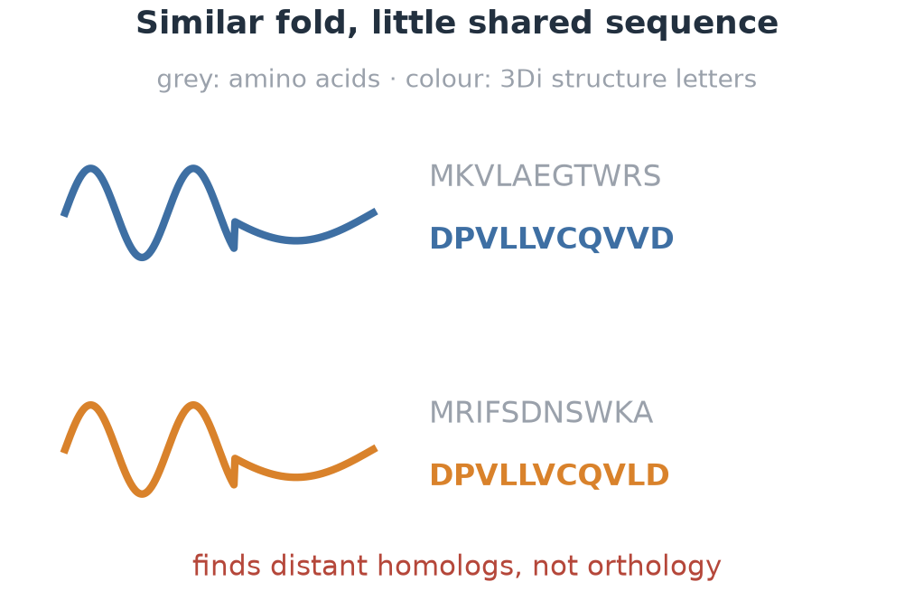
3D structure (3Di)
✓ Pros
Family completeness 0.794 → 0.853, above the sequence ceiling
ProstT5 on GPU: 40–60× faster than CPU
✗ Cons
Paralogs share folds: no orthology signal
OrthoBench test precision 69.5 → 60.1
Full 3Di coverage added nothing more
Rounds 1 + 2
AlphaFold structures written as 3Di letters (Foldseek); ProstT5 fills gaps on the GPU.
Option, off by default
Notes:
3Di was tested in family building (rescue of fragments missed by sequence) and in merge scoring (deep AUC 0.694 vs 0.751 for sequence, rejected). Coverage: 94.5% of QfO proteins from AlphaFold DB/Foldcomp.

Slide 22
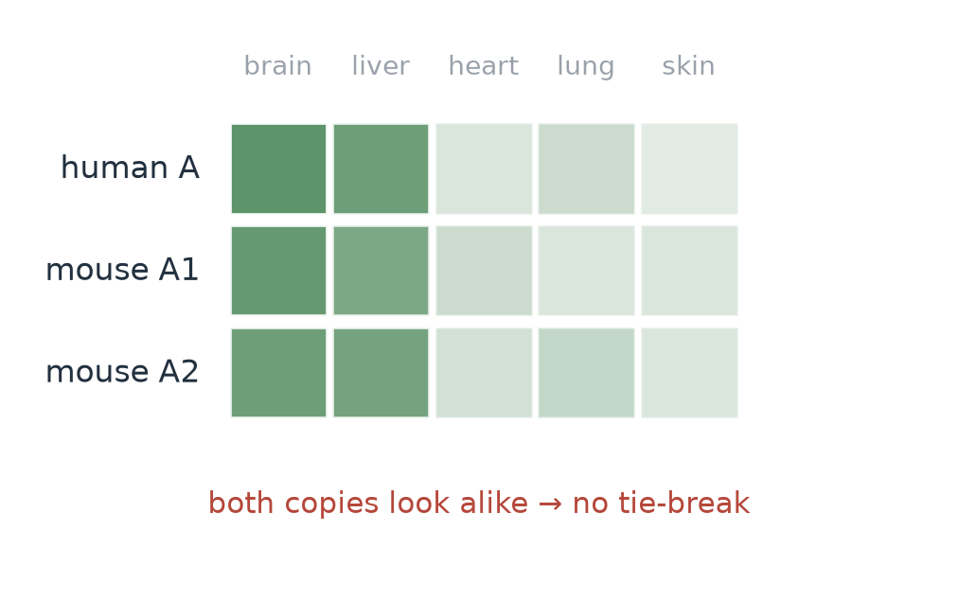
Expression
✓ Pros
Some signal overall (AUC 0.667)
Open data (CC0)
✗ Cons
Hard cases −0.019 [−0.20, +0.15]
Specificity (τ) tie-break: −0.076
Only 10 of 12 benchmark species covered
Rounds 1 + 2
Tissue expression of each gene copy (Bgee v15.2).
Rejected by the pre-registered rule

Slide 23
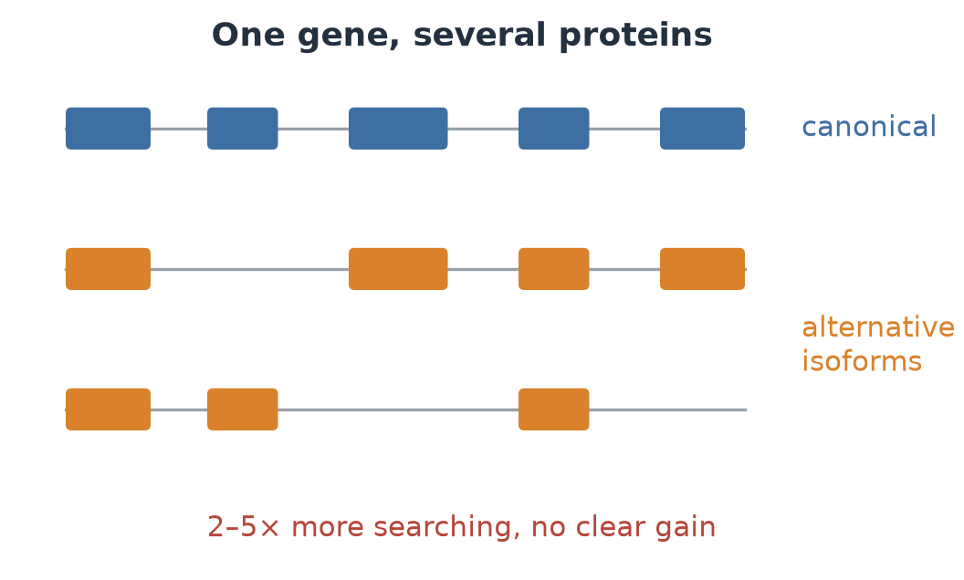
Isoforms
✓ Pros
Could pair orthologous isoforms
Data in every Ensembl release
✗ Cons
Hard cases +0.013 [−0.018, +0.044]
2–5× more search time
Round 1
Search all splice isoforms, not one protein per gene.
Rejected

Slide 24
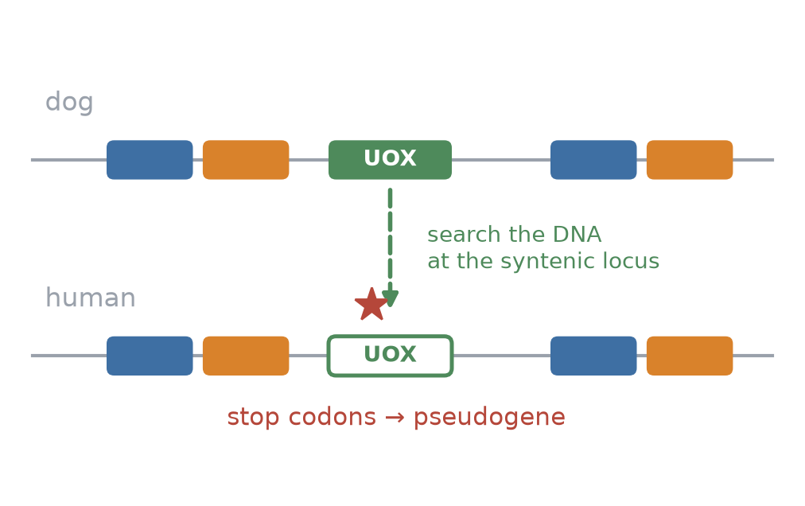
Genomic DNA: are lost genes really lost?
✓ Pros
92% of planted controls found, 0 / 512 false hits
53% of 2,523 apparent mammal losses were not real
Exposed our own fission errors (32%)
✗ Cons
Needs genomes and annotation
Validates results, does not infer them
Round 1
Search the genome at the syntenic locus for each apparent loss (miniprot).
Kept as a quality-control add-on
Notes:
25% were confirmed pseudogenes or deletions, for example the UOX pseudogene in human; GULO was confirmed by a separate clade-level search.

Slide 25
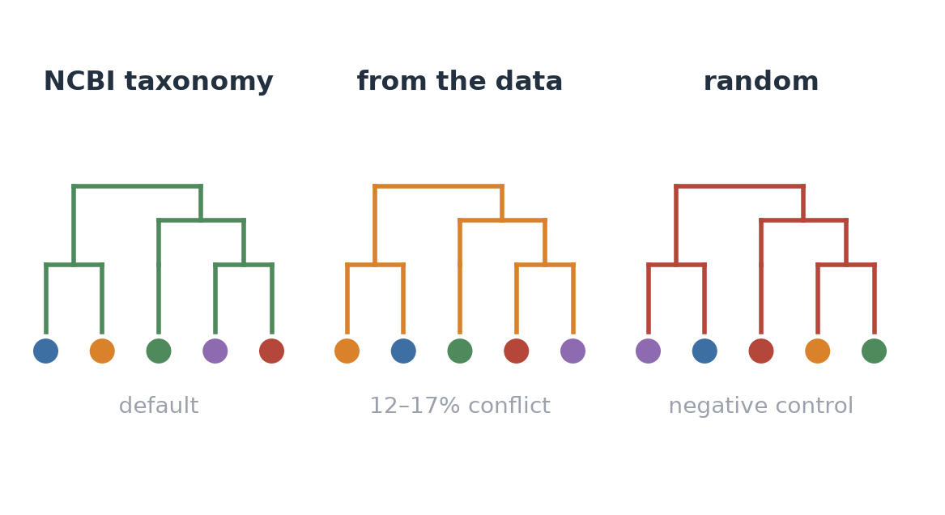
Species tree: one tree for all families?
✓ Pros
A random tree costs 16.4 F: the tree does real work
Small local gene trees correct it per family
✗ Cons
Data-derived trees: +0.02–0.03 recall (n.s.), EC −0.12
Long-branch errors, 25–30% conflict in bacteria
Round 1
The guide tree decides the order of merges.
NCBI taxonomy + per-family local trees
Notes:
Two further policies were planned but not run: delaying merges at uncertain nodes, and per-family guide trees.

Slide 26
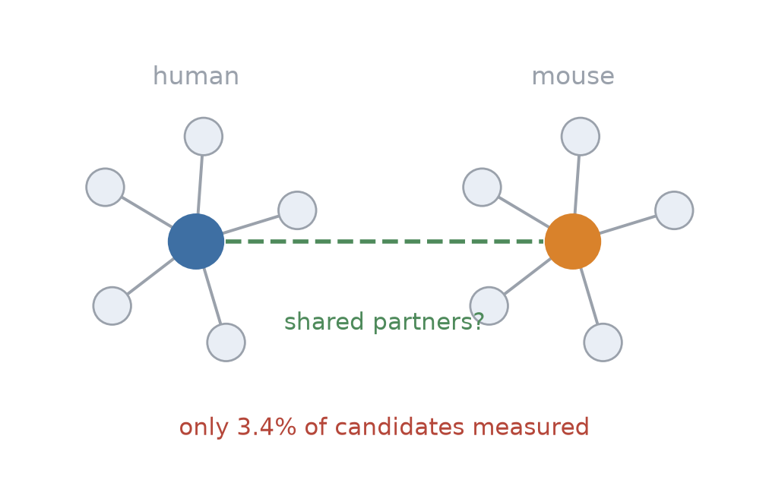
Interaction networks and co-fractionation
✓ Pros
Some signal over all pairs (AUC 0.63)
Cheap: 0.4 CPU-hours
✗ Cons
Covers 3.4% of candidates
Hard cases at chance (AUC 0.50)
Rescued pairs were orthologs only 48–54% of the time
Round 2
STRING v12 (own-species evidence only) and hu.MAP 3.0 complexes.
Fails the first gate, mainly on coverage
Notes:
Per-species co-fractionation data (Wan et al. 2015, McWhite et al. 2020) could not be obtained quickly and were not used; hu.MAP 3.0 is human only.

Slide 27
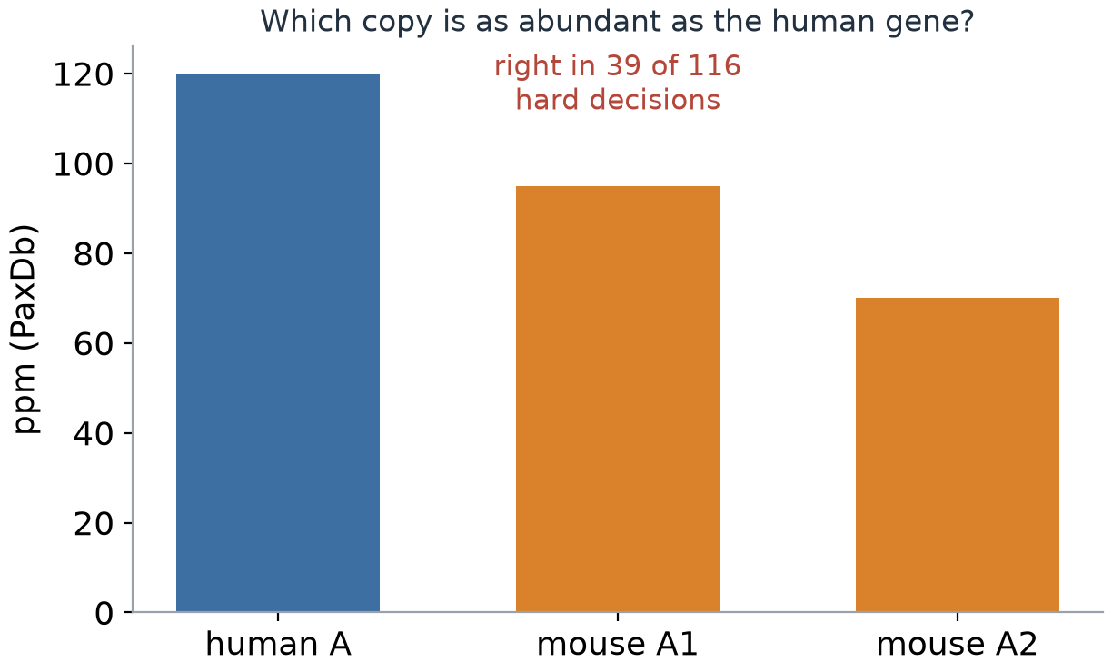
Protein abundance
✓ Pros
AUC 0.68 over all pairs, 0.69 on hard pairs
✗ Cons
Right in only 39 of 116 hard decisions
As a re-ranker: −0.131
Round 2
Whole-organism protein abundance from PaxDb 5.0.
Fails the first gate

Slide 28
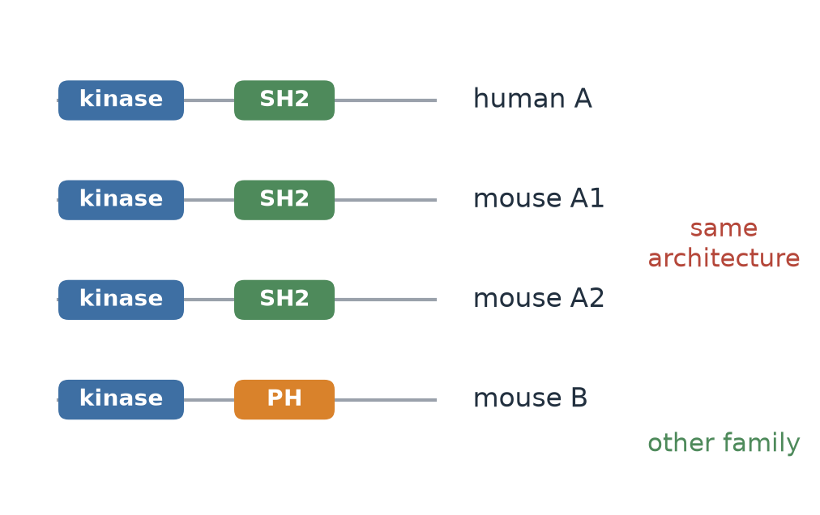
Domain architecture
✓ Pros
Separates different groups (AUC 0.98)
Best gate: TreeFam-A F1 +0.018 [+0.003, +0.034]
✗ Cons
Inside a group no better than shuffled (0.54)
OrthoBench −2.9 OG-F, precision −0.025
48 CPU-hours of annotation
Round 2
Pfam-A 38.2 domains and clans (TED/CATH not needed: Pfam covered >96%).
Fails the guard metrics

Slide 29
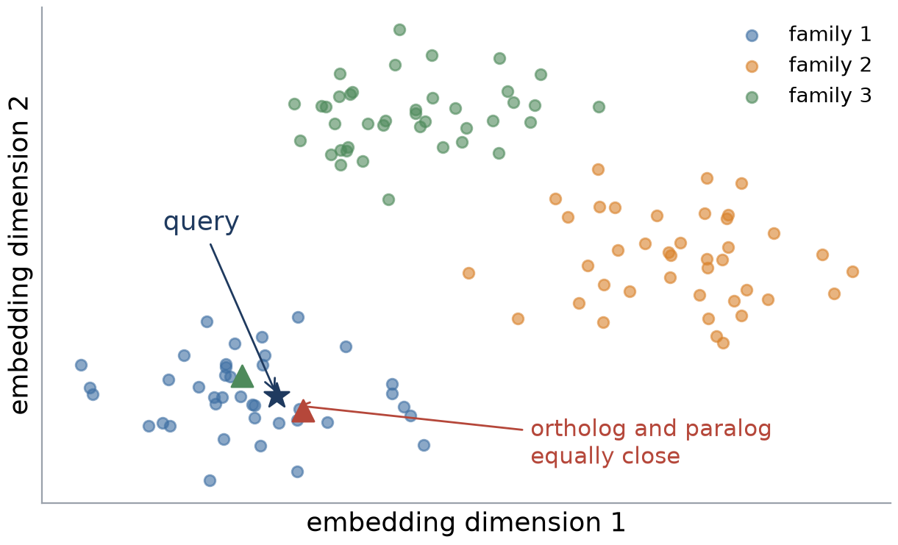
Protein language models
✓ Pros
Above shuffled on all triplets (+0.23–0.33)
Own head: +0.040 on all triplets
Cheap on GPU: 3 GPU-hours
✗ Cons
Below sequence (deep 0.61–0.72 vs 0.757)
Fails where sequence fails; hard −0.007
Neighbour rescue chained 229k of 251k genes
Round 2
ESM-2 (35M–3B), ProtT5, and a head trained on our own synteny pairs.
Fails the first gate
Notes:
ProtT5 licence was unclear on the model hub; it was used locally only and no weights or embeddings were committed.

Slide 30
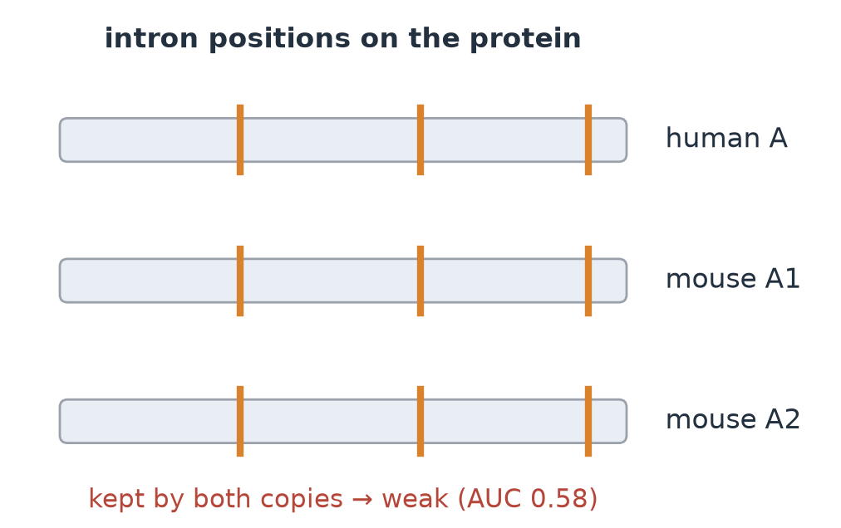
Intron positions
✓ Pros
Some signal (AUC 0.578)
Free with any genome annotation
✗ Cons
Below sequence (0.654)
Tie-break −0.071 [−0.149, +0.007]
Round 2
Shared intron positions and phases from Ensembl gene models.
Not integrated (a logged judgement call)

Slide 31
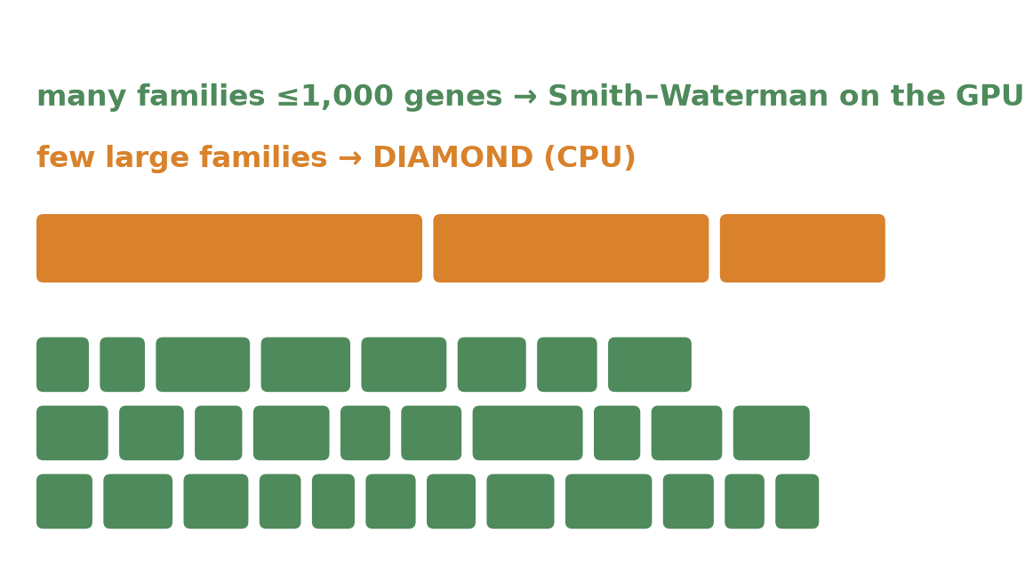
GPU acceleration
✓ Pros
Own CUDA Smith–Waterman: 600–640 GCUPS
1.18× faster end to end, same accuracy
ProstT5 3Di 40–60× faster
✗ Cons
All-GPU scoring changes the score graph: −5 to −8 OG-F
Local trees are not GPU-bound
MMseqs2-GPU slower at these sizes
Post-freeze
An A100 GPU arrived after 19.5 h; all options are opt-in on branch v2-gpu.
Safe GPU option kept; faster variants not equivalent
Notes:
78-85% of DIAMOND time goes to a few families above 1,000 genes. A rank-ratio sparsified all-GPU variant needed about 15x fewer CPU-hours on QfO with similar TreeFam-A dev accuracy, but lost 8.4 OrthoBench dev OG-F. A 1% jitter of CPU scores alone cost 3-7 OG-F, showing how sensitive the small benchmark is.

Slide 32
Informative alone is not useful together
Layer | Signal, all pairs | Signal, hard cases | Inside the pipeline | Verdict
Gene order | strong | shallow only | no test gain | option, on
3D structure | strong | none | loss of precision | option, off
Expression | weak | none | not run | rejected
Isoforms | — | none | not run | rejected
Genomic DNA | — | — | finds errors | QC add-on
Networks | weak | none | not run | fails
Abundance | weak | weak | not run | fails
Domains | strong | weak | loss of precision | fails
Protein LMs | strong | none | not run | fails
Introns | weak | weak | not run | fails
Most layers tell orthologs from paralogs in general.
Few help in the hard cases, the near-equal paralogs where sequence fails.
That is where a layer must add something new.

Slide 33
Decision making
How a layer earned its place, and what to reuse next time

Slide 34
Every layer went through the same funnel
Pre-register · hypothesis, arms, keep rule
Signal alone · AUC vs shuffled control
Hard cases · near-equal paralogs
Inside the pipeline (dev) · lower CI > 0, guards hold
Held-out test, once · separate agent
13 layers entered · 3 helped on development data (gene order, structure rescue, domain gate) · 0 improved held-out results
Notes:
Gene order and the structure rescue reached the held-out test before the freeze; neither replicated. In round 2 no layer passed the keep rule, so nothing reached test. The domain gate passed its own metric but failed the guard metrics.

Slide 35
Decisions here, and how to carry them forward
In this project
Next time
1
Pre-registered keep rule + guard metrics
1
Build a hard-case benchmark first
2
Dev set small: ±2–4 F is noise
2
Same funnel, run by parallel agents
3
Test scored once, after the freeze
3
Fresh, unseen benchmark for version 2
4
Every decision and reason in the research tree
4
Share the protocol with other projects
Notes:
The protocol file docs/L2_protocol.md is general: worktrees per agent, flags default off, data rules, pre-registration, two-step test, resources and deadlines. Five agents ran eight layers in about 14 hours with it.

Slide 36
AI-led research: what worked and what did not
Worked
Did not
~30 approaches tried and dropped, all documented
Tuning pressure on a small dev set
✓
✗
Parallel agents: 5 layers explored overnight
Dev gains that did not replicate on test
✓
✗
Independent checks caught real errors
Overstated claims needed correction
✓
✗
Full record in git: tree, claims, deviations
No human verification yet
✓
✗
Examples of caught errors: omitted pre-registered comparators, too-narrow intervals, a preset mismatch in the scaling claims.
Notes:
Other friction: an API session limit stopped all agents at T+11.7 h (jobs survived); two QfO runs were lost to script edits during a run; the project was paused once to move to a GPU node.

Slide 37
Conclusion
Outcome
AI-led research
Next
A working HOG method in 48 h: strong on OrthoBench, below the best on QfO recall, runs on 1,000 proteomes.
Agents ran the whole cycle, from literature to report, with 7 human instructions. Verification by other agents was essential.
Outgroup tests at deep nodes · linear family step and streamed scores · hard-case benchmark · human verification · reuse in phase 3.
Full record: REPORT.md · technical_report/ · minimal repository with code and predictions

