Slide 1
From many origins to single events
An AI-run study of the genomic transitions to multicellularity
AI hackathon · [dates: ____] · two rounds, about 31 hours of agent work
Notes:
Title. This deck documents the whole experiment: the hackathon context, the prompts, how the AI team decided on the method, the method itself, the results, every hypothesis considered, and what the experience says about AI-led research. The agent was Claude Opus 5.5 acting as principal investigator (PI) and delegating to Opus 5.5 / Sonnet 5.5 subagents. Round 1 took about 13.6 h, round 2 about 17.4 h (about 31 h in total). The date field is left blank on purpose. Source: report/REPORT.md (version note), RESEARCH_TREE.md.

Slide 2






A week-long test of agentic bioinformatics
Human writes a 'predict X' prompt
Beltrao lab
ETH Zürich
Colm Ryan lab
UCD
Claude Opus 5.5 leads as PI
Emanuel Gonçalves lab
IST
Christophe Dessimoz lab
UNIL
Delegates to Opus / Sonnet subagents
Builds, benchmarks, writes up
[dates: ____]
[__ participants] · 13 projects
Humans verify afterwards
Blanks to be filled by the organisers.
This project: own cluster, Singularity in /scratch · R1: 24 CPU, 150 GB · R2: 48 CPU, 500 GB, 1 A100
Notes:
The hackathon (github.com/evocellnet/ai-hackathon) was run by four labs to assess the bioinformatics capabilities of agentic AI. Each project gives Claude Opus 5.5 a 'predict X' problem; it delegates to Opus/Sonnet subagents, builds, benchmarks and writes up a method with minimal human intervention. Humans verify the methodology and benchmarking afterwards. Hackathon projects run on the ETH Euler cluster. Our project is a phase-2 project that ran on a different university cluster, inside a Singularity container in a /scratch folder: 24 CPUs and 150 GB in round 1; 48 CPUs, 500 GB and one A100 GPU in round 2. Blanks for the dates and number of participants are left for the organisers to fill. Source: hackathon README; PROMPT.md; PROMPT_ROUND2.md.

Slide 3
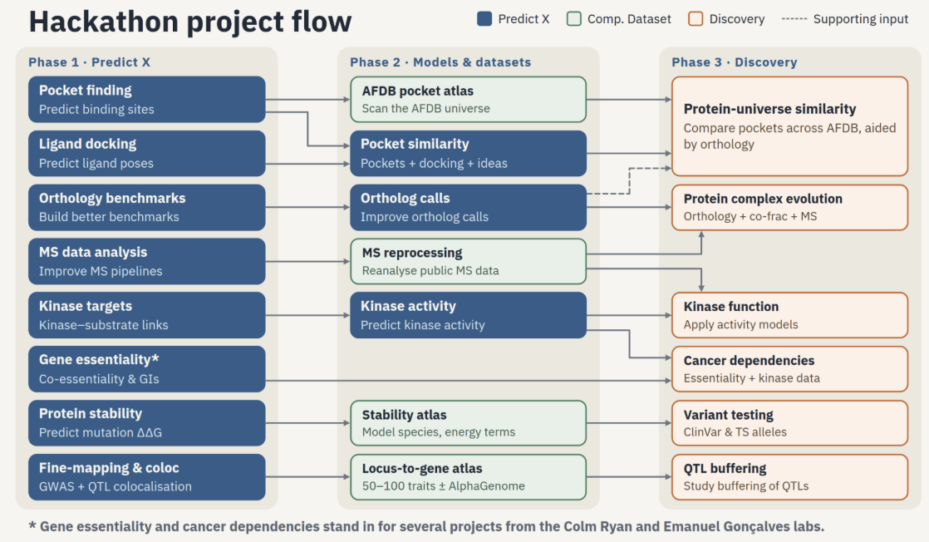
The hackathon in one picture
Image: hackathon organisers.
Notes:
The hackathon project flow, as provided by the organisers (image credit: hackathon organisers). Phase 1, Predict X: method projects such as pocket finding, ligand docking, orthology benchmarks, MS data analysis, kinase targets, gene essentiality, protein stability, fine-mapping and colocalisation. Phase 2, Models and datasets: each method is applied at scale (AFDB pocket atlas, pocket similarity, ortholog calls, MS reprocessing, kinase activity, stability atlas, locus-to-gene atlas). Phase 3, Discovery: projects that combine them (protein-universe similarity, protein complex evolution, kinase function, cancer dependencies, variant testing, QTL buffering). Source: report/slides/img/hackathon_project_flow.png (supplied by the organisers).

Slide 4

Where this project sits in the flow
Phase 1 · Predict X
Phase 2 · Models & datasets
Phase 3 · Discovery
Orthology benchmarks
built Ancestra
Ortholog calls
Ancestra at scale
uses Ancestra
[position in official flow: to be confirmed]
THIS PROJECT
phase2-multicellularity: ancestral gene content at origins of multicellularity
Protein complex evolution
orthology + co-frac + MS
no box of its own in the diagram
touches (Cox et al. LECA complexes)
Simplified from the organisers' flow diagram; only the boxes this project connects to are shown.
Notes:
Placing this project in the organisers' flow. It is a Phase-2 project (workspace phase2-multicellularity) built on the output of the Phase-1 orthology project: Orthology benchmarks produced Ancestra, which feeds the Phase-2 'Ortholog calls' step; this project applies Ancestra to reconstruct ancestral gene content at the origins of multicellularity. In round 2 it also touched the Phase-3 'Protein complex evolution' idea (orthology plus co-fractionation mass spectrometry), using the published LECA complex map of Cox et al. 2026. The project does not appear as its own box in the official diagram; its exact position is to be confirmed by the organisers. Source: report/slides/img/hackathon_project_flow.png; PROMPT.md; report/REPORT.md §9.

Slide 5













Thirteen projects, one shared recipe
Cancer essentiality
Cancer metabolic model
Co-complex from co-essentiality
CNV → trans-transcriptome
Pocket prediction (BURROW)
Ligand docking (ADock)
Pocket similarity
Kinase targets
Kinase activity
Protein stability (physDDG)
Coloc analysis
MS analysis
Orthology: Ancestra
This deck: phase-2 project
multicellularity with Ancestra
builds on
Same recipe for all: one prompt, Claude as PI, subagents, human verification after the fact.
Notes:
The 13 hackathon projects as listed in the hackathon README. Orthology prediction produced Ancestra, the tool this project builds on: our multicellularity study is a phase-2 project that uses Ancestra and its results (highlighted). Source: hackathon README (Projects list).

Slide 6

Every report opens with a human disclaimer
“
Generated by AI
minimal human intervention
This is an exercise in assessing the bioinformatics capabilities of agentic AI … All results in this project were generated entirely by AI with minimal human intervention.
Currently none of the results have been verified by a human.
Not a publication
an exercise in agentic science
Not yet verified
human checks pending
Shortened from the hackathon's human-written header.
Notes:
Each project repository and report starts with a human-written disclosure (quoted in shortened form). It says the work is an exercise in assessing agentic AI, that results were generated entirely by AI with minimal human intervention, that it is not a traditional publication, and that no result has yet been verified by a human. Our project-specific line: investigate multicellularity across the tree of life, executed by Claude Opus 5.5 with Opus/Sonnet subagents. Source: hackathon README (AI disclosure header); README.md; report/REPORT.md.

Slide 7
The initial prompt
B
What the human asked for, which parts are generic, and what changed in round 2
Notes:
Section B: the prompts. Source: PROMPT.md (round 1, about 1,470 words, saved verbatim), PROMPT_ROUND2.md (round 2).

Slide 8
Anatomy of the round-1 prompt
GENERAL · reusable
PROJECT-SPECIFIC
Role: PI agent who delegates
Kinds of multicellularity
Time budget + milestones
Hardware and sandbox
PROMPT.md
≈1,470 words
Ancestra: ancestral genomes
Literature + ≤3 design critiques
EukProt, LukProt, 'Eukaryoma'
Reproducibility rules
9 generic blocks
Research tree
5 science blocks
Menu of analyses
AI lessons file
Most of the prompt is a reusable research protocol; the science fits in one paragraph.
Reporting + writing standards
Selection-pressure question
Human disclaimer
Notes:
The round-1 prompt (PROMPT.md) splits cleanly into two kinds of instructions. GENERAL parts (teal) are a reusable recipe for any agent-run project: the agent is the PI and delegates; a time budget (48 h allocation) with milestones and START.txt; hardware and sandbox (24 CPUs, 150 GB, no GPU); literature review and design critique in at most three review rounds; reproducibility rules (never change metrics to look better, fixed seeds, DATA.md, verification by an agent that did not produce the result); a research tree with a status legend; a LESSONS file; reporting and writing standards; and the human disclaimer. PROJECT-SPECIFIC parts (orange) define the science: kinds of multicellularity (clonal, aggregative, facultative, grey zones), the use of Ancestra to reconstruct ancestral genomes before and after the transitions, datasets (reference proteomes, EukProt, LukProt and 'Eukaryoma'), a menu of analyses (gain, duplication, loss, enrichment, ancestral structure, domain expansion), and the question of detecting a shift in selection pressure in sequences or structures. Source: PROMPT.md.

Slide 9







Round 2: seven new scientific asks
New resources: 48 CPU · 500 GB · one A100 GPU · ~30 h — and a department-head review first
1
2
3
4
EukaryOMA
the database round 1 'could not find'
3D structure
ProstT5 structure letters on GPU
Simple → complex
not only origins of multicellularity
One run per event
dense sampling around each origin
5
6
7
Motifs, death, TFs
motif-binding, cell-death, cell-type TF genes
Specific Pfam families
domain architectures, functions
Protein complexes
co-fractionation map (Marcotte lab)
Head review
Fable agent reads all of it, published
Notes:
The round-2 prompt (PROMPT_ROUND2.md) added resources (48 CPUs, 500 GB, one A100 GPU, about 30 h soft deadline), asked for a department-head review (Fable agent) of round 1 to be published, and listed seven scientific points: (1) 'Eukaryoma' was a misunderstanding: it is EukaryOMA, a precomputed orthology database; (2) 3D structures: use Ancestra's structure mode, predicting structure letters with ProstT5 on the GPU; (3) the step from simple to complex multicellularity; (4) increased resolution: one Ancestra run per multicellularity event; (5) linear-motif binding domains, cell-death genes and cell-type transcription factors; (6) specific Pfam families and their domain architectures; (7) proteomics: protein complexes from the Marcotte co-fractionation study. Source: PROMPT_ROUND2.md.

Slide 10



An external review set the round-2 agenda
What was wrong
What was good
What to do next
7 heterogeneous origins averaged: 13–35% power
Validation overstated: deep-node controls 0 of 3
EukaryOMA wrongly 'not found'
Hashed pre-registration, calibrated null
Diagnosis of why controls failed
Lead: novelty at simple → complex
Cross-check with EukaryOMA
Dense per-event Ancestra runs
Simple → complex, specific families
Fable agent as department head · reviews/round2_department_head_review.txt · public page linked at the end
Notes:
Bridge between rounds. A department-head reviewer (Fable agent) read the round-1 report and research tree and wrote a one-page review, published at https://claude.ai/artifact/NfrexbqRBFmS3A97VvTqcR. Wrong or weak: averaging seven very different origins with 13-35% power at a 1.5-fold effect; overstated validation (deep-node positive controls failed 0 of 3); EukaryOMA wrongly declared not found. Good: hashed pre-registration, a calibrated null, simulated gain inflation, independent re-derivation, and the diagnosis of positive-control failures; two leads (simple-to-complex novelty, new domain architectures on the animal stem). Not evaluated: EukaryOMA cross-check, per-event dense runs, simple-to-complex step, specific Pfam families. Source: reviews/round2_department_head_review.txt; reviews/review_round1.html.

Slide 11
Overview
C
Two rounds, one AI team, about 31 hours
Notes:
Section C: timeline, team and key numbers. Source: RESEARCH_TREE.md; report/REPORT.md.

Slide 12
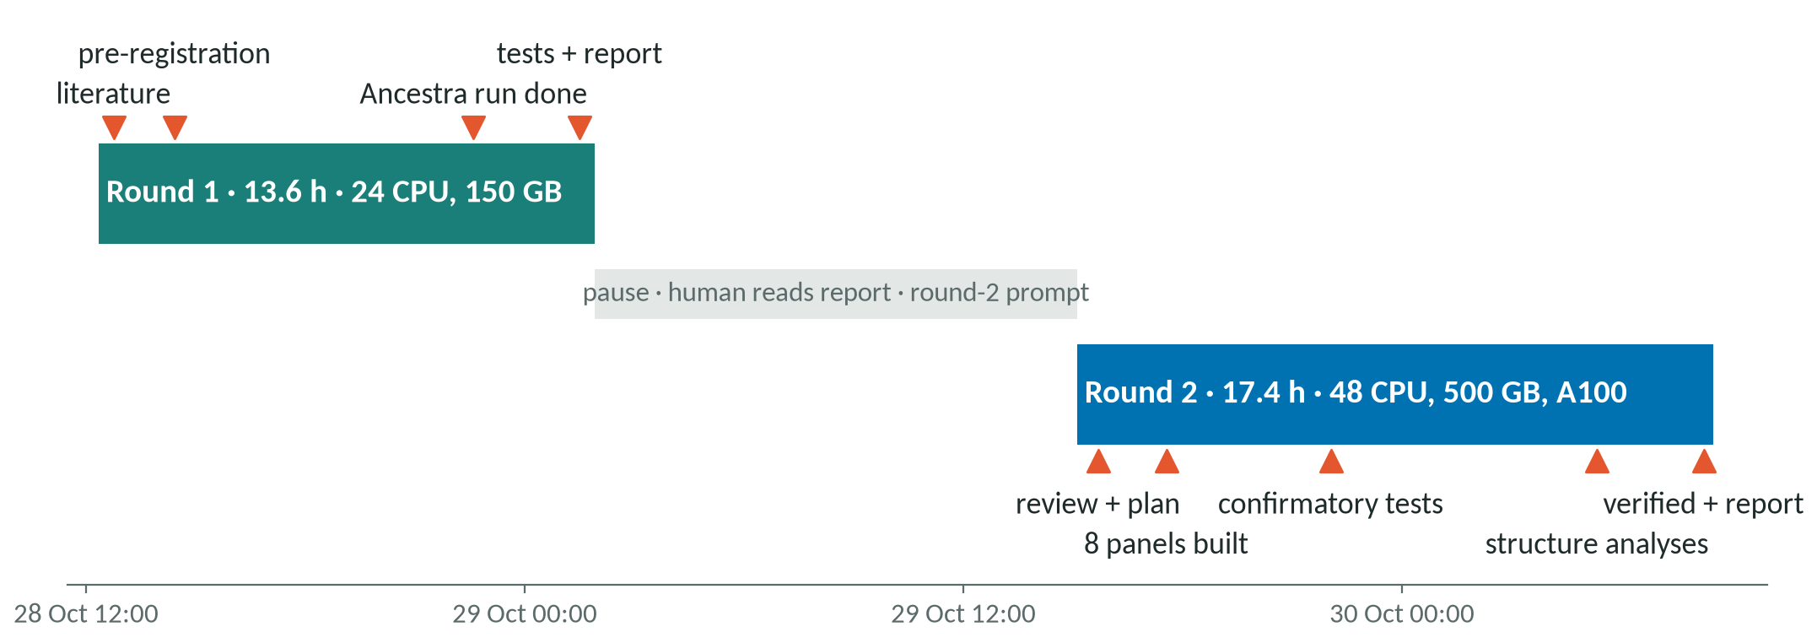
Two rounds in about 31 hours
Milestones from RESEARCH_TREE.md. Wall-clock time; the agent team worked in parallel inside each round.
Notes:
Timeline of both rounds from the research tree milestones. Round 1 started 2026-10-28 12:21 and ended with the final report at 01:55 the next night (13.6 h): literature at t=0.4 h, pre-registration frozen at 14:25, the large eukaryote Ancestra run finished 22:36, all tests and the report by 01:55. Round 2 started 2026-10-29 15:07 with the department-head review and a new plan (15:41), eight dense panels built by 17:33, the confirmatory family closed at 22:03, structure analyses finished 05:20, verification and the final report by 08:31 on 30 October (17.4 h). Between the rounds the human read the report and wrote the round-2 prompt. Source: RESEARCH_TREE.md (M0-M5, R2-M0-R2-M4); START.txt; START_ROUND2.txt.

Slide 13





One PI agent, many specialised agents
Human
2 prompts, verifies later
PI agent · Claude Opus 5.5
plans, delegates, decides, keeps the record
Department head
Fable agent, external
Literature
Data
Analysis
Design reviewers
Verifiers
Audits
Writing, figures
Subagents: Opus 5.5 or Sonnet 5.5, chosen by the PI · verifiers never checked their own work
Notes:
Team structure. The human gave two prompts and will verify the results. A PI agent (Claude Opus 5.5) planned, delegated, reviewed and integrated, and kept the research record (research tree, lessons, decisions). Subagents (Opus 5.5 or Sonnet 5.5) did literature review, data building, analysis, design review (external PI, evolutionary biology, statistics, data/compute, AI failure modes), independent adversarial verification, citation and numbers audits, and writing and figures. A separate Fable agent acted as department head and reviewed round 1 and the final report. Subagents wrote plain-text summaries so that the PI could keep its context lean. Source: report/REPORT.md §11; RESEARCH_TREE.md; reviews/.

Slide 14
The experiment in numbers
187 + 82
2.97 M
8 · 227
2 + 9
eukaryotic + prokaryotic proteomes (round 1)
eukaryotic proteins in round 1
dense panels · proteomes (round 2)
Ancestra runs, round 1 + round 2
16
3
2
≈31 h
literature hypotheses (~250 references)
frozen pre-registrations (git tags)
own claims overturned by verification
total wall time, two rounds
Notes:
Key numbers. Round 1: 187 eukaryotic and 82 prokaryotic proteomes, 2.97 million eukaryotic proteins (36 from transcriptomes). Round 2: eight dense panels with 227 proteomes (3.06 million proteins), 9 Ancestra reconstructions (8 panels plus one sensitivity panel without de novo proteomes), in addition to the two round-1 runs; 3 frozen pre-registrations as git tags (prereg-v1, prereg-r2, prereg-r2-p1); 16 literature hypotheses from about 250 references; every confirmatory number re-derived by an agent that did not produce it, and 2 claims overturned by that verification; about 31 h of wall time. Source: report/REPORT.md §2, §4, Methods; RESEARCH_TREE.md (M1, D11-D15).

Slide 15
How the method was decided
D
Literature, critique, pre-registration, calibration, verification
Notes:
Section D: decision process. Source: RESEARCH_TREE.md (decision log D0-D16); DESIGN.md; DESIGN_ROUND2.md; PREREG.md.

Slide 16


A pipeline of checks before any claim
Literature
16 hypotheses
Design
DESIGN.md
Critique
3 rounds R1 · 1 round R2
Pre-register
hash + git tag
Pilot + calibrate
simulations, nulls, GPU
Round 2
review → new design
Audit + report
numbers, citations
External review
department head
Verify
independent agent
Run
Ancestra + tests
Red: steps done by agents that did not produce the result.
Notes:
Decision flow used in both rounds. A literature review (LITERATURE.md, 16 hypotheses) fed a design (DESIGN.md), critiqued by independent agent reviewers in three rounds in round 1 (5 reviewers, then 3, then a pre-registration audit) and one round of 3 reviewers in round 2. The design was then frozen with hashed inputs and a git tag before any reconstruction output existed. Pilots and calibration (simulated genomes, null calibration on the real tree, GPU pilot) came before long runs. After the runs, an agent that did not produce a result re-derived it; then an external senior review and a numbers audit preceded the report. The department-head review of round 1 closed the loop into round 2. Source: RESEARCH_TREE.md M1-M2, R2-M0; report/REPORT.md §3, §11.

Slide 17
Key decisions, round 1
1 · Separate runs
2 · Novelty ladder
3 · Calibrated null
Observed Orthology across bacteria and eukaryotes adds cost; no transition spans both
Observed Simulations: raw gene gains inflated 2.1–2.6×
Observed Planned null: 14.5% false positives at α = 0.05 on the real tree
Decided Separate eukaryote and prokaryote Ancestra runs
Decided Count only sequence-novel gains; claim a burst only above 2.2×
Decided Calibrated permutation scheme as the primary test
Effect The 1.4 h prokaryote run became the dry run
Effect Rule fixed before any eukaryote output
Effect 4.9% false positives: p-values mean what they say
Notes:
Three round-1 decisions. D0 (t=0): eukaryote and prokaryote reconstructions kept separate, because orthology across domains adds cost and no transition spans domains; the 1.4 h prokaryote run became the pipeline dry run, recovering both prokaryotic positive controls. Method calibration before results: on simulated genomes Ancestra inflated gene gains 2.1-2.6-fold (an old family split into several groups makes old genes look new), so gains were filtered to sequence-novel ones (no DIAMOND hit outside the clade), and a burst of novelty would be claimed only above 2.2-fold (Dev-4), fixed before eukaryote output existed. D6: on the real tree the planned relabelling null was anti-conservative (14.5% false positives at alpha 0.05), so a calibrated permutation scheme (4.9%) became primary. Source: RESEARCH_TREE.md D0, D6, M2, M3; report/REPORT.md §2.

Slide 18
Key decisions, round 2
4 · Dense panels
5 · Unseen events only
6 · Rule before data
Observed One average over 7 origins: 13–35% power; giant component of 73% of proteins
Observed Round-1 nested events already looked novel (p = 0.016)
Observed Deep nodes were Ancestra's weak point
Decided 8 small per-event panels, fast preset, 15–45 min each
Decided Confirmatory test on 4 new events, frozen before their runs
Decided Use structure mode only if controls improve and agreement holds
Effect Sharper events, but only 5–9 controls per panel
Effect No double dipping; power only 18–41%
Effect Rule failed (23.3% → 20.7%): default kept
Notes:
Three round-2 decisions. After the review, eight dense per-event panels replaced one giant run: small runs avoid the giant similarity component that joined 73% of round-1 proteins, and each took 15-45 min; all used the fast preset, on which the 2.2-fold bias rule was calibrated. The confirmatory simple-to-complex novelty test (P1) was restricted to events with no round-1 novelty value and frozen (tag prereg-r2-p1) before their reconstructions existed, to avoid testing a lead on the data that suggested it; the cost was low power (18-41%). The rule for Ancestra's structure mode (adopt only if deep-node controls improve and EukaryOMA agreement does not fall) was fixed before any structure-mode output; it failed (23.3% to 20.7%), so the default was kept. Source: report/REPORT.md §3, §4, §8.2; RESEARCH_TREE.md D11-D15.

Slide 19
The method, explained
E
Simple pictures for the parts that non-experts find hard
Notes:
Section E: method explainers. Source: report/REPORT.md §1.3, §4-§9; external/ancestra-mvp-ai/README.md.

Slide 20
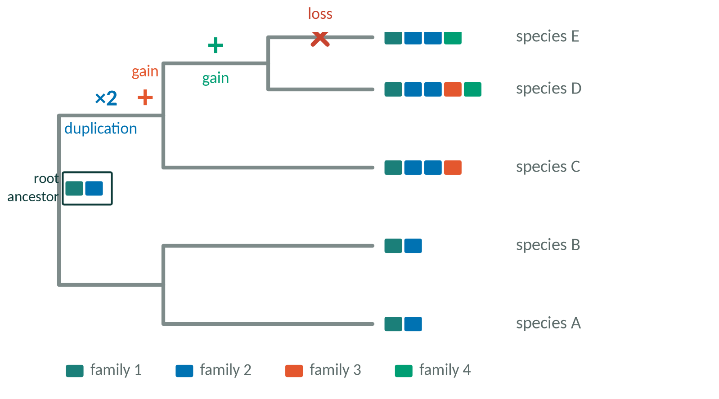

What is ancestral gene content?
Gene family
genes descended from one ancestral gene
HOG
a family at one tree level = one ancestral gene
Events
gain, duplication or loss, read branch by branch
Schematic, not real data.
Notes:
Ancestral gene content: given the proteins of living species and their family tree, infer which genes their common ancestors had. Genes are grouped into families (descendants of one ancestral gene). Reading the tree branch by branch gives gains (a family first appears), duplications (one ancestral gene becomes two) and losses. A hierarchical orthologous group (HOG) is a family seen at one level of the tree: each HOG at a node is one inferred ancestral gene. Schematic: the duplication of family 2 and the gain of family 3 on one branch; the gain of family 4 later; the loss of family 3 in species E. Source: report/REPORT.md §1.3.

Slide 21
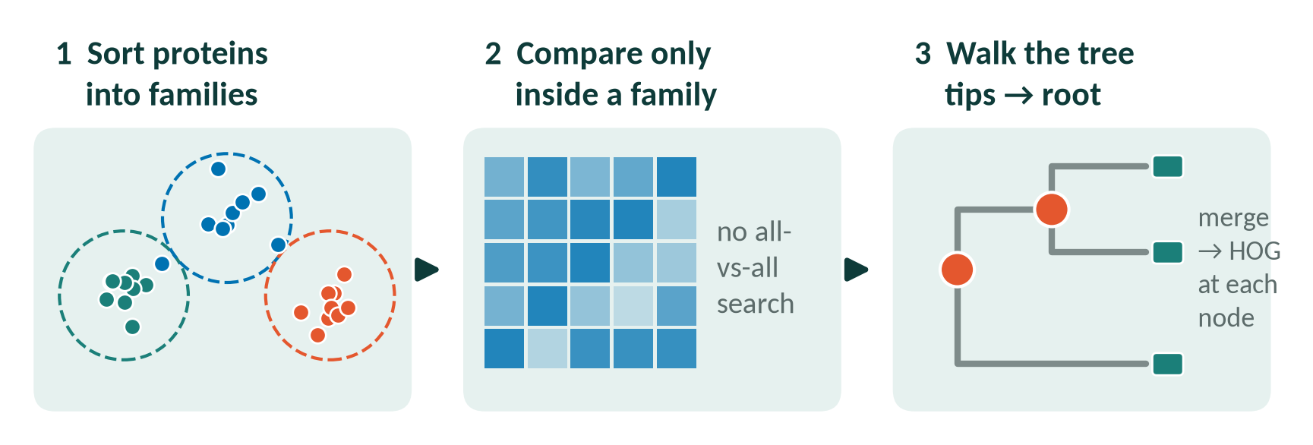
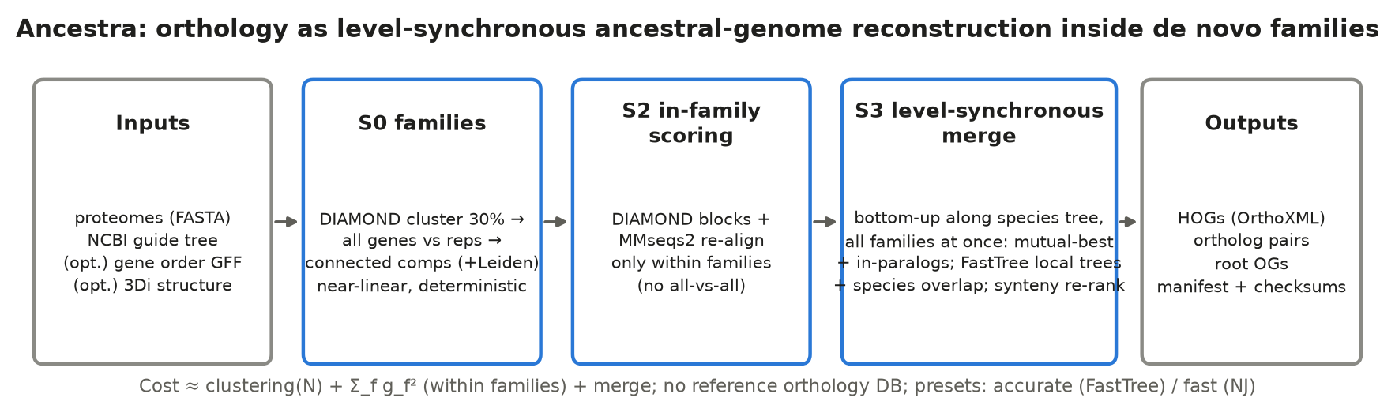
Ancestra in three steps
Lower figure: Ancestra's own method overview, reused with credit (evocellnet/ancestra-mvp-ai, docs/figures/fig1_method.png).
Notes:
Ancestra (github.com/evocellnet/ancestra-mvp-ai) was itself built by AI agents in another hackathon project. Step 1: a reference-free family step clusters proteins with DIAMOND (no all-against-all search, no reference database), with a Leiden cap on giant components. Step 2: similarity is computed only inside families. Step 3: a level-synchronous merge walks the guide species tree from the tips to the root; at each node the ancestral genes of the child lineages are merged by mutual best matches and in-paralog absorption; ambiguous clusters get a small local tree (accurate preset: FastTree; fast preset: neighbour joining). Each merged ancestral gene is a HOG. The lower figure is Ancestra's own method figure, reused with credit. Source: external/ancestra-mvp-ai/README.md; docs/figures/fig1_method.png.

Slide 22

Ancestra among orthology methods
Method | How families are built | Output | OrthoBench F | QfO SwissTree recall
Ancestra (this project) | reference-free DIAMOND families, then level-by-level merge | HOGs at every tree node | 76.2 / 74.8 (accurate / fast) | 0.721 / 0.731
OrthoFinder 3.2 | all-vs-all similarity graph + gene trees | orthogroups, gene trees | 69.7 | 0.825
OMA · FastOMA (EukaryOMA) | pairwise orthologs; FastOMA places genes on a reference | HOGs at every level | 60.4 / 33.1 ‡ | 0.696 / 0.699
SonicParanoid2 · InParanoid · Hieranoid | graph / pairwise; Hieranoid bottom-up | orthogroups, pairs, HOGs | 70.4 (SonicParanoid2) | 0.717 · 0.701 · 0.726
Pfam counts + Dollo / Count | domain annotation, no orthology | copy numbers on the tree | n/a | n/a
Shared homology from similarity graphs; a HOG = all genes from one ancestral gene
Different no reference database; all families merged level by level at once
Numbers from the Ancestra README. ‡ OMA comparators overlap the benchmark. Non-inferiority to OrthoFinder not shown; QfO recall below OrthoFinder.
Notes:
Comparison with other approaches. Common to all orthology methods: homology inferred from sequence similarity, usually as a graph; OMA/FastOMA, Hieranoid and Ancestra report HOGs at every level of a species tree (Hieranoid and Ancestra build them bottom-up). OrthoFinder gives orthogroups and gene trees that need a separate step to be mapped to ancestors. Pfam presence/absence with Dollo or Count parsimony skips orthology and reconstructs copy numbers on the tree. Ancestra's difference: a reference-free family step feeding a level-synchronous merge over all families at once. Benchmarks from the Ancestra README: OrthoBench test F (36 held-out reference groups) and QfO 2022 SwissTree recall (TPR). Caveats: on OrthoBench non-inferiority to OrthoFinder and SonicParanoid2 is not shown (wide intervals); on QfO Ancestra's recall is clearly below OrthoFinder (0.721 vs 0.825); OMA comparators are not independent of the benchmark. In this project, round-2 family tests used Pfam counts with phylogenetic regression, and EukaryOMA (OMA/FastOMA) served as the cross-check. Source: external/ancestra-mvp-ai/README.md (headline results); LITERATURE.md §5.1.

Slide 23
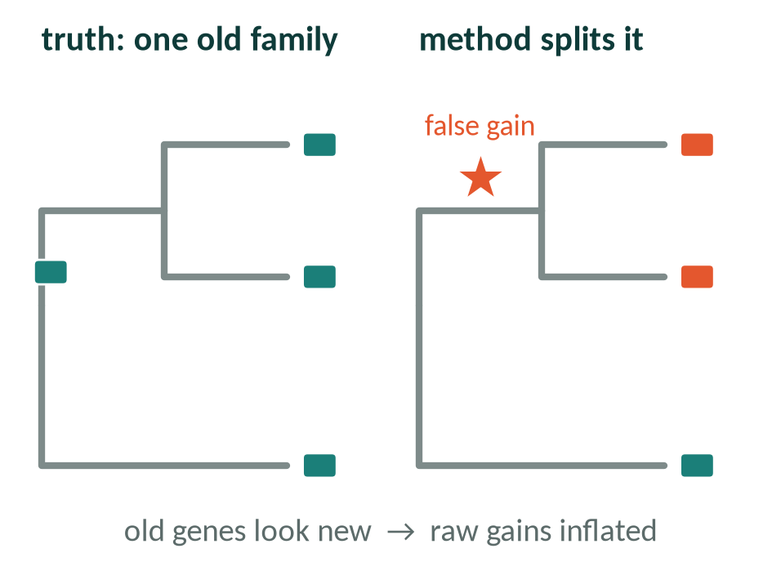
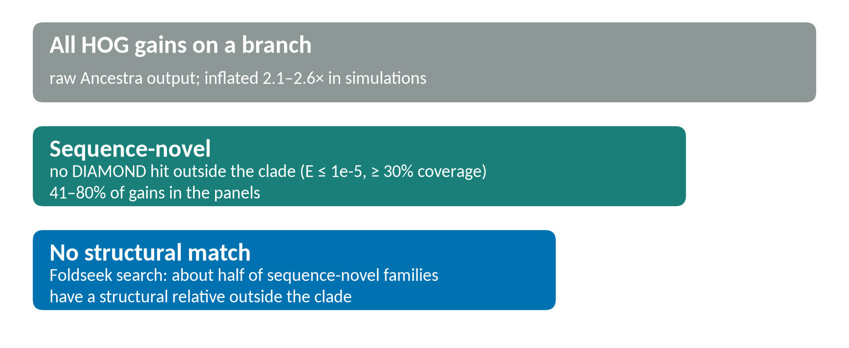
Why 'new gene' counts are inflated
Each rung removes 'new' genes that have detectable relatives outside the clade.
Notes:
Gains are the least certain quantity. If a method splits one old family into two groups, one of them appears to arise on an inner branch: a false gain. On simulated genomes Ancestra inflated gains 2.1-2.6-fold. The project therefore used a novelty ladder: a gain counts as sequence-novel only if none of up to three representative proteins has a DIAMOND hit (E <= 1e-5, >= 30% query coverage) to any protein outside the clade. In the round-2 panels 41-80% of Ancestra's gains were sequence-novel. In round 2 a structural search (Foldseek) found that about half of sequence-novel families have a structural relative outside their clade, so sequence novelty still overstates true novelty. Source: report/REPORT.md §2, §4, §8.3.

Slide 24
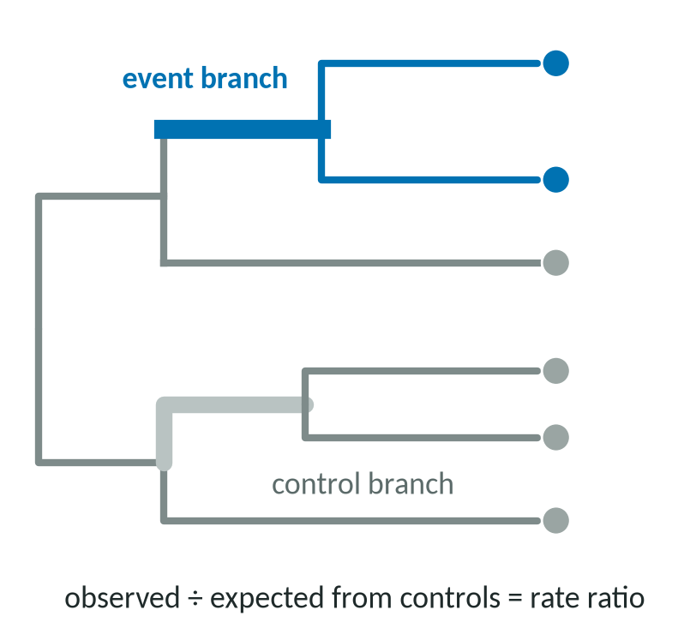
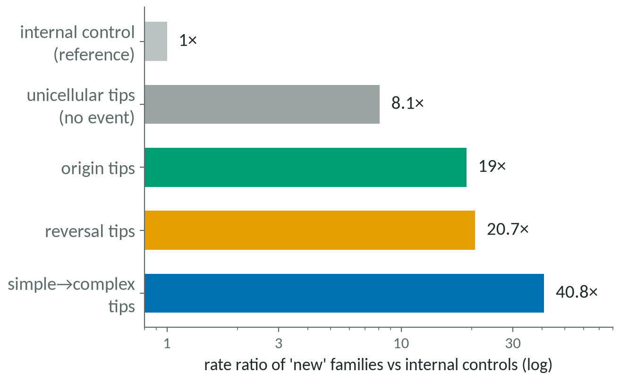
Compare like with like
Right: geometric mean / pooled rate ratios from report Figure 3b. A tip looks 'novel' just for being a tip.
Notes:
Transition branches are compared with control branches: internal branches inside unicellular lineages that are not events. A regression fitted on control branches (negative binomial: branch length, number of descendant species, data quality, distance to the outgroup) predicts how many sequence-novel families a branch should have; the rate ratio is observed divided by predicted. The tip-versus-internal artefact: a gain on a tip (single-species) branch is any gene of that species without a detectable relative, including orphan genes and mis-predicted gene models. Against internal controls every kind of tip scores high whatever its biology: unicellular tips with no event 8.1-fold, origin tips 19-fold, reversal tips 20.7-fold, simple-to-complex tips 40.8-fold. Tips must be compared with tips. Source: report/REPORT.md §6.1, §6.3; Figure 3b.

Slide 25
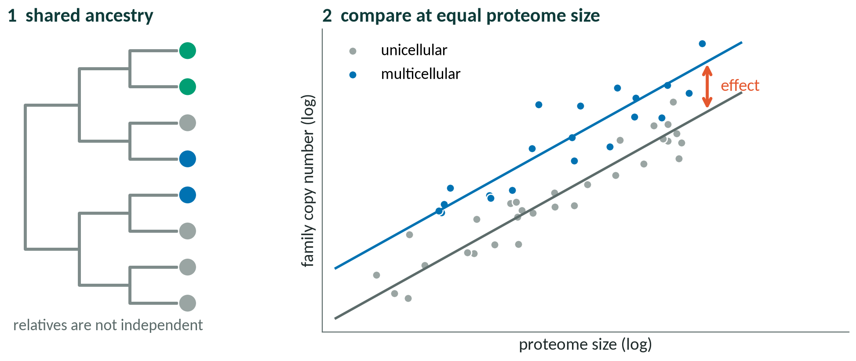
Phylogenetic regression in one picture
PGLS: regression whose errors follow the species tree (Pagel's λ) · 148 genomes · covariates: proteome size, disorder
Notes:
Phylogenetic generalised least squares (PGLS): related species share ancestry, so they are not independent data points. PGLS is a regression whose residuals are correlated according to the species tree, with the strength of that correlation estimated as Pagel's lambda. The family tests asked whether multicellular species carry more copies of a family set than unicellular species of the same proteome size (covariates: log proteome size and disordered fraction), on 148 genome-based proteomes. The right panel is a schematic with illustrative data. Source: report/REPORT.md §7.1 (Pagel 1999; Ho & Ane 2014).

Slide 26
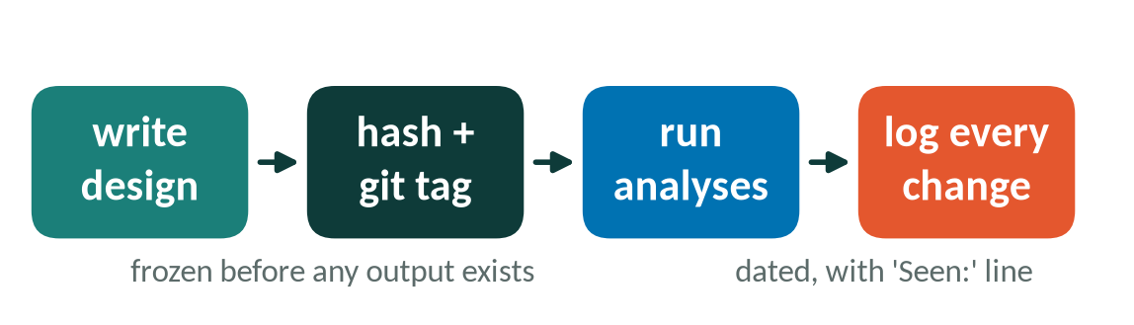
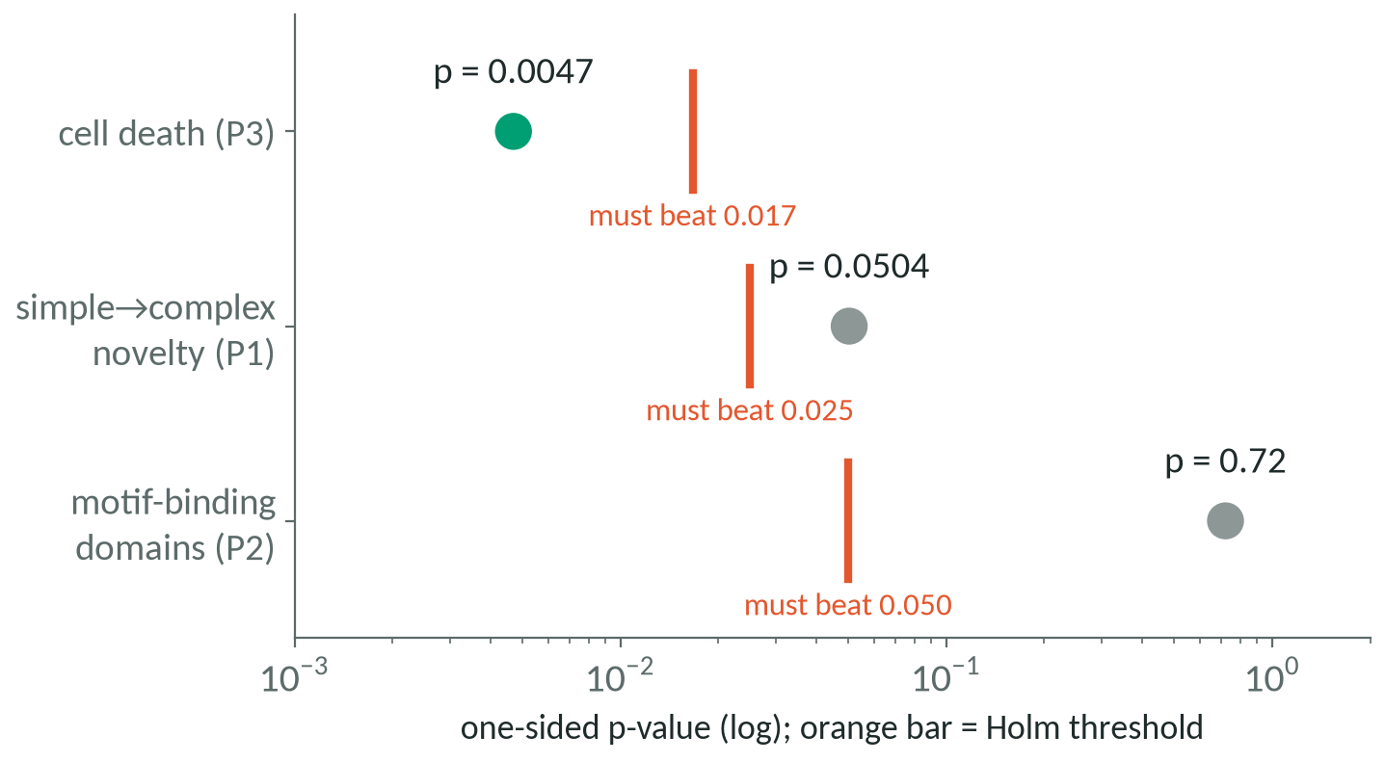
Pre-registration and multiple testing
prereg-v1
round 1 · 15 hashed inputs
prereg-r2
round 2 design + family lists
prereg-r2-p1
4 confirmatory events
Holm: smallest p must beat α/3, the next α/2, …; stop at the first failure.
Notes:
Pre-registration: the design, test statistics and inputs were written down, hashed (sha256) and tagged in git before any relevant output existed (round 1: prereg-v1 with 15 hashed inputs; round 2: prereg-r2 for design and family lists, prereg-r2-p1 for the four confirmatory events). Every later change was logged as a dated deviation with a 'Seen:' line saying which results were visible. Holm correction: with three confirmatory tests, the smallest p-value must beat 0.05/3, the next 0.05/2, the last 0.05; testing stops at the first failure. Cell death (p = 0.0047) beat 0.0167; simple-to-complex novelty (p = 0.0504) did not beat 0.025; motif-binding (p = 0.72) was null. Source: report/REPORT.md §3, §6.2, §7, Methods; PREREG_HASHES.tsv; data/r2_prereg/PREREG_R2_HASHES.tsv.

Slide 27
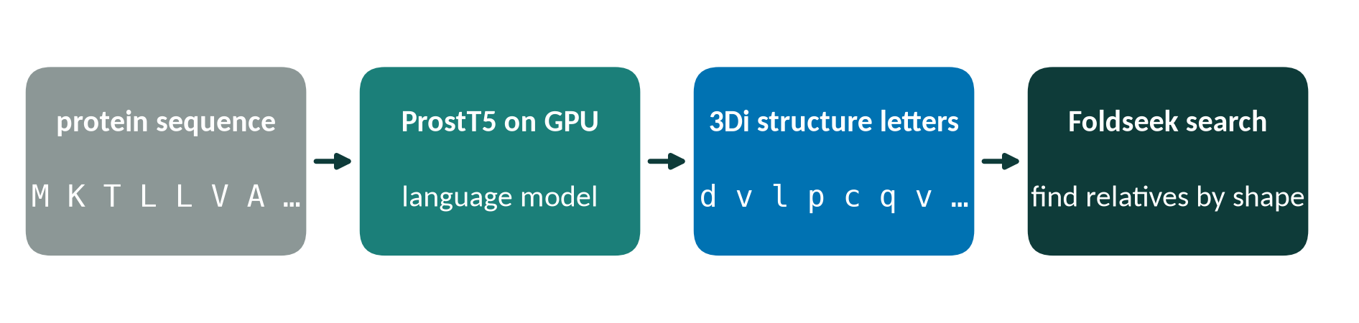
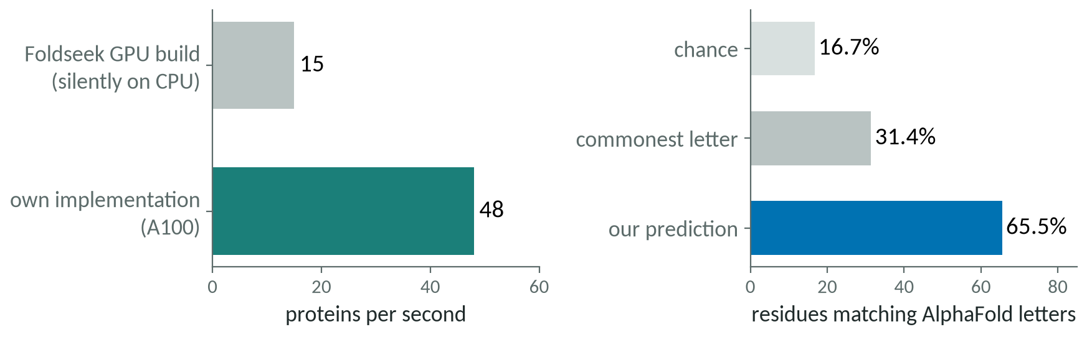
Structure from sequence, on one GPU
Lesson check the device is really used: the pilot caught a silent CPU fallback in the first hour
Notes:
Predicting full 3D structures for three million proteins was not feasible in the time available. Foldseek describes each residue of a structure by one of 20 3Di letters (local geometry of contact with its nearest neighbour), so a structure becomes a searchable string. ProstT5, a protein language model, predicts 3Di letters directly from sequence. A pilot showed Foldseek's GPU build silently ran the model on the CPU (15 proteins/s); the team's own implementation of the ProstT5 encoder and prediction head ran at 48 proteins/s on the A100, agreed with Foldseek's ProstT5 output at 97.1% of residues, and matched letters computed from AlphaFold models at 65.5% of residues (chance 16.7%; always the commonest letter 31.4%; published range 41-65%). Source: report/REPORT.md §8.1; RESEARCH_TREE.md R2-3, R2-4 (van Kempen et al. 2024; Heinzinger et al. 2024).

Slide 28
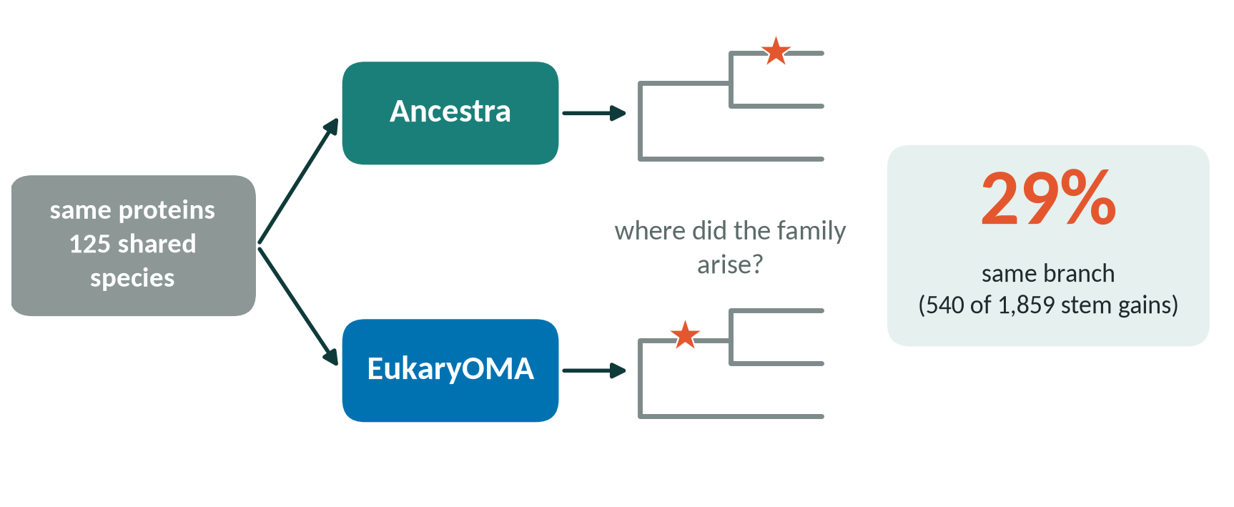
Cross-checking with a second method
Same proteins, same tree, same parser: only the orthology method differs. Agreement measures consistency, not accuracy.
Notes:
EukaryOMA (eukaryoma.unil.ch, release All.Oct2026) is a precomputed orthology database for 1,328 eukaryotic genomes built with OMA/FastOMA. 125 of our 187 species have a EukaryOMA genome; 87.1% of our proteins were mapped by identical sequence or reciprocal best hits. Both sets of HOGs were restricted to the shared species, stripped of their own branch labels, and placed on the same pruned tree by the same parser; a family's origin is the common ancestor of its members. Then: do both methods place the origin of the same family on the same branch? On six transition stems, 29% of Ancestra's stem gains (540 of 1,859) were placed on the same stem by EukaryOMA. It is a cross-method check on largely the same proteins, not independent data. Source: report/REPORT.md §5; Supplement S3.

Slide 29
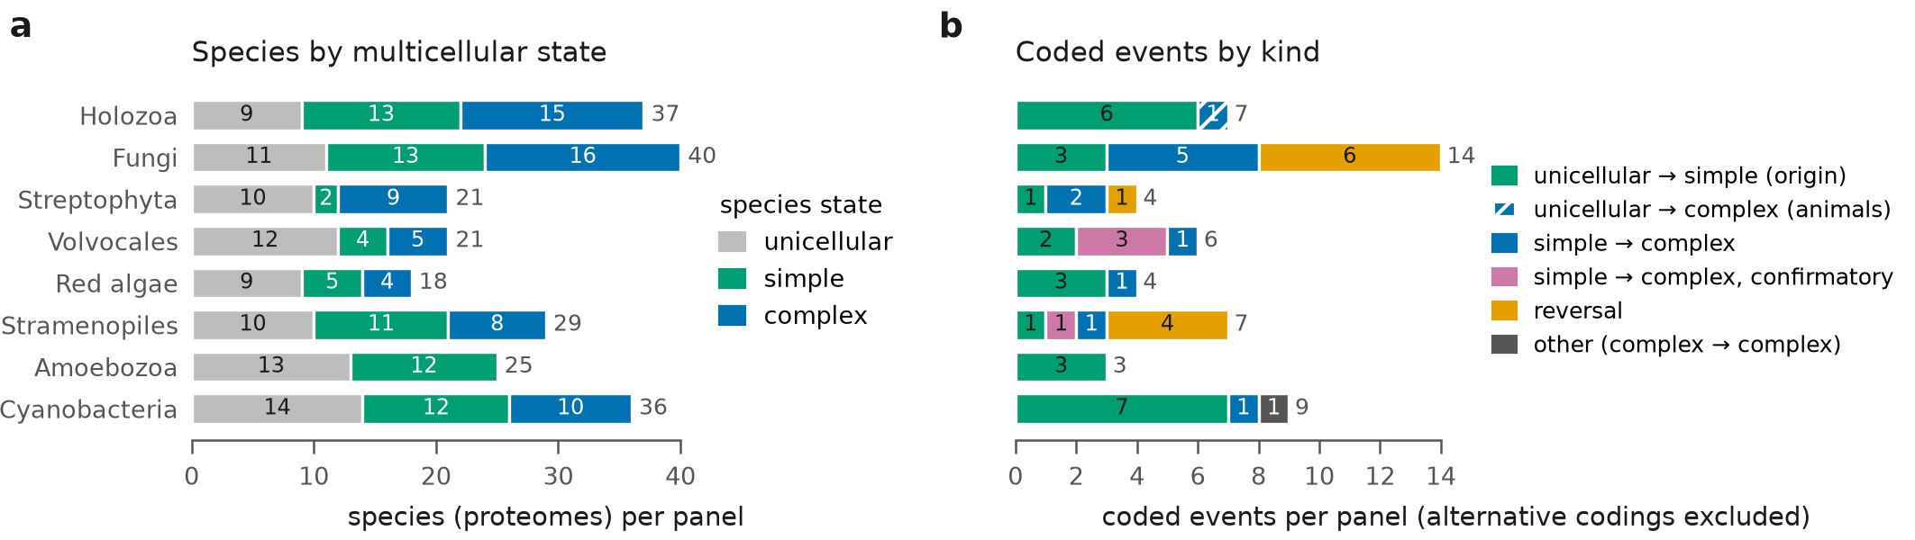
Round 2: eight focused reconstructions
18–40
15–45 min
5–9
proteomes per panel (227 in all)
per reconstruction (round 1: ~9–10 h)
control branches per panel: coarse tests
Notes:
Round-2 design. Eight dense panels (18-40 proteomes each, 227 in all), each built around one or a few origins with as many related genomes as were available, with a fixed rooted species tree and a table of coded events (59 in total: origins, nested simple-to-complex events, reversals). Each reconstruction took 15-45 min, against about 9-10 h for round 1's single eukaryote run. Panels sharpen single events but do not add independent origins, and most panels have only 5-9 control branches, which limits every per-event test. Figure: report Figure 1a-b (panels by state and coded events by kind). Source: report/REPORT.md §4, Table 1, Figure 1.

Slide 30
Main results
F
One message per slide
Notes:
Section F: main results. Master source: report/REPORT.md.

Slide 31
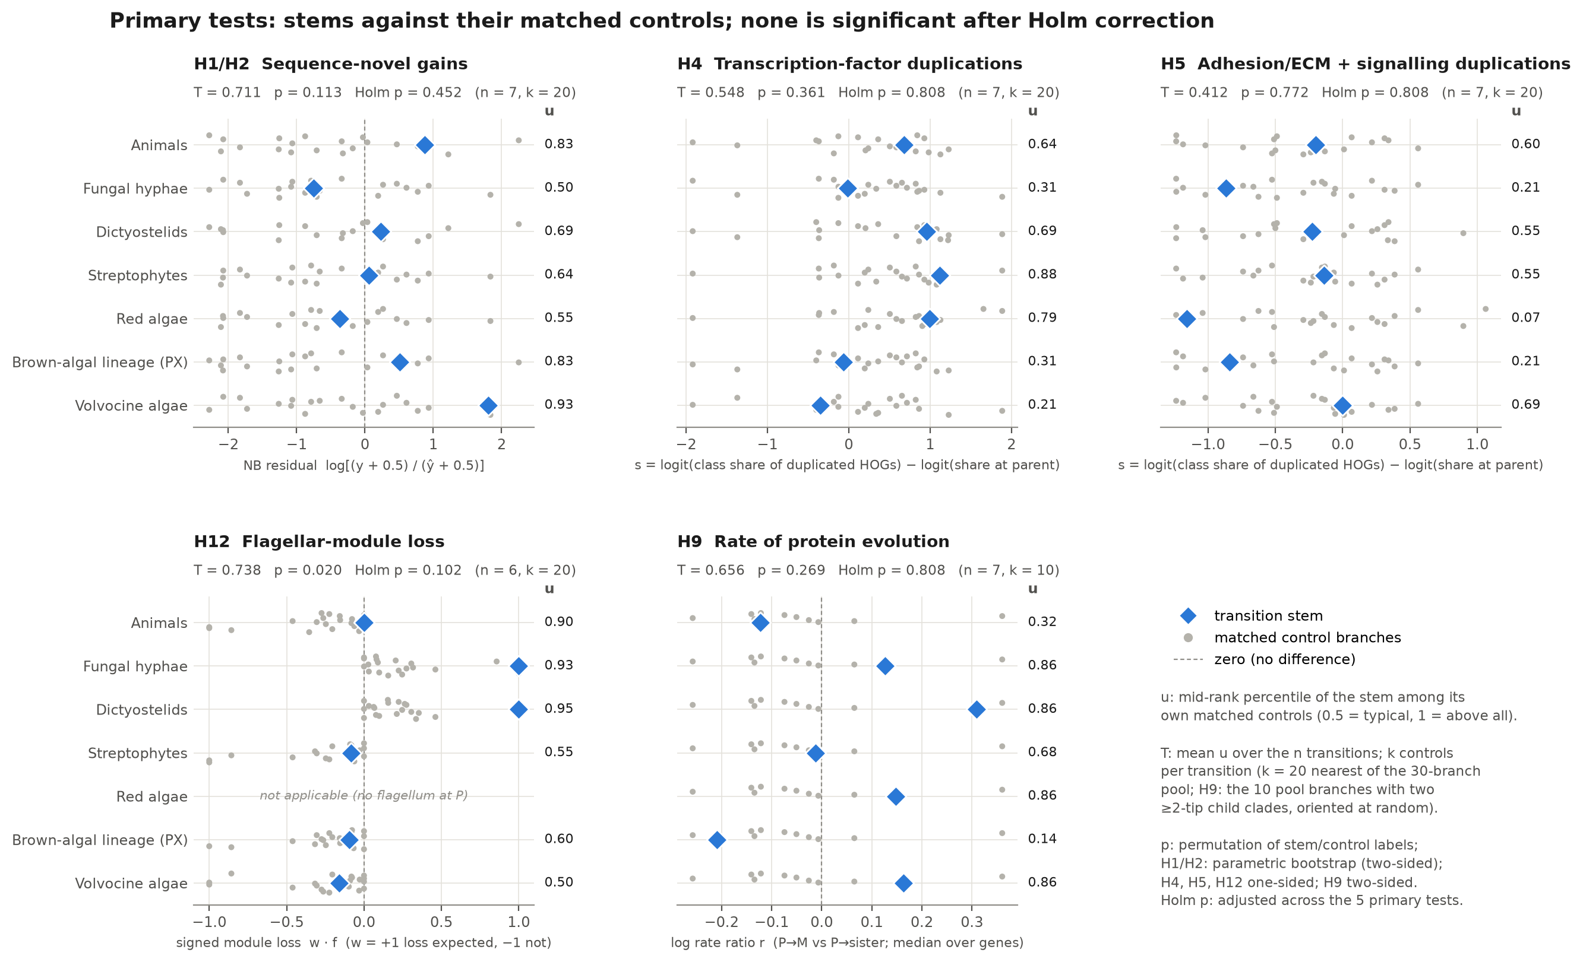
Round 1: no shared signature of seven origins
0 of 5
primary tests significant after Holm
1.10×
rate ratio [0.96–1.26]: no ≥1.5-fold shift
13–35%
power of gene-content tests at 1.5-fold
Notes:
Round 1 compared the transition stems of seven independent eukaryotic origins (animals, fungal hyphae, dictyostelids, streptophytes, red algae, brown-algal lineage, volvocine algae) with matched control branches. None of the five pre-registered primary tests (sequence-novel gains, transcription-factor duplications, adhesion/signalling duplications, flagellar loss, protein evolutionary rate) was significant after Holm correction (smallest adjusted p = 0.10). The gene-content tests had only 13-35% power at a 1.5-fold effect, so they are absence of evidence; the rate test, however, excludes a 1.5-fold or larger average shift (pooled rate ratio 1.10, 95% CI 0.96-1.26). Figure: round-1 Figure 3. Source: report/REPORT_round1.md; report/REPORT.md §2; RESEARCH_TREE.md M4.

Slide 32

Errata: the review caught three overstatements
Claim
Round 1 said
Corrected
Depth imbalance, stems vs controls
1.77 SD
2.06 SD
Positive controls that test Ancestra
'11 of 16'
6 of 9; deep-node 0 of 3
Rate-test p-value
seed-dependent 0.19–0.61
exact: p = 0.31
'Eukaryoma' database
'not found'
EukaryOMA: 1,328 genomes
None of these changes a round-1 conclusion.
Notes:
An agent checked the reviewer's points with new scripts. The depth imbalance between stems and controls was 2.06, not 1.77, control standard deviations. Positive controls were overstated as validation of Ancestra: of the 10 controls that need Ancestra to place an event on a branch, 7 passed, but one is a null control; excluding it, 6 of 9 passed, and all three deep-node placement controls failed. The rate test depended on a random seed (p 0.19-0.61); the exact, orientation-averaged version over 1,024 orientations gives p = 0.31. The power table had used placeholder branch lengths (re-running changed no value by more than 0.025), and the round-1 record had wrongly declared EukaryOMA not found. None changes a round-1 conclusion. Source: report/REPORT.md §2; results/round1_errata/ERRATA.txt.

Slide 33
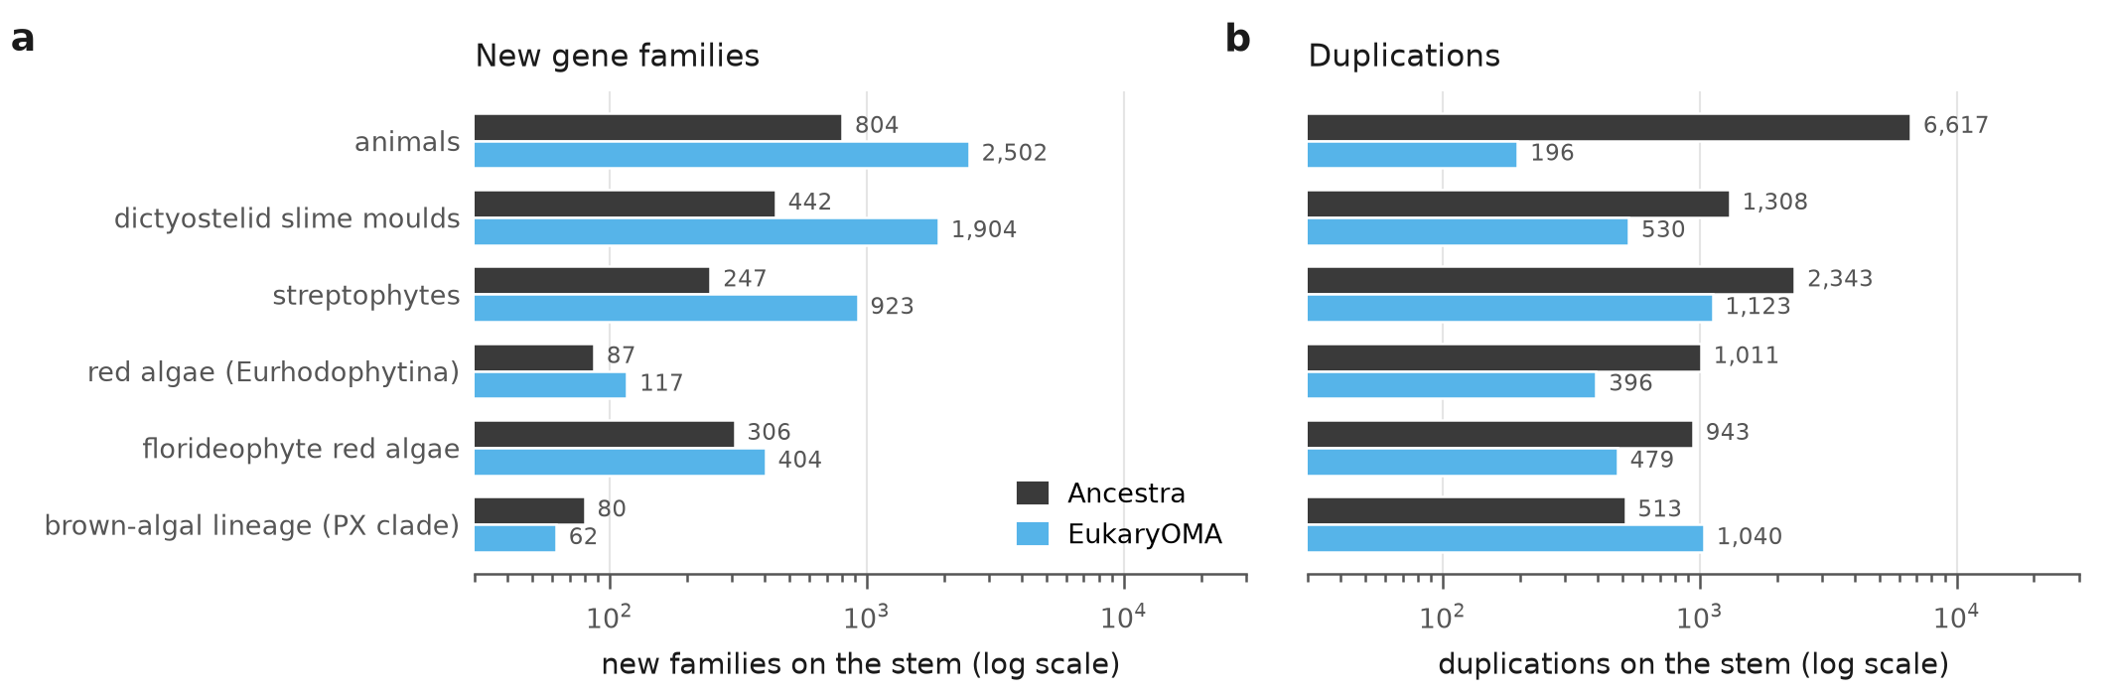
Two orthology methods disagree on where genes arose
29%
9%
4–8%
6,617 vs 196
of Ancestra stem gains on the same branch in EukaryOMA
of EukaryOMA stem gains confirmed by Ancestra
agreement on duplications
animal-stem duplications, Ancestra vs EukaryOMA
Notes:
Ancestra and EukaryOMA place the origin of only a minority of the same gene families on the same branch: 29% of Ancestra's stem gains (540 of 1,859) are placed on the same stem by EukaryOMA, only 9% in the other direction; duplications agree in 4-8% of cases on stems and controls alike. On the animal stem Ancestra reports about 6,600 duplications and 804 new families, EukaryOMA 196 duplications and 2,502 new families. Stems do not agree better than controls once branch depth is taken into account (depth-adjusted expectation 22-24.7%). A count of new families or duplications on a stem therefore says as much about the method as about the biology. Figure: report Figure 2a-b. Source: report/REPORT.md §5.

Slide 34
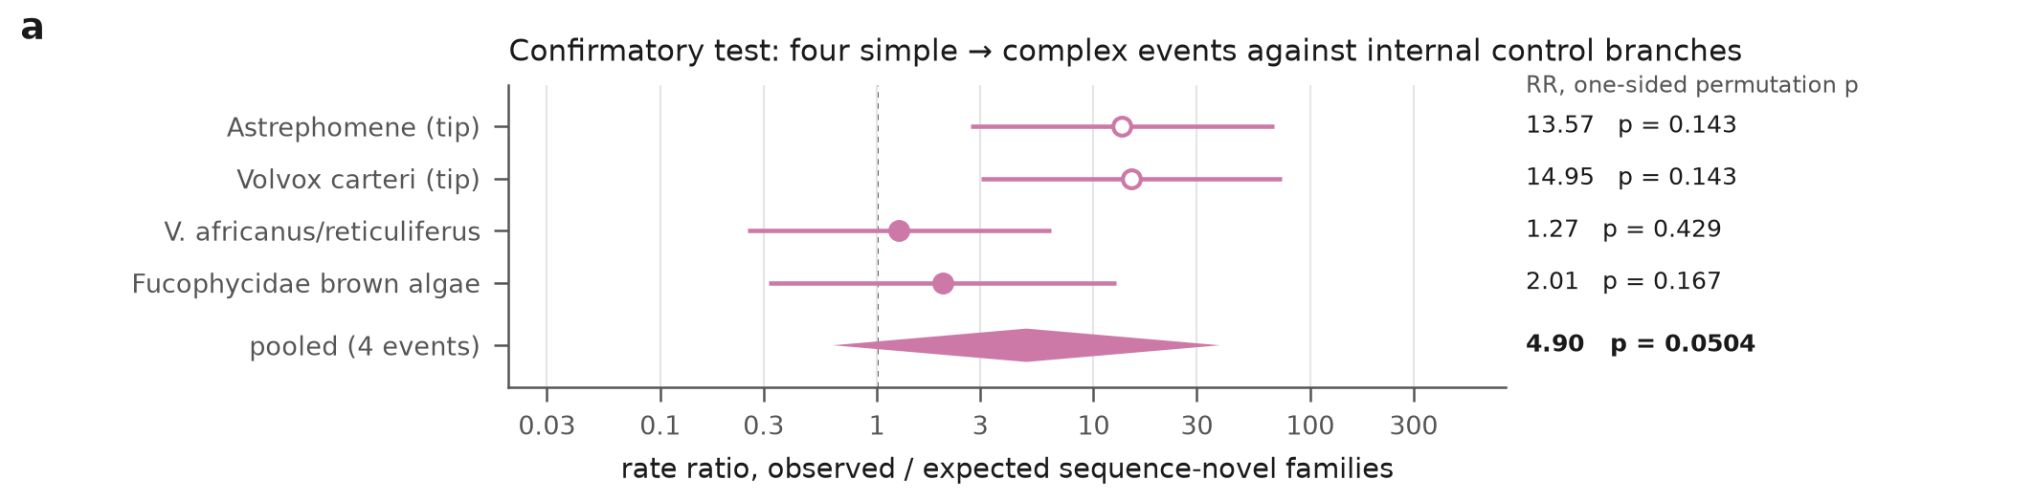
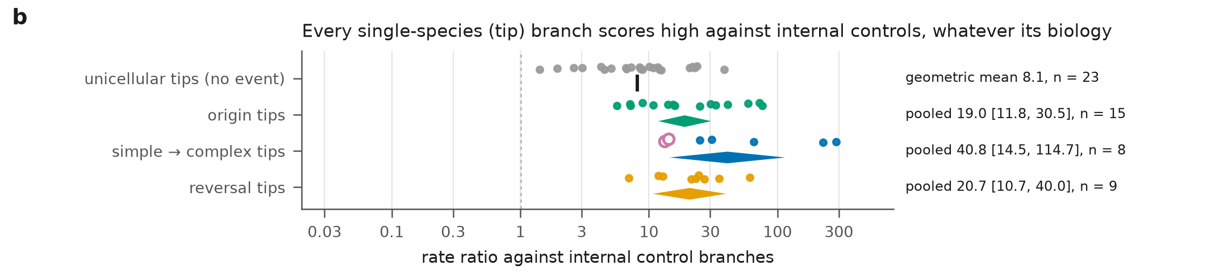
Simple to complex: no significant burst of new genes
p = 0.050
combined, Holm-adjusted 0.10
8.1×
unicellular tips with no event, vs internal controls
0.56–0.80
the tip events, compared tip with tip
Notes:
Confirmatory test P1: four simple-to-complex events never analysed in round 1 (Astrephomene, Volvox carteri, Volvox africanus/reticuliferus, the Fucophycidae brown-algal stem). Combined one-sided p = 0.0504 (Holm-adjusted 0.10): not significant. A variant with an undocumented branch-length floor gives 0.072. The large per-event ratios (13.6 and 14.9) belong to the two single-species tip events, and every kind of tip scores high against internal controls (panel b). Compared tip with tip, Astrephomene scores 0.56 and V. carteri 0.80, combined p = 0.49. Three of the four events share one panel and its controls; treated as one effect per panel, the smallest attainable p (0.031) cannot pass Holm. Figure: report Figure 3a-b. Source: report/REPORT.md §6.2-6.3.

Slide 35
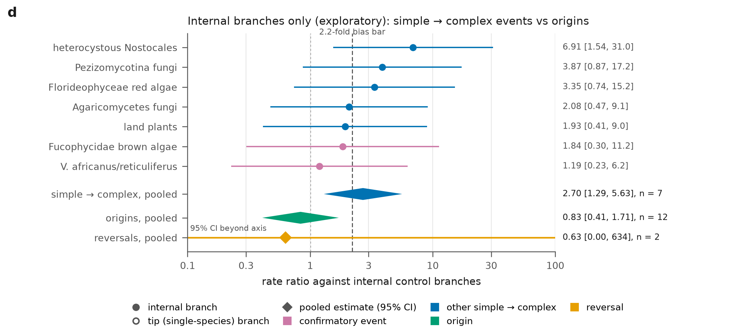
Internal branches only: a weak lead
2.8×
simple → complex, internal [1.34–5.89]
0.82×
origins of simple multicellularity
Lower bound below the 2.2× bias line: exploratory only
Notes:
Restricted to internal branches, seven simple-to-complex events (Pezizomycotina, Agaricomycetes, land plants, V. africanus/reticuliferus, Florideophyceae, Fucophycidae, heterocystous Nostocales) pool to a rate ratio of 2.81 (95% CI 1.34-5.89) as specified (2.70 as implemented, plotted), against 0.82 for twelve internal origins from unicellular ancestors. This is the one gene-content lead that survives round 2, but it is weak: three of seven events were already seen in round 1, it was not pre-registered, events lie deeper than controls, and the lower bound does not clear the 2.2-fold method-bias threshold (itself from a single simulation). Figure: report Figure 3d. Source: report/REPORT.md §6.4.

Slide 36
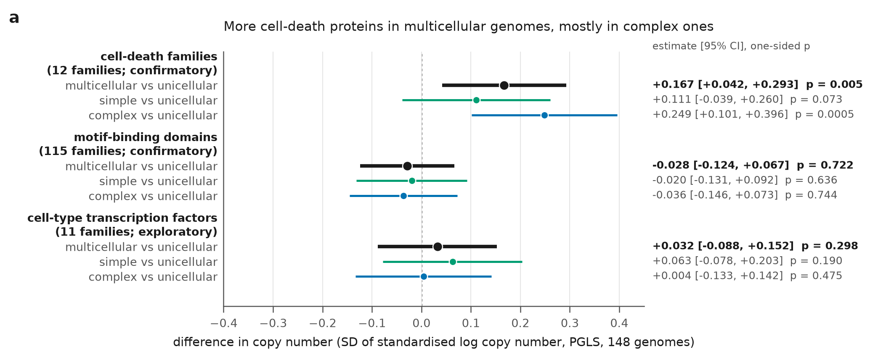
Cell death: the one confirmed signal
1.21×
more cell-death proteins [1.04–1.42], Holm p = 0.014
+0.249 SD
complex vs unicellular (simple: +0.111)
Caveat: size-dependent. Without the 10 largest proteomes p = 0.025; as a share of the proteome p = 0.14. Read as 'more than expected for proteome size'.
Notes:
Confirmatory test P3: 22 pre-defined cell-death families (caspases, metacaspases, NB-ARC, NACHT, HET, HeLo, gasdermins, Bcl-2 and others; 12 kept by the pre-set rule). On 148 genome-based proteomes, PGLS with proteome size and disorder as covariates: multicellular species carry +0.167 SD more (95% CI 0.042-0.293), one-sided p = 0.0047, a geometric-mean 1.21-fold excess (1.04-1.42); Holm-adjusted p = 0.014. The excess is concentrated in complex multicellularity (+0.249, p = 0.0005; simple +0.111, p = 0.073). Robust to leaving out any origin or family, reproduced independently; but without the ten largest proteomes the effect shrinks about 28% (p = 0.025) and as a share of the proteome it is not significant (p = 0.14): 'more than expected for proteome size'. Figure: report Figure 4a. Source: report/REPORT.md §7.2.

Slide 37
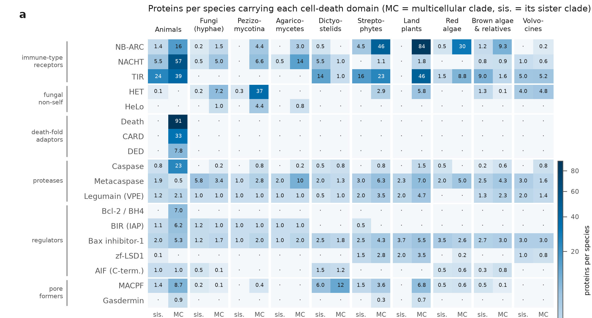
The extra proteins are lineage-specific receptors
Land plants
NB-ARC–LRR immune receptors (+84 / species)
Red algae
NB-ARC–WD40 (+29)
Filamentous fungi
HET (+37), NACHT: non-self recognition
Animals
Death, CARD, DED adaptors; caspases
Dictyostelids, volvocines
no excess
Notes:
What the extra cell-death proteins are (descriptive follow-up on 9,031 proteins carrying any of the 22 domains). Complex species carry on average 138 cell-death proteins, simple multicellular 18, unicellular 22. Land plants: NB-ARC proteins with leucine-rich repeats (plant NLR immune receptors; +84 per species vs Zygnematophyceae). Red algae: NB-ARC with WD40 repeats (+29). Filamentous fungi: HET domains (+37) and NACHT proteins with WD40 or ankyrin repeats (non-self recognition). Animals: death-fold adaptors (Death, CARD, DED), NACHT, caspases, Bcl-2, BIR. Dictyostelids and volvocines: no excess. Not one shared cell-death program: convergence on a function using different receptor architectures. Figure: report Figure 5a. Source: report/REPORT.md §7.3 (Jones & Dangl 2006; Dyrka et al. 2014).

Slide 38
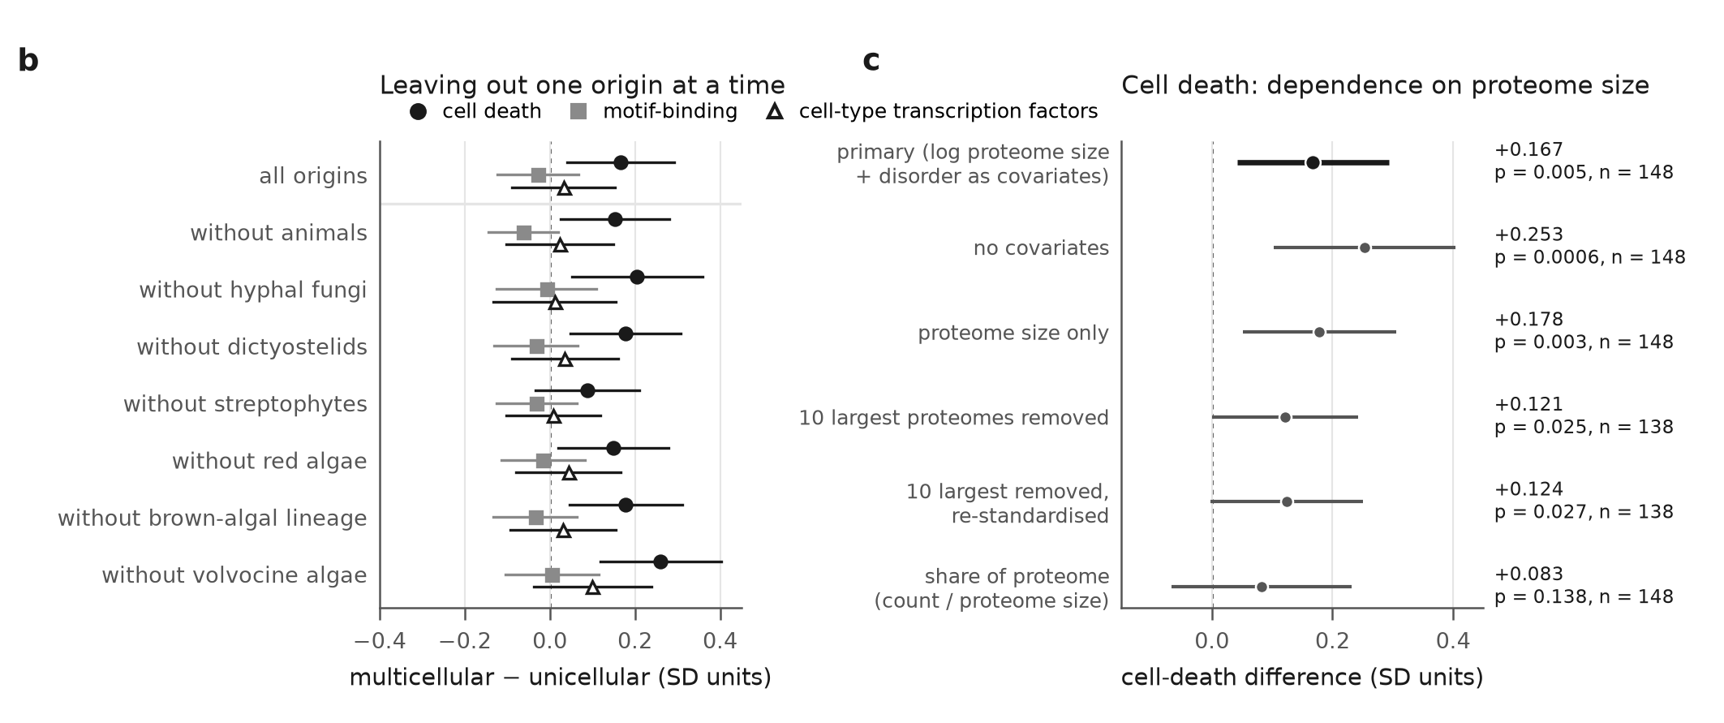
Motif-binding domains and TF families: null
0.98×
motif-binding domains, p = 0.72
+0.03 SD
cell-type TF families, p = 0.30
Left: motif-binding estimates are negative in 6 of 7 leave-one-out runs; cell death stays positive in all 7.
Notes:
Confirmatory test P2: 115 Pfam families that bind short linear motifs (SH2, SH3, PDZ, WW, 14-3-3 and others, from the ELM resource) show no excess in multicellular species: -0.028 SD (95% CI -0.124 to 0.067), one-sided p = 0.72, a 0.98-fold ratio; six of seven leave-one-origin-out estimates are negative. A Bayesian count model gave a small positive estimate (sensitivity; read as a null with unresolved model dependence). Eleven cell-type transcription-factor families (exploratory): +0.032 SD (-0.088 to 0.152), p = 0.30. Known expansions reappear within single origins (T-box and Runt in animals, TEA in hyphal fungi, SBP in land plants). Figure: report Figure 4b-c (leave-one-out; proteome-size sensitivity of cell death). Source: report/REPORT.md §7.4.

Slide 39
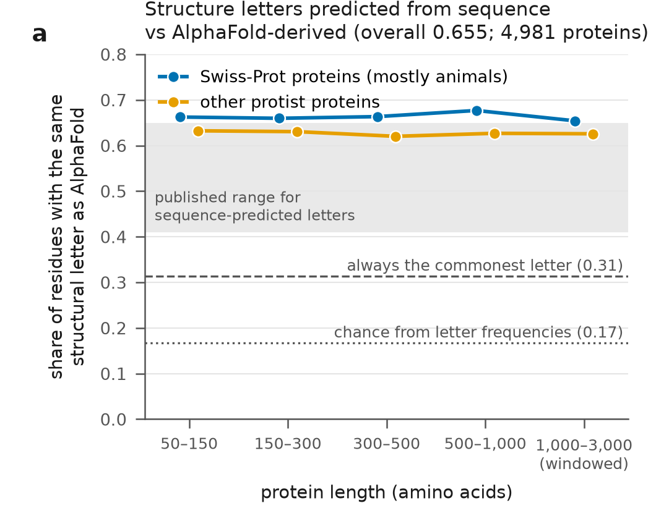
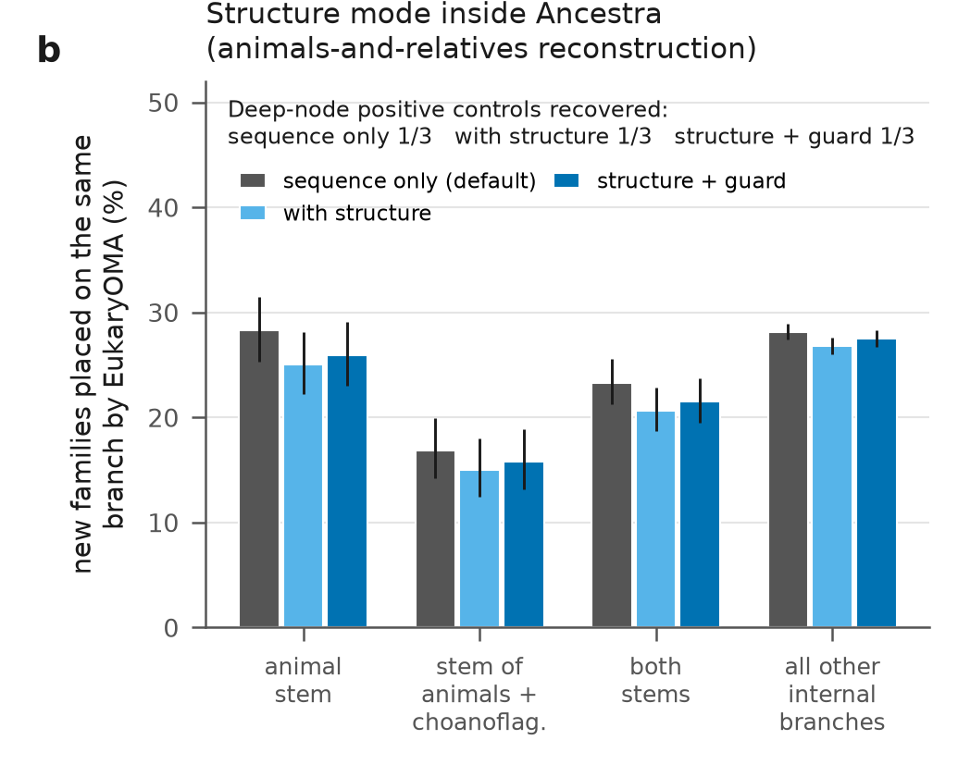
Structure did not help Ancestra
65.5%
23.3% → 20.7%
1 of 3
letters match AlphaFold (chance 16.7%)
EukaryOMA agreement, default → structure
deep-node controls, in every run
Notes:
Predicted structure letters are accurate enough to search with (65.5% residue agreement with AlphaFold-derived letters; panel a). Ancestra's optional structure mode rescues small families into large ones by structural similarity; the rule fixed before any output: replace the default only if the deep-node positive controls improve and agreement with EukaryOMA does not fall. On the Holozoa panel the rescue attached 25,035 small families to 2,400 large ones (a guard confirmed only 17%); deep-node controls stayed 1 of 3 in all three runs; agreement with EukaryOMA on new families at the two animal stems was 23.3% (default), 20.7% (structure) and 21.5% (with guard). The rule failed; the default was kept. One panel, one preset. Figure: report Figure 7a-b. Source: report/REPORT.md §8.1-8.2.

Slide 40
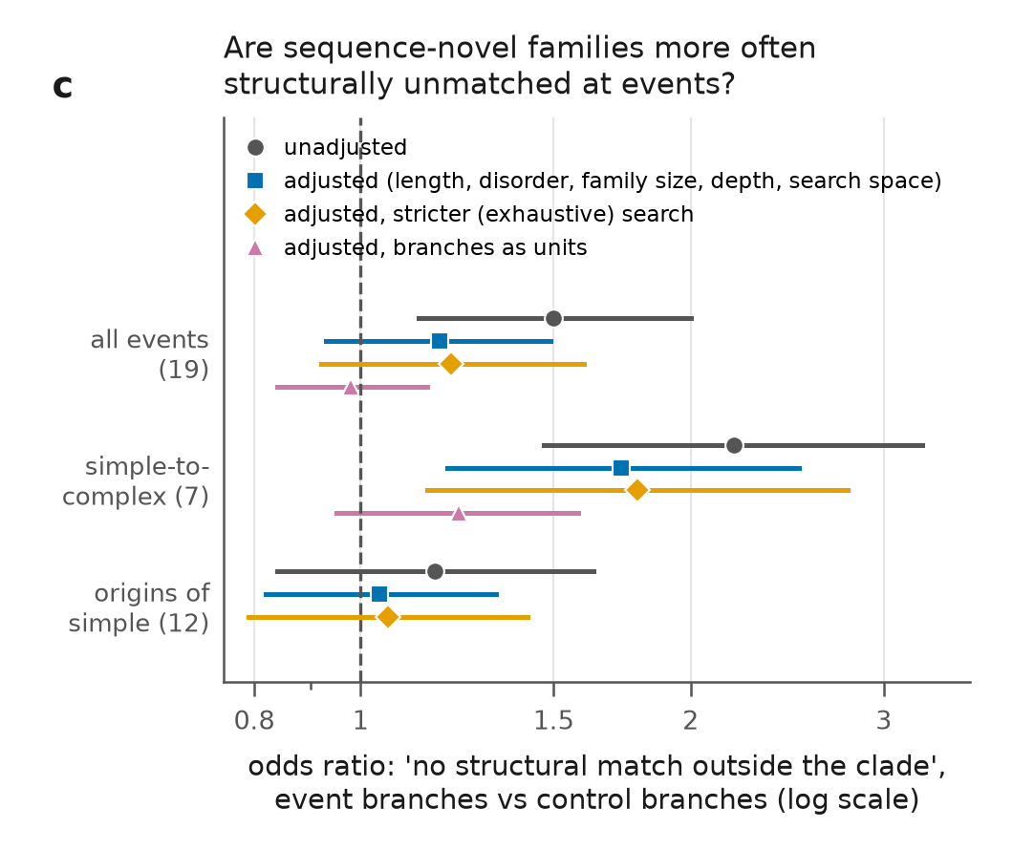
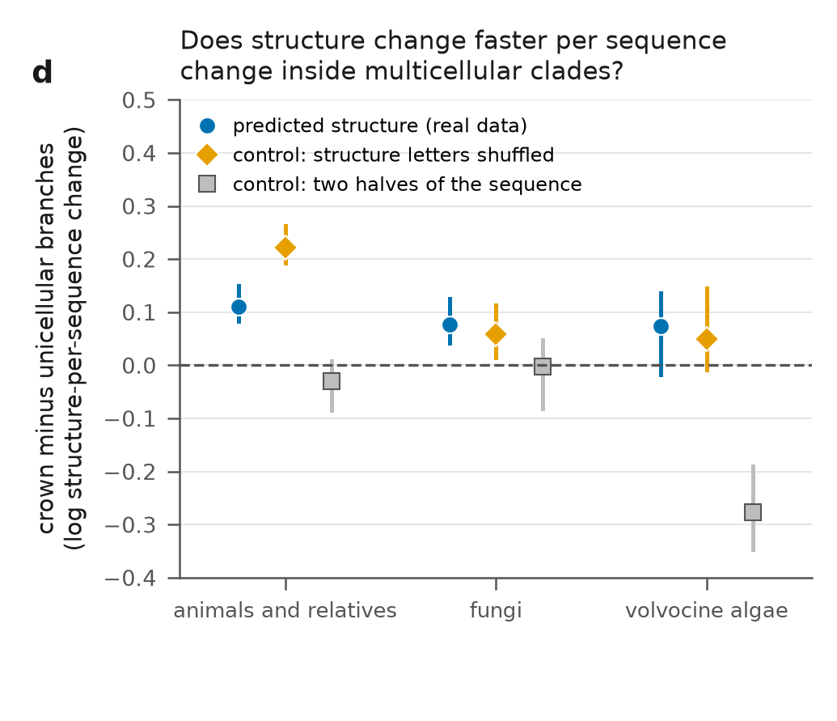
Two structural signals did not survive controls
OR 1.44 → 1.18 [0.93–1.49]
0.222 vs 0.110
after adjusting for length, disorder, depth
shuffled control vs real data (animals)
Notes:
Structural novelty: event branches first seemed to carry more structurally unmatched sequence-novel families than controls (43.7% vs 33.3%, odds ratio 1.44, p = 0.004). An adversarial verifier showed unmatched families are much shorter (median 211 vs 519 aa) and more disordered: 'no detectable fold', not 'new fold'. Adjusted for length, disorder, family size, depth and search space, the odds ratio fell from 1.50 to 1.18 (0.93-1.49), and an exhaustive search found homologues for 21% of 'unmatched' families. Structure-per-sequence change: inside multicellular crowns 3Di change per amino-acid change was 7-12% higher, but a shuffled-letter negative control gave a comparable, in animals twice as large, effect (0.222 vs 0.110). Inconclusive. Figure: report Figure 7c-d. Source: report/REPORT.md §8.3-8.4.

Slide 41
Protein complexes add nothing detectable
No complex enriched across stems after correction
Map holds only ancient (LECA) complexes
13 species mappable
Duplication counts are method-dependent
Data: Cox et al. 2026, LECA interactome from co-fractionation mass spectrometry.
Notes:
Cox et al. (2026) reconstructed protein complexes of the last eukaryotic common ancestor (LECA) from co-fractionation mass spectrometry in 31 species. Only this published LECA map was used (raw elution profiles not reanalysed); it contains only complexes conserved across eukaryotes. Among testable duplications (13 species mappable through UniProt), 66.6% on the animal stem and 72.1% on the fungal-hyphae stem involved a complex subunit, against 63.6% on control branches; brown-algal and volvocine stems were depleted; no complex was enriched across stems after correction; co-retention was, if anything, slightly lower in multicellular species. Treated as a null. Source: report/REPORT.md §9; Supplement S7.

Slide 42
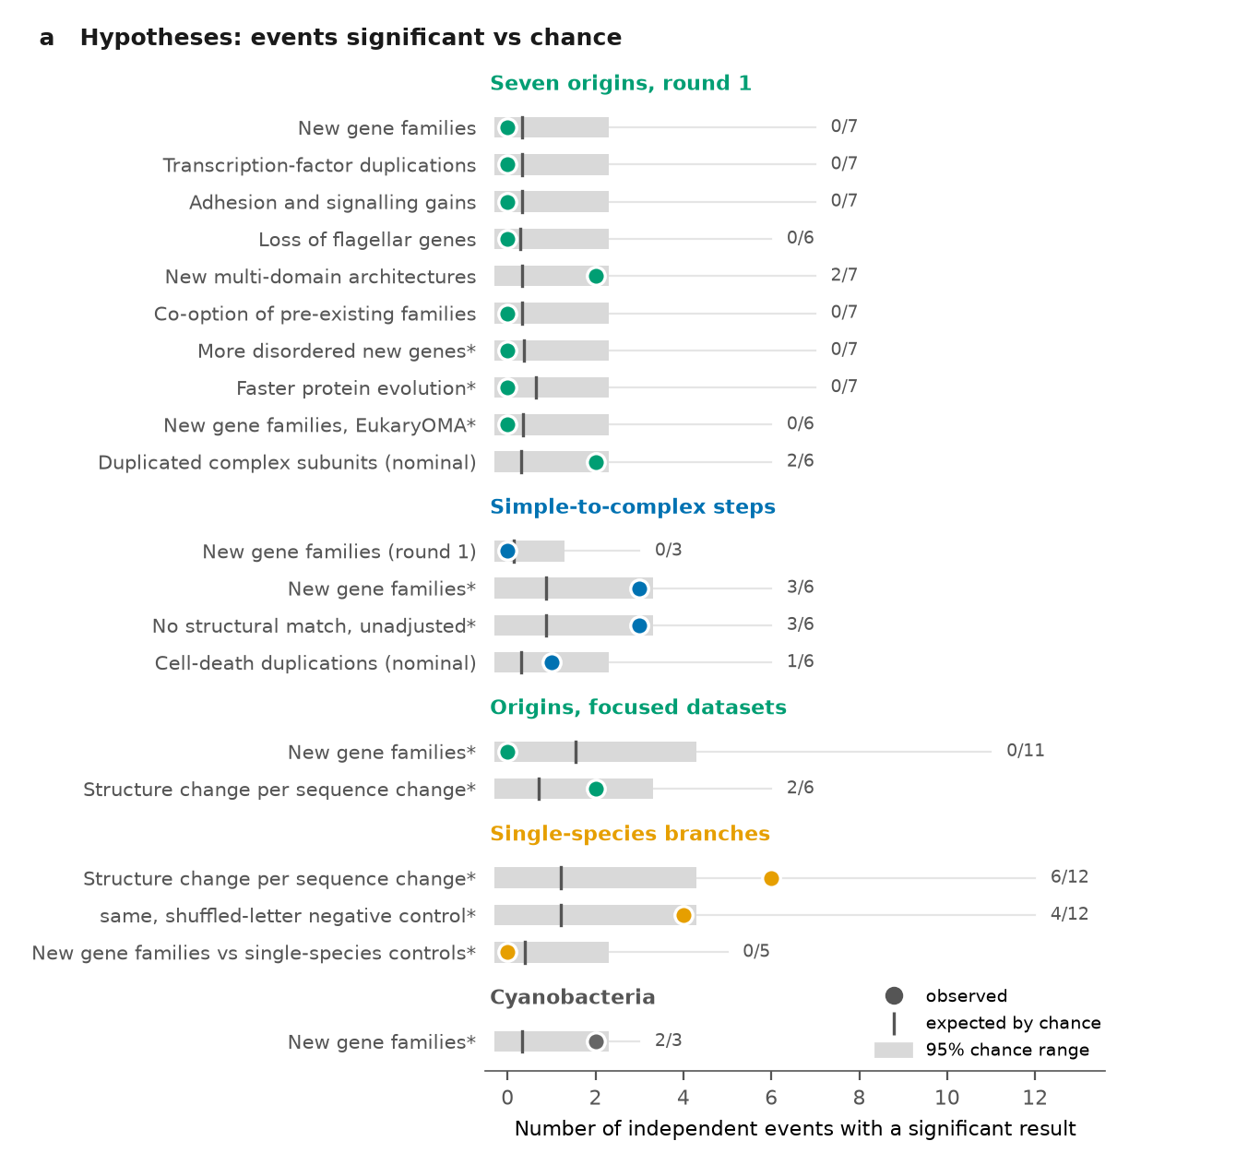
Counting independent origins instead of averaging
0 / 7
0 / 7
new gene families
TF duplications
0 / 7
0 / 6
adhesion, signalling
flagellar loss
Each origin is null on its own
Counting does not rescue the nulls
New domain architectures: 2/7, chance P = 0.04, Holm 0.65
Simple→complex steps (focused panels): 3/6 top-ranked, P = 0.04, Holm 0.17
Cannot add per-event power; it avoids diluting signals. Each tier must be compared with chance.
Added after publication at the project lead's request (exploratory)
Notes:
Addendum added after publication at the project lead's request; exploratory. Instead of averaging effects across origins, count in how many independent origins (or events) a result is significant on its own and compare that count with what chance alone would give. Result: new gene families 0 of 7 origins, transcription-factor duplications 0 of 7, adhesion and signalling 0 of 7, flagellar-gene loss 0 of 6, so each origin is null on its own; counting does not rescue the nulls. Two tiers go slightly beyond chance nominally: new multi-domain architectures 2 of 7 (chance P = 0.04, Holm 0.65) and simple-to-complex steps in the focused panels 3 of 6 top-ranked (P = 0.04, Holm 0.17); neither survives correction. Caveat: this view cannot add per-event power; it avoids diluting a signal that is confined to a few origins, and each tier must be compared with its own chance expectation. Sources: results/r2/recurrence_ladder/summary.txt; results/r2/verification/recurrence_ladder/VERIFICATION.txt; report/REPORT.md section 12 (Figure 8).

Slide 43
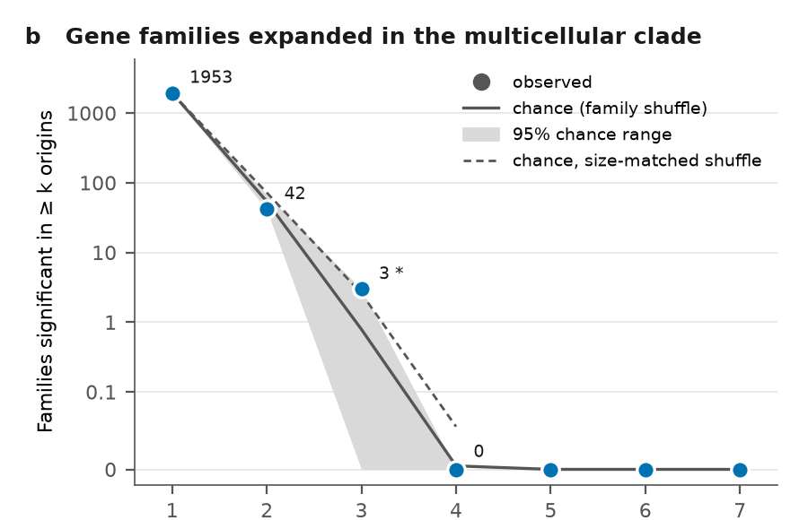
Recurrent families: contractions yes, expansions no
42 vs 54
157 vs 90
expansions in ≥2 origins, observed vs expected
contractions; genome-sisters only 29 vs 18
Contractions inflated by transcriptome-sister artefacts
2 families pass correction: PDEase_I, Vint (q = 0.07)
NB-ARC expanded in animals, red algae, land plants (nested step); primary origins only P = 0.09
Added after publication at the project lead's request (exploratory)
Notes:
Addendum added after publication at the project lead's request; exploratory. Question: are the same gene families expanded (or contracted) in several of the seven origins more often than a family shuffle predicts? Expansions: 42 families significant in at least two origins versus 54 expected, so no excess. Contractions: 157 versus 90 expected, but this is largely an artefact of transcriptome-based sister groups; restricted to genome-based sisters it is 29 versus 18. Two families pass correction (PDEase_I and Vint, q = 0.07). NB-ARC is expanded in animals, red algae and land plants (a nested step), but this is not beyond chance when only primary origins are used (P = 0.09). Figure shows panel (b), families expanded in the multicellular clade; panel (c) (contractions) is in the report. Sources: results/r2/recurrence_ladder/summary.txt; results/r2/verification/recurrence_ladder/VERIFICATION.txt; report/REPORT.md section 12 (Figure 8).

Slide 44


Take-home messages
1
No shared signature across origins; no ≥1.5-fold rate shift
2
Cell death, ~1.2× lineage-specific immune / self–non-self receptors
3
Method matters two orthology methods agree on 29% of stem gains
4
Compare like with like single-species branches always look 'novel'
5
Structure: search, not signal did not help Ancestra; signals failed controls
Notes:
Five take-home messages. (1) No large shared genomic signature across origins; the average protein evolutionary rate did not shift 1.5-fold or more. (2) The one confirmed signal: about 1.2-fold more cell-death proteins than expected for proteome size, mostly in complex lineages, made of lineage-specific immune and self/non-self receptors. (3) Counts of new families and duplications on a branch depend on the orthology method (29% agreement). (4) Tip branches look novel whatever their biology; compare tips with tips. (5) Predicted structure is a good search tool but did not help Ancestra and gave no robust evolutionary signal. Source: report/REPORT.md §10.1.

Slide 45
Every hypothesis, one by one
G
16 from the literature review, plus the round-2 tests
Notes:
Section G: all hypotheses. H1-H16 come from LITERATURE.md §7 and were pre-registered or explored in round 1 (verdicts in results/literature_scorecard.tsv). Round-2 tests come from DESIGN_ROUND2.md §6 and report/REPORT.md. Verdict colours: green supported; red not supported / null / overturned; amber not detected at this power or not significant; blue exploratory lead; grey not tested.

Slide 46
Scorecard of all hypotheses
H1–H2 co-option vs burst
H3 pre-adaptation
H4 TF expansion
H5 adhesion, signalling
H6 receptor kinases
H7–H8 aggregative vs clonal
H9 relaxed selection
H10 disorder
H11 domain shuffling
H12 loss of unicellular genes
H13 cell-cycle co-option
H14–H15 HGT, site convergence
H16 regulation, not coding
R2-P1 simple → complex novelty
R2-P2 motif-binding domains
R2-P3 cell death
R2 structural novelty
R2 protein complexes
supported
not detected / n.s.
not supported / null
exploratory lead
not tested
Notes:
Overview of all hypotheses and verdicts. Round 1 (H1-H16, LITERATURE.md §7): five pre-registered primary tests (H1/H2, H4, H5, H9, H12); others exploratory or cut for time. Round 2: three confirmatory tests (P1 simple-to-complex novelty, P2 motif-binding domains, P3 cell death) and exploratory analyses (structure, complexes). Sources: results/literature_scorecard.tsv; report/REPORT.md §10.1.

Slide 47
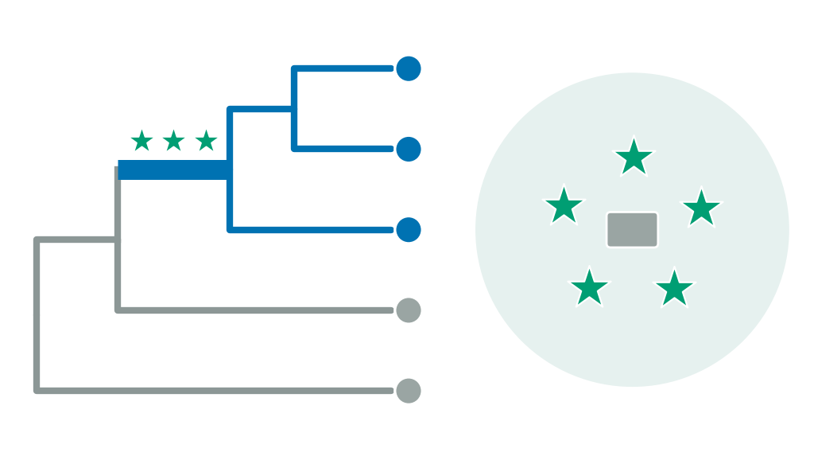

H1–H2 · Co-option or a burst of new genes?
Predicts Burst: more new gene families on transition stems than on controls. Co-option: no excess; the genes were already there.
Bursts reported at animal, land-plant and brown-algal origins; choanoflagellates already carry cadherins and kinases.
Gain counts inflate 2.1–2.6×; denser outgroup sampling moves 'animal-specific' families earlier.
Literature Paps & Holland 2018; Bowles et al. 2020; Denoeud et al. 2024; King et al. 2008; Sebé-Pedrós et al. 2010; Prochnik et al. 2010; Kiss et al. 2019; Richter et al. 2018
NOT DETECTED (LOW POWER)
pooled 1.67× [0.64–4.34], p = 0.11 (Holm 0.45); 80–100% of expanded families present before
Notes:
H1 (co-option precedes the transition) and H2 (burst of novelty) were tested as one comparison: sequence-novel gains per stem, observed versus expected from matched controls, with a co-option index as companion. Result: pooled observed/expected 1.67 (0.64-4.34), parametric-bootstrap p = 0.113, Holm 0.45; below the 2.2-fold method-bias threshold. Co-option index 0.80-1.00: 80-100% of expanded Pfam families were present before the transition in all seven origins (descriptive support for co-option). Minimum detectable effect 2.4-5.9-fold, so not detected at this power. Sources: LITERATURE.md §7; results/literature_scorecard.tsv; report/REPORT_round1.md.

Slide 48
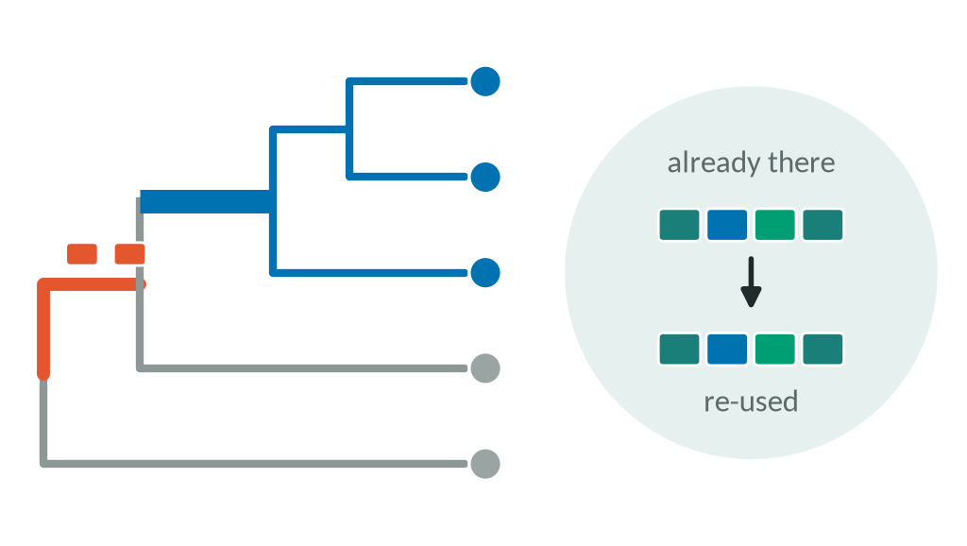
H3 · Pre-adaptation before the transition?
Predicts Ancestors of lineages that later turned multicellular already had more adhesion, TF and signalling genes than sisters that never did.
'Predisposition' reported for complex fungi; gradual assembly of the toolkit in holozoans.
Needs many transitioning and non-transitioning sister pairs with good genomes.
Literature Ocaña-Pallarès et al. 2022; Grau-Bové et al. 2017; Merényi et al. 2020
NOT TESTED
not run in either round
Notes:
H3, gradual pre-adaptive accumulation: multicellularity-related genes accumulate on branches leading to the transition, not only on the transition branch. It was listed as exploratory in the design but not run (pre-transition accumulation on outgroup ancestors was not analysed). Sources: LITERATURE.md §7; results/literature_scorecard.tsv.

Slide 49
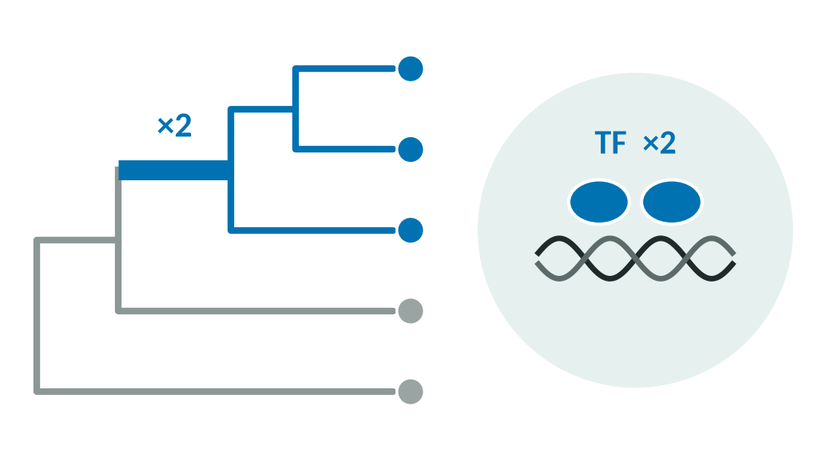
H4 · Do transcription-factor families expand?
Predicts More TF duplications on transition stems than on controls, strongest in complex lineages.
TF repertoires track cell-type number; expansions reappear within origins (T-box, Runt in animals; TEA in fungi; SBP in plants).
Much of the TF toolkit predates multicellular lineages.
Literature de Mendoza et al. 2013; Larroux et al. 2008; Lang et al. 2010; Catarino et al. 2016; Knoll 2011; Nagy et al. 2014
NOT DETECTED (LOW POWER)
R1: odds ratio 1.16 [0.62–2.19], p = 0.36 · R2 TF families: +0.03 SD, p = 0.30
Notes:
H4: TF families expand at the transition, most strongly in complex lineages. Round 1 (primary): share of stem duplications in TF DNA-binding-domain HOGs vs matched controls, T = 0.548, p = 0.361, Holm 0.81, pooled odds ratio 1.16 (0.62-2.19); orthology-free version p = 0.18. Round 2 (exploratory): 11 cell-type TF families, +0.032 SD, p = 0.30. Known expansions reappear within single origins. Sources: results/literature_scorecard.tsv; report/REPORT.md §7.4.

Slide 50
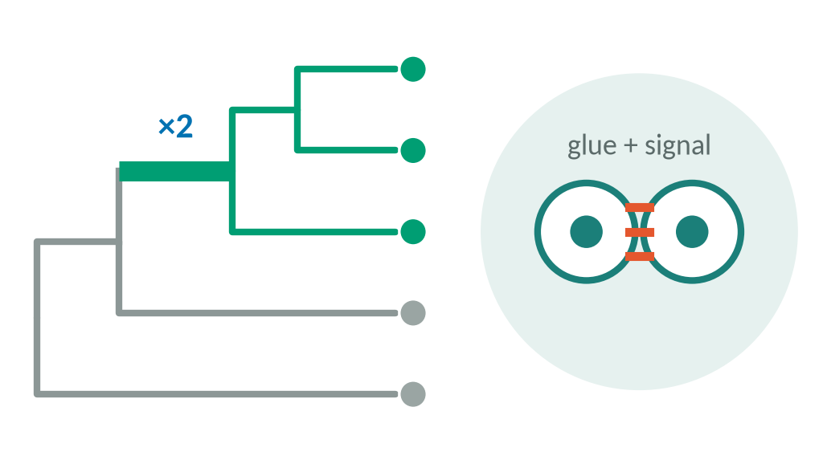
H5 · Convergent adhesion and signalling expansion?
Predicts The same adhesion/ECM and signalling domains expand independently in two or more lineages.
Every multicellular body needs cell adhesion and communication.
Classical cadherins are new domain combinations inside old families, invisible to family-level dating.
Literature Knoll 2011; Abedin & King 2010; Pereira Lobo et al. 2025; Rokas 2008a
NOT DETECTED (LOW POWER)
odds ratio 0.83 [0.55–1.27], p = 0.77; Pfam-wide expansions not above chance
Notes:
H5: adhesion/ECM and communication domains expand convergently. Round 1 primary: T = 0.412, p = 0.772, Holm 0.81; pooled odds ratio 0.83 (0.55-1.27); orthology-free version opposite sign. Pfam-wide convergent expansion 370 vs 643 expected (p = 0.79), top hits transposon domains; in round 2, expansions at two or more origins 42 vs 54 expected (p = 0.98), whereas contractions recur (157 vs 90, p = 0.001). Cadherin and integrin positive controls fail in both Ancestra and EukaryOMA: dating a domain gained inside an older family is a general limit. Sources: results/literature_scorecard.tsv; report/REPORT.md §5, §7.5.

Slide 51
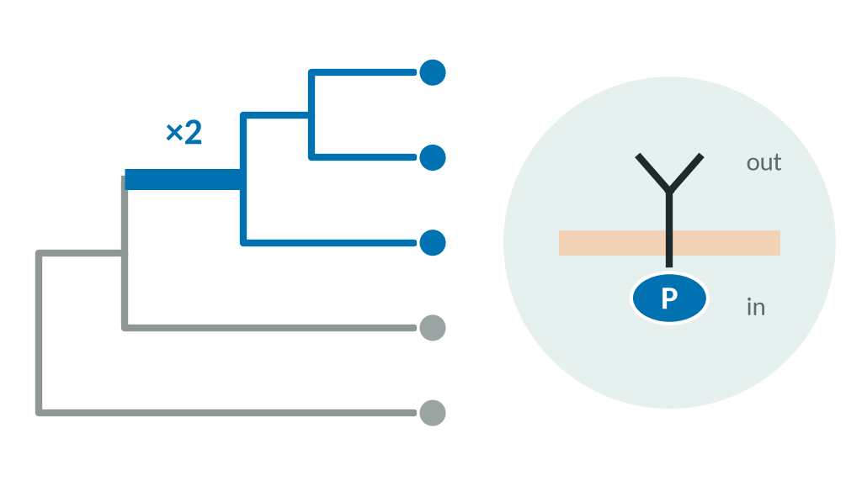
H6 · Receptor kinases in complex lineages?
Predicts Receptor-kinase families duplicate on brown-algal, plant and animal stems, but not on fungal hyphae.
Receptor kinases expanded in Ectocarpus and Arabidopsis; R2: one new kinase family at 5 of 7 complex events.
Receptor-kinase classification not run; kinase recurrence is only suggestive (q = 0.06).
Literature Cock et al. 2010; Shiu & Bleecker 2001; Manning et al. 2008; Kiss et al. 2019
PARTLY TESTED
fungal 'no expansion' control passed; kinase recurrence p = 0.023, q = 0.06
Notes:
H6: receptor kinases and signalling expand independently in complex lineages but not in fungal hyphae. The receptor-kinase classification (transmembrane or extracellular domains) was not run. The expected null on the fungal-hyphae stem was recovered as positive control C15 (no kinase, adhesion or signalling expansion). Round 2 found one new protein-kinase family at five of seven internal simple-to-complex events (recurrence p = 0.023, q = 0.06; suggestive). Sources: results/literature_scorecard.tsv; report/REPORT.md §7.5.

Slide 52
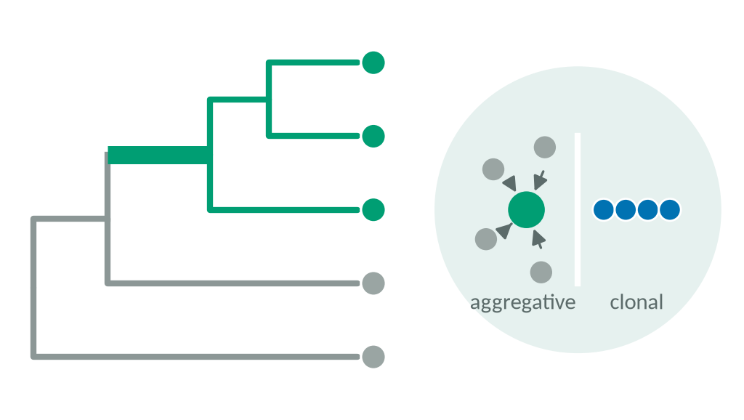
H7–H8 · Aggregative versus clonal
Predicts H7: aggregative origins gain secreted and membrane signals. H8: clonal origins show more gene turnover.
Dictyostelid development relies on extracellular signals; clonal development allows more cell types.
Few aggregative lineages with genomes; most are single species, so the stem is also a tip.
Literature Glöckner et al. 2016; Grosberg & Strathmann 2007; Fisher et al. 2013; Márquez-Zacarías et al. 2021
NOT TESTED
one aggregative primary origin (dictyostelids); not run
Notes:
H7 (aggregative transitions need new extracellular signals and sensors) and H8 (clonal transitions involve more genomic change than aggregative ones) both concern the aggregative/clonal contrast. H8 was demoted to exploratory at design because aggregative transitions are mostly single species; the signal-peptide/transmembrane predictor for H7 was not run. Only one aggregative primary origin (dictyostelids) was available; the dictyostelid polyketide-synthase control (16 vs 1 proteins per species) was recovered but is not the H7 test. Sources: DESIGN.md §4.2; results/literature_scorecard.tsv.

Slide 53
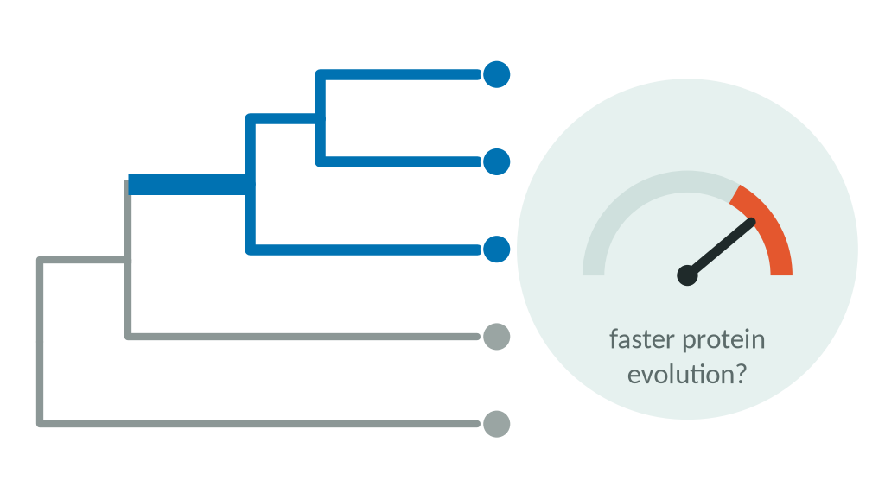
H9 · Relaxed selection after the transition?
Predicts Smaller populations weaken selection: faster protein evolution and larger proteomes after eukaryotic transitions.
Drift theory of genome complexity, recently extended to multicellularity.
Rates differ by lineage (4 stems faster, 3 slower); R2 structure-per-sequence test failed its control.
Literature Lynch & Conery 2003; Lynch 2007; Bingham & Ratcliff 2024; Pentz et al. 2023
NOT SUPPORTED
pooled rate ratio 1.10 [0.96–1.26]: no ≥1.5-fold shift; exact p = 0.31
Notes:
H9, the non-adaptive drift hypothesis: multicellularity lowers effective population size, leading to faster, less constrained protein evolution. Round 1 primary relative-rate test: pooled rate ratio 1.10 (0.96-1.26), excluding a 1.5-fold or larger average shift; the seed-dependent p was replaced in round 2 by the exact orientation-averaged p = 0.31. Gene-level RER found 0 genes at q < 0.10; radical/conservative substitution tests p = 0.60 and 0.16. Round 2 structure-per-sequence divergence was inconclusive (shuffled-letter control as large as the signal). Sources: results/literature_scorecard.tsv; report/REPORT.md §2, §8.4.

Slide 54
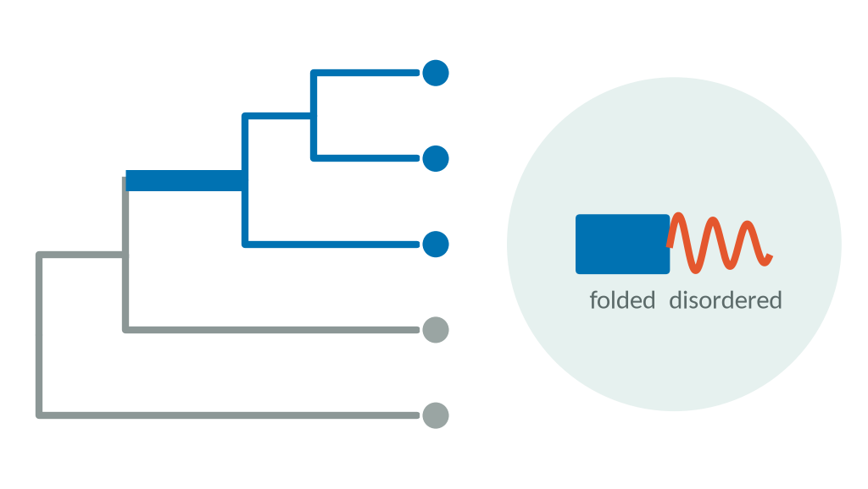
H10 · More disorder with complexity?
Predicts Disorder in transcription factors rises with cell-type number and on transition stems.
Disorder and alternative splicing scale with organismal complexity in earlier surveys.
Mixed directions: disorder up in 4 of 7 transitions, down in volvocines and animals.
Literature Schad et al. 2011; Yruela et al. 2017; Chen et al. 2014; Dunker et al. 2015
NOT DETECTED (LOW POWER)
percentiles vs controls 0.34–0.73; regression on cell-type number not run
Notes:
H10: disorder and splicing scale with complexity. Exploratory round-1 analysis on shared single-copy HOGs: disorder rose in 4 of 7 transitions (+0.019 to +0.037) and fell in volvocines and animals; percentiles relative to controls 0.34-0.73. The phylogenetic regression on cell-type number was not run. Sources: results/literature_scorecard.tsv; results/exploratory/euk/summary.md §4.

Slide 55
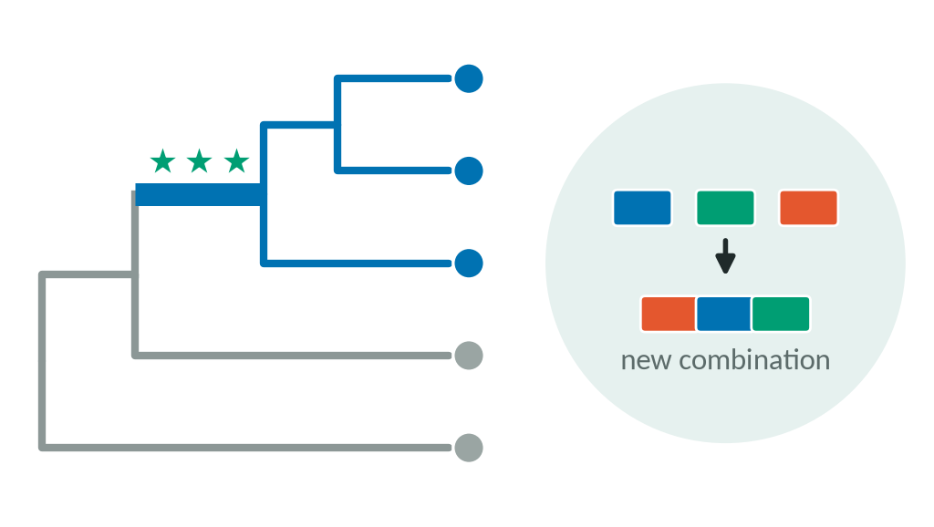
H11 · New domain combinations?
Predicts More new multi-domain architectures on complex-lineage stems than on controls.
Domain shuffling builds new proteins; animal stem: 1,131 new architectures vs control median 34.
Fails a completeness filter (BUSCO ≥ 80%: p = 0.16); exploratory only.
Literature Ekman et al. 2007; Denoeud et al. 2024; Ocaña-Pallarès et al. 2022
EXPLORATORY LEAD
p = 0.005, survives leave-one-out, not robust to data quality
Notes:
H11: domain rearrangement and gene fusion increase at complex transitions. Exploratory round-1 result: new multi-domain architectures on stems T = 0.80, p = 0.005; Metazoa 1,131 vs matched-control median 34; survives leave-one-out (p <= 0.017) and the genome-only subset, but not a BUSCO >= 80% completeness filter (p = 0.16); pooled observed/expected 1.02 (0.36-2.91). Flagged by the department head as worth follow-up. Sources: results/literature_scorecard.tsv; reviews/round2_department_head_review.txt.

Slide 56
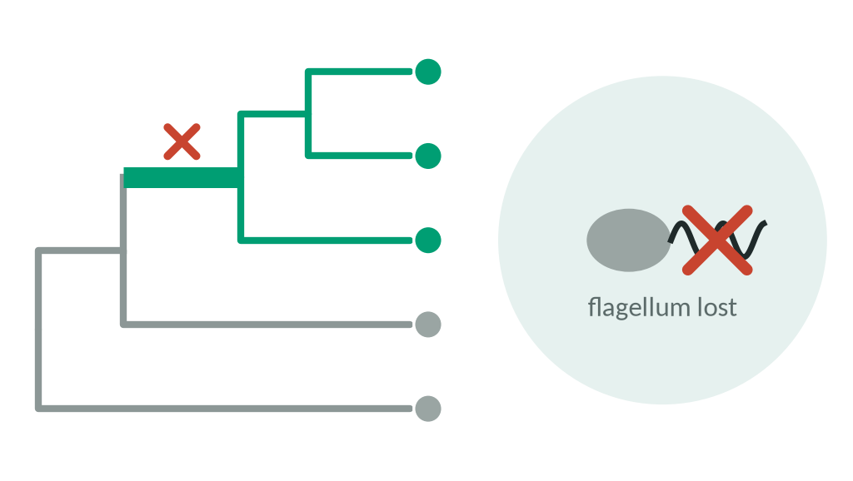
H12 · Shedding unicellular functions?
Predicts Flagellar and phagotrophy genes are lost at transitions; reversals lose multicellularity genes.
Fungi and dictyostelids lost all four flagellar modules, as expected ('shedding of protist genes').
Only two loss-expected stems (power ≤ 0.33); reversals do not preferentially shed transition genes.
Literature Merényi et al. 2023; Yang et al. 2026; Nguyen et al. 2017
NOT DETECTED (LOW POWER)
p = 0.020, Holm-adjusted 0.10; reversal odds 0.86–1.39
Notes:
H12: losses of unicellular functions accompany transitions; reversals lose multicellularity genes. Round 1 primary (flagellar-module loss with pre-registered direction per transition): T = 0.738, p = 0.020, Holm 0.10, not significant after correction; both loss-expected stems (fungal hyphae, dictyostelids) lose all four flagellar modules. The reviewer noted the test is largely a confirmation that spent Holm correction. Reversals (5 yeasts, Zygnematophyceae): odds of losing genes gained at the preceding transition 0.86-1.39 (not supported). Sources: results/literature_scorecard.tsv; reviews/round2_department_head_review.txt.

Slide 57
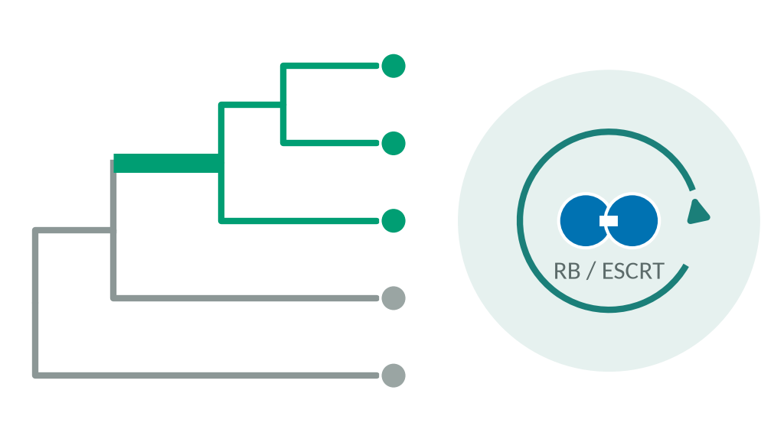
H13 · Is cell-cycle control co-opted?
Predicts RB/E2F, ubiquitin–proteasome and ESCRT/septin genes duplicate or speed up on clonal stems only.
Gonium co-opted the retinoblastoma pathway; incomplete cell division links cells by bridges.
Duplication and rate contrasts were not run; only one co-option control.
Literature Hanschen et al. 2016; Featherston et al. 2018; Chaigne & Brunet 2022
NOT TESTED
RB pathway already present in the unicellular volvocine ancestor (control recovered)
Notes:
H13: cell-cycle and cytokinesis control is co-opted on clonal transition branches. Not tested as specified; the clonal vs aggregative contrast was not run. Positive control C11 was recovered: the RB pathway is present at the unicellular volvocine ancestor, consistent with co-option (Hanschen et al. 2016). Sources: results/literature_scorecard.tsv.

Slide 58
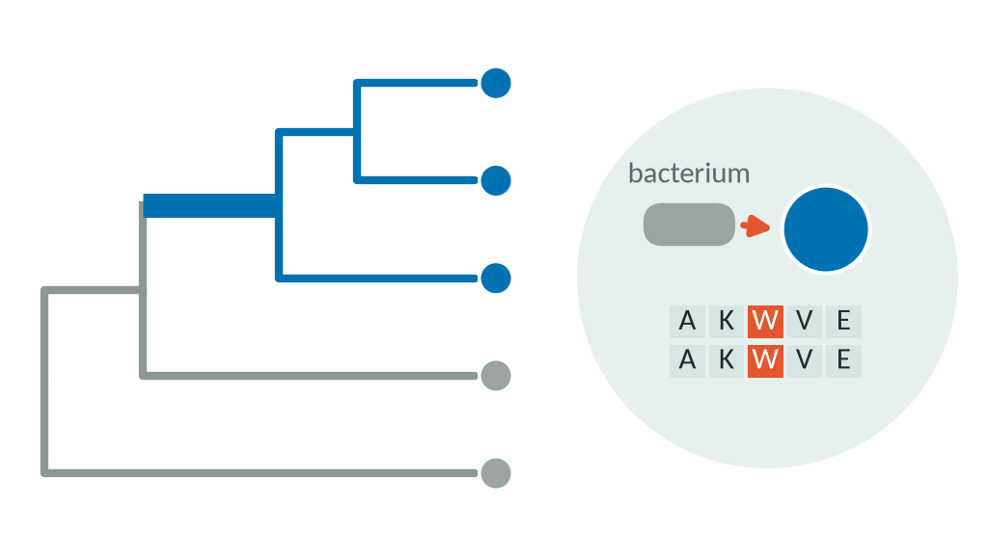
H14–H15 · Gene transfer and site convergence
Predicts H14: non-animal origins gain more genes by horizontal transfer. H15: the same amino-acid changes recur at independent origins.
Gene transfer is common in fungi, protists and brown algae; strong molecular convergence in complex fungi.
Both need per-family gene trees; cut for time at the design stage.
Literature Ocaña-Pallarès et al. 2022; Denoeud et al. 2024; Sheikh et al. 2024; Glöckner et al. 2016; Merényi et al. 2020; Iizuka et al. 2026
NOT TESTED
cut for time (DESIGN.md §4.2)
Notes:
H14 (horizontal gene transfer contributes more to non-animal transitions) and H15 (molecular convergence at the level of sites, testable with CSUBST/PCOC) were both cut for time in the round-1 design (DESIGN.md §4.2). They remain open questions for future work. Sources: LITERATURE.md §5.2, §7; DESIGN.md.

Slide 59
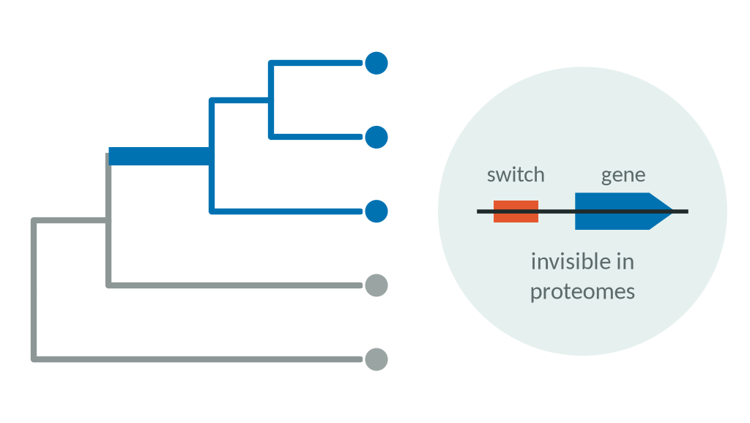
H16 · Regulation rather than new proteins?
Predicts Multicellularity mainly rewires gene regulation; protein-coding content changes little.
Dynamic regulatory genome in Capsaspora; our many nulls are compatible with it.
Regulatory change is invisible in proteomes; compatibility is not evidence.
Literature Sebé-Pedrós et al. 2016; Jiménez-Marín et al. 2022; Nagy et al. 2014
NOT TESTABLE HERE
outside the scope of protein-only data
Notes:
H16: regulatory rather than coding change dominates. Only partly testable with proteomes (expected negative results for novelty in volvocines and fungal hyphae, with TF expansions). The report lists it as a limitation: only protein-coding content was studied; regulatory change, which much of the literature emphasises, is invisible here. Sources: LITERATURE.md §7; report/REPORT.md §10.4.

Slide 60
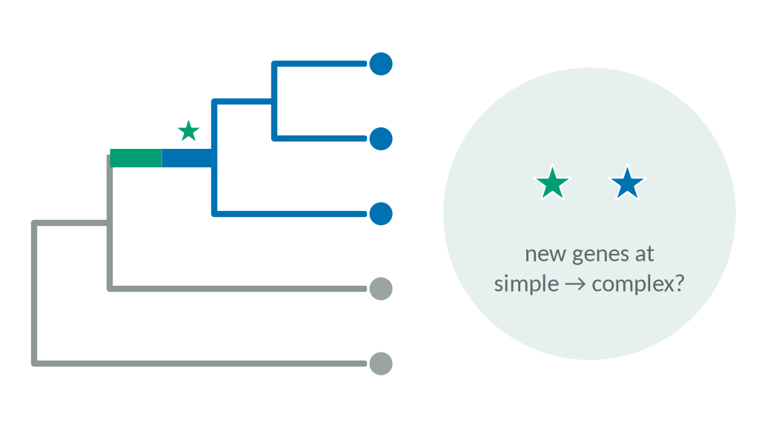
R2-P1 · New genes at simple-to-complex steps?
Predicts Four unseen simple → complex events carry more sequence-novel families than matched controls.
Round-1 lead at nested events (1.9–3.3×); land-plant bursts; convergent expansions in complex fungi.
Power 18–41%; two events are single-species tips; three share one panel's controls.
Literature Knoll 2011; Bowles et al. 2020; Merényi et al. 2020; Nagy et al. 2018; Herron & Michod 2008; Lindsey et al. 2021
NOT SIGNIFICANT
combined p = 0.050 (Holm 0.10); internal-only 2.8× [1.3–5.9], exploratory
Notes:
Round-2 confirmatory test P1. Events frozen before reconstructions: Astrephomene, Volvox carteri, V. africanus/reticuliferus (Volvox is polyphyletic), Fucophycidae stem. Combined p = 0.0504 as specified (0.072 as implemented), Holm 0.10; tip artefact explains the large per-event ratios; with one effect per panel the design could not have reached significance. Internal-only exploratory estimate 2.81 (1.34-5.89) vs origins 0.82. Sources: report/REPORT.md §3, §6; DESIGN_ROUND2.md §6.

Slide 61
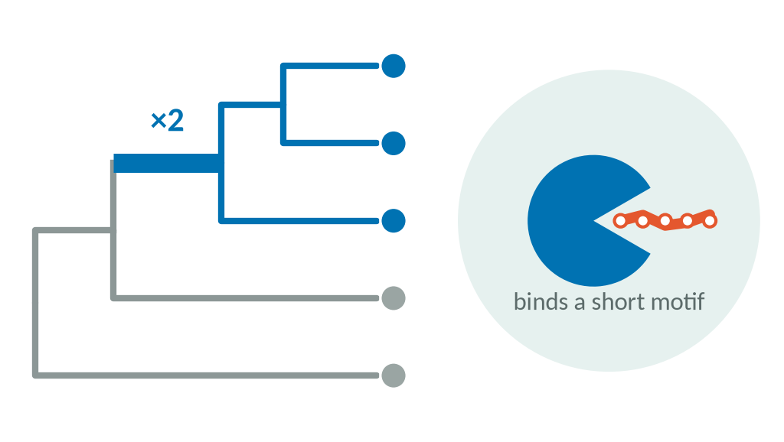
R2-P2 · More motif-binding domains?
Predicts Domains binding short linear motifs (SH2, SH3, PDZ, WW, 14-3-3…) are more abundant in multicellular genomes.
Proposed to expand with regulatory complexity; 115 families fixed from ELM before testing.
Expansion only within animals; contraction in hyphal fungi.
Literature Kumar et al. 2024 (ELM resource)
NULL
0.98-fold, p = 0.72; 6 of 7 leave-one-out estimates negative
Notes:
Round-2 confirmatory test P2: 115 motif-binding Pfam families from ELM; PGLS on 148 genomes; -0.028 SD (95% CI -0.124 to 0.067), p = 0.72, 0.98-fold. A Bayesian phylogenetic count model gave a small positive estimate (sensitivity; considered anti-conservative for many-family sets). Expansion visible within the animal origin and contraction in hyphal fungi: lineage-specific. Sources: report/REPORT.md §7.4; Supplement S5.

Slide 62
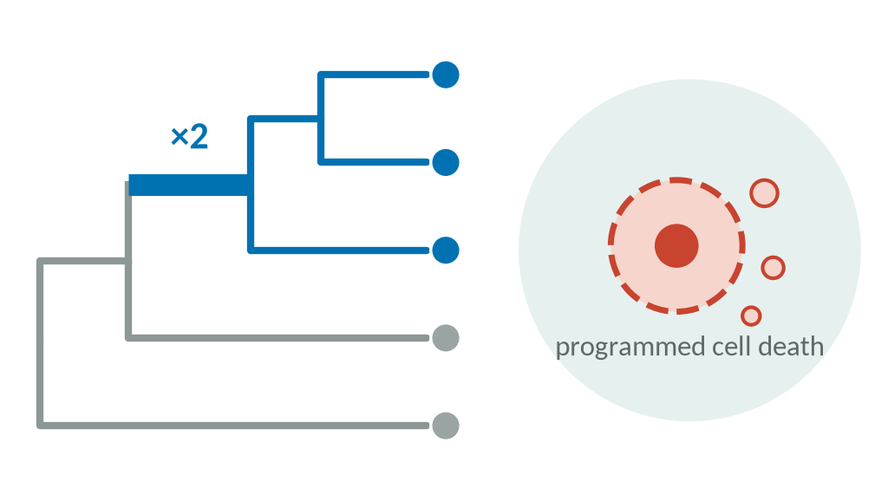
R2-P3 · More cell-death machinery?
Predicts Multicellular genomes carry more programmed-cell-death proteins than expected for proteome size.
Cell death can benefit relatives; a joint origin with virus arms races has been proposed.
Size-dependent; mostly immune receptors; core apoptosis machinery already in the common ancestor of eukaryotes.
Literature Durand et al. 2016; Iranzo et al. 2014; Klim et al. 2018; Jones & Dangl 2006; Dyrka et al. 2014
SUPPORTED
1.21× [1.04–1.42], Holm p = 0.014; mainly complex lineages
Notes:
Round-2 confirmatory test P3, the one supported test: +0.167 SD, one-sided p = 0.0047, 1.21-fold (1.04-1.42), Holm 0.014; complex vs unicellular +0.249 (p = 0.0005). Robust to leaving out any origin or family; independently re-derived; random prevalence-matched sets reached p < 0.05 in 2.5% of cases. Caveats: without the ten largest proteomes p = 0.025; as share of the proteome p = 0.14; mostly lineage-specific immune and self/non-self receptors; cannot separate developmental cell death from immunity. Sources: report/REPORT.md §7.2-7.3, §10.2.

Slide 63
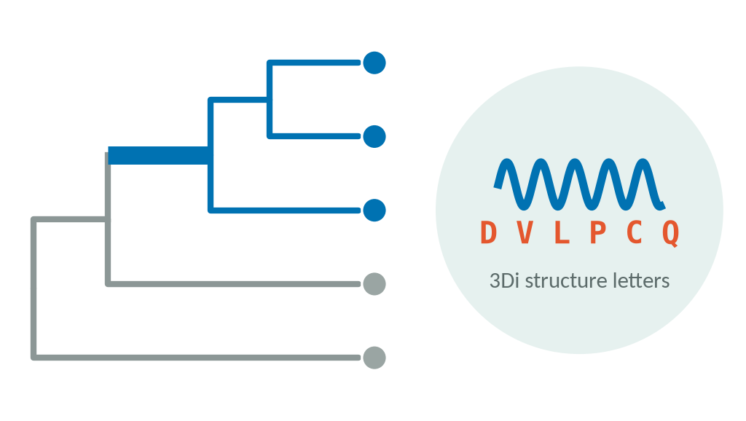
R2 · Structural novelty and constraint
Predicts Families new at events lack structural relatives; structure changes faster per sequence change in multicellular clades.
Folds outlast sequences; ProstT5 + Foldseek make proteome-scale structural search feasible.
'No match' tracks short, disordered proteins; a shuffled-letter control gave the same 'effect'.
Literature Weisman et al. 2020; van Kempen et al. 2024; Heinzinger et al. 2024; Lynch & Conery 2003
OVERTURNED / INCONCLUSIVE
OR 1.44 → 1.18 [0.93–1.49] after adjustment; divergence test inconclusive
Notes:
Round-2 exploratory structure analyses. Structural novelty: unadjusted OR 1.44 (p = 0.004) for structurally unmatched families on event branches; overturned by adversarial verification (length, disorder, depth; adjusted 1.18, 0.93-1.49; exhaustive search found homologues for 21%). A weak simple-to-complex lead remains (family-level adjusted OR 1.73, not significant with branches as units). Structure per sequence change: +7-12% inside crowns, but shuffled control equal or larger. Sources: report/REPORT.md §8.3-8.4.

Slide 64
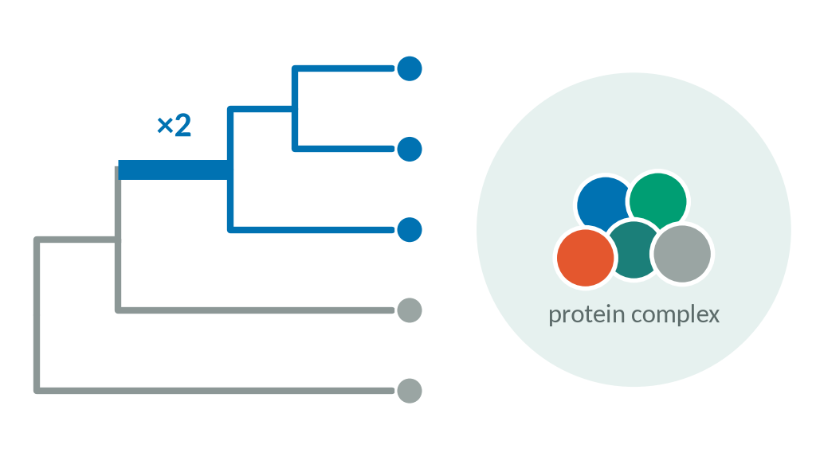
R2 · Protein complexes kept or duplicated?
Predicts Duplications on multicellular stems hit subunits of ancient complexes; complexes stay intact more often.
LECA interactome from co-fractionation mass spectrometry across 31 species.
Map holds only ancient complexes; 13 mappable species; duplication counts depend on the method.
Literature Cox et al. 2026 (Marcotte lab; preprint Cox et al. 2024)
NULL
66.6% (animals), 72.1% (fungi) vs 63.6% controls; none enriched after correction
Notes:
Round-2 exploratory complex analysis using only the published LECA complex map (raw co-fractionation profiles not reanalysed). Stem duplications show no consistent preference for complex subunits; co-retention slightly lower in multicellular species. Treated as a null because duplication counts are method-dependent. Sources: report/REPORT.md §9; RESEARCH_TREE.md W7.

Slide 65
Decisions that transfer
H
What this project did, what went wrong, and what future projects should copy
Notes:
Section H. Source: LESSONS.md (14 rules); agents/retrospective_R2.txt; report/REPORT.md §11.

Slide 66
From this project to future projects
This project
Future projects
Hashed pre-registration, 3 tags
Label tests with < 40% power as estimation
Calibrated on simulations (2.1–2.6×)
Pilot every statistic on control-only data
Adversarial verification: 2 claims overturned
Never let authors verify their own work
Department-head review steered round 2
External review at every round boundary
Dense panels, 15–45 min each
Many small runs beat one giant run
EukaryOMA cross-check (29%)
Run a second method on key counts
GPU pilot caught a silent CPU fallback
Check the device before long jobs
Condensed from LESSONS.md (14 rules) and the fresh-agent retrospective.
Notes:
Transferable practices. Hashed pre-registration (3 tags) kept confirmatory tests separate from later sensitivity analyses; next time, also label tests with power below about 40% as estimation. Calibration on simulations and control data (2.1-2.6-fold gain inflation; null false-positive rate 14.5% to 4.9%) should be extended to piloting every statistic on control-only data, including tip/internal comparability, before freezing. Independent adversarial verification overturned two claims; authors should never verify their own results. External senior review steered round 2. Many small dense runs (15-45 min) beat one giant run. A second method (EukaryOMA) gave the most sobering result. GPU and long-run pilots with a device check, and a LESSONS file of 14 rules, should be carried into the next project. Source: LESSONS.md; agents/retrospective_R2.txt; report/REPORT.md §11.

Slide 67



What went wrong
Errata
3 round-1 overstatements; 8 mismatches in the final numbers audit
Overturned claims
structural novelty and stem agreement, after verification
Tool incidents
self-killing pattern kill (×2), orphaned GPU job, premature wait-loop run, undocumented floor
Low-power test
simple → complex test: 18–41% power, could never pass Holm
All were caught and documented by the process itself; none is hidden in the report.
Notes:
What went wrong, briefly. Errata: round 1 overstated three statements, and a final numbers audit of the round-2 report found eight further mismatches (166 of 174 claims matched). Overturned claims: structural novelty at transitions and better cross-method agreement at stems, both already written into summaries. Tool incidents: twice a pattern-based kill command killed its own caller, once leaving a GPU job unsupervised; a wait loop launched an analysis prematurely on four of eight panels; an undocumented branch-length floor changed the confirmatory p from 0.050 to 0.072. Low power: the simple-to-complex test had 18-41% power and, read with its dependence, could never reach significance. Source: report/REPORT.md §11; RESEARCH_TREE.md R2-M4; LESSONS.md rules 5, 8, 12.

Slide 68
Conclusion
I
AI-led research: outcome and future possibilities
Notes:
Section I. Source: report/REPORT.md §10-§11.

Slide 69

AI-led research: honest, fast, self-correcting
≈31 h
Did well
Did badly
Honest nulls, with power
Low-power confirmatory tests
two complete rounds, from literature to reviewed report
Self-correction: 2 own claims overturned
Design flaws found after seeing data
Not yet verified by a human
Full audit trail: pre-registration, deviations
Undocumented choices, stale numbers
Parallel team, cheap dense runs
Tool handling, lagging records
Notes:
AI-led research outcome. Speed: about 31 hours of wall time for two full rounds, including literature review, data assembly of hundreds of proteomes, 11 reconstructions, GPU structure prediction and two reports. Strengths: honest nulls with stated power, self-correction (verification overturned two of the team's own claims; analysis agents caught the tip artefact themselves), a complete audit trail (pre-registration, dated deviations with 'Seen:' lines, research tree). Weaknesses: confirmatory tests frozen with known low power, design problems found only after seeing data, undocumented analysis choices, lagging records and tool handling. The outcome is a careful, mostly negative study whose clearest product is methodological: where ancestral gene-content reconstruction cannot yet be trusted. Nothing has been verified by a human yet. Source: report/REPORT.md §11; agents/retrospective_R2.txt.

Slide 70

Future possibilities
Human verification
methods and benchmarks, then update the disclaimer
More genomes
EukaryOMA's 1,328 genomes; genome sisters for transcriptome-only lineages
Deep-node orthology
domain-level dating; gene-birth simulator for the bias
Structure at scale
finish 3Di for all proteomes; real 3D models
Experimental links
cell death vs immunity; regulatory data
First step: a human check of methods and benchmarks; nothing here has been verified yet.
Notes:
Future possibilities. Human verification of methodology and benchmarking is pending (the disclaimer will be updated). Data: EukaryOMA's 1,328 genomes and new genome sisters for transcriptome-only lineages. Method: better orthology at deep nodes and domain-level dating (cadherin-like innovations are new domain combinations inside old families); calibrating the gain bias with a gene-birth simulator (recommended, not done). Structure at scale: 3Di prediction stopped at 271 of 322 proteomes; full coverage and 3D models would allow real fold analyses. Biology: the cell-death/immune-receptor result invites experimental and population-level follow-up (developmental cell death vs immunity); regulatory change needs non-protein data. Source: report/REPORT.md §10.3-10.4; RESEARCH_TREE.md R2-M4.

Slide 71
Read more
Final report: claude.ai/artifact/9rkyi2Xwe1VyhCgUcjZuoJ
Department-head review: claude.ai/artifact/NfrexbqRBFmS3A97VvTqcR
Added after publication: report/REPORT.md §12 · results/r2/recurrence_ladder/
Repository: report/REPORT.md · RESEARCH_TREE.md · LESSONS.md · reviews/
Hackathon: github.com/evocellnet/ai-hackathon · [repository URL: ____]
Notes:
Links. Final report page: https://claude.ai/artifact/9rkyi2Xwe1VyhCgUcjZuoJ. Department-head review of round 1: https://claude.ai/artifact/NfrexbqRBFmS3A97VvTqcR. Repository paths: report/REPORT.md (final report), report/REPORT_SUPPLEMENT.md, report/REPORT_round1.md, RESEARCH_TREE.md, LESSONS.md, LITERATURE.md, reviews/. The public GitHub URL of this project's repository is left blank for the PI. Added after publication (project lead's request): report/REPORT.md section 12 and results/r2/recurrence_ladder/summary.txt. Source: RESEARCH_TREE.md R2-M4; report/REPORT.md Data and code availability.

