Slide 1
Updating WormExp
Project structure, documentation and discussion
Jennifer Neumaier

Slide 2
Specifc
WormExp is a transcriptomics database for Caenorhabditis elegans (C. elegans). Here, all data that has been published all over the world are collected and sorted. The database was updated last 2017 and no new datasets were added since then.
Measurable
By the time of March 2022, the database will be updated, so that all recent published data (since 2017) has been added. Additionally, by then features will be implemented, to help regularly updating the database.
Achievable
Updating the database is instrumental for gene enrichment data analysis on C. elegans. Time should be spent to correctly identify good and useable data sets and how a database is set up. This will improve the quality of future experiments.
Relevant
Using databases and transcriptomics data is an integral part for experiments on C. elegans. It is therefore vital, that such a database is correctly set up and regularly updated.
Time-bound
In six month, the database should be updated, so it includes all recent publications, and additionally include features to make updating the database easier. This should reduce the work of a student for 6-months to only a few hours a month.

Slide 3

Projektstrukturplan I
Attention: due to the high number of new datasets found, only the first half (~330 datasets) will be uploaded into the database
Stand: 14.02.22
WormExp
Project management
Transcriptomics data
Optimization
Quality management
Compile list with all needed databases
Script for database search
Guide for WormBase
Goals
Strategy
Get lists with all the newest, published data
Script for automated email notification
Write SOP for updating database
Requirements
Sort new data into categories

Slide 4
Projektstrukturplan II
Stand: 14.02.22

Slide 5
Stakeholder
Stand: 01.10.21
Stakeholder (Kommunikation) | Art der Kommunikation | Rhythmus | Umfang | Inhalt
Project Owner | Direkte Meetings über Zoom | Zweiwöchentlich | Ca. 1h pro Meeting | Vorstellung der Ergebnisse, Besprechung der nächsten Schritte
Database Owner | E-Mail Kontakt | Nach Bedarf |  | Für Fragen und Änderungsvorschläge zur bereits bestehenden Datenbank
Transcriptome Expert | E-Mail Kontakt | Nach Bedarf |  | Für Fragen und Anmerkungen zu Transkriptomdaten

Slide 6
Description of Categories:
Epigenetics:
Chromatine studies, epigenetic markers
Stand: 08.10.21
Tissue:
Specific mention of certain tissues
„intestine specific“/"neuron specific"/"muscles"/"gonades"/"epidermis"
Mutants:
Comparison of wild type and mutants
Also, RNAi experiments
Chemicals/stress:
Heat, UV, high salt, osmotic stress
"exposure"
TF Target:
"TF"/"Transcription"
DAF-16, SKIN-1, HSF-1, HLH-30, ATF-, STAR, etc.
Microbes:
Species name in the title
Reaction of C. elegans to other organisms, "infection"/"exposure"/"food“
Microbiome analysis
Development/Dauer/Aging:
Certain genes that influence development (e.g. DAF)
"lifespan"/"larva"/"L1/L2"/"adult"
DAF/Insulin/food:
Like Development/Dauer/Aging
Like Microbes "Insulin"/"food"/"starvation“
Other:
All gene sets not included in the other categories

Slide 7
Criteria supplementary data
Stand: 12.01.21
1) Wir vertrauen den Autoren, d.h. wir vertrauen ihrer Strategie, signifikant differentiell regulierte Gene zu identifizieren. Entsprechend übernehmen wir ihre Genlisten. In der Übersichts-Excel-Tabelle solltest Du dann eintragen, welche Kriterien genau verwendet wurden. 2) Ausnahme zu obigem Punkt 1: Wenn die Kriterien offensichtlich zu lax waren (zB berücksichtigter p-value > 0.1 und dabei kein p-adjust bzw. fdr und gleichzeitig auch keine Berücksichtigung eines minimalen Foldchange) und wenn gleichzeitig Angaben zu Foldchange und p-Werten vorhanden sind, dann wenden wir striktere Kriterien an, zB: foldchange>=2 und gleichzeitig p-fdr/p-adjust < 0.01. Die Entscheidung, ob die von den Autoren gewählten Kriterein zu lax sind, ist leider subjektiv. Bei Deinem Beispiel (p-value < 0.05 und ein fold-change von 1.4 für upregulated oder < 0.7) würde ich bei den Genlisten der Autoren bleiben, da zumindest eine gewissen Stringenz durch die minimalen Foldchange-Werte umgesetzt wird. Wichtig ist, dass wir bei allen neuen Datensätzen dokumentieren, welche Kriterien verwendet wurden bzw. ob wir von den Autoren abgewichen sind. 3) Wenn die Autoren selbst keine Genlisten erstellt haben und gleichzeitig aber Angaben zu p-Werten und foldchange vorhanden sind, dann wenden wir unsere stringenten Kriterien an: foldchange>=2 und gleichzeitig p-fdr/p-adjust < 0.01.

Slide 8
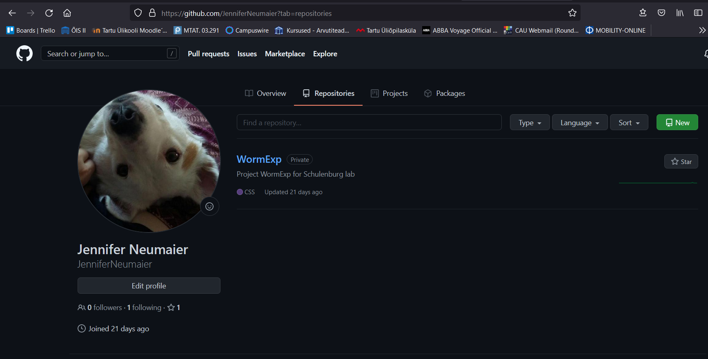

WormExp Project
Databases: ncbi
Datatypes:
GSE
E-MEXP
E-SMDB
Stand: 07.10.21
Transcriptomics: waiting for review
Created Excel file with newest published datasets (with first query)
Highest GSE in WormExp: GSE68709
564 results found, with 41 results overlapping with current database
Paperfinder: ON HOLD
Script that uses PubMed API to search for fitting papers
Use of keyword extractor for best keywords
„Start of WormExp Project“
ArrayExpress: ON HOLD
Database for E-MEXP, E-SMDB etc. data
See if an API is available for it
~175 experiments since 2015
GEOparse: DONE
Script to get query results via python and transform them into .csv output
Updated for usability by other users

Slide 9
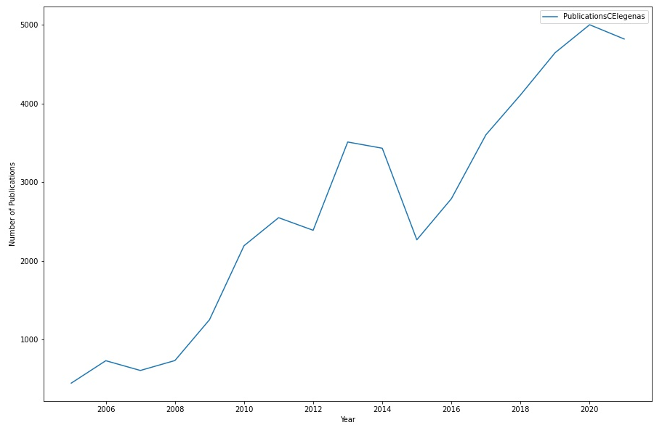
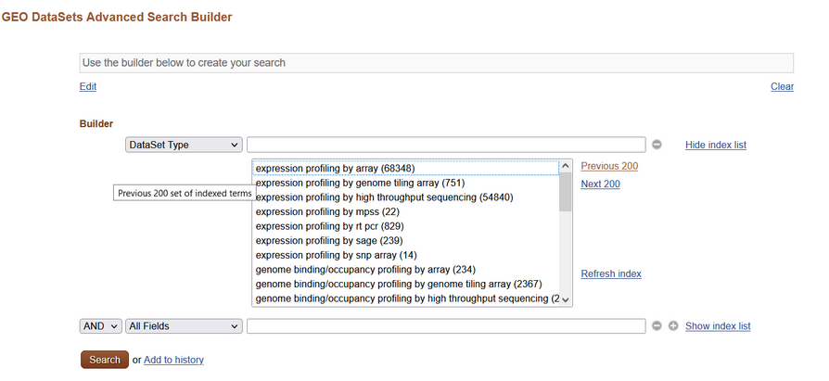
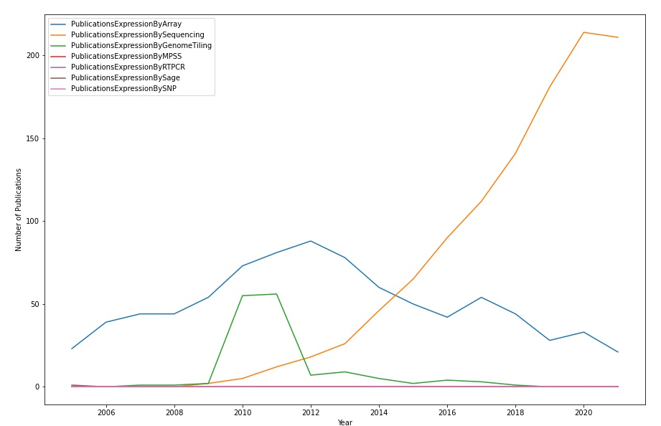
WormExp Project – Query analysis
Stand: 10.01.22
Query analysis to find overlap in data that is already included vs. new data
Use information to find starting point to collect new data
Keywords/Tags are not available for every GEO dataset -> search via DataSet Type (see figure below for all available data set types)

Slide 10
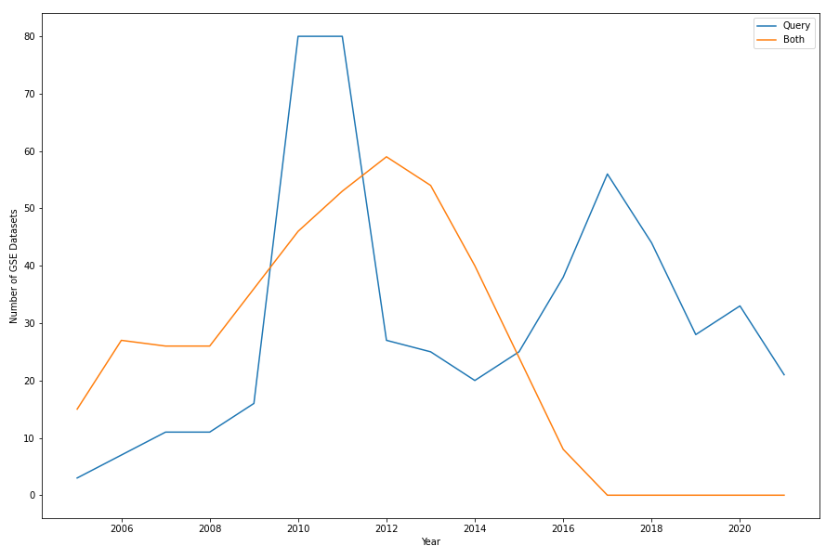
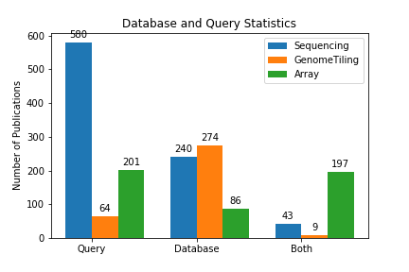
WormExp Project – Query analysis
Stand: 21.10.21
Including all experiment types
„Both“ drops at 2015 -> starting query at 01/01/2015

Slide 11
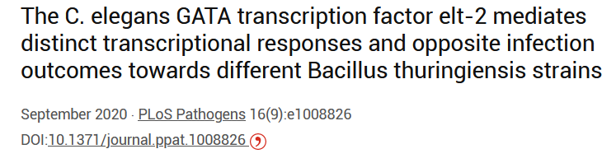
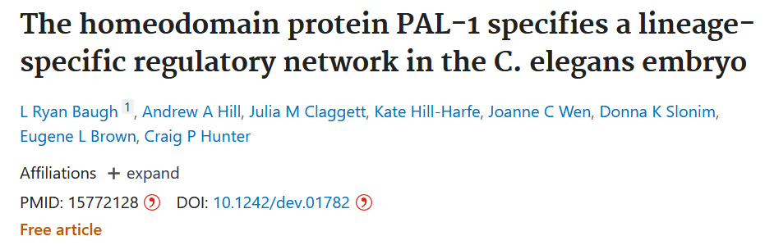
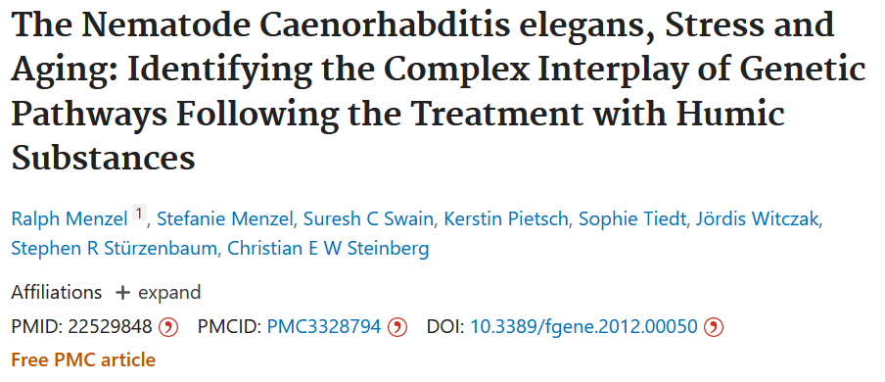
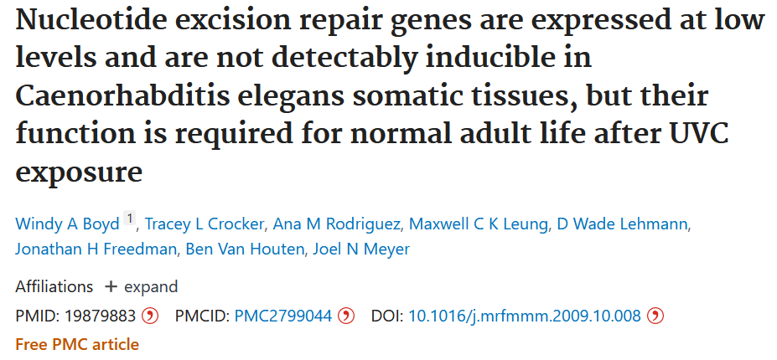
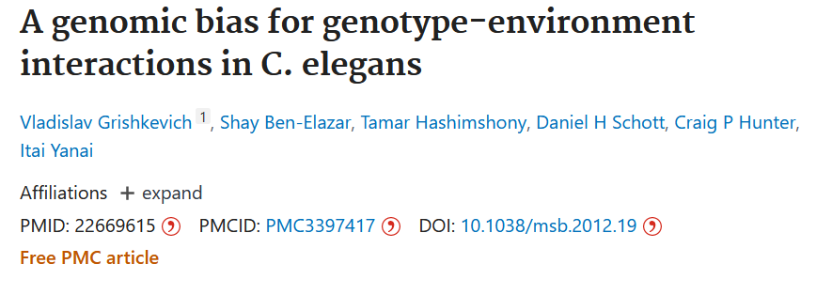
WormExp Project – Paperfinder
Possibilities:
BioEntrez (PubMed)
GoogleScholar
GitHub Projects (Paper_Finder, etc.)
Stand: 25.10.21
rejected
Idea: using five to ten papers to gather keywords and search papers reliable that way
Current Problems:
Extracting best keywords
Finding good API for e.g. GoogleScholar
GitHub projects bring their own baggages…
Suggestions:
Yang: do it manually
Use PubMed database (GEO) and ArrayExpress

Slide 12
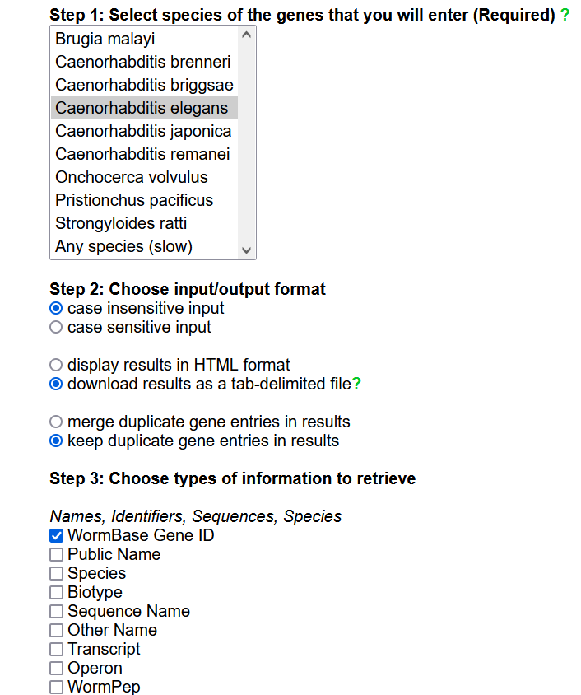
WormExp Project – SimpleMine
Stand: 17.01.22
Link:
https://wormbase.org//tools/mine/simplemine.cgi
Use settings as seen on the right ->
WormExp based on WS235 (now also WS283)
Current version WS283 -> if seen correctly, all changes never changed WormbaseIDs to SequenceIDs (only CGC names)
no check of already assembled WormbaseID datasets

Slide 13
Pilot Study/Test Run
Curated test sets: for v2.0 they are fused with v1.0
Stand: 24.02.22
Possible Problems:
Addition of Epigenetics
New data sets have errors (e.g. Missed gene ID, etc.)
Additions of columns in WormExp_info (are they shown to the scientist?)
Creation of Test:
Repeat of „real“ experiment to confirm functionality
Create test sets to test old and fused database separately
Check if upload works correctly
Make enrichment analysis on each category
Take data sets that are in the database
This way, the program should show those data sets first and show FDR and p-values if 0.0
For fused database the program should find both data sets

Slide 14
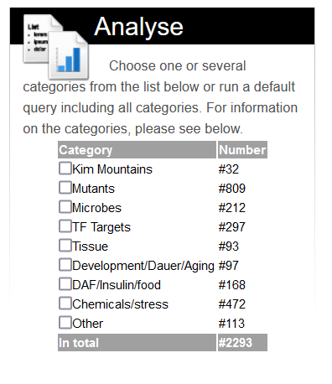
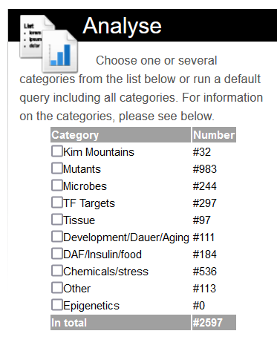
Pilot Study/Test Run
Stand: 24.02.22
V1.0
V2.0
Categories w/o updates:
Other and Kim Mountains
#number only shows unique gene sets

Slide 15
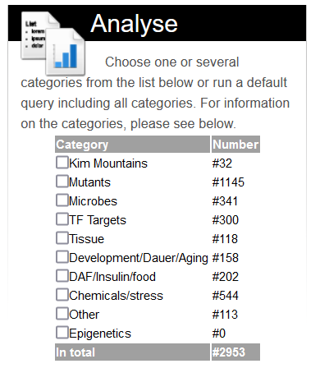
Pilot Study/Test Run
Stand: 10.03.22
V2.0
V3.0
Categories w/o updates:
Other and Kim Mountains
Rough tests with data sets showed that all new datasets were incorporated

Slide 16
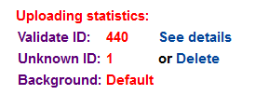
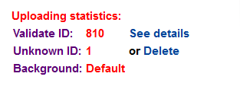
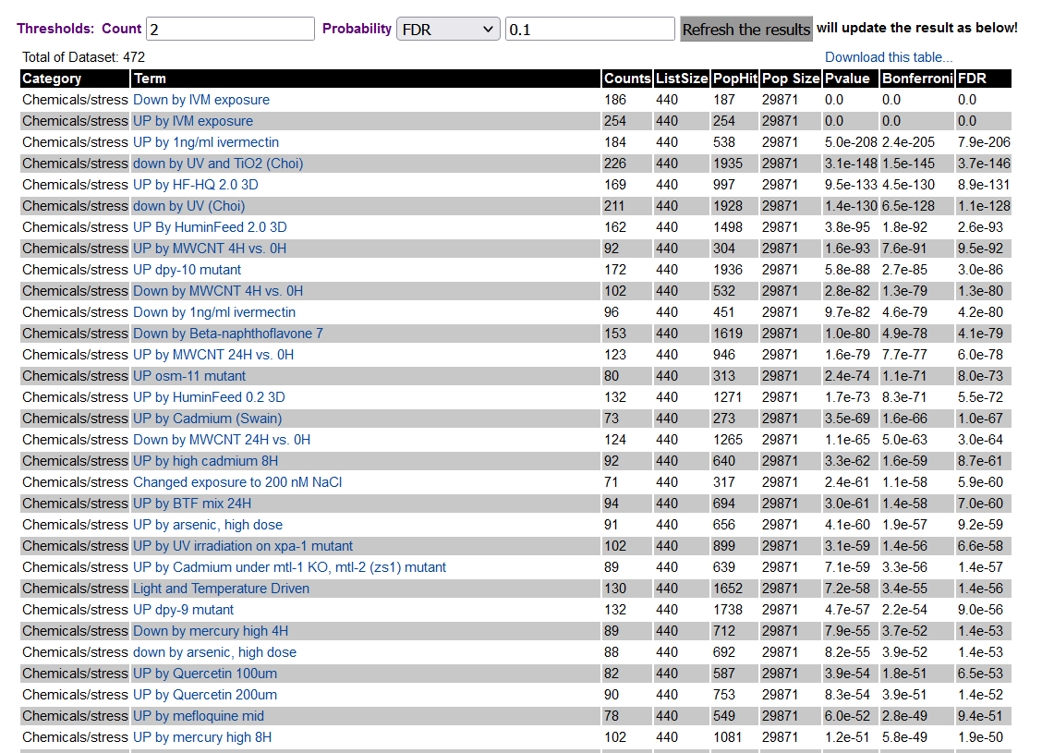
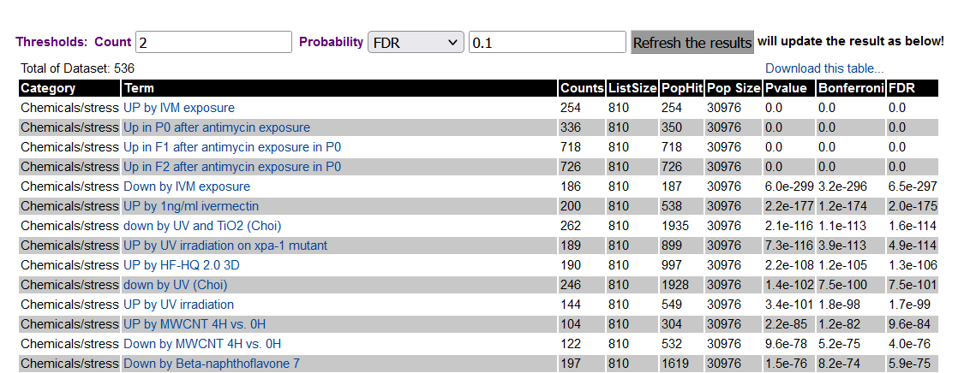
Pilot Study/Test Run
Chemicals/stress
Stand: 24.02.22
V1.0
V2.0
Nicely shows all 4 data sets

Slide 17
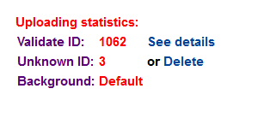

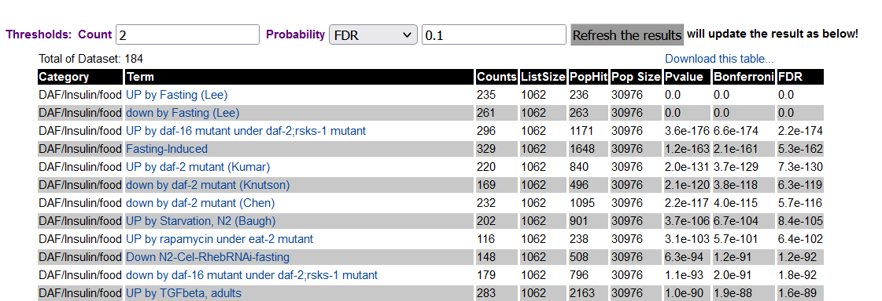
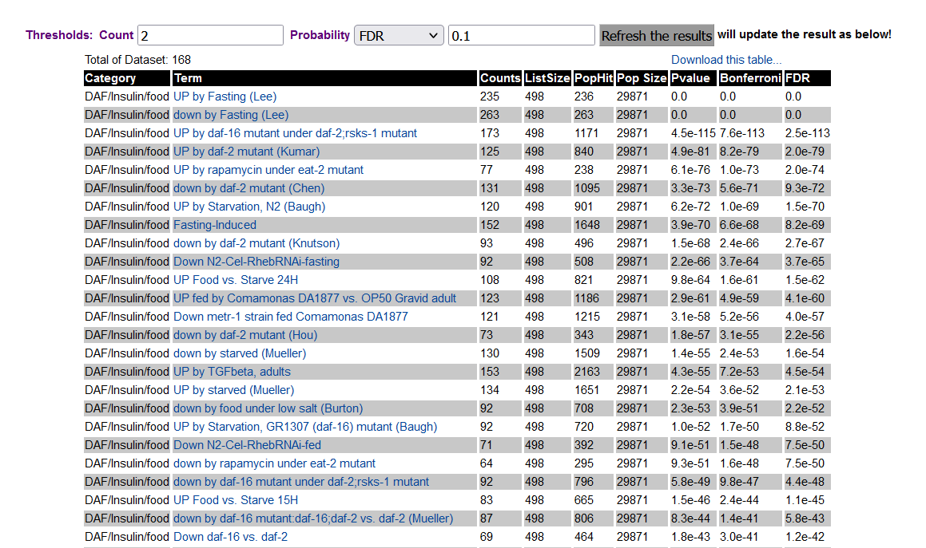
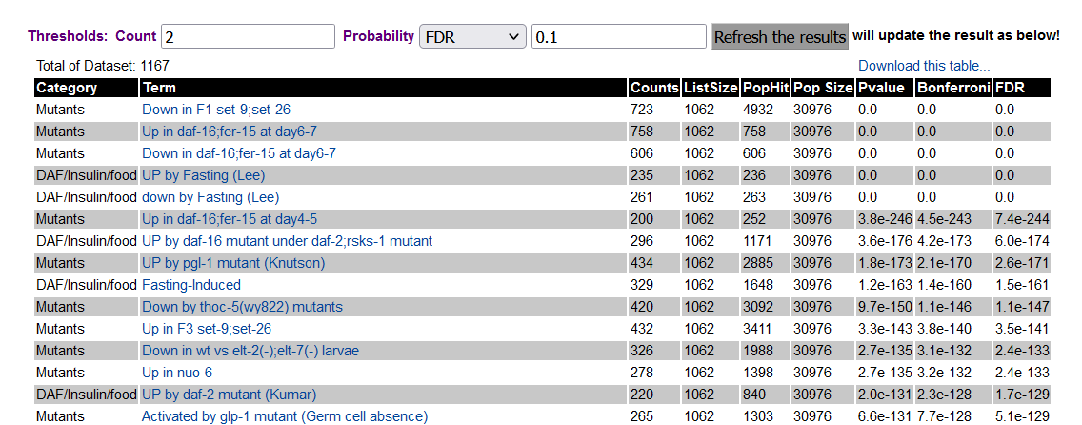
Pilot Study/Test Run
DAF/Insulin/food
V2.0
Stand: 24.02.22
V1.0
Nicely shows all 4 data sets
Can find data sets only after „mutants“ was included

Slide 18
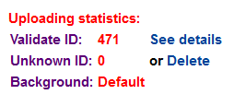
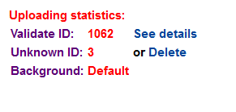
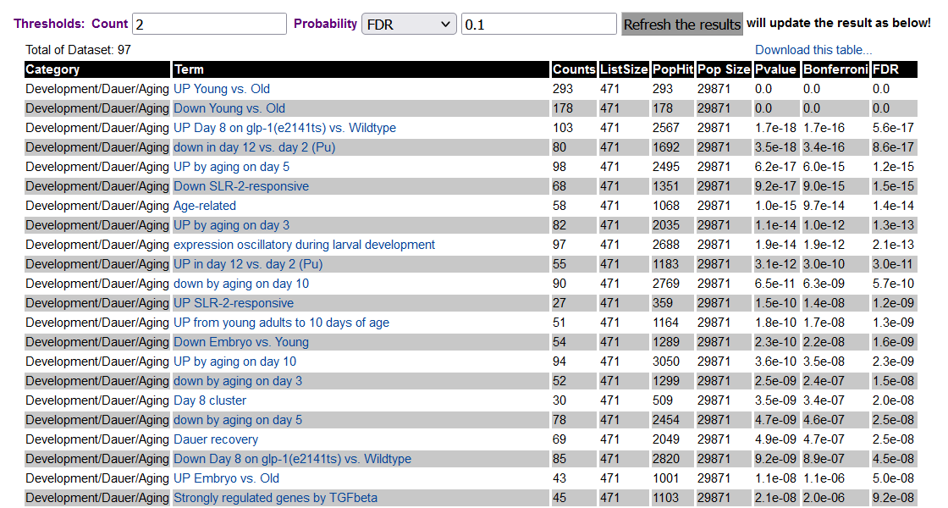
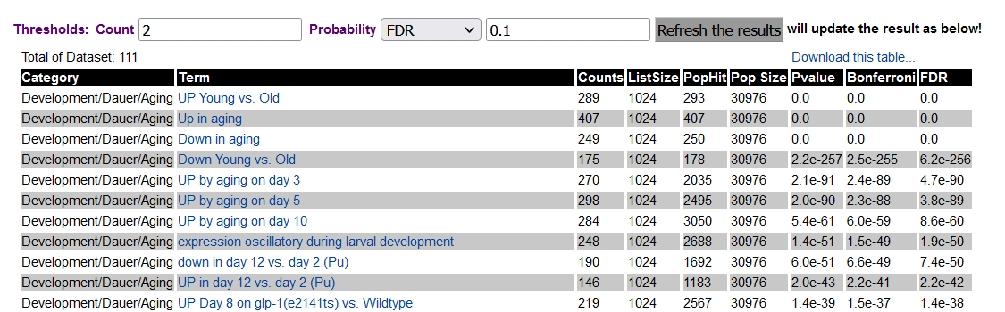
Pilot Study/Test Run
Development/Dauer/Aging
Stand: 24.02.22
V1.0
V2.0
Nicely shows all 4 data sets

Slide 19
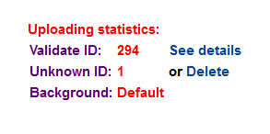
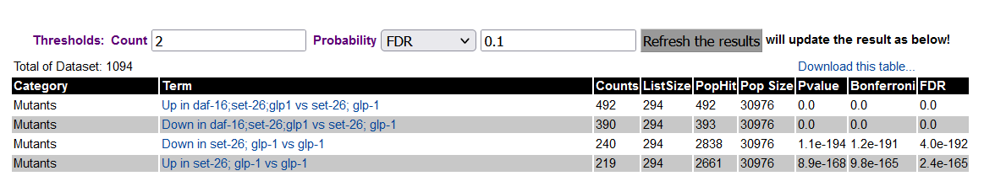
Pilot Study/Test Run
Epigenetics
Stand: 24.02.22
V2.0
Same Problem as DAF

Slide 20
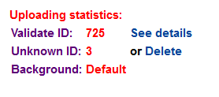
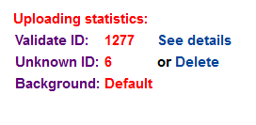
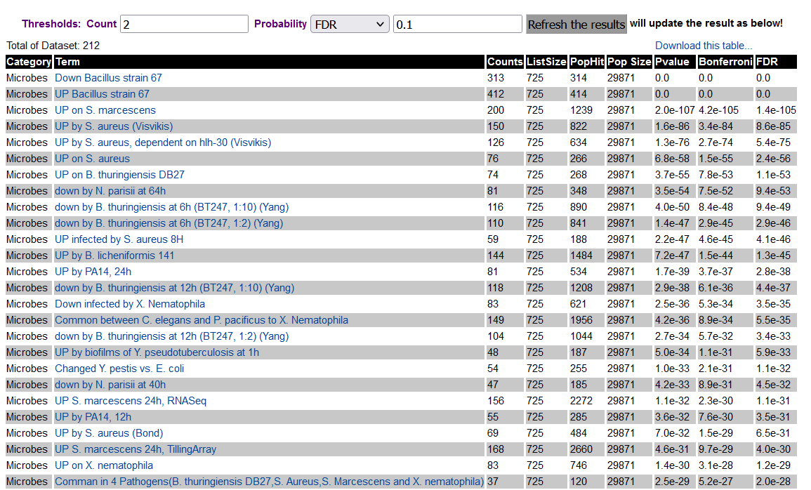
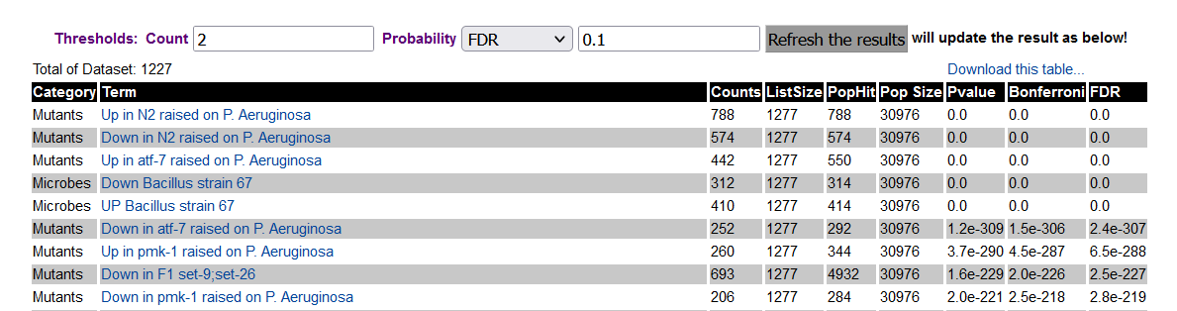
Pilot Study/Test Run
Microbes
Stand: 24.02.22
V1.0
V2.0
Same Problem as DAF

Slide 21
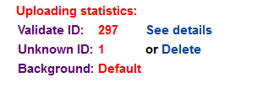
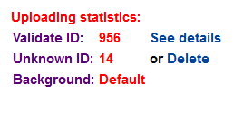
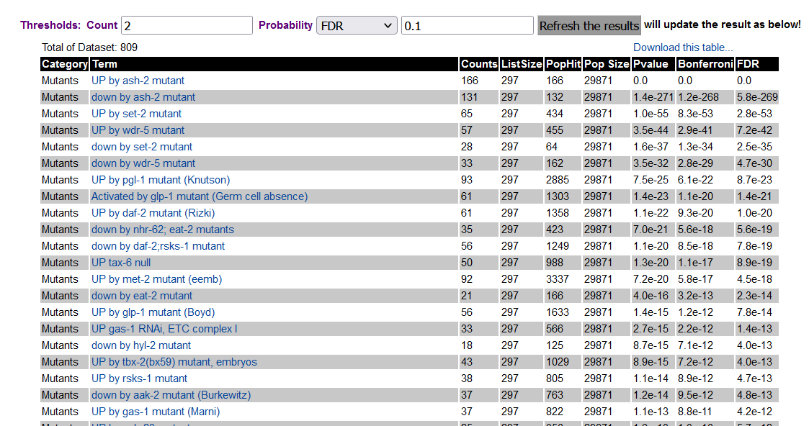
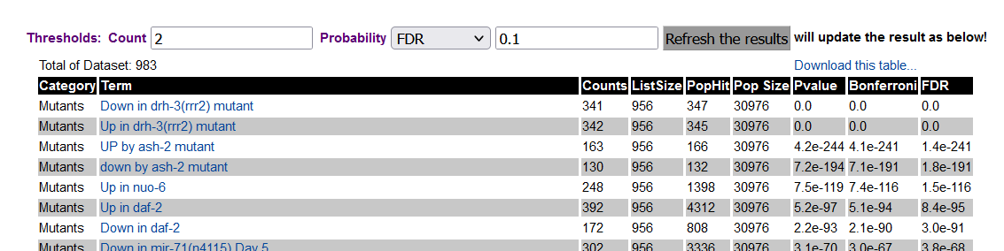
Pilot Study/Test Run
Microbes
Stand: 24.02.22
V1.0
V2.0
Worked well

Slide 22
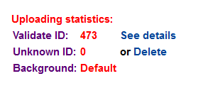
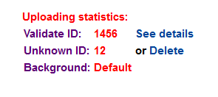
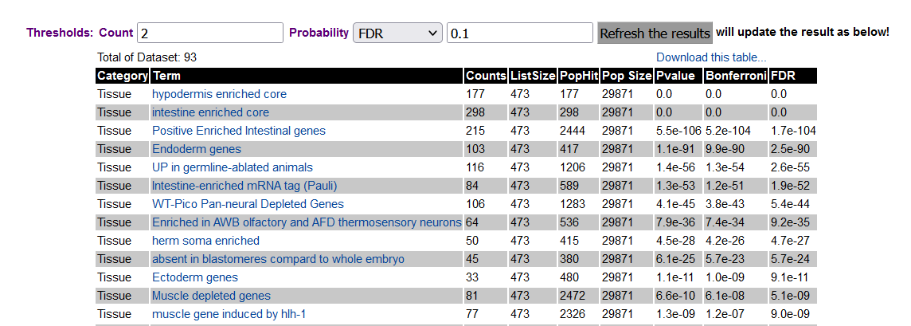
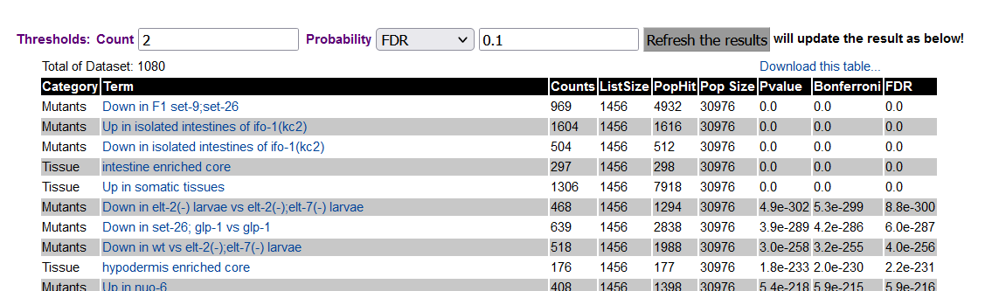
Pilot Study/Test Run
Tissue
Stand: 24.02.22
V1.0
V2.0
Same Problem as DAF

Slide 23
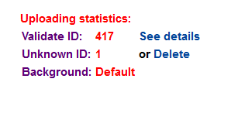
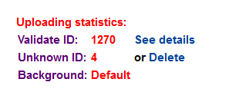
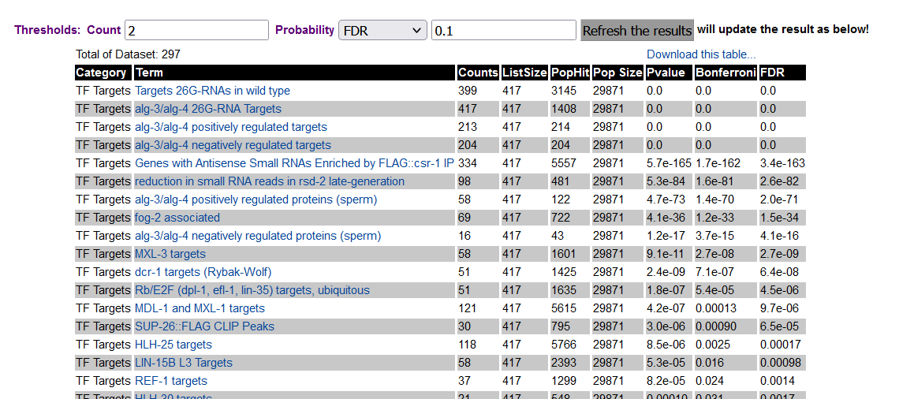
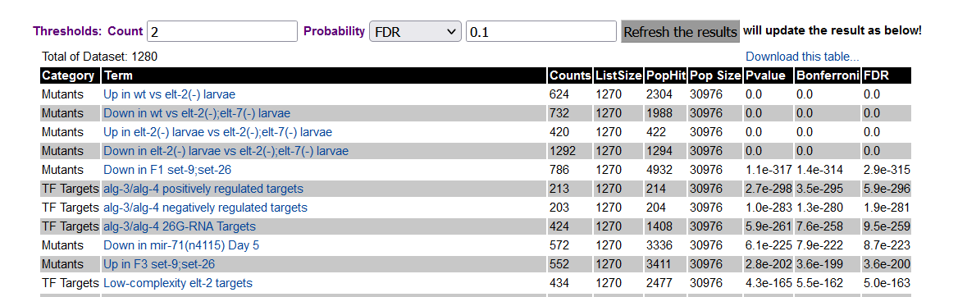
Pilot Study/Test Run
TF Targets
Stand: 24.02.22
V1.0
V2.0
Same Problem as DAF

Slide 24
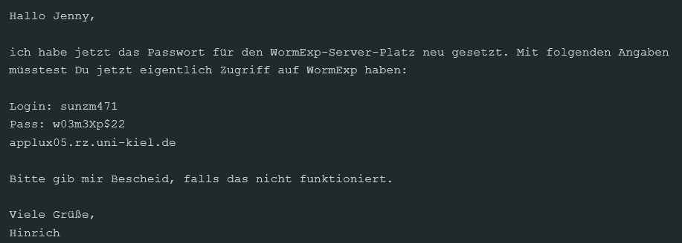
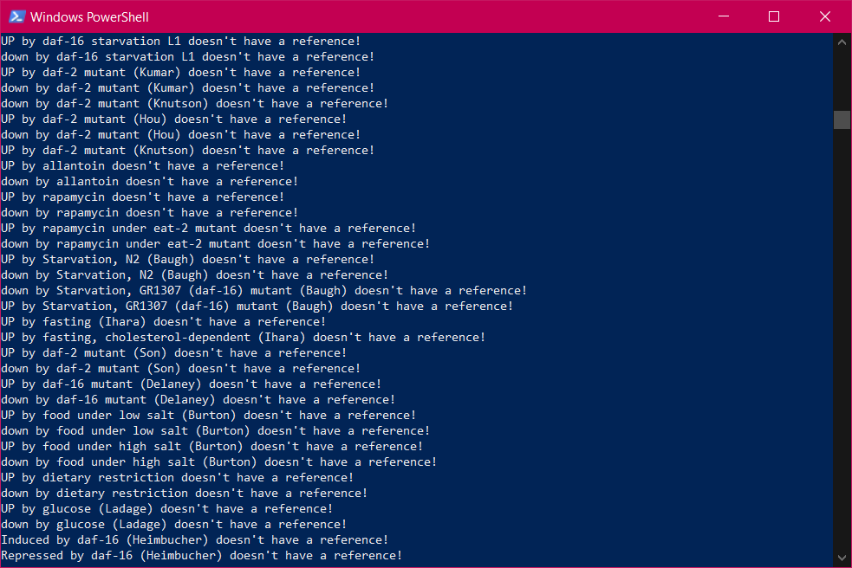
Functional Update of Database
Zugriff auf Server:
Stand: 10.03.22
Problem:
Test has shown that database is not able to categorize datasets in multiple categories
References are only shown correctly if gene set name is hundred percent the same string as in reference -> check all gene sets
Lösungsideen:
1) Analyse anzeige aus webseite rausnehmen und text ändern zu: „immer alle kategorien nutzen“
2) Alle datensätze nur einer kategorie zuordnen
3) Java source code ändern und alle datensätze mehreren Kategorien zuordnen (an Yang abgeben?)
Präferenz der Lösungen: 3) -> 1) -> 2)

Slide 25
Proof of Principle: Enrichment Analysis
Stand: 02.03.22
- gene sets von zarate-potes (247 vs 407, 697 vs 407), vergleich gesamter datenbank (alles)
- paper: erläuterung abb.2 + Excel Dateien
- vergleich mit alten ergebnissen (mehr ergebnisse?)
- visualisierung
Die biologische Frage dahinter ist, inwieweit sich die Veränderung in der Genexpression des Wurms (und damit die Ergebnisse der Enrichment Analyse) zwischen zwei nah verwandten pathogen Stämmen unterscheiden, aber auch zwischen nicht-pathogen und pathogenen Stämmen. Wir haben dafür eigentlich Datensätze für zwei unterschiedliche pathogene Bt Stämme (Bt247 und Bt679) und für einen nicht-pathogenen Stamm, Bt407 (siehe unten).
Ich fände es auch noch interessant, Enrichment Analysen für alle Mikroben Daten Sätze zu machen und zu gucken, ob man in den Ergebnissen Muster erkennen kann, die pathogene Bakterien von nicht-pathogenen Bakterien unterscheiden. Macht das Sinn? Dafür müssten wir alle Mikroben Datensätze einmal durchgehen und ich sage dir dann, welche Mikroben pathogen sind und welche nicht.
Use microbes_list, summarize strains and create heatmap

Slide 26
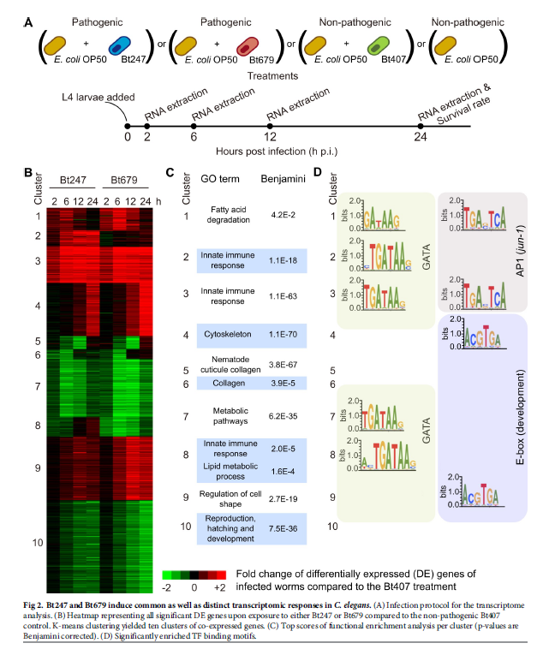
Proof of Principle: Repeat of Zarate-Potes
Stand: 20.03.22
Zarate-Potes:
Extract genes from all clusters (done)
Throw clusters in WormExp and collect in Excel file (done)
Throw away all results with FDR > 0.01 (done)
Note: if I take all cluster data from suppl. 3, then I mix up Bt247 and Bt697 and all life stages and do not consider which results are significant or not
Additional analysis to compare Bt247 24h Clusters and Bt697 24h Clusters
-> see if any genes can be extracted
Visualisation:
Table with old data/matching data/new data
More/less overlaps?

Slide 27
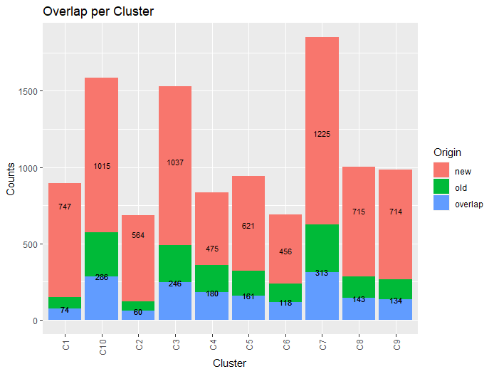
Proof of Principle: Repeat of Zarate-Potes
Stand: 23.03.22
Quantitative analysis
All sets have been found again + a lot more additionally
Remove „old“

Slide 28
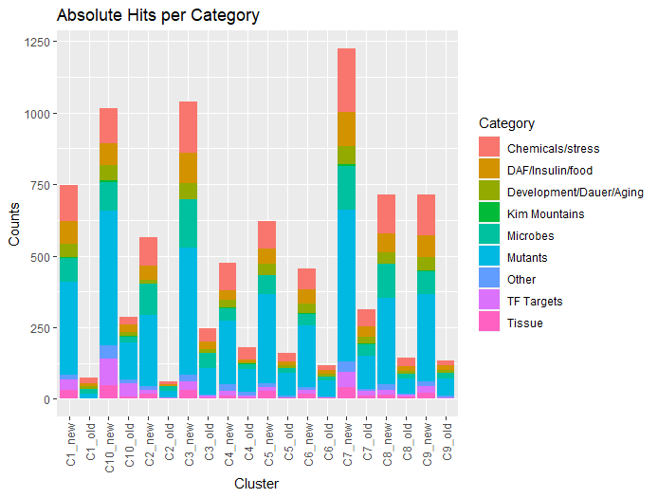

Proof of Principle: Repeat of Zarate-Potes
Stand: 23.03.22
Quantitative analysis

Slide 29

Proof of Principle: Repeat of Zarate-Potes
Something like this
- e.g. Filter out all genes with abundances < 10%
Stand: 23.03.22
Qualitative analysis

Slide 30



>30% abundance filter
Proof of Principle: Repeat of Zarate-Potes
Stand: 23.03.22
Qualitative analysis
>10% abundance filter
>20% abundance filter

Slide 31


Proof of Principle: Repeat of Zarate-Potes
Vergleich von alt/neu mehr oder weniger obsolet, weil alle sets von alt auch automatisch in neu drinnen sind
Stand: 23.03.22
Qualitative analysis
new C1 cluster; only chemicals/stress
old C1 cluster ; only chemicals/stress
Frage: nach was suche ich in den Clustern?

Slide 32

Proof of Principle: Repeat of Zarate-Potes
Qualitative analysis
For chemicals/stress
Stand: 23.03.22

Slide 33

Proof of Principle: Repeat of Zarate-Potes
Qualitative analysis
For chemicals/stress
Stand: 23.03.22
Notes:
Top 10-20 der signifikanten hits nehmen und da die Gene abgleichen
Sortierung
Vergleich alt/neu
Überlappungen zwischen Gensets als neue Heatmap (auch hier Trennung alt/neu)

Slide 34


Proof of Principle: Repeat of Zarate-Potes
Qualitative analysis
Top 30 significant hits, no sorting by category!
Stand: 04.01.22

Slide 35
Proof of Principle: Repeat of Zarate-Potes
Qualitative analysis
Top 30 significant hits, no sorting by category!
Stand: 04.01.22

Slide 36

Proof of Principle: Overlap comparison
Stand: 30.03.22
Overlap comparison:
Compare all of Schulenburg datasets and find overlap in genes
Used 12h gene sets as this was available for all three studies
Notes:
GSE64401 -> mehr WormbaseIDs?
Fokus auf GSE111797 und GSE60063 Überlappungen/Unterschiede
24h dazunehmen

Slide 37


Proof of Principle: Overlap comparison
Stand: 30.03.22
Up
Down
B0024.4, M02H5.8, C17H12.8, K11H12.4, clec-4, T19D12.4, W09G12.7, T24E12.5, far-7, tth-1, scrm-4
D1086.3, lys-4, ilys-5, cpr-5, gst-10, cpr-9, nuc-1, elo-5

Slide 38
Proof of Principle: Microbes list
Stand: 20.03.22
Microbes list:
Collection of list with all (major) microbes in database (done)
Categorizing them into pathogenic/non-pathogenic (done)
Merging some datasets for the same microbe in one dataset (done)
Deleting duplicates
If some gene has been found in up in one dataset and down in the other, then both are kept
Microbe | pathogenic (P)/non-pathogenic (NP) | Refs | GSE_number | stage | significance
E. Coli OP50 | NP | https://pubmed.ncbi.nlm.nih.gov/29515753/ | GSE101524 | Ad1 | FDR<0.05; foldchange unknown
B. subtilis PY79 | NP | https://pubmed.ncbi.nlm.nih.gov/29515753/ | GSE101524 | Ad1 | FDR<0.05; foldchange unknown
Bacillus thuringiensis Bt407 | NP | https://journals.plos.org/plospathogens/article?id=10.1371/journal.ppat.1009454 | GSE111797 | L4 | q < 0.05; foldchange >= 2
Clostridium butyricum CBM588 | NP | https://pubmed.ncbi.nlm.nih.gov/30563064/ | GSE123163 | 3-day old worms cultivated for 5 days before sequencing | p<0.01; foldchange >= 2
Micrococcus luteus | NP | http://www.ncbi.nlm.nih.gov/pubmed/19503598 | GSE15923 | L4? | n.a
Ochrobactrum anthropi MYb71 | NP | https://pubmed.ncbi.nlm.nih.gov/31440221/ | GSE111364 | L4 | padj<0.05; foldchange >= 2
Ochrobactrum pituitosum MYb237 | NP | https://pubmed.ncbi.nlm.nih.gov/31440221/ | GSE111364 | L4 | padj<0.05; foldchange >= 2
Pseudomonas sp. | NP | http://www.ncbi.nlm.nih.gov/pubmed/19503598 | GSE15923 | L4? | n.a
S. maltophilia K279a | NP | https://pubmed.ncbi.nlm.nih.gov/30177956/ | GSE107272 | L4 | Benjamini-Hochberg<0.05; foldchange >= 1.5
Bacillus thuringiensis Bt247 | P | http://www.ncbi.nlm.nih.gov/pubmed/21931778 | E-MEXP-2168 | L4 | n.a.
 |  | https://journals.plos.org/plospathogens/article?id=10.1371/journal.ppat.1009454 | GSE111797 | L4; take one time point or only 6h/12h | q < 0.05; foldchange >= 2
Bacillus thuringiensis Bt247 (1:10) | P | https://pubmed.ncbi.nlm.nih.gov/25720978/ | GSE64401 | L4; take one time point or only 6h/12h | (fold>=2 & fdr <0.05)
Bacillus thuringiensis Bt247 (1:2) | P | https://pubmed.ncbi.nlm.nih.gov/25720978/ | GSE64401 | L4; take one time point or only 6h/12h | (fold>=2 & fdr <0.05)
Bacillus thuringiensis Bt679 | P | https://journals.plos.org/plospathogens/article?id=10.1371/journal.ppat.1009454 | GSE111797 | L4; take one time point or only 6h/12h | q < 0.05; foldchange >= 2
B. thuringiensis DB27 | P | http://www.ncbi.nlm.nih.gov/pubmed/23028509 | GSE36636 | young adult stage | n.a.
Bacillus thuringiensis DB27; Cry5B | P | https://pubmed.ncbi.nlm.nih.gov/30630824/ | GSE125131 | L4 | ANOVA p<0.05; foldchange >= 2
E. coli expressing Cry5B | (P) | https://www.tandfonline.com/doi/full/10.1080/15548627.2016.1256933?scroll=top&needAccess=true | GSE78878 | L4 | p < 0.05; foldchange >= 0
D. coniospora | P | http://www.ncbi.nlm.nih.gov/pubmed/21602919 | NA | L4 | n.a.
E. carotovora | P | http://www.ncbi.nlm.nih.gov/pubmed/17875205 | Wong | L4 | n.a.
E. Faecalis OG1RF | P | https://pubmed.ncbi.nlm.nih.gov/30695063/ | GSE124372 | L4 | q<0.05; foldchange >= 2
 |  | http://www.ncbi.nlm.nih.gov/pubmed/21602919 | Wong | L4 | n.a.
E. faecalis MMH594 | P | https://pubmed.ncbi.nlm.nih.gov/29436902/ | GSE95636 | young adult stage | padj < 0.05; foldchange >=2
E. faecium E007 | P | https://pubmed.ncbi.nlm.nih.gov/29436902/ | GSE95636 | young adult stage | padj < 0.05; foldchange >=2
Harposporium | P | http://www.ncbi.nlm.nih.gov/pubmed/21602919 | NA | L4 | n.a.
Microbacterium nematophilum | P | http://www.ncbi.nlm.nih.gov/pubmed/16809667 | E-MEXP-696 | L3 | n.a.
Myzocytiopsis humicola | P | https://www.sciencedirect.com/science/article/pii/S0960982218300319#app2 | GSE101647 | L4; Time point 12h/24h? | FDR < 0.05; foldchange >= 0
N. parisii | P | http://www.ncbi.nlm.nih.gov/pubmed/24945527 | NA | L1 | n.a.
Orsay Virus | P | https://journals.asm.org/doi/full/10.1128/mBio.00924-17 | GSE95229 | L4 | padj < 0.01 and foldchange >= 2
P. aeruginosa PA14 | P | https://pubmed.ncbi.nlm.nih.gov/27066825/ | GSE60063 | L4, TP: 12/24h | q < 0.05; foldchange >= 2
 |  | https://pubmed.ncbi.nlm.nih.gov/30789901/ | GSE119292 | L4 | padj<0.05; foldchange <= 2
 |  | https://pubmed.ncbi.nlm.nih.gov/32857822/ | GSE121091 | young adult stage; TP: 24h | p<0.01; foldchange >= 2
P. luminscens | P | http://www.ncbi.nlm.nih.gov/pubmed/21602919 | Wong | L4 | n.a.
s. aureus | P | http://www.ncbi.nlm.nih.gov/pubmed/23028509 | GSE36636 | young adult stage | n.a.
S. marcescencs | P | http://www.ncbi.nlm.nih.gov/pubmed/23028509 | GSE36636 | young adult stage | n.a.
 |  | http://www.ncbi.nlm.nih.gov/pubmed/21602919 | Wong | L4 | n.a.
Stenotrophomonas maltophilia JCMS | P | https://pubmed.ncbi.nlm.nih.gov/30177956/ | GSE107272 | L4 | Benjamini-Hochberg<0.05; foldchange >= 1.5
Vibrio cholerae E7946 | P | http://www.ncbi.nlm.nih.gov/pubmed/22675448 | GSE34026 | L1 | n.a.
X. nematophilia | P | http://www.ncbi.nlm.nih.gov/pubmed/23028509 | GSE36636 | young adult stage | n.a.
Y. pestis | P | http://www.ncbi.nlm.nih.gov/pubmed/20133945 | GSE20053 | L4 | n.a.

Slide 39
Question/Notes for next meeting
Stand: 08.10.21
Datafinder script | Notes | Transcriptomics dataset | Notes
Changing query? | Compare tags of already existing database tags/directly analyzing papers from database to find out best tags (ask Yang) | Checking on datasets already in database: some were updated a few years after submission? | If data was actually updated, then yes also possibly updating database
 |  | Categories for Microbiome analysis, epigenetic experiments and proteins | See slide 7
 |  | Validation of methodology? | No, argument is that publication is quality score enough.
 |  | datasets multiple times in the database due to multiple categories? | Yes.

Slide 40
Question/Notes for next meeting
Stand: 21.10.21
Datafinder script | Notes | Paperfinder dataset | Notes | Transcriptomics dataset | Notes
Query analysis showed that a query using high throughput sequencing and publication dates starting from 2015 includes all newer publications |  | Google Scholar produces ~10.000 results when working with C. Elegans + expression profiling tags since 2015 PubMed API: https://biohpc.cornell.edu/resources/seq_comp/PB607_introductory/entrez/NCBI_entrez.html
 |  | A lot of DataSets do not have Keywords/Tags in metadata (although this category exists).

Slide 41
Question/Notes for next meeting
Stand: 03.11.21
Datafinder script | Notes | Paperfinder dataset | Notes | Transcriptomics dataset | Notes
What is Chr? How do I recognize over- and underexpressed genes |  |  |  | Suggestion for procedure: Categorize papers Collect gene names for UP/DOWN for every category | Datensätze ohne paper rauslassen
If Excel file, find column with gene name and log2FC and create list that outputs up and downregulated genes |  |  |  | Size adjusted counts or normalized counts? (is RPMK/FPMK/DESeq2 comparable?) | Nur signifikante tests rausnehmen und dann größer/kleiner null
Script to automatically download supplementary files from FTP server
If Excel file, find column with gene name and log2FC and create list that outputs up and downregulated genes

Slide 42
Question/Notes for next meeting
Stand: 15.11.21
Datafinder script | Notes | Paperfinder dataset | Notes | Transcriptomics dataset | Notes
 |  |  |  | Summary from last week: Found good supplementary files and compiled first datasets Started doing .txt files
 |  |  |  | As often: Analysis still to do Either data is only as normalized counts Or in BW or CEL/CHP files
 |  |  |  | If DESeq2 data given: - P- or q-value < 0.05 was chosen | Check these datasets and if available choose padj < 0.05
 |  |  |  | Oftentimes, WormbaseID not given -> how to do that?
 |  |  |  | Compressing data? -> e.g. Sometimes repeating controls (hermaphrodite expression levels or control worms)

Slide 43
Question/Notes for next meeting
Stand: 20.11.21
Datafinder script | Notes | Paperfinder dataset | Notes | Transcriptomics dataset | Notes
 |  |  |  | Chose all positive log-folds for upregulated and all negative for downregulated -> no distinction if it is >2log-fold FDR > padj?

Slide 44
Question/Notes for next meeting
Stand: 20.01.22
Datafinder script | Notes | Paperfinder dataset | Notes | Transcriptomics dataset | Notes
 |  |  |  | Wormbase ID: manual check of changes since WS235 (now: WS283). Suggestion: only run datasets through WormbaseID, that do not have them yet and add Excel Sheet with changes since then Waiting for correct categorization to assemble WormBaseIDs For now: trying to find hints for WS version used in papers

Slide 45

Project holder
Hinrich Schulenburg (hschulenburg@zoologie.uni-kiel.de )
Transcriptomics
Katja Dierking (kdierking@zoologie.uni-kiel.de)
WormBase
Wentao Yang (Wentao.Yang@STJUDE.ORG)
Bioinformatics
Lucas Moitinho-Silva (l.silva@ikmb.uni-kiel.de)

Slide 46
RNA-seq metrics
Stand: 03.11.21
Normalization in DESeq2 handles:
Differences in library sizes
Differences in library composition
Techniques:
RPKM (reads per kilobase million): normalized read counts for sequencing depth and gene length -> for single end RNA-seq
FPKM (fragments per kilobase million): normalized read counts for lsequencing depth and gene length -> for paired end RNA-seq
TPM (transcripts per million)
DESeq2
Steps:
log base e for every count
Average each row of log values
Filter out 0/Inf
Subtract the average log value from the log(counts) (ratio)
Calculate the median of the ratios for each sample
Convert medians to „normal numbers“ to get the final scaling for each sampe
Divide original read counts by the scaling factors
DESeq adjusts for differences in library composition:
RNA-Seq is often used to compate one tissue type to another (e.g. Liver vs spleen)
It could be that there are a lot of liver specific genes transcribed in liver but not in spleen
Differences in library composition also due to trancription factor knock-outs

Slide 47
Manual data analysis
Gene expression profiling by array:
E.g. ChiP-Seq
Datasets per GSM in GEO
Dataset consists of counts
Stand: 03.11.21
To-Do:
- Check out datasets in database to see by which rules datasets were included
Rules:
if reference provide gene set (usually supplemental files or figs), take it;
otherwise check GSE if they provide geneset in GSE;
if you can't find gene set in reference or GSE, do the analysis yourself to get the gene set.
Check WormBase Version -> check gene name assignment
Gene expression profiling by high-throughput sequencing:
E.g. RNA-Seq
Dataset consists of normalized DeSeq counts
Log2 ratio

