Slide 1
MUESLI DISTRIBUTION COMPANY
A Data Analytics Project Presentation
November, 2022

Slide 2
Agenda
01. Project Goal
02. Muesli Distribution Company Workflow
03. Key Performance Indicators
04. Data Set and EDA
05. Conclusion and Outlook

Slide 3

The Project
The project aims to provide Muesli Distribution Company with a data-based understanding of its delivery process.
Task 1: Business understanding and extraction of information from stakeholder briefing
Task 2: Development of KPIs to assist the company in keeping track of the health of their business and improve their services to their customers
Task 3: Performing EDA based on the developed KPIs
Task 4: A presentation to stakeholders describing how the business is performing based on the KPIs developed

Slide 4
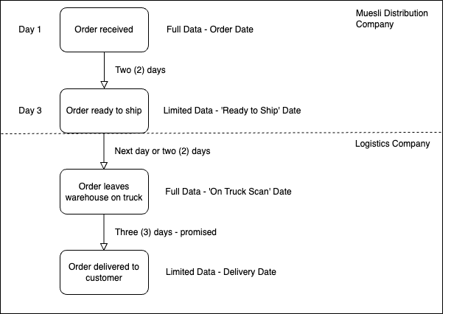
Museli Distribution Company Workflow
Additional Note
Customers can pay for Express Processing. That is, orders leave on the truck the day the order is ready for shipping.
Assumption
Exact delivery dates for some shipments were gathered via marketing promotions where customers scanned a QR code on the package to register for a price. The assumption here is that customers always scan the code on their arrival.
Data
The company, on some occasions, sent some interns into the warehouse to record the 'Ready to Ship' date for as many orders as possible.

Slide 5
Key Performance Indicators
Order Lead Time
The average time taken for customers to physically receive their orders from the time they were placed
The average time taken to get orders ready to be shipped
The average order delivery time, i.e., the time taken by the logistics partner to deliver the order to customers
The rate at which orders were dispatched on schedule or ahead of schedule
The rate at which orders were delivered on schedule or ahead of schedule
Order Cycle Time
Delivery Time
On-Time Ready-to-Ship Rate
On-Time Delivery Rate
Other Metrics

Slide 6
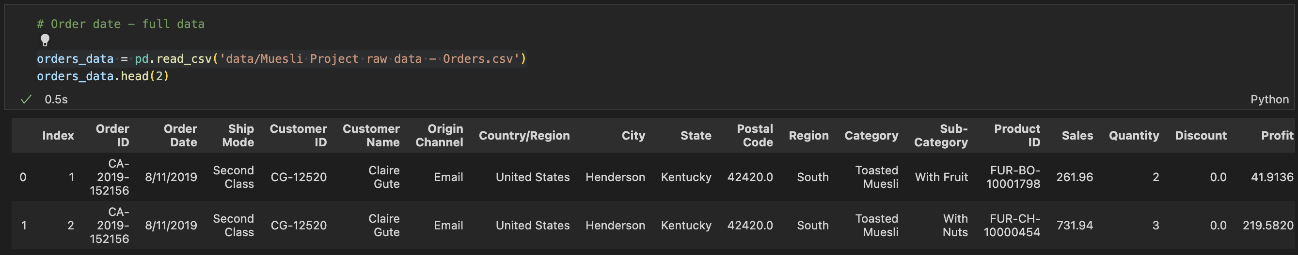
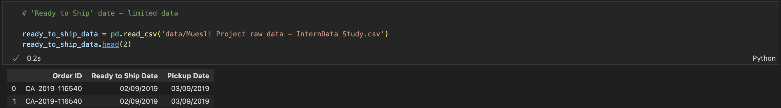
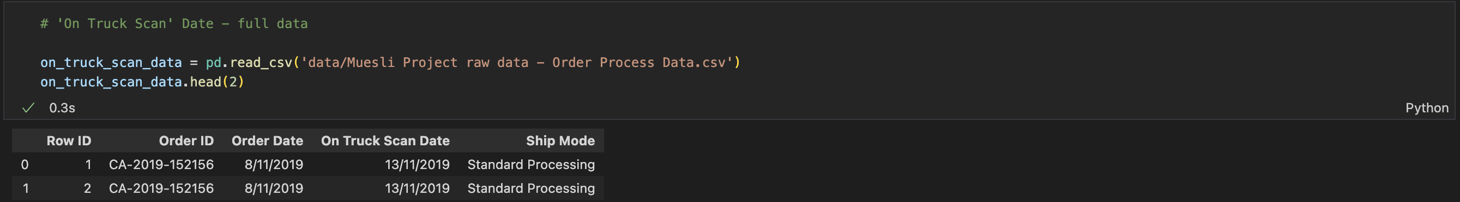
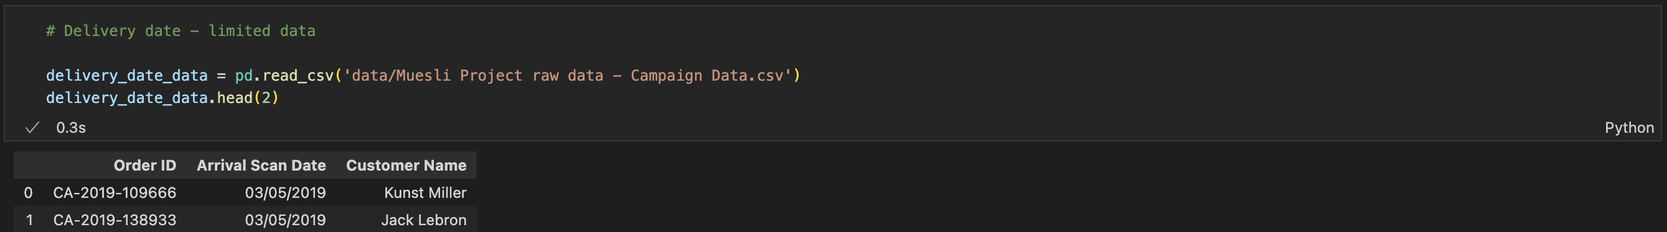
Data Set
Data
Four raw datasets were provided by Museli
Orders Data
Intern Data
Order Process Data
Campaign Data
Initial Data Exploration
The data was loaded into pandas, cleaned, and simple EDA was performed to describe the data, carry out descriptive statistics, and identify missing values (e.g., postal code for Vermont) and outliers.
Joining of DataFrames
DataFrames were combined and augmented to generate the needed data to validate assumptions and KPIs.

Slide 7
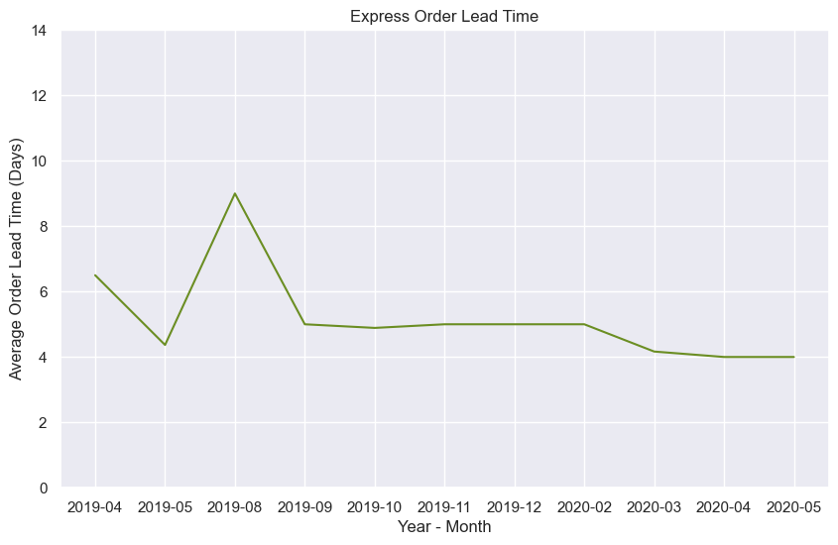
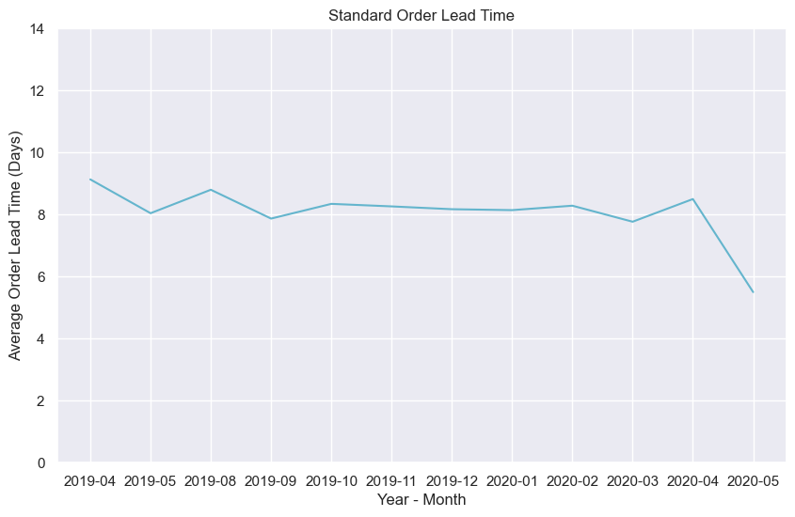
KPI 1 - Order Lead Time (Monthly and Yearly)
Avg. OLT - 2019
5 Days
Avg. OLT - 2019
9 Days
Avg. OLT - 2020
5 Days
Avg. OLT - 2020
8 Days
The average order lead time in 2019 and 2020 for express orders was five days. Five days were promised for express delivery (Two days for processing the orders, the order leaves the warehouse once it is ready to ship and three days for delivery as promised by the logistics company).
The average order lead time in both years was nine days and eight days, respectively. This is above the promised seven days maximum for standard order delivery (Two days for order processing, two days maximum to load on the truck and three days maximum promised by the logistics company).

Slide 8
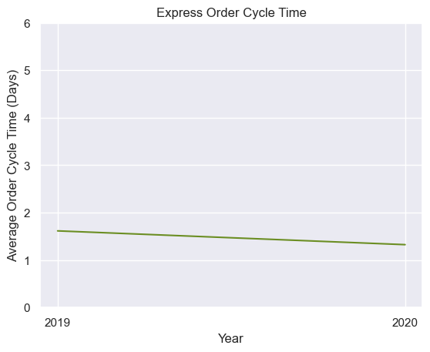
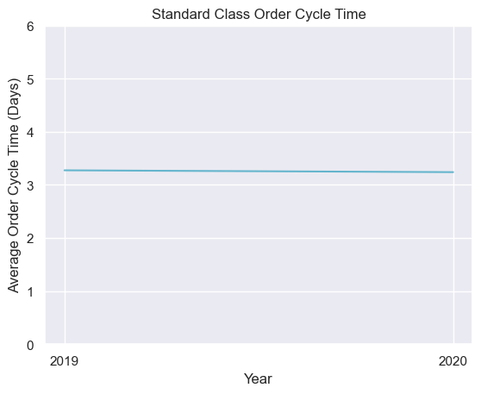
KPI 2 - Order Cycle Time (Yearly)
Avg. OLT - 2019
2 Days
Avg. OLT - 2019
4 Days
Avg. OLT - 2020
2 Days
Avg. OLT - 2020
4 Days
This KPI was aggregated yearly due to the limited data on the ‘ready to ship date’. Data was not available for some of the months
The order cycle time for express orders improved slightly between 2019 and 2020. Overall, even though it takes more than one day to get an express order ready for shipping, the target of two days by the warehouse is met.
The order cycle here should also be two days or less. In 2019 and 2020, it took more than three days to get a standard order ready. This is above the target and has to be focused on for improvement by the warehouse management.

Slide 9
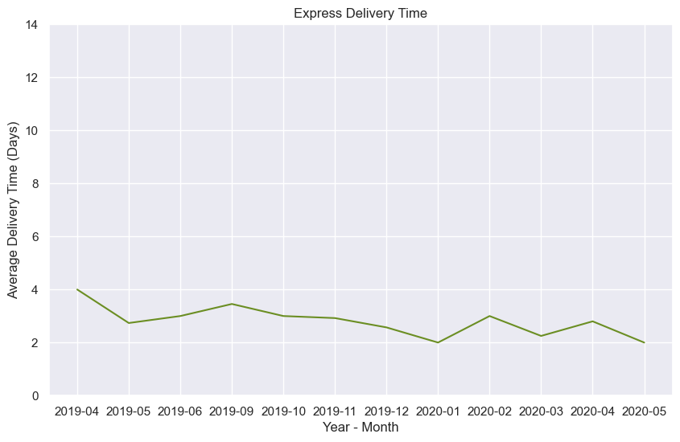
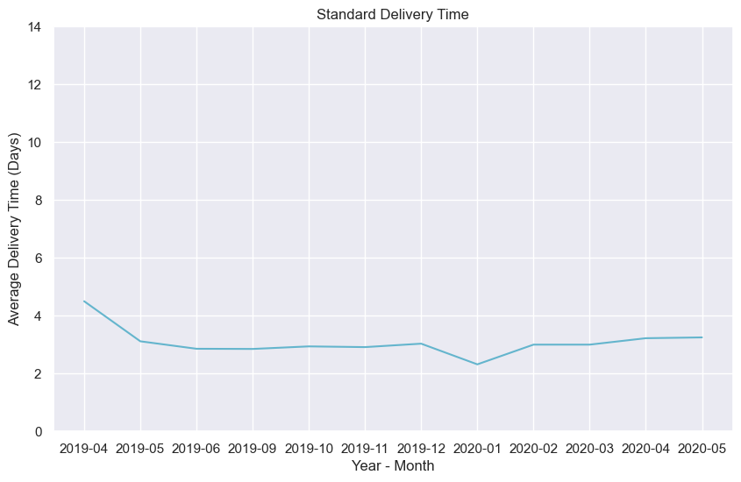
KPI 3 – Order Delivery Time (Monthly and Yearly)
Avg. ODT - 2019
3 Days
Avg. ODT - 2019
3 Days
Avg. ODT - 2020
3 Days
Avg. ODT - 2020
3 Days
According to the stakeholder, three days was promised by the delivery company for delivery. This was achieved in the two years under consideration. Express delivery took three days on the average as promised.
Same as the express delivery, on the average the delivery time in 2019 and 2020 was three days. In line with the goal of the logistics company.

Slide 10
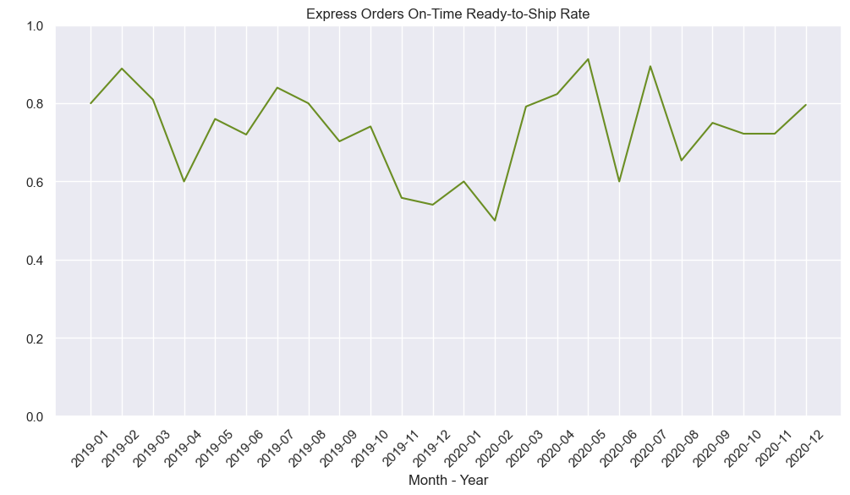
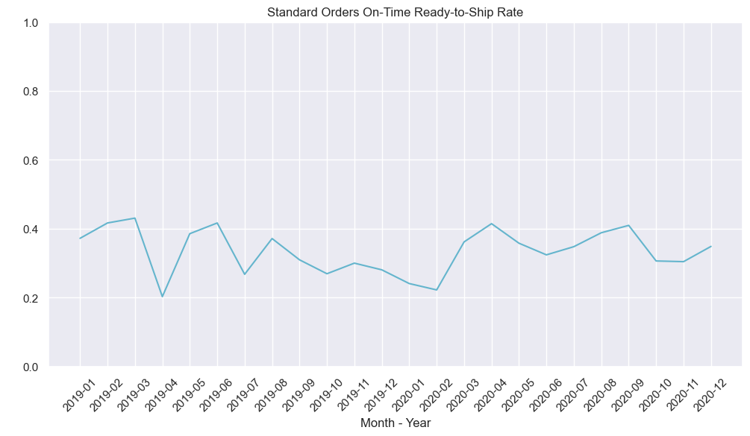
KPI 4 – On-Time Ready-to-Ship Rate (Monthly and Yearly)
On-Time RTS Rate - 2019
0.70
On-Time RTS Rate - 2019
0.32
On-Time RTS Rate - 2020
0.75
On-Time RTS Rate - 2020
0.34
On-time ready_to_ship rate is well above the average, with some months recording as high as 0.9. The average score started to see some improvements in 2020
PS - Both orders data and on-truck scan date data used to analyze this KPI are complete data sets hence the reason for the data spanning the twelve months of both years
The on-time ready-to-ship rate for standard orders was below average. This indicator buttresses what previous KPIs highlighted – order lead time and order cycle time. Most standard orders were not processed on schedule, as seen in the order cycle time, and this undoubtedly contributed to the prolonged order lead time.

Slide 11
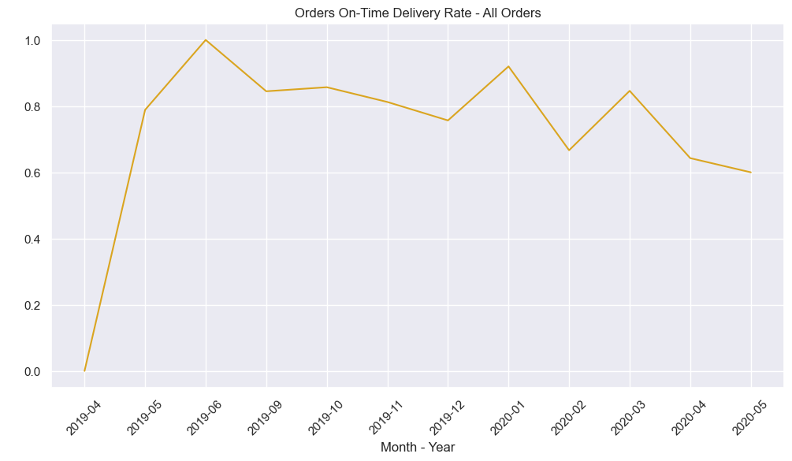
KPI 5 – On-Time Delivery Rate (Monthly and Yearly)
On-Time Delivery Rate - 2019
0.81
On-Time Delivery Rate - 2020
0.78
The chart above showed the rate of on-time delivery for the months when there was a marketing promotion that provided a means of obtaining data on the delivery date of an order.
There is no distinction between express and standard deliveries in terms of delivery duration. The promise from the logistics company was simply three days’ delivery for orders.
Above average on-time delivery rate. There was a decline in the rate in 2020, mainly in the last two months. The reason for this has yet to be verified, as this could have resulted from the promotion ending or the logistics company taking more time to deliver the orders.

Slide 12
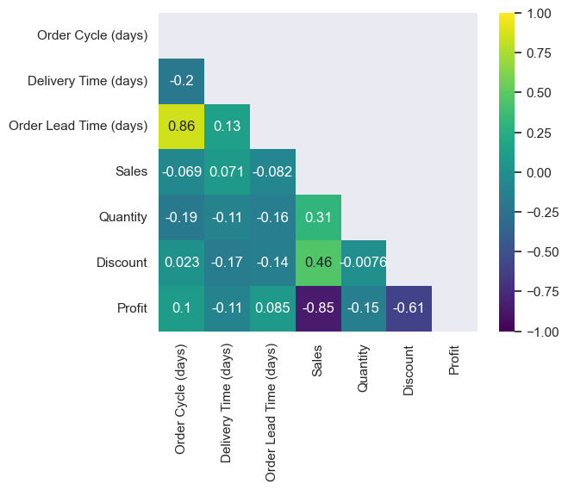
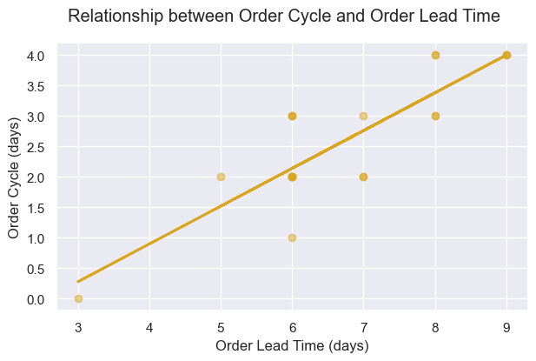
Correlation Matrix
R_Squared - 0.733 i.e. 73% of the variation in Order Cycle data is explained by the model
P > |t| = 0.000 - Less than the confidence level (0.05). There is a statistically significant relationship between the order lead time and the order cycle

Slide 13
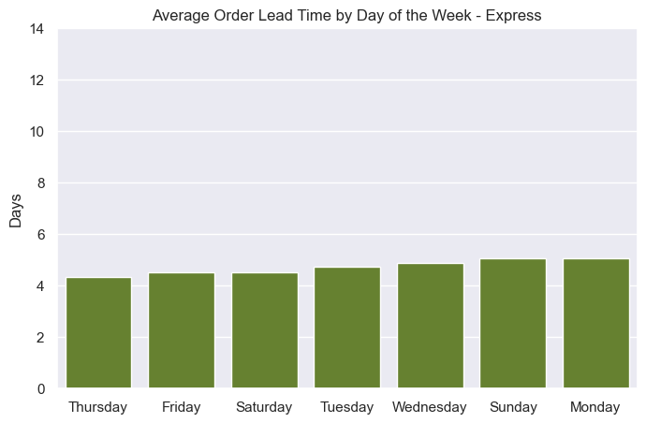
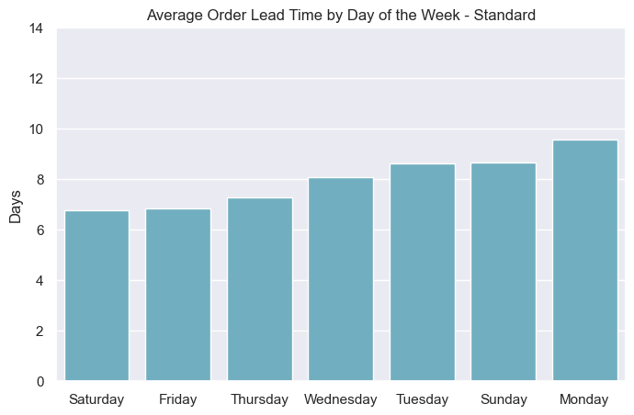
Order Lead Time by Day of the Week

Slide 14
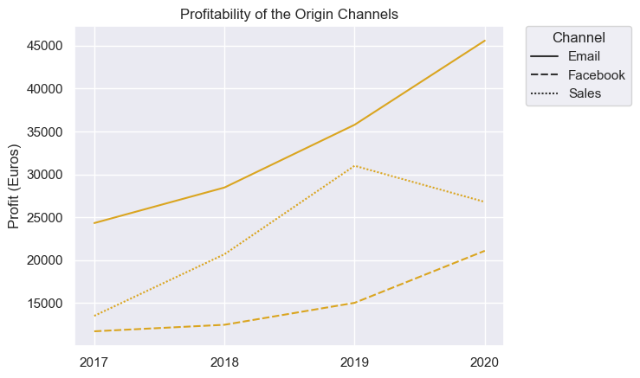
Profitability of the Origin Channels

Slide 15
Summary
Standard Order Cycle Time
Standard Order Lead Time
This is an important KPI that should be focused on by the business. Changes should be made in the warehouse operations to reduce this indicator from four days to two days.
Reduction in the order cycle time will consequently bring down the order lead time, which should also be kept below the target level of seven days.

Slide 16

Thank you

