Slide 1
School Management System
Softpro Internship
20 September 2024

Slide 2
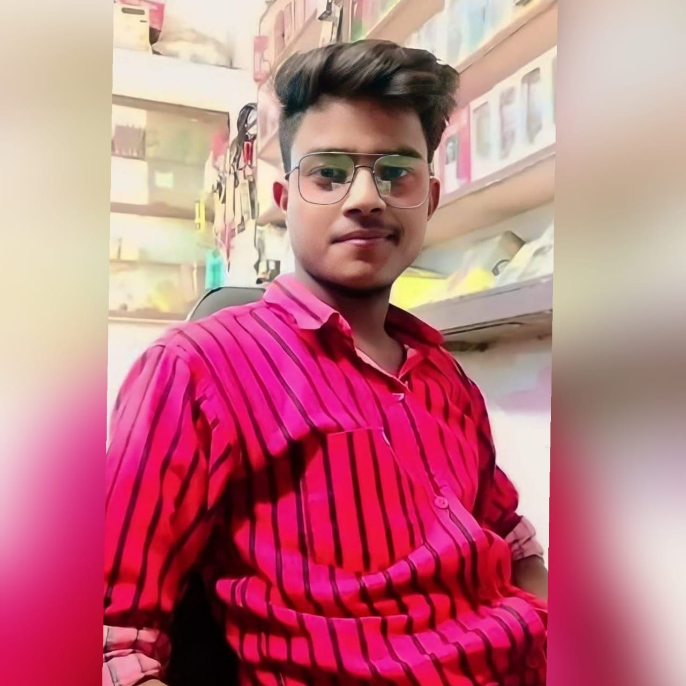
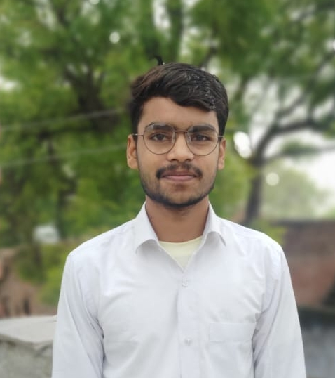
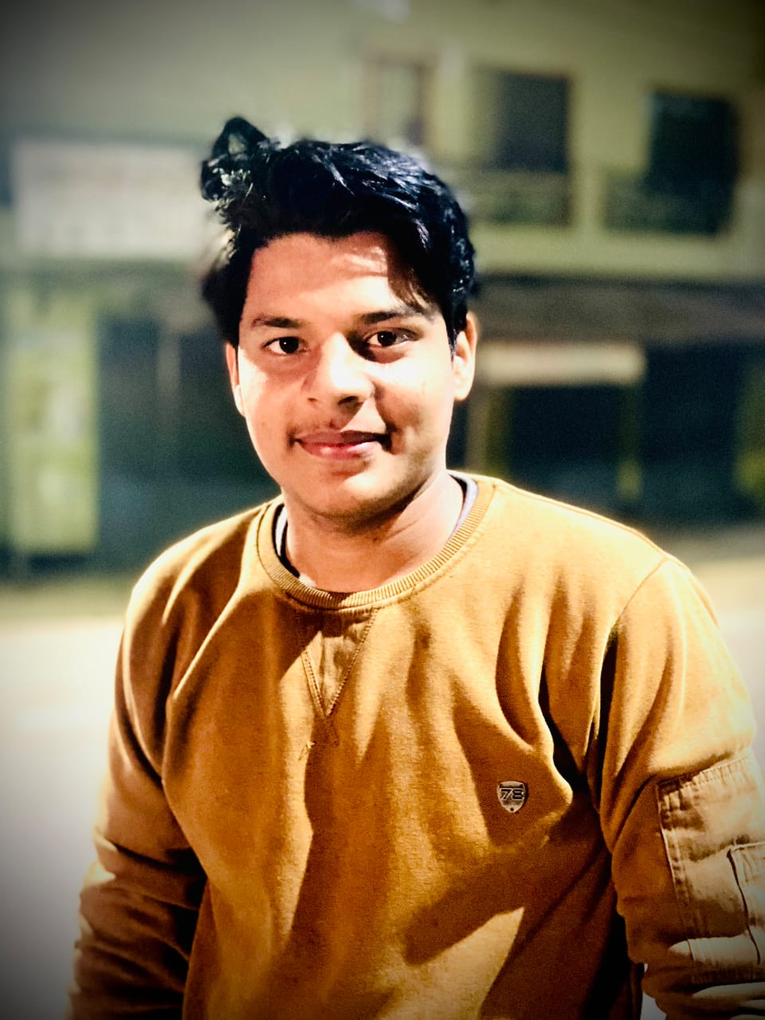
Presentation Presentators
Anuj Kumar Nirmal
Utkarsh Dubey
Utkarsh Kumar

Slide 3
Overview
About Softpro
About Softpro Team
About Project
Objectives of Project
Features & Functionality
Technologies Used
Modules
Project Demonstration
Conclusion

Slide 4
About to SoftPro India
SoftPro India
Softpro India Computer Technologies (P) Ltd. is a leading IT
firm in Lucknow, established in 2004 by IIT-Kanpur and IET Lucknow technocrats. A part of the Softpro Group, it has global offices and is known for its rapid growth. Under Er. Ajay Chaudhary, Softpro India delivers .
major government projects, including the URISE project, and partners with the Department of Technical Education for engineering student traning.

Slide 5
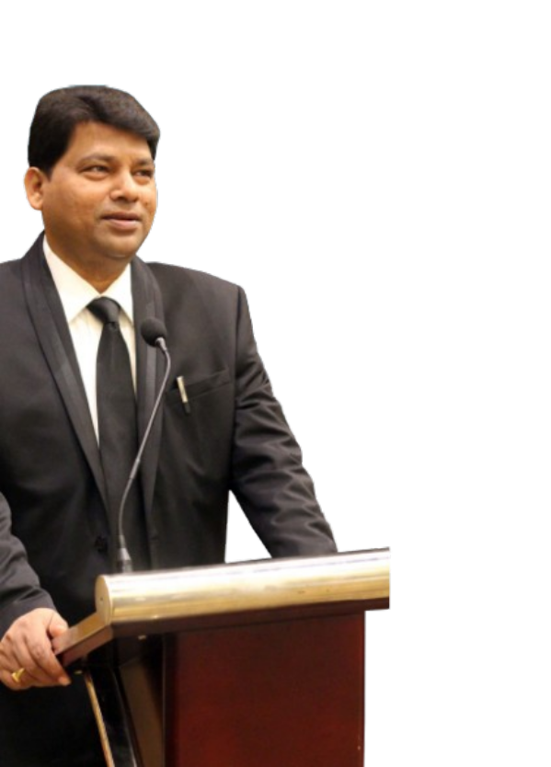

Er. Ajay Chaudhary
Founder Director
Softpro India
01
MD and Chairman
Softpro Group of Companies, Lucknow
MEMBER:
Academic council IET Lucknow
Board of Technical Education, Lucknow
BOS - Dr R L Awadh University,
Ayodhya
02
03
EX-MEMBER EXECUTIVE COUNCIL
Dr. APJ Abdul Kalam Technical University,
Lucknow

Slide 6
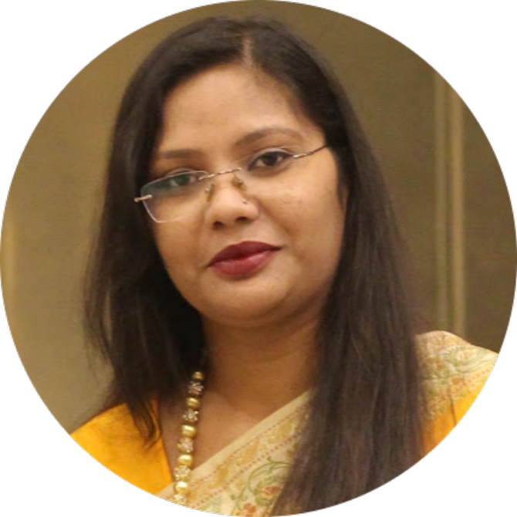
Ms. Yashi Asthana
Chief Executive Officer
Softpro India
CO-FOUNDER
NGO Under CSR of Softpro Group
01
02
MCA
Jiwaji University, Gwalior
03
EX-EMPLOYEE
Wipro Technologies, Mysore
“A Journey from An HR – Executive to a CEO”

Slide 7
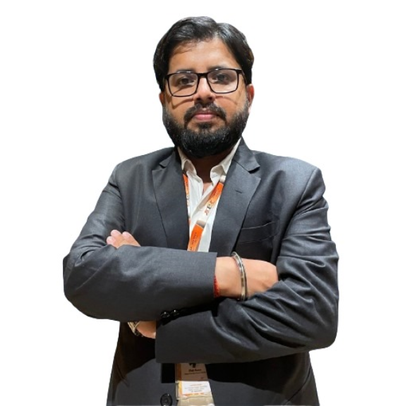
Er. Rohit Kumar
Chief Technical Officer
Softpro India
Our Consultant
12+ years of experience and Highly Skilled professional with expertise in Full stack developer Python,JAVA,.NET,PHP,MERN Power BI Development, ETL Processes.
01
02
Throughout his career, he has successfully managed and delivered projects for prominent companies and orgnizations such as AKTU ,URISE Project,,IIM AYODHYA,Bihar university project and many more.
02
His work has spanned various domains, enabling me to develop a deep understanding of the challenges and solutions in these fields.
03

Slide 8
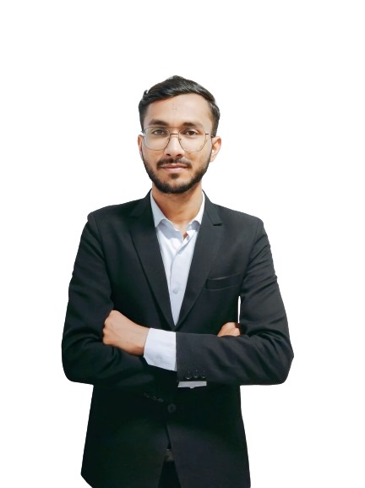
Our Consultant
01
Er.Ashif
Software Engineer
Softpro India Computer Technologies (p) Limited
Worked on various projects like:
IIMM Ayodhya
Seth AR Jaipuria School ,
Barabanki

Slide 9
About to the Project
Feasibility Study
Feasibility study assesses the practicality and benefits of developing the SMS for the organization. It is an ongoing process throughout the system life cycle.
The project is a School Management System (SMS) designed to enhance and streamline school administration. Below is an overview of the project's feasibility analysis and planning stages:
Technical Feasibility
For the design and development of the system, several software products have been accommodated.
Database design – SQLite3
Interface design – HTML, CSS, Java Script and Bootstrap.
Coding – Python with Django Framework
The technology (Python with Django Framework) has enough efficiency for the development of the system. Therefore the project is technically feasible.
Operational Feasibility
The web-based application provides users with easy access to services, fulfilling their requirements efficiently.
It ensures proper management of user information, reduces manual workload, and simplifies handling of large databases.
The system minimizes the risk of data loss and aims to satisfy all users and end-users by improving operational efficiency.
Schedule Feasibility
The project timeline has been planned to align with the client's expectations.
The system is scheduled to be delivered within the agreed timeframe, making the project feasible in terms of scheduling.

Slide 10





TECHNOLOGIES USED
For Frontend
For Backend
IDE

Slide 11

Modules In Our Project
Student Information System
Login Management System
Complain Management System
Class Management System
Attendance Management System
Teacher Management System
News Management
Enquiry Management
Study Material Management

Slide 12
Accessibility of End Users
01
03
Admin
Student
02
04
Teacher
Parents

Slide 13
Management
Analysis
Action
Management
Admin can Analysis and take action .
Admin can Manage Teachers and , Students etc.
Teacher and Admin can Manage the Attendence , Study
material , attendance etc.

Slide 14
Project Demonstration

Slide 15
Thank You

