Slide 1
A working tutorial of the scanning script

Slide 2
Abbreviations used
TF: Transcription Factor
TFBS: Transcription Factor Binding Sites
HCT: Homotypic Clusters
PWM: Position Weighted Matrices

Slide 3
Jobs performed by the script:
Retrieve sequences (upstream/coding/downstream) of the genes of an organism.
Retrieve the same sequences from multi samples/accessions/ecotypes of the organism
Scan the extracted FASTA sequences of the PWM of the TFs.
Check homotypic clustering of the transcription factor binding sites.
Create networks using Igraph

Slide 4
Tools used
RSAT suite (installed in HPC)
MEME suite (installed in HPC)

Slide 5
Prerequisite
Download the FASTA sequences of the genome of our interest using the command “install-organism” (using RSAT)
Download all the PWMs of transcription factors of an organism from Cis-BP (manually)

Slide 6
Inputs:
The list of DEGs

Slide 7
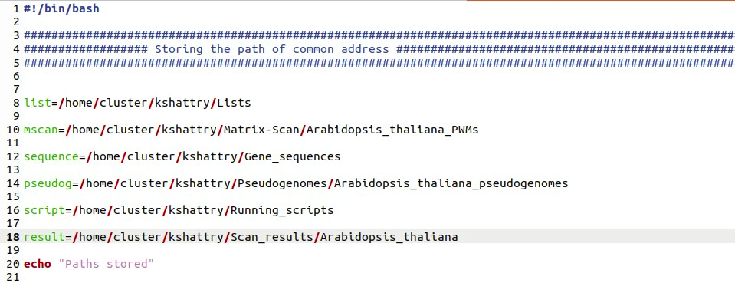
To be edited
The path to different files

Slide 8
Task 1: Retrieve the list of DEGs
The list of DEGs (for example):
AT1G01060
AT1G01070
AT1G01080
AT1G01120
AT1G01120
AT1G01140
AT1G01250
AT1G12610

Slide 9
Retrieving sequence:
retrieve-seq -org organism_name -feattype gene -type upstream -format fasta -label name -from -1000 -to -1 -i /path/to/genelist -o /name/of/resultant/fasta
(The bolds are to be edited)

Slide 10
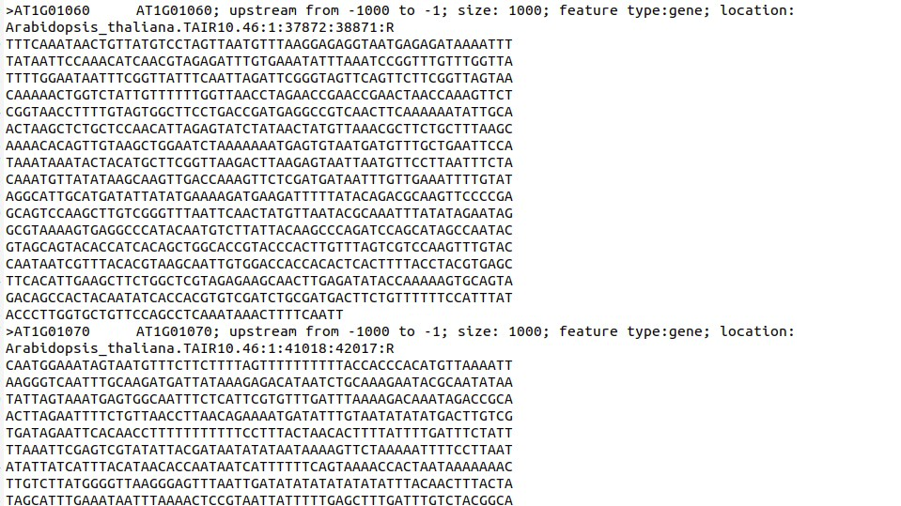
Fig: Retreived FASTA sequences

Slide 11
Task 2: Scanning the FASTA by PWMs
Collect all the PWMs of the TFs that were differentially expressed
PWMs are matrices which depicts the preferential binding of a TF
Put together all the PWMs in the same file
Convert the PWM from previous format (JASPAR/TRANSFAC) to MEME format (done by MEME).
We use the FASTA sequences to develop a background model for PWM scanning.
The background is developed using fasta-get-markov in the script.
The conversion is done by transfac2meme command in the script.
The scanning is done using FIMO in the script.

Slide 12
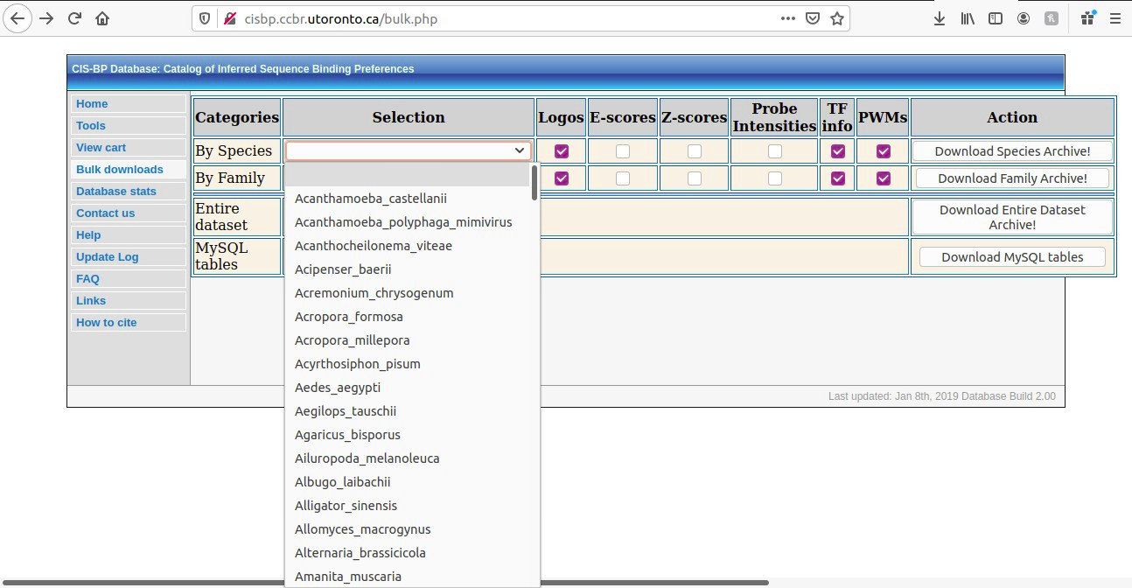
Fig: A snapshot of how to download from Cis-BP

Slide 13
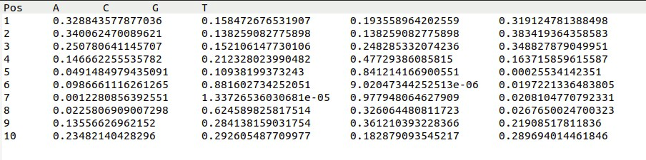
Fig: A PWM. It tells us the probability of binding of a TF with if a nucleotide (column name) is present at a certain position (row name) of the TFBS.

Slide 14
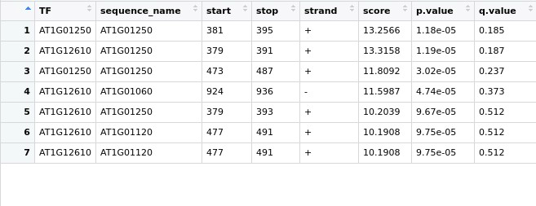
Fig 2: Scanning result in R. The columns are TF, sequence name (name of genes),start position,stop position,strand(+/-),score, p-value(the cut-off considered)

Slide 15
Task 3: Homotypic clustering of TFBS
This is performed in R.
The script considers a cluster of sites if the sites in cluster are seperated by a minimum distance of 5 bp and a maximum of 80 bp.

Slide 16
Task 4: Creating a network
The network is created using Igraph in R.
We check the scale-free nature of the above mentioned network.
The Ɣ value of the degree distribution of the network should be in the range: 2<Ɣ <3, in order to be called scale-free.
The gamma value is checked using the package poweRLaw

Slide 17
Task 5: Finding hub genes
We will find out the degree of each nodes.
Arrange the genes in decreasing order of the degrees.
From the top we start deleting the genes from the network and check the resultant Ɣ of the network. If the value is in the range, 2<Ɣ<3 we keep deleting further.
Once the value is out of range, we stop deleting.
When Ɣ is out of range, the network isn’t scale-free and hence the hub genes loses its importance.

Slide 18
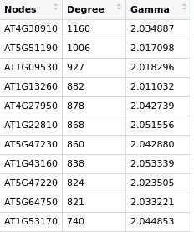
Fig 3: Hub genes from a network of 6000 genes

Slide 19
Best of Luck

