Slide 1

Solving 2048 with SOAR
Cognitive Technology
Triet Pham

Slide 2
Designing the reward function
The goal is to inform the agent whether it’s taking the correct action at each step.
This can be hard because 2048 is a game that has no clear goal heuristic.
2048 meta also changes mid game as you reach larger tile numbers.
I decided to reward based on two separate calculations:
Reward score = how well is the highest tile + how well is the board

Slide 3
Designing the reward function
Score multiplier depending on where the highest value tile is located at
x3 | x1 | x1 | x3
x1 | x-1 | x-1 | x1
x1 | x-1 | x-1 | x1
x3 | x1 | x1 | x3
how well is the highest tile = Highest tile value * multiplier

Slide 4
Prioritizing moves, narrowing the search space
Which quadrant the highest value is at also determine the prioritization of movement.

Slide 5
Designing the reward function
Ideally we want to keep the larger numbers toward the direction of favored movements.
Good
Bad

Slide 6
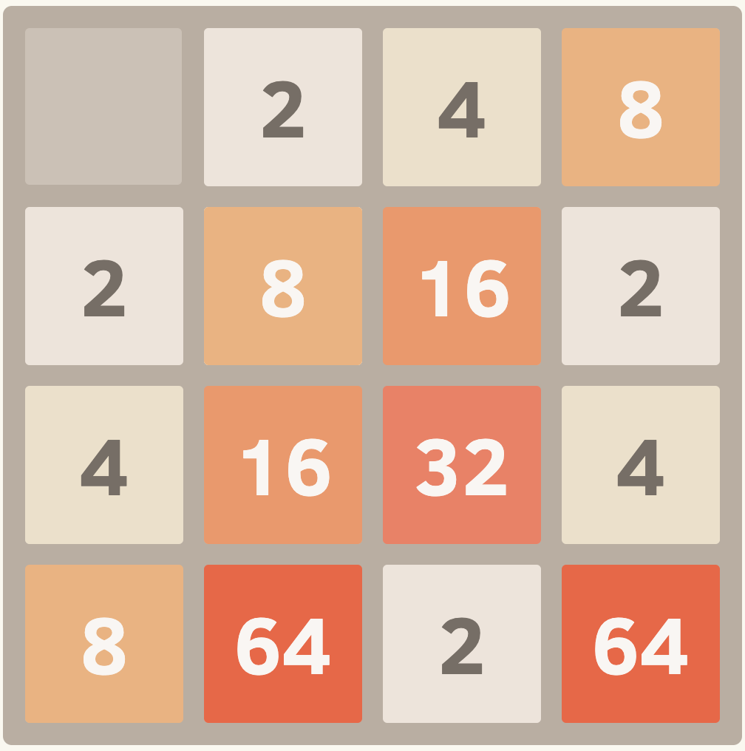
Designing the reward function
Example of a bad scenario
These tiles are acting as blocker preventing merges into the larger block.
Favored directions:

Slide 7
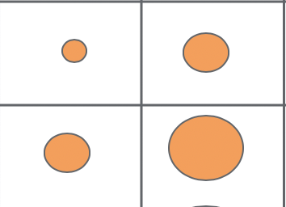
Designing the reward function
We take the sum of difference between the blocks relative to the favored direction to get a sense whether the entire board is good for the upcoming states.
block2
Favored directions:
block3
block1
how well is the board= (block1 - block3) + (block1 - block2) …for every block

Slide 8
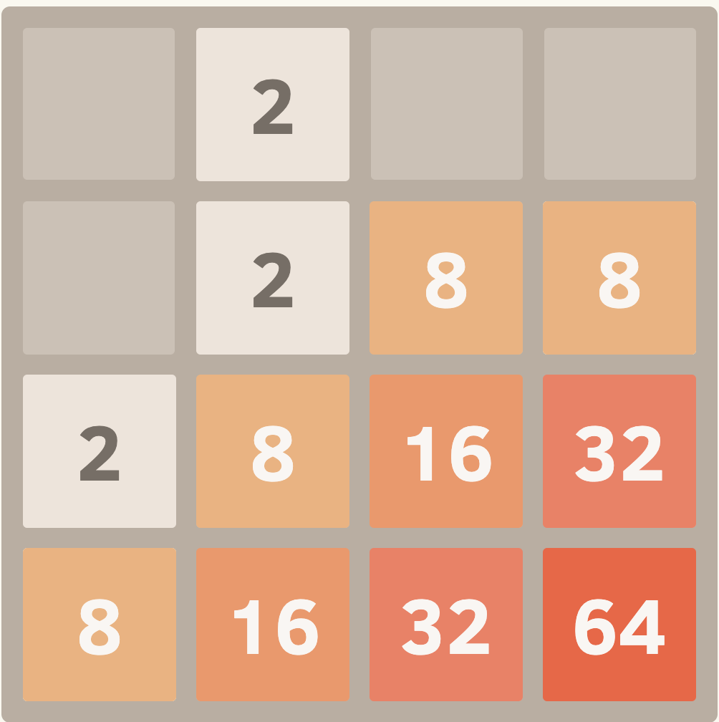
A trick to 2048
2048 grid has limited space, so it is a good idea to combine smaller blocks whenever you can.
In SOAR, we can break impasse between actions by taking the action that combine more smaller blocks.
i.e. taking the reciprocal of the block value
Moving down reciprocal: 1/2 = .5
Moving right reciprocal: 1/8 = .128

Slide 9
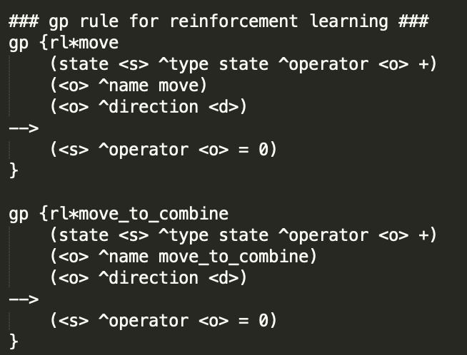
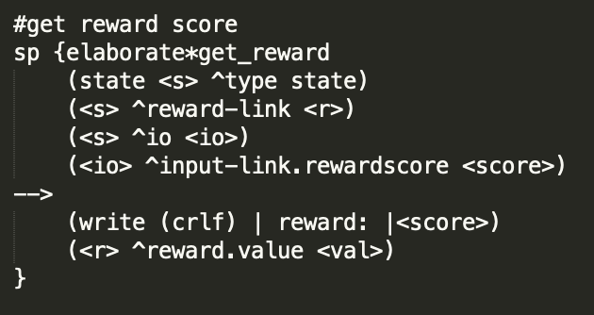
And that’s all!
SOAR takes care of the rest. It has built in reinforcement learning.
Gp rule for different moves
Pass reward calculation to input link

Slide 10
Visualization
first
0
1
2
3
0
Corners:
0-0
0-3
3-0
3-3
1
second
2
3

