Slide 1






megaradio
Global Radio Streaming
for Every Screen
50,000+ stations · 238 countries · Samsung, LG, Apple TV, Android TV
Seed Round 2025
themegaradio.com
CONFIDENTIAL — INVESTOR PRESENTATION 20251 / 18

Slide 2

No native TV radio apps
Samsung Smart Hub and LG Content Store offer fewer than 3 radio apps globally, none with full station catalogs.
THE PROBLEM
Radio listening on TV is a broken experience
Fragmented discovery
Listeners cannot browse by genre, country, or language. Finding a station requires knowing its exact name or frequency.
85% of smart TVs ship with no dedicated radio app. Listeners are forced onto phones, laptops, or old-fashioned FM — while TV screens sit idle.
No cross-device continuity
Favorites, history, and preferences don't follow users from phone to TV — every session starts from scratch.
RADIO MEGA2 / 18

Slide 3



THE SOLUTION
One app. Every screen. Every station.
Native TV Apps
50,000+ Stations
Cross-Device Sync
Purpose-built for Samsung Tizen and LG webOS — remote-first navigation, 10-foot UI, ambient mode.
Curated catalog across 238 countries, 50 languages, organized by genre, mood, and location.
Favorites, history, and preferences follow users from TV to mobile to web — one account, every device.
Radio Mega is the first multi-platform streaming app built exclusively for the living room — designed from the ground up for TV remote navigation and large-screen consumption.
RADIO MEGA3 / 18

Slide 4
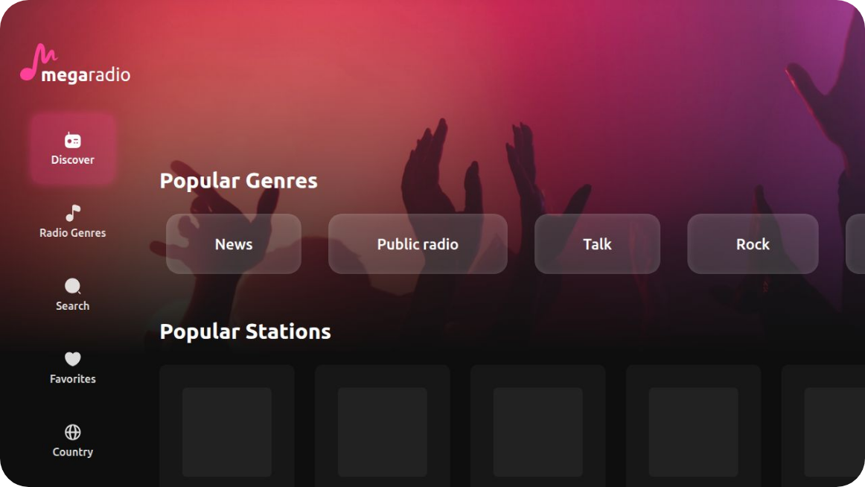
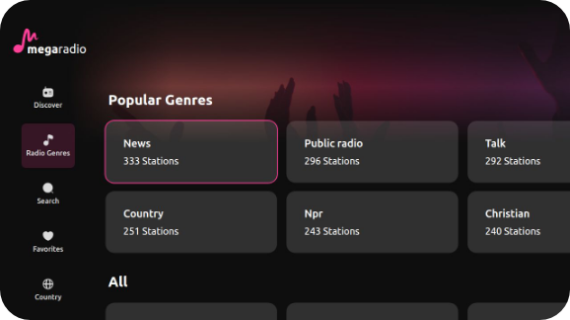
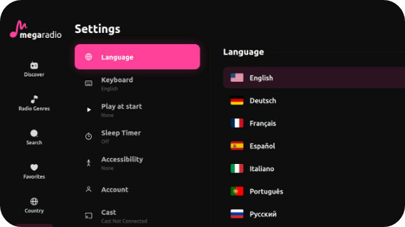
PRODUCT
Designed for the living room
Remote-first navigation
D-pad focus system built for every major Smart TV platform.
Smart discovery by country, genre & language
Curated browsing across 50K+ stations from 238 countries.
Ambient screensaver mode
Station art and visualizer fill the screen when idle.
Device-code login & cross-device sync
Scan a QR on your phone to log in — no TV keyboard needed.
RADIO MEGA4 / 18

Slide 5

MARKET SIZE
A $50B+ addressable market growing at 15% per year
TAM
SAM
SOM
$52B
$14B
$800M
Global online audio
Smart TV audio
5-year target
Streaming radio, podcasts, and live audio worldwide (2025 estimate)
Radio and audio consumed via connected TV and OTT devices globally
1% capture of SAM through premium + B2B channels by 2030
1.2Bsmart TVs in active use globally (2025)
15%CAGR online radio 2023-2028
500M+weekly radio listeners in Europe alone
RADIO MEGA5 / 18

Slide 6

BUSINESS MODEL
Four revenue streams, one platform
01 — Premium Subscription
02 — Programmatic Advertising
Ad-free listening, offline favorites, early platform access. Individual and family plans.
Audio + display ads served to free-tier users. CPM-based, geo-targeted, brand-safe inventory.
$4.99 / mo · $39.99 / yr
$8–12 CPM · Revenue share with stations
03 — B2B Licensing
04 — Station Partnership
White-label platform for hotels, airlines, and hospitality chains. Branded apps on their TV estate.
Promoted placement, analytics dashboards, and verified station badges for broadcaster partners.
$2K–15K / mo · Per property
$199–999 / mo · Per station
RADIO MEGA6 / 18

Slide 7



REVENUE PROJECTIONS
Path to $10M ARR by Year 3
ARR GROWTH ($M)
Year 1 (2026)$820K
Year 2 (2027)$3.4M
$0.82M
$3.4M
$10.1M
Year 3 (2028)$10.1M
2026
2027
2028
Gross margin target
Projections based on 150K premium users Y1, 600K Y2, 1.8M Y3 — plus B2B and advertising revenue
72%
RADIO MEGA7 / 18

Slide 8

TECHNOLOGY
Purpose-built for every screen
FRONTEND
TV PLATFORMS
React + TypeScriptCore UI framework
Samsung TizenTizen 4.0+
ViteBuild tool
LG webOSwebOS 4.0+
Tailwind CSSStyling system
Apple TVtvOS — Q3 2025
WouterLightweight router
Android TVFire TV — Q4 2025
BACKEND
DATA & API
Node.js + ExpressAPI server
Radio Browser API50K+ stations
PostgreSQLPrimary database
Drizzle ORM + ZodType-safe data layer
Stream proxyReliable playback
OAuth 2.0 Device FlowTV auth standard
RADIO MEGA8 / 18

Slide 9






PLATFORM STRATEGY
TV first. Then everywhere.
PHASE 1 — NOW
PHASE 2 — 2025
PHASE 3 — 2026
Smart TV
Mobile Companion
Web & B2B
Own the largest screen in the home. Build the brand, grow the audience, establish OEM relationships. TV radio is habit — the daily listening session is 2.4 hours.
Web player completes the cross-device story. B2B white-label SDK lets hotels, airlines, and broadcasters embed Radio Mega under their own brand.
iOS and Android apps serve as remote controls for the TV — and as standalone listening clients on the go. The TV session drives mobile install; mobile drives premium conversion.
Progressive web app (PWA)
Samsung Tizen — LIVE
Hotel & hospitality white-label
LG webOS — LIVE
iOS — Q4 2025
Apple TV — Q3 2025
Android — Q4 2025
OEM pre-install partnerships
Android TV / Fire TV — Q4 2025
TV remote control via app
Cross-device favorites sync
Broadcaster SDK
RADIO MEGA9 / 18
2 platforms
5 TV platforms
Mobile + Web
B2B white-label
Live today
By Q4 2025
2025–2026
2026

Slide 10
COMPETITIVE LANDSCAPE
No direct competitor owns the TV screen
FEATURE
Radio Mega
TuneIn
iHeart
Spotify
FM Radio
Native Smart TV app
✓
✓
—
—
—
Full TV remote navigation
✓
—
—
—
—
50K+ stations
✓
✓
—
—
—
238-country catalog
✓
—
—
—
—
Free tier available
✓
✓
✓
✓
✓
Cross-device sync
✓
✓
✓
✓
—
Ambient TV mode
✓
—
—
—
—
B2B / white-label
✓
—
—
—
—
Radio Mega is the only platform combining native TV remote UX, a full global station catalog, ambient mode, and B2B white-label — in one product.
RADIO MEGA10 / 18

Slide 11

TRACTION
Early signals across two live platforms
2
50K+
238
50
Live TV platforms
Indexed stations
Countries available
UI languages
MILESTONES
Q1 2025
Samsung Tizen app deployed to Samsung Smart Hub globally
Q2 2025
LG webOS launch · 50 language localization complete
Q2 2025
Device-code OAuth auth system live · cross-device sync
Q3 2025
Apple TV + Android TV · B2B pilot with first hotel chain
Q4 2025
Premium subscription launch · programmatic ad inventory
RADIO MEGA11 / 18

Slide 12

UNIT ECONOMICS
Strong fundamentals from day one
MONTHLY ACTIVE RETENTION
72%
30-day retention for premium subscribers — vs. 40-50% music streaming average
Customer Acquisition Cost
Organic app store
discovery + TV pre-install
DAILY SESSION LENGTH
$1.80
2.4h
Average daily listening session on TV — radio is background media, driving long engagement
Lifetime Value (Premium)
Based on 24-month
avg. subscription
$38
CHURN (projected monthly)
3.8%
LTV / CAC Ratio
Radio listeners are habit-driven — lower churn than on-demand streaming
21x
Industry benchmark: 3x+
RADIO MEGA12 / 18

Slide 13





BRAND IDENTITY
A premium media brand for the living room era
LOGO SYSTEM
COLOR PALETTE
Primary Pink
#FF4199
megaradio
Accent Cyan
#01D7FB
Background Dark
App icon variants
#0E0E0E
Gradient Brand
Pink → Cyan
TYPOGRAPHY
BRAND POSITION
Ubuntu
Premium — not mass market
RADIO MEGA13 / 18
Radio Mega targets listeners who want a curated, high-quality experience — not a utility app with 10K genre checkboxes.
Primary typeface — all weights
Bold
Medium
Light
700
500
300
Global — locally relevant
50 UI languages, country-first browsing, region-specific recommendations.

Slide 14





TEAM
Built by operators who understand the living room
Founder & CEO
Lead Engineer
Advisory Board
themegaradio.com
Full-stack TV specialist
Hiring Q3 2025
Product vision, business development, platform partnerships
Samsung Tizen, LG webOS, React, Node.js, multi-platform TV SDK expertise
Seeking advisors from broadcast media, OEM partnerships, and consumer subscription businesses
We are hiring
careers@themegaradio.com
Senior React/TV engineer · Head of Partnerships · Content Operations Lead
RADIO MEGA14 / 18

Slide 15
ROADMAP
12 months to category leadership
Q2 — 2025
Q3 — 2025
Q4 — 2025
H1 — 2026
Samsung + LG live
Apple TV launch
Android + Fire TV
Recommendation AI
50 languages
Premium tier
Programmatic ads
Series A fundraise
Auth & sync
B2B hotel pilot
Mobile companion
OEM pre-installs
RADIO MEGA15 / 18

Slide 16
USE OF FUNDS
Engineering & Platform Development
40%
Raising $2.5M seed round
Apple TV, Android TV, Fire TV builds · backend scaling
Sales & Partnerships
25%
OEM pre-install deals · B2B hospitality rollout · hotel pilot
18-month runway. Two live platforms today. Funding accelerates Apple TV, Android TV, B2B rollout, and premium launch.
Marketing & UA
20%
App store optimization · brand campaigns · influencer audio
Operations & Headcount
10%
Content ops · customer support · legal / finance
Target close
Q3 2025
Reserve
5%
Working capital buffer
RADIO MEGA16 / 18

Slide 17

FINANCIAL SUMMARY
Three-year P&L snapshot
METRIC
2026
2027
2028
Premium subscribers
150K
600K
1.8M
Subscription revenue
$820K
$3.4M
$8.2M
Advertising revenue
$0
$620K
$1.9M
B2B / licensing revenue
$0
$280K
$1.1M
Total revenue
$820K
$4.3M
$11.2M
Gross margin
64%
70%
74%
EBITDA
($1.8M)
($0.4M)
$2.1M
Free cash flow break-even
—
—
Q2 2028
Projections are forward-looking estimates. Not financial advice. See full model in data room.
RADIO MEGA17 / 18

Slide 18




JOIN US
Radio for the
television era
We have built the product, shipped to two platforms, and proven the model. We are looking for partners who believe radio deserves the same premium experience as every other great streaming service.
Raising
$2.5M Seed
Contact
Live demo
invest@themegaradio.com
themegaradio.com/tv
Scan to see the live app
themegaradio.com/tv
RADIO MEGA18 / 18
Samsung & LG Smart TV · no install required
Samsung Smart Hub — available now·LG Content Store — available now·50,000+ stations · 238 countries

