Slide 1
mt-DNA Analysis Internals

Slide 3
Data Processing Overview
BAM Read Loader
de novo assembly
- Finds Large Deletions
- Calls Indels
- Creates Majority Consensus Sequence
-Assigns Haplotypes
Confirm all SNP Match
Annotate Variants
SNP Caller
- Call Heteroplastic SNPs
- Assign Haplotype
Read Loading
Analysis Tools
Combine and Triage
Depth of Coverage Tool
Generates a PDF plot and file for Depth of Coverage
Paired End Peak Finder

Slide 4
Step 1: Read Loading – Avoiding NuMTs and Filtering
Grab all reads from the mtDNA and any nuclear locations likely to be from the mtDNA
Filter Reads as Follows:
Quality trim the end of those reads (Mean QC > 22, Ends trimmed until QC > 22)
Remove Duplicates (SAM Flag: 1024)
Re-align reads originally aligned to nuclear DNA to mtDNA
Notes on Reads from Nuclear DNA
Aligners typically randomly assign reads to one location if there are multiple equivalent possible mapping locations.
Due to NuMTs, this can mean that some information is lost prior to analysis.
We want to recover information without reprocessing all reads in the BAM file.
We also want to account for the fact that the genome is circular.
Goal: Define target regions to query for reads that may be mitochondrial, thereby avoiding

Slide 5
Defining where mitochondrial reads go by simulation
Took all mitochondrial sequences in phylotree (2,736 mtDNA genomes representing the global diversity).
Simulated typical Illumina reads from each
Length = 100 bp
Error rate = 1%.
Insert Size = Normal(150, 30)
Aligned reads with BWA Mem

Slide 6
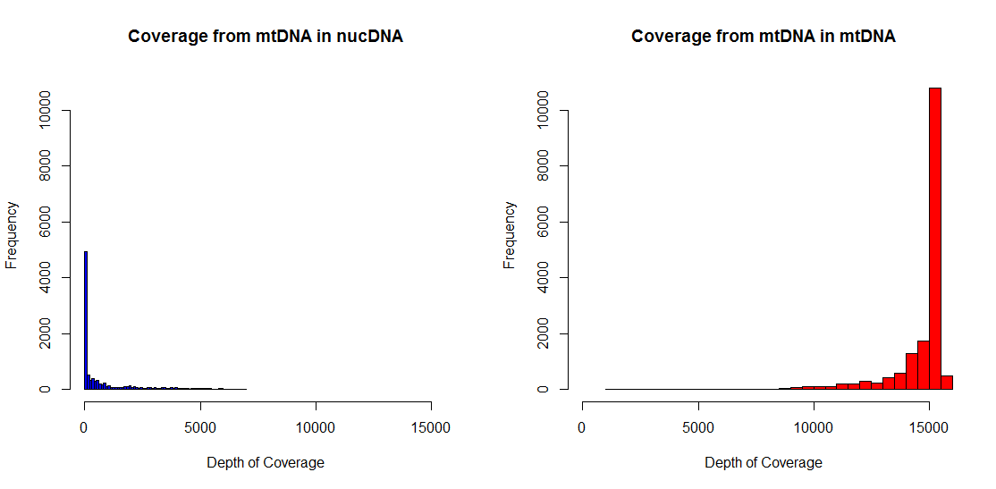
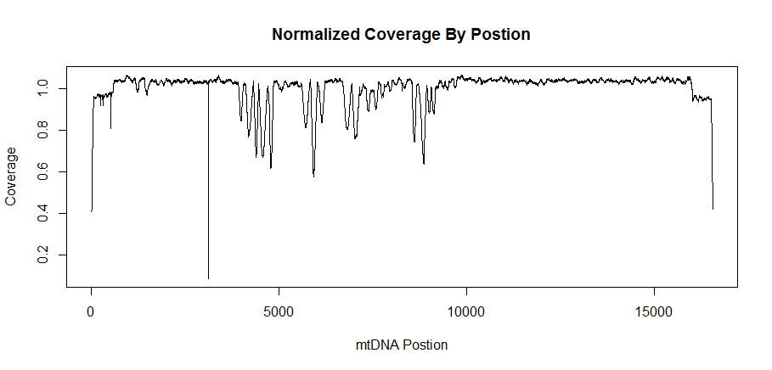
BWA defined alternate mapping locations.
Only 3% of reads from the mtDNA actually aligned somewhere else.
These reads fall in to 47 intervals on the nuclear genome.
When grabbing reads, we take all the reads aligned to the mtDNA, as well as realign any reads within these 47 bp regions.
We also have a “pseudo” mtDNA sequence that tacks on a portion of the front of the sequence to the back to account for any changes.

Slide 7
Transition Place Holder

Slide 8
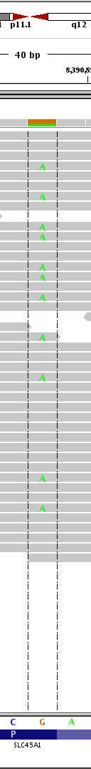
Basic SNP Calling (akin to Unified Genotyper)
This algorithm is designed to find Heteroplasmy in samples.
It is akin to our past UnifiedGenotyper step (call SNPs with Ploidy = 100), but significantly faster.
Key difference is that UG integrates over 176,851 different possible ploidies, while we assume a continuous model.

Slide 9

SNP Heteroplasmy Model
Models assumes a continuous frequency of each base
Goal is to infer this vector for each position.
Uses same likelihood model as UG
Implements EM algorithm to infer underlying frequncies.

Slide 10
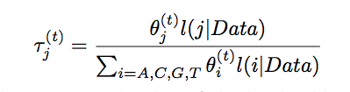

Note on the EM Step
The EM – Algorithm goes beyond simple read counts and also uses quality information to assess the frequency of each bp in the sample.
It initializes the unknown frequency of each base according to the read counts, and iterates using the QC scores of the reads until convergence.
However, in practice, with high coverage (~1000X) simply counting basepairs of each type provides an accurate estimate. The effect of the EM algorithm is to shrink the counts of low frequency, low quality reads, but these already quite low (<1%).
To save computational time (~30 seconds), one can simply use the read counts by passing the –skip_em flag to the program.

Slide 11
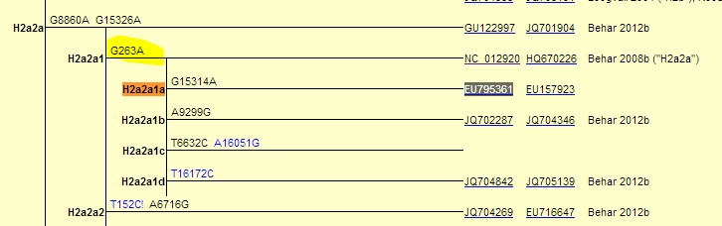
Haplotype Calling
Used for two purposes
Provide demographic information about the sample.
Provide additional quality information.
Implementation
Using standard Phylotree Haplotype classification method for consistency (Phylotree v15)
Algorithm - essentially a brute force routine that ranks haplotypes by a weighted hamming distances to known reference sequences.

Slide 12
Haplotype Report
In addition to haplotype, the following metrics for SNPs
Unfortunately, phylotree is inconsistent in how it treats indels, so these are not used.
Polymorphisms in Sample
Polymorphisms in Reference Haplotype
Polymorphisms in Both

Slide 13
Place holder

Slide 14
de novo Assembly Step
Used to:
Call indels
Generate a complete consensus sequence
Find large deletions

Slide 15
Assembly algorithm overview

Slide 16
Paired End Algorithm
Two steps
Define a “abnormal” range of template sizes
Makes a histogram of all template sizes from paired end reads.
This histogram should be unimodal
To define the boundary of “normal”, we start from the maximum value in this histogram and move right in sliding windows of size 3 positions until we obtain a local minima or an average coverage of 0.
Look for an unusual number of “abnormal” reads
Abnormal reads of a given template length are assumed to be Poisson distributed.
We estimate that distribution robustly using the median.
Then look for any template length above this cutoff with a p < 0.05 (correcting for mulitple tests).

Slide 17
Simple Algorithm Works Well

Slide 18
Triage Reporting - Did it work?
Analysis Tool (s) | Triage Characteristic (s)
Depth of Coverage | Was all coverage > 1000X
Assembler | Did we obtain a complete assembly? Was a high proportion of reads used for the assembly?
Assembler and SNP Caller | Do both haplotypes match? Are all consensus SNPs present in both?
Assembler and Paired End Analysis | Is their consistent evidence for a deletion (or no deletion) in both?
Haplotype Calls | Is there an unusual amount of variation not seen previously? Is there only one best haplotype assignment?

Slide 19
Known Limitations
In the event of a large deletion event, the SNP calling step can call incorrect SNPs due to the misaligned reads.
If the rCRS sequence is no longer used, or b37 is changed, this will change the results.

