Slide 1

The advantages and challenges of working in small circles

Slide 2
Goals
Software that definitely analyzing the mtDNA obtained from next generation sequencing studies to obtain
A definitive list of mutations that exist in the genome
Estimates of all mutations that appear at heteroplasmic frequency, including long range deletions
Reporting that places these variations in a population genetic and functional context

Slide 3
Isn’t everyone doing that? Yes… but mtDNA is different

Slide 4
Challenge 1: Circular Genome
Notes:
From PlotCoverage.M at D:\MTData\CoverageData

Slide 5
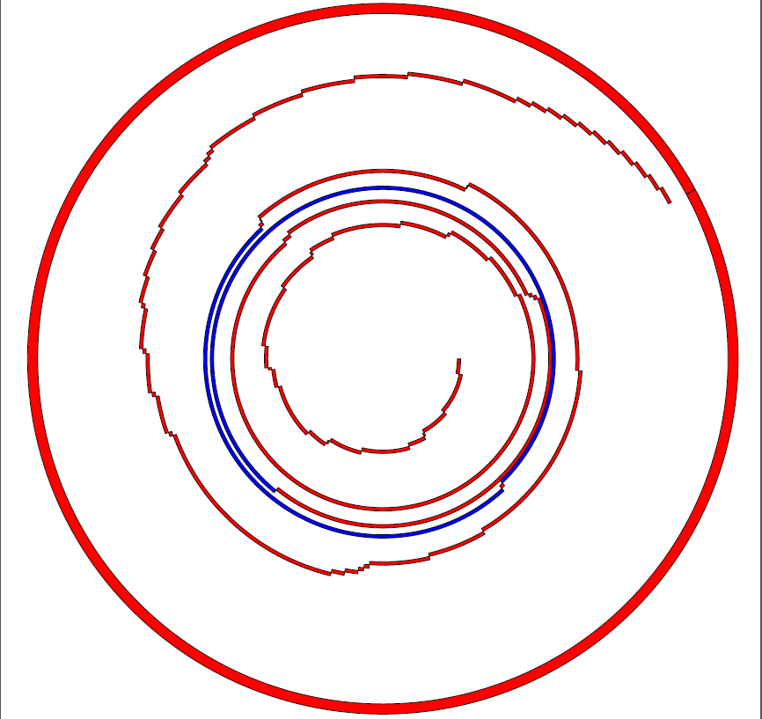
NuMites
Not to mention elevated polymorphism…

Slide 6
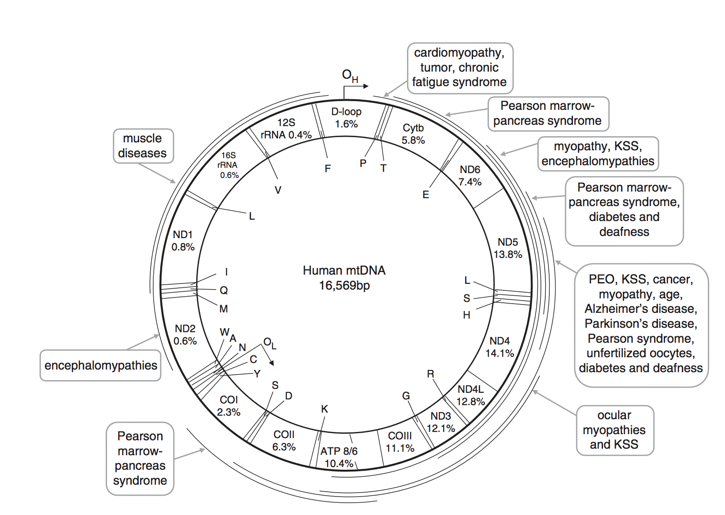
Deletions
Chen. et. al 2001

Slide 7
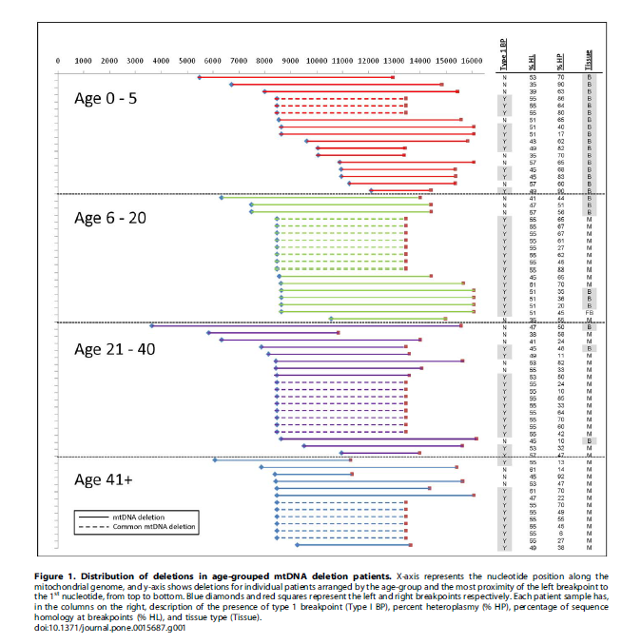
Deletions continued.

Slide 8
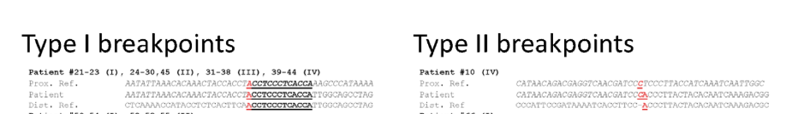
Deletions
Cataloged in mitomap
68% Direct repeats
12% imperfect repeats
20% no direct repeats
Variety of diseases related to mitochondrial function
Can vary by tissue type and by age.
Sadikovic et. al. 2010

Slide 9
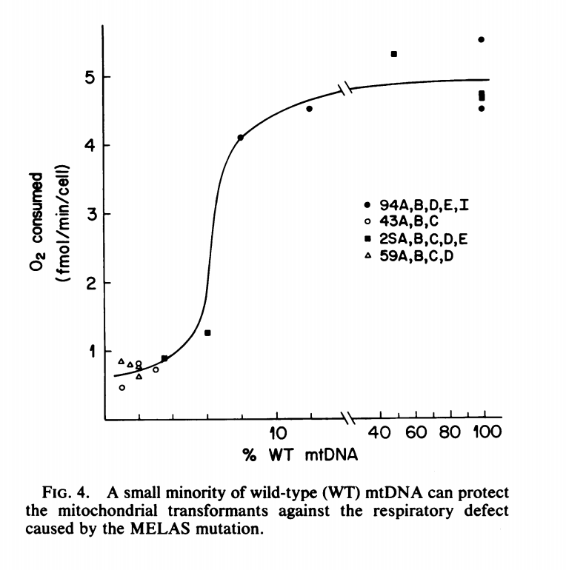
Frequency Dependent

Slide 10
How to handle these challenges?
Goal not to completely re-invent the wheel
But rather, to strap existing wheels on to a car and win Le Mans
Lots of work on blah, blah, heteroplasmic deletions will be the big thing

Slide 11
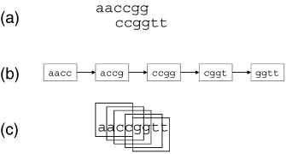
Assemble DeBrujin Graphs
Central idea: Cut sequence in to Two reads from the sequence AACCGGTT

Slide 12
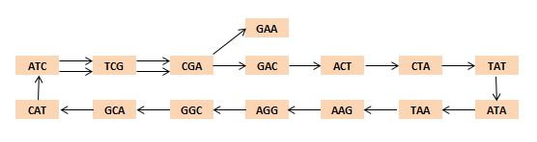
Concept: Very Basic Idea: Follow the Nodes!
At a high level, easy to understand.
Actually lots of paths, N-P hard problems and computational issues to work out with large datasets of imperfect quality.

Slide 13
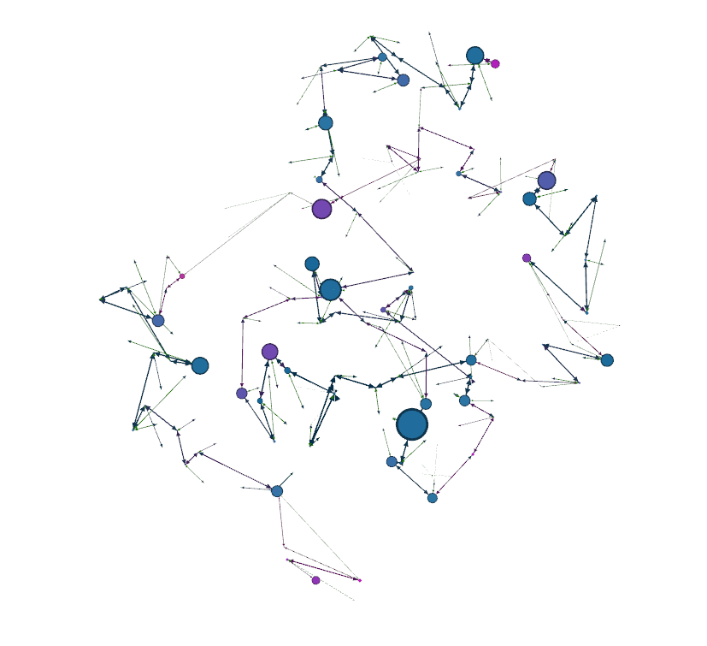
Reality: Graphs are not simple
Nodes = 663,515 : Edges = 2,236,524
Coding issues aside, real question is how to reduce the graph. At what frequency is a variant real with a continuum of frequencies possible?

Slide 14
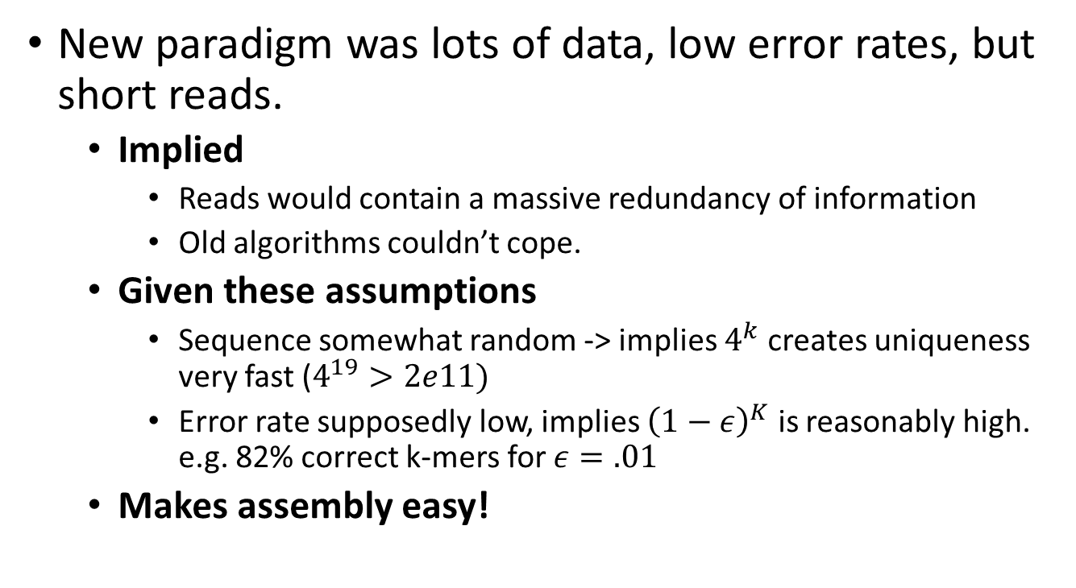
Why it was supposed to be – but was not – a big deal.
New paradigm was lots of data, low error rates, but short reads.
Implied
Reads would contain a massive redundancy of information
Old algorithms couldn’t cope.
Given these assumptions
Sequence somewhat random -> implies $4^{k}$ creates uniqueness very fast ($4^{19}>2e11)$
Error rate supposedly low, implies ${\left(1−ε\right)}^{K}$ is reasonably high. e.g. 82% correct k-mers for $ε=.01$
Makes assembly easy!

Slide 15
Reasonably even coverage?
Well covered bacterial genome shown above.

Slide 16
But with mitochondria
Assumptions better match the sales pitch
High coverage per base
Repeats infrequent
Means

Slide 17
Key Simplification: With mitochondria the only challenge is to simplify the graph to a believable set.

Slide 18
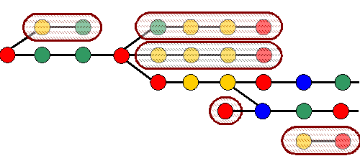
How to reduce the graph?
Different methods proposed, used by different groups

Slide 19
How to reduce the graph?
Option:
End Erosion
Parameter:
Length to erode
Different methods proposed, used by different groups

Slide 20
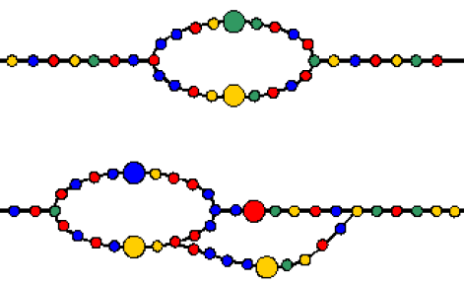
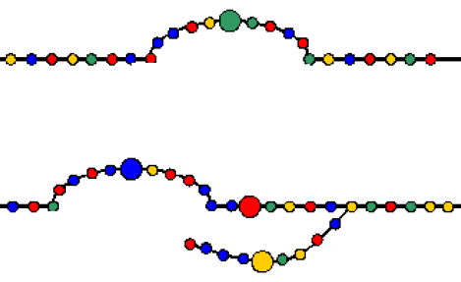
How to reduce the graph?
Option:
Bubble Popping
Parameter:
How long to look (bubble length)

Slide 21
How to reduce the graph?
Coordinate Transform
Option:
Kmer Coverage
Parameter:
Decision Model

Slide 22
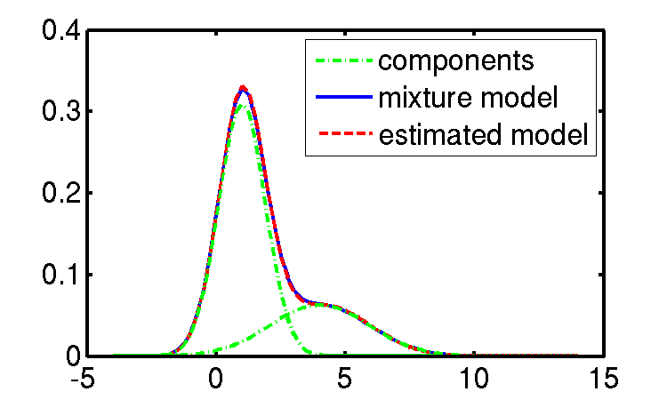
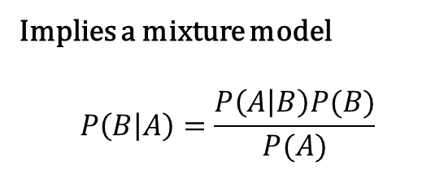
How to reduce the graph?
Coordinate Transform
Implies a mixture model
$$P\left(B | A\right)=\frac{P\left(A | B\right)P(B)}{P(A)}$$
Option:
Kmer Coverage
Parameter:
Decision Model

Slide 23
How to reduce the graph?
Decision Point
Coordinate Transform

Slide 24
Comparative perspective on graph simplification
Method | Implemented by | Used in MitoAssembler
Edge Pruning | Euler, Velvet, SOAP | Yes
Bubble Popping | AllPaths, ABYSS | Yes
Node K-mer Coverage | Velvet, Soap, Euler, Haplotype Caller. | Yes
Progressive K-mer scaling | Euler, Haplotype caller | No
Quality Score | Allpaths, CABOG | Not yet.
Connected to known reference sequence |  | Yes
Read Threading | Euler, GATK Haplotype Caller | No
Summary aided by: Milller et. al 2010

Slide 26
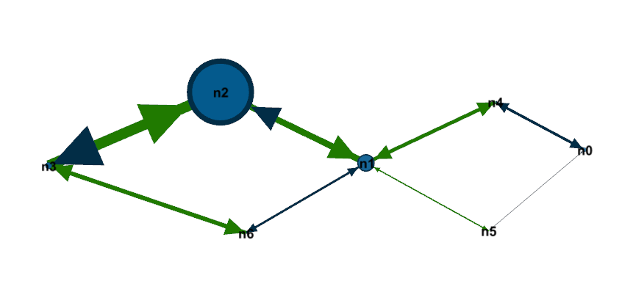
How the Graph Changes

Slide 27
What does that mean?
Node 2
Coverage=1000
Node 6
Coverage=1000
Node 1
Coverage=1000
Node 5
Coverage=1000
Node 8
Coverage=1000
Node 3
Coverage=100
Node 7
Coverage=1000

Slide 28
A Deletion?
Reference: 5,000-13,000
Node 2
Coverage=1000
Reference: 1-5,000
Reference: 13,000-16,539
Node 1
Coverage=1000
Node 5
Coverage=1000
Node 3
Coverage=100
Unknown of length 20
“Paint” with known reference locations

Slide 29

First Bifurcation
~10% Frequency

Slide 30
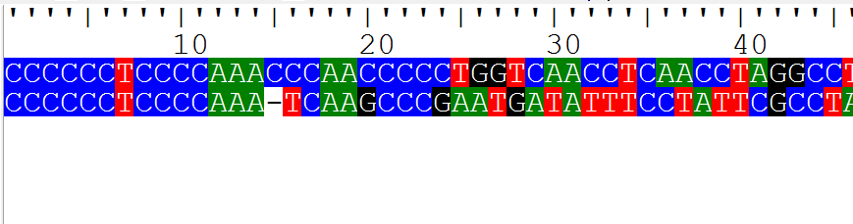
Second Bifurcation
~10% Frequency

Slide 31
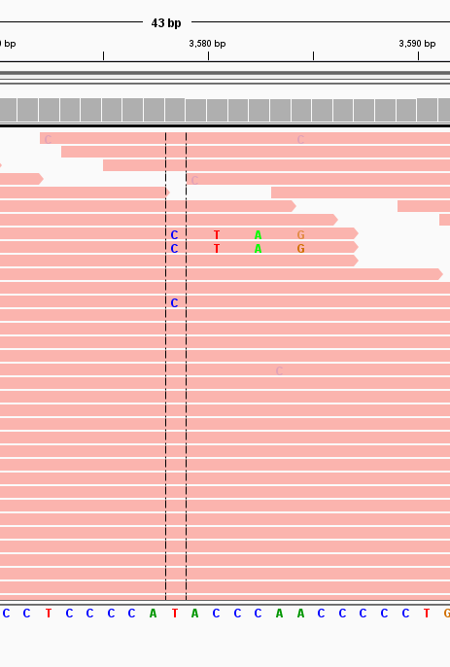
Second Bifurcation
Deletion found!
~10% Frequency

Slide 32
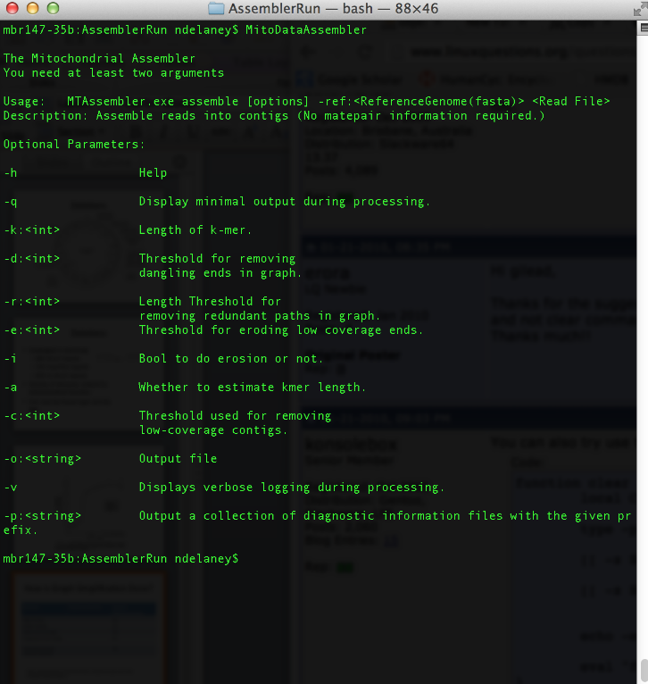
Program overview
Output
Assembled Contigs
Histogram of counts at different steps.
Final graph of assembly
All possible paths through assembly
Report with list of possible deletions and frequency estimate
Input
BAM
Fasta
Fastq
SAM
etc.
Optional parameters

Slide 33
Program overview
Output
Assembled Contigs
Histogram of counts at different steps.
Final graph of assembly
All possible paths through assembly
Report with list of possible deletions and frequency estimate
GraphML files at every step.
Input
BAM
Fasta
Fastq
SAM
etc.
Optional parameters

Slide 34
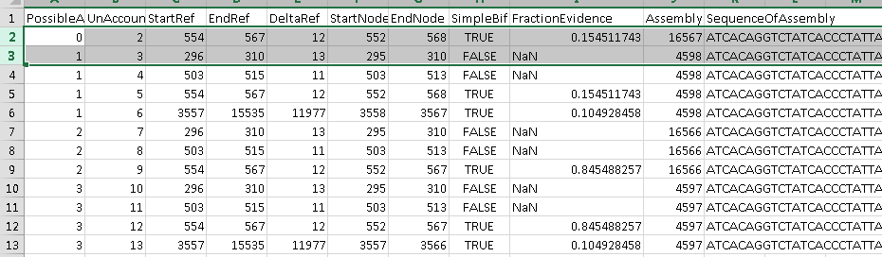
Program overview
Output
Assembled Contigs
Histogram of counts at different steps.
Final graph of assembly
All possible paths through assembly
Report with list of possible deletions and frequency estimate
Input
BAM
Fasta
Fastq
SAM
etc.
Optional parameters

Slide 35
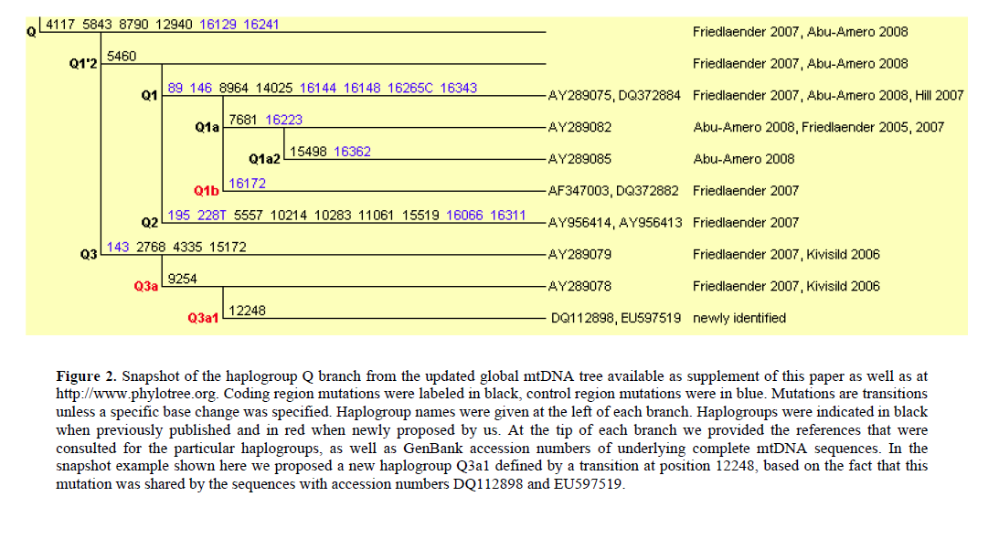
Next Steps
Separate local deletions from error model (?)
More elegant deletion frequency estimates
Integrate annotations better
Current tool:
HaploGrep+MitoAssembler
(yet to add value)

Slide 36
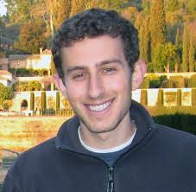


Acknowledgments
Sarah Calvo
Danny Lieber
Steve Hershman
Vamsi

