Slide 1
CLIA Exome + Mito Evaluation
5/21/2014

Slide 2
Previous Results Recap
There were several oddities in last round:
Coverage did not increase with increase total bait concentration.
Rebalancing the probe weights did not lead to a more balanced coverage profile
Total coverage was lower at a given bait concentrations.
The next steps were:
Mulligan the last experiment and rebalance the probes to see if there was an error somewhere.
Check the calculations on probe rebalancing to ensure errors were not made.

Slide 3
New 2 Factor Experiment Data
6 runs designed to test the effect of:
Old v. New Probes
Varying Concentration
Probe Set | Concentration (uL) | Pond Library
Original | 2.5 | Pond-344404, Pond-344412
Original | 5 | Pond-344397, Pond-344405
Original | 7.5 | Pond-344398, Pond-344406
Repool | 2.5 | Pond-344399, Pond-344407
Repool | 5 | Pond-344401, Pond-344408
Repool | 7.5 | Pond-344409, Pond-344410
Note: Data for pond 344409 is missing and not on server.

Slide 4
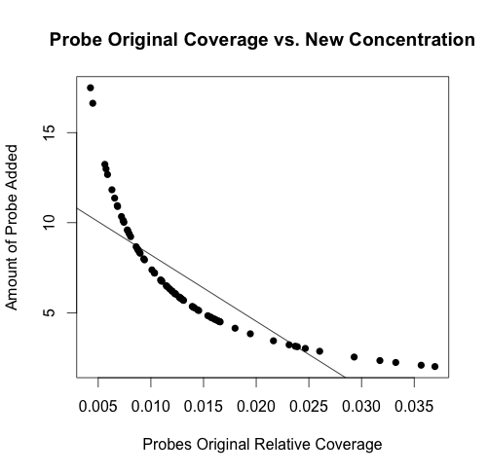
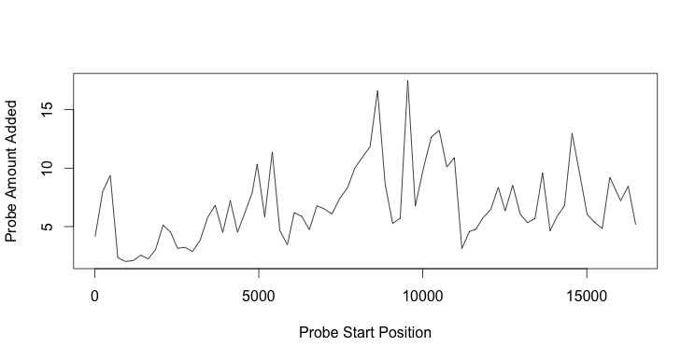
Quick Sanity Check
Examining Alvin’s amount of probe added versus the original coverage shows that we are correctly adding a higher concentration of probes for regions that were poorly covered (see graph on left, ~1/x).
Suggests simple transposition of relative concentrations can’t explain the results.

Slide 5
The Data

Slide 6
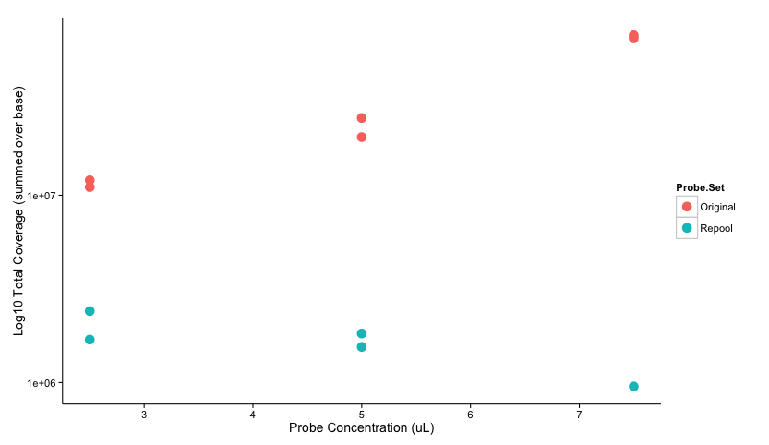
Total Coverage of Realigned mtDNA by probe set and concentration
Note Y-axis is log scale. Examining figure, we see that the old probe set not only has much higher coverage, but also has coverage increase with probe concentration. While the new probe set does not increase concentration with increasing spike-in amount

Slide 7
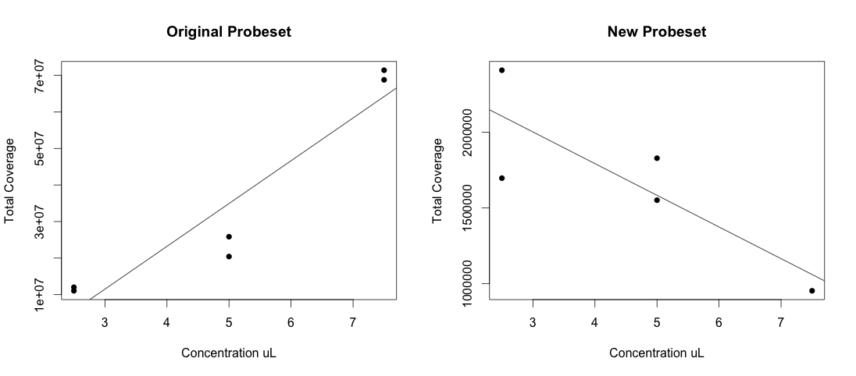
Relationship between probe concentration and spike-in quantity
Old probes replicated better and were a better match. (Note this is mtDNA coverage)

Slide 8
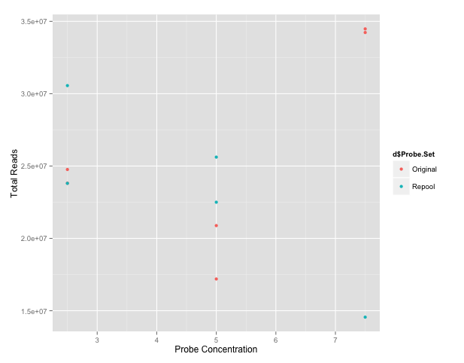
Total Reads Per Sample (whole genome)
Notes:
This is all reads aligned to mtDNA

Slide 9
%mtDNA of All Reads From mtDNA
Once again old probes nice and linear with spike in.

Slide 10
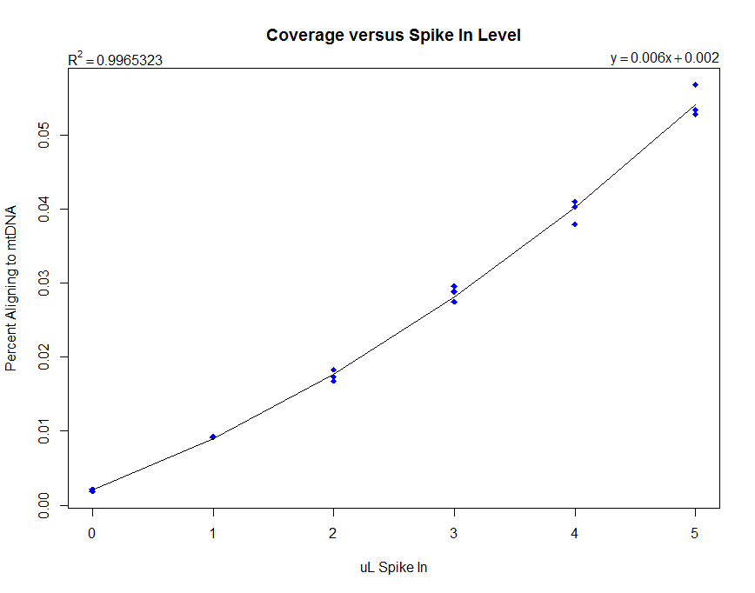
Previous Data For Old Probes
This was the pattern we were expecting.

Slide 11
Previous Data For New Probes
The new probes last time didn’t increase with spike in this time, and this appeared to be the case again.

Slide 12
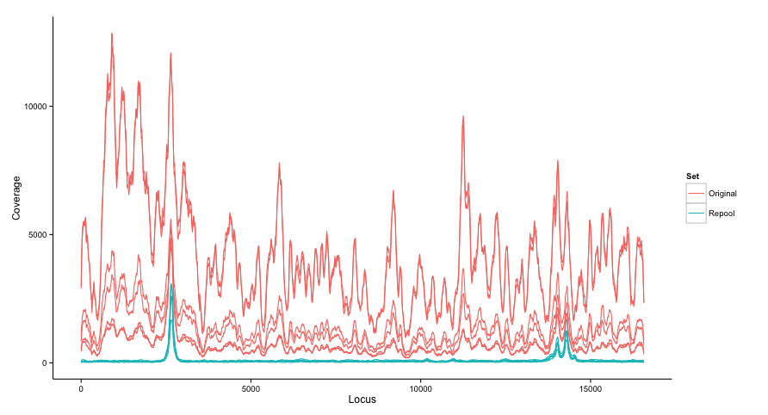
Absolute Coverage By Probe Set
As before, the new probes have much larger spikes in coverage due to the nuclear baits.
The dual humps before ~15,000 appear more noticeable in both sets though.

Slide 13
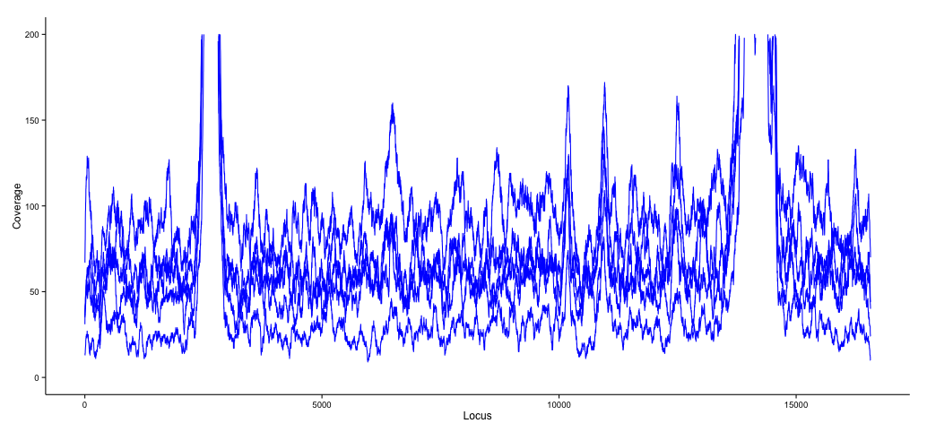
Absolute Coverage for New Probes Zoomed In
Coverage is even but very low…

Slide 14
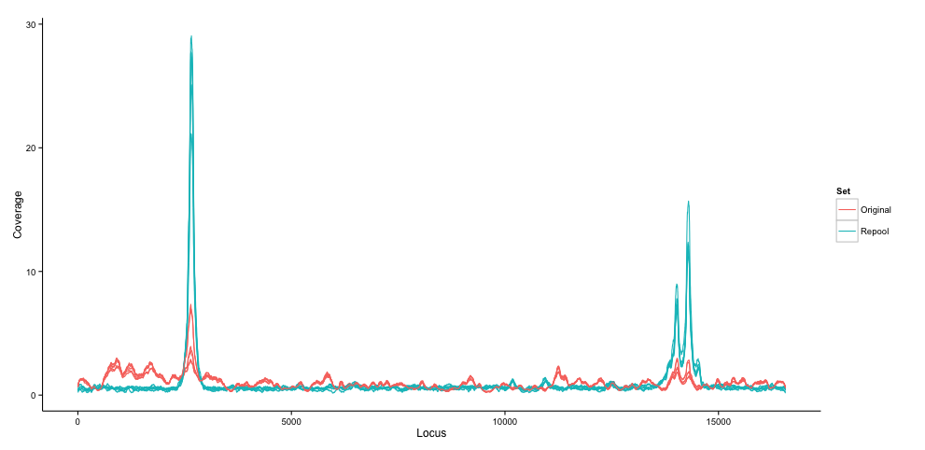
Normalized Coverage By Probe Set

Slide 15
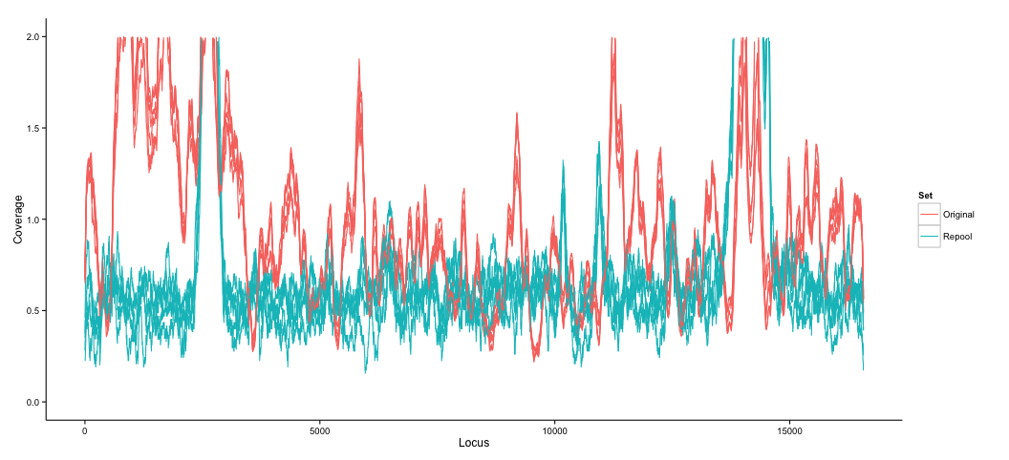
Normalized Coverage By Probe Set (Zoomed)

Slide 16
Conclusions
Once again, increasing probe concentrations and rebalancing the probes did not lead to any increases in coverage.
We still cannot explain this, but know it isn’t completely idiopathic as we replicated it while simultaneously showing the old probes could increase coverage.
Question: The probe rebalance method does not appear to be working. Do we abandon it? The old method is inefficient as due to uneven coverage we need higher total coverage, but perhaps we should do a cost benefit analysis of attempting this again versus just increasing Mito coverage to 1000X.

