Slide 1
mt-DNA Analysis Internals

Slide 2
Data Processing Overview
BAM Read Loader
de novo assembly
- Finds Large Deletions
- Calls Indels
- Creates Majority Consensus Sequence
-Assigns Haplotypes
SNP Caller
- Call Heteroplastic SNPs
- Assigns Haplotype
Read Loading
Analysis Tools
Combine and Triage
Depth of Coverage Tool
- Creates PDF plot and CSV
Paired End Peak Finder
- Looks for deletions
Triage
- Did data meet expected quality standards?
- Did all analyzes succeed?
- Did different analysis steps agree?
- Did tools all agree?
Reporting
- Were any deletions found?
- What are the heteroplasmy levels at each position?
- What is the consensus sequence and alignment with reference?
- What variants were present?
- What annotations apply to those variants?
- What is the haplotype of the sample?

Slide 3
Step 1: Read Loading – Accounting for NuMTs and avoiding long processing times
Grab all reads from the mtDNA and any nuclear locations likely to be from the mtDNA
Filter Reads as Follows:
Quality trim the end of those reads (Mean QC > 22, Ends trimmed until QC > 22)
Remove Duplicates (SAM Flag: 1024)
Re-align reads originally aligned to nuclear DNA to mtDNA
Notes on Reads from Nuclear DNA
Aligners typically randomly assign reads to one location if there are multiple equivalent possible mapping locations.
Due to NuMTs, this can mean that some information is lost prior to analysis.
We want to recover information without reprocessing all reads in the BAM file.
We also want to account for the fact that the genome is circular.
Goal: Define target regions to query for reads that may be mitochondrial, thereby avoiding excessive processing.

Slide 4
Defining where mitochondrial reads align using simulations
Took all mitochondrial sequences in phylotree (2,736 mtDNA genomes representing the global diversity).
Simulated typical Illumina reads from each
Length = 100 bp
Error rate = 1%.
Insert Size = Normal(150, 30)
Aligned reads with BWA-mem

Slide 5
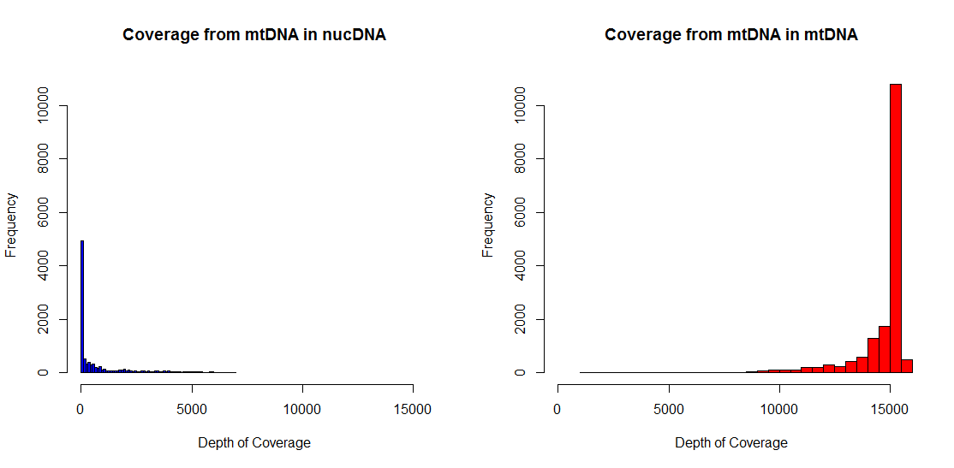
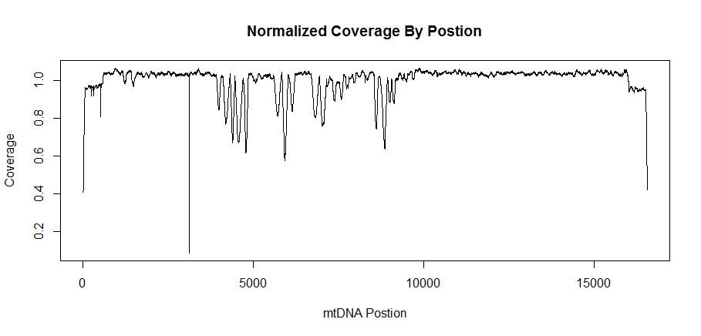
BWA defined alternate mapping locations.
Only 3% of reads from the mtDNA actually aligned somewhere else.
These reads fall in to 47 intervals on the nuclear genome.
When grabbing reads, we take all the reads aligned to the mtDNA, as well as realign any reads within these 47 bp regions.
We also have a “pseudo” mtDNA sequence that tacks on a portion of the front of the sequence to the back to account for any changes.

Slide 6
Data Processing Overview
BAM Read Loader
de novo assembly
- Finds Large Deletions
- Calls Indels
- Creates Majority Consensus Sequence
-Assigns Haplotypes
SNP Caller
- Call Heteroplastic SNPs
- Assigns Haplotype
Read Loading
Analysis Tools
Combine and Triage
Depth of Coverage Tool
- Creates PDF plot and CSV
Paired End Peak Finder
- Looks for deletions
Triage
- Did data meet expected quality standards?
- Did all analyzes succeed?
- Did different analysis steps agree?
- Did tools all agree?
Reporting
- Were any deletions found?
- What are the heteroplasmy levels at each position?
- What is the consensus sequence and alignment with reference?
- What variants were present?
- What annotations apply to those variants?
- What is the haplotype of the sample?

Slide 7
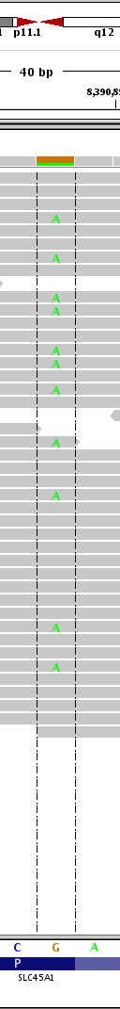
Basic SNP Calling (akin to Unified Genotyper)
This algorithm is designed to find Heteroplasmy in samples.
It is akin to our past UnifiedGenotyper step (call SNPs with Ploidy = 100), but significantly faster.
Key difference is that UG integrates over 176,851 different possible genotypes, while we use a continuous frequency model.

Slide 8

SNP Heteroplasmy Model
Models assumes a continuous frequency of each base at each position
Goal is to infer this vector for each position.
Uses same likelihood model as UG
Implements E-M algorithm to infer underlying frequencies.

Slide 9
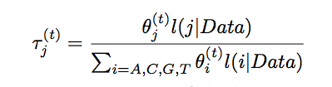

Note on the E-M Step
The EM – Algorithm goes beyond simple read counts and also uses quality information to assess the frequency of each bp in the sample.
It initializes the unknown frequency of each base according to the read counts, and iterates using the QC scores of the reads until convergence.
However, in practice, with high coverage (~1000X) simply counting basepairs of each type provides an accurate estimate. The effect of the EM algorithm is to shrink the counts of low frequency, low quality reads, but these already quite low (<1%).
To save computational time (~30 seconds), one can simply use the read counts by passing the –skip_em flag to the program.

Slide 10
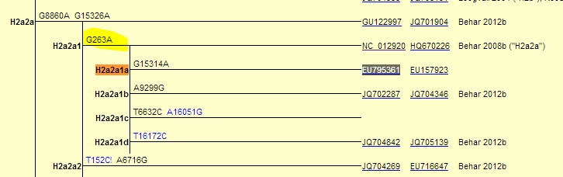
Haplotype Calling
Used for two purposes
Provide demographic information about the sample.
Provide additional quality information.
Implementation
Using standard Phylotree Haplotype classification method for consistency (Phylotree v15)
Algorithm - essentially a brute force routine that ranks haplotypes by calculating a weighted hamming distance to known reference sequences and selecting the highest scoring hit.

Slide 11
Haplotype Report
Best Haplotype
Agreement between SNPs
Score for Best Haplotype
Unfortunately, phylotree is inconsistent in how it treats indels, so these are not used for assignment or comparison.
Polymorphisms in Sample
Polymorphisms in Reference Haplotype
Polymorphisms in Both

Slide 12
Data Processing Overview
BAM Read Loader
de novo assembly
- Finds Large Deletions
- Calls Indels
- Creates Majority Consensus Sequence
-Assigns Haplotypes
SNP Caller
- Call Heteroplastic SNPs
- Assigns Haplotype
Read Loading
Analysis Tools
Combine and Triage
Depth of Coverage Tool
- Creates PDF plot and CSV
Paired End Peak Finder
- Looks for deletions
Triage
- Did data meet expected quality standards?
- Did all analyzes succeed?
- Did different analysis steps agree?
- Did tools all agree?
Reporting
- Were any deletions found?
- What are the heteroplasmy levels at each position?
- What is the consensus sequence and alignment with reference?
- What variants were present?
- What annotations apply to those variants?
- What is the haplotype of the sample?

Slide 13
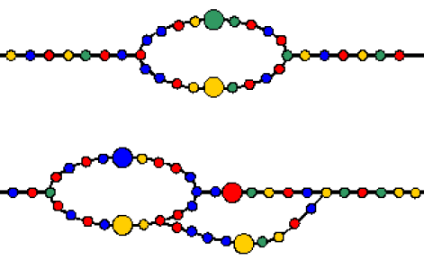
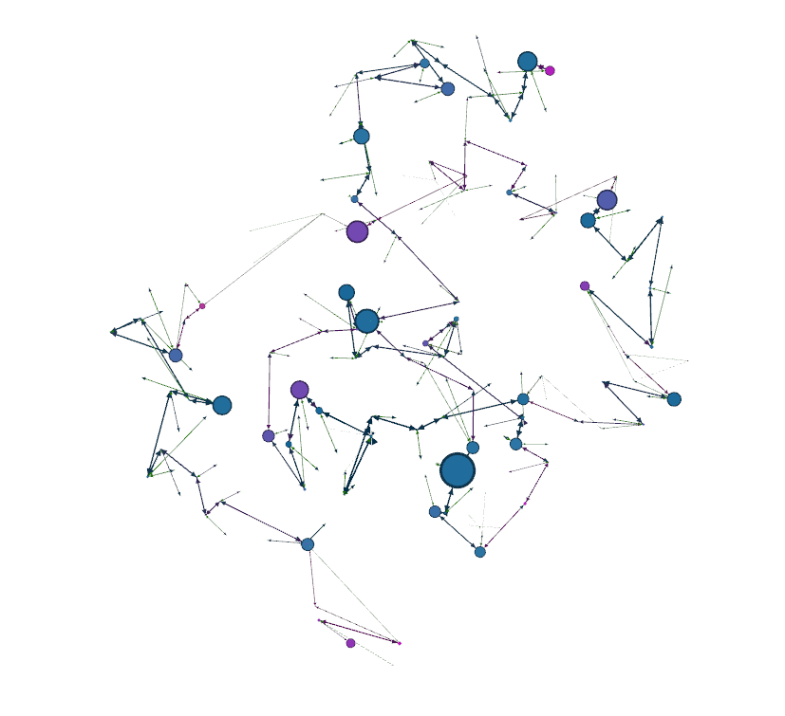
de novo Assembly
Used to:
Call indels
Generate a complete consensus sequence
Find large deletions

Slide 14
Finding Large Deletions
Reference: 5,000-13,000
Coverage= 1000X
Coverage= 1000X
500X
500X
Reference: 1-5,000
Reference: 13,000-16,539
Node 5
Coverage=1000
50X
Unknown sequence of length 20
Coverage= 100X
Coverage= 100X
50X
Step 1 – Find large deletions by looking for alternate paths through graph that “skip” large sections of the genome
Step 2 – Estimate the deletion frequency using 2 methods
- The ratio of the average k-mer coverage of each path.
- The ration of the edge weights leaving the split.

Slide 15
Finding Large Deletions
Sequence Number | Has Deletion | StartRef | EndRef | Deletion Size | Deleted Regions | Fraction Evidence | Avg Coverage | Assembly Length | Sequence
0 | TRUE | 0 | 16567 | 11,983 | 3,555-15,537; | 0.68 | 639.3611 | 4587 | GATCACA…
1 | FALSE | 0 | 16567 |  |  | 0.32 | 676.0745 | 16589 | GATCACA…
Each assembled molecule is then output in a CSV file

Slide 16
Calling Heteroplasmic Indels
Indels are identified as short “bubbles” in the graph.
Unlike SNPs, there is no good likelihood model for indels
As such, we assign frequencies by simply counting occurances of each type.
In this case, 30%, 20% and 50%
Seq 1: TTTCCACCAAACCCCCCCCCTCCCCCCGCT - 30X
Seq 2: TTTCCACCAAA-CCCCCCCCTCCCCCCGCT - 20X
Seq 3: TTTCCACCAAA--CCCCCCCTCCCCCCGCT - 50X

Slide 17
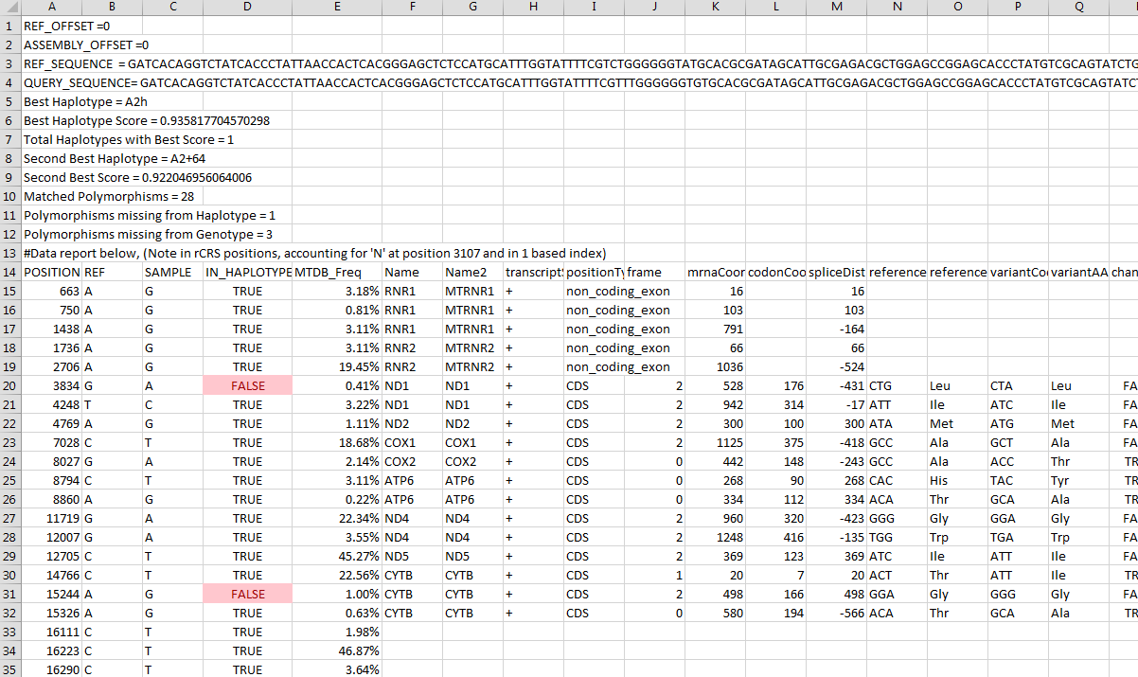
Generating and Annotating Consensus
For the consensus assembled mtDNA molecule we report:
Full sequence and alignment with reference
Haplotype assignment and concordance
mtDB Frequency of all mutations found
Annotations of all mutations found.

Slide 18
Data Processing Overview
BAM Read Loader
de novo assembly
- Finds Large Deletions
- Calls Indels
- Creates Majority Consensus Sequence
-Assigns Haplotypes
SNP Caller
- Call Heteroplastic SNPs
- Assigns Haplotype
Read Loading
Analysis Tools
Combine and Triage
Depth of Coverage Tool
- Creates PDF plot and CSV
Paired End Peak Finder
- Looks for deletions
Triage
- Did data meet expected quality standards?
- Did all analyzes succeed?
- Did different analysis steps agree?
- Did tools all agree?
Reporting
- Were any deletions found?
- What are the heteroplasmy levels at each position?
- What is the consensus sequence and alignment with reference?
- What variants were present?
- What annotations apply to those variants?
- What is the haplotype of the sample?

Slide 19
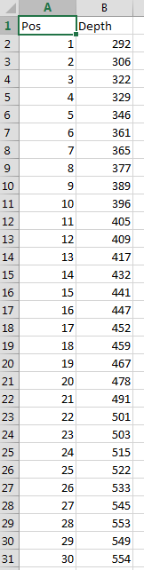
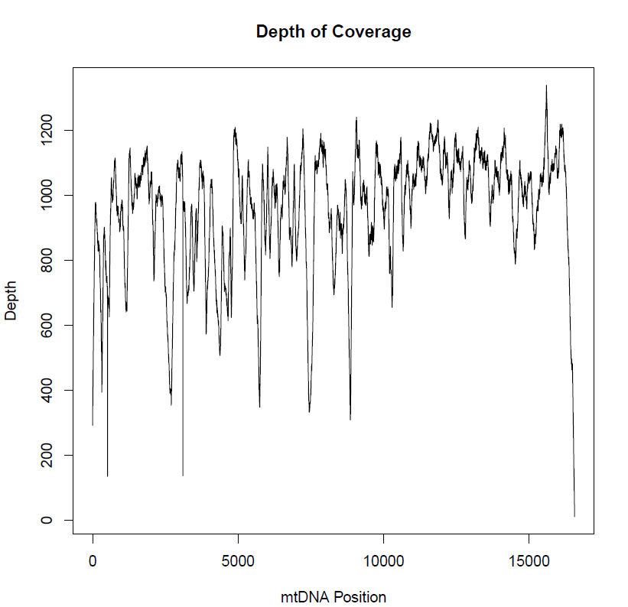
Depth of Coverage Tool
Basic plot and CSV
Can be skipped using
–skip_dp
flag.

Slide 20
Data Processing Overview
BAM Read Loader
de novo assembly
- Finds Large Deletions
- Calls Indels
- Creates Majority Consensus Sequence
-Assigns Haplotypes
SNP Caller
- Call Heteroplastic SNPs
- Assigns Haplotype
Read Loading
Analysis Tools
Combine and Triage
Depth of Coverage Tool
- Creates PDF plot and CSV
Paired End Peak Finder
- Looks for deletions
Triage
- Did data meet expected quality standards?
- Did all analyzes succeed?
- Did different analysis steps agree?
- Did tools all agree?
Reporting
- Were any deletions found?
- What are the heteroplasmy levels at each position?
- What is the consensus sequence and alignment with reference?
- What variants were present?
- What annotations apply to those variants?
- What is the haplotype of the sample?

Slide 21
Paired End Algorithm
Two steps
Define a “abnormal” range of template sizes
Makes a histogram of all template sizes from paired end reads.
This histogram should be unimodal
To define the boundary of “normal”, we start from the maximum value in this histogram and move right in sliding windows of size 3 positions until we obtain a local minima or an average coverage of 0.
Look for an unusual number of “abnormal” reads
Abnormal reads of a given template length are assumed to be Poisson distributed.
We estimate that distribution robustly using the median.
Then look for any template length above this cutoff with a p < 0.05 (correcting for mulitple tests).

Slide 22
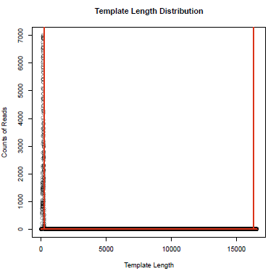
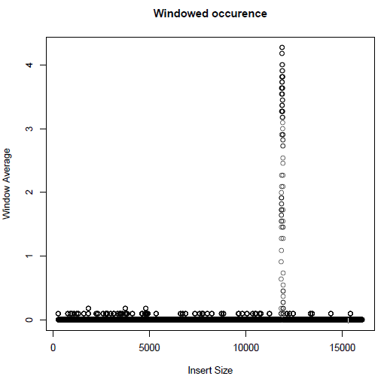
Very Simple Algorithm Works Very Well
Deletion of ~12 kb

Slide 23
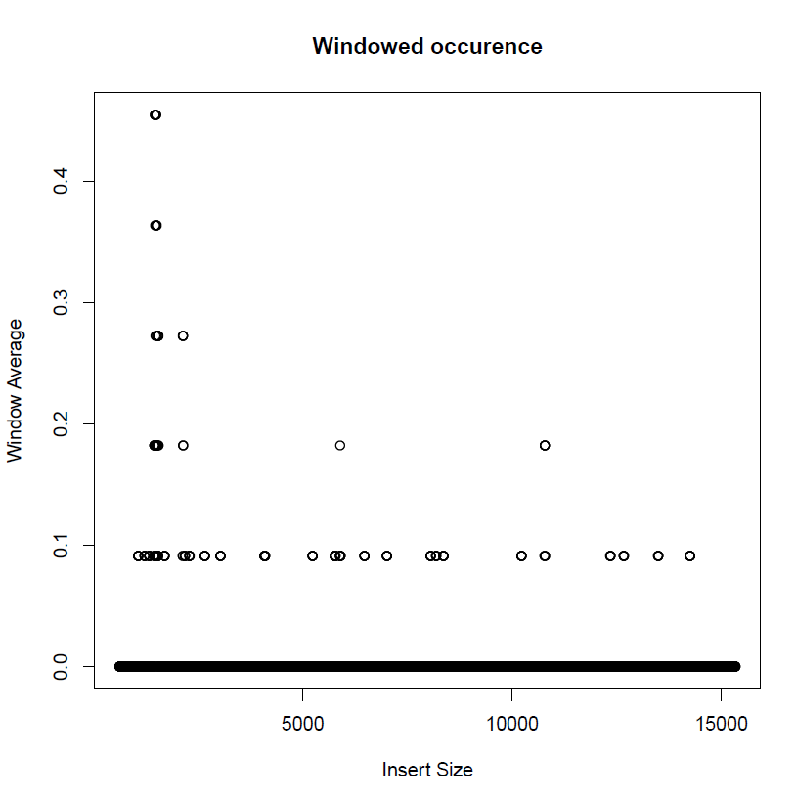
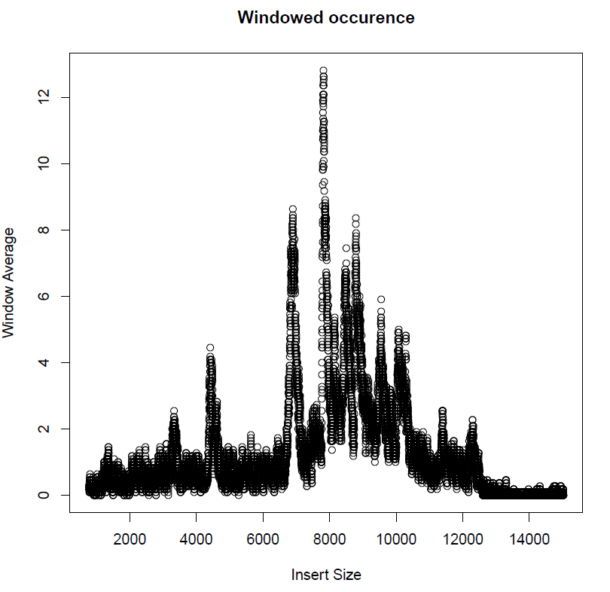
Except…..
No Deletion
12kb Deletion
????

Slide 24
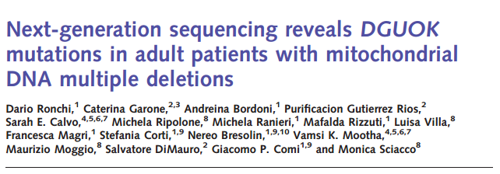
Multiple deletions pose analysis and interpretation problems
Patient with DGUOK Mutation

Slide 25
Triage Reporting - Did it work?
Analysis Tool (s) | Triage Characteristic (s)
All Tools | Were they successful, did anything fail and why?
Depth of Coverage | Was all coverage > 1000X
Assembler | Did we obtain a complete assembly? Was a high proportion of reads used for the assembly?
Assembler and SNP Caller | Do both haplotypes match? Are all consensus SNPs present in both?
Assembler and Paired End Analysis | Is their consistent evidence for a deletion (or no deletion) in both?
Haplotype Calls | Is there an unusual amount of variation not seen previously? Is there only one best haplotype assignment?
How to report and structure this output?

Slide 26
Reports
End use files currently produced from BAM:
Overall consensus sequence and report with variants listed and annotated
CSV files with depth of coverage
Plot with depth of coverage
CSV with any references
CSV file with indel/SNP heteroplasmy at each site
Diagnostic Files Currently produced from BAM
Multiple plots and reports on assembly at each step.
Assembly visualizations
Contigs from assembly mapped to reference
Overall file with different diagnostics at every step.

Slide 27
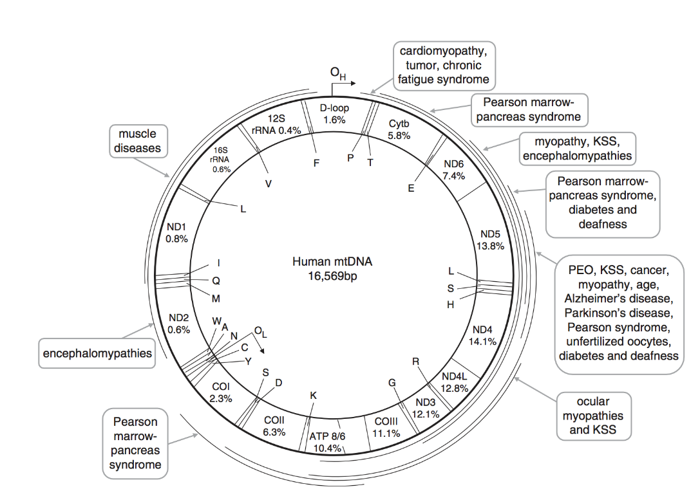
Known Limitations
With large deletions, the SNP calling can be unreliable to the misaligned reads at the deletion junction (assembly unaffected).
Data that is not paired-end
Mark duplicates removes most reads
Can’t run paired end search.
Multiple mutations are poorly tested and not well reported.
If the control region itself is deleted, may create an edge case that is not found.

