Slide 1
M&T
By Edwin Hung, Kevin Yong, Chungmoo Lee

Slide 2
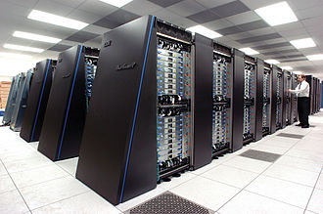

Slide 3
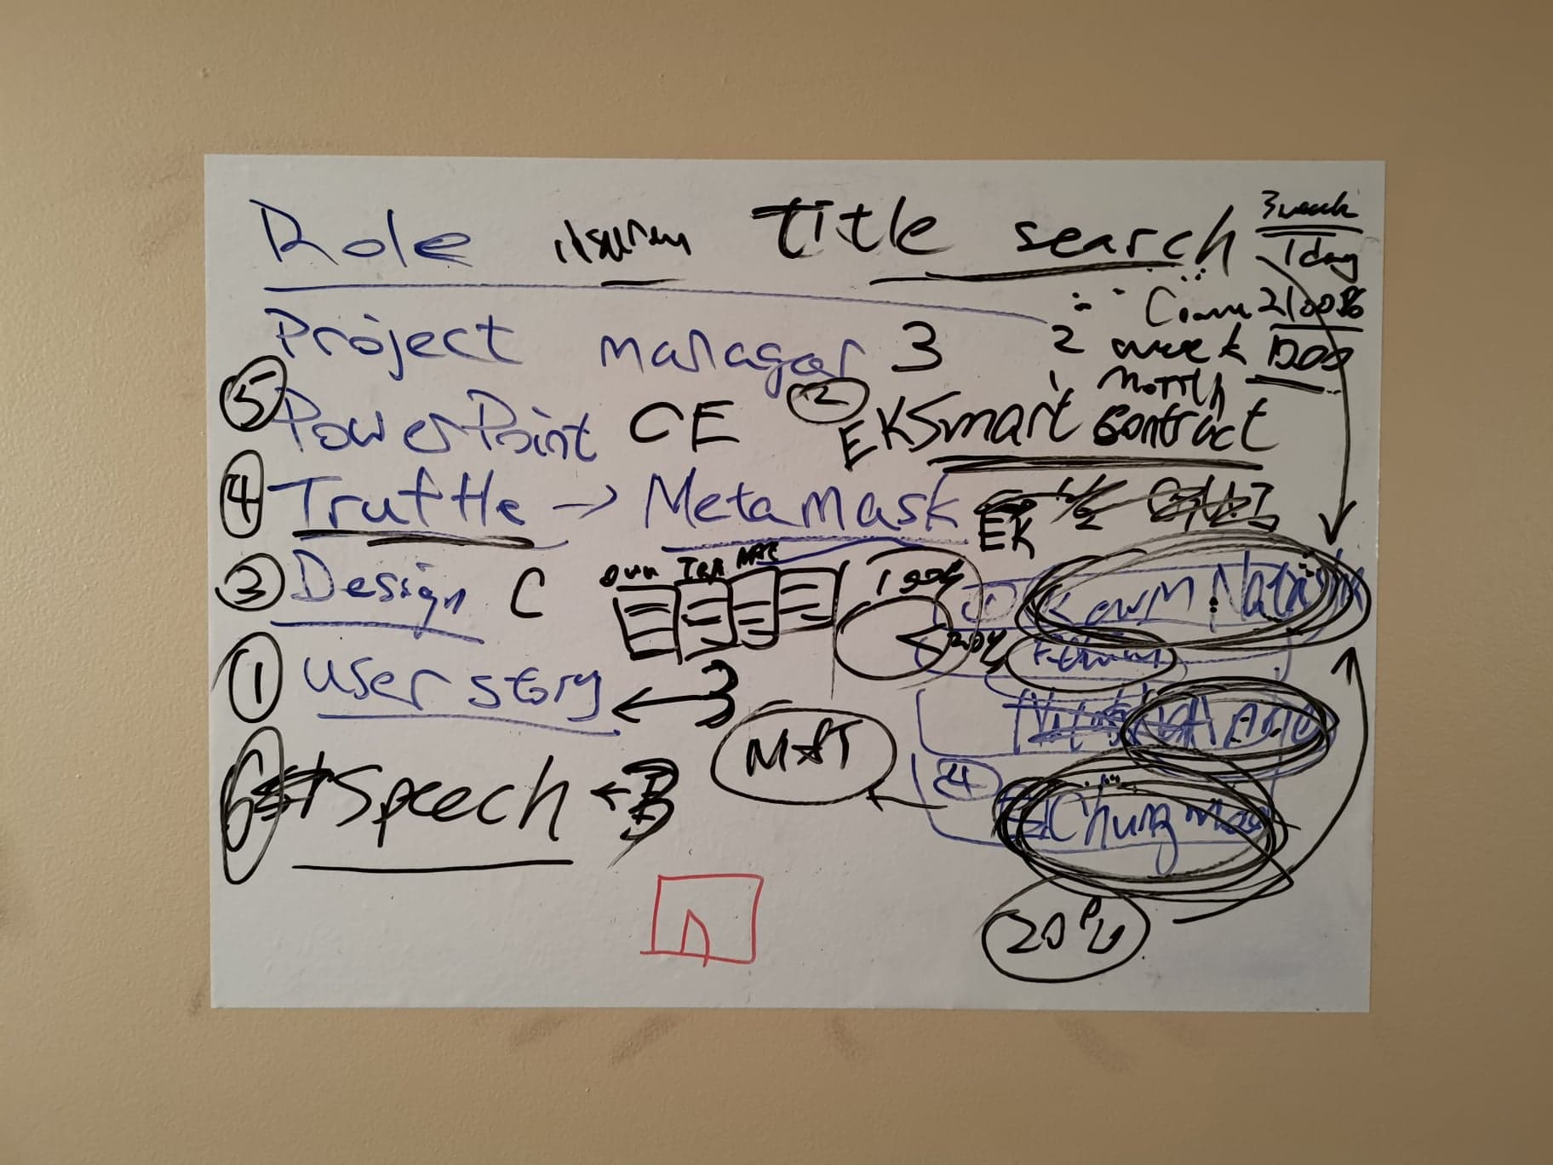

Slide 4


SaFeChecker

Slide 5
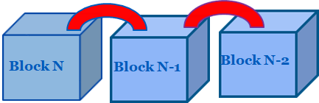
Base on Blockchain
Diagram by Bina

Slide 6
Current Problems?
Problems
Money
Time
Lawyer + title search = $4000
One Month

Slide 7
Solutions
Save Money
SaFeChecker
Save Time
Build Trust

Slide 8

How does this work?
Mortgage status
Tax status
Judgement

Slide 9


New Owner
Ledger

Slide 10
SaFeChecker

