Slide 1

A small server for remote controlling the Arduino IDE using MQTT and REST from a web page!

Slide 2
The Problem
Compiling and flashing Arduino boards
  Without a computer, or at least not one per student
  Without access to the Internet
  From a non Arduino tool like Snap
Why not make
a little service?

Slide 3
Arduinobot
A headless server software that can run on a Raspberry pi, or any other machine
Accepts verify & upload jobs over MQTT or REST and reports results back
Can concurrently serve several users, for example many pupils in a class room

Slide 4
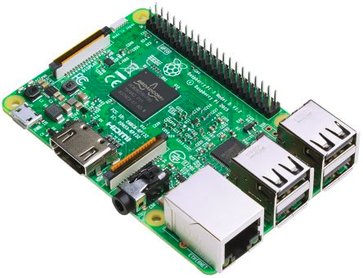

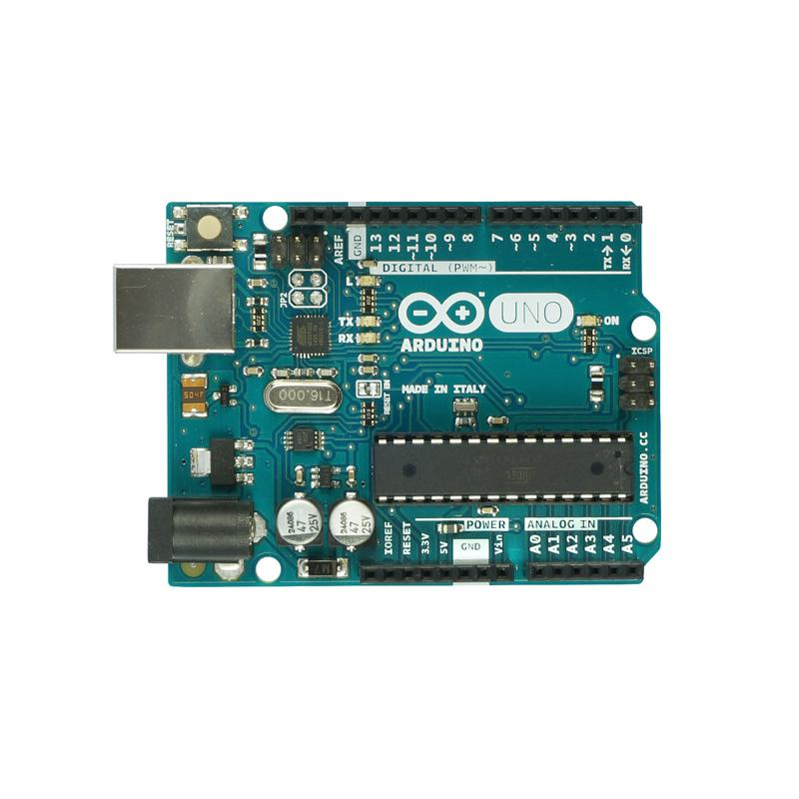


Architecture
HTTP/REST
MQTT
USB

Slide 5
Arduinobot
Written in 400 lines of Nim compiling via C
Very small and resource friendly
Spawns each job on threadpool using Arduino IDE CLI
Trivial to build and install as a service
Offers same API over HTTP or MQTT using JSON
MQTT can easily be used over Websockets

Slide 6
Arduinobot
Currently no state on the server, all source code is sent base64 encoded
Both stdout and stderr are reported back verbatim, separately
…but errors are also reported back separately in a JSON array, with message and line number etc, for easy handling in client

Slide 7
Arduinobot demo client
Written in 400 lines of Javascript
  CodeMirror as editor
  Standard PAHO library for MQTT
  Bootstrap v3 to look reasonably good
Purpose: To show how to use Arduinobot!

