Slide 1
An Update On NUGGETS OF A PLANET
The little martian that created civilization
MARIE-ÈVE COUSINEAU

Slide 2
Main Goal
The player has to combine elements together, which will one by one create a path towards the five Special Islands.
Once the five Special Islands are unlocked, the player wins.

Slide 3
Alchemy (no change)

Slide 4
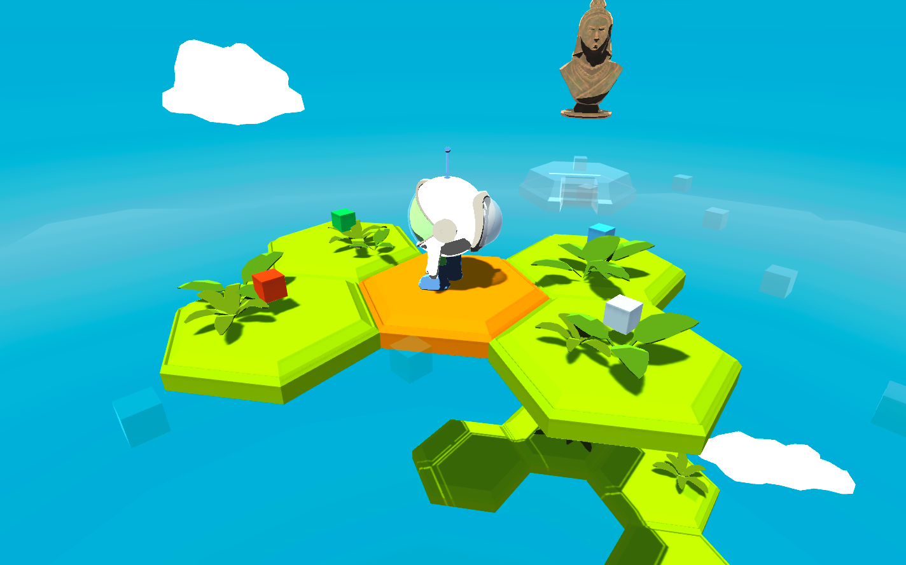
Let’s try the prototype

Slide 5
Previous tasks
Model Onye in Blender and animate him. ✔
Make sketches of elements and Special Islands. ✗
Model those in Blender too. ✗
Fix few bugs that I noticed already; ✗
When you see the elemet floating for like 0.5 seconds?
Sometimes the islands stop mid-way in the air
Near Energy Island, player is stuck somehow
Put all the islands (elements) in the game. ✗
Implement more GUI elements (text, feedback). ✔
Improve visuals: textures, materials, nicer animations, etc. ✔
Five Special Islands will be visible from the beginning, but ‘transparent’ ✔

Slide 6
What I got from playtesting
Player does not know if he picked up the item or not (Not very visible in Onye’s bag) - Need some kind of feedback from that
Some people thought the ‘mixing’ did not work, but in reality it’s because it’s not an existing combination. - Need feedback for that as well.
Move the stairs, because it looks like you can go on the human island with the life island.
Player would perhaps need hints sometimes.
Text more visible, bigger.

Slide 7
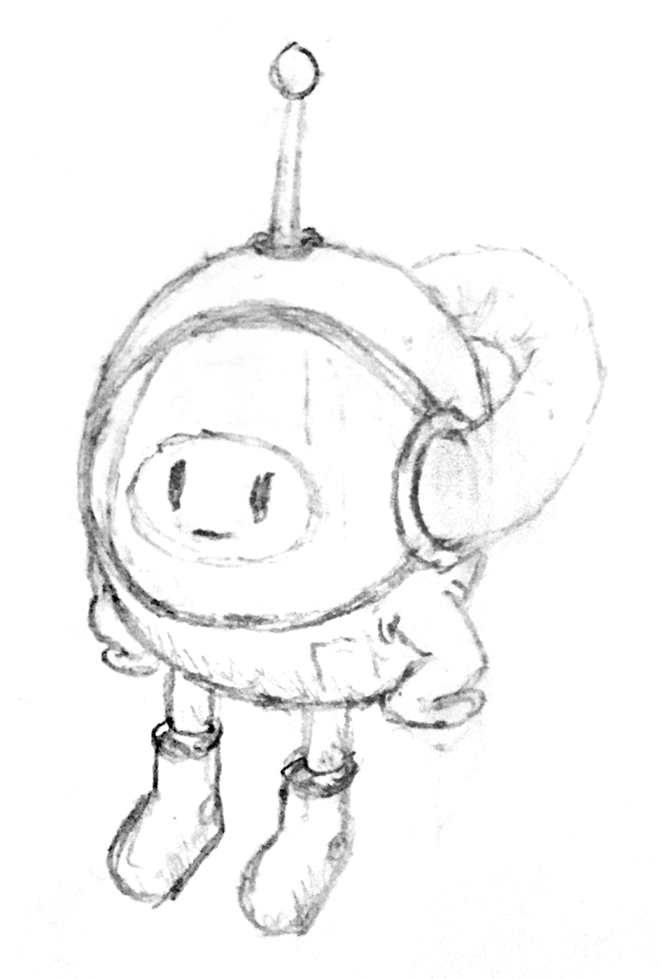
Thanks for listening!

