Slide 1
CAMAC
Через плату-расширение GTBC
сзади VME-крейта
VME
GTBV4
GSI
RIO3-1
.1.31
GTB
VME modules
MESYTEC, CAEN, ???
RIO3-2
.1.32
VME modules
MESYTEC, CAEN, ???
“Внутренняя” сеть 192.168.
“Event builder”
PC
lipc-1
.1.41
RIO3-3
.1.33
VME modules
MESYTEC, CAEN, ???
eth0
159.93.80.161
nra161
eth1
.1.1
lyserv
fc:75:16:56:e8:f6
RIO4-1
.1.11
VME modules
MESYTEC, CAEN, ???
“Server”
PC
RIO4-2
.1.12
VME modules
MESYTEC, CAEN, ???
Switch

Slide 2
JINR network
“In-the-cave” network
“Event builder”
PC
“User”
PC
Running software:
??? Event builder ???
“User”
PC
Running software:
Go4 + libUserAnalysis.so
“Server”
PC
“User”
PC
Switch
nfs
NAS
data storage
Server
exolina3.jinr.ru
nfs mount
Server
exolina2.jinr.ru
nfs
Server
exolina.jinr.ru
obsolete

Slide 3
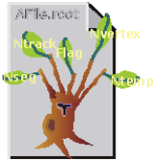

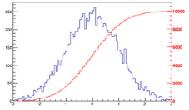
Lmd file
OR
“Raw data”
“Mbs”
“Lmd”
Go4 + libUserAnalysis.so
Go4 user analysis module, performed with high usage of Go4 functionality.
Mbs stream
Individual output streams into ROOT files can(should) be deactivated to save some CPU time and HDD storage.
Unpacking
step
(source)
ROOT tree in outputUnpacking.root
“Unpacked raw data”
UserEventUnpacking
Simple online
monitoring step
(processor)
ROOT tree in outputMonitoring.root
“Simple monitoring data”
UserEventMonitoring
Advanced online
monitoring step
(processor)
ROOT tree in output***.root
setup-
dependent
“Advanced monitoring data”
UserEvent*** (Not yet implemented)
setup
config. file
???
Online analysis
step
(processor)
Online monitoring
ROOT histos in
Go4AnalysisASF.root
Each step in its own directory inside the file
(Not yet
implemented)
more steps possible

Slide 4
Scenario A – “на коленке”
native ROOT
user macros
See: analyse.C macro
Required:
native ROOT (massive, but we still all use it);
Go4 UserLibrary headers (compact and easy to get);
Go4 UserLibrary compiled .so, rootmap and .pcm files;
a few Go4 headers and compiled .so libraried.
The last two items are not easy to get, but we anyway have them on the “server PC” so they can be taken from there.
??? Possible issue – ROOT version compatibility and ROOT modules availability
‘rootlogon.C’ in the current directory
{
TString myGO4SYS = gSystem->Getenv("GO4SYS");
if (myGO4SYS == "") {
cerr << "GO4SYS environment variable not defined. "
<< "Please run go4login or define GO4SYS manually. " << endl
<< "Only $GO4SYS/include path will be passed to the ROOT interpreter."
<< endl;
return;
}
gInterpreter->AddIncludePath(myGO4SYS + "/include/");
}

Slide 5
Scenario B – “с пушки по воробьям”
ExpertRoot
Required:
ExpertRoot =>
FairRoot =>
FairSoft =>
native ROOT
Go4 UserLibrary headers, compiled .so, rootmap and .pcm files;
a few Go4 compiled .so libraried.
No full Go4 built (???)
A lot of time, qualification and nerve for initial setup.
Full-blown analysis, numerous tools, long-term support, etc...
Implementation problematic:
Use event class which is neither from ExpertRoot, nor FairRoot. This class is a TGo4EventElement daughter and in principle, it has to be used in ExpertRoot as is (header+so).
ERGo4FileSource should be able to read the data from whatever input ROOT file produced by Go4.

Slide 6
FairRoot
Go4
Go4 UserLibrary
ExpertRoot
TGo4EventElement
FairSource
(FairFileSource?)
ERGo4FileSource
UserEventXXX
FairTask
ERXXXAnalysisTask
TGo4EventProcessor
UserProcXXX
XXX = {
Unpacking
Monitoring
***
}

Slide 7
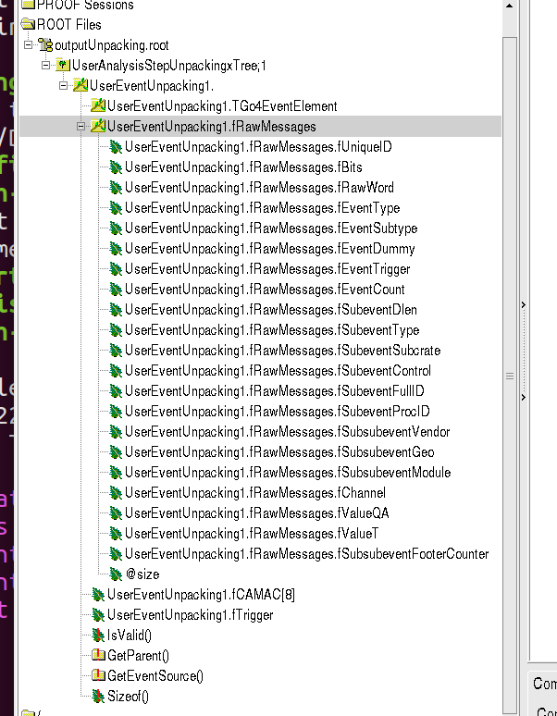
UserEventUnpacking
TClonesArray of RawMessage’s
Some additional information such as
raw CAMAC words
???
RawMessage
Independent of the block type (ADC, QDC, TDC, ???)
Essence:
channel, value
Necessary information from the headers/footers:
subsubevent header/footer:
vendor – {MESYTEC, CAEN, ???, AFFEAFFE, OTHER}
geo/module
footerCounter
subevent header:
procID – crate ID {VME0, VME1, CAMAC}
event header:
Additional information from the headers/footers:
subevent header:
dlen, type, subcrate, control, fullID,...
event header:
type, subtype, dummy, trigger, count,...

Slide 8
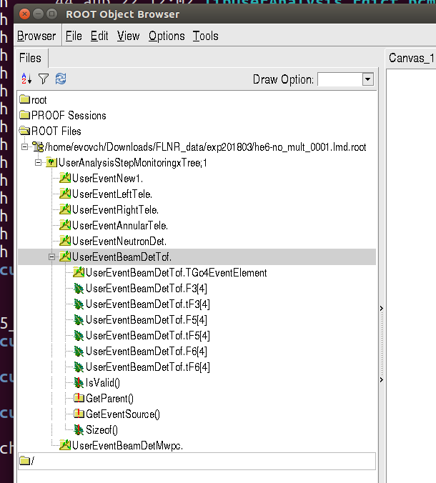
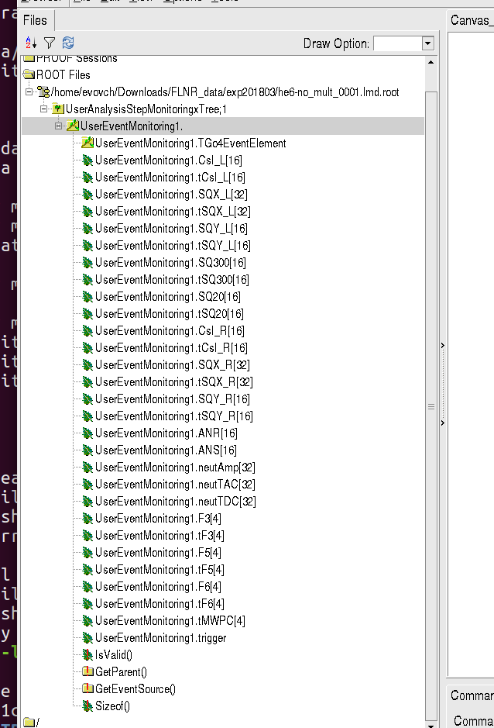
UserEventMonitoring
Composite event structure – many classes, the list of branches can be set during runtime depending on the setup configuration.
Flat event structure – one class, not possible to deactivate individual elements.

Slide 9
UserEventMonitoring
Left telescope (square)
CsI_L[16], tCsI_L[16]
SQX_L[32], tSQX_L[32]
SQY_L[16], tSQY_L[16]
Square telescope 300 um
SQ300[16], tSQ300[16]
Square telescope 20 um
SQ20[16], tSQ20[16]
Right telescope (square)
CsI_R[16], tCsI_R[16]
SQX_R[32], tSQX_R[32]
SQY_R[16], tSQY_R[16]
Annular telescope
ANR[16]
ANS[16]
Neutron detectors – stilbene
neutAmp[32]
neutTAC[32]
neutTDC[32]
ToF
F3[4], tF3[4]
F5[4], tF5[4]
F6[4], tF6[4]
MWPC
MWPC[] - ???
tMWPC[4]
neutron detectors
CsI_L CsI_R
SQY_L SQY_R
SQX_L SQX_R
SQ20
L - left
R - right
target
F6 (ToF)
MWPC2_Y
MWPC2_X
MWPC1_Y
MWPC1_X
F5 (ToF)
F3 (ToF)
NOTE: F{separator focus number}

Slide 10
Neutron detector (stilbene) readout
Stilbene
PMT
4 channels x 8
MESYTEC
MPD4
ADC
neutAmp
Last
dynode
Anode
neutTAC
CF
discrim.
TDC
[CAEN]
neuTDC
gamma / neutron PID using neutTAC vs. neutAmp
neutron
CF discrim
Inverted signal is delayed and added to the attenuated original signal. This provides hardware walk correction.
gamma

Slide 11
Why create so many entities – steps, classes, data streams, frameworks, libraries, etc?
Modular structure allows to combine elements, keeping the unchanged ones and rewriting only some of the classes.
This in turn pushes towards the usage of version control systems (go git!)
New setup or new experiment – new branch.
Unpacking procedure and corresponding class in principle should not change at all.
Only when new type of electronics is purchased and the unpacking code has to be extended.

Slide 12
MESYTEC mADC-32
MESYTEC mQDC-32
MESYTEC mTDC-32
CAEN V775 (32ch TDC)
CAEN V775N (16 ch TDC)
CAEN V785 (32ch ADC)
CAEN V785N (16ch ADC)
CAEN V792 (32ch QDC)
CAEN V792N (16ch QDC)
CAEN V862 (32ch QDC)
MESYTEC MPD-4
CAEN V560 (16ch scalers)
???

Slide 13
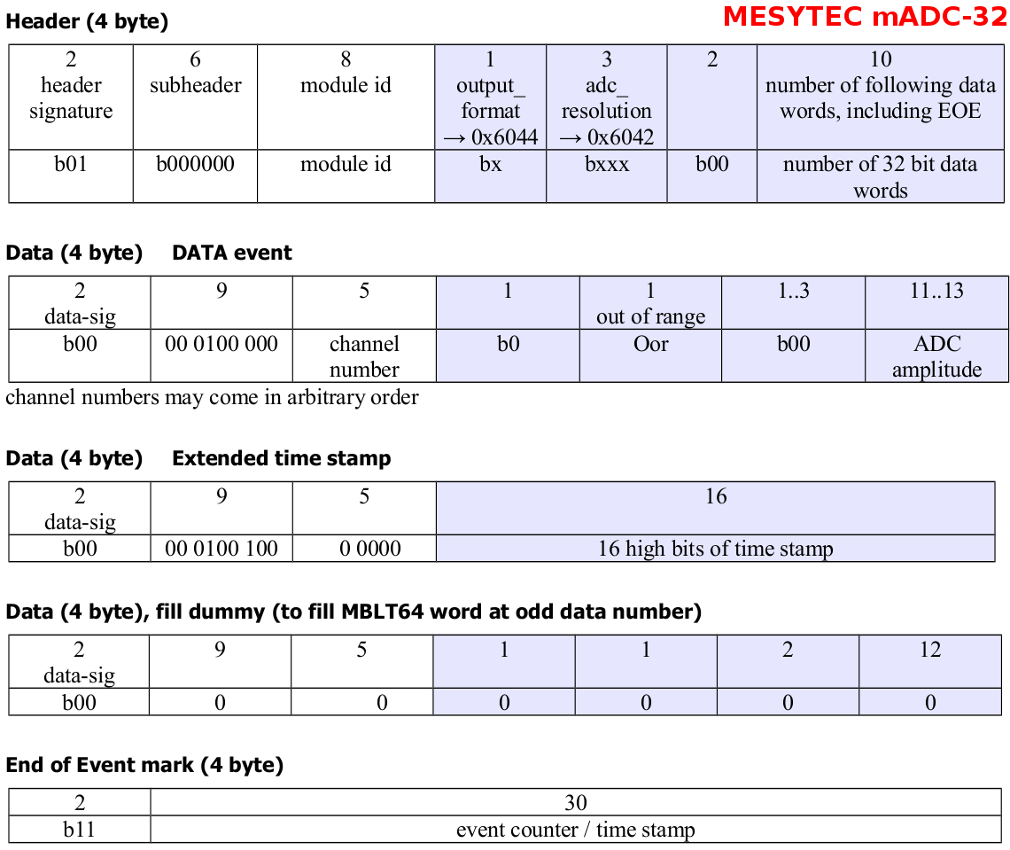
MESYTEC mADC-32

Slide 14
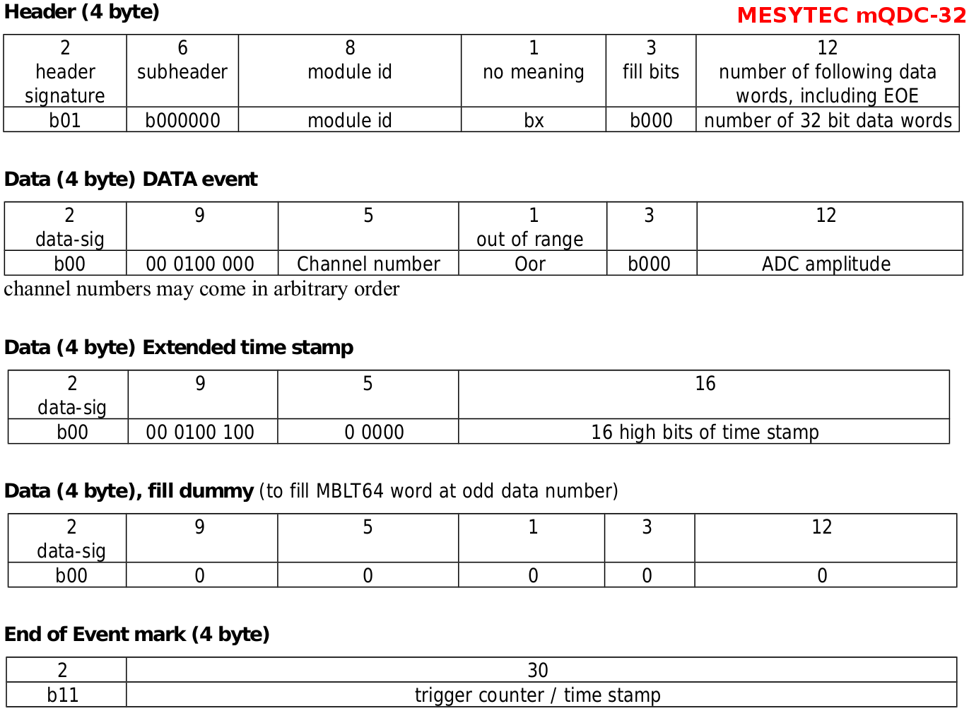
MESYTEC mQDC-32

Slide 15
MESYTEC mTDC-32

Slide 16
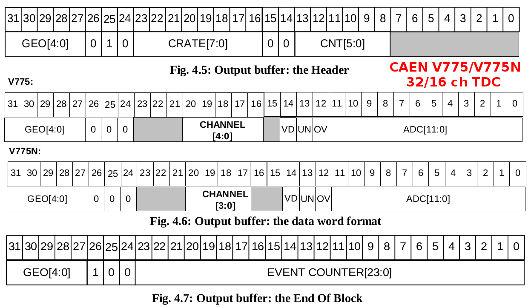
CAEN V775 (32ch TDC) & V775N (16ch TDC)

Slide 17
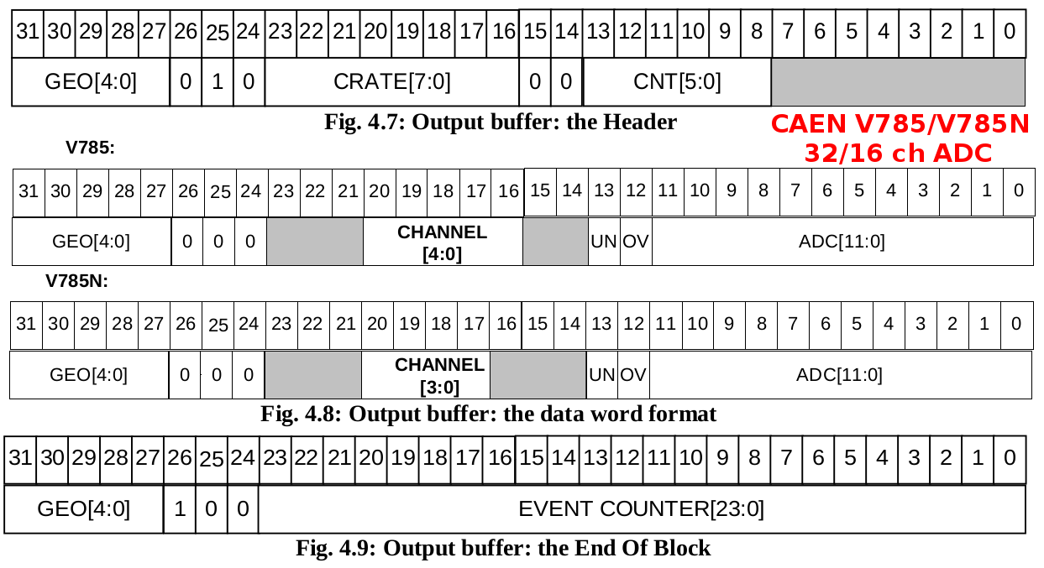
CAEN V785 (32ch ADC) & V785N (16ch ADC)

Slide 18
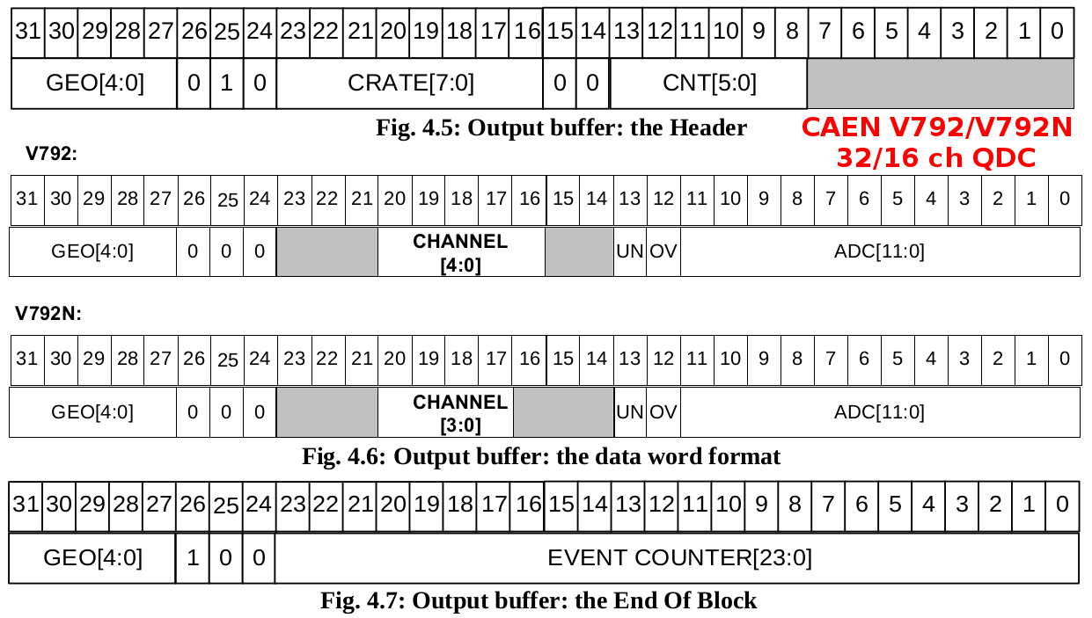
CAEN V792 (32ch QDC) & V792N (16ch QDC)

Slide 19
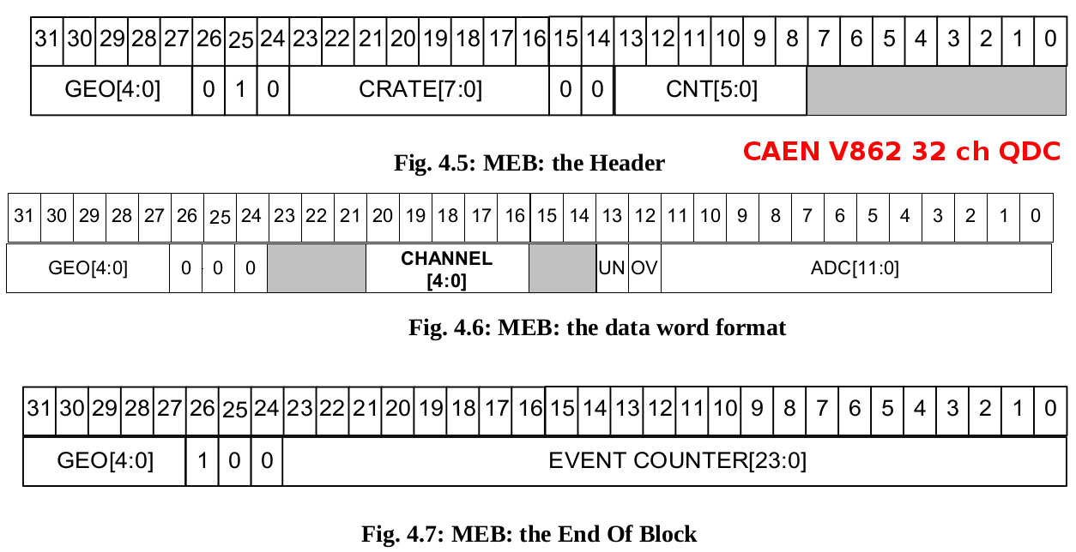
CAEN V862 (32ch QDC)

