Slide 1
Running Tests: Rebooting the Computer During Automated Testing

Slide 2


Slide 3
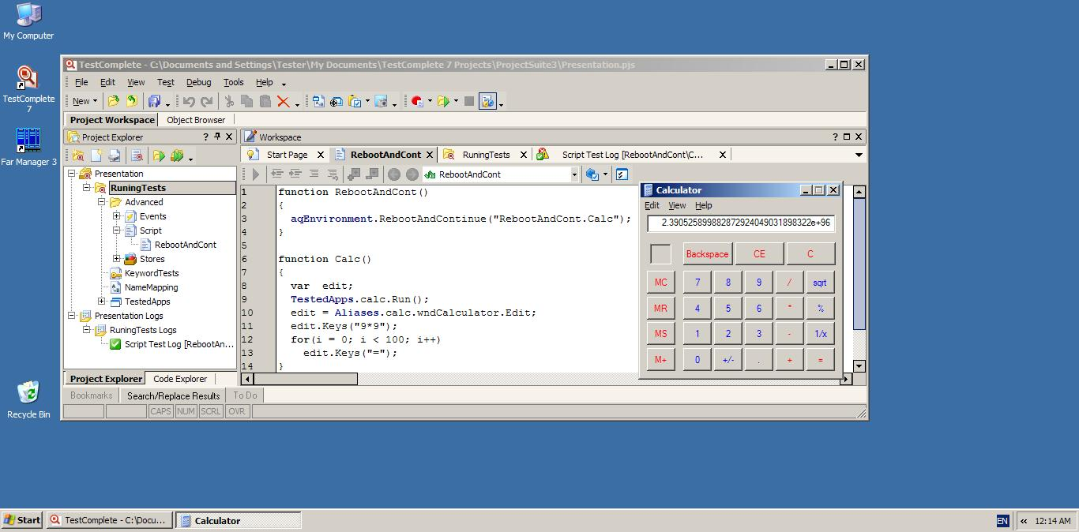

Slide 4
Rebooting the Computer During Automated Testing
TestComplete lets you reboot the computer during automated testing. After it is rebooted, TestComplete can continue running the test from a specific script function.
You can also shut down or reboot the computer at the end of the test

Slide 5
Function
To reboot the computer during automated testing, use this method:
aqEnvironment.RebootAndContinue(“UnitName.FunctionName”, “login”, “password”)

Slide 6
details
The aqEnvironment.RebootAndContinue method reboots the computer, logs in and continues the test run from the specified script function of the current test project. This function must meet the following conditions:
It must have no parameters. To pass data to this function, you can use project or project suit variables, or read data from the file.
It must prepare the environment and the tested application for further testing: run the tested application, bring it to the needed state, initialize global script variables and so on.
Tip:To run a keyword test after rebooting the computer, create a wrapper script function that will call this keyword test and specify this function in the RebootAndContinue call.

Slide 7
How RebootAndContinue Works
The aqEnvironment.RebootAndContinue method does the following:
Saves the user account information to this registry key:
HKEY_USERS\{USER_SID}\Software\Microsoft\Windows\CurrentVersion\RunOnce
where {USER_SID} is the ID of this user account.
Logs off the current user.
Reboots the computer.
Logs in automatically using the account saved in the registry.
Starts TestComplete.
Removes its data from the above-mentioned registry key.
Note:If this data is not removed (for example, if TestComplete was terminated or if the logged in user does not have permissions for this key), this user account may be used next time Windows starts.
Opens the same test project in TestComplete and runs the specified script function.

Slide 8
Requirements
On Windows Vista and later Windows versions, you must run TestComplete as an administrator to use RebootAndContinue.
The following registry key must exist:
HKEY_USERS\{USER_SID}\Software\Microsoft\Windows\CurrentVersion\RunOnce
where {USER_SID} is the ID of the user account used to log in after restart. This user must have permissions to create and delete values in this key.
Windows must not show a legal notice message before the logon screen is displayed (this message cannot be closed automatically). To disable the legal notice, set blank values for the following registry keys:
HKEY_LOCAL_MACHINE\SOFTWARE\Microsoft\Windows NT\CurrentVersion\Winlogon\LegalNoticeCaption HKEY_LOCAL_MACHINE\SOFTWARE\Microsoft\Windows NT\CurrentVersion\Winlogon\LegalNoticeText

Slide 9

Thanks!

