Slide 1
Langchain

Slide 2
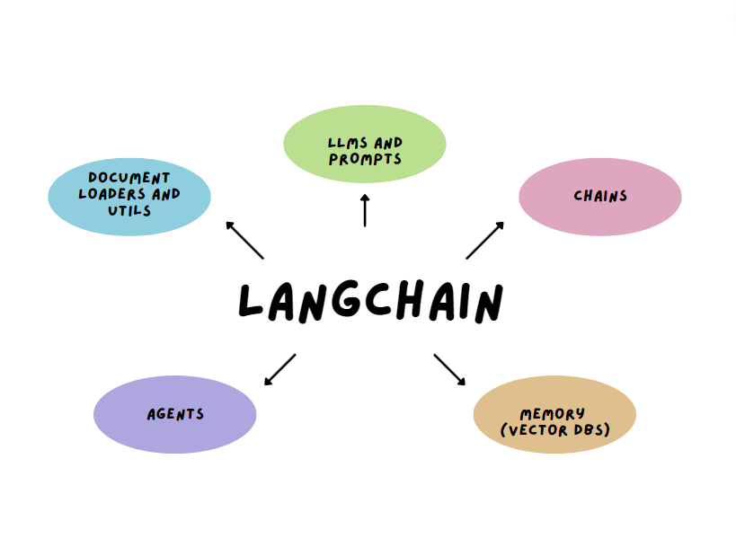

Slide 3
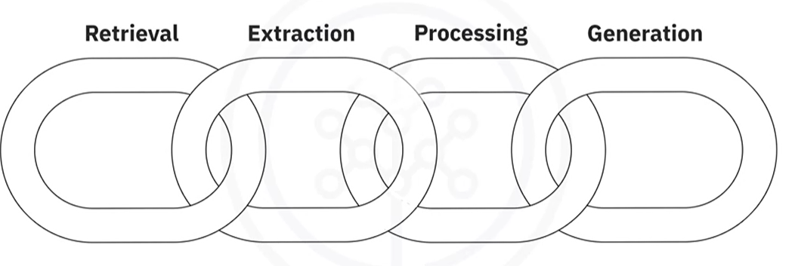
Why is it called like this?

Slide 4
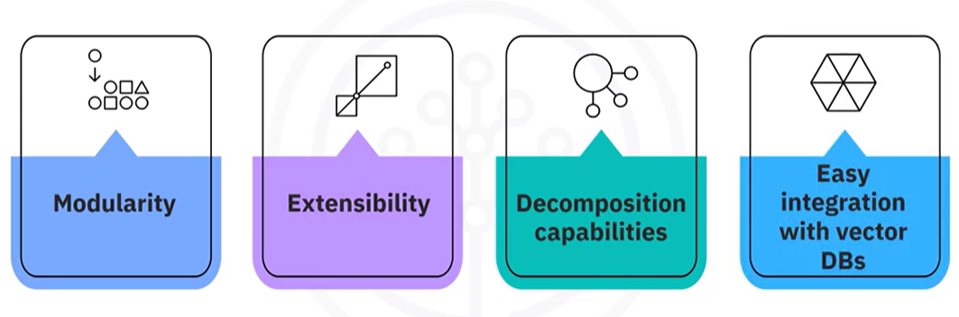
Benefits

Slide 5
LCEL (Lanchain Expression language)
Better composability
Clearer visualization of data flow
Greater flexibility when constructing complex chains

Slide 6
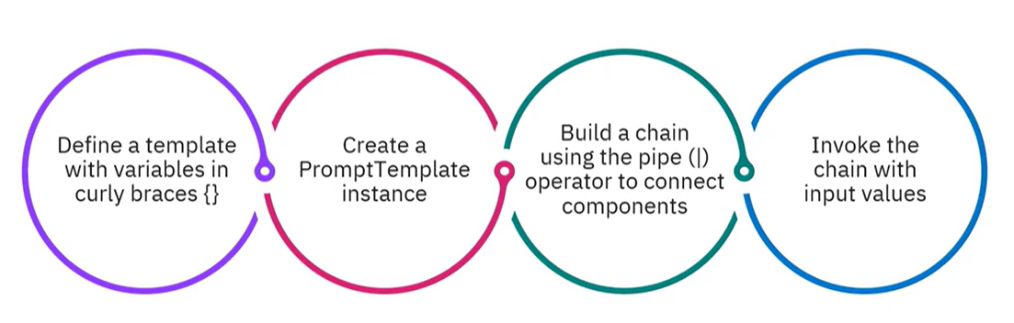
LCEL pattern

Slide 7
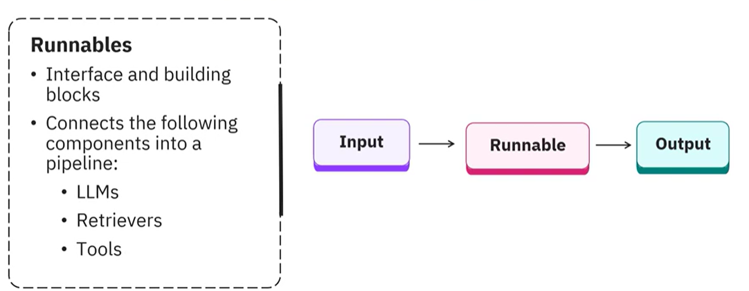
Runnable composition primitives
Notes:
There are sequential and parallel runnables

Slide 8
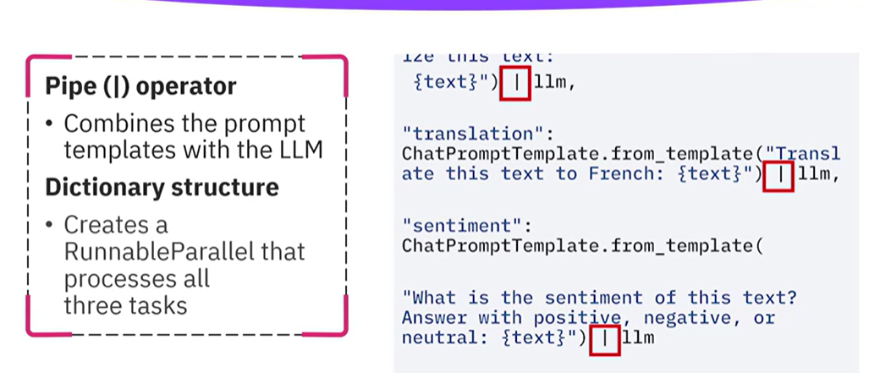
Parallel

Slide 9
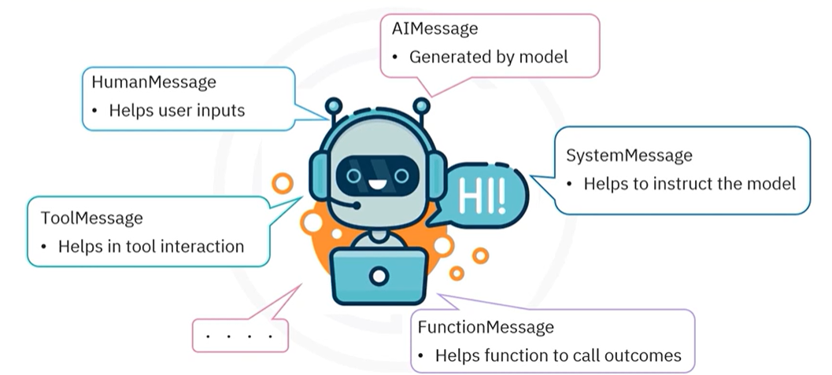

Slide 10
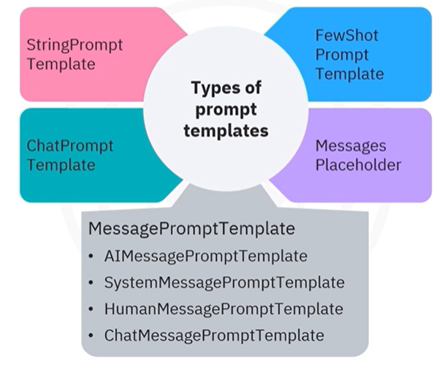

Slide 11
