Slide 1
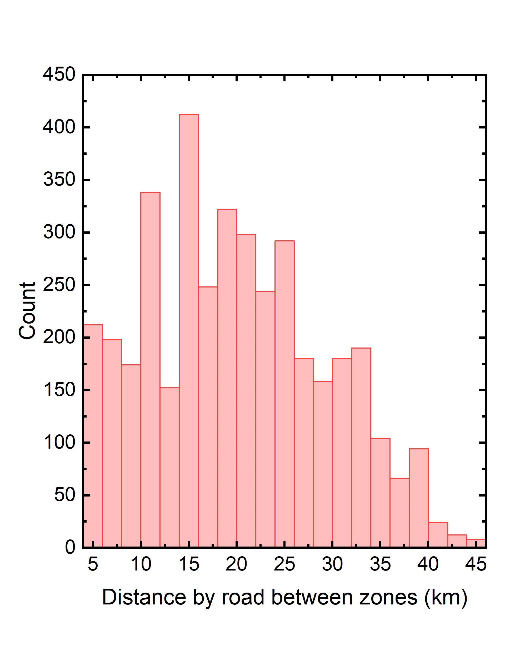
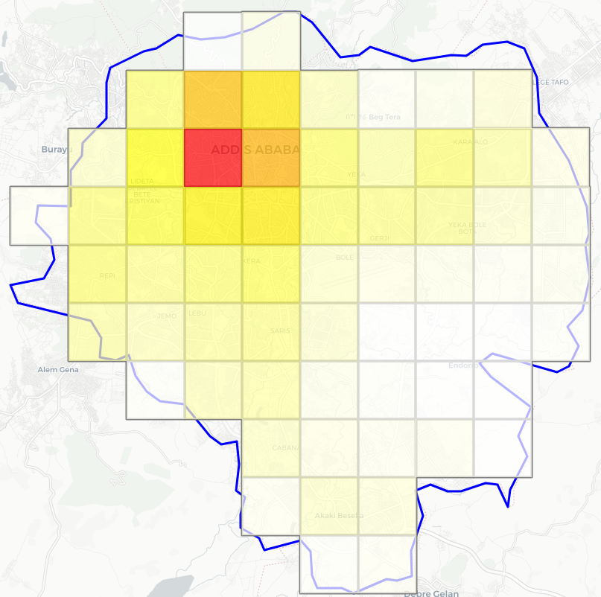


Mobility Demand
Map showing the number of vehicles per traffic zone (result of the vehicle allocation)
Distribution of road distances between traffic zones, shown as a histogram.

Slide 2
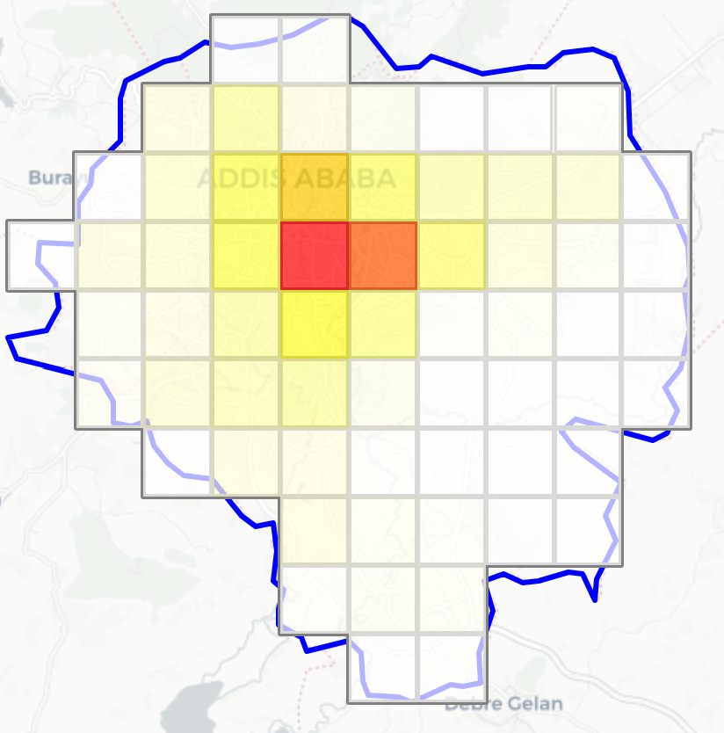
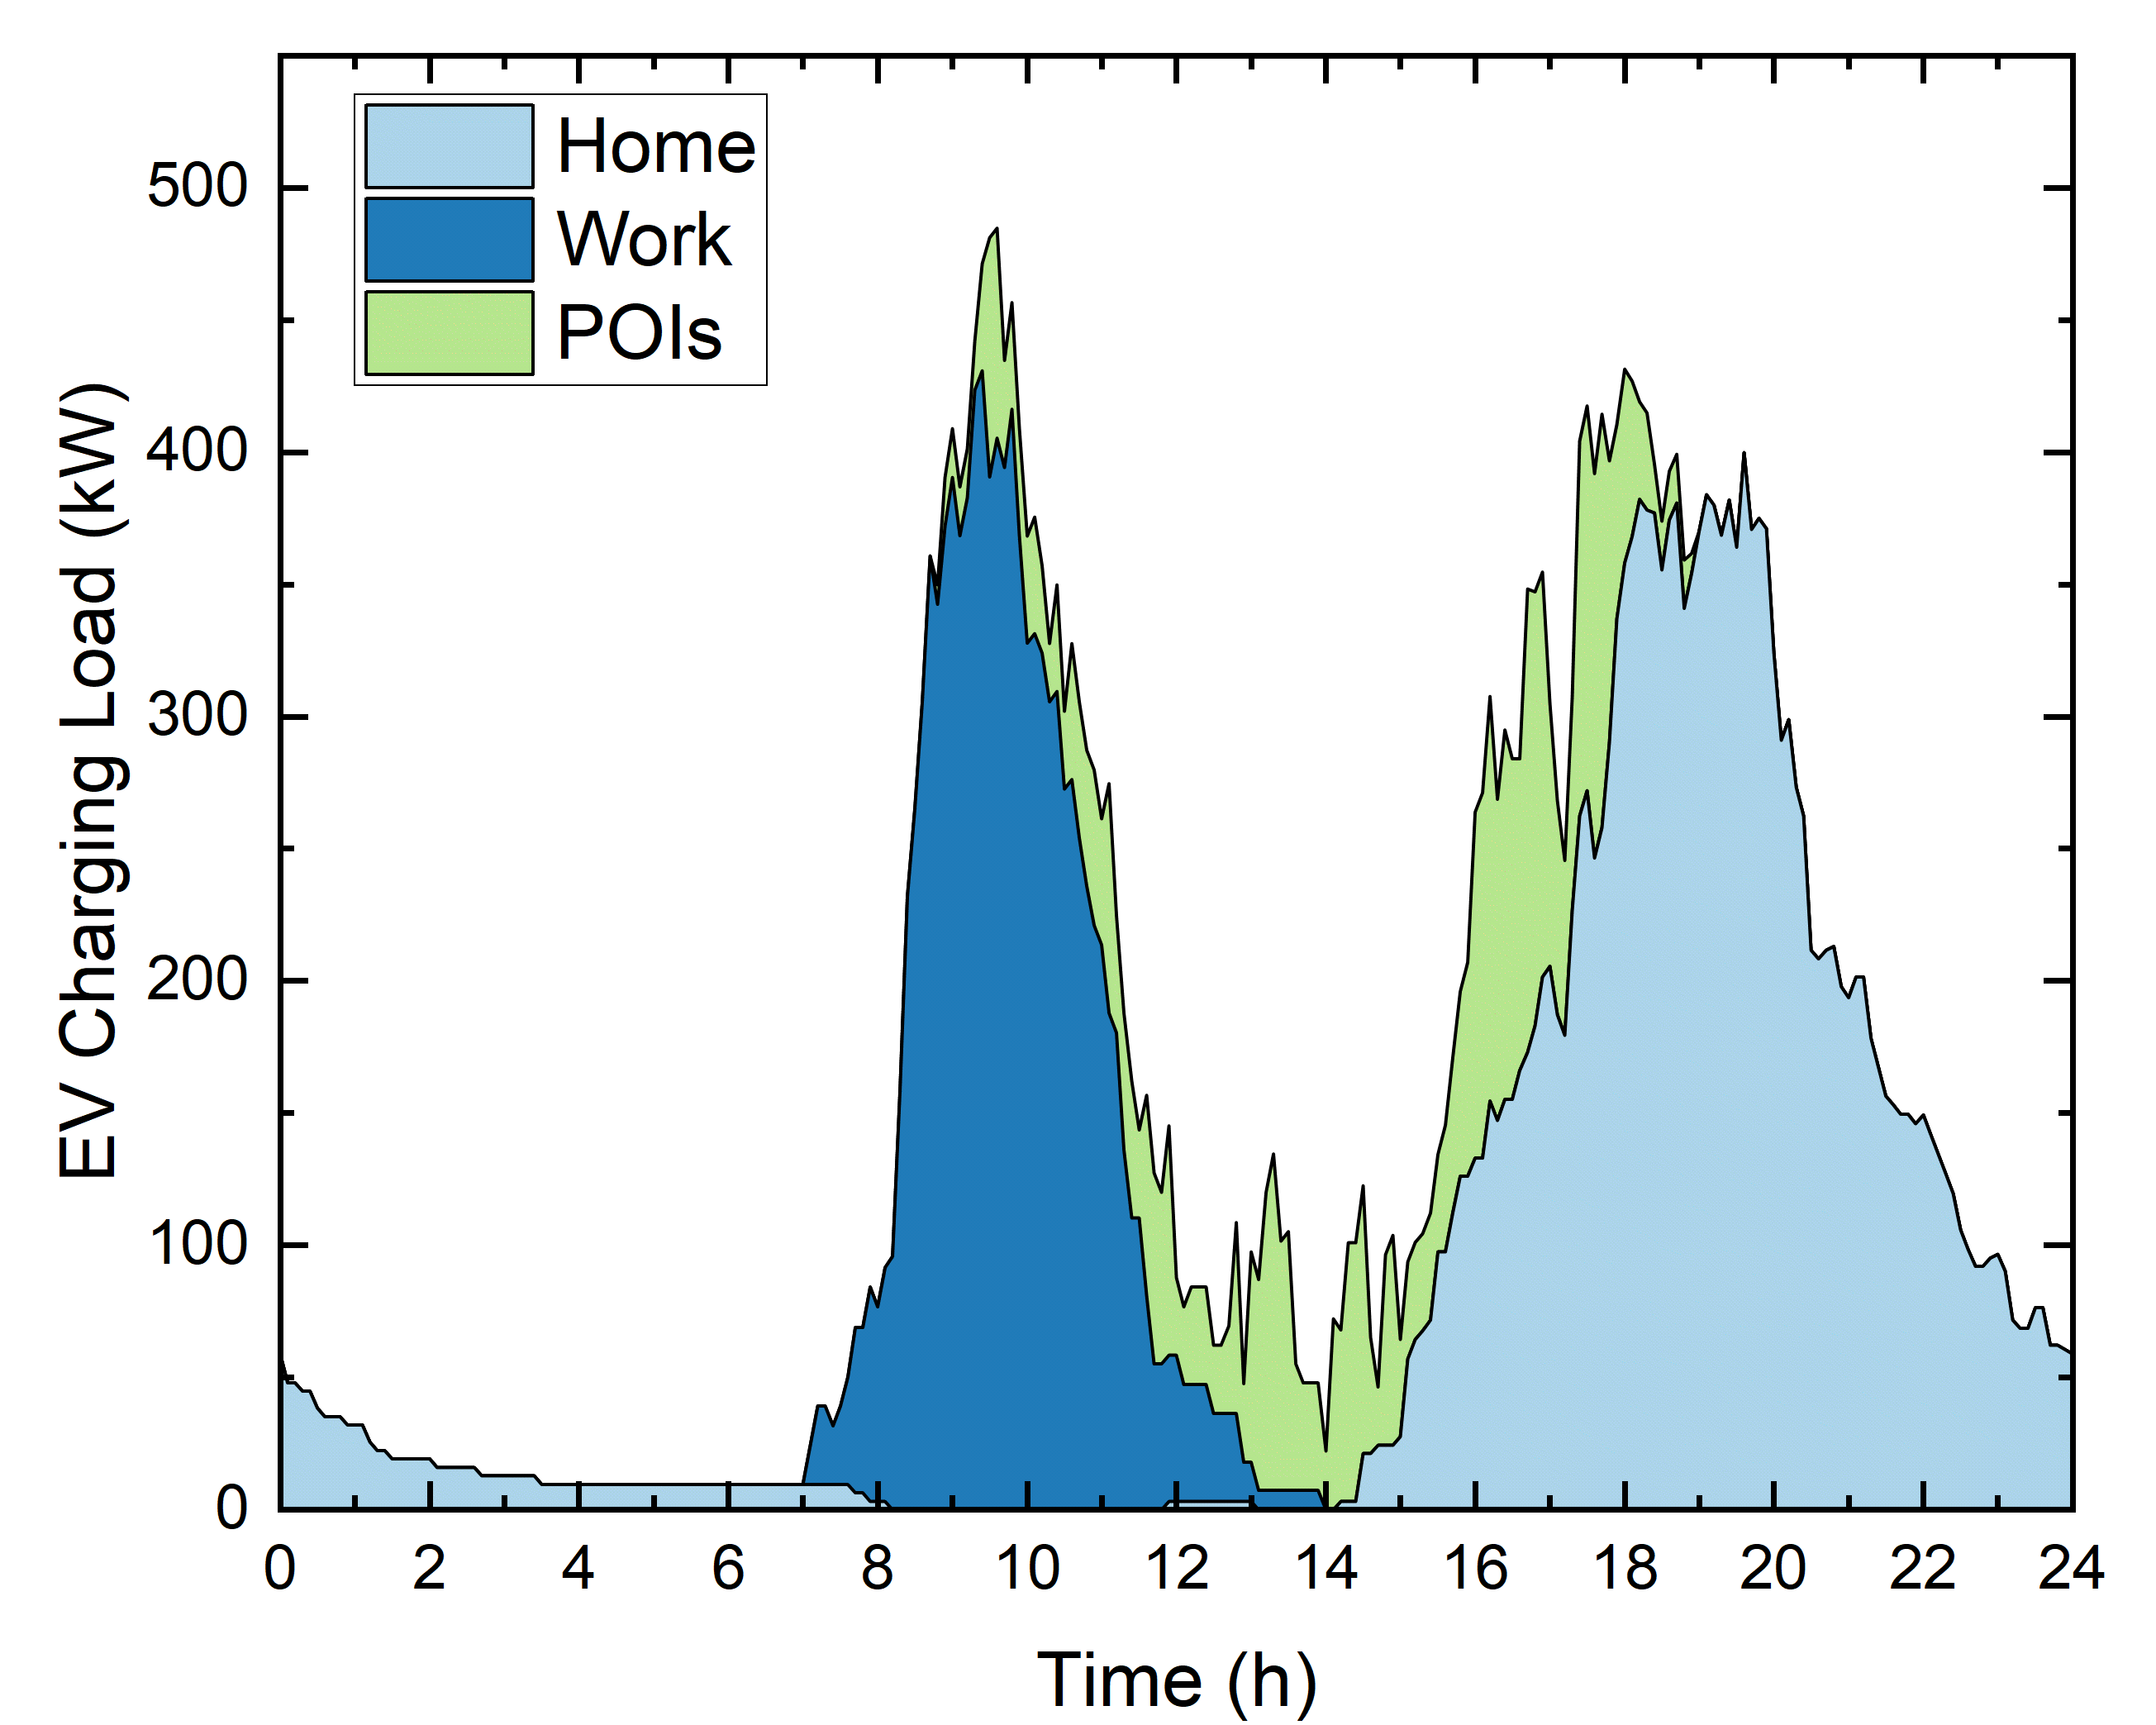


Charging Demand
Map showing the charging demand per traffic zone, at workplaces (similar maps are available for home and POIs)
Charging load curve by location type (Home, Work, and POIs)

Slide 3
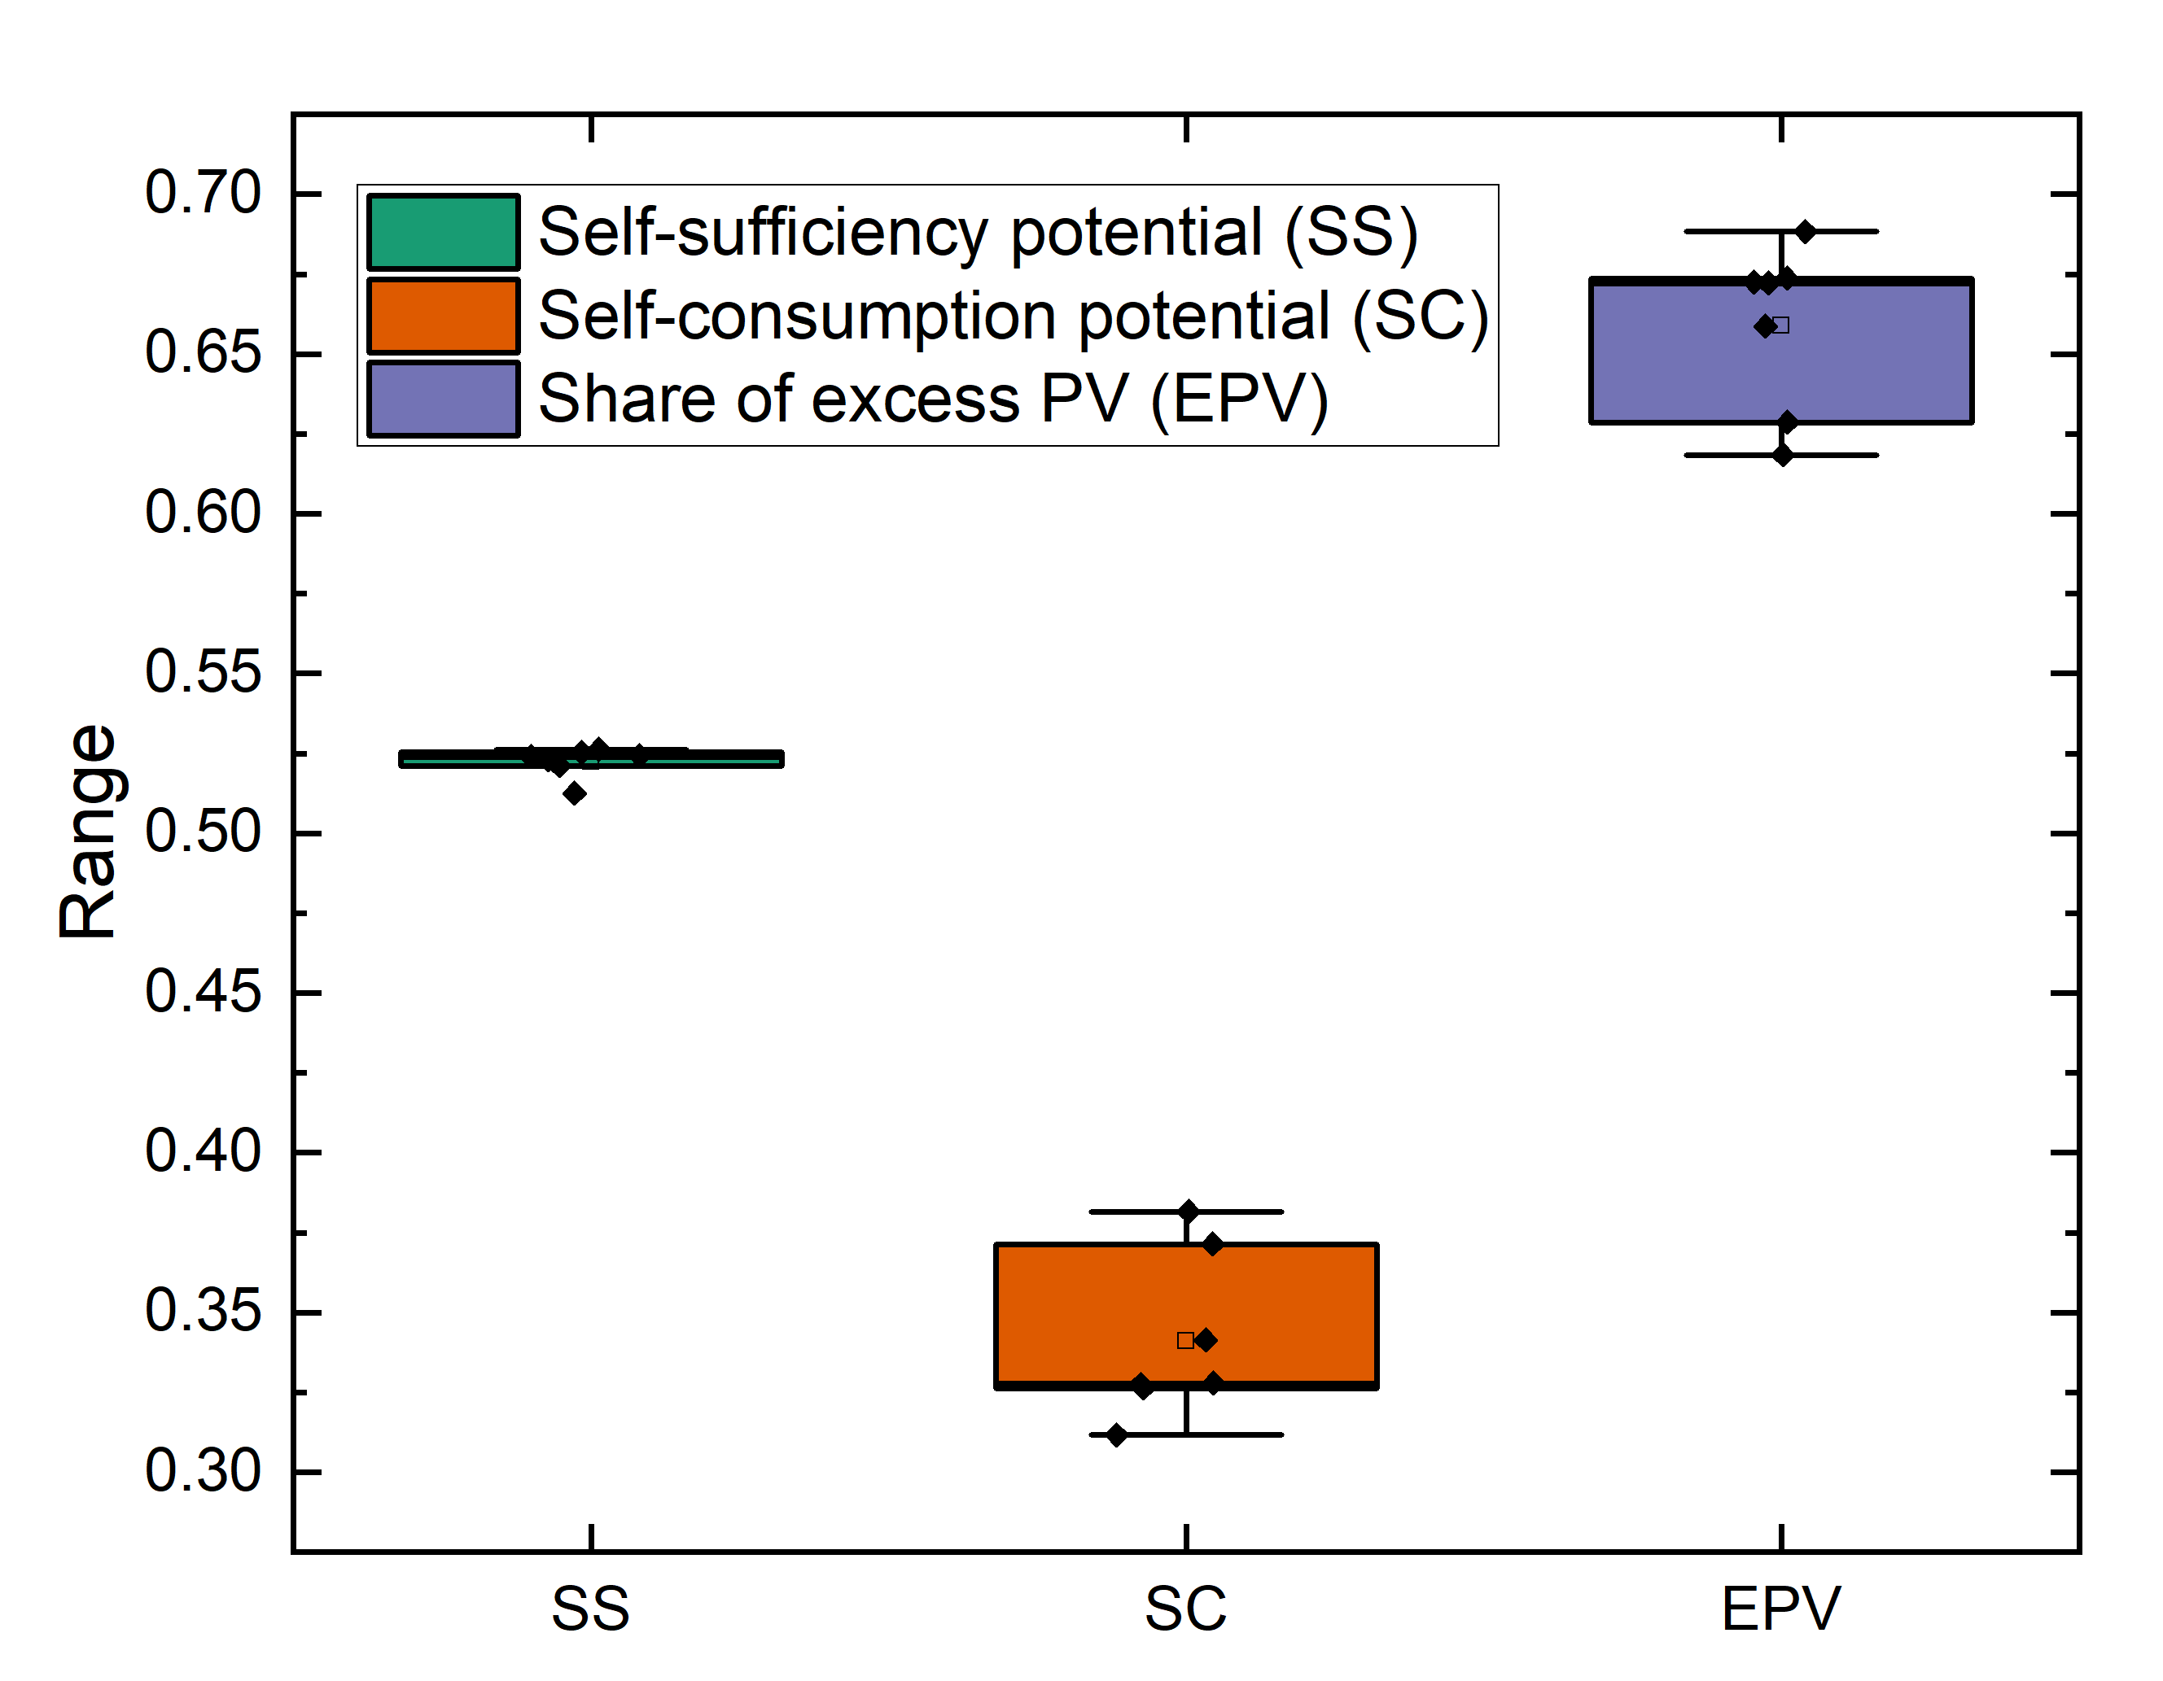
EV-PV Complementarity
Some EV-PV Complementarity indicators calculated over the first week of January 2020 (with 1 MW of PV)

