Slide 1
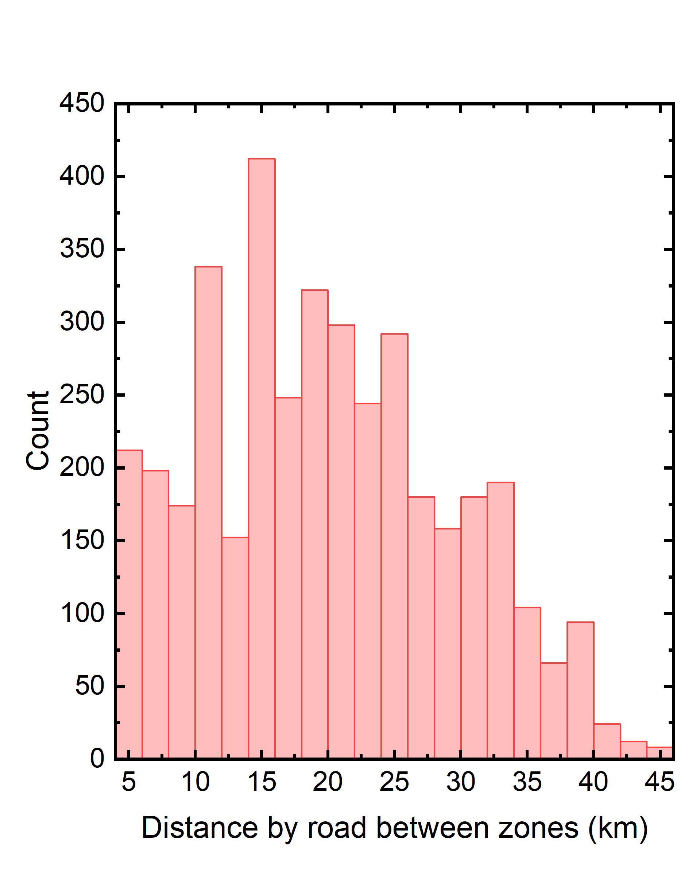
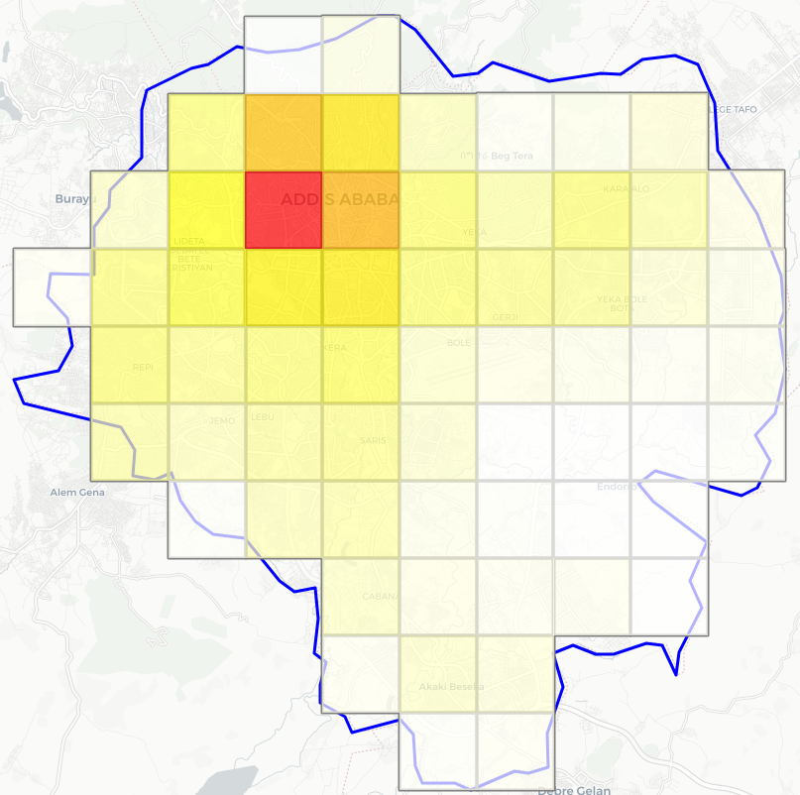


Map showing the number of vehicles per traffic zone (result of the vehicle allocation)
Distribution of road distances between traffic zones, shown as a histogram.

Slide 2
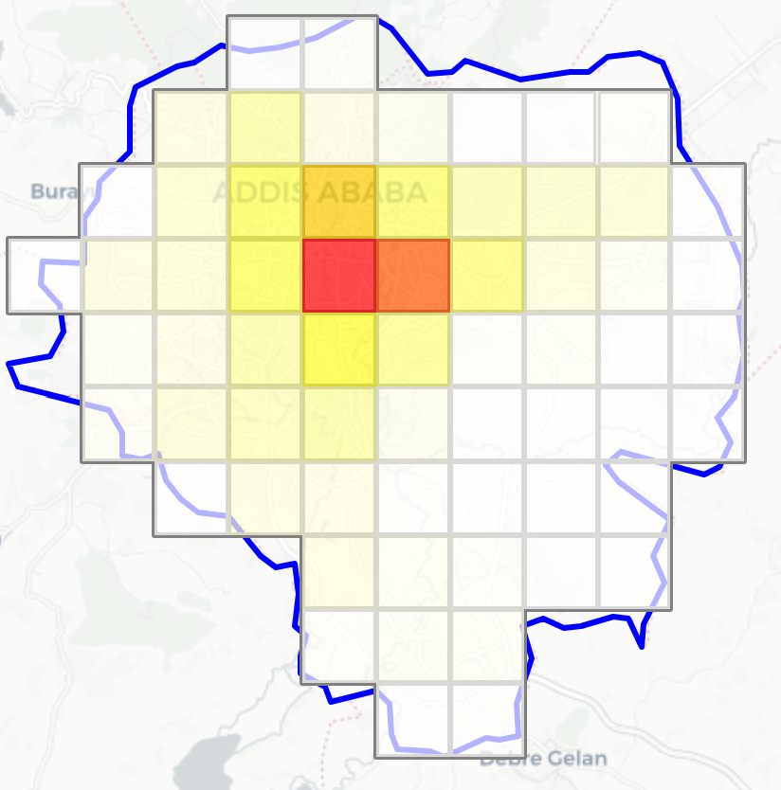
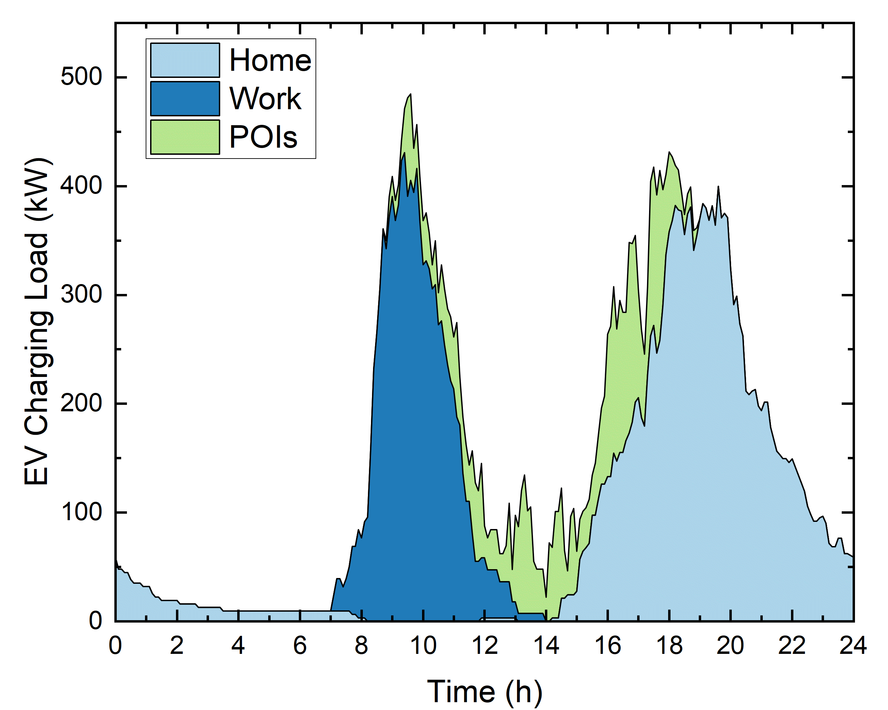


Map showing the charging demand per traffic zone, at workplaces (similar maps are available for home and POIs)
Charging load curve by location type (Home, Work, and POIs)

Slide 3
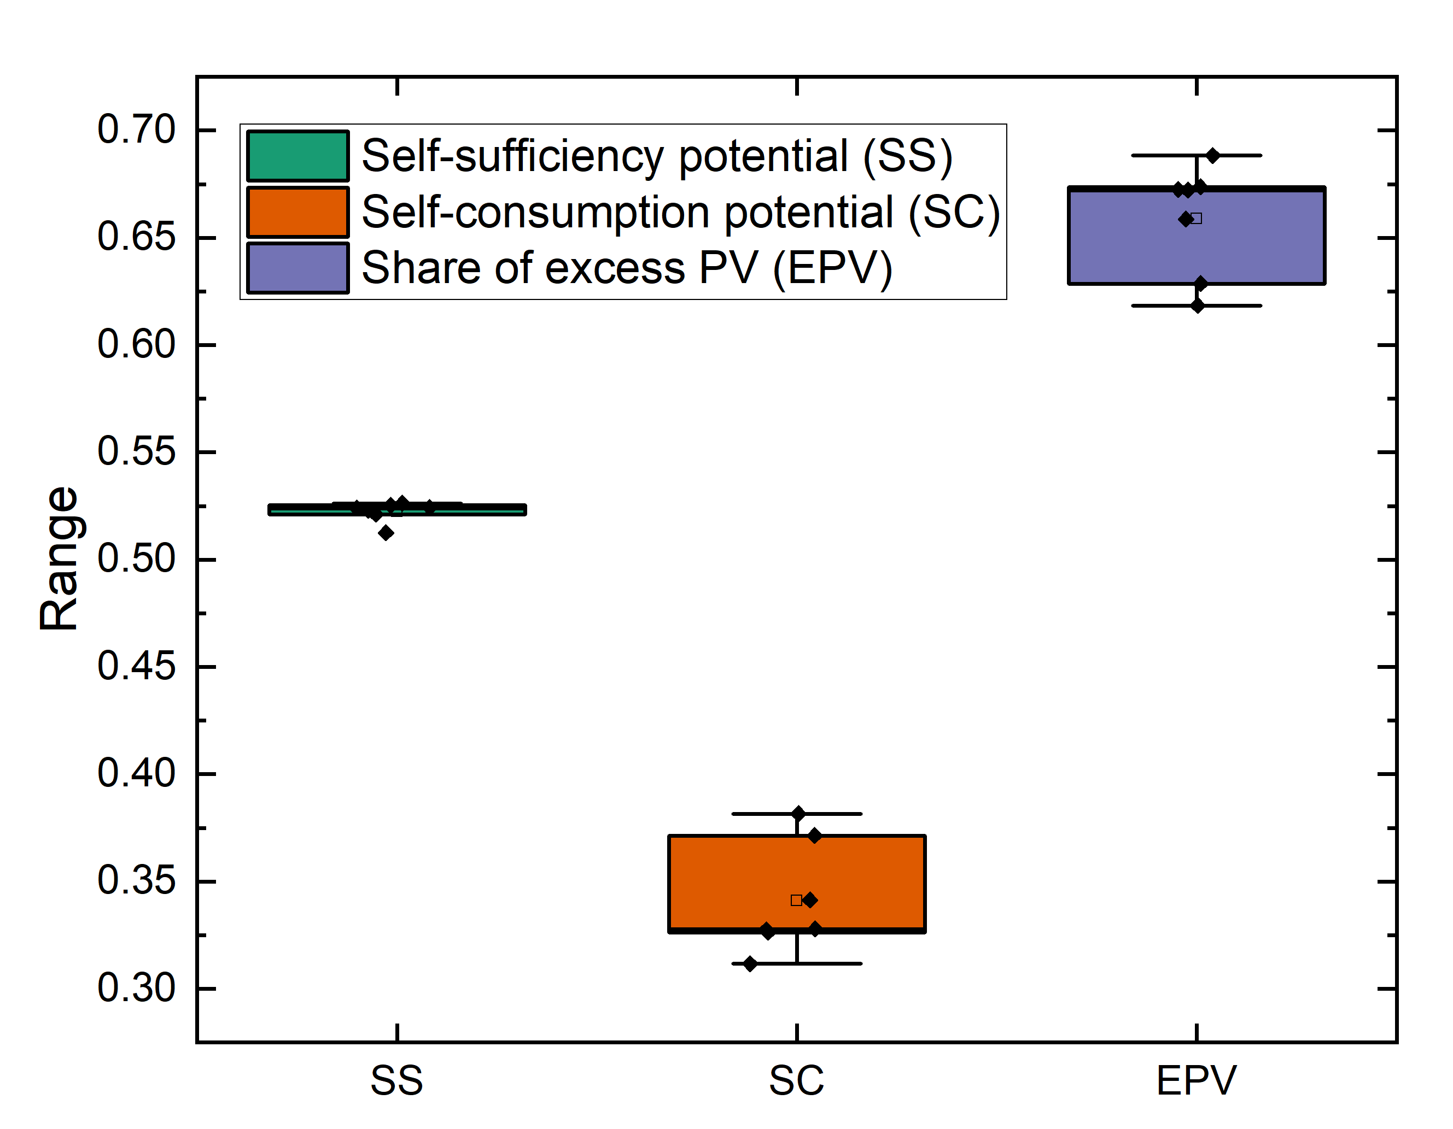
Some EV-PV Complementarity indicators calculated over the first week of January 2020 (with 1 MW of PV)

