Slide 1
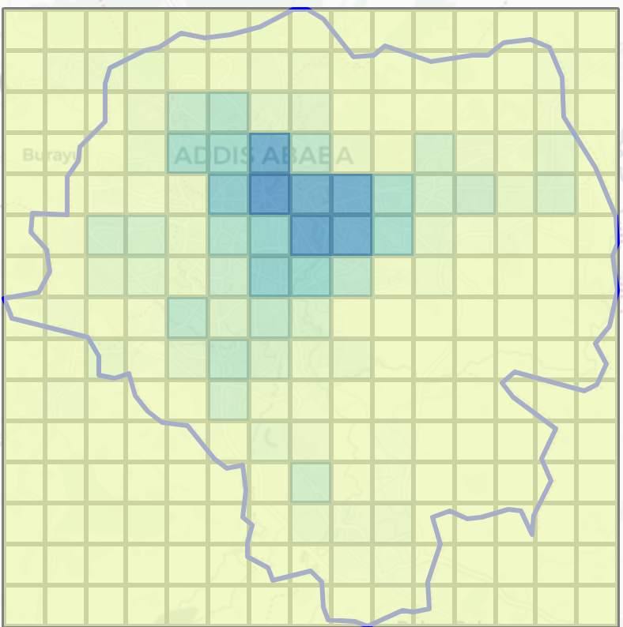

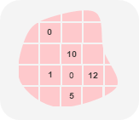
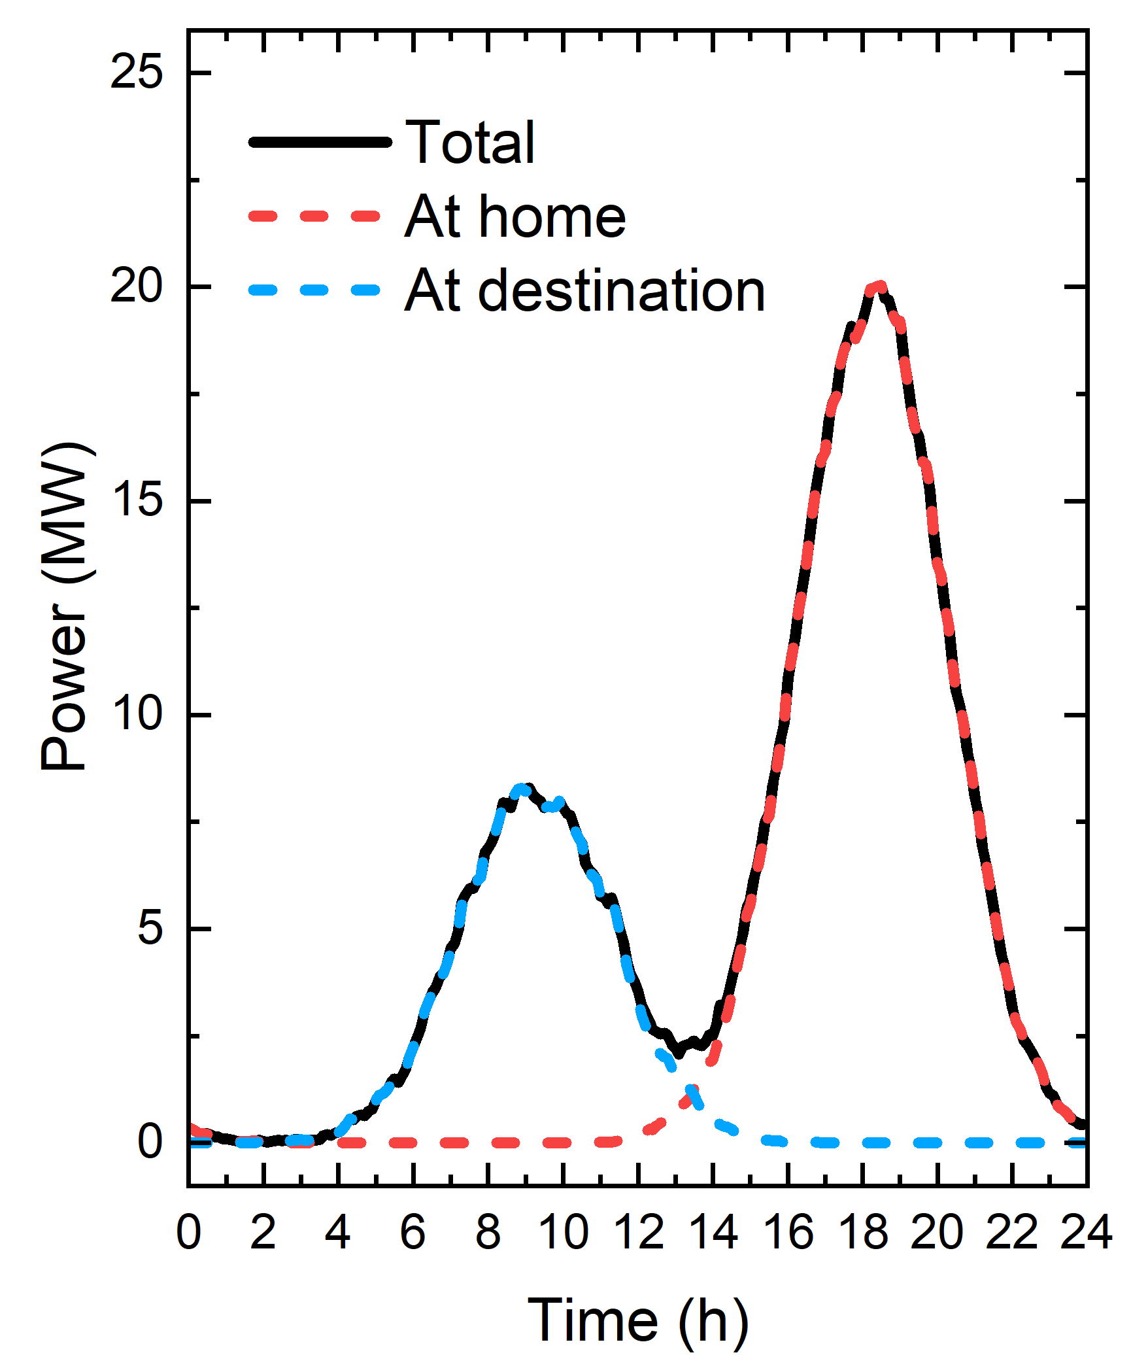





Inputs
Processing
Outputs
User-defined area of interest and desired spatial resolution
Spatial
Simulation setup
Area zoning
GIS data allocation
GIS data
Population density
List of commuting destinations (e.g., workplaces)
2. Mobility Demand
Trip generation
Trip distribution
EV scenario parameters
EV fleet (cars, motorbikes, …)
Charging location
Charging time
Smart charging
3. Charging demand
Spatial demand allocation
Charging curve
EV charging demand
Temporal
PV installation type (rooftop, groundmounted, …)
Weather data fetching
PV output simulation (PVLib)
PV hourly capacity factor
Self-sufficiency
Installed PV capacity
EV-PV synergy metrics
Self-consumption
…

Slide 2
