Slide 1


HEAT ISLAND EFFECT
IN ONTARIO
Guided by: Dr Justin Slater
25th July 2024
Presented by
Niraj Pradipkumar Patil
DATA*6500: Analysis of Spatial-Temporal Data

Slide 2
INTRODUCTION

Slide 3

PROBLEM STATEMENT
Some areas become significantly warmer than their surroundings
Relevance to Ontario
Significant urbanization and diverse climate in Ontario
By identifying HIE hotspots, targeted interventions can be developed to protect from extreme heat events
Causes
Urbanization
Human Activities
Reduced Vegetation
Consequences
Increased Energy Consumption
Elevated Emissions
Public Health Impacts
Water Quality Degradation
Notes:
Global temperatures are rising steadily, with cities and urban areas experiencing the most intense heat. This phenomenon, known as the Heat Island (HI) effect, occurs because urban regions have a higher concentration of buildings, roads, and other infrastructure that absorb and retain heat. As a result, temperatures in these areas can be significantly higher than in surrounding rural regions.
Definition:
The Heat Island Effect (HIE) refers to the phenomenon where certain areas become significantly warmer than their surrounding areas. This temperature difference is primarily due to human activities and the alterations of the natural environment.
Causes:
Dense concentrations of buildings, roads, and other infrastructure absorb and retain heat more than natural landscapes such as forests and water bodies.
Increased energy consumption, transportation emissions, and industrial activities contribute to higher temperatures in urban areas.
The replacement of green spaces with concrete and asphalt surfaces reduces the natural cooling effects provided by plants and trees.
Consequences:
Higher temperatures lead to greater use of air conditioning, which increases energy demand and can strain power grids.
Increased energy consumption often results in higher emissions of greenhouse gases and air pollutants, exacerbating climate change and air quality issues.
Higher temperatures can cause heat stress, exacerbate respiratory conditions, and lead to heat-related illnesses and fatalities, particularly among vulnerable populations.
Increased surface temperatures can affect water bodies by raising the temperature of stormwater runoff, impacting aquatic ecosystems.

Slide 4
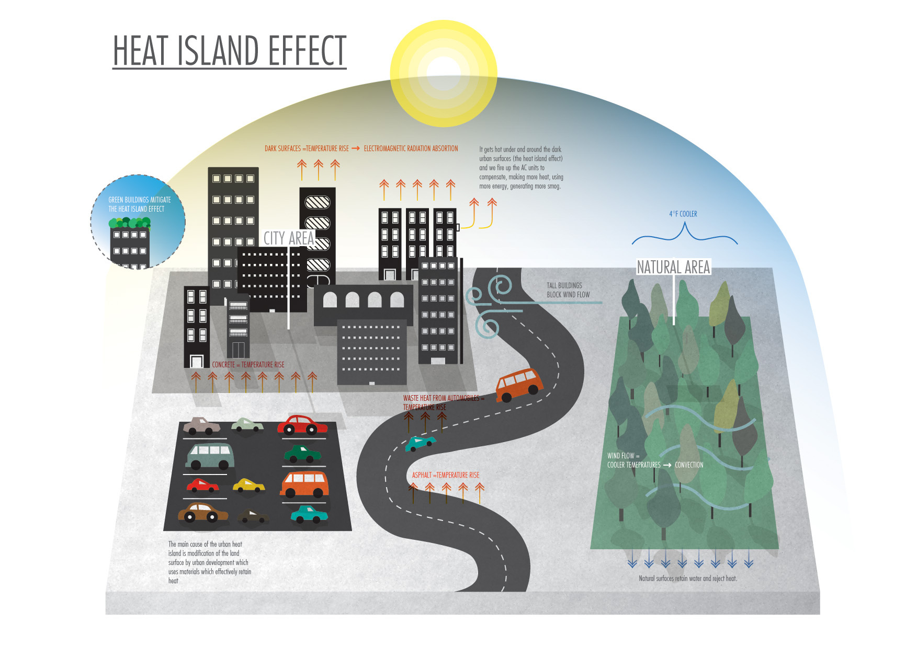
Illustration by Rachel Sender (https://rachelsender.com/Heat-island-effect)
Notes:
Temperature rise can enhance the absorption of electromagnetic radiation

Slide 5
MOTIVATION
Purpose of the Project
To understand how urbanization and natural features contribute to temperature variations
Importance
Lower energy use, reduce emissions, improve air quality
Combat climate change and protect public health
Goals
HIE Index:
  Quantify heat island effect across regions
Measuring HIE:
  Forecast future heat island effects based on current data trends
Urban Planning:
  Provide actionable insights to mitigate heat island effect and improve public health

Slide 6
DATA ACQUISITION

Slide 7
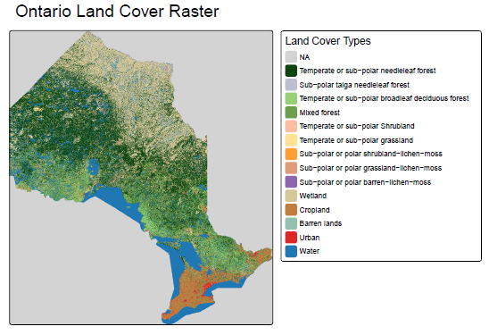
This map portrays the Distribution of land Covers
Regions to focus on:
  Urban Areas
  Forests
  Grasslands
Data Source: Government of Canada; Natural Resources Canada; Canada Centre for Remote Sensing
Notes:
This map displays the distribution of different land cover classes in Ontario, highlighting areas of urban
development, forests, water bodies, and more. It helps in understanding the spatial patterns of land cover
and their potential impact on heat islands.
Here, we identified that various types of forests, Wetland and Water are the major land cover types in
Ontario. These could be important factors in finding relation between NDVI and temperature.

Slide 8
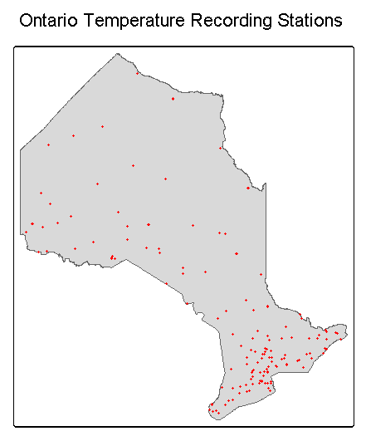
WEATHER STATIONS AND TEMPERATURE
187 weather stations within Ontario
Data includes:
  Mean, Minimum and Maximum Temperatures (°C)
  Total Precipitation (mm)
Temporal Length: 1 year (2023)
Temporal Resolution: Monthly
Data Source: Government of Canada

Slide 9
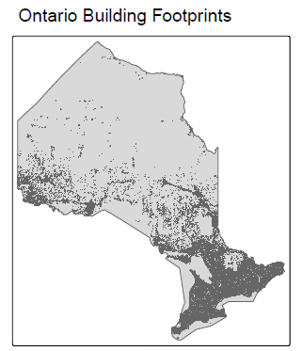
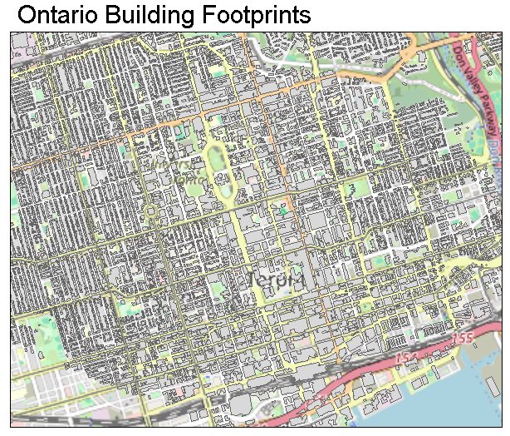
BUILDING FOOTPRINTS
Toronto Building Footprints
Data Source: Microsoft

Slide 10
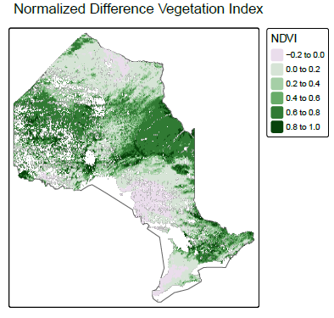
Numerical indicator used to quantify healthy green
NDVI > 0: Represents vegetated areas
NDVI = 0: Indicates bare soil or rock
NDVI < 0: Represents water bodies or clouds
Data Source: NOAA National Centers for Environmental Information Metadata

Slide 11
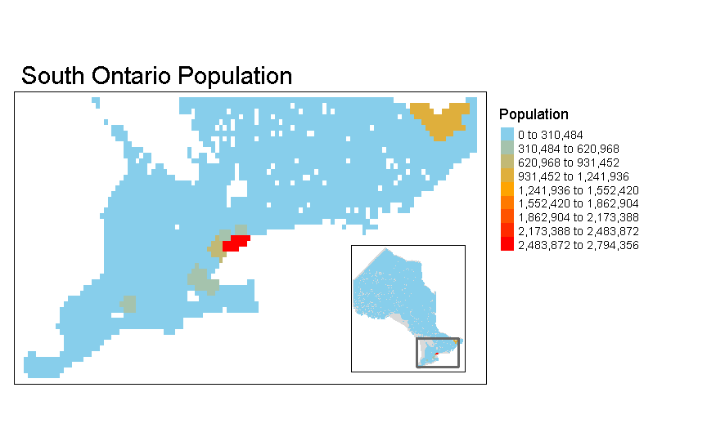
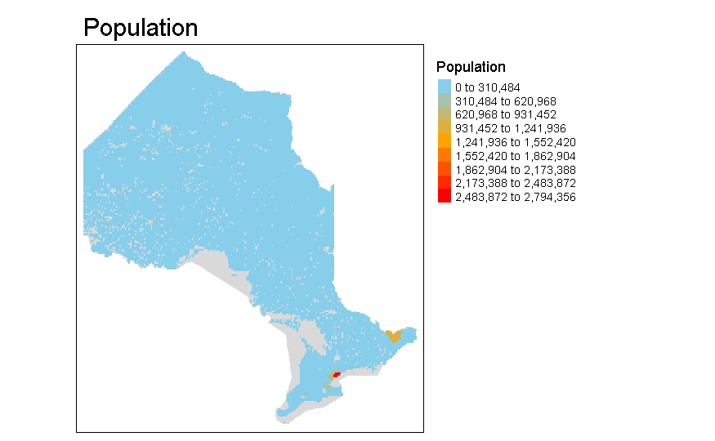
CANADA CENSUS
Data Includes:
  Population in 2021
  Land Area (in square kilometres)
Data Source: CensusMapper API, Statistics Canada

Slide 12
ANALYSIS

Slide 13
ANALYSIS METHODS
Steps for Deriving and Predicting Heat Island Effect
Handling missing values
Aligning datasets
Estimating temperature
Correlation Analysis, Regression Models, and Validation Metrics
Identify relationships between temperature and geospatial features
Use statistical models to predict HIE based on input features
Describe metrics used to assess model performance (e.g., R², RMSE)

Slide 14
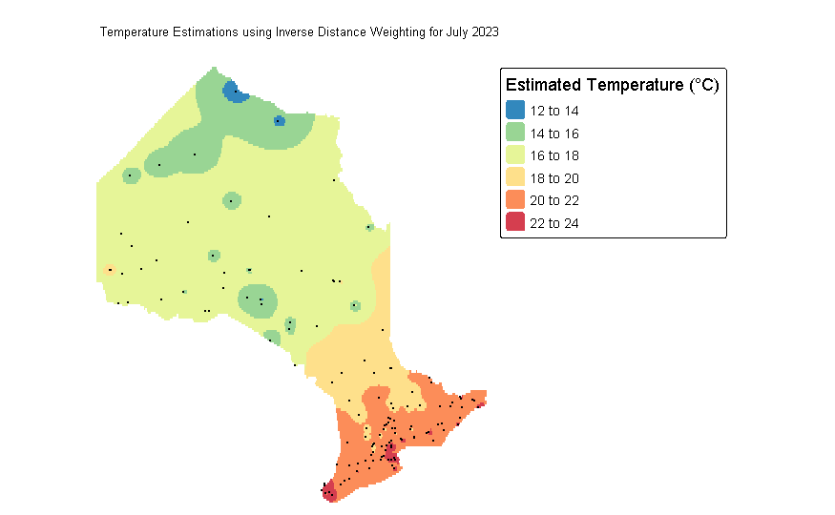
Temperature estimates can be derived from theweather recording stations using Inverse Distance Weighting

Slide 15
TEMPERATURE VS OTHER FACTORS

Slide 16
DERIVING HIE INDEX
Finding the difference in temperatures between the Heat Island region and the average temperature surrounding the Heat Island region.
HIE index (given time) = Temp. (within the HI region) - Average Temp. (surrounding)

Slide 17
MODELING

Slide 18
MODELING APPROACH
Model can be created by combing all the data sources as attributes and HIE index as a target attribute to be predicted.
Data such as NDVI, land cover, temperature, building footprints can help explain the covariance in the model.
An algorithm such as Elastic net regression, Linear regression, Ensemble learning methods such as Random forest etc. can be used to model the temperature predictor.
Model will be trained using spatial cross validation as part of learner.
Model evaluation will be done using RMSE, R-SQUARED error.

Slide 19
WHY HIE INDEX?
Better city planning - How does HIE index change with the introduction of new infrastructure within the region? (New Airports, subway lines, etc.)
Better temperature forecasting - How does recent wildfire affect the temperatures in the nearby urban areas?
Better localized insights - HIE index predictions offer detailed, localized information about temperature variations within urban areas, which can significantly differ from regional or overall temperatures. This allows for more precise energy consumption forecasts for specific neighborhoods or districts.

Slide 20
FUTURE SCOPE
Predicting HIE index throughout the year, to measure the different intensities of HIE index for a given region
Predicting HIE index globally
Feature engineering height of building or equivalent variable

Slide 21
THANK YOU

