Slide 1
NASA TM-100991 · BALLIN, 1988
Replicating a real-time turboshaft engine model
The T700-GE-700 engine and its fuel control, rebuilt from the report and checked against every comparison it prints
October 2026
Notes:
Ballin's report is a NASA Technical Memorandum, public domain (17 U.S.C. 105). Every 'Ballin, Figure N' image in this deck is cropped from its scanned pages. Numbers about our model are computed when the deck is built: read from the project's results file, the one its README quotes, or from the model itself. The few typed by hand are quoted from the decision log.

Slide 2
OVERVIEW
What this presentation covers
The source and the engine
  Ballin's report, the T700, and what replication means
One engine, three models
  Simple nonlinear, real-time and linear, and how they relate
How the model is built
  Gas path and its thermodynamics, volumes, spools, heat soakage, the real-time frame, fuel control, sensors, data from a scan
How the engine is run
  Steady state, open loop, closed loop, manoeuvres, linearization
How closely it matches
  Every comparison the report prints
Findings, decisions and limits
  What the report never printed, where it is wrong, and where we differ
Replicating NASA TM-100991 · T700-GE-700 real-time engine model
2
Notes:
Six parts plus a short backup section. Parts 1-3 build the common baseline; parts 4-6 are the results.

Slide 3
1 · THE SOURCE AND THE ENGINE
The source: NASA TM-100991 (Ballin, 1988)
Ballin, M. G., A High Fidelity Real-Time Simulation of a Small Turboshaft Engine, NASA TM-100991, NASA Ames Research Center, July 1988.
Purpose: an engine model fast enough for a piloted helicopter simulator. It flew with the Gen Hel UH-60A blade-element rotor simulation on a CDC 7600 [pdf p.36].
What it gives us:
Eqs. 1–80: the engine model and its real-time solution
Appendix A: 33 constants and 11 engine functions (the maps), printed as plots
Appendix B: 12 linear models (A and b matrices) at three flight conditions
Appendix C: the complete fuel control: 22 block diagrams and 8 schedules, no equations
Validation: Table B.1 (trim states), Table 1 (eigenvalues), Figures 6–10 (steady sweeps, fuel transients), Figures 4–5 (linear responses), Table 3 (a prototype test engine), Figures 11–15 (the closed loop inside the helicopter)
Replicating NASA TM-100991 · T700-GE-700 real-time engine model
3
Notes:
Figures 11-15 run the engine inside the Gen Hel helicopter simulation, which the report uses and does not contain. Gen Hel stays out of scope; Figures 11-15 are compared by running our closed loop on what it prints, his rotor speed imposed or our rotor free under his torque (decision log #39, #81). Hardware: 'It has been executed successfully in conjunction with the Gen Hel UH-60A simulation using a CDC 7600 computer' [pdf p.36]. Appendix A: pdf pp.55-66; Appendix B: pdf pp.67-76; Appendix C: pdf pp.77-101.

Slide 4
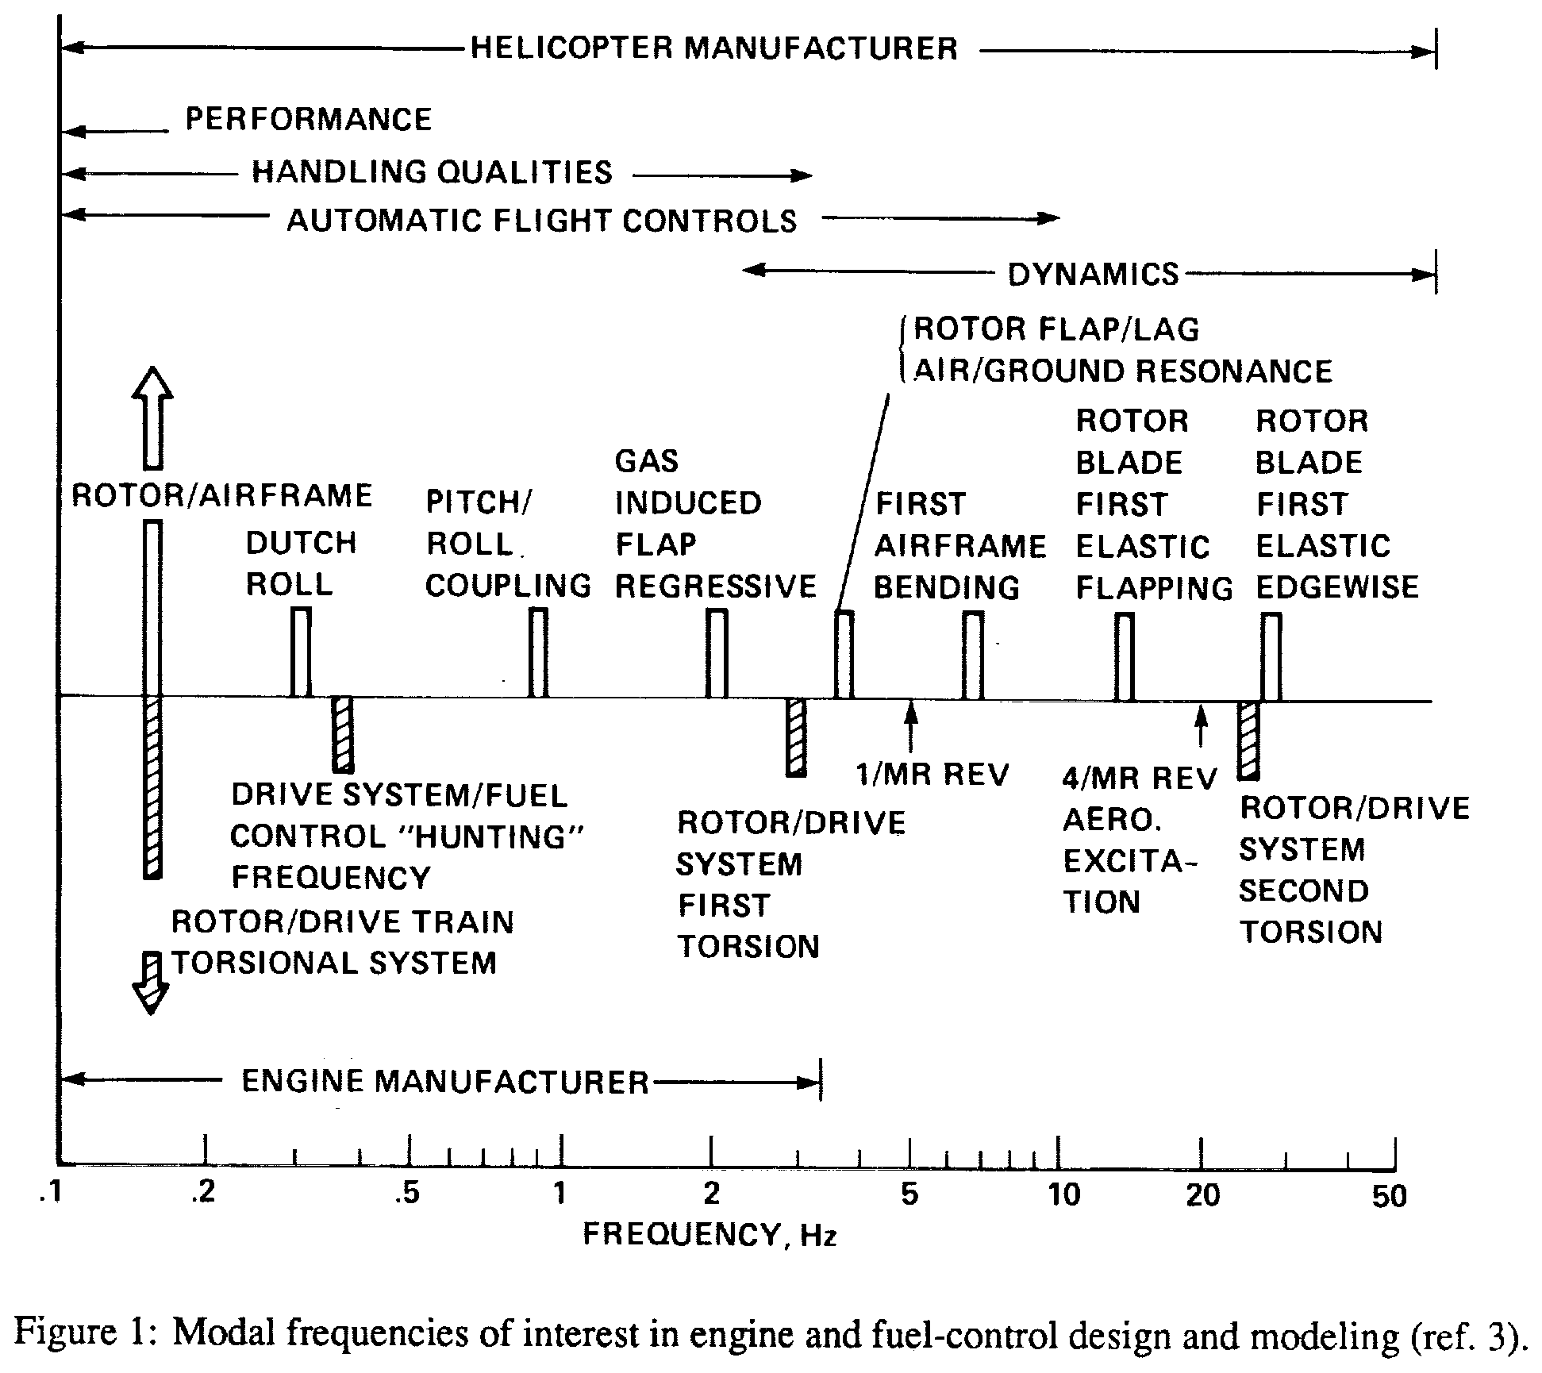
1 · THE SOURCE AND THE ENGINE
Why the engine matters to a flight simulator
The pilot feels the engine through rotor speed. Fuel control, drive train and rotor interact at low frequency (Figure 1, right).
A simulator must keep that band right, in real time: Ballin's frame limit was 10 ms [pdf p.38].
Faster physics, such as gas filling and emptying the engine's internal volumes, can be approximated as long as that band survives.
Ballin, Figure 1 (from his ref. 3), pdf p.16
Replicating NASA TM-100991 · T700-GE-700 real-time engine model
4
Notes:
Figure 1 shows which modal frequencies matter to which party (helicopter manufacturer, engine manufacturer). The engine/fuel-control/drive-train interaction ('hunting', rotor/drive-system torsion) sits at the low end. 10 ms: 'a restriction on time step to a maximum value of 10 msec was established based on a maximum allowable error of 0.1 percent between time steps' [pdf p.38]. The report's errata sheet [pdf p.5] corrects one label of Figure 1: 'GAS INDUCED FLAP REGRESSIVE should be CONTROL-SYSTEM-INDUCED FLAP REGRESSIVE'.

Slide 5
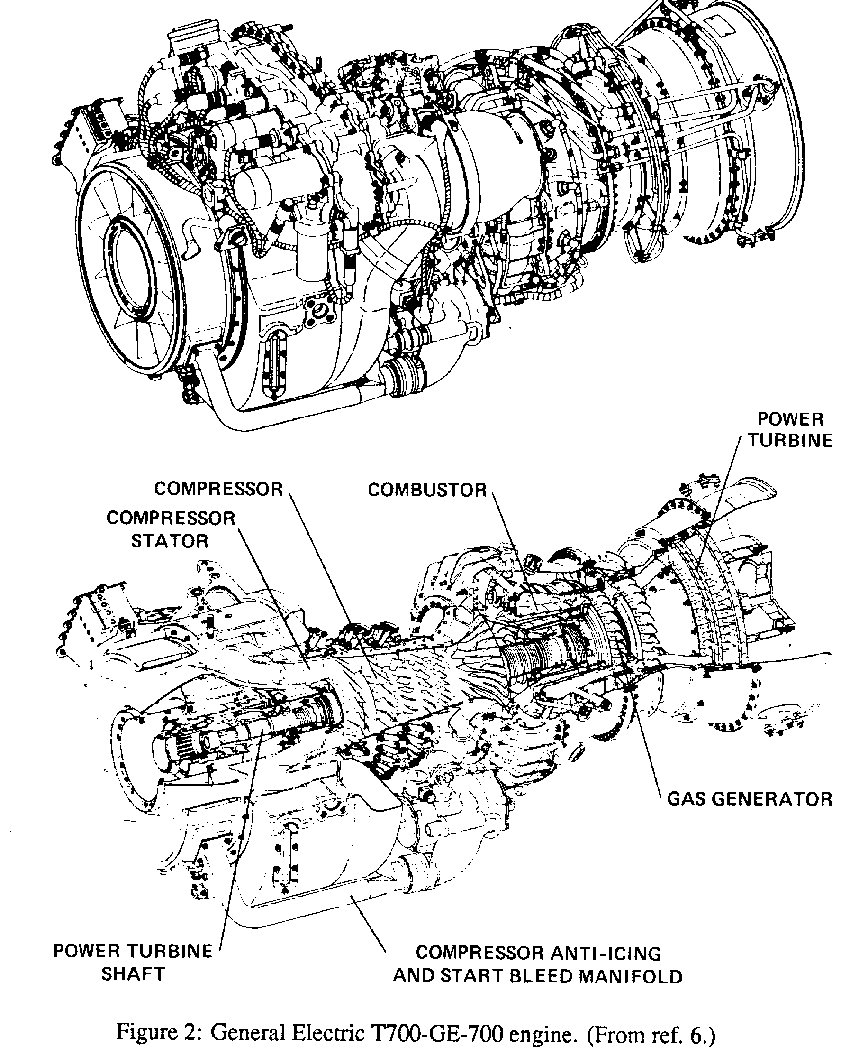
1 · THE SOURCE AND THE ENGINE
The engine: General Electric T700-GE-700
A small turboshaft of the 1600-hp class that powers the UH-60A Black Hawk; the model is one engine.
Compressor: five axial stages and one centrifugal stage, with variable inlet guide vanes and stator vanes on the first two stages.
Combustion chamber: annular and flow-through, at low fuel pressure.
High-pressure turbine (the report's gas-generator turbine): two axial stages, cooled by air bled from the compressor exit; drives the compressor at speed NG.
Power turbine: two stages, independent and uncooled; its coaxial shaft runs forward through the engine to the output, at speed NP.
Ballin, Figure 2 (from his ref. 6), pdf p.18; description pdf p.17
Replicating NASA TM-100991 · T700-GE-700 real-time engine model
5
Notes:
pdf p.17: 'It consists of a five-stage axial and a single-stage centrifugal flow compressor; a low-fuel-pressure, flowthrough annular combustion chamber; a two-stage axial flow gas generator turbine; and a two-stage independent power turbine (ref. 5). The first two stages of the compressor use variable-geometry inlet guide vanes and stator vanes, and air is bled from the compressor exit to cool the gas generator turbine. The power turbine, which is uncooled, has a coaxial driveshaft which extends forward through the front of the engine where it is connected to the output shaft assembly.'

Slide 6
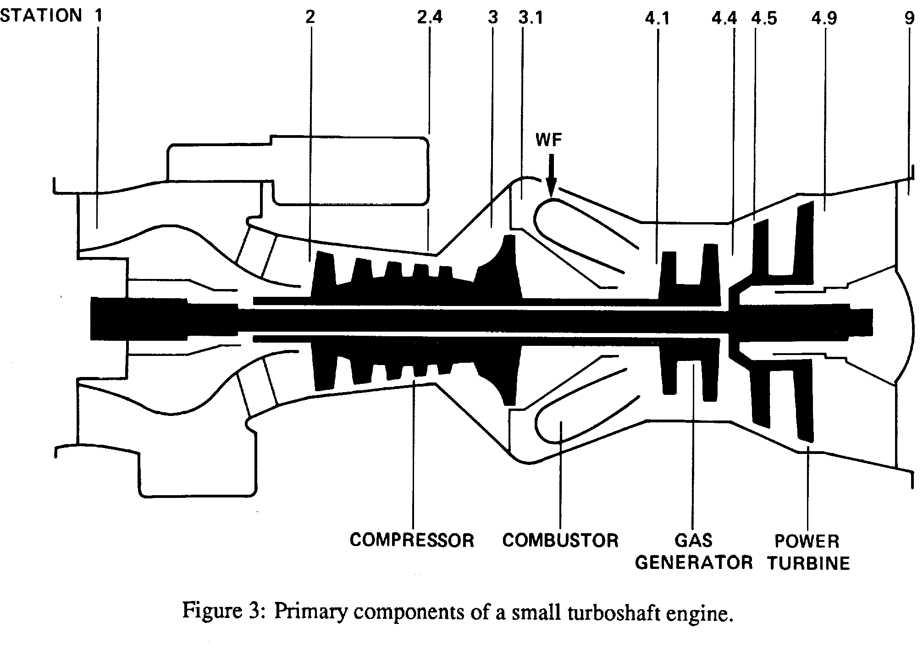
1 · THE SOURCE AND THE ENGINE
Stations and components
Station | Where
2 | compressor face
2.4 | stage-4 bleed: seal pressurization, power-turbine balance
3 | compressor diffuser exit; bleed to cool combustor and turbine
3.1 | combustor
4.1 | combustor exit = gas-generator turbine inlet (a mixing volume)
4.4 | gas-generator turbine exit, before the cooling air returns
4.5 | power-turbine inlet, cooling air mixed back in
4.9 | power-turbine exit
9 | exhaust
Ballin's Figure 3: primary components of a small turboshaft engine. WF marks the fuel entering the combustor.
There is no station 4 or 5.
Ballin, Figure 3 and text, pdf pp.20–21
Replicating NASA TM-100991 · T700-GE-700 real-time engine model
6
Notes:
Station definitions are the report's own words, pdf p.20. Worth stressing to a performance audience: T45 here is not the T4.5 of another engine's convention.

Slide 7
1 · THE SOURCE AND THE ENGINE
What “replication” means here
Reproduce the report as written, including its simplifications and its admitted biases. Not an improvement.
Every number is traced to a page of the report and read from the page image; the scan's text layer corrupts digits and symbols.
Where the report is silent, we decide, record why, and measure what the choice changes.
Where following it literally fails, we depart from it and measure the cost. There are four such departures (Part 6).
Never tuned to pass: no constant is adjusted to improve agreement. Acceptance bounds come from the scan's measured read error.
An example of what not to fix: Ballin's model reads turbine temperature slightly low at trim in every validation case, and he says so [pdf p.47]. Reproducing that bias is correct.
Built in Python with NumPy, in the report's own units (lbm, psia, °R, hp, rpm) and symbols.
Backup slide, hidden in the show
Replicating NASA TM-100991 · T700-GE-700 real-time engine model
7
Notes:
The decision log mentioned later is a file in the project where every question about the report is recorded with its evidence and outcome. Ledger numbers (#NN) appear only in these notes, for reference.

Slide 8
2 · ONE ENGINE, THREE MODELS
One engine, three models
Simple nonlinear model
Eqs. 1–53, pdf pp.22–26
5 states: NG, NP, P3, P41, P45
the gas volumes are integrated
Real-time model
Eqs. 69–80, pdf pp.36–37
NG and NP integrated (7 ms / 14 ms)
pressures solved inside each frame
volume dynamics approximation
Compared with: Table B.1, Figures 6–8, Table 3
Compared with: Figures 9–10, Figure 4's Gen Hel line
linearize
closed loop
Linear models
±2 % perturbation at a trim, pdf p.28
2-, 3-, 5-, 6-DOF and reduced-order 5-DOF
Appendix B matrices, Table 1 eigenvalues
Fuel control
Appendix C, pdf pp.77–101
ECU + HMU: governors, limits, schedules
sensor and actuator dynamics
Compared with: Table 1, Appendix B, Figures 4–5
With the real-time model: Table B.1, Figures 11–15
Steady states are the same in the simple nonlinear and the real-time model: the approximation changes only how the engine moves between them.
Replicating NASA TM-100991 · T700-GE-700 real-time engine model
8
Notes:
Simple: Ballin's model descends from the NASA Lewis hybrid model, 'a greatly simplified version of the nonreal-time component-type digital simulation developed by GE' [pdf p.20]. GE's own models enter the report only as comparison data (the GE series of Figures 6-8): the status-81 model, 'a comprehensive analysis-oriented model which is used for detailed representation of the engine thermodynamic cycle', and the unbalanced torque model, 'a simplified model which is optimized to reproduce engine dynamics for control system design purposes' [pdf pp.38-39]. Ballin himself calls Eqs. 1-53 'the complete nonlinear digital simulation' [pdf p.27]: complete beside his real-time reduction, not beside GE's models. The simple nonlinear model (Eqs. 42-44) carries the three pressures as integrator states. The real-time model sets their derivatives to zero (Eqs. 72, 73, 79) and solves them algebraically each frame. The linear models are central differences of the nonlinear models at three trims. Equal equilibria: checked below flight idle too, where the printed P45 iteration needed our exact solve (#57).

Slide 9
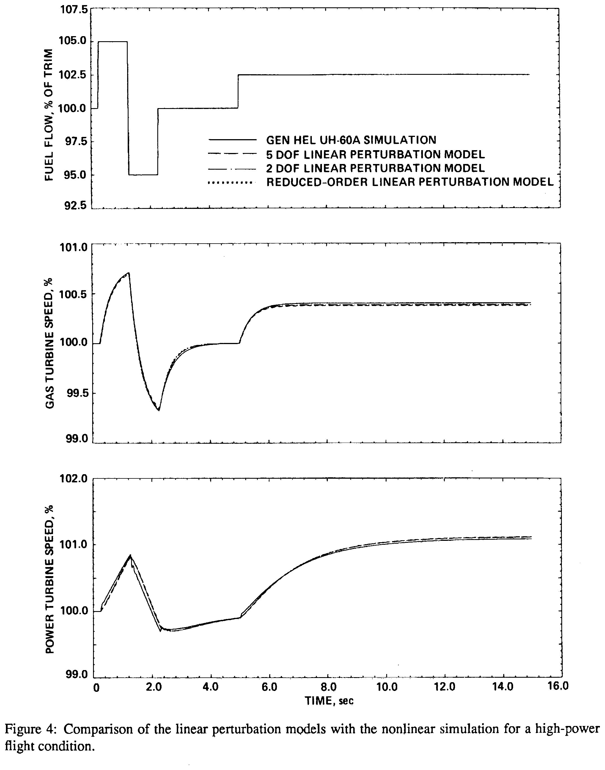
2 · ONE ENGINE, THREE MODELS
Why the real-time model drops the volume dynamics
Mode 5-DOF, hover | Eigenvalue 1/s | Time constant | Corner frequency |λ|/2π, Hz
NP | −0.565 | 1.77 s | 0.09
NG | −2.66 | 0.38 s | 0.42
P3 | −51.6 | 19.4 ms | 8.2
P45 | −3,060 | 0.33 ms | 487
P41 | −4,900 | 0.20 ms | 780
Euler integration, the simplest explicit step, is stable only for Δt < 2/|λ|: about 0.4 ms for the fastest mode. Ballin's engine frame is 7 ms.
The spools are about a thousand times slower than P41 and P45. So: integrate only NG and NP, and solve P3, P41, P45 inside each frame as if the volumes filled instantly.
Conclusions: “The modeling of high-speed dynamics which represent changes of mass flow between the internal control volumes was found to be unnecessary” [pdf p.54].
Ballin's Figure 4: linear models against the nonlinear simulation in Gen Hel. The 2-DOF model has no volume dynamics, and tracks the others.
Table 1, pdf p.31; Ballin, Figure 4, pdf p.30; frame, pdf p.47; Conclusions, pdf p.54
Replicating NASA TM-100991 · T700-GE-700 real-time engine model
9
Notes:
Eigenvalues are Ballin's printed Table 1 values (5-DOF, hover). UNITS. Table 1 prints no unit. The eigenvalues are per second: the A matrices are derivatives with respect to time (Eq. 54), and our linear models, built with time in seconds, land within 4.7 % of every printed value (hover NG: ours -2.69 against -2.66; P41: ours -5,007 against -4,900). A per-minute or per-cycle reading would be 60 or 2π times off and could not match. Radians: every Table 1 eigenvalue is real ('five stable, nonoscillatory modes', pdf p.29), so each mode is a pure decay e^(λt) with time constant τ = 1/|λ|; no 2π enters the table. The 2π lives in the spool equations, which turn torque over inertia (rad/s²) into rpm/s with 60/2π (Eqs. 39-41, 45, 47, pdf p.25); our code carries those factors, and the matching NG and NP eigenvalues confirm it. Eigenvalues do not depend on the units of the states (rpm, psia), only on the time unit. The table's last column sets each mode against a frequency axis in Hz, such as Figure 1's (slide 4): a first-order mode's corner frequency is |λ|/2π. NG at 0.42 Hz sits beside Figure 1's drive-system/fuel-control 'hunting' bar (about 0.37 Hz, read off the figure) and NP at 0.09 Hz at its left edge (0.1 Hz): the band the simulator must keep. P45 and P41, at 487 and 780 Hz, are far beyond its right edge (50 Hz). STABILITY LIMIT. Take one mode alone: dx/dt = λx with λ < 0, whose exact solution decays. One Euler step of length Δt multiplies x by (1 + λΔt). The step is stable only while that factor lies between -1 and +1, that is Δt < 2/|λ|. Between 1/|λ| and 2/|λ| it still decays but flips sign every step, so an accurate step must sit well below 1/|λ|. P41 (λ = -4,900 /s): limit 0.41 ms; at 7 ms the factor is -33.3, so a disturbance in P41 grows 33-fold every frame, about 10^15 in ten frames (70 ms). P45 (λ = -3,060 /s): limit 0.65 ms, factor -20.4 at 7 ms. P3 (λ = -51.6 /s) is different: its limit is 39 ms, so a 7 ms Euler step is stable (factor 0.64 against the exact 0.70). The case for dropping P3 is bandwidth, not stability: the three pressure modes 'are outside the bandwidth of interest for the modeling of rotor and propulsion system dynamics. These modes are well above the second drive-train torsional mode and the rotor blade first in-plane elastic mode of a typical helicopter' [pdf p.29]. On Figure 1's axis that holds for P41 and P45 but not for P3: its 8.2 Hz corner lies below the rotor/drive system second torsion (about 25 Hz) and the rotor blade first elastic edgewise mode (about 28 Hz), both read off Figure 1. Figure 1 is a generic chart (ref. 3), not the UH-60A's, so this is a caution, not an error; the direct evidence is Figure 4, where the 2-DOF model, without P3, tracks the 5-DOF. P3 is also tied to P41 across the combustor, so the two are solved together (Eqs. 75-78). NG at 7 ms (factor 0.9814 against the exact 0.9816) and NP at 14 ms (factor 0.9921) step accurately. The other trims are no easier: the fastest pressure mode gives 0.43 ms in 80 kt level flight and 0.44 ms in the descent. Higher-order explicit methods move the limit only by a constant factor: classical Runge-Kutta (RK4) to 2.79/|λ| = 0.57 ms. Every explicit method has a bounded stability region, so none reaches 7 ms. Integrating the volumes would take at least 18 Euler sub-steps per frame just to stay stable, or an implicit method that iterates every step. Ballin's own words: 'The discrete modeling of such high-frequency dynamics necessitates stepping forward in time in extremely small increments, resulting in a high computation overhead which is unacceptable for real-time simulation' [pdf p.26]. The 2/|λ| figures are ours; the report gives no number. They hold for small motions about a trim; in a large transient the local eigenvalues move with the operating point. Figure 4: fuel-flow pulses at a high-power condition; the 5-DOF, 2-DOF and reduced-order linear models lie on top of each other, and the Gen Hel nonlinear simulation with them in NG. In NP the Gen Hel line parts from them by up to 0.17 % of trim: rotor-blade lag dynamics, which the linear rotor load leaves out (pdf p.29).

Slide 10
3 · HOW THE MODEL IS BUILT
The gas path, component by component
Component | What the model computes | Report function (plot)
Inlet | station 2 pressure and temperature from ambient | —
Compressor | corrected airflow from the map, against Ps3/P2 and corrected speed; exit temperature | f1 (Fig. A1), f2 (A2)
Bleeds | seal pressurization and power-turbine balance (stage 4); impeller-tip leakage and turbine cooling (diffuser) | f3, f4, f5 (A3–A5)
Combustor | efficiency, exit temperature T41, pressure drop | f6 (A6)
Gas-generator turbine | enthalpy drop against P45/P41; choked flow W41 | f7 (A7)
Station 4.5 | turbine cooling air mixed back in | —
Power turbine | enthalpy drop against P49/P45; flow against Ps9/P45 | f8, f9 (A8, A9)
Exhaust | pressure loss against corrected speed | f10 (A10)
Torques | compressor, gas-generator turbine, power turbine (with a speed-damping term) | —
Gas properties come from the report's own straight-line enthalpy–temperature fits (Table A.1; next slide).
Eqs. 1–41, pdf pp.22–25; functions f1–f10 from Appendix A, pdf pp.56–65
Replicating NASA TM-100991 · T700-GE-700 real-time engine model
10
Notes:
One forward pass of Eqs. 1-41 gives every station value and the three torques from the five states and the fuel flow. Every constant is in Table A.1, pdf p.55 (33 values). The thermodynamic fits use the report's K_H/K_T constants; nothing else in the model computes a gas property.

Slide 11
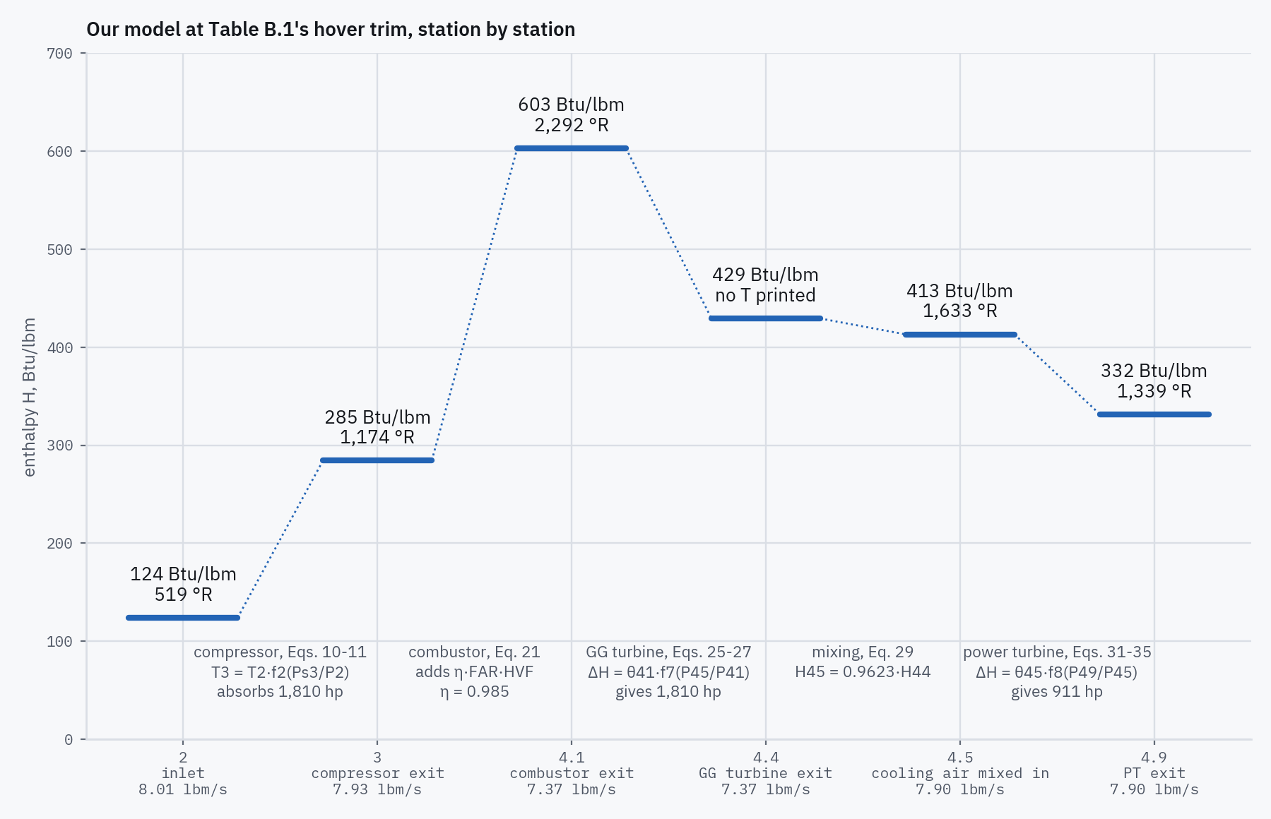
3 · HOW THE MODEL IS BUILT
How the energy is carried: Ballin's thermodynamics
No gas tables. At each station, enthalpy is a straight line in temperature: a fixed specific heat, 0.239 to 0.301 Btu/lbm·°R.
Compressor: exit temperature from pressure ratio alone (f2).
Turbines: enthalpy drop = θ × f(pressure ratio), θ a straight line in inlet temperature (f7, f8).
No efficiency maps: the efficiencies are built into f2, f7 and f8.
Combustor: fuel energy = 18,300 Btu/lbm × efficiency 0.985.
Cooling air returns as a fixed fraction: H45 = 0.9623·H44. At hover 1.5 % of the energy is lost, as printed.
Torque = power ÷ speed. At hover the compressor takes all 1,810 hp of the gas-generator turbine; the power turbine gives 911 hp (Table B.1: 911.1).
Eqs. 3–41, pdf pp.22–25; constants Table A.1, pdf p.55; trim Table B.1, pdf p.67
Replicating NASA TM-100991 · T700-GE-700 real-time engine model
11
Notes:
Every number on the picture is our model at Table B.1's hover trim, computed when the deck is built. Specific heat per station, Btu/lbm·°R: 0.239 at the inlet, 0.250 after the compressor, 0.301 at the combustor exit, 0.284 through the turbines. θ is the 'squared critical velocity ratio' of his ref. 7 [pdf p.24]. Torque is 778.12·W·ΔH/speed with the 60/2π of rpm (Eqs. 39-41). The straight-line fits: H2 = K_H2·T2 (Eq. 3), H3 (Eq. 11) and H41 (Eq. 24) from temperature, T41 (Eq. 22), T45 (Eq. 30) and T49 (Eq. 36) from enthalpy; each fit has its own intercept, so the stations do not share one enthalpy datum. Station 4.4 has no temperature: the report computes none. The compressor torque (Eq. 39) charges all the inlet air up to 0.71·H3 and only the air past the stage-4 bleed the remaining 0.29·H3: 'Effects of the compressor interstage bleed flows are accounted for with an empirically determined function' [pdf p.25]. The power turbine torque carries a speed-damping term, zero at design speed. The station 4.5 energy shortfall is decision log #52.

Slide 12
3 · HOW THE MODEL IS BUILT
Volume dynamics: mass storage only
P3 = K_{V3} ∫ T3 · (WA3 − WA3_{bl} − WA31) dt
P41 = K_{V41} ∫ T41 · (WA31 + W_{f} − W41) dt
P45 = K_{V45} ∫ T45 · (W41 − W45 + B₃ K_{bl} WA2) dt
(42)
(43)
(44)
“Conservation of mass is applied to determine intervolume pressure dynamics for stations 3, 4.1, and 4.5” [pdf p.25].
Each pressure integrates the net mass flow into its volume, scaled by the gas temperature there. K_{V3} = 0.97, K_{V41} = 6.17, K_{V45} = 13.63: empirical constants; the report gives no volumes.
Limitation: there is no energy equation for the volumes. Their temperature is set by the component upstream, so a volume stores mass but not energy.
In the real-time model these three are set to zero and solved, not integrated.
Eqs. 42–44, pdf p.25; Eq. 73, pdf p.36; Table A.1, pdf p.55
Replicating NASA TM-100991 · T700-GE-700 real-time engine model
12
Notes:
K_V units: psia per (lbm·°R). K_V3 is smallest, consistent with the diffuser being the largest volume, but the report never states a volume. Eq. 43 is shown with +W_f: the page prints -W_f, and Eq. 73 and Eq. 77 both use +W_f, which mass conservation needs (misprints slide, 62; decision log #29).

Slide 13
3 · HOW THE MODEL IS BUILT
Spool dynamics
NG = (60/2π) ∫ (Q_{GT} − Q_{C}) / J_{GT} dt
NP = (60/2π) ∫ (Q_{PT} − Q_{req}) / (J_{PT} + J_{load}) dt
(45)
(46, 47)
Gas generator: turbine torque minus compressor torque; J_{GT} = 0.0445 ft·lbf·s².
Power turbine: turbine torque minus the load; J_{PT} = 0.062 ft·lbf·s². The turbine torque carries a damping term proportional to NP − NP_{des}.
The load torque Q_{req} and the load inertia J_{load} come from the helicopter simulation, which the report does not contain.
We recovered both from Appendix B's own matrices: J_{load} = 9.25 × J_{PT}, consistent to 0.2 % across the three flight conditions (Part 4 shows how).
Trims and the open-loop transients hold NP, as the report does [pdf pp.39, 67]; the closed loop integrates it.
Eqs. 45–47 and Table A.1, pdf pp.25, 55; Appendix B, pdf pp.68–76
Replicating NASA TM-100991 · T700-GE-700 real-time engine model
13
Notes:
J_load = 9.25 × J_PT, consistent to about 0.2 % across the three trims (the three ratios are on slide 33); the load-torque slope dQreq/dNP is recovered per trim from Appendix B's NP diagonal (decision log #6). Consequence: the NP row of every linear comparison is supplied rather than predicted. The damping term is proportional to the displacement NP − NP_des, not to dNP/dt, despite the prose calling it 'a damping factor based on change of power turbine speed' [pdf p.25].

Slide 14
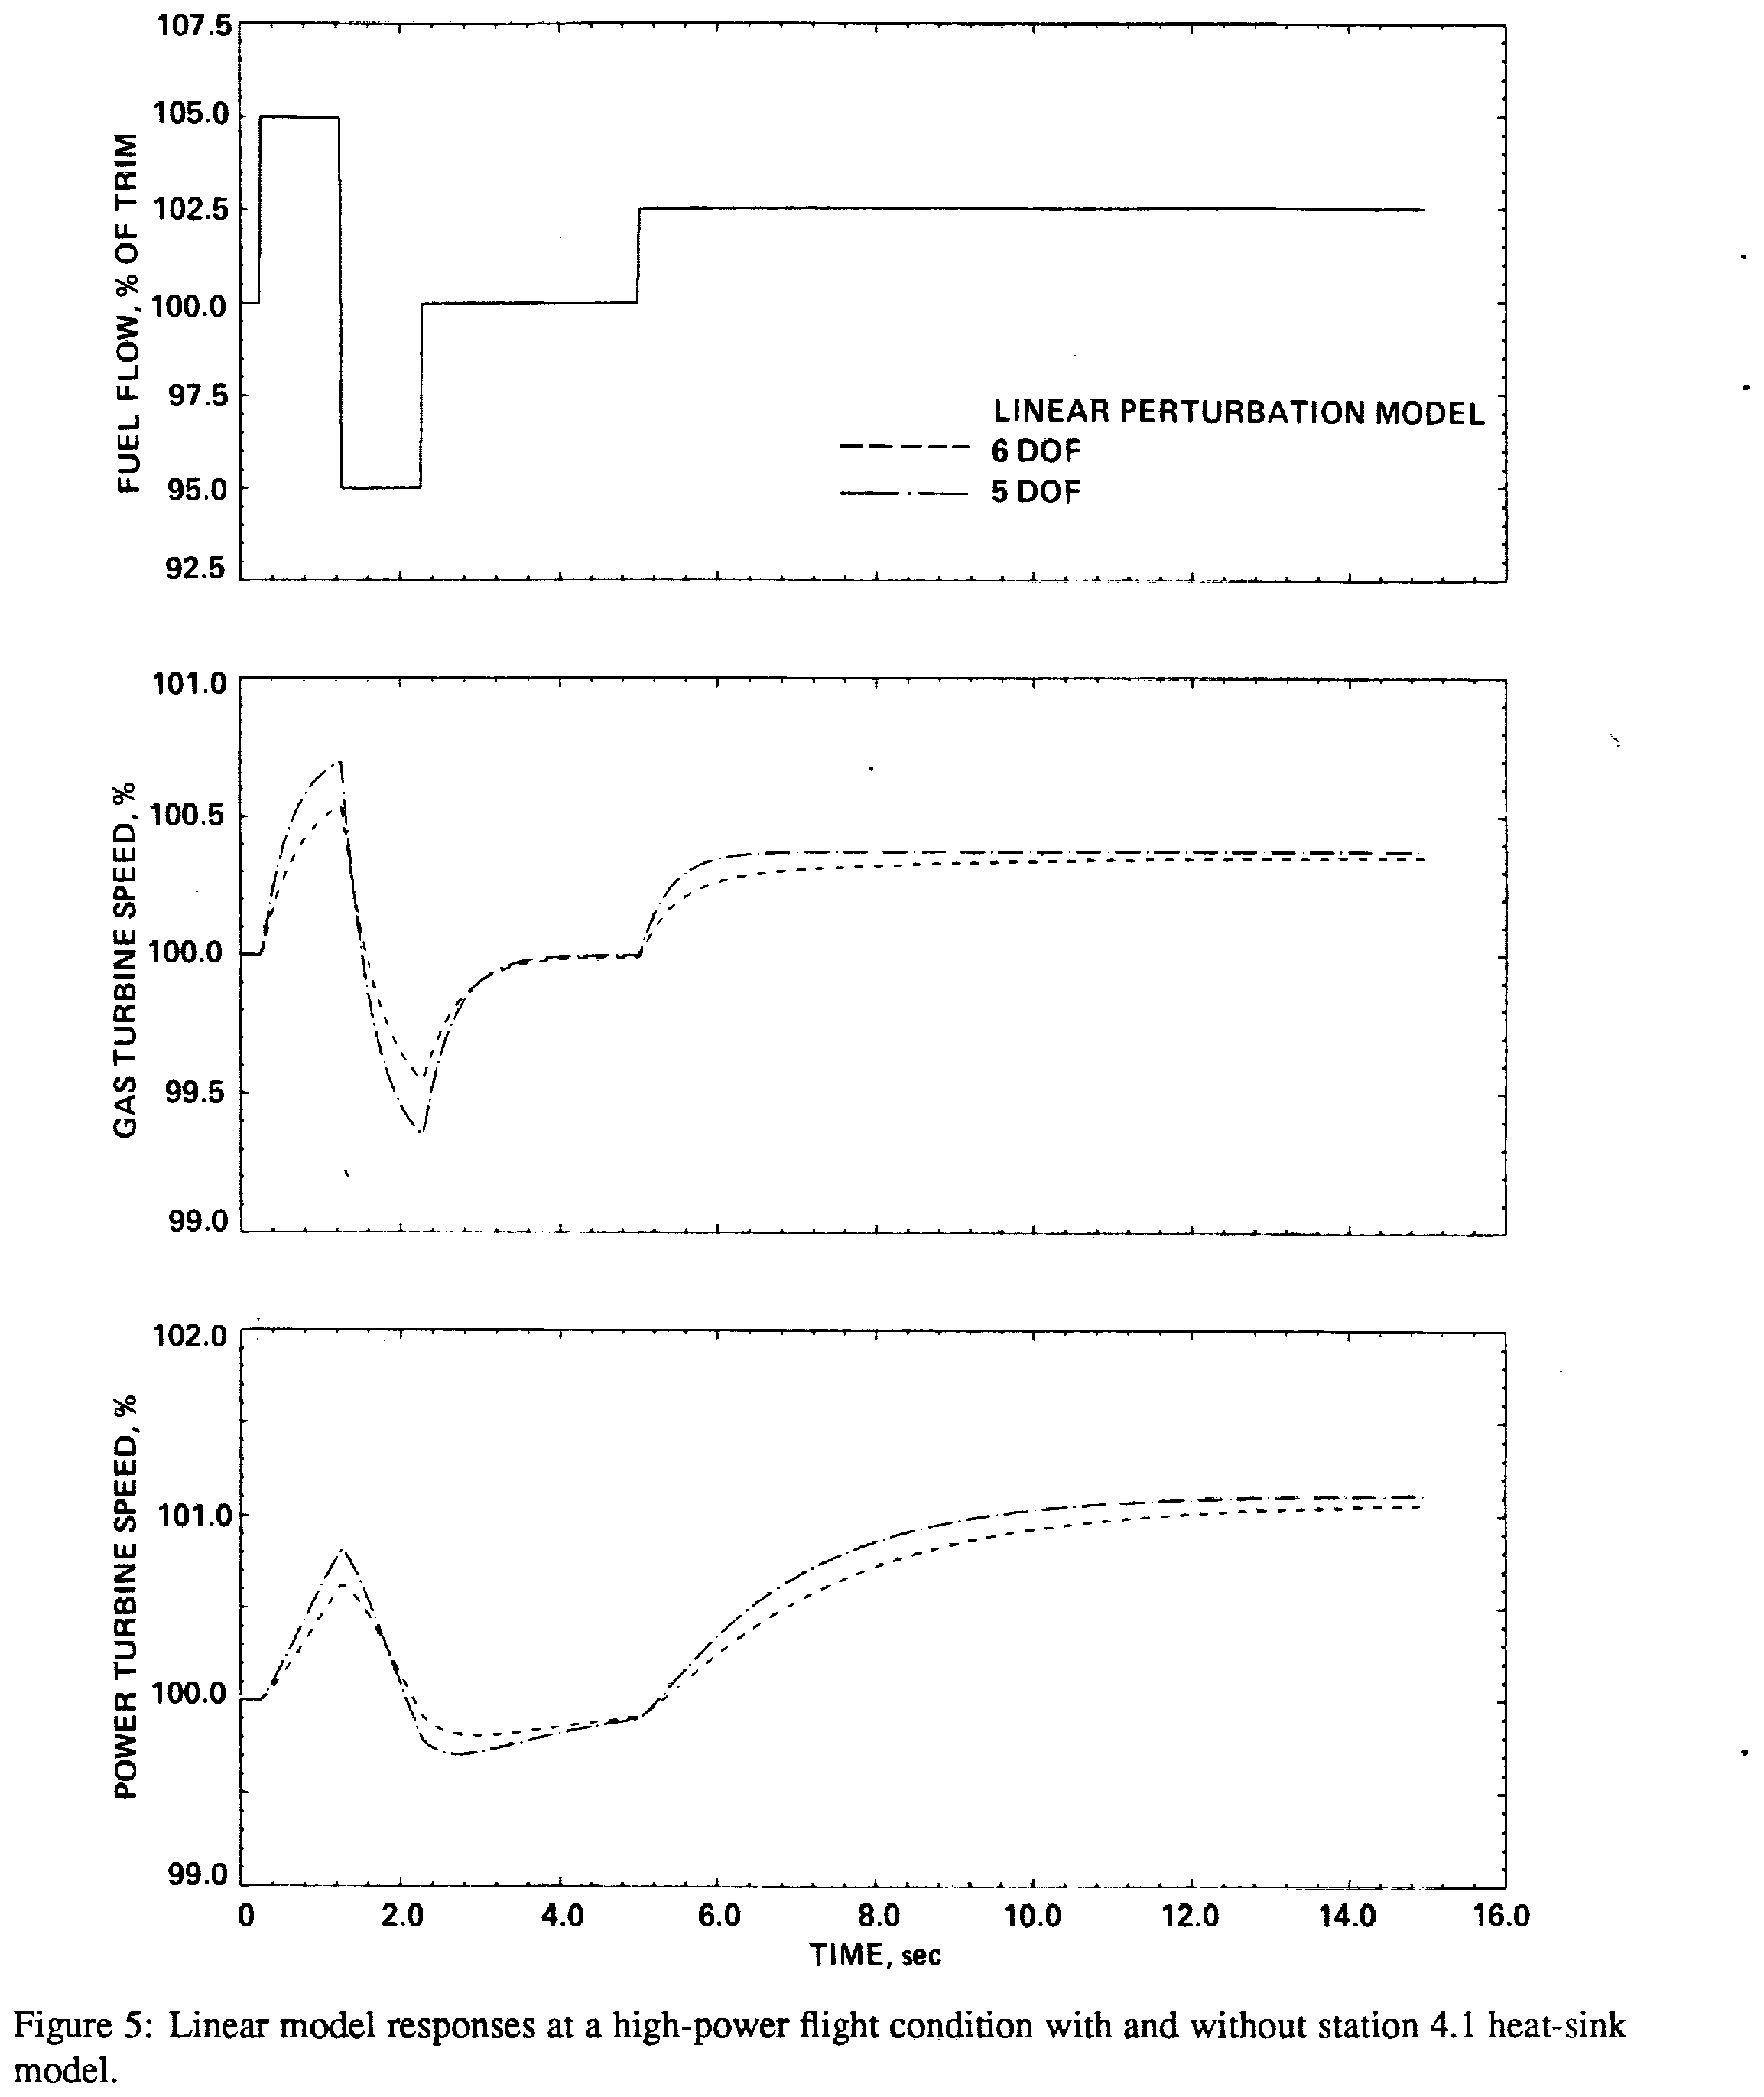
3 · HOW THE MODEL IS BUILT
Heat soakage at station 4.1
“There is a transient energy transfer which is caused by the metal mass of the turbine absorbing heat from the hot gas. This is especially significant at station 4.1, immediately downstream of the combustor.” [pdf p.25]
Metal: c_{pm} M dT_{m}/dt = h A_{m} (T_{gi} − T_{m}) (48)
Gas: c_{pg} W_{g} (T_{gi} − T_{go}) = c_{pm} M dT_{m}/dt (49)
The time constants change with T41, airflow and speed (Eqs. 51–53, TC_{T41} = 0.29 and the function f_{hs}, Fig. A11).
We integrate the metal temperature (Eqs. 48–49). The report's lead–lag form (Eq. 50) assumes constant coefficients, and goes stale on a fuel step.
Limits Ballin states: the same constants for heating and cooling; no heat sink at station 4.5.
Ballin's Figure 5: linear responses with (6-DOF) and without (5-DOF) the station 4.1 heat sink.
Eqs. 48–53, pdf pp.25–26; Ballin, Figure 5, pdf p.34; limits pdf pp.47, 50
Replicating NASA TM-100991 · T700-GE-700 real-time engine model
14
Notes:
Eq. 50 collapses Eqs. 48-49 into a lead-lag T41/T41_ns. That collapse holds for constant coefficients only; Eqs. 51 and 53 make them functions of T41 and W41, so a lead-lag memory carries a stale high-frequency gain through a fuel step. Integrating the metal temperature is what closed our T41 overshoot gap (decision log #47). DC gain is exactly 1, so the heat sink cannot move a trim. Ballin's limits: p.47 and p.50 (same constants for increasing and decreasing power; 'A small effective lag may be added with the inclusion of a T45 heat-sink model', p.50).

Slide 15
3 · HOW THE MODEL IS BUILT
One real-time frame, step by step
1. Start of frame: NG, NP, P3, P41, P45, and one mass flow carried from the previous frame
6. Gas-generator turbine and station 4.5 at the previous frame's P45 → W41, T45 (Eqs. 26–31)
2. Compressor, once per frame: map f1 at this frame's P3 → airflow, bleeds, T3 (Eqs. 1–17)
7. P45 loop: fixed point, at most 8 passes to < 0.1 % (Eq. 80). If it cannot converge: exact solve (our departure)
3. Opened iteration: combustor inlet flow = the compressor exit flow of the previous frame (Eq. 74)
8. Power turbine and exhaust → W45, enthalpy drop (Eqs. 32–38)
4. Combustor: fuel–air ratio and T41; heat sink (Eqs. 19–25, 48–53)
9. Torques → explicit Euler step: NG every 7 ms, NP every 14 ms (Eqs. 39–47)
5. Inner loop: P3 ↔ P41, fixed point, at most 10 passes to < 0.1 % (Eqs. 76–78)
10. Carry the compressor exit flow into the next frame
Our flowchart, from Eqs. 69–80 and pdf pp.35–37: the report prints none. Dark grey: the real-time approximations. Step 10 loops back to step 1.
Replicating NASA TM-100991 · T700-GE-700 real-time engine model
15
Notes:
Ames rules shaped this: 'Present implementation restrictions at Ames require a minimum amount of multiple-pass coding or iteration and the use of the Ames simulation-standard function table processor routines as much as possible' [pdf p.35]. 'up to ten iterations may be required for convergence with less than 0.1 percent error' (inner loop) and 'Eight iterations resulted in an error equal to less than 0.1 percent of the steady-state value' (P45) [pdf p.37]. The order of steps is ours where the report is silent: e.g. step 6 uses the previous frame's P45, decided by Ballin's own Figure 9 (decision log #75). Step 7's exact solve: decision log #45, #57.

Slide 16
3 · HOW THE MODEL IS BUILT
What the real-time approximation costs
The opened loop leaves a one-frame lag in the combustor inlet flow, so the answer depends on the step size: “Because of the opened compressor mass-flow iteration, however, response is dependent on time step.” [pdf p.38]
Ballin capped the step at 10 ms, for at most 0.1 % error between time steps [pdf p.38]. He ran the engine every 7 ms and NP every 14 ms, with the rotor [pdf p.47].
Why fixed-point iteration rather than Newton: “Because multiple passes are required to determine elements of the Jacobian for quadratic convergence methods, they were found to involve more computation than linearly convergent methods.” [pdf p.36]
The report names no integrator. We use explicit Euler, consistent with the “no iteration between time steps” of earlier real-time models [pdf p.35].
On modern hardware, speed is no longer the limit. Ballin's engine had “only a small percentage of the available computation time” on a 1988 CDC 7600 [pdf pp.35–36]. Today one frame takes well under a millisecond on any ordinary processor, even in plain Python. We keep his 7 ms because the response depends on the step.
pdf pp.35–38, 47
Replicating NASA TM-100991 · T700-GE-700 real-time engine model
16
Notes:
The residual left by opening the loop is of order (dWA3/dt)·Δt: halving Δt halves it, so changing Δt changes the transient. That is a modelling error, not a truncation error. The p.35 phrase is from Ballin's list of 'Typical restrictions that have been used in previous real-time models'. The integrator choice is decision log #26. Frame cost, measured on a 2019 laptop core in plain Python: a few tens of microseconds per frame, held at trim or in the middle of a fuel step, so about two orders of magnitude inside 7 ms; compiled code would be faster again. The cost has no bearing on the results: the frame is fixed at 7 ms whatever the hardware, and the same input gives the same output on any machine.

Slide 17
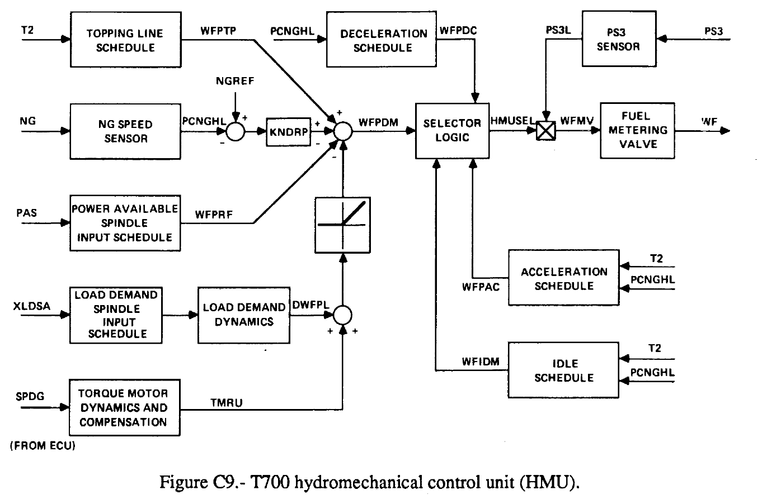
3 · HOW THE MODEL IS BUILT
Fuel control, part 1: the HMU (hydromechanical unit)
The primary loop: governs NG on a droop line, applies the idle, acceleration and deceleration limits, and meters fuel. It runs alone if the electrical trim is null.
Droop line, read sign by sign off the diagram:
WFPDM = WFPTP + KNDRP·(NGREF − PCNGHL)
− WFPRF − max(DWFPL + TMRU, 0)
Limit selection is a fixed cascade (Fig. C18):
HMUSEL = max(min(max(WFPDM, WFIDM), WFPAC), WFPDC)
Everything above is a fuel-flow parameter, Wf/Ps3. It becomes fuel flow at the metering valve: WFMV = HMUSEL × PS3L.
Ballin, Figure C9, pdf p.89; Figures C18–C19, pdf p.92
Replicating NASA TM-100991 · T700-GE-700 real-time engine model
17
Notes:
WFPTP is the topping line, the ceiling; everything else subtracts from it. Idle floor, then acceleration ceiling, then deceleration floor: the drawn order means the deceleration floor outranks the acceleration ceiling. Appendix C has no equations at all; these were read off the block diagrams summing junction by summing junction, because a misread sign inverts the control and still gives plausible numbers.

Slide 18
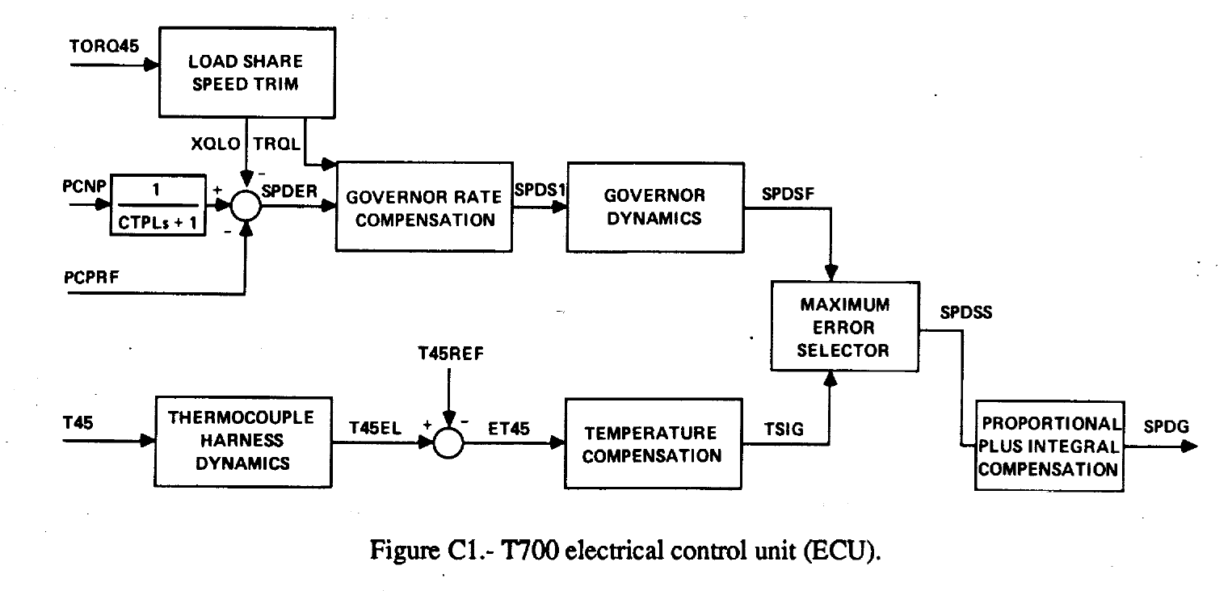
3 · HOW THE MODEL IS BUILT
Fuel control, part 2: the ECU (electrical control unit)
Speed error: SPDER = PCNP/(CTPL·s + 1) − XQLO − PCPRF
Temperature error: ET45 = T45EL − T45REF
Each error is compensated; a maximum-error selector passes the larger to the proportional-plus-integral stage, so T45 limiting takes over from speed governing when its error is the bigger.
Single engine, as drawn: the load-share link (Fig. C2) is open.
At every Table B.1 trim the sensed T45 sits about 360–570 °R below its limit, so the temperature path is idle in steady flight.
Governs power-turbine speed NP and limits T45.
Its only output, SPDG, drives a torque motor that trims the HMU's droop line downward: more SPDG, less fuel.
Ballin, Figure C1, pdf p.85; Figures C2–C8, pdf pp.85–88
Replicating NASA TM-100991 · T700-GE-700 real-time engine model
18
Notes:
Sign trap: SPDER is positive when sensed NP exceeds the reference and drives SPDG up, and more SPDG means less fuel (the HMU subtracts TMRU). The P+I integrator limits are Fig. C8. Figure C3's rate-gain switching is in the model too.

Slide 19
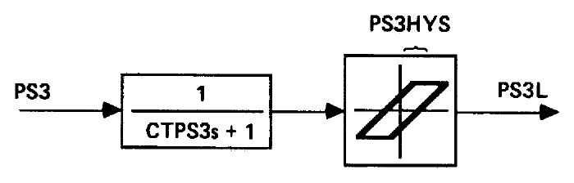
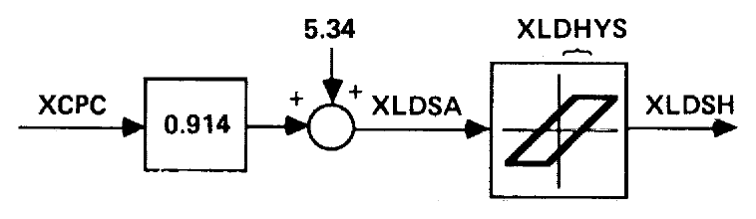
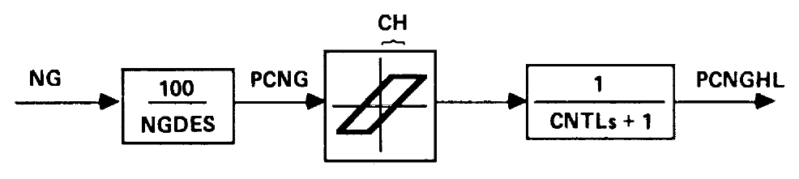
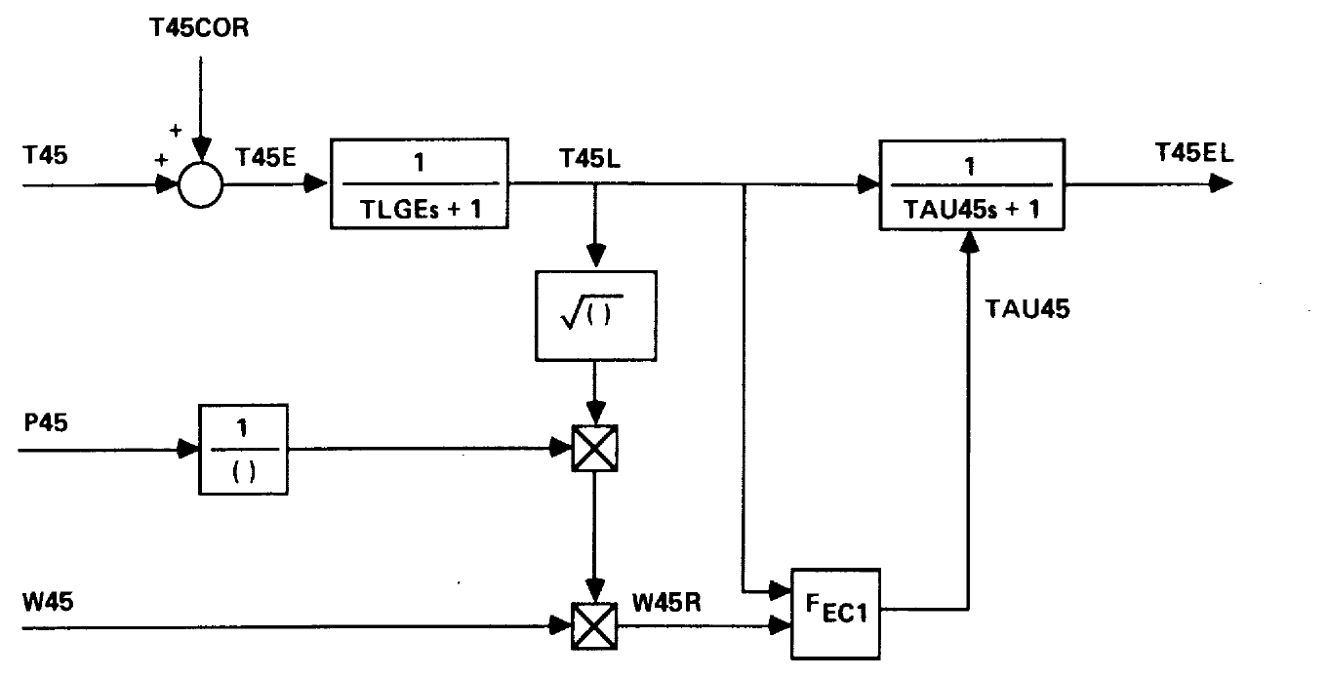
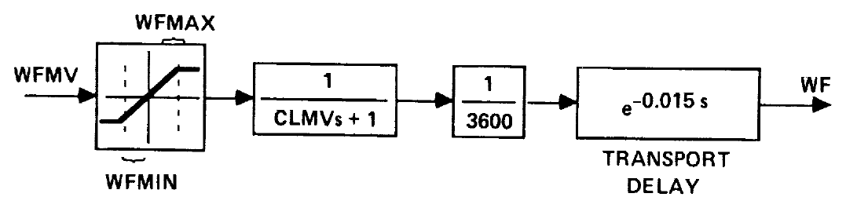
3 · HOW THE MODEL IS BUILT
Sensor and actuator dynamics
NG speed sensor (C15): 0.05 %NG hysteresis band, then a lag
Ps3 sensor (C11): a lag, then a 0.375 psia hysteresis band
Collective rigging (C13): 2.5° hysteresis (UH-60A)
Fuel metering valve (C19): limits, a lag and a 0.015 s transport delay
T45 thermocouple harness (C5): two lags, the second one scheduled (F_EC1)
In all, the fuel control has 22 continuous states and 4 memory elements (three hysteresis bands and a transport delay).
Ballin, Figures C5, C11, C13, C15, C19, pdf pp.87–92; Table C.1, pdf pp.83–84
Replicating NASA TM-100991 · T700-GE-700 real-time engine model
19
Notes:
The NG sensor's hysteresis band CH = 0.05 %NG is what makes the closed loop settle into a small limit cycle rather than a point (decision log #61). Whether a printed hysteresis constant is the whole band or the half band is not stated; we take the whole band (decision log #54). The torque motor (C10) and the load-demand dynamics (C12) are further lags in the loop.

Slide 20
3 · HOW THE MODEL IS BUILT
Assumptions and shortcomings
Not in the model
What Ballin says about his own model
Energy storage in the gas volumes: mass conservation only
Tip-clearance effects: the report never mentions them
Heat soakage anywhere but station 4.1
Map dynamics: every compressor and turbine map is a steady lookup
Inlet-guide-vane dynamics [pp.38, 50]
The engine clutch the report describes [p.19]
The helicopter: rotor load and inertia come from outside
Operation above 100 %NG [p.39], or fuel control below flight idle [p.38]
T41 and T45 at trim slightly low in every validation case [p.47]
Heat-sink constants the same for heating and cooling [pp.47, 50]
Damping slightly greater than the test data [p.50]
Load-demand compensation weaker than the aircraft's [pp.47, 50]
Response depends on the time step [p.38]
Not valid at low power-turbine speeds [p.39]
Everything in both lists is preserved as Ballin had it, to match his results as closely as possible.
Ballin's admitted limits: pdf pp.38, 39, 47, 50, 54
Replicating NASA TM-100991 · T700-GE-700 real-time engine model
20
Notes:
Validity ceiling: 'the maximum gas generator speed for which the model is valid is 100 percent' [pdf p.39], set by the extent of the supplied function tables. Below flight idle the report eliminated fuel control [pdf p.38]. The clutch: 'power from each engine must also pass through a clutch which disengages the engine from the gearbox if transmission speed exceeds that of the engine shaft' [pdf p.19], not represented in any equation. 'clearance' appears nowhere in the report.

Slide 21
3 · HOW THE MODEL IS BUILT
From a 1988 scan to numbers
The report prints its 19 function tables only as plots: 11 engine functions (Appendix A) and 8 control schedules (Appendix C). Twelve body figures, 4 to 15, carry the validation references. Recovering them is a measurement, treated as one.
Render
Calibrate
Rectify
Extract
Verify
Reproduce
the embedded 300 dpi bitmap, never a resampled image
frame, tick lattice, axis polynomial: never by eye
page skew as a coordinate transform; pixels untouched
a model fitted to each printed marker; curves traced column by column
overlays, marker counts, held-out checks
every file regenerated from the page must come out byte for byte
The read error is measured, not guessed. Figures 9 and 10 include the fuel-flow input, whose two levels the caption prints. Digitizing that panel measures the read error directly.
Pipeline: the project's digitizing tools; read-error method: Figures 9–10, pdf pp.45–46
Replicating NASA TM-100991 · T700-GE-700 real-time engine model
21
Notes:
Defects the pipeline caught, if asked: pages scanned slightly rotated (a ramp of up to 4.2 % of panel height on Figures 9-10, decision log #63); a 'sloped' combustor efficiency that was the page's tilt (#62); an apparent conflict between Table B.1 and Figures 6-7 that was our own digitizer (#46). Held-out check example: Figure A2's markers are printed at the integers 1-20 and the extraction, never told so, recovers them.

Slide 22
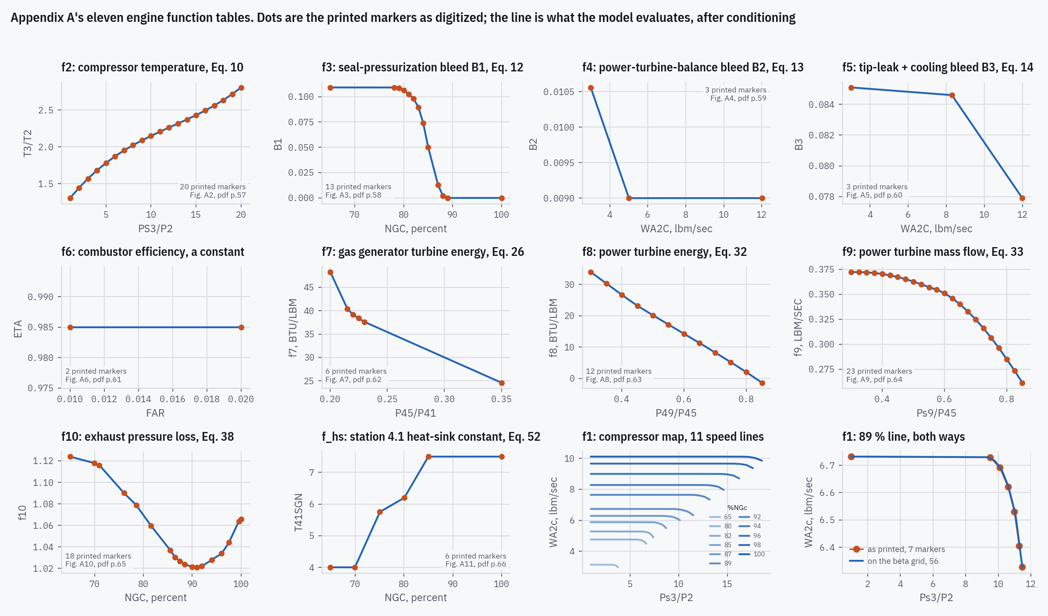
3 · HOW THE MODEL IS BUILT
Appendix A's engine functions, as digitized
Orange dots are Ballin's printed markers as digitized; blue lines are what the model evaluates, after conditioning. The compressor map f1 (bottom row, third) has 11 speed lines on our beta grid; the last panel draws its 89 % line two ways.
Figures A1–A11, pdf pp.56–66
Replicating NASA TM-100991 · T700-GE-700 real-time engine model
22
Notes:
Some functions have physics that must hold exactly (a bleed that reaches zero is zero; a monotone ratio does not wobble); that is enforced when the table is loaded, and the files keep the ink as measured. The last panel compares the 89 % speed line drawn two ways (see the compressor-map decision in Part 6).

Slide 23
3 · HOW THE MODEL IS BUILT
How accurately the maps are read
Map | What it gives | Against | Points | Value axis | Argument axis
f1 | compressor corrected flow WA2c | PS3/P2, NGc | 77 | 0.05–0.16 | 0.04–0.45
f2 | compressor temperature ratio T3/T2 | PS3/P2 | 20 | 0.03 | 0.04
f3 | stage-4 seal bleed fraction | NGc | 13 | 0.14 | 0.12
f4 | PT balance bleed fraction | WA2c | 3 | 0.12 | 0.20
f5 | tip leakage and cooling bleed | WA2c | 3 | 0.17 | 0.16
f6 | combustor efficiency | fuel-air ratio | 2 | 0.04 of value | 0.11
f7 | GG turbine enthalpy drop / θ41 | P45/P41 | 6 | 0.05 | 0.04
f8 | PT enthalpy drop / θ45 | P49/P45 | 12 | 0.11 | 0.07
f9 | PT corrected flow | Ps9/P45 | 23 | 0.03 | 0.03
f10 | exhaust pressure ratio P49/Ps9 | NGc | 18 | 0.11 | 0.13
f_hs | heat-sink constant | NGc | 6 | 0.12 | 0.12
Measured, not estimated. Each figure's own redundancy is the ruler: printed frame values, the tick lattice, construction lines, markers printed at known positions.
Typical 1σ: about a tenth of a percent of a curve's span. Small for a value: the trims match Table B.1 to 0.22 % rms.
Large for a slope. A linear model differences two readings close together, across the breakpoints of a piecewise-linear table: Part 5 shows what that costs.
f1's weakest line is the 65 % one, whose six sloped markers overprint each other.
1σ read error per printed point, median, in % of each curve's span on that axis; f1 by marker family, from its header table.
Each map file's own header (data/maps/*.csv); Figures A1–A11, pdf pp.56–66. Backup slide, hidden in the show
Replicating NASA TM-100991 · T700-GE-700 real-time engine model
23
Notes:
How each file's uncertainty is measured is written in its header: the frame edges fitted sub-pixel, the axis model chosen by a held-out test (a calibration must predict a printed value it was never shown), and the estimator checked against printed ground truths such as construction lines. Appendix C's schedules are read the same way. f6 is drawn as a constant, so its value error is given against the value itself.

Slide 24
3 · HOW THE MODEL IS BUILT
Implementation, in brief
Python 3 and NumPy only in the model; SciPy and Matplotlib only in the analysis tools.
One function per component, in the report's order. Variable names are the report's symbols, and each constant carries its page.
Deterministic: the same input gives bit-identical output, every run.
Over 1,500 automated checks. They include every comparison in this presentation, each with an acceptance bound that cannot be widened silently.
Every digitized file is regenerated from the page images on demand, and must come out identical.
Public: github.com/evrenge/t700-engine-model; every result and figure is in its results/ folder.
Backup slide, hidden in the show
Replicating NASA TM-100991 · T700-GE-700 real-time engine model
24
Notes:
The model core has no SciPy because Ballin's real-time constraint is the point: fixed-step explicit integration only, so the behaviour being reproduced is not hidden by an adaptive solver.

Slide 25
4 · HOW THE ENGINE IS RUN
Five ways the engine is run
Scenario | Model | Given | Solved / output | Compared with
Steady state (trim) | simple nonlinear, all derivatives zero | fuel flow, NP, ambient | NG, P3, P41, P45, shaft torque | Table B.1; Figures 6–8; Table 3
Open-loop transient | real-time, 7 ms frame | fuel flow against time; NP held | everything else, in time | Figures 9–10
Closed loop | real-time + ECU + HMU | load torque, pilot inputs | fuel flow, speeds, the whole state | Table B.1, found on its own
Manoeuvres | closed loop | a load step, collective or speed reference; or Ballin's printed inputs | responses | Figures 11–15, on Ballin's printed inputs
Linear | nonlinear models at a trim, ±2 % differences | trim state | A and b matrices, eigenvalues | Table 1; Appendix B; Figures 4–5
Replicating NASA TM-100991 · T700-GE-700 real-time engine model
25
Notes:
The slides that follow take these one at a time, in this order.

Slide 26
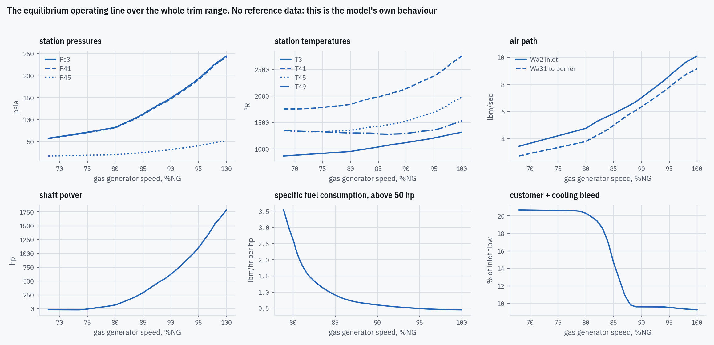
4 · HOW THE ENGINE IS RUN
Steady state: trimming the engine
A trim is an equilibrium of the simple nonlinear model: we solve dNG/dt = dP3/dt = dP41/dt = dP45/dt = 0 for NG, P3, P41, P45 at given fuel flow, NP and ambient.
NP is held: the load belongs to the helicopter. The shaft torque that balances it is an output, and Table B.1 prints it, so it is a check.
Damped Newton with a finite-difference Jacobian.
Shaft power goes negative below 75.3 %NG: there the free turbine absorbs power, and the report drops fuel control below flight idle [pdf p.38].
The equilibrium operating line, fuel flow 130–806 lbm/hr, power turbine at design speed. Not compared with anything: this is the model on its own.
pdf pp.38, 67
Replicating NASA TM-100991 · T700-GE-700 real-time engine model
26
Notes:
The trim solves the simple nonlinear model with its derivatives set to zero, so the same equilibria hold for the real-time model. Table B.1's printed torque is 'Engine torque (ref. shaft)' [pdf p.67]. Best specific fuel consumption 0.451 lbm/hp/hr at 100.0 %NG.

Slide 27
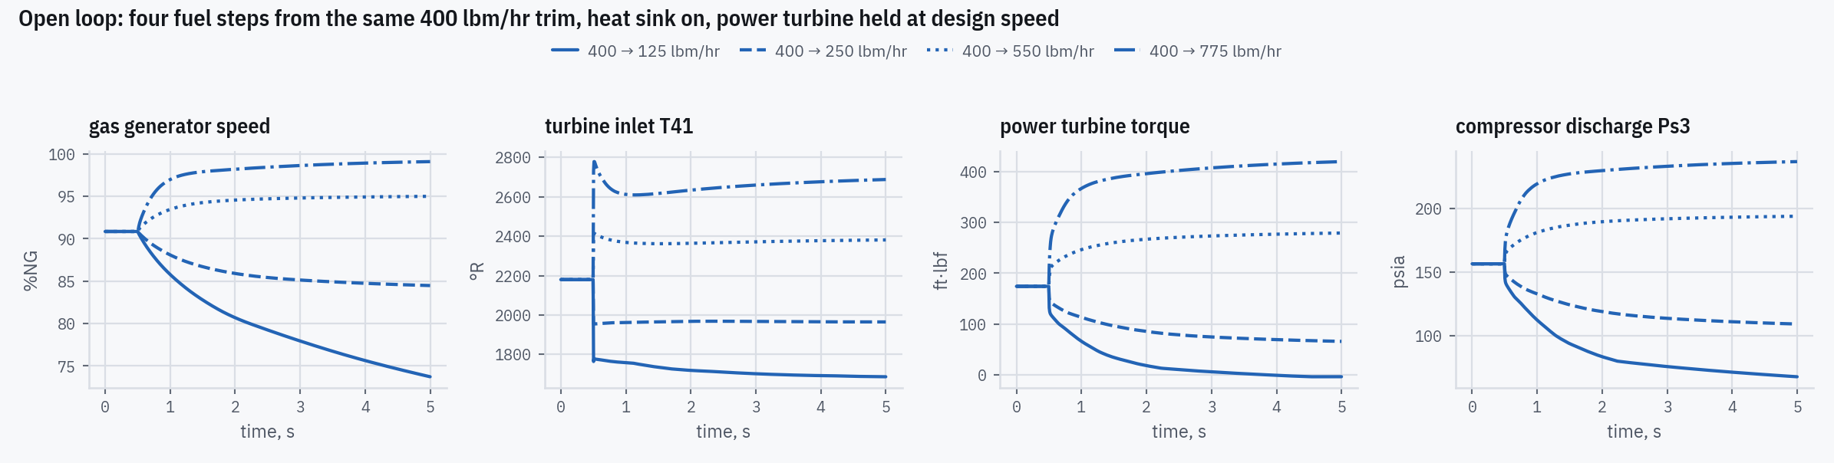
4 · HOW THE ENGINE IS RUN
Open loop: fuel steps
Step from 400 to, lbm/hr | NG start, % | NG end, % | T41 peak, °R | T41 settled, °R | Overshoot, °R
125 | 90.9 | 73.7 | — | 1,687 | —
250 | 90.9 | 84.5 | — | 1,965 | —
550 | 90.9 | 95.0 | 2,414 | 2,381 | 33
775 | 90.9 | 99.1 | 2,778 | 2,688 | 91
As in Figures 9–10: NP held “constant by suppressing the NP integration” [pdf p.39], heat sink on, 7 ms frame.
The T41 spike: burner temperature moves before the spool can respond; the station 4.1 heat sink damps it. Peak and overshoot apply to the steps up.
pdf p.39; Figures 9–10, pdf pp.45–46
Replicating NASA TM-100991 · T700-GE-700 real-time engine model
27
Notes:
Figures 9 and 10 are the 775 and 125 lbm/hr steps. The NP hold and its value (design speed, sea-level standard) are decision log #36.

Slide 28
4 · HOW THE ENGINE IS RUN
Closed loop: engine and fuel control together
HMU
hydromechanical unit
SPDG: torque-motor trim
ECU
electrical control unit
NG, Ps3, T2
fuel flow Wf
NP, torque, T45, W45, P45
Pilot
collective, power lever,
speed reference
Engine
real-time model, 7 ms
Load
Table B.1 torque + the
Appendix B slope × ΔNP
Fuel flow becomes an output. Each control reads the engine's previous frame, as a real-time implementation does.
A genuine cross-check: engine from the report's body and Appendix A, control from Appendix C. Hold Table B.1's printed shaft torque and set the speed reference: the loop finds the printed state on its own, worst 0.25 % over NG, NP, Wf, Ps3 and shaft power at three trims.
The NG sensor's hysteresis keeps it in a small limit cycle (NP 12.7–16.3 rpm peak to peak), so closed-loop values are averaged over whole cycles.
The load: Table B.1's torque plus the Appendix B slope times the NP change, on the Appendix B inertia, the same two numbers as the linear models (slides 32–33).
Appendix C, pdf pp.77–101; Table B.1, pdf p.67
Replicating NASA TM-100991 · T700-GE-700 real-time engine model
28
Notes:
Both controls start in equilibrium with their held inputs: the report states no initial condition for the block diagrams (decision log #55). The limit cycle is the printed 0.05 %NG sensor band, not numerics: refining the frame from 7 to 1.75 ms leaves it unchanged, and removing that one band collapses it (decision log #61).

Slide 29
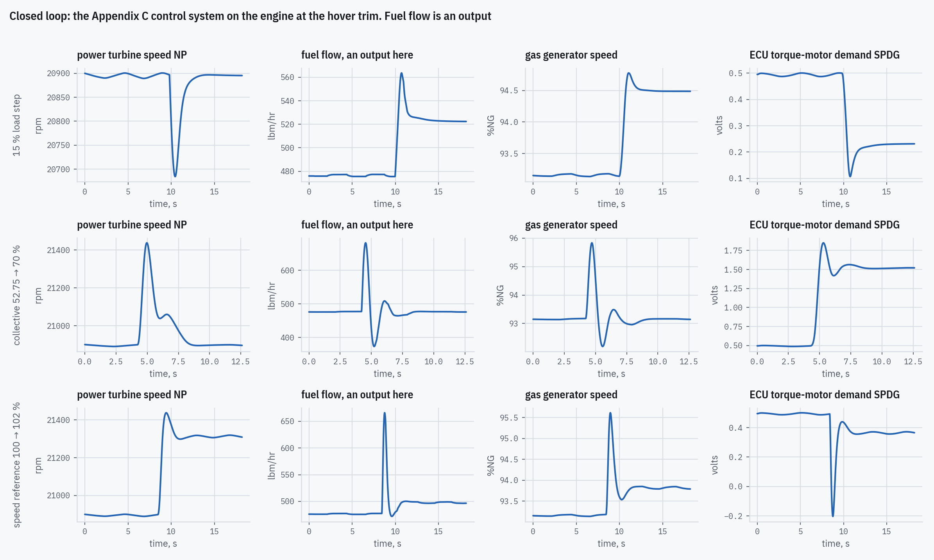
4 · HOW THE ENGINE IS RUN
Closed-loop manoeuvres
Manoeuvre | NP range, rpm | NP settled | Wf range, lbm/hr | Wf settled
15 % load step | 20,685–20,901 | 20,896 | 476–564 | 522
collective 52.75 → 70 % | 20,890–21,438 | 20,898 | 373–682 | 476
speed reference 100 → 102 % | 20,889–21,438 | 21,315 | 472–666 | 497
Load: Table B.1's torque plus the Appendix B slope times (NP − 20,895 rpm), with the Appendix B inertia.
The collective slam exercises only the load-demand feedforward: our load depends on speed alone, so the control anticipates a load that never arrives and NP rises rather than dipping.
The report's own manoeuvres (Figures 11–15) fly the engine inside the Gen Hel helicopter simulation, which is not in the report. Figures 11–15 are compared instead by running our closed loop on what they print (Part 5).
Our runs at the hover trim; the report's Figures 11–15 (pdf pp.48–53) are compared in Part 5
Replicating NASA TM-100991 · T700-GE-700 real-time engine model
29
Notes:
Fuel flow is an output in every panel. The figure's rows are the three manoeuvres; columns NP, Wf, NG and the ECU torque-motor demand. Gen Hel itself is out of scope (decision log #39); Figures 11-15 are compared in Part 5 (#81).

Slide 30
4 · HOW THE ENGINE IS RUN
Linearization: how we built our own linear models
Ballin: “plus or minus two percent of equilibruim [sic] conditions” [pdf p.28]. We take central differences of the nonlinear model at a trim: A = ∂ẋ/∂x, b = ∂ẋ/∂Wf.
Three trims (Table B.1; sea level, UH-60A at 16,825 lbm, NP 20,895 rpm): hover, 911.1 hp; 80 kt level flight, 552.6 hp; 80 kt with 1000 ft/min descent, 302.6 hp.
Each variant is made the way Ballin made his [pdf pp.26–28]: 5-DOF from the simple nonlinear model; 2-DOF from a model with the pressures in balance; reduced 5-DOF by setting the 5-DOF's pressure derivatives to zero.
Modes are named by the state that dominates them, not by sorting: at descent the two fastest modes lie a few percent apart, and sorting would pair them by size, not by physics.
How each cell is calculated, and how the NP row gets the helicopter load: the next three slides.
 | Heat sink off | Heat sink on
Full volume dynamics | 5-DOF B2, B4, B6 | 6-DOF B8, B10, B12
Pressures in balance | 2-DOF B1, B3, B5 | 3-DOF B7, B9, B11
Order reduction | reduced 5-DOF Table 1 only | —
B1–B12: Appendix B's figures, each printing an A matrix and b vector. 6-DOF adds T41 as a state.
pdf pp.26–33, 67; Appendix B, pdf pp.68–76
Replicating NASA TM-100991 · T700-GE-700 real-time engine model
30
Notes:
Three trims: decision log #3. With exact derivatives the 2-DOF and the reduced 5-DOF would be the same model (implicit differentiation gives the Schur complement); at the ±2 % step they part, Ballin's and ours alike (decision log #49). The ±2 % step itself: decision log #56. Matching by dominant state: participation factors.

Slide 31
4 · HOW THE ENGINE IS RUN
Linearization, step by step: how each cell is calculated
“Each state or control was then individually perturbed and the effects of its change were determined in the state derivatives at the input of each integrator.” [pdf p.28]
1 · Trim. Find the steady state at the flight condition: every derivative zero. Hover: W_{f} 476.3 lbm/hr, NG 41,638 rpm, P3 184.3, P41 174.1, P45 37.40 psia; NP held at 20,895 rpm.
2 · Freeze. No time stepping. The model only evaluates its five state derivatives: dNG/dt, dNP/dt, dP3/dt, dP41/dt, dP45/dt (Eqs. 42–47).
3 · Push one quantity ±2 %, everything else held at trim, and evaluate the five derivatives at +2 % and at −2 %.
4 · Divide. Cell = (derivative at +2 % − derivative at −2 %) ÷ (4 % of the trim value). One push fills one column of A; pushing W_{f} fills b.
Example: A(NG,NG) = (−3,800 − 4,224) ÷ 1,666 = −4.82 /s.
Worked example, hover: push NG by ±2 % (±833 rpm)
Row (derivative) | NG − 2 % 40,805 rpm | NG + 2 % 42,471 rpm | Cell = change ÷ 1,666 rpm | Ballin B2
dNG/dt, rpm/s | +4,224 | −3,800 | A(NG,NG) = −4.82 | −4.474
dNP/dt, rpm/s | +14.8 | −19.5 | A(NP,NG) = −0.0206 | −0.02444
dP3/dt, psia/s | −696 | +658 | A(P3,NG) = 0.813 | 0.7524
dP41/dt, psia/s | 0 | 0 | A(P41,NG) = 0 | 0
dP45/dt, psia/s | −989 | +837 | A(P45,NG) = 1.10 | 1.063
NG row, the gas-generator torque balance (Eq. 45): dNG/dt = (60/2π)(Q_{GT} − Q_{C}) / J_{GT}. At NG − 2 %: 233.0 − 213.3 = +19.7 ft·lbf; at + 2 %: 223.9 − 241.6 = −17.7 ft·lbf.
P3, P41, P45 rows, the mass balance of each volume (Eqs. 42–44).
NP row, the power-turbine torque balance (Eq. 47). It contains the helicopter load: next slide.
A cell's unit: the row's rate per unit of the column, e.g. (rpm/s) per rpm = 1/s. Six pushes, twelve evaluations: the whole 5-DOF A and b.
Method pdf p.28; Eqs. 42–47 pdf p.25; Table B.1 pdf p.67; Ballin's Figure B2 (5-DOF, hover) pdf p.68
Replicating NASA TM-100991 · T700-GE-700 real-time engine model
31
Notes:
How to read a cell: A(NG,NG) = −4.82 /s means that if NG sits 1 rpm above trim with everything else frozen, the compressor takes more torque than the turbine gives and NG starts falling at 4.82 rpm/s. A positive cell pushes the row's state up. The eigenvalues are then computed from the finished matrix; each is a mode's decay rate, e.g. the NG mode, −2.69 /s, is a time constant of 0.37 s. The 2-DOF is made the same way, but after each push the three pressures are re-solved to balance before the derivatives are read (Ballin's second simulation, pdf p.27). The ±2 % step is Ballin's own; a tiny step gives different numbers, because the maps are piecewise linear and the step averages across their kinks (decision log #56). The numbers on this slide are computed by our model when the deck is built.

Slide 32
4 · HOW THE ENGINE IS RUN
The NP row: where the helicopter load comes in
dNP/dt = (60/2π) · (Q_{PT} − Q_{req}) / J, J = J_{PT} + J_{load}
ΔQ_{req} = (∂Q_{req}/∂NP) · ΔNP + (∂Q_{req}/∂(dNP/dt)) · Δ(dNP/dt)
(46, 47)
(55)
 | NG | NP | P3 | P41 | P45 | W_{f} (b)
dNG/dt | engine | 0 | engine | engine | engine | engine
dNP/dt | engine ÷ J | (engine − load) ÷ J | engine ÷ J | engine ÷ J | engine ÷ J | engine ÷ J
dP3/dt | engine | 0 | engine | engine | 0 | 0
dP41/dt | 0 | 0 | engine | engine | 0 | engine
dP45/dt | engine | 0 | engine | engine | engine | engine
Push | What changes | NP-row cell
NG, P3, P41, P45 | Q_{PT} only: the rotor does not feel them | (60/2π) · ΔQ_{PT}/Δx ÷ J
W_{f} (column b) | Q_{PT} only | (60/2π) · ΔQ_{PT}/ΔW_{f} ÷ J
NP itself | Q_{PT} and Q_{req} | (60/2π) · (ΔQ_{PT}/ΔNP − ∂Q_{req}/∂NP) ÷ J
Ballin's 5-DOF matrix at hover, zeros as printed. Light grey: engine only. Darker grey: needs the load.
Only changes of Q_{req} enter, never its value. At trim Q_{req} = Q_{PT}: 228.9 ft·lbf at hover; Table B.1 prints 229.0 (“Engine torque (ref. shaft)”).
So the helicopter supplies just two numbers, and the report prints neither: the inertia J and the load slope ∂Q_{req}/∂NP. Next slide: how we found them.
Nothing else depends on NP: its column is zero except the diagonal, so the other four rows, and their eigenvalues, never see the load. “The power turbine state is completely decoupled from the other states. The neglected dynamics of the simplified load representation therefore have no effect on the gas-generator turbine or volume dynamics.” [pdf p.29]
Eqs. 46–47, 55, 59–62, pdf pp.25, 28–29; Table B.1, pdf p.67; Figure B2, pdf p.68
Replicating NASA TM-100991 · T700-GE-700 real-time engine model
32
Notes:
Q_req depends only on NP (and its rate), so pushing NG, P3, P41, P45 or the fuel flow moves only the engine's own torque Q_PT; Q_req stays at its trim value. Pushing NP moves both: the turbine torque falls with speed and the rotor's required torque rises with it. The second derivative in Eq. 55, with respect to NP acceleration, is the rotor blades' inertia; Eqs. 59–62 [pdf pp.28–29] fold it into the denominator of every NP-row cell, so it acts exactly like extra inertia. That is why J here means the power turbine, drive train, hub and blade effect together. Table B.1 prints the NP these trims use, 20,895 rpm [pdf p.67].

Slide 33
4 · HOW THE ENGINE IS RUN
Finding the two load numbers in Appendix B
1 · The inertia J, from the fuel cell b(NP)
2 · Check: the other four NP cells
3 · The load slope, from the NP diagonal
Push W_{f} ±2 % (466.8–485.8 lbm/hr): Q_{PT} goes 227.78 → 229.96 ft·lbf.
With J_{PT} alone: b(NP) = 9.549 × 410.8 ÷ 0.062 = 63,275.
Ballin prints 6,174: 10.25 times smaller, and the same at all three trims, so it is an inertia:
J = 10.25 × J_{PT} = 0.636 ft·lbf·s²
With that J, nothing fitted (ours vs Ballin, hover):
A(NP,NG): −0.0206 vs −0.02444
A(NP,P3): −43.8 vs −41.28
A(NP,P41): 35.6 vs 33.02
A(NP,P45): 229 vs 232.1
At all three trims: 10 of 12 within 8 %, worst 16 %.
Push NP ±2 % (20,477–21,313 rpm): Q_{PT} goes 236.5 → 221.4 ft·lbf, −0.0181 ft·lbf/rpm.
Engine alone: A(NP,NP) = −0.272 /s. Ballin prints −0.565.
The rotor supplies the rest:
∂Q_{req}/∂NP = −0.0181 + 0.565 × 0.636 ÷ 9.549
= 0.0195 ft·lbf/rpm
 | Hover | Level 80 kt | Descent 80 kt
b(NP) with J_{PT} alone ÷ Ballin's | 10.249 | 10.260 | 10.237
A(NP,NP), engine alone, 1/s | −0.272 | −0.208 | −0.162
A(NP,NP), printed, 1/s | −0.565 | −0.4461 | −0.3567
Load slope ∂Q_{req}/∂NP, ft·lbf/rpm | 0.0195 | 0.0159 | 0.0130
What this means for the comparison
The NP eigenvalue is A(NP,NP) itself, so step 3 makes it match by construction: Table 1's 9 NP values are inputs, not tests.
Its other 18 eigenvalues, and every cell outside the NP row, contain no load: they test the engine model alone.
Appendix B, Figures B2, B4, B6, pdf pp.68–70; Eqs. 59–62, pdf pp.28–29; Table A.1 (J_PT), pdf p.55
Replicating NASA TM-100991 · T700-GE-700 real-time engine model
33
Notes:
J here is an effective inertia: Eq. 46's J_load (drive train and hub) plus the rotor blades' inertia term, which Eqs. 59–62 add to J in every NP-row cell. Appendix B cannot separate the two, and the linear model does not need them separated. The project keeps J_load = 9.25 × J_PT = 0.5735 ft·lbf·s², from hover; with it, b(NP) lands within 0.13 % at all three trims. Step 2 is the real test of the inertia: those four cells are the engine's own torque derivatives divided by J, so their misses are the engine model's (map slopes), not the load's. The load slope falls with power. Decision log #6. Numbers computed by our model when the deck is built.

Slide 34
5 · HOW CLOSELY IT MATCHES
Scorecard: every comparison the report prints
Comparison | What is compared | n | rms | worst
Table B.1, open loop | printed engine state at three trims | 21 | 0.22 % | −0.81 %
Table B.1, closed loop | NG, NP, Wf, Ps3 and shaft power, fuel an output | 15 | 0.08 % | +0.25 %
Figure 6 | NG against fuel flow (in %NG points) | 31 | 0.07 | −0.23
Figure 7 | shaft power against fuel flow (in shp) | 25 | 1.81 shp | +5.16 shp
Figure 8 | Ps3 against NG | 31 | 0.22 % | −0.47 %
Table 3 (characterization) | test engine, cases 2–6, against Ballin's model, which ran other maps | 30 | 7.7 % | +13.4 %
Figure 9, fuel step | whole curve, five panels, % of each panel's change | 5 | 0.6–1.4 % | —
Figure 10, fuel chop | whole curve, five panels, % of each panel's change | 5 | 1.4–3.8 % | —
Figures 11–15 (closed loop) | his rotor speed imposed, or our rotor free; % or % of trim | 25 | 0.02–3.2 % | —
Table 1 | printed eigenvalues: NG, P3, P41, P45 modes | 18 | 2.37 % | +4.70 %
Table 1, NP mode | supplied from Appendix B (slide 33): not a test | 9 | — | —
Appendix B, A | printed state-matrix elements, NP diagonal excluded | 146 | 6.5 % | −33.7 %
Appendix B, b | printed fuel-column elements, hover b(NP) excluded | 41 | 6.5 % | +24.3 %
Figures 4–5 | linear models in time, rms difference from his curves, % of trim | 12 | 0.005–0.045 % | —
Each comparison has an acceptance bound in the project, set from the scan's read error or today's result, and never widened to pass.
Deviation = (ours − printed) / printed, unless noted
Replicating NASA TM-100991 · T700-GE-700 real-time engine model
34
Notes:
Figure 6 is scored in %NG points because its ordinate is already a percentage. For the transients, 'whole curve' is the rms of the gap between our trace and Ballin's over his printed window, as a percent of each panel's own excursion. Appendix B spans eight decades of magnitude; its worst elements are explained on slide 57. Excluded as supplied, not tested: Table 1's NP modes, Appendix B's NP-diagonal elements and the hover b(NP), which set the load (slide 33).

Slide 35
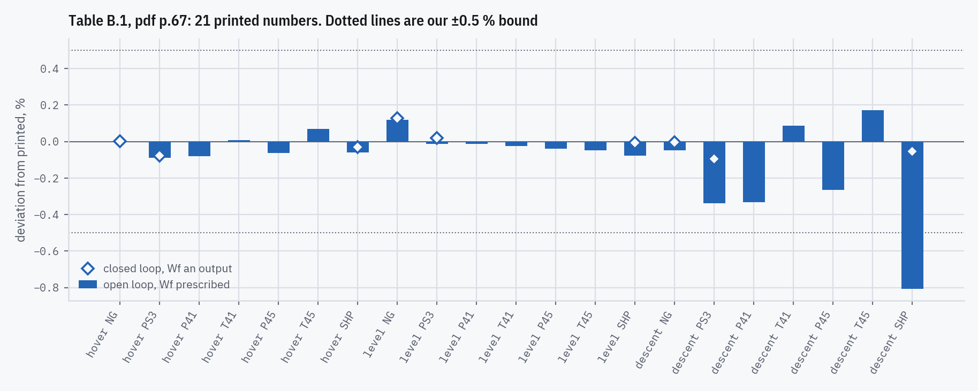
5 · HOW CLOSELY IT MATCHES
Table B.1: the printed engine state at three trims
Trim | Quantity | Printed | Ours | Dev. %
hover | NG | 41,638 | 41,638 | +0.00
hover | T41 | 2,292 | 2,292 | +0.01
hover | SHP | 911.1 | 910.6 | −0.06
level | NG | 39,768 | 39,816 | +0.12
level | T41 | 2,102 | 2,101 | −0.02
level | SHP | 552.6 | 552.2 | −0.08
descent | NG | 38,072 | 38,054 | −0.05
descent | T41 | 1,982 | 1,984 | +0.09
descent | SHP | 302.6 | 300.2 | −0.81
21 printed numbers: NG, Ps3, P41, T41, P45, T45 and shaft power at hover, level flight and descent. Open loop rms 0.22 %, worst −0.81 % (descent shaft power).
Bars: open loop, fuel prescribed. Diamonds: closed loop, where fuel is an output and the engine must find the printed state by itself.
Table B.1, pdf p.67
Replicating NASA TM-100991 · T700-GE-700 real-time engine model
35
Notes:
Table B.1 is the report's most precise steady-state reference: no digitizing error of ours, and Appendix B and Table 1 come from the same three trims. Full 21-row table in the backup.

Slide 36
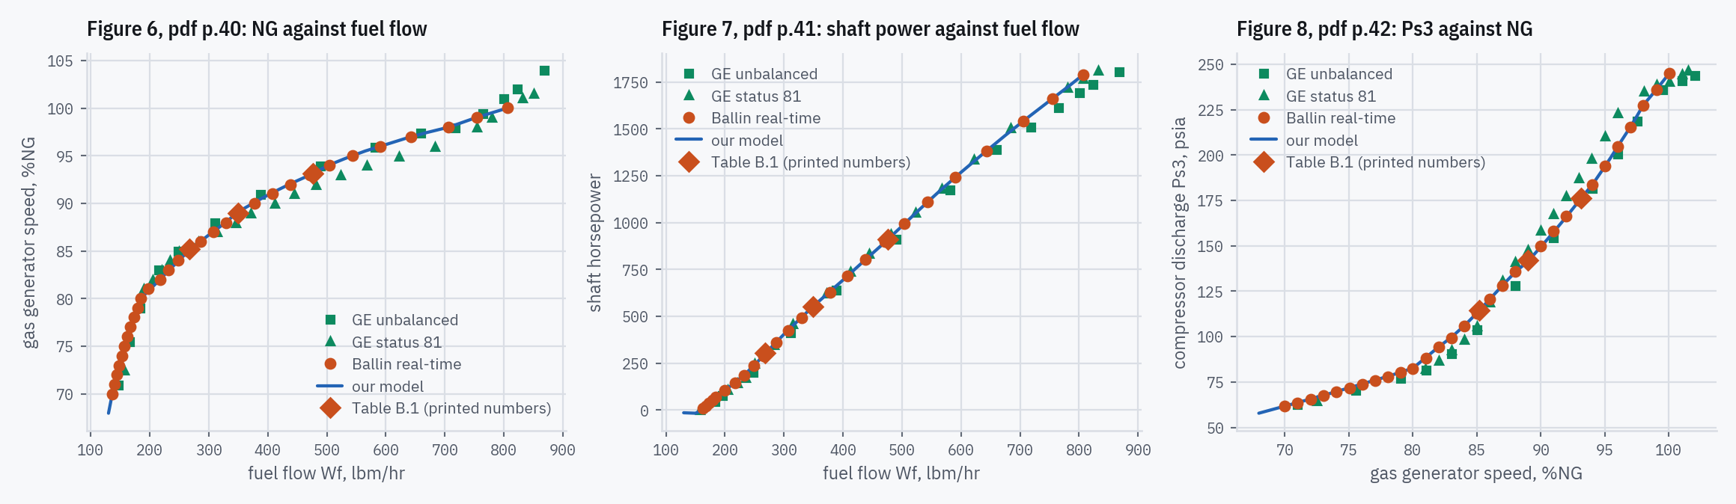
5 · HOW CLOSELY IT MATCHES
Figures 6–8: the steady sweeps
Figure | Points | mean | rms | worst
6: NG vs fuel flow (%NG pts) | 31 | −0.01 | 0.07 | −0.23
7: shaft power vs fuel flow (shp) | 25 | +0.96 | 1.81 | +5.16
8: Ps3 vs NG (%) | 31 | +0.04 | 0.22 | −0.47
Blue: ours. Orange: Ballin's model, the target (diamonds: Table B.1's printed numbers). Green: GE's two computer models [pdf p.38], for context only (triangles status 81, squares unbalanced torque).
Agreeing with GE more closely than Ballin does would not be evidence of anything.
Figures 6–8, pdf pp.40–42
Replicating NASA TM-100991 · T700-GE-700 real-time engine model
36
Notes:
Every marker we read is scored, including the top points, which need the compressor map a tenth of a point above 100 %NG (Part 6). The report's sharpest steady-state claim, a fuel overestimate of 'as much as five percent' against GE in the 81-86 %NG band [pdf p.39], is reproduced: ours peaks at 6.43 % against Ballin's 6.05 % (decision log #67). Figure 7 is scored in shaft horsepower; the hidden slide after this one shows why (decision log #83).

Slide 37
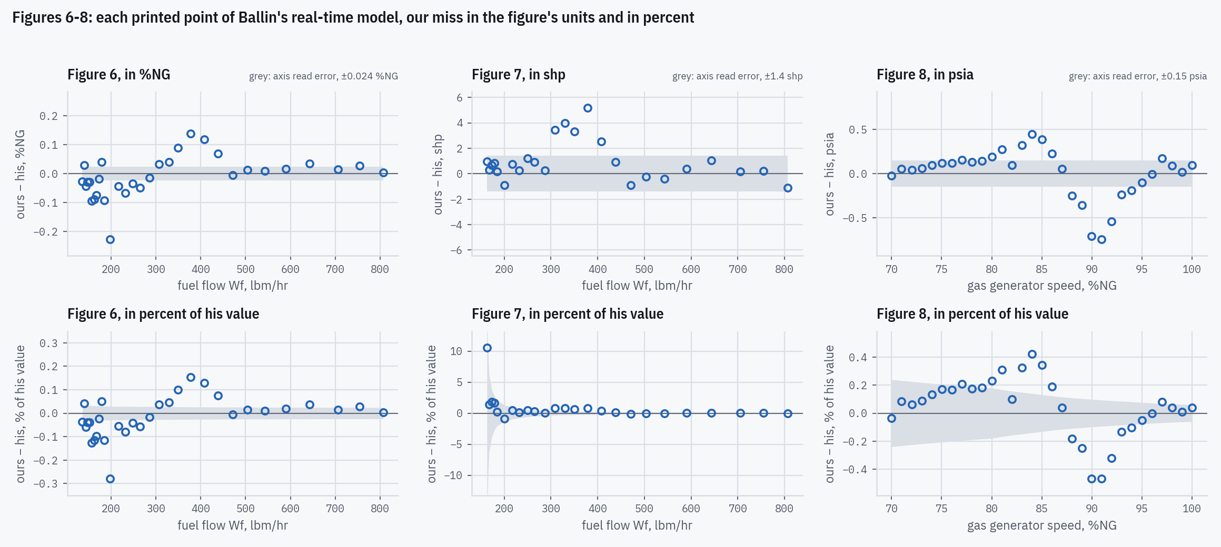
5 · HOW CLOSELY IT MATCHES
Figures 6–8: each point's miss, in units and in percent
Grey: the axis read error each digitized file publishes. In the figure's units it is constant; in percent it grows as his value falls.
Figure 7 falls to 9 shp at low power, where the read error alone is 15 % of the value. Its worst miss in percent, +10.6 %, is +1.0 shp. So Figure 7 is scored in shp.
Figure 6 is already a percentage, and Figure 8's Ps3 never falls below 61 psia: either way tells the same story.
Outside the grey, the gap is larger than the axis reading can explain: up to 5.2 shp on Figure 7 and 0.74 psia on Figure 8.
Figure | Units | rms | worst | rms, % | worst, % | Read error
6 | %NG (scored) | 0.070 | −0.227 | 0.08 | −0.28 | ±0.024 %NG
7 | shp (scored) | 1.81 | +5.16 | 2.22 | +10.57 | ±1.40 shp
8 | psia | 0.28 | −0.74 | 0.22 (scored) | −0.47 | ±0.15 psia
Figures 6–8, pdf pp.40–42; decision log #83. Backup slide, hidden in the show
Replicating NASA TM-100991 · T700-GE-700 real-time engine model
37
Notes:
Each blue circle is one of Ballin's printed real-time markers: our model at his abscissa, minus his value. Top row in the figure's own units, bottom row in percent of his value. The read error is the axis calibration's, the held-out error with which the digitizer's axis maps predict printed ticks; it is the number each file's header publishes. Scored units: Figure 6 in %NG points, Figure 7 in shp, Figure 8 in percent (decision log #83).

Slide 38
5 · HOW CLOSELY IT MATCHES
The report disagrees with itself
Table B.1 and Figures 6–7 describe the same three operating points. Where they differ, Table B.1 is primary: it has no digitizing error of ours, and Appendix B and Table 1 come from the same trims.
Trim | Quantity | Wf, lbm/hr | Table B.1 vs Ballin's figure | Ours vs Table B.1
hover | NG | 476.3 | +0.00 %NG pts | +0.00 %NG pts
hover | SHP | 476.3 | −0.03 % | −0.06 %
level | NG | 349.3 | −0.02 %NG pts | +0.12 %NG pts
level | SHP | 349.3 | +0.72 % | −0.08 %
descent | NG | 267.7 | +0.02 %NG pts | −0.05 %NG pts
descent | SHP | 267.7 | +1.20 % | −0.81 %
The widest self-disagreement: 1.20 % (descent shaft power).
There our gap to Table B.1 is smaller than the report's own.
Other places the report disagrees with itself are in Part 6.
Table B.1, pdf p.67; Figures 6–7, pdf pp.40–41
Replicating NASA TM-100991 · T700-GE-700 real-time engine model
38
Notes:
Figure 7 prints 25 real-time markers, many of them touching a GE glyph or each other at low power; all are read. On its steep low-power end the curve climbs about 3 shp per lbm/hr, so the nearest printed marker matters when reading a row.

Slide 39
5 · HOW CLOSELY IT MATCHES
Table 3: a prototype test engine, Ballin's model and ours
Case | Source | NG, % | NP, % | WA2, lbm/s | P3, psia | T3, °R | T45, °R
1 | Test engine | 65.9 | 52.6 | 3.20 | 58.0 | 832.0 | 1,413
 | Ballin's model | 70.0 | 83.8 | 3.59 | 63.4 | 855.9 | 1,372
 | Ours | 75.2 | 84.3 | 4.17 | 72.6 | 911.9 | 1,251
2 | Test engine | 84.7 | 95.7 | 5.16 | 113.1 | 1,026 | 1,577
 | Ballin's model | 86.4 | 100.6 | 5.52 | 119.0 | 1,043 | 1,555
 | Ours | 86.9 | 106.7 | 6.11 | 130.7 | 1,071 | 1,451
3 | Test engine | 87.7 | 95.7 | 6.16 | 139.0 | 1,081 | 1,626
 | Ballin's model | 88.1 | 97.8 | 6.27 | 141.7 | 1,084 | 1,629
 | Ours | 89.8 | 104.3 | 7.05 | 156.1 | 1,109 | 1,509
4 | Test engine | 90.4 | 95.7 | 6.92 | 161.1 | 1,127 | 1,731
 | Ballin's model | 90.7 | 97.3 | 7.00 | 163.3 | 1,130 | 1,734
 | Ours | 92.6 | 104.4 | 7.88 | 179.9 | 1,156 | 1,601
5 | Test engine | 92.6 | 95.7 | 7.66 | 184.8 | 1,173 | 1,838
 | Ballin's model | 92.8 | 98.2 | 7.73 | 186.4 | 1,178 | 1,855
 | Ours | 95.2 | 105.5 | 8.77 | 206.6 | 1,207 | 1,699
6 | Test engine | 95.9 | 95.7 | 8.50 | 211.9 | 1,228 | 1,974
 | Ballin's model | 96.1 | 99.4 | 8.53 | 213.8 | 1,233 | 2,009
 | Ours | 98.0 | 104.9 | 9.48 | 233.2 | 1,265 | 1,860
Six test-cell points [pdf p.43]: inlet P2 and T2, fuel flow, exhaust P49 and the dynamometer torque. Power-turbine speed floats until its torque meets the load, as Ballin did [pdf p.39].
Ballin's column ran the test engine's own maps, printed nowhere: “compressor-mass-flow and turbine-energy functions derived from this test engine were used in place of the standard functions” [pdf p.39]. Ours runs the standard ones.
Cases 2–6, ours against his: airflow +12.0 %, P3 +10.0 %, T45 −7.5 %, NP +6.6 %, the same sign every time: the standard maps describe a stronger engine than the prototype.
So the gap measures the prototype against the specification T700, not our model against his. Nothing is tuned toward either column.
Not the inlet, not the heat: with P2 and T2 free, matching his column needs P2 25–28 % below Table 2's and T2 37–43 °R colder (cases 2–5), and still misses by 1.3–1.8 % rms. The cooler T45 is the extra air at the same fuel.
Tables 2–3, pdf pp.43–44; setup pdf p.39
Replicating NASA TM-100991 · T700-GE-700 real-time engine model
39
Notes:
Case 1 sits far below the power-turbine speeds the model is valid for, as Ballin says [pdf p.39], and is not bounded. The table is the report's own Table 3 with our row added (shaded); his column cannot be reproduced without the prototype's maps. Exhaust: the printed P49 is met through Eq. 38; reading it as the back pressure instead moves cases 2–6 by under 1 % on the gas generator and 1.4–2.9 % on NP (decision log #34, #79). Against Figures 6–8, where Ballin's model ran the standard maps, ours agrees to a fraction of a percent: that is why the Table 3 gap is the maps.

Slide 40
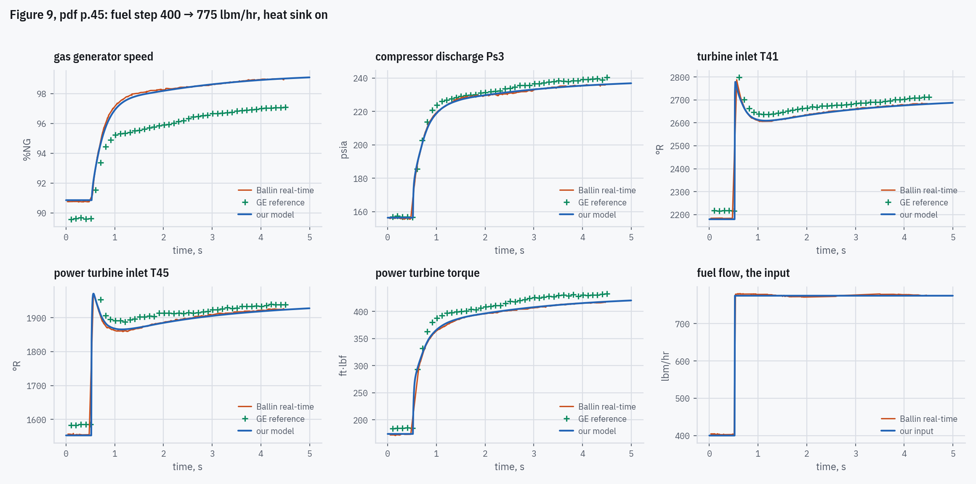
5 · HOW CLOSELY IT MATCHES
Figure 9: fuel step, 400 → 775 lbm/hr
Panel | Ballin | Ours | Dev. % | Shape
NG, % | 98.98 | 98.97 | −0.01 | 1.43
Ps3, psia | 235.72 | 235.79 | +0.03 | 0.71
T41, °R | 2,682.0 | 2,679.0 | −0.11 | 0.67
T45, °R | 1,924.4 | 1,921.3 | −0.16 | 0.82
PT torque | 415.98 | 416.60 | +0.15 | 0.62
Ballin / Ours / Dev.: the end state, over his final window.
Shape: rms gap over the whole curve, % of the panel's own change.
The sixth panel is the input: both levels are printed in the caption, so drawing it shows our model was given Ballin's step, at the instant read off the figure.
Without the heat sink our T41 spike overshot about three times as far as Ballin's and NG rose too fast. With it the spike is close to his and NG lags slightly (63 % at 0.32 s against 0.28 s).
Figure 9, pdf p.45
Replicating NASA TM-100991 · T700-GE-700 real-time engine model
40
Notes:
Figure 9: open loop, NP held, heat sink on, 7 ms frame. The step instant is not printed anywhere; it is read off the figure's own fuel-flow panel (0.5232 s on Figure 9, 0.5217 s on Figure 10; decision log #37). Whole-curve comparisons exclude the reference's own sampling hole on the vertical edge (#66) and use Ballin's printed window (#68).

Slide 41
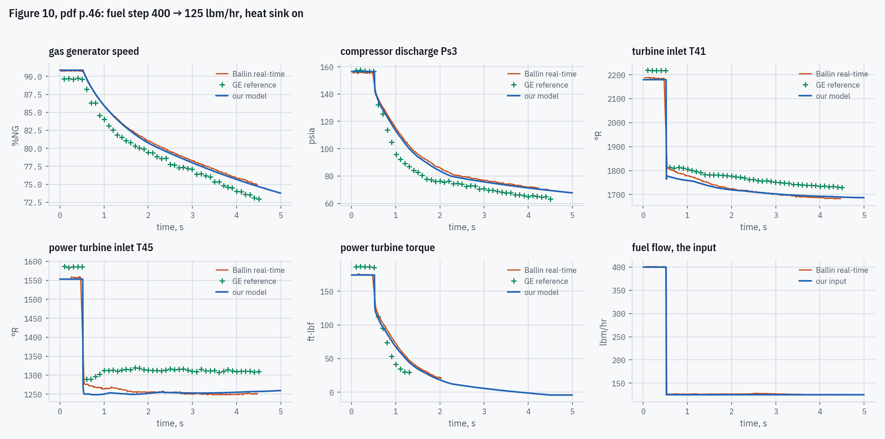
5 · HOW CLOSELY IT MATCHES
Figure 10: fuel chop, 400 → 125 lbm/hr
Panel | Ballin | Ours | Dev. % | Shape
NG, % | 75.44 | 75.20 | −0.31 | 1.44
Ps3, psia | 70.83 | 70.38 | −0.63 | 1.68
T41, °R | 1,684.0 | 1,691.0 | +0.42 | 3.80
T45, °R | 1,250.6 | 1,256.0 | +0.43 | 2.90
PT torque | — | — | — | 2.39
Ballin / Ours / Dev.: the end state, over his final window.
Shape: rms gap over the whole curve, % of the panel's own change.
Ballin's traces stop at about t = 4.47 s with the speed still falling, so neither has settled; comparisons are made at matched times. His torque line merges with the panel's zero line after about 2 s, so that panel has no end state.
The chop runs off the printed range of f8, and is where the printed P45 iteration fails (Part 6).
Figure 10, pdf p.46
Replicating NASA TM-100991 · T700-GE-700 real-time engine model
41
Notes:
Figure 10: open loop, NP held, heat sink on, 7 ms frame. The step instant is not printed anywhere; it is read off the figure's own fuel-flow panel (0.5232 s on Figure 9, 0.5217 s on Figure 10; decision log #37). Whole-curve comparisons exclude the reference's own sampling hole on the vertical edge (#66) and use Ballin's printed window (#68).

Slide 42
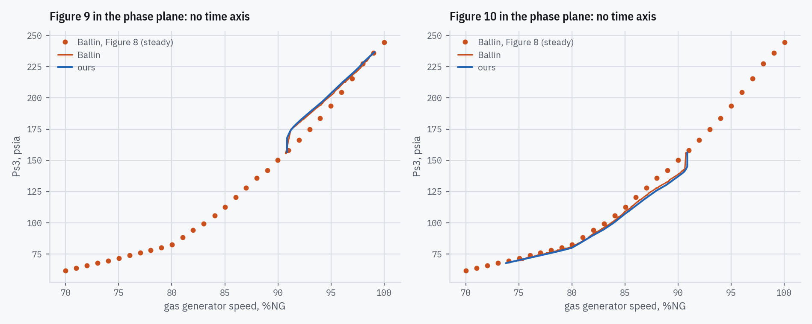
5 · HOW CLOSELY IT MATCHES
Both transients without the time axis
Ps3 against NG, so the comparison does not depend on when the step happened. Both transients run below the steady line (orange dots, Figure 8): a choked station 4.1 nozzle passes the same flow at a lower pressure once the temperature falls. Gap to Ballin's path: rms 0.67 % (Figure 9), 1.27 % (Figure 10).
Figures 8–10, pdf pp.42, 45–46
Replicating NASA TM-100991 · T700-GE-700 real-time engine model
42
Notes:
The phase plane removes timing from the comparison, so a residual here is a shape difference, not a delay.

Slide 43
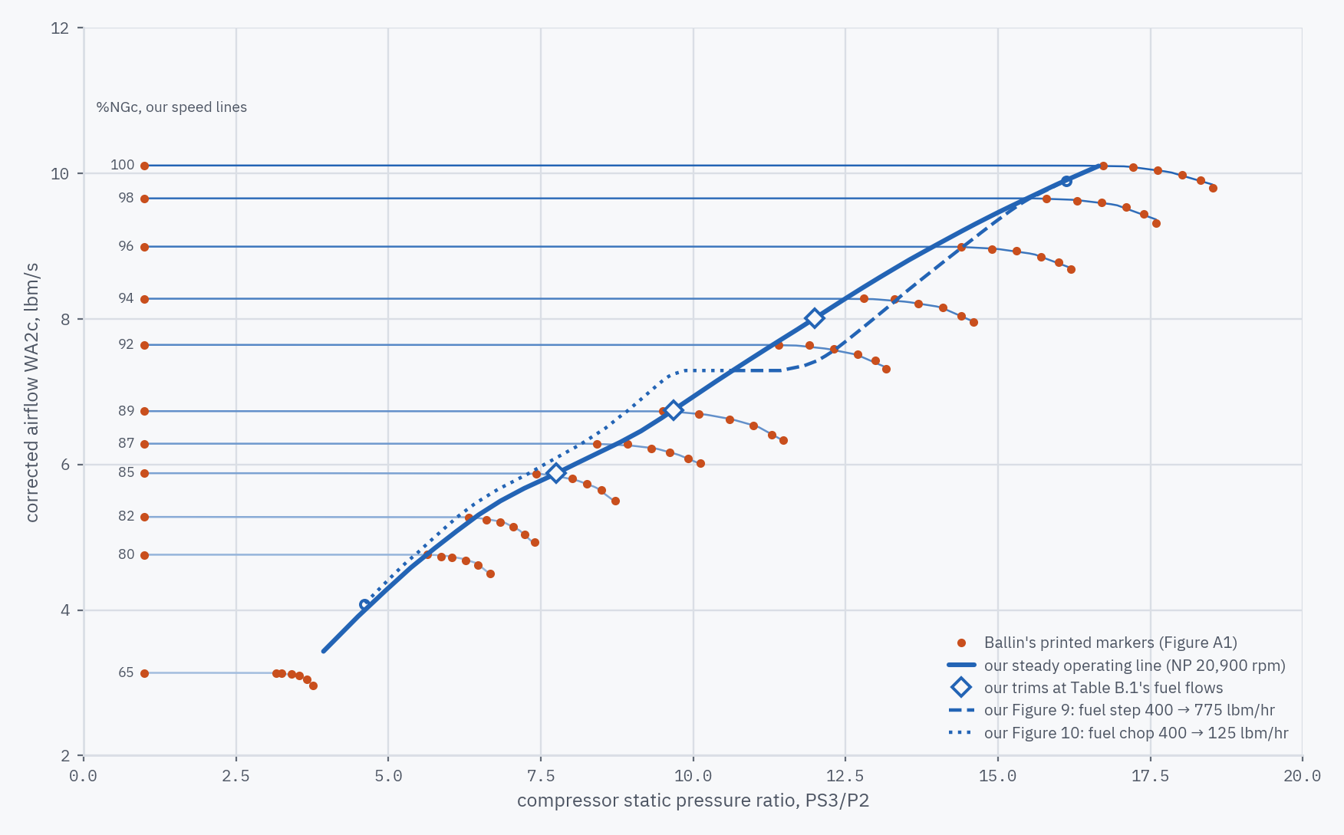
5 · HOW CLOSELY IT MATCHES
The same runs on Ballin's compressor map
Steady operating line at NP 20,900 rpm, 68–100 %NGc, across the knees of the speed lines. Diamonds: our trims at Table B.1's fuel flows. Orange dots: Ballin's printed map points; everything blue is ours.
Fuel step (Figure 9): the path swings toward the high-pressure-ratio end of the speed lines, as an acceleration does, and stays inside the drawn lines.
Fuel chop (Figure 10): toward lower pressure ratio.
Neither leaves the compressor map. The turbine maps are where they run off the data: f7, f9 on the step, f8 on the chop.
Below 80 %NGc Figure A1 has only the 65 % line: the model interpolates across a 15-point gap.
No surge line: “No modeling of compressor surge … was attempted” in the NASA Lewis model the report builds on [pdf p.20], and Figure A1 draws none.
Figure A1, pdf p.56; Table B.1, pdf p.67; Figures 9–10, pdf pp.45–46; pdf p.20
Replicating NASA TM-100991 · T700-GE-700 real-time engine model
43
Notes:
PS3/P2 is the compressor static pressure ratio Figure A1 uses; at sea-level standard WA2c equals WA2. The paths are the same 7 ms open-loop runs as Figures 9-10, NP held. 'Runs off the data' is measured by the model's map clamp counter: a read outside a table's printed range is counted, never silently extrapolated. Drawn by our model when the deck is built.

Slide 44
5 · HOW CLOSELY IT MATCHES
Figures 11–15: the choices made where the report is silent
Question (the report is silent) | Our choice, confirmed | Why
How to run without Gen Hel | two tests: his rotor speed imposed as our NP, or our rotor free under his torque | “a rigid-shaft drive train model” [pdf p.47]: everything the airframe does reaches the engine through it, except the collective
The flight-test day | a standard day | at his NG our engine burns 1.18–1.23× his fuel, so his day was not standard: fuel and torque are compared in % of trim
Where each run starts | his printed NG and rotor speed | the two engine states his panels print directly
The starting collective | what our fuel control needs to burn our trim fuel | the report prints no collective in our control's unit
Collective, inches to % of maximum (Figures 11, 13) | proportional, 0 in. = 0 %: 8.8 and 9.6 % per inch | our control reads “percent of maximum” [pdf p.81] and his axis starts at 0 in.; the line through both trims would give 13.5 % per inch, and across that range Figure 13's torque rms moves from 1.7 to 10.0 % of trim
Load slope at 55, 87, 90 kt | Appendix B's level 80 kt slope | the nearest printed trim; hover cases take the hover slope
Figure 15's trim power (no NG printed) | his main-rotor torque on our scale | the mean ratio of his torque to ours at Figures 11–14's trims; tail rotor and accessories in proportion
Figure 15's full-down collective | 0 % of maximum | “the full-down position” [pdf p.50]; his trace's floor, where it runs on the frame
Decision log #81; pdf pp.47–52, 81, 90
Replicating NASA TM-100991 · T700-GE-700 real-time engine model
44
Notes:
Each choice is ours, made where the report prints nothing, logged as decision log #81 and confirmed by the project owner. The collective scale is the one that moves Figure 13 most: its settled torque is 3 % low at our proportional reading, and would match at a scale a little below 8.8 % per inch, the bottom of the 8.8–13.5 % per inch range our readings span.

Slide 45
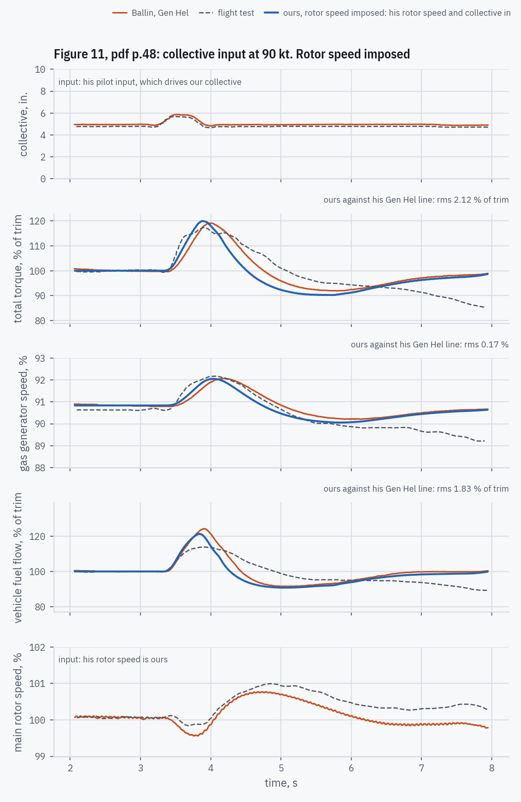
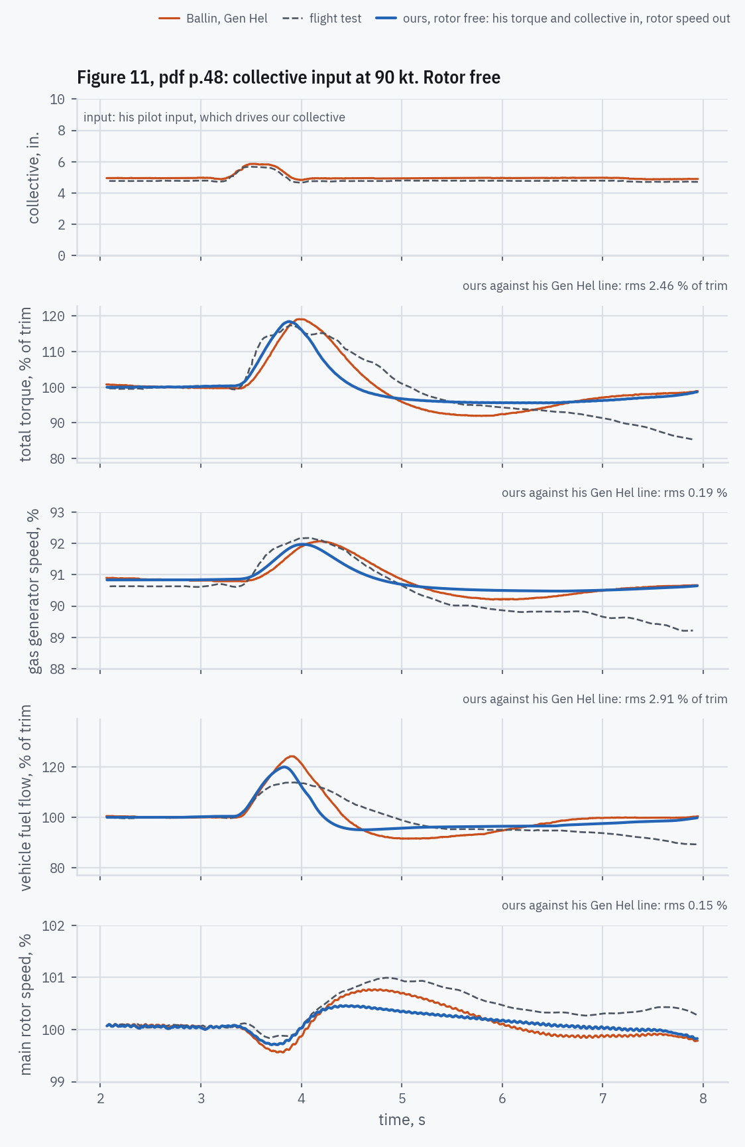
5 · HOW CLOSELY IT MATCHES
Figure 11: collective input at 90 kt
Left, rotor speed imposed: his rotor speed is ours; we predict torque, NG and fuel. Right, rotor free: his torque is our rotor's load; we predict the rotor speed too.
Where ours misses his, and why
Our fuel turns back sooner. It peaks at 121 % of trim at 3.84 s, his at 124 % at 3.92 s, and is back under 110 % at 4.09 s against his 4.23 s. Why: in our control his collective reaches the fuel through the HMU's load-demand path (Fig. C17, pdf p.91), so ours follows his collective back down at once. NG and torque follow our fuel.
Rotor free: with less torque as the collective comes back, our rotor overspeeds less, 100.46 % against his 100.77 %. Overspeeding less, our governor then cuts less, so our rotor ends a little above his.
Figure 11, pdf p.48; drive train pdf p.47; decision log #81
Replicating NASA TM-100991 · T700-GE-700 real-time engine model
45
Notes:
His lines go into our closed loop as digitized: the 17 Hz ripple in his rotor speed and every kink included, nothing smoothed. Rotor free integrates rather than differentiates: our rotor speed is his plus what the difference between our engine torque and his accelerates through the rotor's inertia (Appendix B, decision log #6). Every cause named here was measured inside our fuel control during the run (its load-demand term, governor trim and limits), with no constant changed. Fuel and torque are in % of their own trim, because his day was not standard (decision log #82).

Slide 46
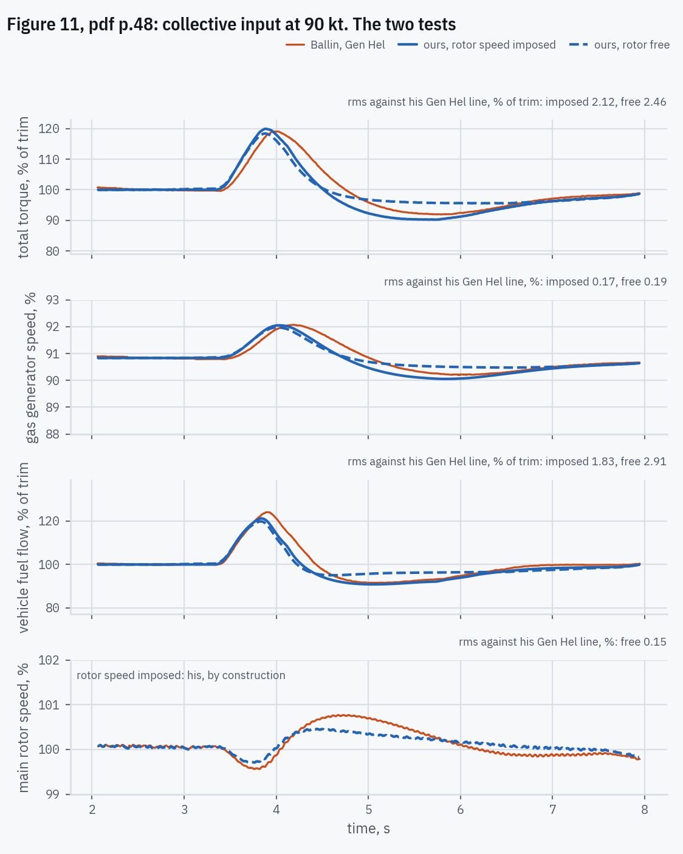
5 · HOW CLOSELY IT MATCHES
Figure 11: the two tests side by side
Rotor speed imposed pins his rotor speed, so a miss shows in our torque and fuel. Rotor free pins his load instead: once settled our torque must carry it, and the miss moves into our rotor speed.
Where the two methods agree, where they part, and why
The pulse itself: both follow the collective up and back together.
After it: they part most at 5.5 s, rotor free 5.5 % of trim above in torque. With his rotor speed imposed, our governor sees his overspeed and cuts; free, our rotor overspeeds less and the governor cuts less. His line lies between.
Settled at 7.6 s: torque 97.5 and 97.4 % of trim against his 98.2.
Figure 11, pdf p.48; decision log #81. Backup slide, hidden in the show
Replicating NASA TM-100991 · T700-GE-700 real-time engine model
46
Notes:
Orange: Ballin's Gen Hel line. Blue solid: ours with his rotor speed imposed. Blue dashed: ours with the rotor free under his torque. The flight test is left out here; it is on the slide before.

Slide 47
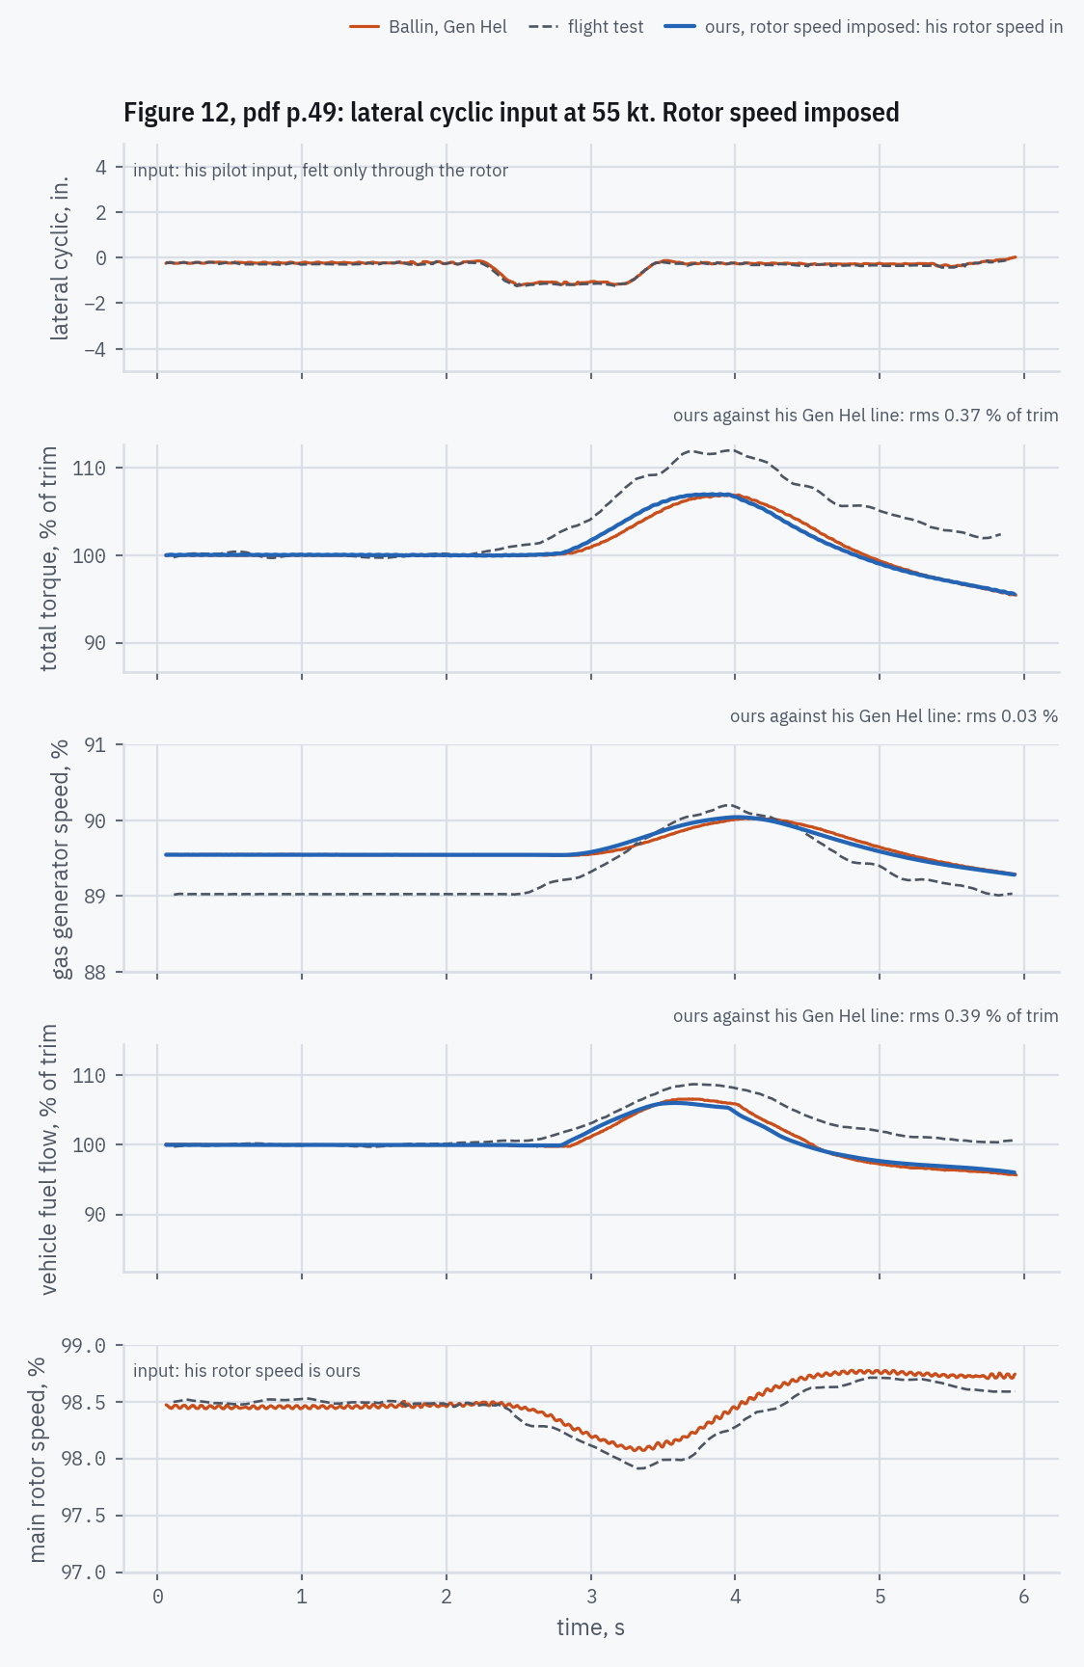
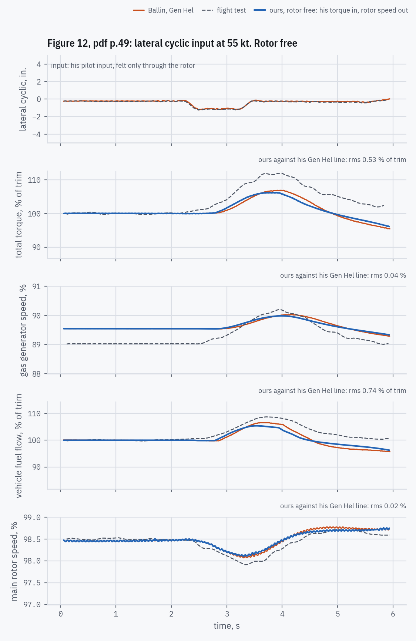
5 · HOW CLOSELY IT MATCHES
Figure 12: lateral cyclic input at 55 kt
Left, rotor speed imposed: his rotor speed is ours; we predict torque, NG and fuel. Right, rotor free: his torque is our rotor's load; we predict the rotor speed too.
Where ours misses his, and why
No miss beyond a few tenths. Rotor speed within 0.024 % rms; fuel within 0.4 % of trim (rotor speed imposed) and 0.7 % (rotor free).
His lateral cyclic reaches the engine only through the rotor: the flight-test inputs are “single-axis” [pdf p.47], so the collective stays put.
Figure 12, pdf p.49; drive train pdf p.47; decision log #81
Replicating NASA TM-100991 · T700-GE-700 real-time engine model
47
Notes:
His lines go into our closed loop as digitized: the 17 Hz ripple in his rotor speed and every kink included, nothing smoothed. Rotor free integrates rather than differentiates: our rotor speed is his plus what the difference between our engine torque and his accelerates through the rotor's inertia (Appendix B, decision log #6). Every cause named here was measured inside our fuel control during the run (its load-demand term, governor trim and limits), with no constant changed. Fuel and torque are in % of their own trim, because his day was not standard (decision log #82).

Slide 48
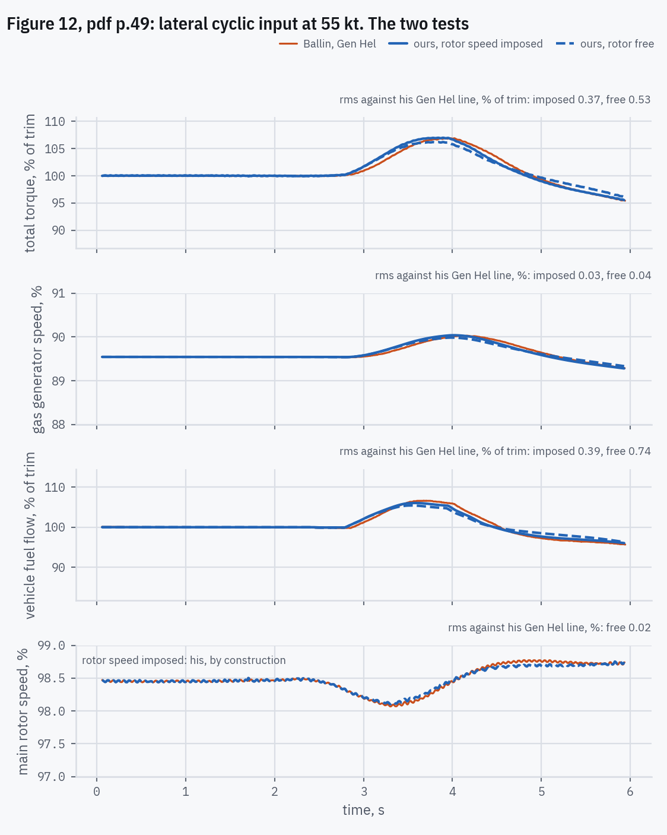
5 · HOW CLOSELY IT MATCHES
Figure 12: the two tests side by side
Rotor speed imposed pins his rotor speed, so a miss shows in our torque and fuel. Rotor free pins his load instead: once settled our torque must carry it, and the miss moves into our rotor speed.
Where the two methods agree, where they part, and why
The two agree: 0.44 % of trim apart in torque, 0.03 % in NG, rms. A lateral cyclic input barely loads the engine, and either way our engine and fuel control answer as his do.
Figure 12, pdf p.49; decision log #81. Backup slide, hidden in the show
Replicating NASA TM-100991 · T700-GE-700 real-time engine model
48
Notes:
Orange: Ballin's Gen Hel line. Blue solid: ours with his rotor speed imposed. Blue dashed: ours with the rotor free under his torque. The flight test is left out here; it is on the slide before.

Slide 49
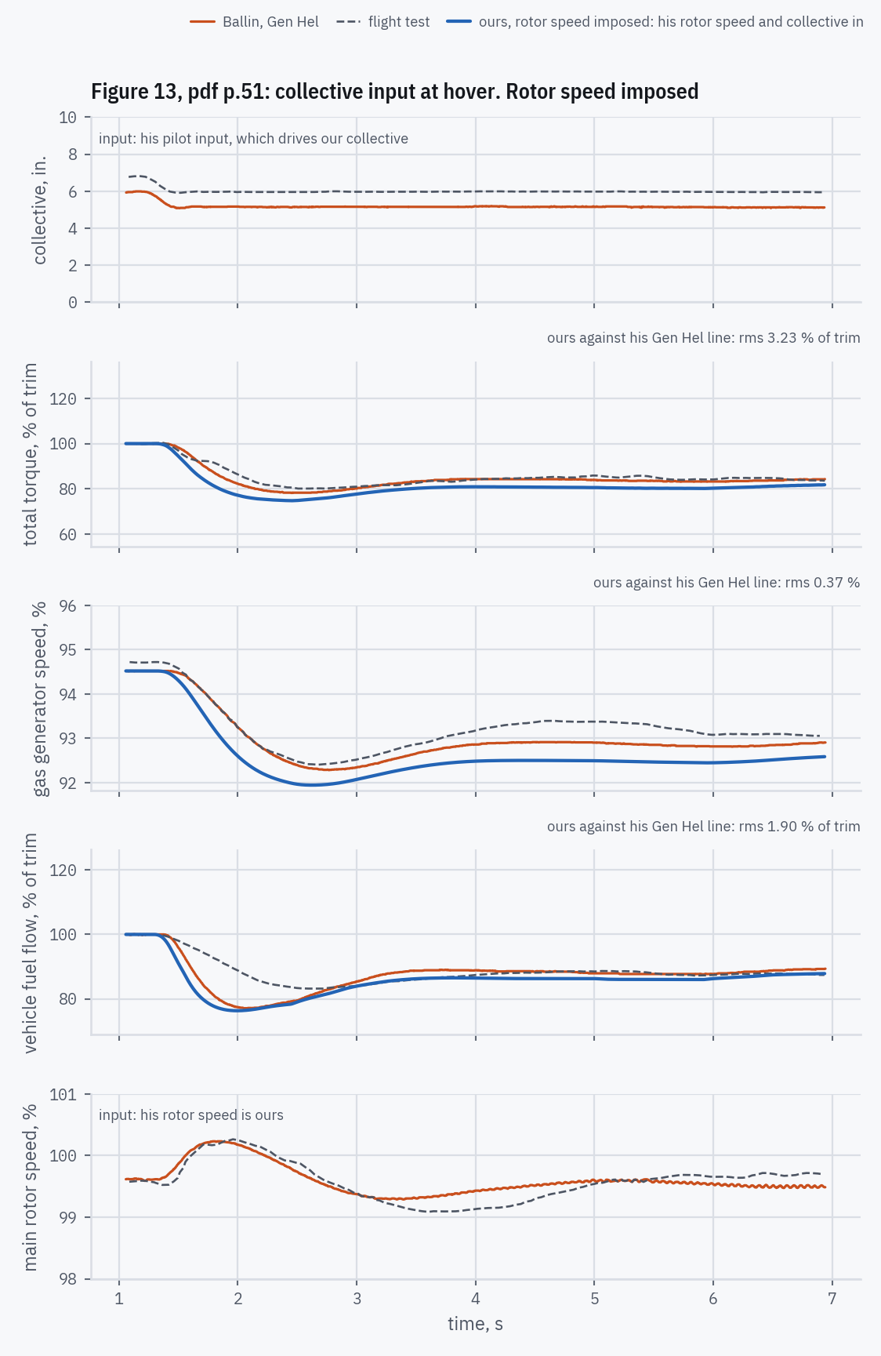
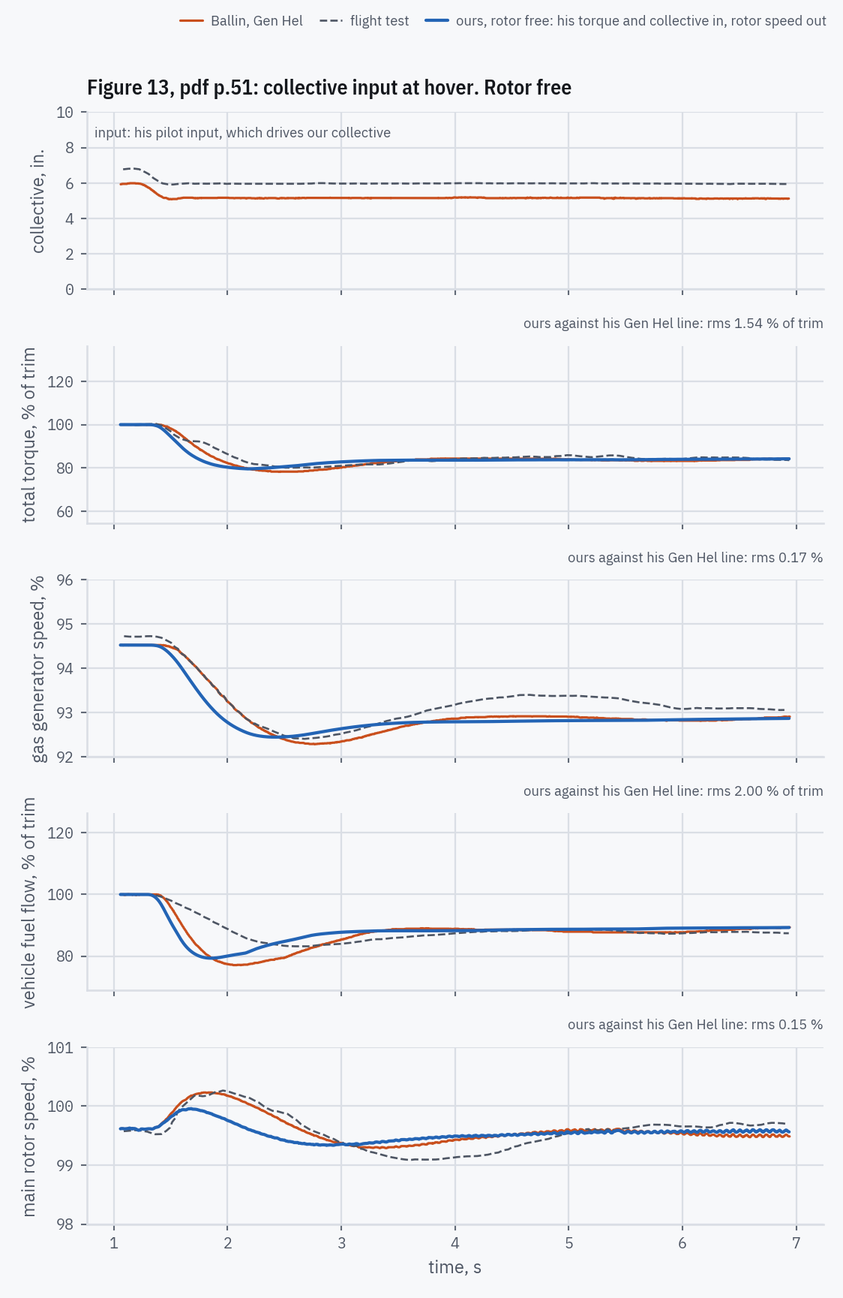
5 · HOW CLOSELY IT MATCHES
Figure 13: collective input at hover
Left, rotor speed imposed: his rotor speed is ours; we predict torque, NG and fuel. Right, rotor free: his torque is our rotor's load; we predict the rotor speed too.
Where ours misses his, and why
Our fuel falls sooner, under 97 % of trim at 1.41 s against his 1.48 s, through the same load-demand path as on Figure 11.
Rotor speed imposed: our torque settles 3 % of trim low: at 6 s, 80.3 % against his 83.2. Why: the collective's inch-to-percent scale is not printed. At our proportional reading, 9.6 % per inch, our collective cuts too much; at 8.0 % per inch ours reads 84.0 %. His lies between, so the scale that matches is a little below 8.8 % per inch, the bottom of the range our readings span.
Rotor free: our rotor overspeeds less, 99.96 % against his 100.23 %, because our fuel falls sooner.
Figure 13, pdf p.51; drive train pdf p.47; decision log #81
Replicating NASA TM-100991 · T700-GE-700 real-time engine model
49
Notes:
His lines go into our closed loop as digitized: the 17 Hz ripple in his rotor speed and every kink included, nothing smoothed. Rotor free integrates rather than differentiates: our rotor speed is his plus what the difference between our engine torque and his accelerates through the rotor's inertia (Appendix B, decision log #6). Every cause named here was measured inside our fuel control during the run (its load-demand term, governor trim and limits), with no constant changed. Fuel and torque are in % of their own trim, because his day was not standard (decision log #82).

Slide 50
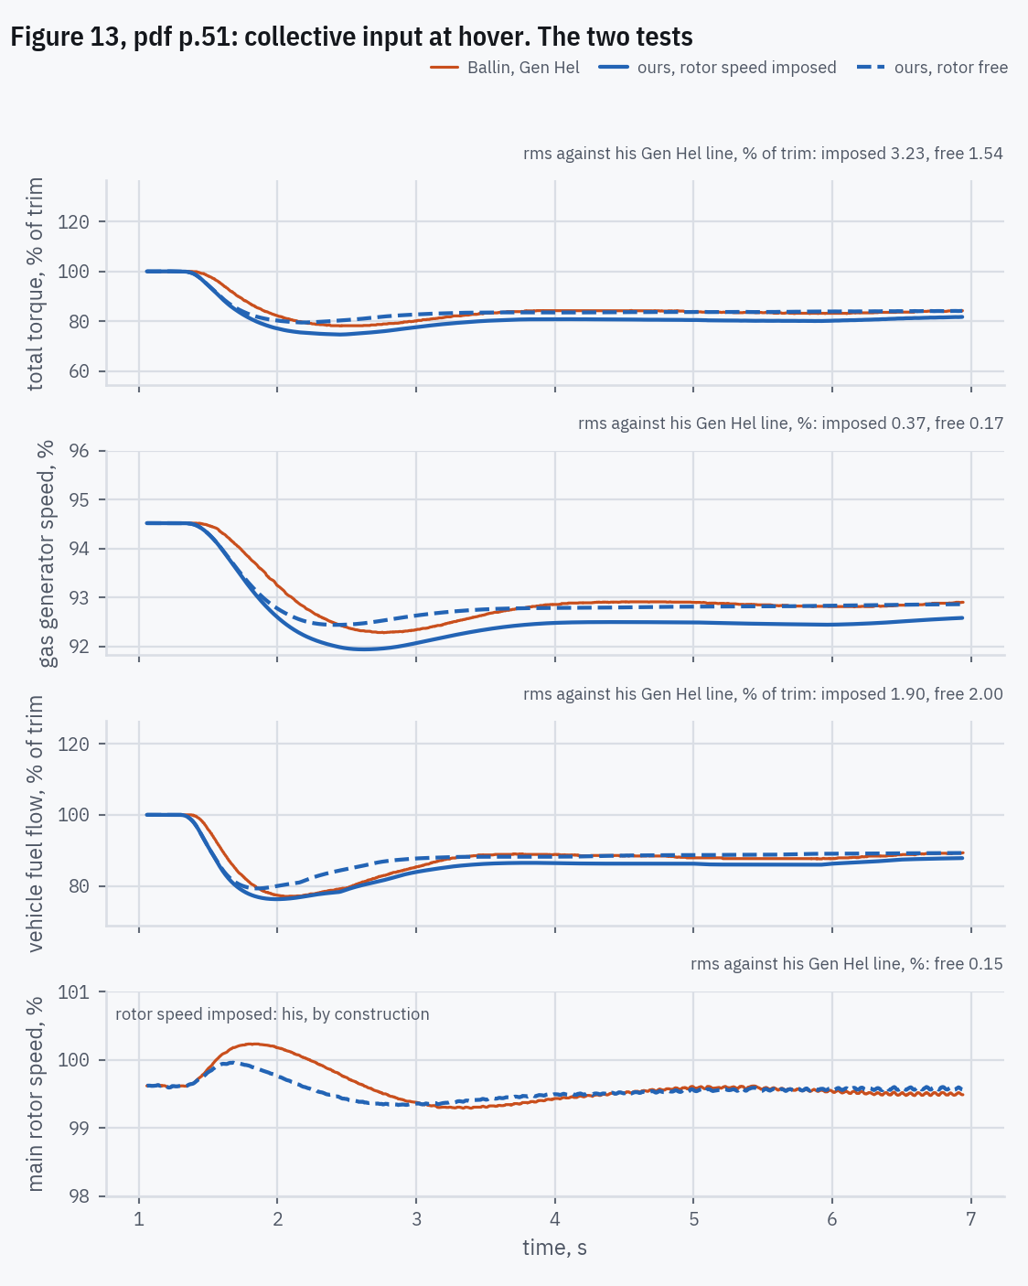
5 · HOW CLOSELY IT MATCHES
Figure 13: the two tests side by side
Rotor speed imposed pins his rotor speed, so a miss shows in our torque and fuel. Rotor free pins his load instead: once settled our torque must carry it, and the miss moves into our rotor speed.
Where the two methods agree, where they part, and why
Just after the input: they part most at 2.7 s, rotor free 5.9 % of trim above in torque. Free, our rotor overspeeds less, because our fuel falls sooner, so the governor cuts less.
Settled at 6.6 s: rotor free carries his torque, 84.1 % of trim against his 84.0, because his load sets it. With rotor speed imposed it is 81.4: there the collective's unprinted scale sets it (previous slide).
Figure 13, pdf p.51; decision log #81. Backup slide, hidden in the show
Replicating NASA TM-100991 · T700-GE-700 real-time engine model
50
Notes:
Orange: Ballin's Gen Hel line. Blue solid: ours with his rotor speed imposed. Blue dashed: ours with the rotor free under his torque. The flight test is left out here; it is on the slide before.

Slide 51
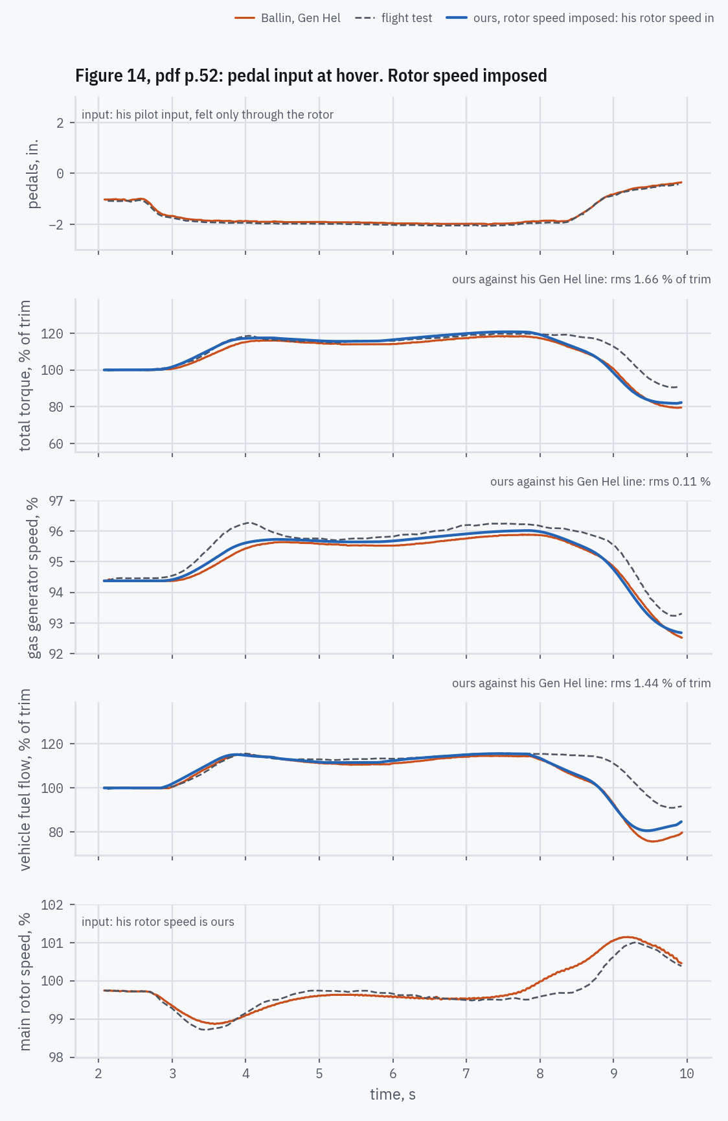
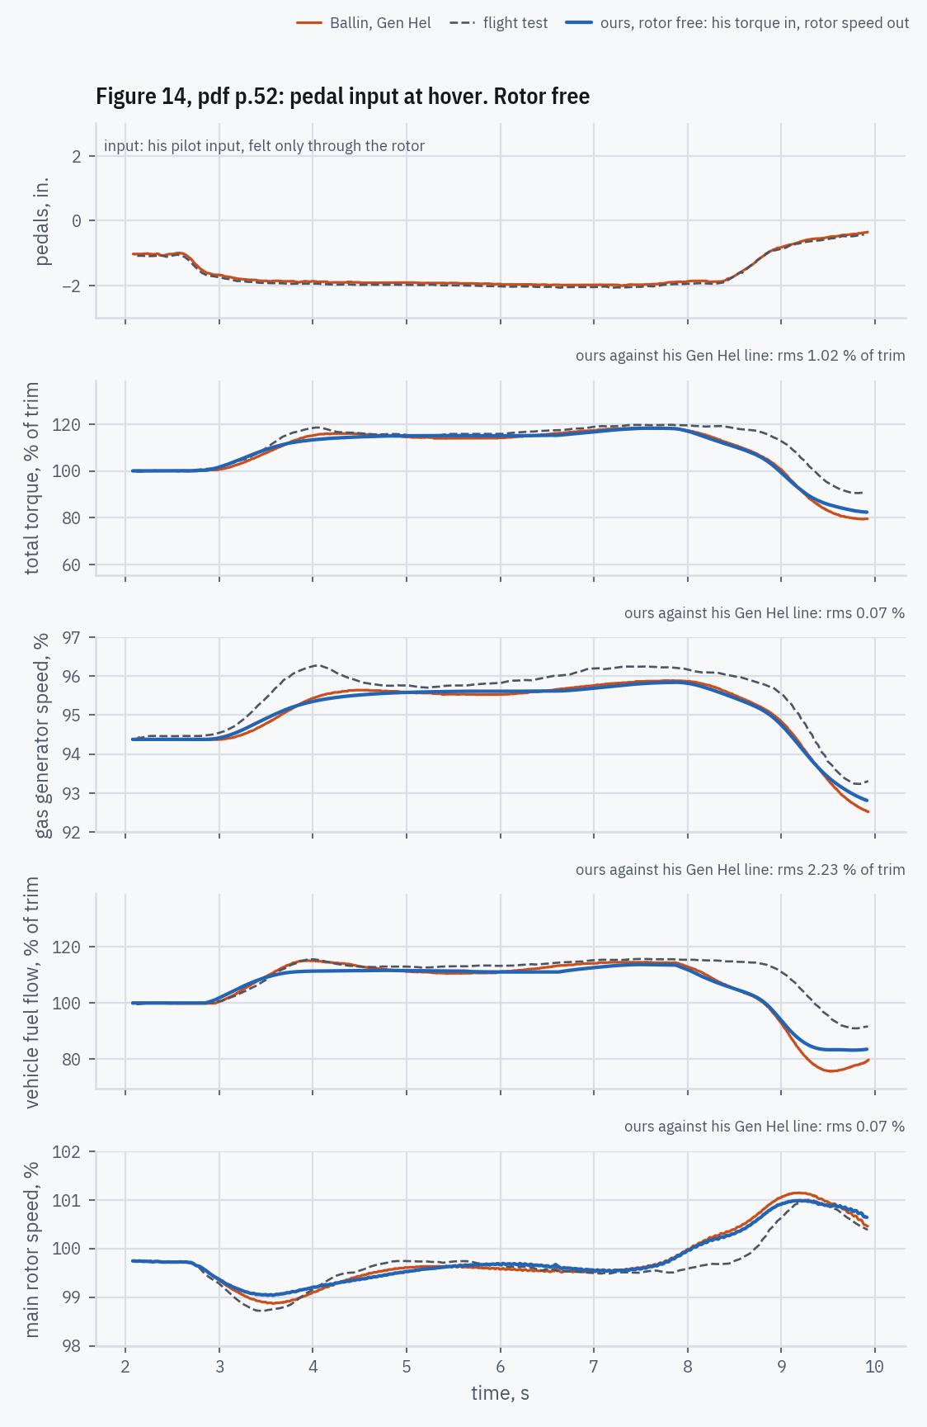
5 · HOW CLOSELY IT MATCHES
Figure 14: pedal input at hover
Left, rotor speed imposed: his rotor speed is ours; we predict torque, NG and fuel. Right, rotor free: his torque is our rotor's load; we predict the rotor speed too.
Where ours misses his, and why
Both tests follow him closely until the end.
At the end his fuel bottoms at 76 % of trim, ours at 81 % (rotor speed imposed). As his rotor overshoots, our ECU cuts fuel, but as NG falls the HMU's droop gives part of it back. His deeper cut cannot be traced: his control's internals are not printed.
Figure 14, pdf p.52; drive train pdf p.47; decision log #81
Replicating NASA TM-100991 · T700-GE-700 real-time engine model
51
Notes:
His lines go into our closed loop as digitized: the 17 Hz ripple in his rotor speed and every kink included, nothing smoothed. Rotor free integrates rather than differentiates: our rotor speed is his plus what the difference between our engine torque and his accelerates through the rotor's inertia (Appendix B, decision log #6). Every cause named here was measured inside our fuel control during the run (its load-demand term, governor trim and limits), with no constant changed. Fuel and torque are in % of their own trim, because his day was not standard (decision log #82).

Slide 52
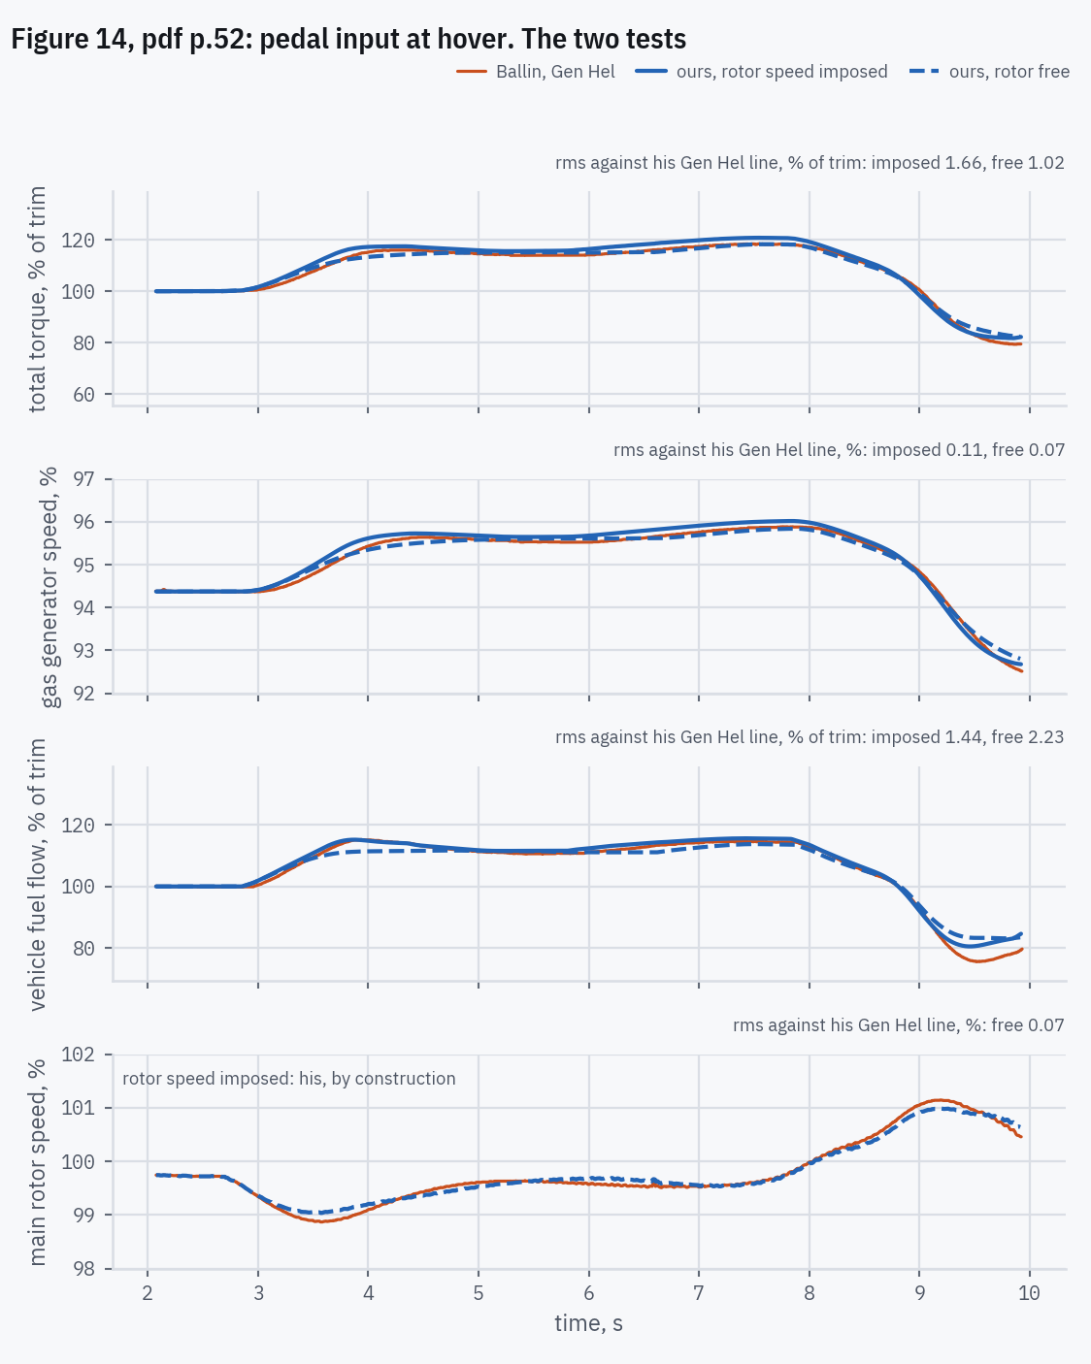
5 · HOW CLOSELY IT MATCHES
Figure 14: the two tests side by side
Rotor speed imposed pins his rotor speed, so a miss shows in our torque and fuel. Rotor free pins his load instead: once settled our torque must carry it, and the miss moves into our rotor speed.
Where the two methods agree, where they part, and why
As the pedals go in: they part most at 3.9 s, rotor free 4.0 % of trim below in torque. Free, our rotor dips less than his, so the governor asks for less.
At 9.6 s, the last reading, both sit above his fuel: 81.5 and 83.4 % of trim against his 76.1.
Figure 14, pdf p.52; decision log #81. Backup slide, hidden in the show
Replicating NASA TM-100991 · T700-GE-700 real-time engine model
52
Notes:
Orange: Ballin's Gen Hel line. Blue solid: ours with his rotor speed imposed. Blue dashed: ours with the rotor free under his torque. The flight test is left out here; it is on the slide before.

Slide 53
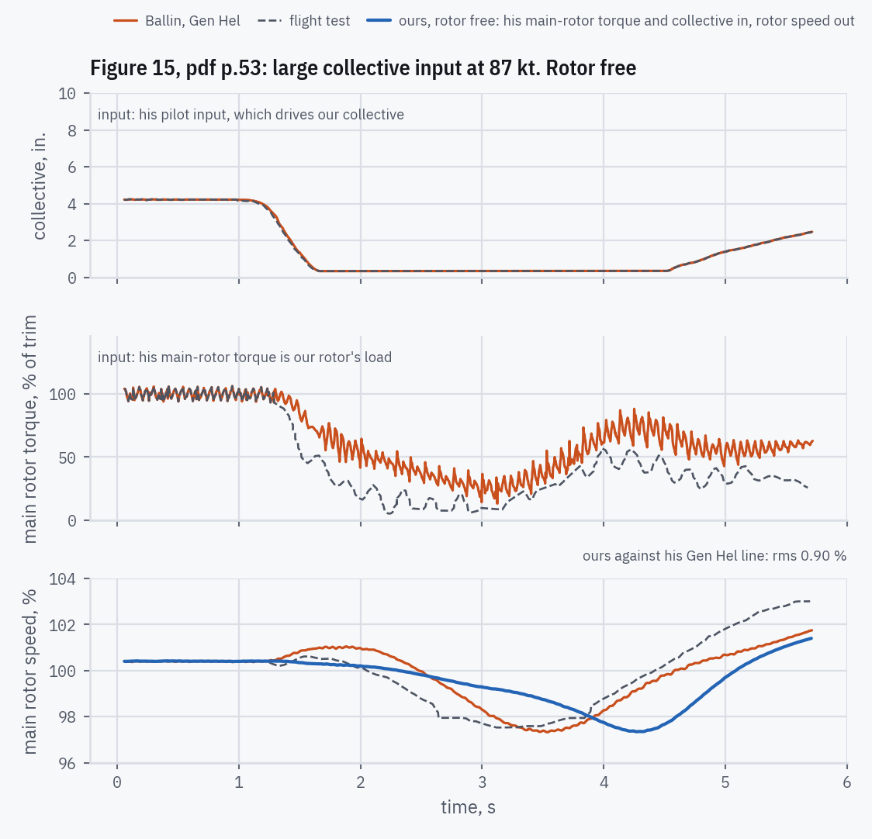
5 · HOW CLOSELY IT MATCHES
Figure 15: large collective input at 87 kt
Rotor free: his main-rotor torque is our rotor's load and his collective drives ours; our rotor makes its own speed.
Where ours misses his, and why
Only rotor free: Figure 15 prints no NG, fuel or engine torque, so with his rotor speed imposed there would be nothing of his to compare.
Ours does not overspeed. His rotor rises to 101.05 % at 1.89 s. Our fuel falls with the collective at once, then sits on the deceleration limit (Fig. C22, pdf p.93) from 1.5 to 2.7 s.
Our dip comes later. On that limit our engine still gives torque, so our rotor slows at 1.0 %/s against his 3.2 %/s and reaches its low, 97.3 %, at 4.27 s against his 97.3 % at 3.53 s.
A recorded finding (decision log #81): a flat line at the trim misses his rotor speed by 1.34 %, ours by 0.90 %: 1.49 times better, just short of the 1.5× our check asks to show that his inputs, not the trim, drive the result. Our dip is as deep as his, but 0.74 s late.
Figure 15, pdf p.53; drive train pdf p.47; decision log #81
Replicating NASA TM-100991 · T700-GE-700 real-time engine model
53
Notes:
His lines go into our closed loop as digitized: the 17 Hz ripple in his rotor speed and every kink included, nothing smoothed. Rotor free integrates rather than differentiates: our rotor speed is his plus what the difference between our engine torque and his accelerates through the rotor's inertia (Appendix B, decision log #6). Every cause named here was measured inside our fuel control during the run (its load-demand term, governor trim and limits), with no constant changed. Fuel and torque are in % of their own trim, because his day was not standard (decision log #82).

Slide 54
5 · HOW CLOSELY IT MATCHES
Figures 11–14: what day did they fly? Two readings, as evidence
 | Standard day (used) | A: 59 °F every day | B: one common temperature
Temperature | 59 °F | 59 °F | 79 °F
Pressure, psia (altitude, 1000 ft) | 14.7 (0) | 11.9–12.3 (4.8–5.8) | 13.0–13.3 (2.7–3.3)
Gearbox ratio implied | — | 81.7 | 89.0
His 8 trim numbers, rms miss | about 20 % | 0.64 % | 0.08 %
Rotor free, rotor speed rms, Fig 11 / 12 / 13 / 14 | 0.150 / 0.024 / 0.154 / 0.072 | 0.119 / 0.018 / 0.126 / 0.059 | 0.113 / 0.017 / 0.161 / 0.059
His trims print fuel and torque at his NG. On a standard day our engine needs about a fifth more of both, on every figure: most of the gap is air pressure.
Eight numbers, nine unknowns (a pressure and a temperature per figure, one gearbox ratio), so one assumption each: A fixes the temperature, B makes it common. B fits the trims eight times closer; A improves the transients a little more.
Decided: the comparisons stay on a standard day, in % of trim. These two readings are evidence about his boundary conditions, not constants of the model.
pdf pp.47–52, 67; decision log #82
Replicating NASA TM-100991 · T700-GE-700 real-time engine model
54
Notes:
Fit by least squares on our trims at his NG: his fuel directly, his torque through one ratio for all four figures (validation/test_flight_test_day.py). These are estimates of his boundary conditions, never constants of the model. Decision log #82 closes on a standard day.

Slide 55
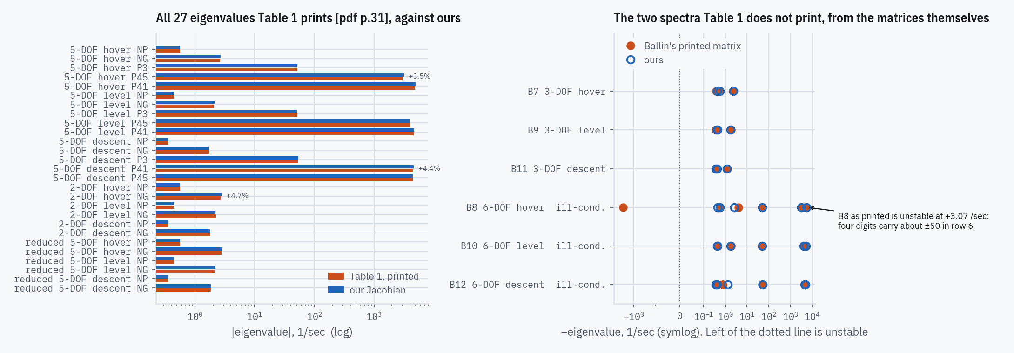
5 · HOW CLOSELY IT MATCHES
Table 1: every printed eigenvalue
18 tested eigenvalues (left; NG, P3, P41, P45 modes of the 5-DOF, 2-DOF and reduced 5-DOF): rms 2.37 %, worst +4.7 % (2-DOF NG mode, hover). The 9 NP values are supplied (slide 33) and agree by construction.
2-DOF and reduced 5-DOF would be one model with exact slopes; at the ±2 % step they part, Ballin's own by up to 4.3 %, ours by up to 3.5 %.
Right: the 3-DOF and 6-DOF spectra, which Table 1 omits, against Ballin's own printed matrices.
Table 1, pdf p.31; Appendix B, pdf pp.68–76
Replicating NASA TM-100991 · T700-GE-700 real-time engine model
55
Notes:
Worst row: 2-DOF hover NG: printed −2.69, ours −2.816. Table 1's descent P41/P45 labels disagree with B6; that is on the misprints slide (62). 2-DOF against reduced 5-DOF: decision log #49. The NG mode, the one a pilot feels, matches within 1.5 % (5-DOF), 4.7 % (2-DOF) and 2.1 % (reduced 5-DOF) at the three trims (decision log #49). The 6-DOF matrices cannot be compared by eigenvalue: row 6 differences large terms, so the printed rounding makes B8 look unstable; they are compared element by element instead.

Slide 56
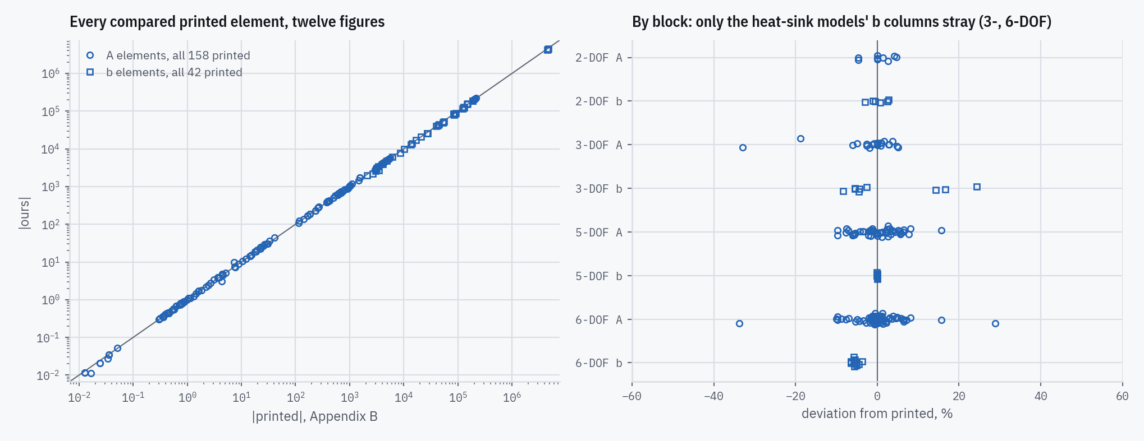
5 · HOW CLOSELY IT MATCHES
Appendix B: every printed matrix element
Block | n | mean % | rms % | worst %
2-DOF A | 6 | +0.58 | 3.88 | −4.7
2-DOF b | 6 | +0.24 | 2.02 | −2.9
3-DOF A | 18 | −2.67 | 9.45 | −33.0
3-DOF b | 9 | +2.73 | 11.77 | +24.3
5-DOF A | 51 | −0.10 | 5.05 | +15.7
5-DOF b | 11 | −0.02 | 0.08 | −0.1
6-DOF A | 71 | −0.09 | 6.71 | −33.7
6-DOF b | 15 | −5.44 | 5.48 | −6.4
No digitizing, no read error: the linearized model term by term against printed numbers, over eight decades.
187 elements tested: 79 within 2 %, 128 within 5 %, 9 beyond 10 % (next slide). 13 are supplied, not tested: the NP diagonal and the 5-DOF hover b(NP), which set the load.
5-DOF fuel column: 0.08 % rms. With the heat sink (6-DOF) the same column runs uniformly low, −5.4 %. Appendix B was generated with a different heat-sink constant (Part 6): with its time constants, the NG, NP, P41 and P45 rows land within 0.2 %, and b(T41) moves to +5.5 to +6.6 %.
Appendix B, pdf pp.68–76
Replicating NASA TM-100991 · T700-GE-700 real-time engine model
56
Notes:
The table counts tested elements only. With the heat-sink time constants Appendix B implies, four of the five printed rows of the 6-DOF fuel column match within 0.2 % at all three trims; b(T41) goes from −5.8…−3.7 % to +5.5…+6.6 %, so the constant explains the uniform offset but not that element (decision log #31). The 3-DOF fuel column is the same constant's: next slide. The largest misses are on the next slide; the descent A(T41,NG) miss once logged against the compressor map (#73) is mostly the heat-sink constant (#31).

Slide 57
5 · HOW CLOSELY IT MATCHES
The largest Appendix B misses, and their causes
Of 187 tested elements, 9 miss by more than 10 %, for three reasons. None of them involves the load.
Elements | Miss | Cause | Check
3-DOF T41 row: b(T41) at all three trims, A(T41,NG) at level and descent (5) | 14–33 % | Appendix B was generated with heat-sink constant TC_{T41} ≈ 0.32; the report prints 0.29, and its transients fit 0.29 (Part 6) | With Appendix B's own time constants: b(T41) 2–6 %, A(T41,NG) 5 and 7 %
6-DOF A(P45,P3), level and descent (2) | 29–34 % | A small remainder of cancelling terms: B10 and B12 print −4.315 and −7.397, where the 5-DOF prints −255.1 and −261.9 | Ours collapses the same way: −3.1 and −9.9
A(NP,NG) at hover, one value printed in B2 and B8 (2) | 16 % | A tiny element that changes sign across the trims (−0.02444, 0.01283, 0.03555): a small miss is a large percentage | The miss is 0.004 /s, in a row whose pressure terms are tens to hundreds
The load enters only the NP row, and the one NP-row element here, A(NP,NG), is an engine torque derivative: the load does not depend on NG.
Supplied, not tested: the 13 elements that set the load (slide 33).
Appendix B, pdf pp.68–76; Table A.1 (TC_T41), pdf p.55; Eqs. 51–53, pdf p.26
Replicating NASA TM-100991 · T700-GE-700 real-time engine model
57
Notes:
Hover A(T41,NG) goes the other way under Appendix B's time constants (0.8 → 13.2 %): that element is built through the NG column and also carries the compressor-map slope. The 6-DOF A(P45,P3) is excluded from the project's bounds for the cancellation reason. Decision log #31, #73. The build fails if a new miss beyond 10 % has no recorded cause.

Slide 58
5 · HOW CLOSELY IT MATCHES
Why slopes agree less well than levels
Levels: the trims match Table B.1 to 0.22 % rms. Slopes: Table 1 to 2.37 % rms, Appendix B's elements to 6.5 %.
A linear model is a table of map slopes. Every map is read to about a tenth of a percent of its span, but a slope differences two readings close together, and it jumps at each breakpoint of a piecewise-linear table.
The step matters most. Ballin's ±2 % is an amplitude: it averages across the tables' kinks. Using it as he did is what brings Table 1 to 2.4 %.
Which compressor table is used barely matters for Table 1: our traced lines and Ballin's seven-point table agree to a tenth of a point.
How the slopes are taken | rms | worst
Ballin's ±2 % step, our traced compressor lines (as built) | 2.37 % | 4.7 %
The same, with Ballin's seven-point compressor table | 2.34 % | 4.4 %
A tiny step (10⁻⁵) instead of ±2 % | 6.62 % | 14.9 %
Smooth curves instead of straight lines between the same printed points* | 5.85 % | 16.1 %
The 18 tested Table 1 eigenvalues. *Decision log #43, measured 2026-10-12 over all 27 modes, when straight lines gave 1.75 %.
Method pdf p.28; decision log #43, #56, #60
Replicating NASA TM-100991 · T700-GE-700 real-time engine model
58
Notes:
Every row but the last is computed by our model when the deck is built. The tangent step is what an analyst would normally use for a Jacobian; Ballin's 'plus or minus two percent of equilibruim [sic] conditions ... considered to be adequate based on the rotor speed deviations' [pdf p.28] is an amplitude matched to real excursions (decision log #56). Interpolation: linear is what the report's own numbers show (#43). The compressor-table choice is the open question #60.

Slide 59
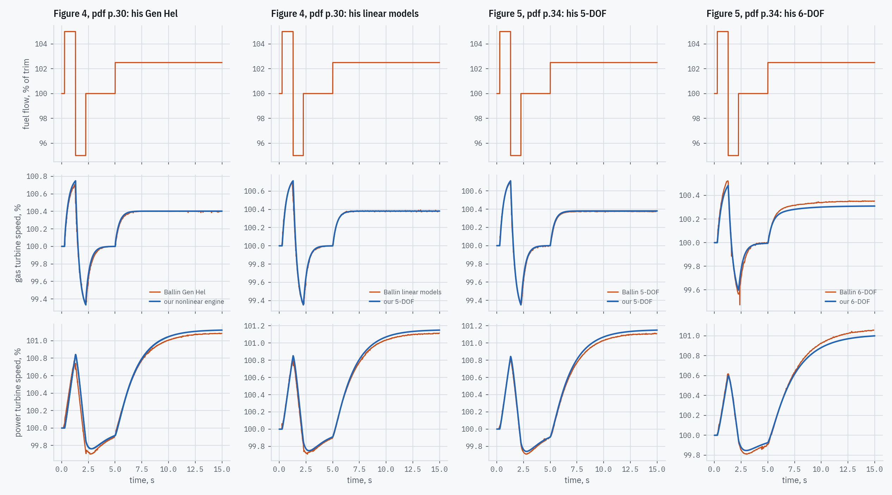
5 · HOW CLOSELY IT MATCHES
Figures 4–5: Ballin's linear-model curves against ours
Ballin's curve | Ours | NG / NP
Fig 5: 5-DOF | 5-DOF | 0.005 / 0.028
Fig 5: 6-DOF | 6-DOF | 0.030 / 0.033
Fig 4: Gen Hel | nonlinear | 0.008 / 0.045
Fig 4: linear | 5-DOF | 0.005 / 0.025
Fig 4: linear | 2-DOF | 0.012 / 0.011
Fig 4: linear | reduced | 0.005 / 0.026
rms difference, % of trim
Figure 5: our 5-DOF lies on his 5-DOF; our 6-DOF follows his 6-DOF, slightly more damped.
Figure 4: his three linear models lie on one another; his Gen Hel line parts from them. Our linear models follow his linear line.
In NP his Gen Hel line leads and dips at each fuel step: rotor-blade lag, which the linear rotor load leaves out (pdf p.29). Our nonlinear engine carries the same linear rotor load, so in NP it follows his linear line (0.012 %).
His own printed hover matrices draw his curves (0.003 % on Figure 5's 5-DOF): the trim is hover.
Figures 4–5, pdf pp.30, 34; text pp.29, 33; Appendix B, pdf pp.68–70
Replicating NASA TM-100991 · T700-GE-700 real-time engine model
59
Notes:
Input: +5 %, −5 %, back to trim, then +2.5 % fuel, read off his fuel panel; the plateaus sit on printed tick values. Figure 5's curves are separated from the ink: where both are inked and apart, the outer is the 5-DOF and the inner the 6-DOF, damped by the heat sink. Scores allow the figure's time read error, 0.03–0.04 s. The nonlinear run is our real-time engine at hover with Appendix B's inertia and load slope, heat sink off. His 6-DOF curve cannot be recomputed: B8 is unstable as printed. His two lines in each figure are told apart on the scan by following each by its own slope, started where they are farthest apart and labelled there by his own B2, and restarted at a fuel step where they touch (Figure 4's NP lines cross at the first peak); drawn back onto the page, every point sits on its own line. Appendix B's own heat-sink constants barely change our 6-DOF. Swapping the pairs scores 1.9–18 times worse, so the comparison can fail (decision log #31, #80). Figure 4's linear line against his B2: 0.006 / 0.009.

Slide 60
6 · FINDINGS, DECISIONS AND LIMITS
Values the report never prints, recovered from its own numbers
Heat-sink time constants τ₁, τ₂ (Eq. 63): printed nowhere. Each 3-DOF block of Appendix B fixes both: 2.080 / 3.099 s (hover), 2.200 / 3.413 s (level), 2.390 / 3.854 s (descent).
They need TC_{T41} ≈ 0.32, not the printed 0.29: Appendix B was generated with a different constant than the transient simulations. We keep the printed 0.29; the report's transients fit it better.
Load inertia and load slope (Eqs. 46–47): owned by the helicopter model. Recovered from Appendix B's NP rows: J_{load} = 9.25 × J_{PT}.
Standard day (Eqs. 5, 8): T_{std}, P_{std} never printed; 518.67 °R and 14.696 psia, consistent with Table B.1.
Power-turbine speed for each comparison: design speed, 20,900 rpm, for Figures 6–10; 20,895 rpm for Table B.1, Table 1 and Appendix B, as Table B.1 prints.
The fuel-step instants of Figures 9–10, read off the figures' own fuel panels.
Eq. 63, pdf p.31; Appendix B, pdf pp.68–76; Table A.1, pdf p.55
Replicating NASA TM-100991 · T700-GE-700 real-time engine model
60
Notes:
Decision log: τ1/τ2 and TC_T41 #31; load #6; standard day #15; NP per comparison #35, #36; step instants #37. The TC_T41 finding explains our 6-DOF fuel column running about 5 % low against Appendix B in four of its five rows; b(T41) does not follow (slide 56).

Slide 61
6 · FINDINGS, DECISIONS AND LIMITS
Problems in the printed method, found and handled
Eq. 80's P45 iteration cannot converge in a fuel chop. Its fixed point repels where f9's slope (in log terms) is steeper than −1. Below flight idle the frame then sat on false equilibria up to 7 %NG away from the true ones. We solve the same equation exactly, which takes one division.
The heat sink is what fixed the transient. Without it our T41 spike overshot 3.3 times as far as Ballin's. With the heat sink integrated as the metal temperature (Eqs. 48–49) it sits at 0.6–1.2 times his.
“±2 %” is an amplitude, not a derivative step. Using it as Ballin did took Table 1 from 6.6 % to 2.4 % rms.
Station 4.5 mixing does not conserve energy: Eq. 29 makes the mixed enthalpy a fixed fraction of H44 [pdf p.24]. The printed coefficient sits 1.1–1.7 % below an energy-conserving mix. Reproduced as printed.
The closed-loop limit cycle is the printed NG-sensor hysteresis, not a numerical artifact.
Eq. 80, pdf p.37; Eqs. 48–53, pdf pp.25–26; pdf p.28; Eq. 29, pdf p.24
Replicating NASA TM-100991 · T700-GE-700 real-time engine model
61
Notes:
Decision log: Eq. 80 #45, #57 (false equilibria between about 125 and 175 lbm/hr, up to 7.07 %NG); heat sink #47; ±2 % step #56 (rms over the 18 tested eigenvalues, as on the slopes slide); station 4.5 energy #52 (overall balance −1.52 % at hover, everything else closes to 1e-13); limit cycle #61.

Slide 62
6 · FINDINGS, DECISIONS AND LIMITS
Misprints, and how the report settles them
Where | As printed | What the rest of the report requires
Eq. 43 | fuel leaves the 4.1 volume (−W_{f}) | +W_{f}, as Eq. 73 prints the same balance
Eqs. 79–80 | B₃·B₄·WA2; the engine model has no B₄ | B₃·K_{bl}·WA2, as Eq. 44 writes it
Eq. 74 | lags only the bleed flow | the sentence above it lags the whole compressor flow; both coded, prose used
pdf p.32 | F2's sixth column labelled as another state | the column is with respect to T41
Table A.1 | units of TC_{T41} | Eq. 51 is right; the printed units are not
Fig. A10 | axis labelled PS9/P49 | the values are P49/Ps9, as Eq. 38 needs
Fig. A3 | the 0.11 tick label sits off its tick | the plateau is 0.1091; the label is the defect
Table 1 | descent modes P41 −4430, P45 −4530 | Figure B6, the same model and trim, has them the other way round; scored as printed
In each case the report itself decides the question; nothing is corrected from outside knowledge.
pdf pp.25–26, 31–32, 36–37, 55, 58, 65, 70
Replicating NASA TM-100991 · T700-GE-700 real-time engine model
62
Notes:
Decision log: Eq. 43 #29; B4 #30; Eq. 74 #22; p.32 label #76; TC_T41 units #4; Fig. A10 #5; Fig. A3 #42; Table 1 labels #78: B6's P45 column is zero in the P3 and P41 rows, so its P45 mode is its P45 diagonal, −4431; under B6's labels our descent P41/P45 would miss by +2.07/+0.34 % instead of +4.38/−1.87 %, so scoring as printed is harder on us. Also logged: Figure A6's axis reads 'FUEL-TO-RATIO' (#7) and p.38 prints 'GF' for 'GE' (#41). Appendix C does define a B4, an unrelated ECU switch in the NP loop (Fig. C3, pdf pp.77, 86).

Slide 63
6 · FINDINGS, DECISIONS AND LIMITS
Where we differ from the report: four departures
What | The report | We | What it changes
P45 solve (Eq. 80) | fixed-point iteration | the same iteration first; an exact solve where it cannot converge | only in a chop and below flight idle: removes false equilibria
Compressor map interpolation (f1) | seven printed points per speed line | each speed line traced from the drawn line; his table kept beside it | better on some comparisons, worse on others; kept by decision
Above the map's top line | the map ends at 100 %NG | f1 extends a tenth of a point above 100 % before it clamps | reaches Ballin's top points of Figures 6–8; nothing else moves
Limited integrators (Figs. C3, C7, C10) | an integrator and a separate limiter, which winds up | a clamped integrator, which does not | identical on everything printed; differs only in a sustained load dump
pdf pp.37, 39, 56, 86–89
Replicating NASA TM-100991 · T700-GE-700 real-time engine model
63
Notes:
Decision log: P45 #45, #57; compressor map #60 (kept open on purpose); top line #77; integrators #59. Each is measured: the model can run the printed alternative, so the cost of each departure is a number, not an opinion.

Slide 64
6 · FINDINGS, DECISIONS AND LIMITS
Where the report is silent or ambiguous, and what we chose
Question | Our choice | Why
Which runs used the heat sink | a switch; Figures 9–10 with it | the report says so only for its linear results; for 9–10 it is our inference
Order inside a frame (Q_{GT}'s P45) | the previous frame's P45 | Ballin's own Figure 9 fits it clearly better
Eq. 74's two readings | the prose: whole flow lagged | it is the sentence that describes opening the loop; both converge to the same trim
Combustor efficiency f6 | a constant | Figure A6 draws one; the slope was the page's tilt
Hysteresis constants | the whole band | the ordinary meaning; no printed response isolates it
Integrator; table interpolation | explicit Euler; linear | neither is named; linear is what the report's own numbers show
Initial state of the fuel control | every block in equilibrium | a trimmed engine then sits still
Replicating NASA TM-100991 · T700-GE-700 real-time engine model
64
Notes:
Decision log: heat sink #47 (and the configuration note); Q_GT order #75 (Figure 9 whole-curve mean 0.85 % as coded against 1.40 % re-evaluated); Eq. 74 #22; f6 #62; hysteresis #54; integrator #26; interpolation #43; initial state #55.

Slide 65
6 · FINDINGS, DECISIONS AND LIMITS
Limits of the source data, and how questions were tracked
Two questions stay open on purpose. Neither blocks a result; both concern the compressor map, which sits under every comparison:
How to interpolate the map. Ballin's seven-point table and our traced lines each win on some comparisons; the choice is recorded as a judgement.
Figure A1's eleven speed lines do not form one smooth family within our measured read error. Either the read error is understated across lines, or the printed lines are not one smooth family. Nothing in the report can settle it.
The decision log: every question the report raised was written down with its evidence and its outcome.
79 logged · 77 settled · 2 kept open on purpose
Backup slide, hidden in the show
Replicating NASA TM-100991 · T700-GE-700 real-time engine model
65
Notes:
Decision log: #60 (interpolation) and #74 (speed-line family). 'Settled' covers questions closed by the report itself, by measurement, or by a recorded decision.

Slide 66
6 · FINDINGS, DECISIONS AND LIMITS
Summary
A real-time engine model is a deliberate approximation of the nonlinear one: the slow dynamics (spools, heat soakage, controls, sensors) are integrated; the fast gas-volume dynamics are solved inside each 7 ms frame.
The replication reproduces every comparison the report's printed data allows: trims to 0.22 % rms, eigenvalues to 2.4 % over the 18 tested modes, steady sweeps and transients close to Ballin's own lines.
With the fuel control closed, the engine finds Table B.1's printed state on its own (worst 0.25 %) and follows Ballin's Figures 11–15 manoeuvres; where it parts from his line, the cause is measured in our control.
Values the report never prints were recovered from its own numbers, never from outside knowledge, and some of them show where the report disagrees with itself.
Four departures, each measured; everything else follows the report, including its known biases.
Replicating NASA TM-100991 · T700-GE-700 real-time engine model
66
Notes:
Source: github.com/evrenge/t700-engine-model; report.json and every figure are in its results/ folder.

Slide 67
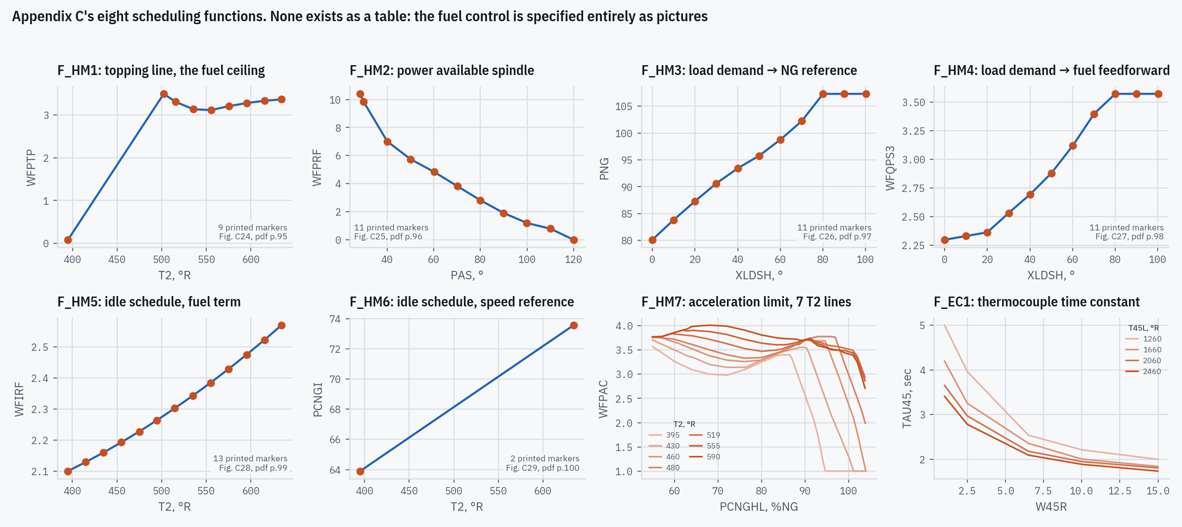
BACKUP
Appendix C's eight schedules, as digitized
Figures C23–C30, pdf pp.94–101
Replicating NASA TM-100991 · T700-GE-700 real-time engine model
67
Notes:
Six are single curves; F_HM7 (acceleration limit) and F_EC1 (thermocouple time constant) are two-dimensional families, traced column by column.

Slide 68
BACKUP
Table B.1 in full
Trim | Quantity | Printed | Ours | Dev. %
hover | NG | 41,638 | 41,638 | +0.000
hover | PS3 | 176.34 | 176.18 | −0.089
hover | P41 | 174.28 | 174.14 | −0.081
hover | T41 | 2,292 | 2,292 | +0.007
hover | P45 | 37.42 | 37.40 | −0.061
hover | T45 | 1,632 | 1,633 | +0.069
hover | SHP | 911.1 | 910.6 | −0.060
level 80 kt | NG | 39,768 | 39,816 | +0.120
level 80 kt | PS3 | 142.13 | 142.11 | −0.013
level 80 kt | P41 | 140.26 | 140.24 | −0.011
level 80 kt | T41 | 2,102 | 2,101 | −0.024
Trim | Quantity | Printed | Ours | Dev. %
level 80 kt | P45 | 30.66 | 30.65 | −0.039
level 80 kt | T45 | 1,501 | 1,500 | −0.049
level 80 kt | SHP | 552.6 | 552.2 | −0.077
descent 80 kt | NG | 38,072 | 38,054 | −0.048
descent 80 kt | PS3 | 114.27 | 113.88 | −0.338
descent 80 kt | P41 | 112.77 | 112.40 | −0.331
descent 80 kt | T41 | 1,982 | 1,984 | +0.087
descent 80 kt | P45 | 25.54 | 25.47 | −0.265
descent 80 kt | T45 | 1,424 | 1,426 | +0.172
descent 80 kt | SHP | 302.6 | 300.2 | −0.806
Table B.1, pdf p.67
Replicating NASA TM-100991 · T700-GE-700 real-time engine model
68
Notes:
Open loop: fuel flow prescribed at the printed value, NP held at 20,895 rpm.

Slide 69
BACKUP
Table 1 in full
Model | Trim | Mode | Printed | Ours | Dev. %
5-DOF | hover | NP | −0.565 | −0.565 | supplied
5-DOF | hover | NG | −2.66 | −2.69 | +1.18
5-DOF | hover | P3 | −51.6 | −51.7 | +0.19
5-DOF | hover | P45 | −3,060 | −3,166 | +3.47
5-DOF | hover | P41 | −4,900 | −5,007 | +2.18
5-DOF | level | NP | −0.446 | −0.446 | supplied
5-DOF | level | NG | −2.08 | −2.11 | +1.51
5-DOF | level | P3 | −52.2 | −51.0 | −2.35
5-DOF | level | P45 | −4,040 | −3,948 | −2.28
5-DOF | level | P41 | −4,640 | −4,736 | +2.08
5-DOF | descent | NP | −0.357 | −0.357 | supplied
5-DOF | descent | NG | −1.75 | −1.75 | +0.28
5-DOF | descent | P3 | −52.6 | −53.6 | +1.83
5-DOF | descent | P41 | −4,430 | −4,624 | +4.38
Model | Trim | Mode | Printed | Ours | Dev. %
5-DOF | descent | P45 | −4,530 | −4,445 | −1.87
2-DOF | hover | NP | −0.565 | −0.565 | supplied
2-DOF | hover | NG | −2.69 | −2.82 | +4.70
2-DOF | level | NP | −0.446 | −0.446 | supplied
2-DOF | level | NG | −2.23 | −2.20 | −1.27
2-DOF | descent | NP | −0.357 | −0.357 | supplied
2-DOF | descent | NG | −1.82 | −1.77 | −2.85
reduced 5-DOF | hover | NP | −0.565 | −0.565 | supplied
reduced 5-DOF | hover | NG | −2.81 | −2.86 | +1.82
reduced 5-DOF | level | NP | −0.446 | −0.446 | supplied
reduced 5-DOF | level | NG | −2.16 | −2.21 | +2.11
reduced 5-DOF | descent | NP | −0.357 | −0.357 | supplied
reduced 5-DOF | descent | NG | −1.83 | −1.83 | +0.14
Table 1, pdf p.31
Replicating NASA TM-100991 · T700-GE-700 real-time engine model
69
Notes:
NP modes are supplied (the load comes from Appendix B), so their near-zero deviations are not predictions.

Slide 70
BACKUP
Glossary
Symbol | Meaning | Symbol | Meaning
NG, NP | gas-generator, power-turbine speed | Wf, WF | fuel flow
%NG | NG as % of design, 44,700 rpm | WA2, WA3 | air flow at stations 2, 3
NGc | corrected gas-generator speed | W41, W45 | gas flow into the turbines
P3, P41, P45 | total pressures at stations 3, 4.1, 4.5 | Ps3 | compressor static discharge pressure
T41, T45 | temperatures at 4.1, 4.5 (T45: PT inlet) | θ₂, δ₂ | T2, P2 over the standard day
Q_{GT}, Q_{C}, Q_{PT} | turbine, compressor, PT torques | Q_{req} | load torque (helicopter)
J_{GT}, J_{PT}, J_{load} | inertias | K_{V3}, K_{V41}, K_{V45} | volume coefficients
ECU, HMU | electrical, hydromechanical control units | SPDG | ECU output to the torque motor
DOF | degrees of freedom (states) of a linear model | SHP | shaft horsepower
H2 … H49 | enthalpies at the stations, Btu/lbm | θ₄₁, θ₄₅ | squared critical velocity ratios (Eqs. 25, 31)
Nomenclature, pdf pp.9–13; Appendix C nomenclature, pdf pp.77–82
Replicating NASA TM-100991 · T700-GE-700 real-time engine model
70
Notes:
NG_des = 44,700 rpm and NP_des = 20,900 rpm are Table A.1 rows [pdf p.55].

