Slide 1
The Microservices Architecture Journey Encapsulating Services
presented by Turkey Java Community

Slide 2

Who am I?

Slide 3

Turkey Java Community

Slide 4
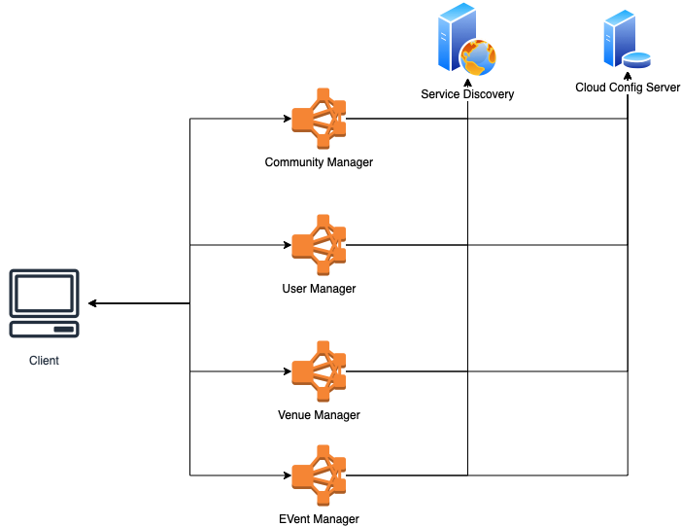
W/o API Gateway

Slide 5
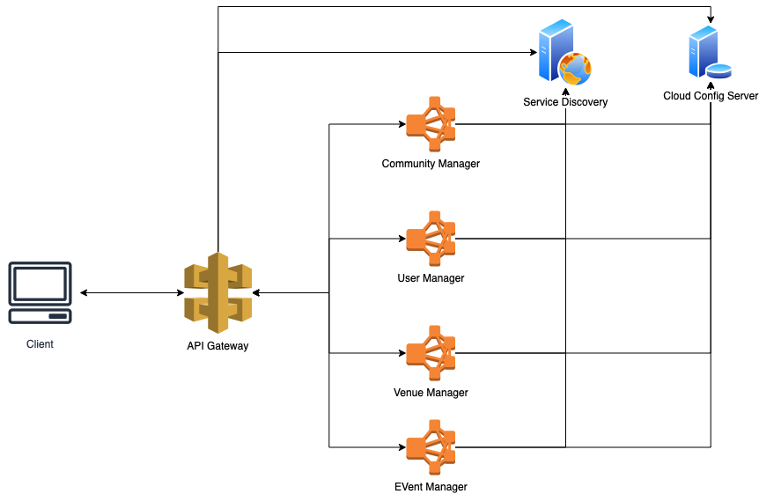
With API Gateway

Slide 6
Why is API Gateway?
Single entry point for all provided end-points by each service - Centralized access to decentralized services
Encapsulates services – Abstraction of service language and protocol independence
A service can provide a RESTful end-point written in Java whereelse another one can provide a gRPC end-point implemented in Go
Management of scalability of services
Management of service routing
Change routing to new versions while deployment
Management of traffic

Slide 7

Code Kata !!!

