Slide 1
The Microservices Architecture Journey An Expected Service Discovery & DB Migration
presented by Turkey Java Community & thanks to Martin Fowler ☺

Slide 2

Who am I?

Slide 3
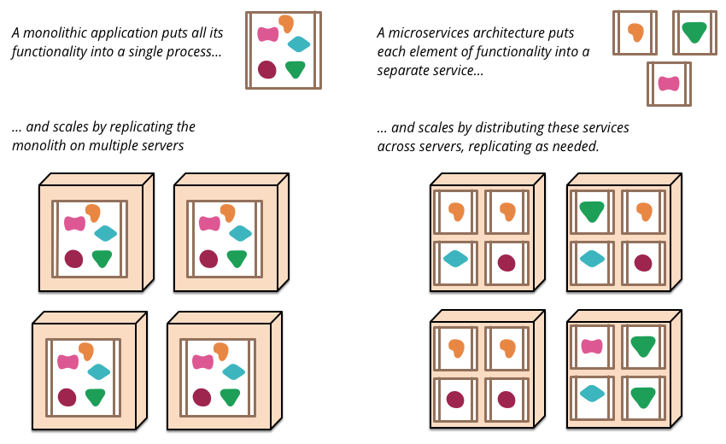
Microservice Architecture - Componentization via Services
https://martinfowler.com/articles/microservices.html

Slide 4
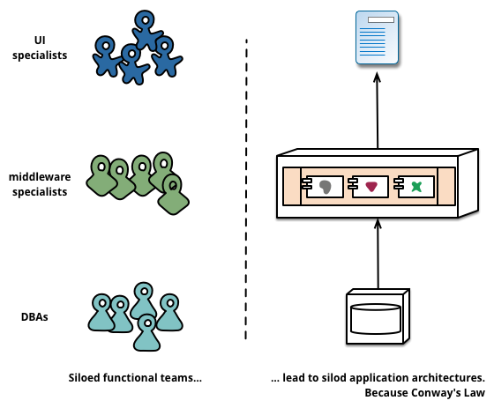
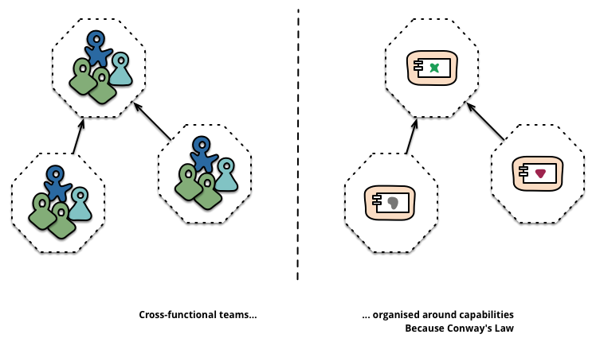
Microservice Architecture – Business Capabilities & Products not Projects
https://martinfowler.com/articles/microservices.html
Amazon’s motto; “You build, you run it”

Slide 5
Microservice Architecture – Smart End-Points & Dump Pipes
https://martinfowler.com/articles/microservices.html
Be of the web, not behind the web !
- Ian Robinson

Slide 6
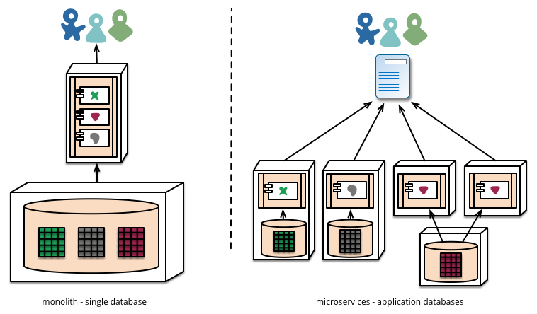
Microservice Architecture - Decentralized Governance & Decentralized Data Management
https://martinfowler.com/articles/microservices.html

Slide 7
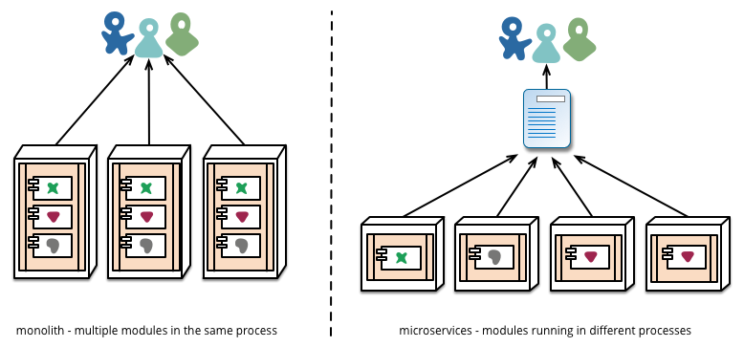
Microservice Architecture – Infra Automation & Design for Failure
https://martinfowler.com/articles/microservices.html

Slide 8
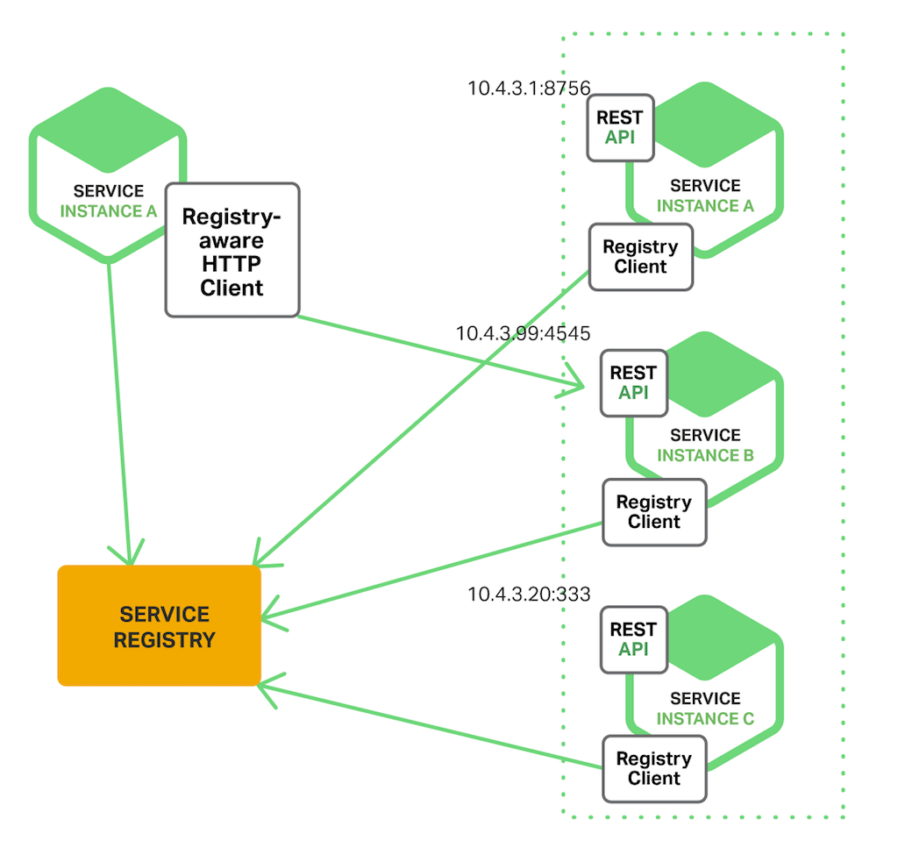
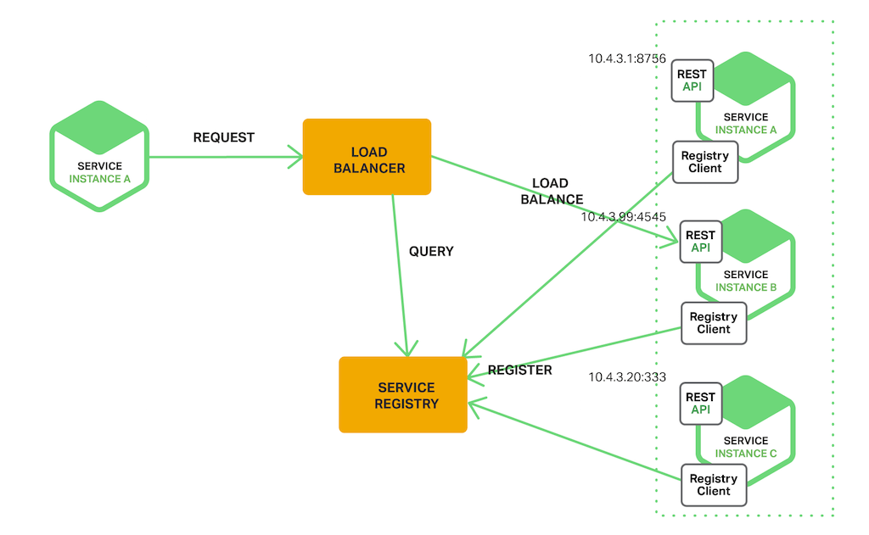
Microservice Architecture – Service Discovery
https://www.nginx.com/blog/service-discovery-in-a-microservices-architecture/
Client-Side Service Discovery
Server-Side Service Discovery

Slide 9
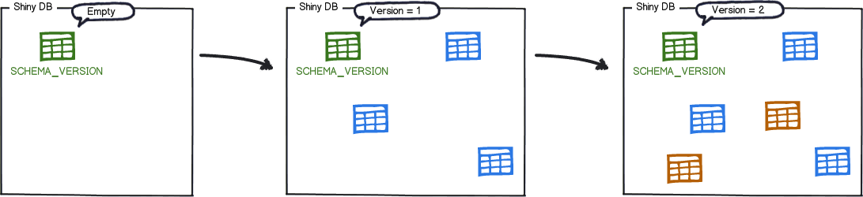
Microservice Architecture – Flyway DB Migration
https://flywaydb.org

Slide 10

Turkey Java Community

