Slide 1
The Microservices Architecture Journey Externalized Configuration Management
presented by Turkey Java Community

Slide 2

Who am I?

Slide 3

Turkey Java Community

Slide 4
The Twelve-Factor App
https://12factor.net
I. Codebase
One codebase tracked in revision control, many deploys
II. Dependencies
Explicitly declare and isolate dependencies
III. Config
Store config in the environment
IV. Backing services
Treat backing services as attached resources
V. Build, release, run
Strictly separate build and run stages
VI. Processes
Execute the app as one or more stateless processes
VII. Port binding
Export services via port binding
VIII. Concurrency
Scale out via the process model
IX. Disposability
Maximize robustness with fast startup and graceful shutdown
X. Dev/prod parity
Keep development, staging, and production as similar as possible
XI. Logs
Treat logs as event streams
XII. Admin processes
Run admin/management tasks as one-off processes

Slide 5
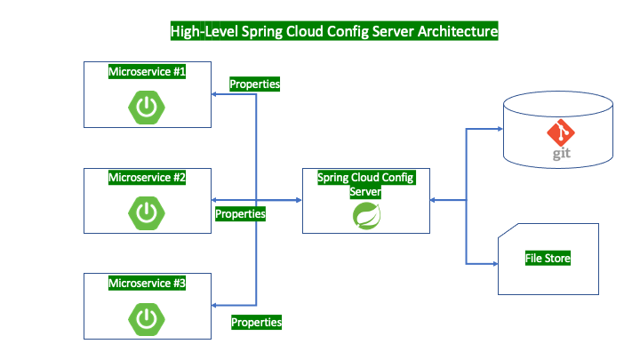
Spring Cloud Config Server
https://evrentan.medium.com/spring-cloud-config-server-be63e4a91c79

Slide 6
Microservice Architecture – Business Capabilities & Products not Projects
https://evrentan.medium.com/spring-cloud-config-server-be63e4a91c79
Main features of Spring Cloud Config Server are as below described in Spring Documentation page;
HTTP, resource-based API for external configuration (name-value pairs, or equivalent YAML content)
Encrypt and decrypt property values (symmetric or asymmetric)
Embeddable easily in a Spring Boot application using @EnableConfigServer
The config client features (for Spring applications) are as below again from Spring Documentation page;
Bind to the Config Server and initialize Spring Environment with remote property sources
Encrypt and decrypt property values (symmetric or asymmetric)
Spring Cloud Config Server supports two ways of configuration data storage;
Local File Storage
Git or SVN Repository Storage

Slide 7

Code Kata !!!

