Slide 1
Reconstructing the Pit I HG stockpile
Material movement, 3-D block model and uncertainty
MIN E 413 term project | Fall 2026 | Team: [Member 1], [Member 2], [Member 3], [Member 4], [Member 5]
Notes:
Presenter: [Member 1] (project lead). Introduce the team and the Mine Manager's request: a defensible, updatable platform that reconstructs where truck-dumped material ended up in the long-term stockpile, and a block model of tonnage, grade, metal and uncertainty.

Slide 2
The answer first: 48.6 kt placed during the record, tied to surveyed fill
48.6 kt
44.7 kt
3.9 kt
90 kt
record-period inventory (P10-P90 48.1-56.0 kt)
FMS-tracked: measured tonnes and grades, placed by CPST
unattributed: surveyed fill in FMS-gap intervals; grade imputed
pre-record core: inferred geometry, assumed grade (whole pile 138 kt)
Record-period grade 8.57% Cu; contained Cu P10-P90 4.08-4.95 kt (as-supplied units, implausibly high: confirm with Geology).
Not included in those ranges: if the 47% volume excess is loads missing from the FMS (not bulking), the record period holds 71.3 kt. Confirming the FMS density basis settles it.
Plan reclaim on the FMS-tracked benches with P10/P90 ranges; sample the pre-record core before committing it to a production target.
Reproducible with one command; every input hashed; an independent implementation (B) agrees to about 2%.
Notes:
Presenter: [Member 1]. State the main message before the detail. We lead with the material placed during the two-week record, because it is tied to surveyed volumes and measured grades. The pre-record core and the whole-pile total come second, clearly labelled. Say explicitly what the ranges do not include.

Slide 3
1 Data and QA/QC
Presenter: [Member 2] (data and QA/QC lead)

Slide 4
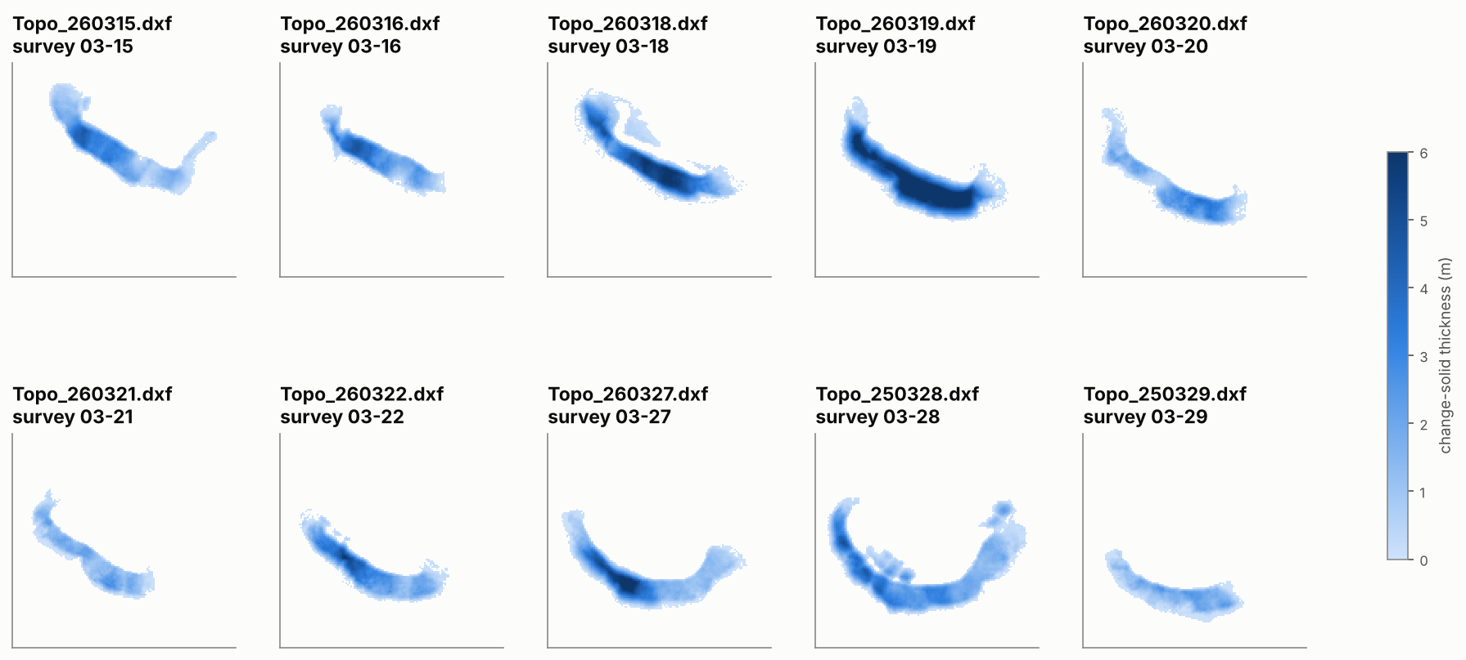
Each survey file is a change solid, not a surface
Every grid cell is crossed by exactly two faces: top = this survey, bottom = previous surface
Bottom of solid s equals top of solid s-1 to 0.000 m (P5-P95)
So the files give measured daily fill directly, but only where change occurred
35,096 m³ in 10 solids, 03-15 to 03-29
Notes:
Presenter: [Member 2]. This was the key discovery in the data: the DXFs are Vulcan change solids. That is why each file looks like a crescent band, the active crest and face, rather than the whole pile.

Slide 5
Data-quality findings that shape the model
Payload is estimated
Grades are source values
Stuck GPS, unreliable Z
100% of payloads are multiples of 38 t (bucket passes): per-load error plus a systematic payload factor
21 grade signatures repeated across 275 loads: correlated grade error
14 loads (2.4 kt) share one default position: location treated as unknown, not invented. Dump Z not used
Headers and names wrong
FMS has real gaps
Cuts hidden in solids
DXF header says inches (data are metres); two files carry year 2025: re-dated by logged interventions MI-001/002
03-23 to 03-27 and after 03-29 08:17. 03-17 (no dumps, no survey) was a non-dumping day, not an outage
Solid bottoms up to 2 m below earlier surfaces: dozer cuts re-handled as sources
Notes:
Presenter: [Member 2]. No record was deleted: 40 named QA rules at record, file and dataset level, 25 triggered, each with a documented treatment (D2). Emphasise that these findings changed the method: payload and grade error enter the Monte Carlo, Z is ignored, and gaps become an explicit 'unattributed' class.

Slide 6
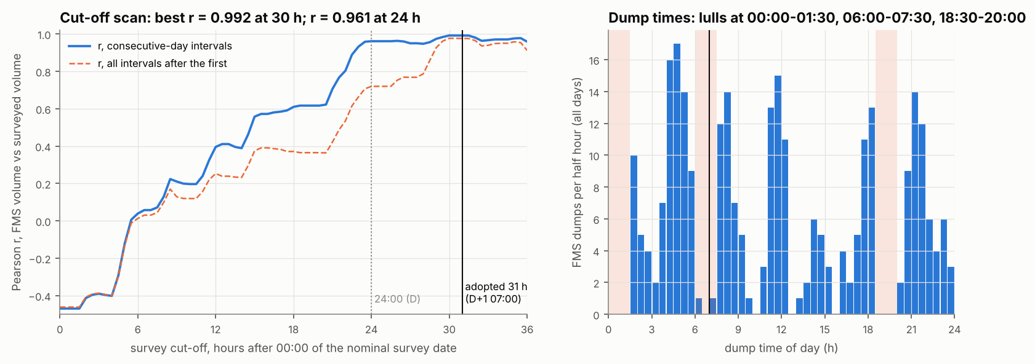
A survey labelled D closes its interval at D+1 07:00
Survey time was not supplied: the cut-off was scanned 0-36 h after 00:00 of the survey date
r = 0.992 at D+1 07:00 vs 0.961 at midnight; ratio spread 0.08 vs 0.23
Independent evidence: dumping stops 06:00-07:30 and 18:30-20:00 (shift changes)
Version 1 searched only 21:00-23:59 and stopped at the end of its range
Notes:
Presenter: [Member 2]. A data-driven choice of an unrecorded parameter (A-05), corroborated by an independent signal in the FMS. This was the largest sensitivity driver in version 1; inside the dump-free window it hardly matters any more.

Slide 7
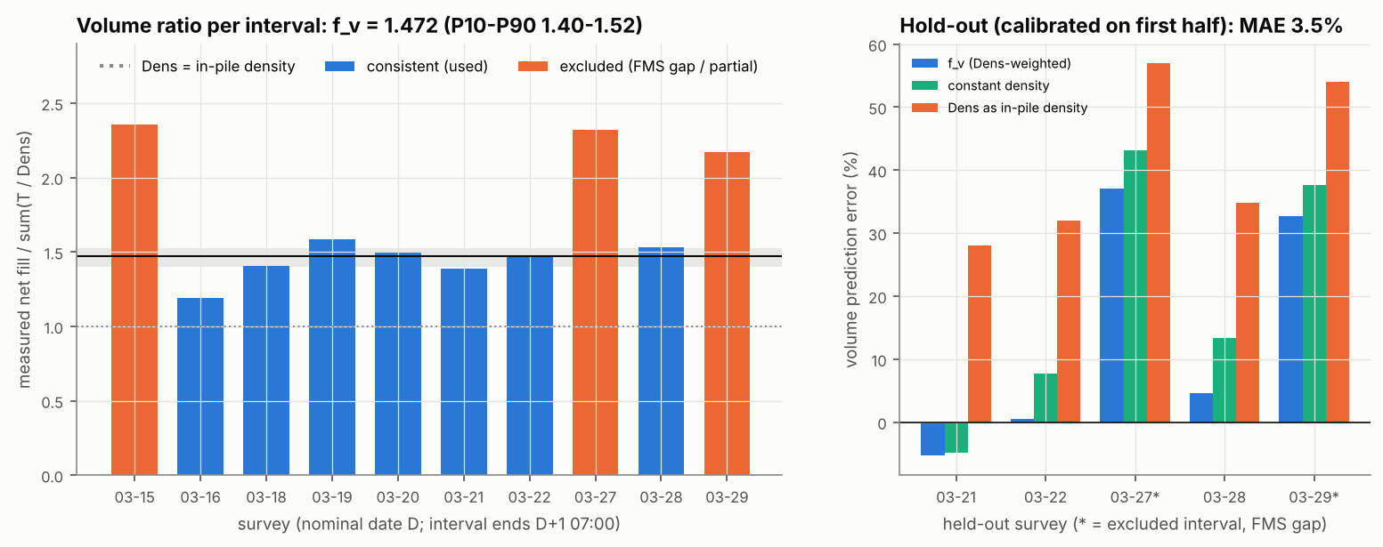
Measured fill is 1.47 × recorded tonnes ÷ density on every complete day
Volume factor f_v = 1.472 on 7 complete intervals (P10-P90 1.40-1.52)
Calibrated on the first half, it predicts the second to 3.5% (density as in-pile: 32%)
FMS-gap intervals (03-15, 03-27, 03-29) sit at 2.2-2.4: that fill is unattributed
Same f_v as the independent implementation B (1.476)
Notes:
Presenter: [Member 2]. f_v fixes the in-pile volume of each load. What it means in tonnes is the open question: bulking (base case, in-pile density 1.40 t/m³), under-recorded payloads, or missing loads. See the scenario slide.

Slide 8
2 Material-movement algorithm
Presenter: [Member 3] (algorithm lead)

Slide 9
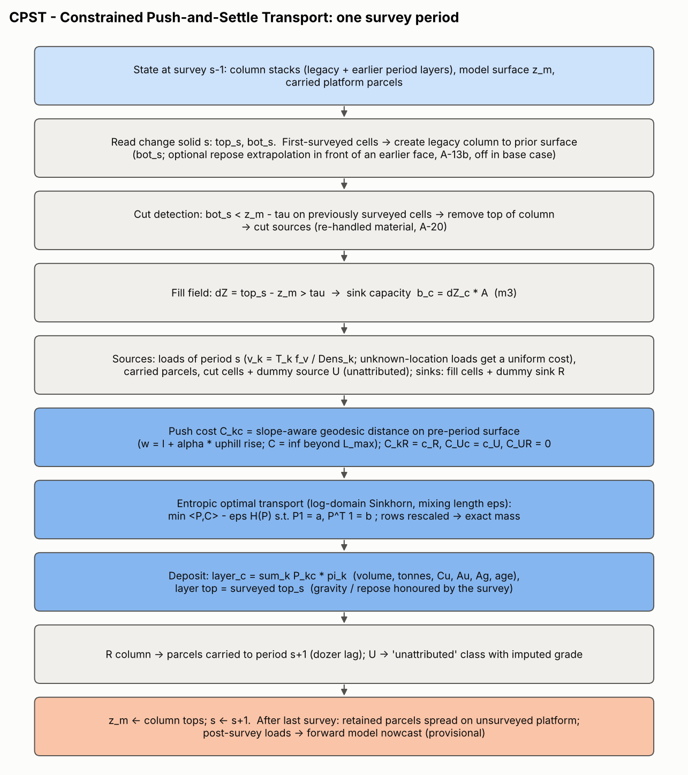
CPST: surveys say where, FMS says what, push work says which
Sinks = observed fill per 1 m column; sources = truck loads, carried platform parcels, cut material
Cost = dozer push work: slope-aware geodesic distance (uphill penalised, ≤ 90 m)
Entropy-regularised optimal transport (Sinkhorn): mixing length ε = 6 m
Dummy nodes keep it honest: U = fill with no FMS source, R = FMS volume not yet on the face
Every operation is linear in tonnes and metal, so conservation is exact
Notes:
Presenter: [Member 3]. Optimal transport was invented by Monge in 1781 for moving cuts to fills, the same earthworks problem. Walk through questions A to J: initial placement (point parcel at dump X/Y), direction (least-work route), distance (capacity plus max push), downslope (the surveyed face is at repose), mixing (epsilon), reconciliation (column marginals = survey), mass and metal (exact), sequential updating (column state), numerical stability (tolerance, grid tests).

Slide 10
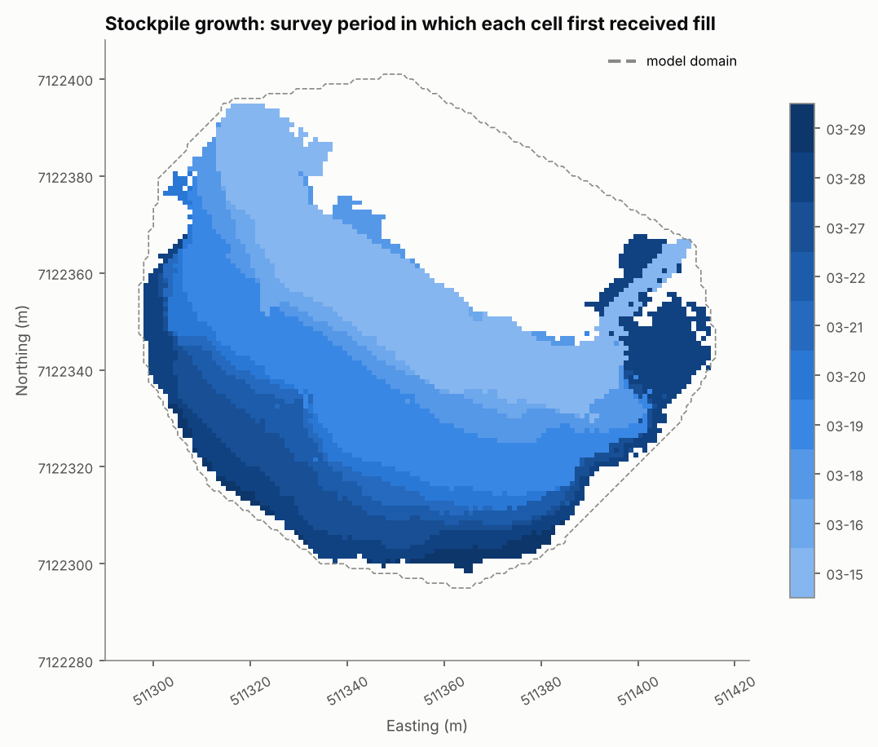
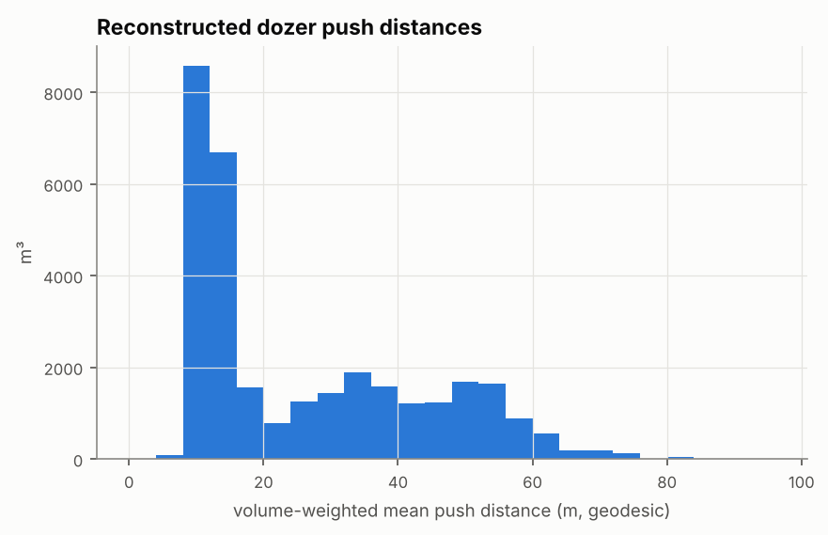
Push distances and the face advance are physically plausible
Crest advanced about 30 m south in two weeks
Reconstructed pushes are mostly tens of metres, well inside the dozer economic range
Notes:
Presenter: [Member 3]. Growth characterisation (Task 2): when each cell first received fill.

Slide 11
3 Block model, validation and uncertainty
Presenter: [Member 4] (block model and validation lead)

Slide 12
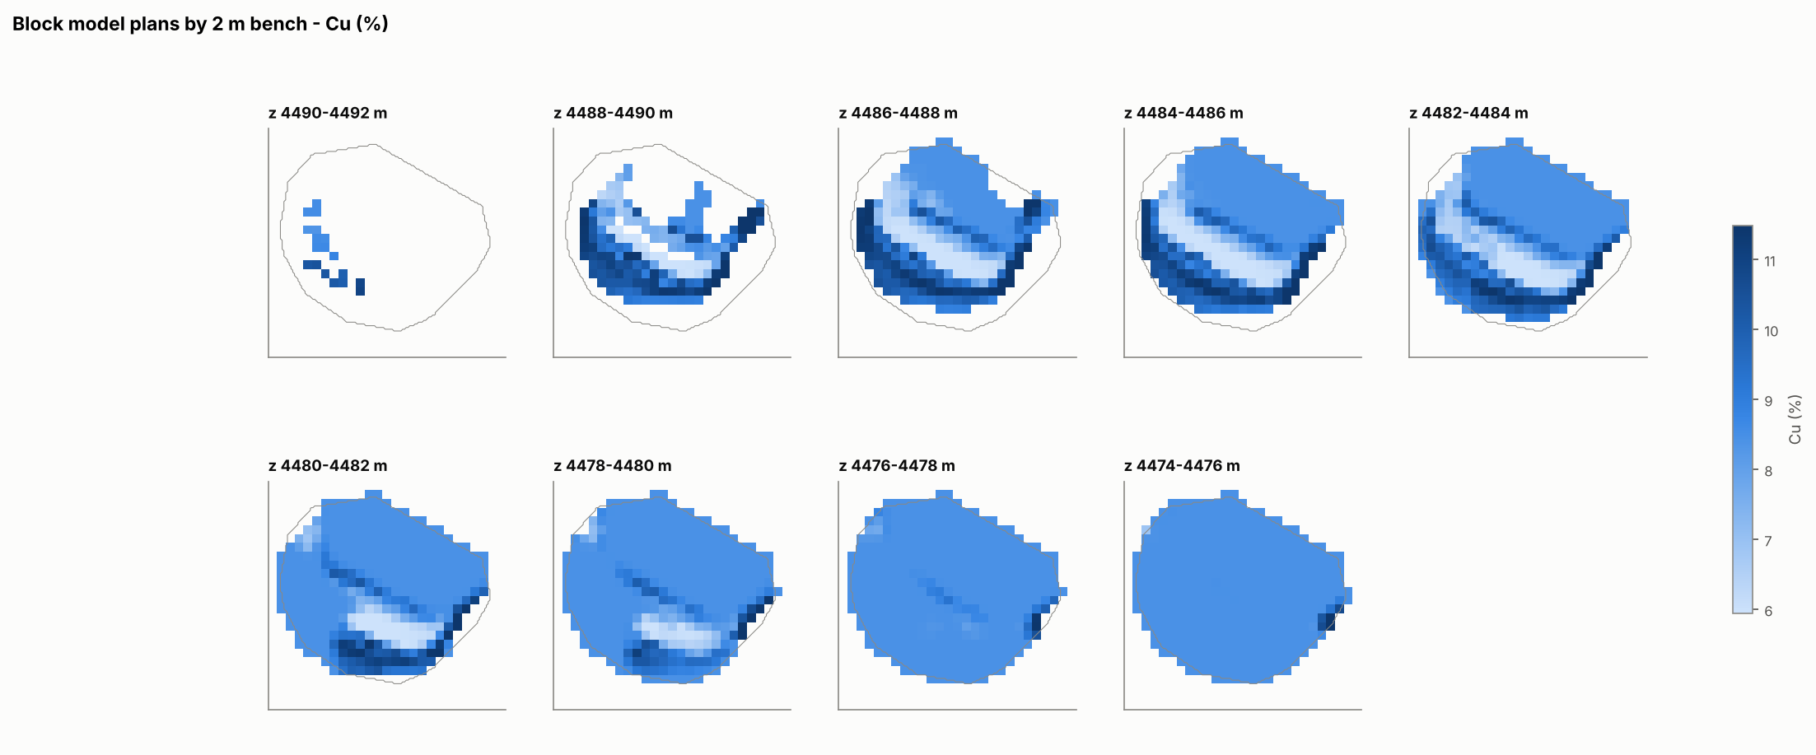
Block model: 5 × 5 × 2 m, Cu grade by bench
Notes:
Presenter: [Member 4]. Block size justified by GPS error plus mixing length (~5 m) horizontally and daily layer thickness vertically. Partial blocks keep their fill fraction. Grades are composited from metal over tonnes.

Slide 13
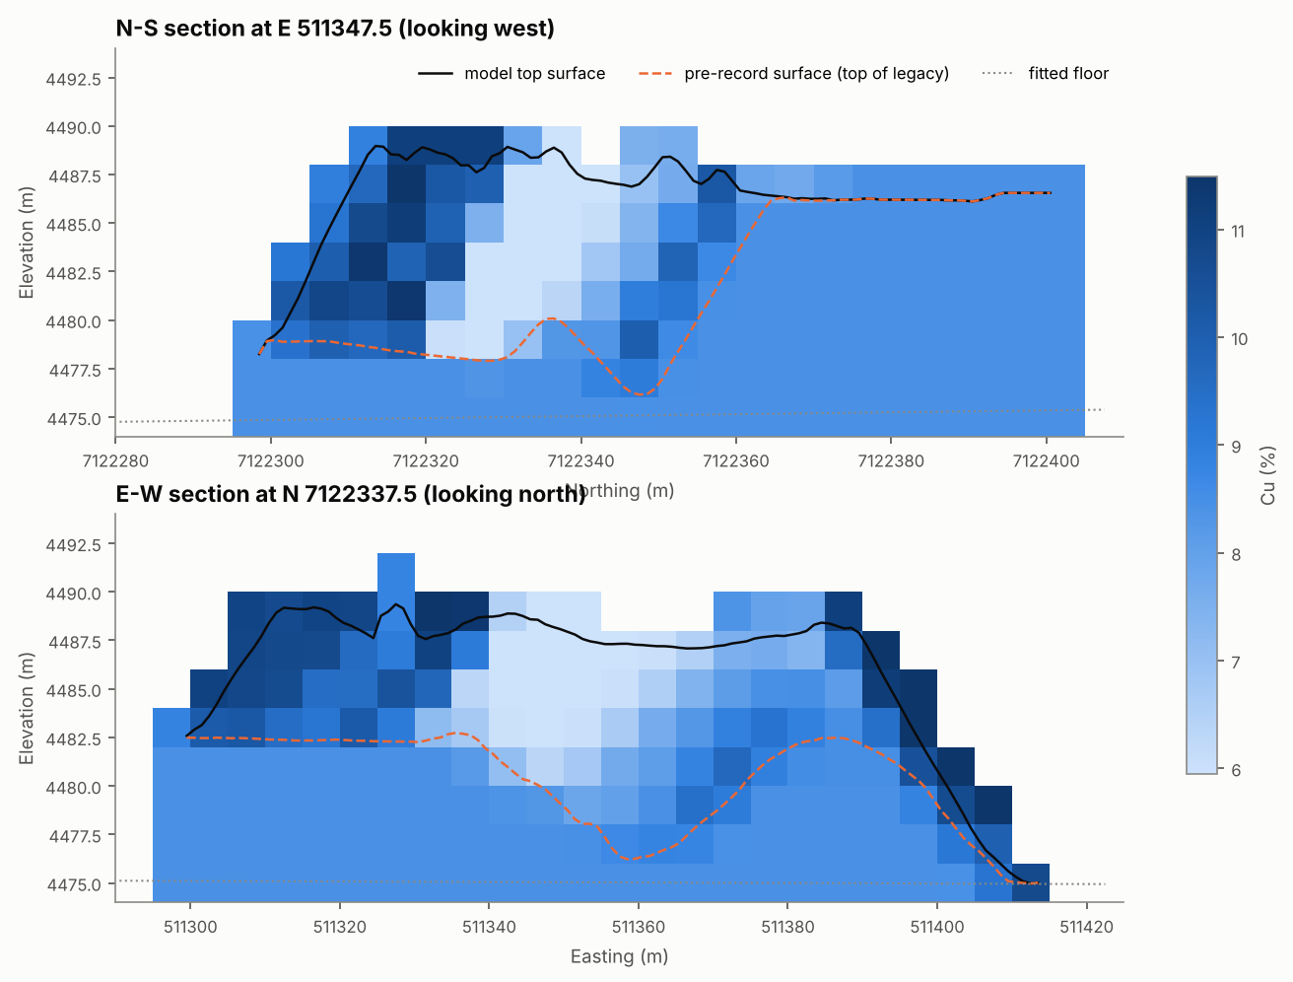
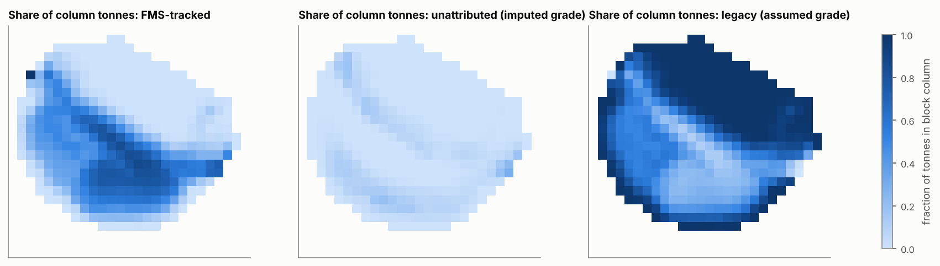
Tracked material forms a skin on the advancing face
Orange dashed = pre-record surface: everything below is the pre-record core, with an assumed grade
Reclaim of the outer benches recovers mostly FMS-tracked material
Notes:
Presenter: [Member 4]. Show where measured and assumed information sit in 3-D.

Slide 14
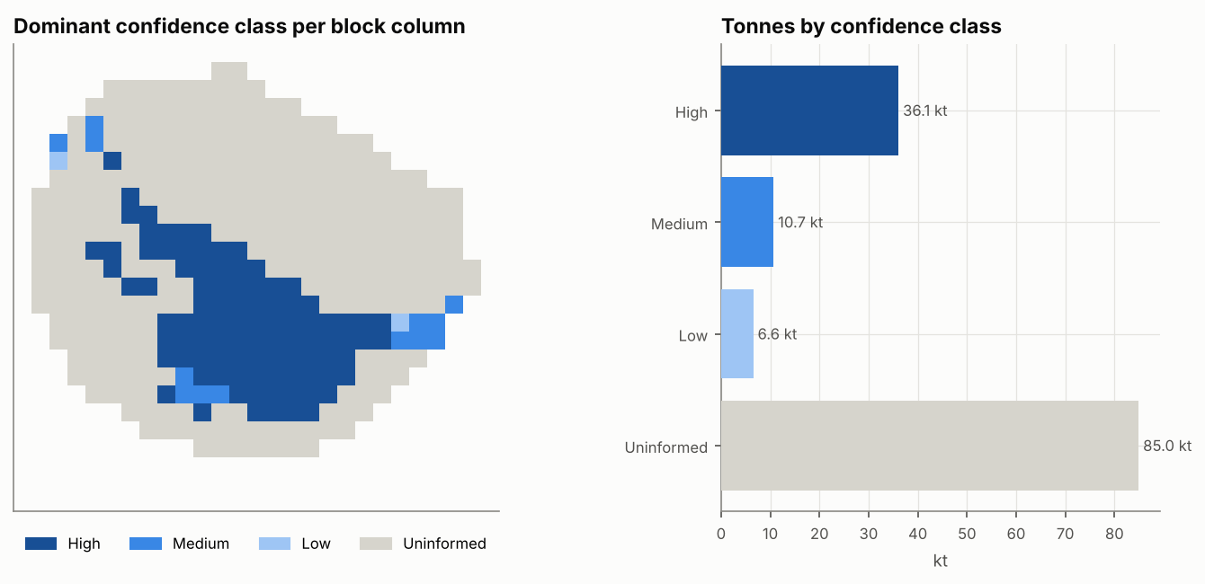
Inventory by information and confidence class
High + Medium confidence: 46.8 kt
Classes are internal planning classes, not JORC/NI 43-101 categories
Notes:
Presenter: [Member 4]. The pre-record core and unattributed grades are not measurements; they are reported separately.

Slide 15
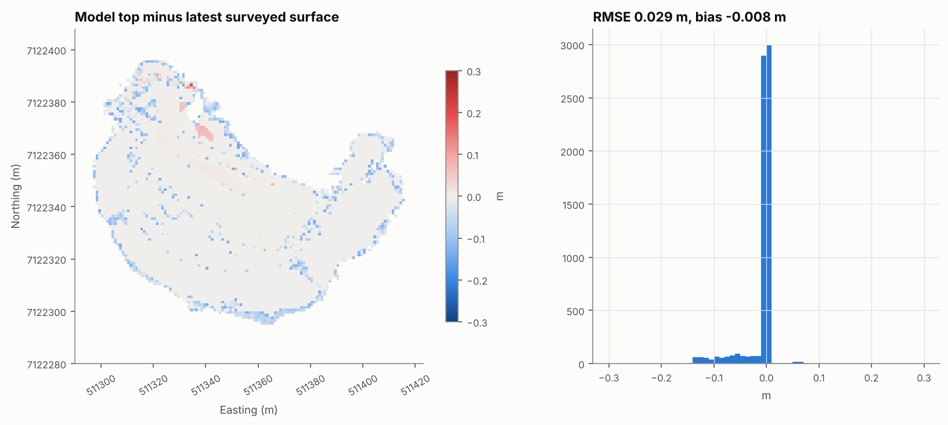
Validation: exact balances, survey-matched geometry
< 10⁻⁹
relative mass and Cu/Au/Ag balance error (FMS in vs block model)
0.03 m
RMSE model vs latest survey; 100.0% of cells within 0.14 m
Geometry is constrained by design, so it is a check on numerics. Independent tests are on the next slide
Automated test enforces conservation on every code change
Notes:
Presenter: [Member 4]. Visual agreement alone is not validation; these are quantitative.

Slide 16
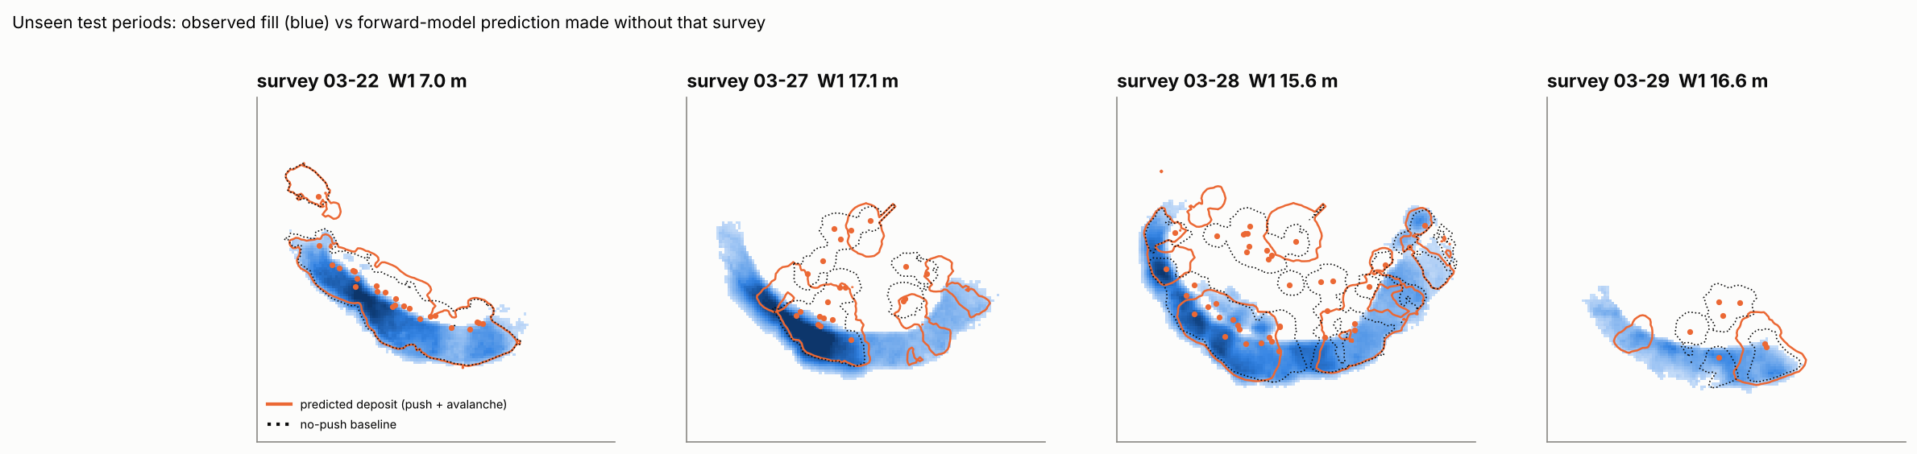
Independent tests: prediction and known-truth twin
Forward model on unseen intervals: earth-mover error 14.1 m vs 14.3 m without dozer push and 30.6 m for uniform spreading
Physics alone predicts where fill lands only moderately well, which is why the surveys must constrain the allocation
Twin: CPST block Cu r = 0.93; beats period-average and global-mean baselines
Stress test with a truth rule CPST does not assume (random crest): 0.68% vs 1.06% Cu RMSE
Notes:
Presenter: [Member 4]. Temporal validation uses periods never used for calibration. The twin experiment generates a stockpile with known truth (forward physics with random dozer deviations), observes it like the real one (GPS noise, 15% missing FMS records, survey noise) and reconstructs it blind.

Slide 17
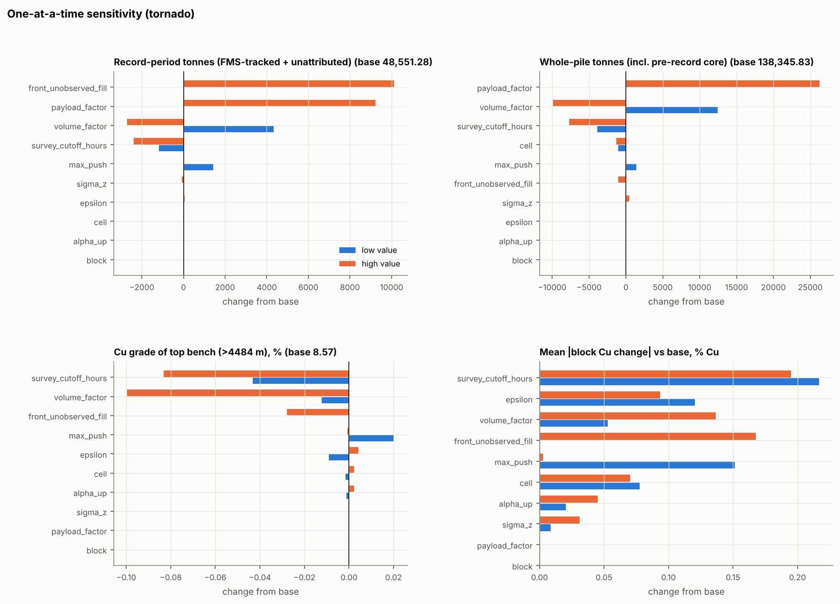
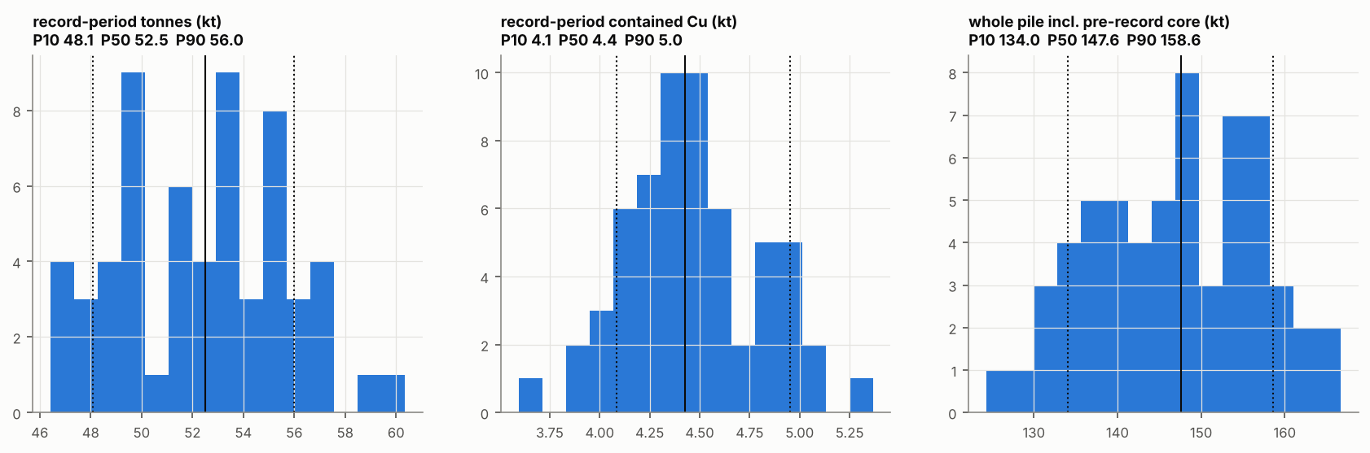
Uncertainty: what moves the answer
Monte Carlo (60 runs): GPS, payload, payload factor, volume factor, assay, survey, cut-off, mixing, push
Record-period tonnes P10-P90 48.1-56.0 kt; whole pile 134-159 kt
Block grade ranges for pre-record blocks use the load-scale prior, not false precision
Notes:
Presenter: [Member 4]. Distinguish measured, inferred, assumed and model-generated information. The pre-record grade is a scenario assumption whose range cannot be quantified from the supplied data.

Slide 18
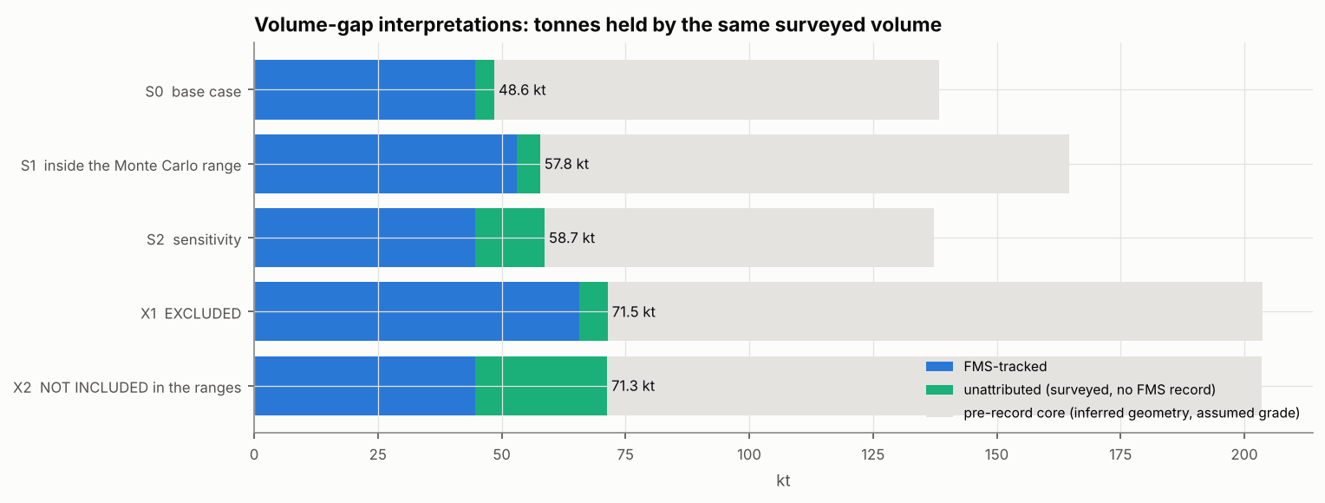
What does the 47% volume excess mean?
Bulking (base): FMS density is a bank density, recorded tonnes correct: 48.6 kt
Up to 19% payload under-recording (largest load to 362 t): 57.8 kt (inside the range)
All under-recording: loads of 447 t, excluded
Loads missing from the FMS: 71.3 kt. Not included in the ranges, not excluded either
Cheapest fix: confirm whether Dens is a bank or a loose density, and run a pile density test.
Notes:
Presenter: [Member 4]. The volume of the FMS material is calibrated; how many tonnes it holds is not identifiable from volumes. Version 1 implicitly assumed missing loads and never tested bulking; version 2 reports all interpretations, and says plainly which one is outside the ranges.

Slide 19
4 Platform and professional practice
Presenter: [Member 5] (platform lead) with [Member 1]

Slide 20
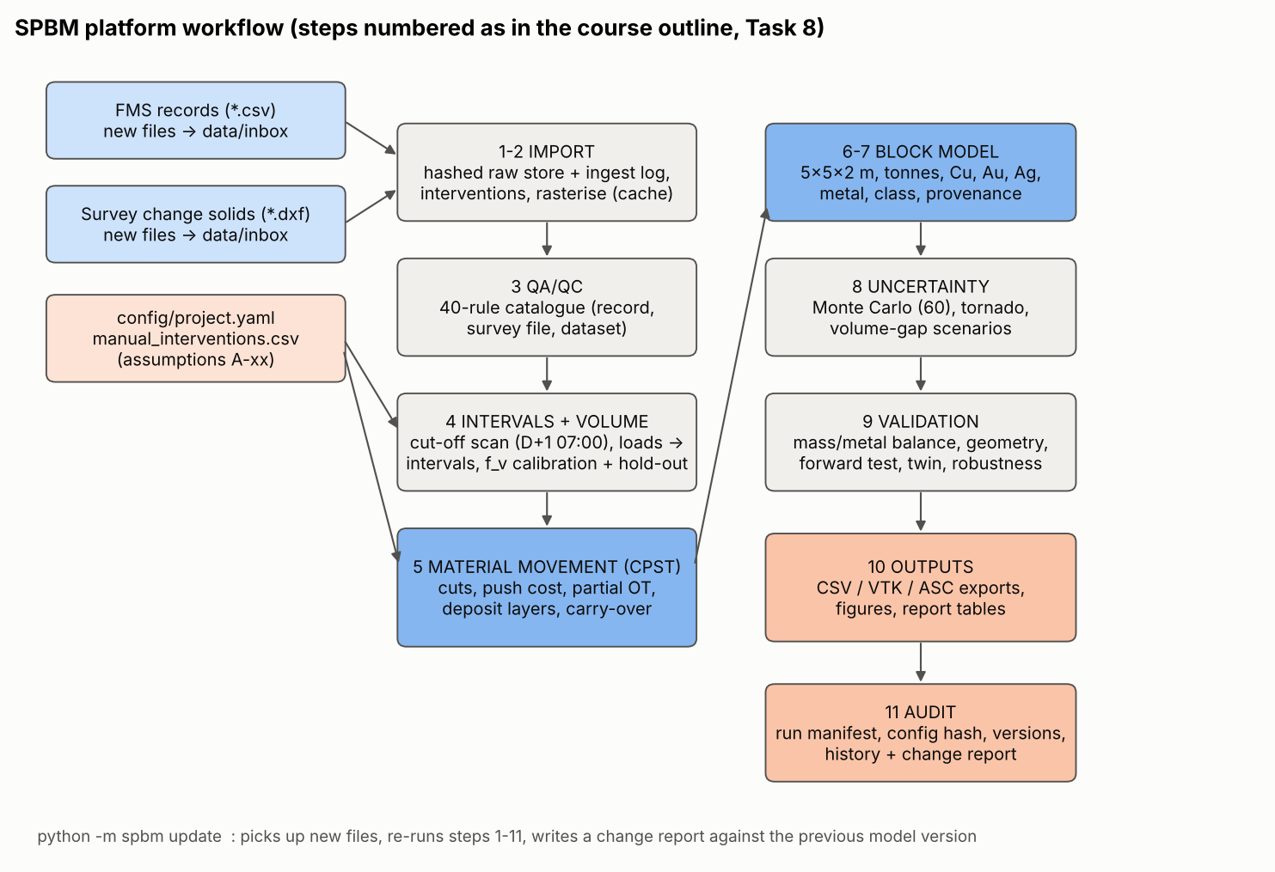
A repeatable, auditable in-house platform
One command: python -m spbm update
Managed raw store: every input SHA-256 named and logged; a changed file needs a supersede intervention
Manual interventions need a reason, author and date, or the run stops
40-rule QA catalogue; 66 automated tests
Run manifest, model history and automatic change report
Open formats: CSV, VTK, ESRI grids
Notes:
Presenter: [Member 5]. Demonstrate (or show the recorded demo of) examples/demo_update.sh: build the model to the 03-22 survey cut-off, then update with the later data and read the change report. Mention that version 2 combines our platform with the stronger ideas of an independent implementation (B), disclosed in Appendix A.

Slide 21
Professional accountability and equity
Accountability
Equity and inclusion
Never present a single expected value: lead with the record-period range and say what it excludes
Pre-record grade is assumed: decline a 'definitive' whole-pile inventory until sampled
We corrected our own version 1 after an independent comparison, and documented why
Data gaps are periods and systems, not crews: no attribution without evidence
Average imputation can bias exactly the least-documented zones: flag, do not hide
Explainable outputs (maps, classes, provenance) for planners, operators and processing
Scenario response: management asked for a definitive inventory. We provide it with ranges and information classes, and state what the data cannot yet support.
Notes:
Presenter: [Member 1] and [Member 5]. Response to the course scenario (Section 6.2): management asks for a definitive inventory. Our position: provide it with ranges and classes, and state clearly what we cannot yet support.

Slide 22
Limitations and recommendations
1
Confirm the FMS density basis; test the pile density; calibrate buckets
Resolves bulking vs missing tonnes (up to +47%)
2
Audit FMS completeness for 03-23 to 03-27 and after 03-29 08:17
Converts unattributed volume to tracked material
3
Survey the whole pile now, and the original ground if records exist
Removes most pre-record geometry uncertainty (A-13, A-14)
4
Density, moisture and grade sampling of the pre-record core
Replaces assumed grades; confirms Cu/Au units
5
Record survey acquisition times; fix the DXF unit header
Removes A-05; avoids unit errors downstream
Notes:
Presenter: [Member 5]. Key limitations: the meaning of the volume excess; no full-pile or pre-pile survey; two weeks of FMS against a pile built over the life of Pit I; grades are source-block values; mixing parameters are uncalibrated without tracers.

Slide 23
Plan with ranges, sample the unknown, update every survey
Questions?
All results reproducible: python -m spbm run
Notes:
Presenter: [Member 1]. Close and take questions. Any member may be asked about data treatment, assumptions, algorithm, validation, uncertainty, software or professional decisions.

