Slide 1
Charts part 5
Jorge Polanco
Manoj Kumar P
Edward Vrijghem
Charles Payet
Zong Xinghao

Slide 2
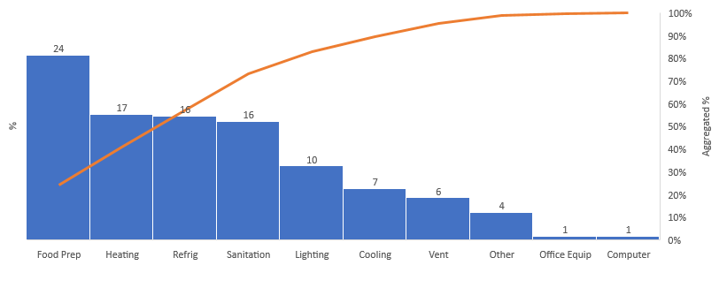
Restaurant energy use
The top 4 consume 75% of the energy

Slide 3
Better for you Beverages
Fruit Juice and Carbonated Soft Drinks seem to be preferred

Slide 4
Kellogg
Total Sales are increasing across all continents

