Slide 1

Monopoly
Evrim Gürkan
Ahmet Ceylan

Slide 2
Introduction
Used technology
Used patterns
Quick demo
Code behind

Slide 3
Used technology
Visual Studio 2008
Asp.net
C#
Jquery
Css3

Slide 4
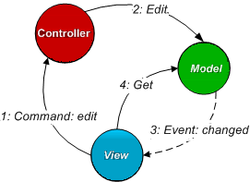
Used patterns - MVC

Slide 5
Used patterns
Creational patterns
Singleton
Behavioral patterns
Command
Iterator
Observer
Template method

