Slide 1
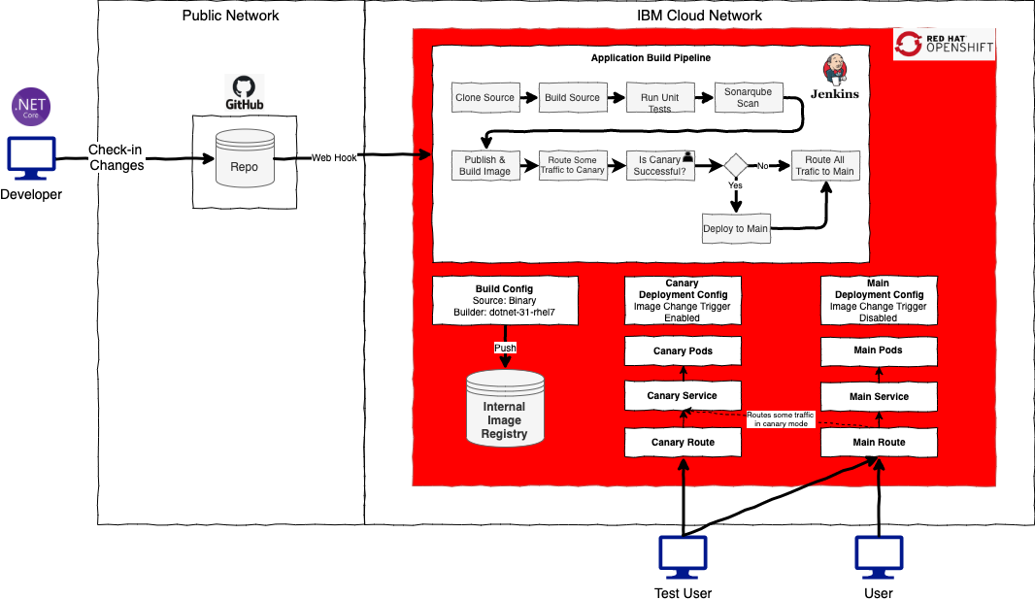
OpenShift Canary Release Demo
IBM Global Services
Cloud Application Innovation

