Slide 1
Hyperspectral Imaging Deep Learning Case Study

Slide 2
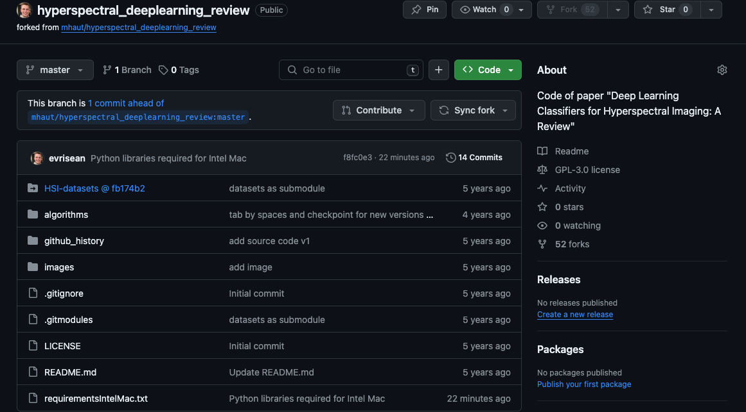
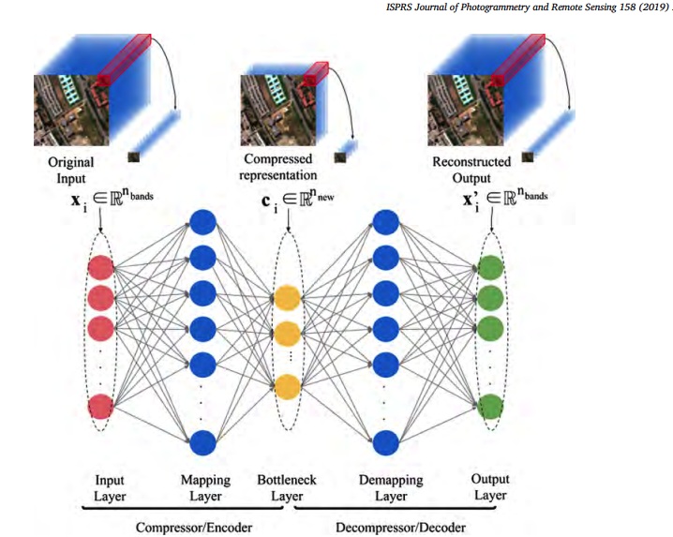
Github + paper

Slide 3
Important Notes
They do preprocessing then reshaping next

Slide 4
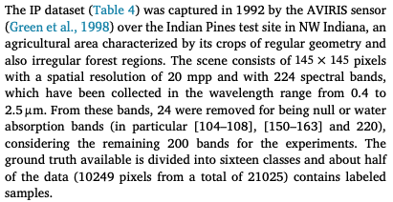
Test Case 1- Indian Pines with SVM
PLS_Toolbox
Python
21025x220
145x145
Image Size before training
Pixel size
21025x200
145x145
Size of pixels are folded into the sample mode (145x145 = 21025).
So each “sample” SVM sees is a pixel.

Slide 5
Test Case 2- Indian Pines with Conv1d
PLS_Toolbox
Python
21025x220
145x145
Image Size before training
Pixel size
Input Shape
21025x200x1
145x145
200x1

Slide 6
How to understand conv1d in this context
Folded
Original
145
200
21025
21025
145
200
200
1

Slide 7
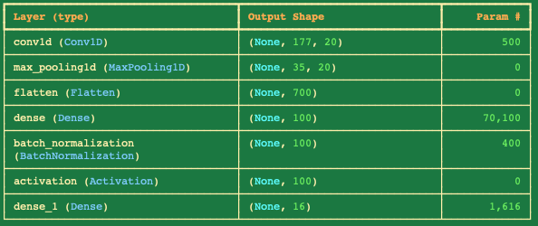
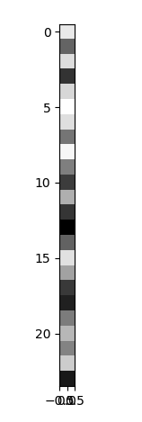
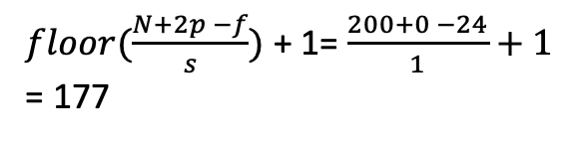
How to understand conv1d in this context
Conv1d layer
This is just 1 filter
.
.
.
1
24
21025
$floor(\frac{N+2p −f}{s})$ + 1= $\frac{200+0 −24}{1}+1$ = 177
200
1
1
…
177
Output
1
20
177
1
177

Slide 8

How to understand conv1d in this context
…
1
…
177
…
1
20
177
…
1
177
$floor(\frac{N+2p −f}{s})$+ 1= $\frac{177+0−5}{5}+1$ = 35
Max Pool layer
5
1
…
35
5
1
20
Just takes the max in each 5x5 grid and downsamples
Output
35
1
35

Slide 9
Test Case 3- Indian Pines with Conv2d
PLS_Toolbox
Python
21025x220
145x145
Image Size before training
Pixel size
Input Shape
21025x200
145x145
19x19x200
Creates image cubes with a window size of 19 and pads with 0’s

Slide 10
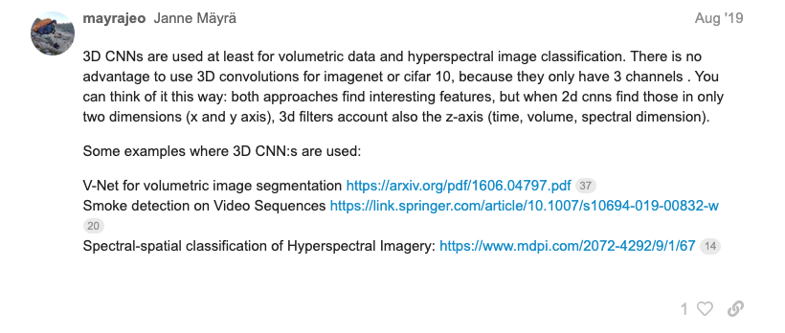
Test Case 4- Indian Pines with Conv3d
PLS_Toolbox
Python
21025x220
145x145
Image Size before training
Pixel size
Input Shape
21025x19x19x40x1
145x145
19x19x40x1
Creates image cubes with a window size of 19 and pads with 0’s
https://forums.fast.ai/t/are-there-any-successful-vision-models-that-use-3d-convolutions/52503

Slide 11
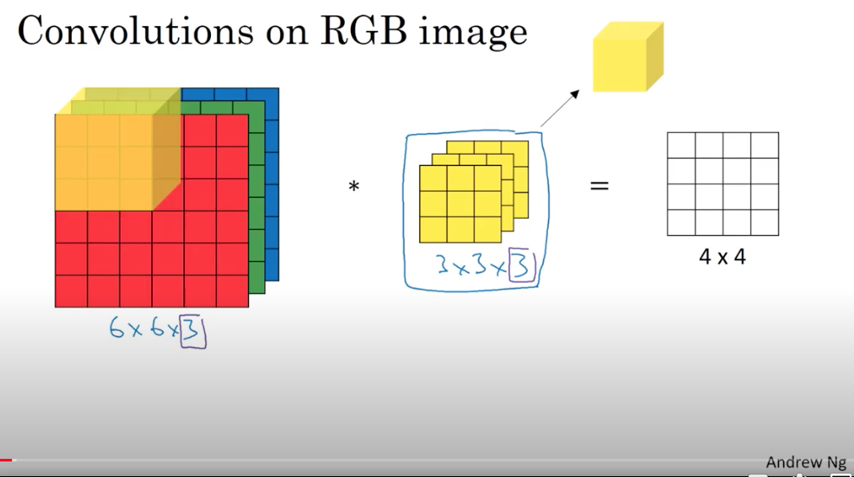
Filter
Output

Slide 12
