Slide 1

CONCURRENT PROGRAMMING
ASSIGNMENT SERIES 1
October 2024
TEAM 11

Slide 2
1.1
FIFO PIPES
An Overview of Pipe Implementation Using Threads in C.

Slide 3
MAIN IDEA
Implement a FIFO pipe mechanism using threads.
The FIFO Pipes ensure that data in the pipe is read in the same order it was written
Pipes are used to make threads communicate and exchange data
This makes synchronizing easier and our programs faster and more efficient

Slide 4
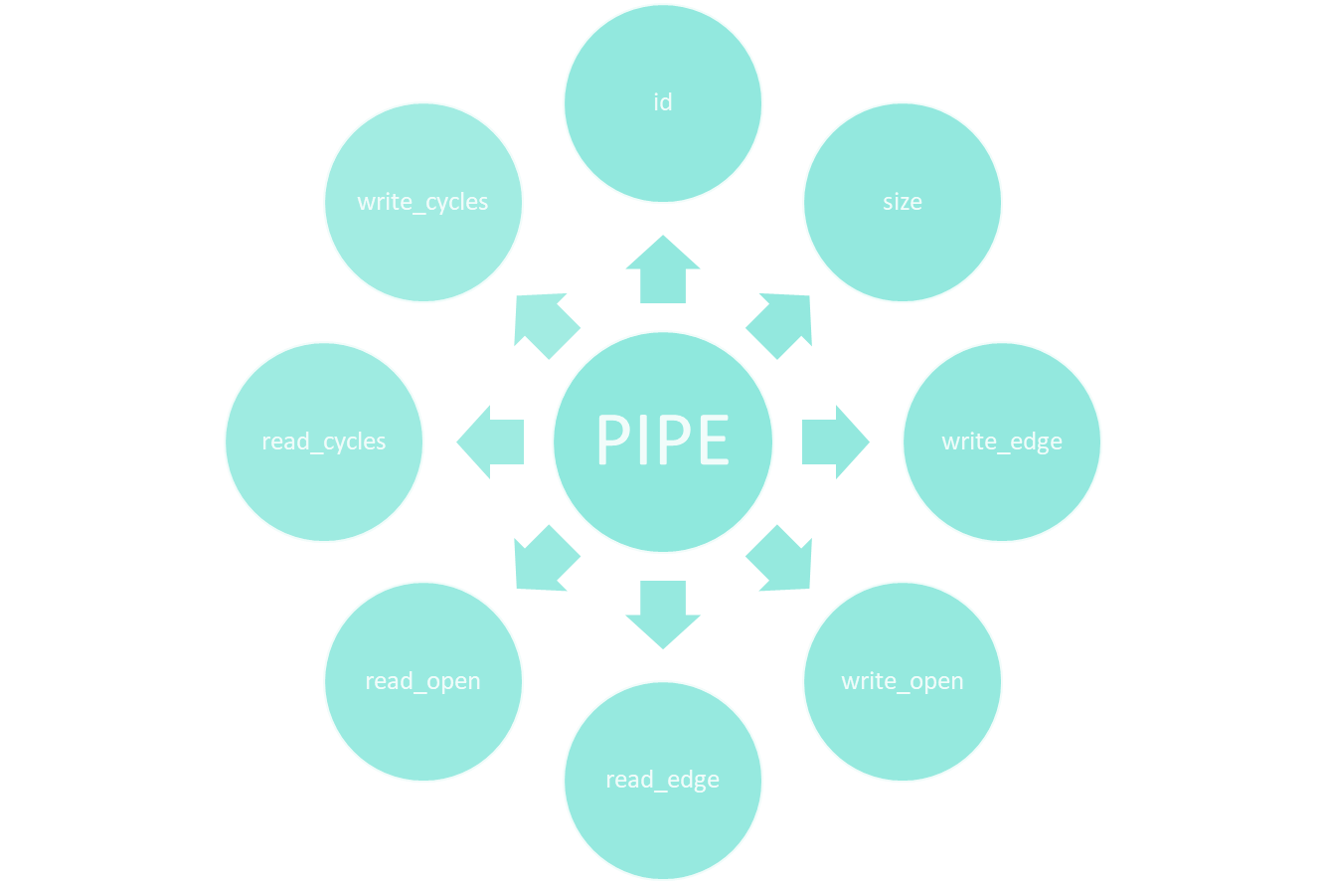
BUT WHAT IS A PIPE?

Slide 5
THE FUNCTIONS
int pipe_open(int size);
Creates a pipe
int pipe_write(int p, char c);
Writes one byte to pipe (p)
int pipe_writeDone(int p);
Closes pipe (p) for writing
int pipe_read(int p, char *c);
Reads one byte from pipe (p)
int my_read(int fd, void *buffer, int size, int *left_read);
Reads from file
int my_write(int *fd, void *buffer, int size);
Writes to file

Slide 6
WHAT ARE THREADS RESPONSIBLE FOR?
THREAD 1
THREAD 2
Reads data from a file and writes it to pipe 1
Reads from pipe 2 and writes to a new file
Reads from pipe 1 and writes to another file
Reads from data from the created file and writes them
FILE
PIPE 1
FILE.COPY
FILE.COPY2
PIPE 2

Slide 7
THE CHALLENGES
Handling read/write operations in ring buffers.
Synchronizing access to shared data between threads.
THE SOLUTIONS
Properly managing pipe edges and cycles.
Implementing conditions to handle concurrency.

Slide 8
1.2
PRIMALITY TESTER
Implementation of a multi-thread primality tester

Slide 9
MAIN IDEA
This program takes positive integers as input and checks if they are prime or not.
Main is the coordinator of all threads.
Main assigns jobs to threads the so-called workers.
Workers busy wait for a job to be assigned to them.
When all jobs are finished, workers terminate.

Slide 10
MAIN
Takes the number of threads (N) as a command-line argument.
Initializes each thread and sets default values for thread control variables.
Error handling in case of thread creation failure.
IS_PRIME
Calculates if a number is a prime or not.
WORKER
Checks if the assigned number is prime.
Updates thread status when work is completed.
Terminates when requested by the main program.

Slide 11
CHALLENGES
Synchronization Issues:
Avoiding race conditions when accessing shared resources.
Termination Handling:
Ensuring threads stop correctly without hanging or leaking resources.

Slide 12
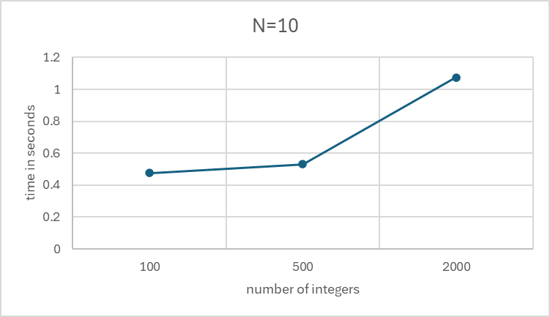
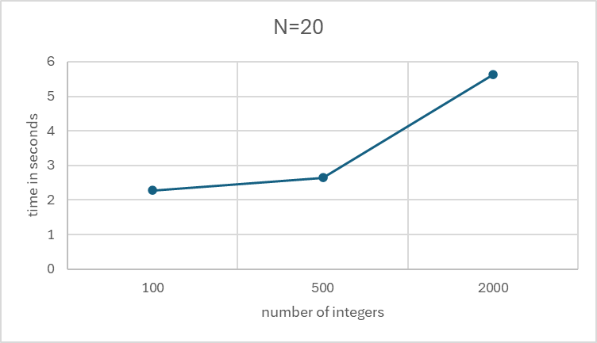
PERFORMANCE ANALYSIS

Slide 13
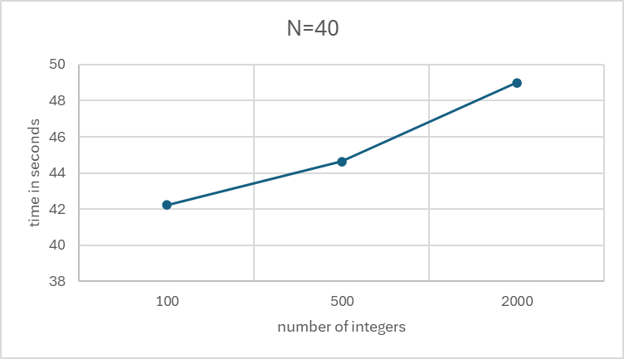
PERFORMANCE ANALYSIS

Slide 14
1.3
EXTERNAL MERGESORT
A Parallel Approach to Sorting Large Files

Slide 15
MAIN IDEA
Efficiently sort large files using a parallel merge sort.
Implementation of External Merge Sort algorithm using threads to synchronize the whole process of merging a file.
Merge sort algorithm for external file sorting.
This makes synchronizing easier and our programs faster and more efficient.

Slide 16
THE FUNCTIONS
PARALLEL MERGESORT
Parallel Execution: Uses threads to sort and merge file segments in parallel.
Threshold: Splits files larger than MIN_SIZE (64) for parallel processing.
Threading Structure:
- Two threads per file split.
- Splits until file segments are small enough.
MERGE SORT
Purpose: Sorts an array by recursively dividing and merging.
Key Steps:
1. Recursively split the array.
2. Use merge function to combine sorted halves.
3. Continue until array is sorted.
MERGE
Purpose: Merges two sorted arrays into one.
Process:
- Splits array into left and right halves.
- Compares and merges in sorted order.
- Handles remaining elements in either half.

Slide 17
Python File Generation
Purpose: Create random integers and store them in a binary file.
Sample Code:
for _ in range(1000):
integers.append(random.randint(1, 1000))
write_integers_to_binary_file(file_name, integers)
Output: A binary file 'integers.bin' containing 1000 random integers.

Slide 18
Thanks!
Do you have any questions?
Evryviadis Liapis
Evaggelos Plytas
Aikaterini Tsiaousi

