Slide 1





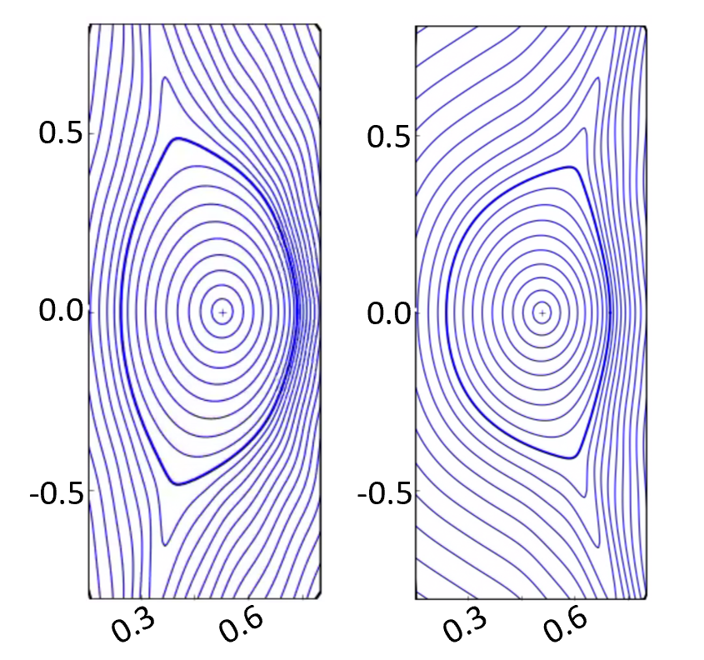
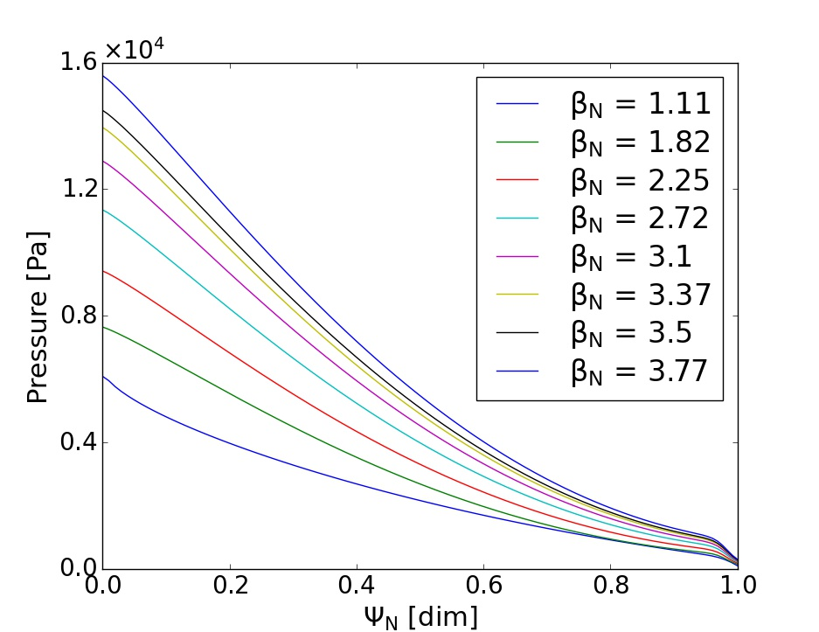
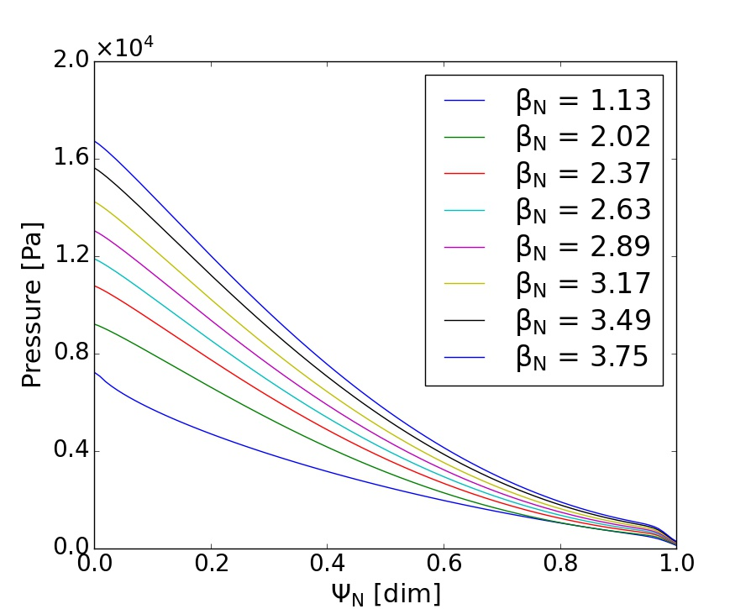
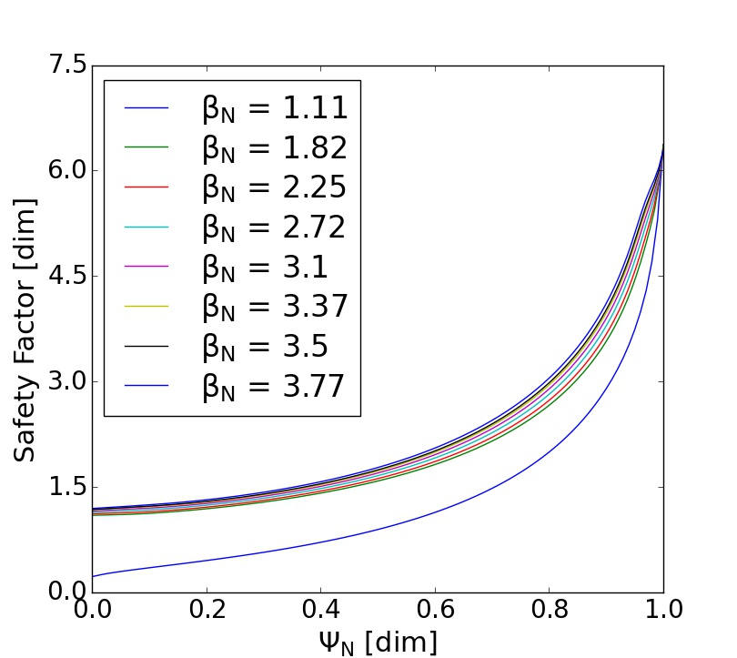
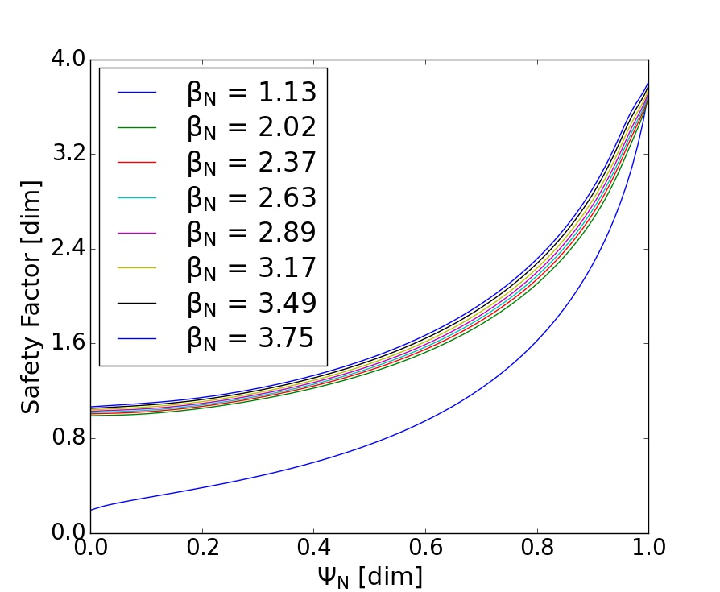
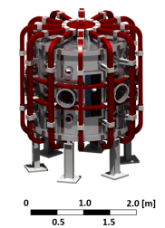
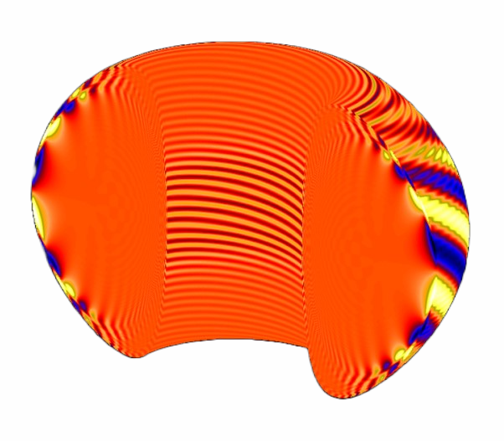
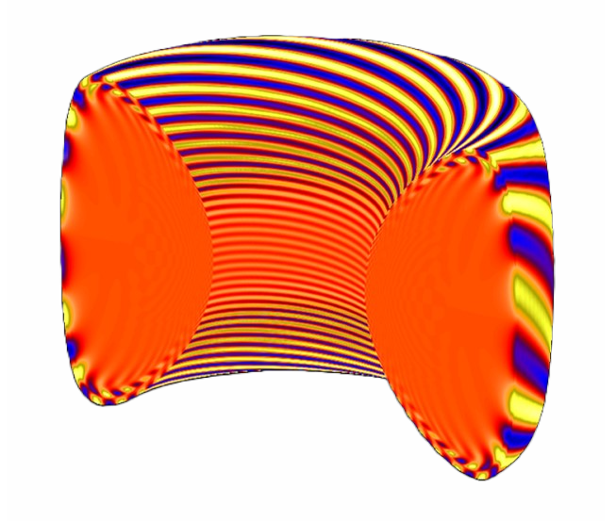
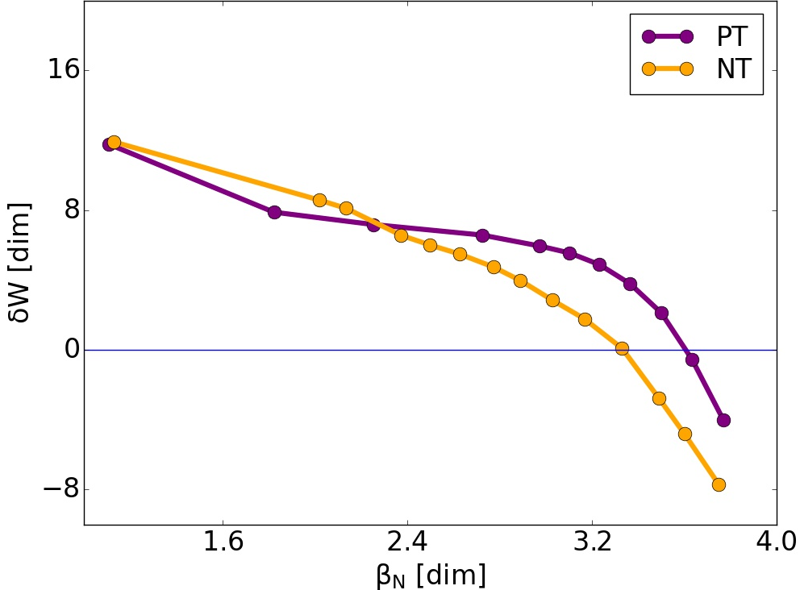
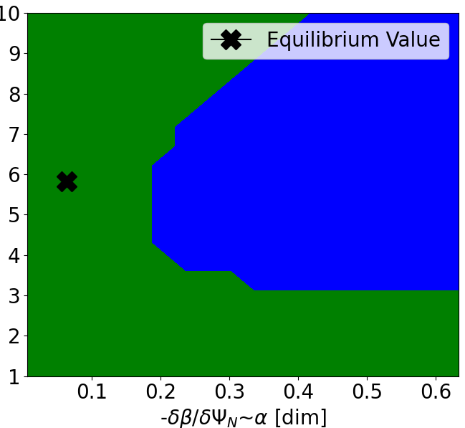




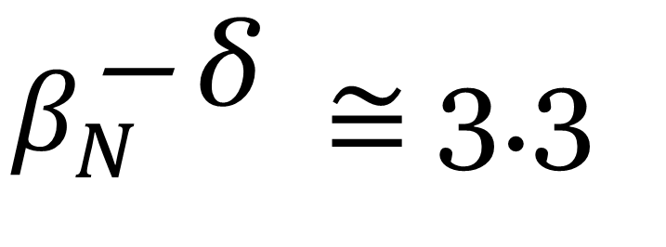
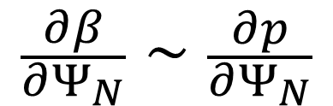

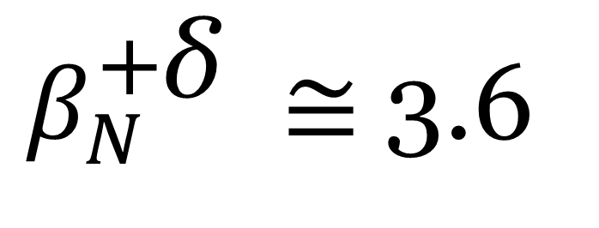
Analyzing mode stability to identify stable operating regions for the novel SMall Aspect Ratio Tokamak (SMART)
John Labbate¹, Jack Berkery², Jason Parisi², Mario Podesta², Jesus Dominguez-Palacios³, Diego José Cruz-Zabala³, Alex Reyner Viñolas³, Manuel Garcia-Munoz³, Eleonora Viezzer³, Alessio Mancini³, Andrew Oak Nelson⁴, Joseph McClenaghan⁵, Yueqiang Liu⁵
¹U. Maryland, College Park, ²Princeton Plasma Physics Laboratory, ³U. Sevilla, ⁴Columbia U., ⁵General Atomics
Introduction
Equilibria Construction and Stability Analyses
SMART is currently being constructed at U. Sevilla
Spherical tokamak purposed with exploring various plasma shapes, specifically negative triangularity (NT)
NT avoids edge-localized modes (ELMs) while maintaining H-mode-like plasma core confinement¹
Experimentally confirmed by DIII-D²
Pressure gradients at plasma edge are kept low by NT¹
Determining stable operating regions for SMART’s plasma configurations is essential to the device’s practicality
Equilibria Construction (Fig. 2)
Anticipated positive triangularity (PT) and NT scenarios for single points in time generated using FIESTA⁴ and TRANSP⁵
Pressure profiles altered via PRO_create⁶ and CHEASE⁷ to explore β_{N} parameter space
β_{N} ~ Plasma pressure (P), normalized
Stability Analyses of Global Modes
Fourier decomposition of flux surface displacements with toroidal mode number n:
n = 1 imposes the main operating limit via the kink instabilities¹²
n > 1 peeling and ballooning modes can impose hard and soft operating limits¹
GPEC/DCON⁹ calculate displacements and change in potential energy (δW) for desired mode numbers
Indicates ideal magnetohydrodynamic (MHD) no-wall mode stability in presence of perturbations
ballstab⁸ calculates infinite-n ballooning stability
Fig. 2: Base equilibria provided by Diego José Cruz-Zabala, pressure, and safety factor (q) profiles for PT and NT cases.
z [m]
PT
z [m]
NT
0
0
r [m]
r [m]
PT
Ψ_{N} = 0.96
NT
(a)
(b)
Ψ_{N} = 0.96
0
Conclusions
Fig. 1: (a) SMART model³ and (b) 3-D visualization of plasma triangularities (δ) provided by Jesus Dominguez-Palacios.
0
DCON predicts n = 1 no-wall, ideal MHD β_{N} limit for PT to be slightly greater than for NT (Fig. 3)
Similar limit for PT and NT supported by Boyes et al., 2023¹³
Hard to directly compare δ due to difference in q-profiles
Infinite-n instability observed in low q and β_{N} NT (Table 2)
Expected from NT; Limits ELMs by preventing high ΔP at pedestal while not altering core¹, but may be due to q < 1
However, Fig. 4 and Tables suggest infinite-n pedestal pressure gradient limits have not yet been reached by rescaled equilibria with elevated q
+δ
PT
NT
0.0
1.0
2.0 [m]
0.5
1.5
-δ
Results
Software Workflow
No-Wall, Ideal MHD n = 1 β_{N} Limits
Further Equilibria and Stability Considerations
SMART Coil Structure
FIESTA⁴
TRANSP⁵
$β_{N}^{\text{+}\text{δ} }≅$3.6
Equilibria Improvements
Addition of coils and x-points in equilibria
Resolve q < 1 in plasma core and align q profiles between δ
q < 1 regions are unstable due to sawtooth oscillations and the internal kink mode¹⁴
Expand dataset of equilibria scenarios
Explore more parameter spaces (δ, B, etc.)
Stability Analyses Improvements
Examine additional modes, such as infernal (low n > 1) modes
Include wall effects in DCON (wall-limit)
Add resistive MHD effects to DCON and ballstab
Equilibria Generated
$β_{N}^{\text{− }\text{δ} }≅$3.3
STABLE
Equilibria Pressure Scans Generated
UNSTABLE
Fig. 3: DCON-calculated n = 1 potential energy at various β_{N} values for both PT and NT.
PRO_create⁶
CHEASE⁷
ballstab⁸
GPEC/DCON⁹
Fig. 4: ballstab-calculated infinite-n ballooning stability for PT with β_{N} = 1.11 at Ψ_{N} = 0.96 (example)
$$\hat{s}=\frac{r}{q}\frac{∂q}{∂r}$$
$$\frac{∂β}{∂Ψ_{N}}∼\frac{∂p}{∂Ψ_{N}}$$
See Fig. 2
Acknowledgements and References
Generated by Diego José Cruz-Zabala
Thank you to all the co-authors on this project for providing me with the opportunity to complete this work and a fantastic experience working and learning about tokamak fusion with SMART.
This work was made possible by funding from the Department of Energy for the Summer Undergraduate Laboratory Internship (SULI) program. This work is supported by the US DOE Contract No. DE-AC02-09CH11466 in addition to grant numbers DE-SC0022270 and DE-SC0022272.
Software configured using One Modeling Framework for Integrated Tasks (OMFIT)¹⁰
UNSTABLE
Software configured using the Stability, Transport, Equilibrium, and Pedestal (STEP) module¹¹
STABLE
Stability Analyses

