Slide 1
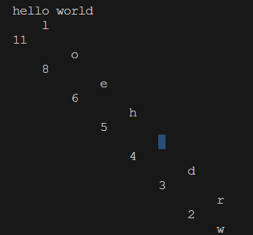
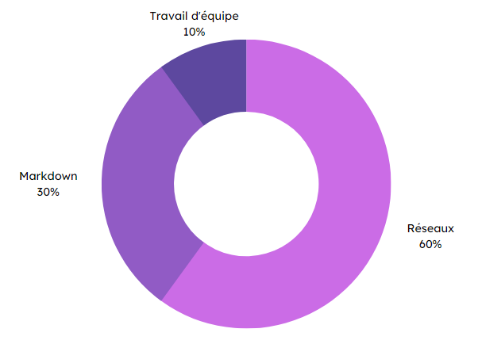


Specifications
Final rendering
In pairs:
Create a library that manages binary reading and writing.
Implement Move-to-Front algorithm (encoding & decoding).
Develop Huffman coding (compression & decompression).
Huffman coding output
Data compression
algorithms
Methodes and technologies
Skills
Makefile
10%
Teamwork
30%
C programming
60%
THÉRON Evan – All Rights Reserved

